Slide 1
Lecture 08 Linked Lists
CS211 – Fundamentals of Computer Programming II
Branden Ghena – Winter 2022
Slides adapted from: Jesse Tov

Slide 2
Administrivia
Homework 3 due tonight
Remember that slip days exist
Beware: office hours are overloaded
Prepare for long delays until you can get help, and only high-level help
Feel free to ask questions on Campuswire too
I’ll be checking it all evening
No lab due this weekend!
Get started on Homework 4 early instead (which will be out tonight)

Slide 3
Homework 3 hint: comparing strings
char* a = “abc”
char b[4] = {‘a’, ‘b’, ‘c’, ‘\0’}
if (a == b) {
print(“They match!\n”);
} else {
print(“They do not match\n”);
}
This code prints: “They do not match\n”. Why?
What does a == b compare?
Two pointers!

Slide 4
Strings must be compared with strcmp()
https://www.cplusplus.com/reference/cstring/strcmp/
int strcmp(const char* str1, const char* str2)
Compares two strings character-by-character until reaching a ‘\0’
Returns an integer value of the following:
<0 – str1 comes before str2 alphabetically
0 – str1 is equal to str2
>0 – str1 comes after str2 alphabetically

Slide 5
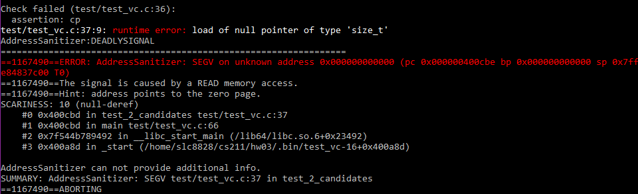
SEGV is a null pointer dereference
This AddressSanitizer error is due to dereferencing a NULL pointer
Often in Homework 3, it’s because you tried to read a NULL candidate name
Possibly with `strcmp()`

Slide 6
Today’s Goals
Practice dynamic memory allocation with arrays
How do we make an array the dynamically changes size?
Introduce and explore concept of linked lists
What are they and what are their advantages?
How do we write code that uses them?
Discuss concept of pointers to pointers

Slide 7
Getting the code for today
cd ~/cs211/lec/ (or wherever you put stuff)
tar -xkvf ~cs211/lec/08_linked_lists.tgz
cd 08_linked_lists/

Slide 8
Outline
Dynamic Arrays
Linked Lists
Linked List Details
Pointers to Pointers

Slide 9
Dealing with dynamic input
What if you want to read in data, but you don’t know how much data there might be?
Arrays in C are a fixed size
But you can malloc() as many times as needed
Request some memory
Use until you run out
Request more memory and copy existing values over
realloc() makes this simple

Slide 10
Example of dynamic memory: read_line()
char* read_line(void)
Reads an entire line at a time from stdin
Can’t know in advance how many bytes there will be to read
Keeps reading in bytes until ‘\n’ character or end-of-file
Needs to request more memory until it holds the entire line
Note: part of the 211 library, not standard C

Slide 11
Live coding: implement read_line()
readline.c
char* read_line(void)
Requirements
Read from stdin until ‘\n’ or end-of-file (EOF)
Allocate an array to hold the read characters
Make sure to end it with a ‘\0’
Returns
NULL pointer if EOF was reached immediately
Pointer to string otherwise (not including the newline character)

Slide 12
Realloc versus malloc
We could just malloc() and copy ourselves, what does realloc() add?
realloc() can be far more efficient
Doesn’t have to copy data at all if there is room in the heap to expand
Also simpler for programmers
Can’t forget to free the old memory if realloc() does it for you

Slide 13
Default string size will change efficiency
Memory efficiency
Pointer returned could have way more memory than characters
User might hold on to memory for a while before freeing
The less wasted memory, the less memory the program needs
Runtime speed
malloc() and realloc() are slow
The fewer times we call them, the faster the program will run
Need to pick a sweet spot to balance the two of these
Real program: starts at 80 characters, doubles size when reallocating

Slide 14
Does efficiency really matter though?
If you’re writing a CS211 homework: no
If you’re writing a Javascript interpreter for Firefox,
Which has millions of users
times hundreds of websites per day for each user
times hundreds of lines of code per website
and each line of code is read with read_line()
YES

Slide 15
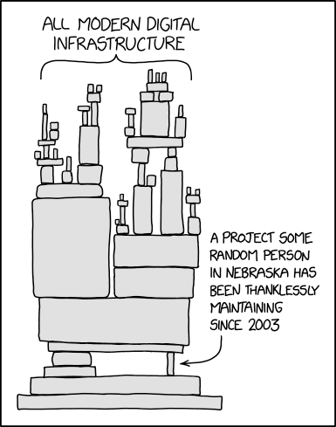
Break + relevant xkcd
https://xkcd.com/2347/

Slide 16
Outline
Dynamic Arrays
Linked Lists
Linked List Details
Pointers to Pointers

Slide 17
Problems with arrays
They make a lot of sense when you have fixed data
But they’re not very flexible for dynamic data
Not smooth or simple to grow/shrink arrays
Lots of thought for how to dynamically change memory
Writing to an array only overwrites existing slots, doesn’t append
How would we add data to front of an array?

Slide 18
Live coding example
array_add_front.c
Let’s write a function that adds to the front of an existing array
print_array()
Prints contents of array so we can see what the program is doing
add_to_front()
Appends a value to the front of an existing array
It’s annoying to try to append to an array
It’s also very inefficient. Needs to move every element

Slide 19
An alternative: linked allocations
array_pointer:
 | 3 | 4 | 2 | 3
linked_list_pointer:
 | 3 |  |  | 4 |  |  | 2 |  |  | 3 | NULL

Slide 20

Linked list analogy as a train
Think of a linked list as a train

Slide 21
Linked list analogy
Think of a linked list as a train
Multiple Nodes are linked together into a Linked List
Next Pointer
Next Pointer
Node (Head)
Node
Node (Tail)

Slide 22
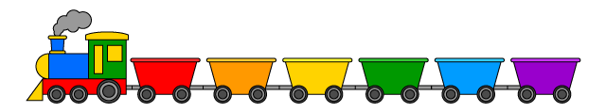
Linked list analogy
Think of a linked list as a train
Multiple Nodes are linked together into a Linked List
Additional Nodes can be added anywhere in the Linked List
Just disconnect, add the Node in between, and reconnect
Next Pointer
Next Pointer
Next Pointer
Next Pointer
Next Pointer
Next Pointer
Node (Head)
Node
Node
Node
Node
Node
Node (Tail)

Slide 23
C code for a linked list structure
Array version:
int myarray[];
Linked List version:
struct node {
int value;
struct node* next;
};
typedef struct node node_t;
node_t* head;

Slide 24
Rules for linked lists
The variable holding the “list” is actually a pointer to the first node of the list
Just like an array is a pointer to the first element in the array
First node: the “Head” of the list
Each node must have a pointer to the next node in the list
The last node in the list has a NULL pointer
Last node: the “Tail” of the list

Slide 25
Live coding example
linked_list.c
Working with a linked list
Create an empty list
Add elements to the list
Determine length
Print entire list

Slide 26
Break + Question: Which is better, and why?
void free_list(list_t list) {
while (list != NULL) {
free(list);
list = list->next;
}
}
void free_list(list_t list) {
if (list != NULL) {
free_list(list->next);
free(list);
}
}

Slide 27
Break + Question: Which is better, and why?
void free_list(list_t list) {
while (list != NULL) {
free(list);
list = list->next;
}
}
void free_list(list_t list) {
if (list != NULL) {
free_list(list->next);
free(list);
}
}
Error: use after free!!
Best would be a working while loop

Slide 28
Outline
Dynamic Arrays
Linked Lists
Linked List Details
Pointers to Pointers

Slide 29
The memory for each list node must be managed
linked_list.c
Lists are composed of many small memory allocations rather than one large memory allocation (like arrays)
So every individual node needs to be separately freed in order to destroy the entire list
Let’s write list_destroy()

Slide 30
Lists have no random access
linked_list.c
You can ask an array for any item, and you get it immediately
array[6]
All access for linked lists is sequential
You must start at the head and “walk” the list until you get to the item
list->next->next->next->next->next->next->value
Let’s write get_at_index()

Slide 31
Items can be added at any point in the list
linked_list.c
We can add/remove the middle item of the list
Just make sure you get the next pointer right
Arrays can’t support that kind of thing
You would have to copy over all the later elements in the array
Let’s write list_append_front() and list_remove_front() functions

Slide 32
Break + Open Question
Which uses more memory, an array or a linked list?
Assume each contains the same values
How much more?

Slide 33
Linked lists take more memory than arrays
Each node must include data and a “next” pointer
This increases overall memory use
As a cost for the ease of use that linked lists provide
Compare an array of int versus linked list of int
Linked list will be 3x the amount of memory
The large in size your data is, the less the overhead will be

Slide 34
Outline
Dynamic Arrays
Linked Lists
Linked List Details
Pointers to Pointers

Slide 35
Pointers are another type of value
Values could be a number, like 5 or 6.27
Or they could be a “pointer” to an object
Points at the object, not the variable or value
It points at the “chunk of memory”
Technically, in C it holds the address of that memory
z: | 5
z_pointer:

Slide 36
We can make a pointer to another pointer
Pointers are values stored in an object
That object has a memory address
We could make a pointer to a pointer
z: | 5
z_pointer:
z_pointer_pointer:

Slide 37
Double pointers in C
To make a pointer to something, add a * to the type
z: | 5
z_pointer:
int z = 5;
int* z_pointer = &z;
int** z_pointer_pointer = &z_pointer;
z_pointer_pointer:

Slide 38
When is this useful?
linked_list.c
Various functions in the linked list code need to return the new head of the linked list
Instead, they could update the linked list variable
struct node* list_append_front(struct node* list, int value);
could become
void list_append_front(struct node** list, int value);

Slide 39
Also occurs in arguments to main
argv is an array of strings
Strings are char*
So argv is char**
char* argv[] is equivalent to char** argv

Slide 40
Outline
Dynamic Arrays
Linked Lists
Linked List Details
Pointers to Pointers

