Slide 1
Lecture 09 Bits, Bytes, and Integer Encoding
CS211 – Fundamentals of Computer Programming II
Branden Ghena – Winter 2022
Slides adapted from: Jesse Tov

Slide 2
Administrivia
Homework 4 due on Thursday
You can do it!
Remember that office hours get busy right before the deadline
It’ll be harder to get help and you’ll get less time

Slide 3
Administrivia
No lecture on Thursday
Take a nap instead so you can recharge
Next week starts C++ 🎉

Slide 4
Today’s Goals
Discuss concept of pointers to pointers
Go below the level of C and understand how the computer thinks about data with bits and bytes
Understand how this leads to the boundaries of common C types
Note: this isn’t a main focus of this class
I just wanted to take today to explain more deeply
This will all come up again if you take CS213

Slide 5
Outline
Pointers to Pointers
Bits and Bytes
Integer Encoding
C Type Bounds

Slide 6
Reminder: Pointers are another type of value
Values could be a number, like 5 or 6.27
Or they could be a “pointer” to an object
Points at the object, not the variable or value
It points at the “chunk of memory”
Technically, in C it holds the address of that memory
z: | 5
z_pointer:

Slide 7
We can make a pointer to another pointer
Pointers are values stored in an object
That object has a memory address
We could make a pointer to a pointer
z: | 5
z_pointer:
z_pointer_pointer:

Slide 8
Double pointers in C
To make a pointer to something, add a * to the type
z: | 5
z_pointer:
int z = 5;
int* z_pointer = &z;
int** z_pointer_pointer = &z_pointer;
z_pointer_pointer:

Slide 9
When is this useful?
linked_list.c
(from last lecture)
Various functions in the linked list code need to return the new head of the linked list
Instead, they could update the linked list variable
struct node* list_append_front(struct node* list, int value);
could become
void list_append_front(struct node** list, int value);

Slide 10
Also occurs in arguments to main
argv is an array of strings
Strings are char*
So argv is char**
char* argv[] is equivalent to char** argv

Slide 11
Outline
Pointers to Pointers
Bits and Bytes
Integer Encoding
C Type Bounds

Slide 12
Positional Numbering Systems
The position of a numeral (e.g., digit) determines its contribution to the overall number
Makes arithmetic simple (compared to, say, roman numerals)
Any number has one canonical representation
Example: base 10
10456₁₀ = 1*10⁴ + 0*10³ + 4*10² + 5*10¹ + 6*10⁰
Usually, we leave out the zeros:
1*10⁴ + 4*10² + 5*10¹ + 6*10⁰

Slide 13
Positional Numbering Systems
Other bases are also possible
Base 60, used by the Babylonians
The source of 60 seconds in a minute, 60 minutes in an hour
And 360 degrees in a circle
Base 20, used by the Maya and Gauls (bits remain in French today)
Base 2: 10010010₂
= 1*2⁷ + 1*2⁴ + 1*2¹
= 128₁₀ + 16₁₀ + 2₁₀
= 146₁₀

Slide 14
Base 2 Example
Computer Scientists use base 2 a LOT
Let’s convert 134₁₀ to base 2
We need to decompose 134₁₀ into a sum of powers of 2
Start with the largest power of 2 that is smaller or equal to 134₁₀
Subtract it, then repeat the process
134₁₀ – 128₁₀ = 6₁₀
6₁₀ – 4₁₀ = 2₁₀
2₁₀ – 2₁₀ = 0₁₀
134₁₀ = 1×128 + 0×64 + 0×32 + 0×16 + 0×8 + 1×4 + 1×2 + 0×1
134₁₀ = 1×2⁷ + 0×2⁶ + 0×2⁵ + 0×2⁴ + 0×2³ + 1×2² + 1×2¹ + 0×2⁰
134₁₀ = 10000110₂

Slide 15
Why computers use Base 2
Simple electronic implementation
Easy to store with bi-stable elements
Reliably transmitted on noisy and inaccurate wires
Straightforward implementation of arithmetic functions
(Pretty much) all computers use base 2
0
1
0
3.3V
2.8V
0.5V
0.0V

Slide 16
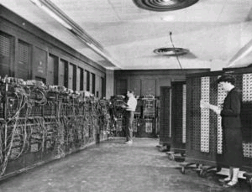
Why don’t computers use Base 10?
Because implementing it electronically is a pain
Hard to store
ENIAC (first general-purpose electronic computer) used 10 vacuum tubes / digit
Hard to transmit
Need high precision to encode 10 signal levels on single wire
Messy to implement digital logic functions
Addition, multiplication, etc.
(See CE203 for details)
Notes:
Mayans use a vigesimal system (base 20)
Decimal system – developed in India, improved by Arab mathematicians and brought to the west by Pisano (in the 13th century!)

Slide 17
Base 16: Hexadecimal
Hex | Decimal | Binary
0 | 0 | 0000
1 | 1 | 0001
2 | 2 | 0010
3 | 3 | 0011
4 | 4 | 0100
5 | 5 | 0101
6 | 6 | 0110
7 | 7 | 0111
8 | 8 | 1000
9 | 9 | 1001
A | 10 | 1010
B | 11 | 1011
C | 12 | 1100
D | 13 | 1101
E | 14 | 1110
F | 15 | 1111
Writing long sequences of 0s and 1s is tedious and error-prone
And takes up a lot of space on a page!
So we’ll often use base 16 (also called hexadecimal)
Base 2 = 2 symbols (0, 1) Base 10 = 10 symbols (0-9) Base 16, need 16 symbols
Use letters A-F once we run out of decimal digits

Slide 18
Base 16: Hexadecimal
Hex | Decimal | Binary
0 | 0 | 0000
1 | 1 | 0001
2 | 2 | 0010
3 | 3 | 0011
4 | 4 | 0100
5 | 5 | 0101
6 | 6 | 0110
7 | 7 | 0111
8 | 8 | 1000
9 | 9 | 1001
A | 10 | 1010
B | 11 | 1011
C | 12 | 1100
D | 13 | 1101
E | 14 | 1110
F | 15 | 1111
16 = 2⁴, so every group of 4 bits becomes a hexadecimal digit (or hexit)
If we have a number of bits not divisible by 4, add 0s on the left (always ok, just like base 10)
1 0 1 0 0 1 0 1 1 1 1 0 1 1
0 0
0x297B
“0x” prefix = it’s in hex

Slide 19
Bytes
A single bit doesn’t hold much information
Only two possible values: 0 and 1
So we’ll typically work with larger groups of bits
For convenience, we’ll refer to groups of 8 bits as bytes
And usually work with multiples of 8 bits at a time
Conveniently, 8 bits = 2 hexits
Some examples
1 byte: 0b01100111 = 0x67
2 bytes: 11000100 00101111₂ = 0xC42F
“0b” prefix = it’s in binary

Slide 20
Break + Practice problem
Convert 0x42 to decimal
Steps
Convert 0x42 to binary:
Convert binary to decimal:

Slide 21
Break + Practice problem
Convert 0x42 to decimal
Steps
Convert 0x42 to binary:
0x4 -> 0b0100 0x2 -> 0b0010 0x42 -> 0b 0100 0010
Convert binary to decimal:

Slide 22
Break + Practice problem
Convert 0x42 to decimal
Steps
Convert 0x42 to binary:
0x4 -> 0b0100 0x2 -> 0b0010 0x42 -> 0b 0100 0010
Convert binary to decimal:
1*2⁶ + 1*2¹ = 64 + 2 = 66

Slide 23
Break + Practice problem
Convert 0x42 to decimal
Critical thinking:
What are the maximum and minimum values?
Minimum 0 (0x00)
Maximum 255 (0xFF)
How big is 0x42 out of 0xFF?
~25% (0x40, 0x80, 0xC0, 0x100)
So 255/4 ≈ 256/4 ≈ 64

Slide 24
Outline
Pointers to Pointers
Bits and Bytes
Integer Encoding
C Type Bounds

Slide 25
These two lines of code are equivalent
char mychar = 97;
char mychar = ‘a’;
Per the ASCII table, the character ‘a’ has a decimal value 97
The character value and decimal value are equivalent
These two are also equivalent
char diff = ‘c’ - ‘a’;
char diff = 99 - 97;

Slide 26
Big idea: bits can be used to represent anything
Depending on the context, the bits 11000011 could mean
The number 195
The number -61
The number -1.1875
The value True
The character ‘├’
The ret x86 instruction
You have to know the context to make sense of any bits you have!
People and software they write determine what the bits actually mean

Slide 27
Expressing C types in bits
Two families of encodings to express those using bits
Unsigned encoding for unsigned integers
Two’s complement encoding for signed integers
Size + encoding family determine which C type we’re representing
Each type will use a fixed size (# of bits)
For a given machine
Fixed size is because computers are finite!

Slide 28
Unsigned integer encoding
Just write out the number in binary
Works for 0 and all positive integers
Example: encode 104₁₀ as an unsigned 8-bit integer
104₁₀ = 0×2⁷ + 1×2⁶ + 1×2⁵ + 0×2⁴ + 1×2³ + 0×2² + 0×2¹ + 0×2⁰
⇒ 01101000
⇒ 0x68
(Binary To Unsigned)

Slide 29
Bounds of unsigned integers
For a fixed width w, a limited range of integers can be expressed
Smallest value (we will call UMin):
all 0s bit pattern: 000…0, value of 0
Largest value (we will call UMax):
all 1s bit pattern: 111...1, value of 2^{w} – 1
2^{w} – 1 = 1×2^{w-1} + 1×2^{w-2} + ... + 1×2¹ + 1×2⁰ = 11111...
Maximum 8-bit number = 2⁸-1 = 256-1 = 255

Slide 30
Two’s complement encoding
Good news: can represent both positive and negative numbers
Bad news: need to make the encoding more complicated
Plan:
Start with unsigned encoding, but make the largest power negative
Example: for 8 bits, most significant bit is worth -2⁷ not +2⁷
To encode a negative integer
First, set the most significant bit to 1 to start with a big negative number
Then, add positive powers of 2 (the other bits) to “get back” to number we want
Example: encode -6 as a 4-bit two’s complement integer
-6₁₀ =
1 × -2³
+ 0 × 2² + 1 × 2¹ + 0 × 2⁰
⇒ 0b1010
⇒ 0xA

Slide 31
Two’s complement examples
Encode -100 as an 8-bit two’s complement number
-100₁₀ =
1 × -2⁷
-128
+ 0 × 2⁶
+ 0
+ 0 × 2⁵
+ 0
+ 1 × 2⁴
+ 16
+ 1 × 2³
+ 8
+ 1 × 2² + 0 × 2¹ + 0 × 2⁰
+4 +0 +0
Problem becomes: encode +28 as a 7-bit unsigned number
-100₁₀ = 0b10011100 = 0x9C

Slide 32
Two’s Complement Shortcut
Shortcut: determine positive version of number, flip it, and add one
100₁₀ = 0b01100100
Flipped = 0b10011011
Plus 1 = 0b10011100 = 0x9C
Sidebar: binary addition
0b01
+0b01
------
0b10
0b011
+0b001
-------
0b100

Slide 33
Interpreting binary signed values
Converting binary to signed:
Note: most significant bit tells us sign!! 1 -> negative
Checking if a number is negative is just checking that top bit
Note: there is only one zero value
0b00000000 = 0 0b10000000 = -128
-1: 0b111…1 = -1 (regardless of number of bits!)
Sign bit

Slide 34
Bounds of two’s complement integers
For a fixed width w, a limited range of integers can be expressed
Smallest value, most negative (we will call TMin):
1 followed by all 0s bit pattern: 100…0 = -2^{w-1}
Largest value, most positive (we will call TMax):
0 followed by all 1s bit pattern: 01...1, value of 2^{w-1} – 1
Beware the asymmetry! Bigger negative number than positive

Slide 35
Unsigned & Signed Numeric Values
X
B2U(X)
B2T(X)
Equivalence
Same encodings for non-negative values
Uniqueness
Every bit pattern represents unique integer value
Each representable integer has unique bit encoding
⇒ Can Invert Mappings
Can go from bits to number and back, and vice versa
U2B(x) = B2U⁻¹(x)
Bit pattern for unsigned integer
T2B(x) = B2T⁻¹(x)
Bit pattern for two’s complement integer
0000
0
0
0001
1
1
0010
2
2
0011
3
3
0100
4
4
0101
5
5
0110
6
6
0111
7
7
1000
8
–8
1001
9
–7
1010
10
–6
1011
11
–5
1100
12
–4
1101
13
–3
1110
14
–2
1111
15
–1

Slide 36
Practice + Break
What range of integers can be represented with 5-bit two’s complement?
A -31 to +31
B -15 to +15
C 0 to +31
D -16 to +15
E -32 to +31

Slide 37
Practice + Break
What range of integers can be represented with 5-bit two’s complement?
A -31 to +31 No asymmetry and 6-bits
B -15 to +15 No asymmetry
C 0 to +31 Unsigned
D -16 to +15 Correct
E -32 to +31 6-bits

Slide 38
Outline
Pointers to Pointers
Bits and Bytes
Integer Encoding
C Type Bounds

Slide 39
Standard sizes of C types on modern (64-bit) computers
1 byte
char, unsigned char, signed char
bool
2 bytes
short, unsigned short, signed short
4 bytes
int, unsigned int, signed int
float
8 bytes
long, unsigned long, signed long
double
Every pointer type! (for a 64-bit computer, which you’re all on)

Slide 40
Ranges for different bit amounts
Observations
|TMin | = TMax + 1
Asymmetric range
UMax = 2 * TMax + 1
C Programming
#include <limits.h>
Declares constants, e.g.,
ULONG_MAX
LONG_MAX
LONG_MIN
Values are platform specific
Notes:
Note the asymmetry on the 2’s-complement range, a source of bugs; why the asymmetry? 0 is nonnegative which means it can represent one less positive number
Note also that UMax is just over 2 TMax (Umax = 2*Tmax+1)

Slide 41
Overflow
What happens if you exceed the bound of a variable type?

Slide 42
Overflow
What happens if you exceed the bound of a variable type?
Unsigned Variables
They wrap!
char a = 255;
a++;
// a now equals 0
char b = 2;
b = b-5;
// b now equals 253

Slide 43
Modulo behavior in binary numbers
10000
0000
1111
0001
1110
0010
1101
0011
-1
1100
0100
+1
1011
0101
1010
0110
1001
0111
1000

Slide 44
Overflow
What happens if you exceed the bound of a variable type?
Signed Variables
UNDEFINED BEHAVIOR
Usually they wrap (that’s what the hardware does)
But also the compiler can do anything it wants

Slide 45
Remember that overflow/underflow can occur in C
Warning: programmers often fail to account for wrapping!
Sometimes it leads to unexpected behavior

Slide 46
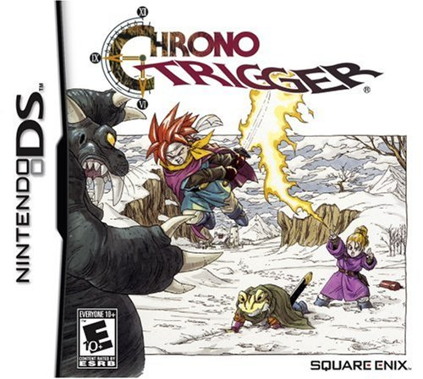

Overflow example in the real world
Dream Devourer
Special boss in the Nintendo DS edition
Wanted to make it even more challenging
32000 hit points
Takes forever to defeat
Hit points stored as a 16-bit signed integer
Range: -32768 to +32767

Slide 47
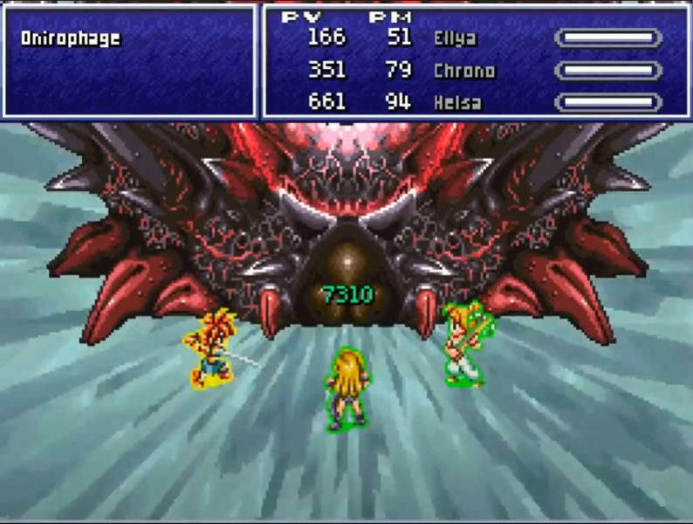
Chrono Trigger signed overflow bug
Solution: heal it
Hit points go negative and it dies

Slide 48
Outline
Pointers to Pointers
Bits and Bytes
Integer Encoding
C Type Bounds

