Slide 1
Lecture 03 BLE Introduction
CS397/497 – Wireless Protocols for IoT
Branden Ghena – Spring 2022
Materials in collaboration with Pat Pannuto (UCSD)

Slide 2
Administrivia
Think about project ideas
Make posts on campuswire with ideas to iterate on
Also good for recruiting partners
I’m happy to schedule office hours to discuss!
First lab is available
Goal: familiarize yourself with Wireshark
Install it, do some basic scanning, explore a little
Writeup: “prove to me that you did this lab”
Due next week Thursday by end-of-day
Submit on Gradescope
Next week: Wireshark + BLE

Slide 3
Today’s Goals
Introduction to Bluetooth Low Energy
What are the goals of the protocol?
What do the lower layers look like?
What roles do devices take?

Slide 4
Bluetooth Low Energy Resources
Good walkthrough of BLE:
https://www.silabs.com/documents/public/user-guides/ug103-14-fundamentals-ble.pdf
[5.2 specification] [4.2 specification] (link to PDF download)
Also: [Supplement v9]
I used a mix of 5.2 and 4.2 for this
Will talk about BLE 5 differences as part of next lecture

Slide 5
Outline
BLE Background
BLE Layers
Physical Layer
Link Layer
BLE roles
Advertising
Scanning

Slide 6
Basics of Bluetooth Low Energy (BLE)
Direct device-to-device communication
Usually: Computer to Thing
Smartphone to device, Laptop to device, etc.
Focus on making the “Thing” really low energy
Push energy-intensive requirements onto “Computer”
Devices (Computer or Thing) are servers with accessible fields
Not the traditional send-explicit-packets interface you might be expecting
Lower layers are still exchanging packets to make it work

Slide 7
A note on outdated notation
Master/Slave paradigm
Master is the “Computer” and is in charge of interaction
Slave is the “Device” and has little control over interaction parameters
Really common notation in EE side of the world.
Not intended to be harmful, but also literally inconsiderate.
Field is changing for the better. It’s going to take some time.
Central/Peripheral
Device/Peripheral
Controller/Peripheral
Master/Minion
Primary/Secondary

Slide 8
BLE development
Protocol development
Research product
Specification
Hardware support
Usefulness and iteration
Bluetooth Low Energy
Research in early 2000s: Bluetooth Low End Extension and Wibree
Specification in 2009: Bluetooth version 4.0
Hardware support in 2011/12: iPhone 4s, nRF51 series
4.1 and 4.2 (2014), 5.0 (2016, first in phones 2017, really 2019 though)

Slide 9
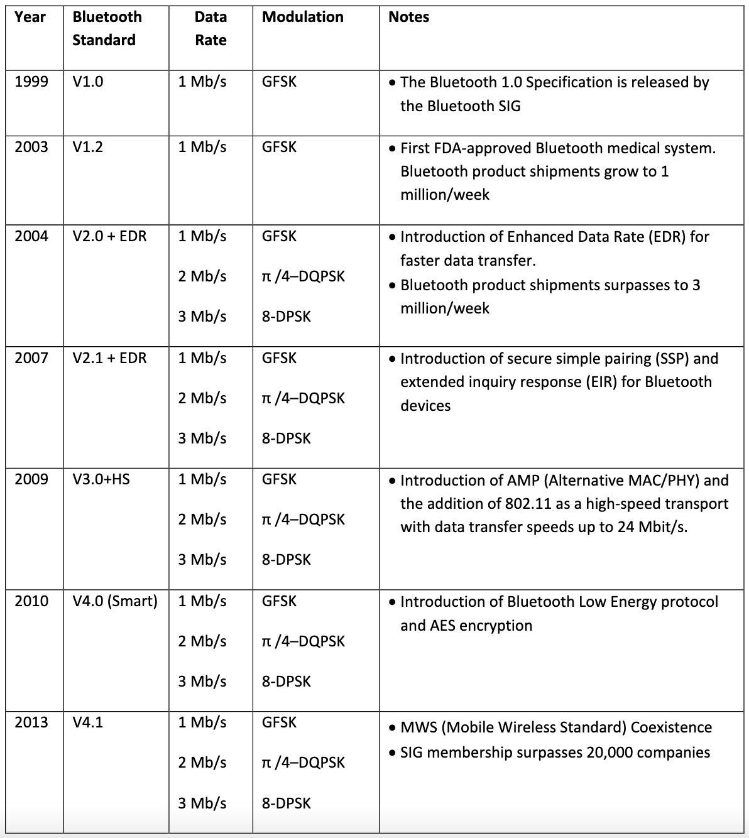
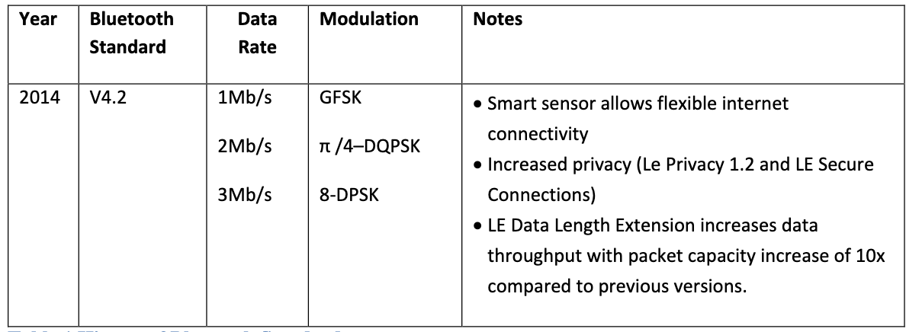
Bluetooth has a long history — the IoT is near-exclusively BLE (Bluetooth 4.0+) as opposed to Bluetooth Classic (<4.0)

Slide 10
Bluetooth Specification
Problem: a bit overwhelming…
5.2 spec: 3256 pages
We only care about Vol 6: Low Energy Controller
Part A: Physical Layer Specification
Part B: Link Layer Specification
CSS: Part A: Data Types Specification
So ~250 pages
Tip: be willing to just ignore things when skimming specs
5.2 spec covers BLE and Bluetooth Classic and a bunch of upper layer stuff that we never have to care about

Slide 11
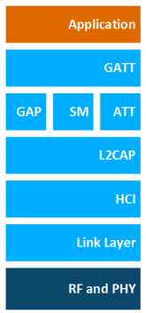
BLE Layers
GAP
Host – Configuration and Server
GAP – Generic Access Profile
Configure advertising
GATT – Generic ATTribute profile
Configure connections
HCI - Host Controller Interface (sigh)
Controller - Communication
Link Layer – send packets
RF and PHY – send bits
Host
Controller

Slide 12
BLE mechanisms
Advertising
Discovery
Advertisements – broadcast messages indicating device details
Ephemeral, uni-directional communication from Advertiser to Scanner(s)
ALOHA access control
Connections
Interaction
Bi-directional communication between Peripheral and Central
Maintained for some duration
TDMA access control

Slide 13
BLE network topology
Peripheral
Connection
Central & Scanner
Scanner
Connection
Peripheral
Advertisement
Advertisement
Advertisement
Advertisement
Advertiser
Advertiser
Advertiser

Slide 14
Multiple roles at the same time
Topology picture is a simplification of roles
A single device can have multiple roles simultaneously
Scanning and Advertising simultaneously
Peripheral and Scanner and Advertiser simultaneously
Peripheral and Scanner and Central and Advertiser simultaneously
Getting a bit out of hand though
Also possible:
One Peripheral can be connected to multiple Centrals
This is relatively new in BLE still, you’ll find old docs saying you can’t

Slide 15
Break + Check your understanding
Which roles is each device likely to have?
Keyboard
Laptop
Smartphone

Slide 16
Break + Check your understanding
Which roles is each device likely to have?
Keyboard
Advertiser and Peripheral
Laptop
Scanner and Central
Smartphone
Advertiser, Peripheral, Scanner, and Central

Slide 17
Outline
BLE Background
BLE Layers
Physical Layer
Link Layer
BLE roles
Advertising
Scanning

Slide 18
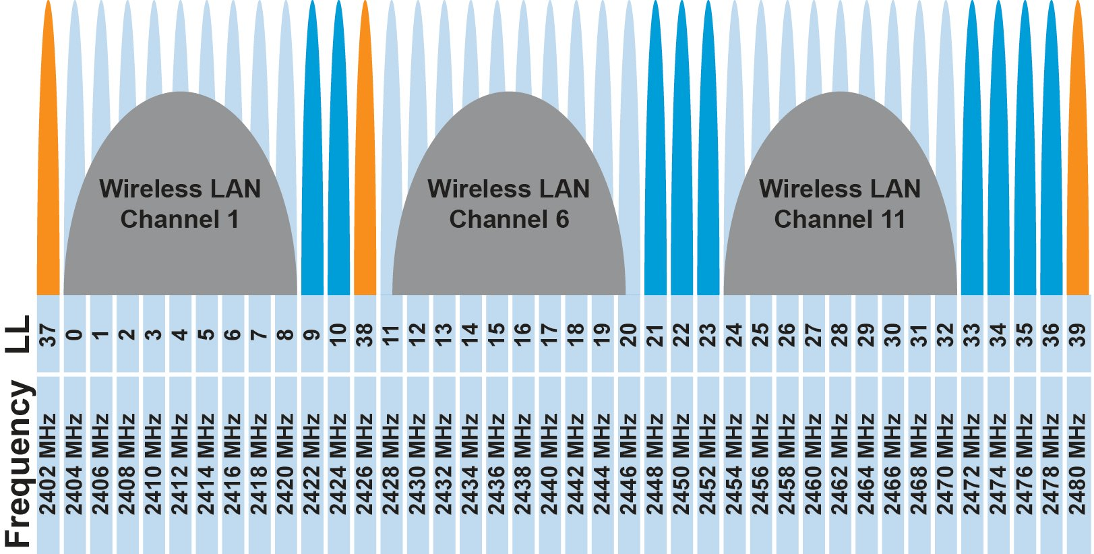
BLE frequency
2.4 GHz carrier, Forty 2-MHz channels, 1 Mbps data rate
37, 38, 39 for advertising
0-36 for connection (FHSS)
Why doesn’t BLE avoid WiFi altogether?

Slide 19
BLE frequency
2.4 GHz carrier, Forty 2-MHz channels, 1 Mbps data rate
37, 38, 39 for advertising
0-36 for connection (FHSS)
Why doesn’t BLE avoid WiFi altogether?
Can’t on 2.4 GHz
Wants 2.4 GHz for technology improvements

Slide 20
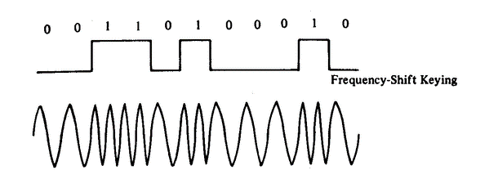
BLE modulation
Gaussian Frequency-Shift Keying (GFSK)
Improvement on base Frequency-shift Keying
Smoother transitions between bits -> reduces nearby interference

Slide 21
Gaussian FSK lessens spectral leakage at the expense of some loss in intersymbol discriminability
Notes:
Images from http://j3.rf-explorer.com/40-rfe/article/53-tutorial-how-to-use-rf-explorer-to-monitor-a-rfbee?start=4

Slide 22
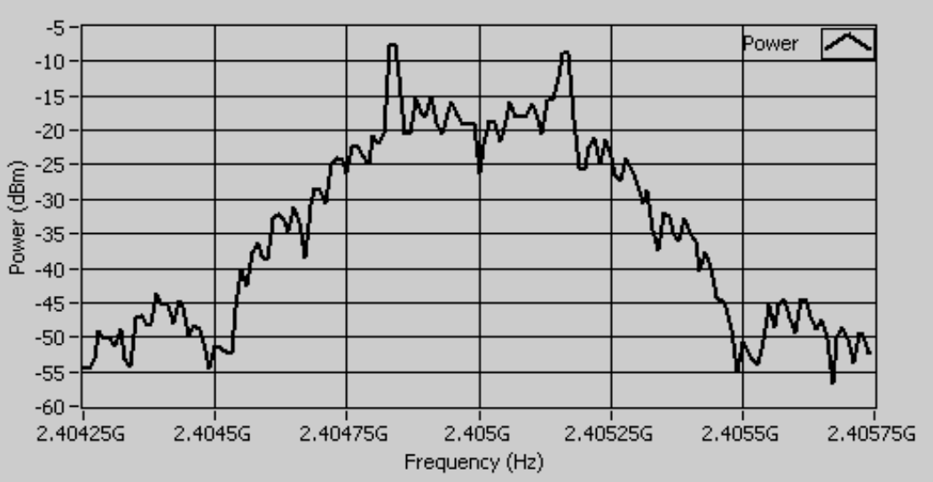
An example from `good case` BLE hardware
Notes:
Fig 8 in https://download.ni.com/evaluation/rf/intro_to_bluetooth_test.pdf

Slide 23
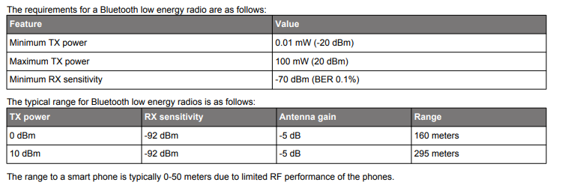
BLE signal strength
Remember nRF52840 capabilities
Transmit: up to 8 dBm
Receive sensitivity: -95 dBm

Slide 24
Outline
BLE Background
BLE Layers
Physical Layer
Link Layer
BLE roles
Advertising
Scanning

Slide 25
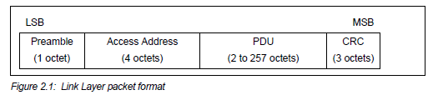
Packet structure
Same packet structure for both advertisements and connections
Fields are filled in little endian (the opposite of network byte order 😡)
Access address unique for each connection (randomly chosen)
In Advertising always set to 0x8E89BED6

Slide 26
Device addresses
Public and private address forms
Public
48 bits: 24-bits of company ID, 24-bits of company assigned number
Literally the same MAC address scheme as Ethernet and WiFi
Private
Top two MSbs specify type
46 bits of random
46 bits of hash of an identity key
Why have the two types?

Slide 27
Device addresses
Public and private address forms
Public
48 bits: 24-bits of company ID, 24-bits of company assigned number
Literally the same MAC address scheme as Ethernet and WiFi
Private
Top two MSbs specify type
46 bits of random
46 bits of hash of an identity key
Why have the two types? Privacy

Slide 28
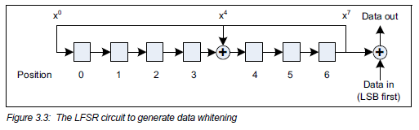
Data whitening
Avoid long series of repetitive bits (all zeros or all ones)
Would cause RF noise to be more focused in one direction
Radio hardware desires output to have zero DC-bias (or close to that)
Great example of the PHY and MAC being interwoven in wireless
I always forget this exists, since hardware usually handles it automatically

Slide 29
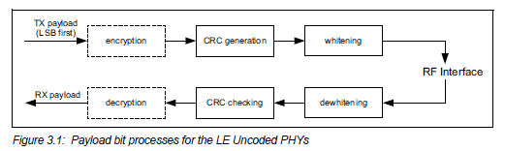
Bit processing pipeline

Slide 30
Break + Question
With enough scanners, could you track BLE devices as they move?

Slide 31
Break + Question
With enough scanners, could you track BLE devices as they move?
Depends on how long they use a device address for
You can do a scan of BLE transmissions to find device addresses
Scans at multiple locations can detect when a device moves throughout an area
But if the device re-randomizes between two scanners, you can’t follow it anymore
Re-randomizing at a scanner could be detectable…

Slide 32
Outline
BLE Background
BLE Layers
Physical Layer
Link Layer
BLE roles
Advertising
Scanning

Slide 33
Advertising
BLE discovery mechanism
Make nearby devices aware of advertiser’s existence
Communicate some information from or about advertiser
Traditional purpose is to enable connections, but this is also useful for general communication
Advertisements
Periodic broadcast messages with data
Scan Requests/Responses
Scanner sends responses after getting a request
Only occurs when scanner is listening
Almost literally “bonus advertisement data”

Slide 34
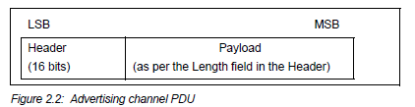
Advertising packet layering

Slide 35
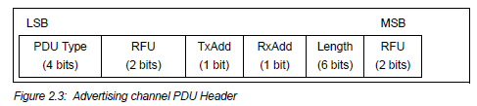
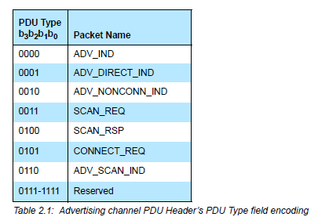
BLE advertising header
ADV_IND
Advertisement
Allows connections and scan requests
ADV_NONCONN_IND
Advertisement
No connections or scan requests
ADV_SCAN_IND
Advertisement
No connections but allows scan requests
SCAN_REQ
Scan request
SCAN_RSP
Scan response

Slide 36

Advertisement payloads
AdvA – address of the advertiser
TxAdd bit from header specifies if this is a “public” or “random” address
Remaining up to 31 bytes are available for use
Putting it all together, up to 47 bytes total:
BLE Packet
Advertising PDU
Preamble 1 Byte | Access Address 4 Bytes | Header 2 Bytes | Advertiser Address 6 Bytes | Advertiser Data (Payload) 0-31 Bytes | CRC 3 Bytes

Slide 37
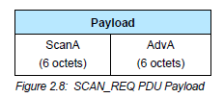
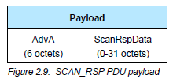
Scan Requests and Responses
Scan request
Just the two addresses: the scanner’s and the advertiser’s
Scan response
Identical to an advertisement
But only occurs after a request

Slide 38
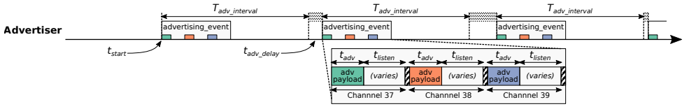
Advertising timing
Advertising Events occur periodically [20ms – 10.24 s] (or longer)
Plus a random delay after each instance [0-10ms]
Why?
User picks the rate as a tradeoff of energy and discovery latency

Slide 39
Advertising timing
Advertising Events occur periodically [20ms – 10.24 s] (or longer)
Plus a random delay after each instance [0-10ms]
Why? Avoid repeat collisions
User picks the rate as a tradeoff of energy and discovery latency

Slide 40
Advertising event
Three transmissions, one on each advertising channel
Always in the same order
Transmission, followed by listening window on that same channel
Requests will be sent >=150 us (Inter-Frame Spacing, IFS) after Tx
Followed by a retune to the next channel frequency
This short listen window is the magic “low energy” part

Slide 41
Preserving energy in communication
Most energy is spent listening
This is due primarily to how long listening durations are compared to transmissions
Example: maximum-sized BLE transmission:
8 bits/byte * 47 bytes = 376 bits at 1 Mbps = 0.376 ms transmitting
So listening for an entire second is >2500 times longer
But listening for only 0.376 ms requires sub-ms synchronization, which itself costs energy to manage…
Instead, when advertising, nRF radios listen for ~0.200 ms, only after a transmission

Slide 42
Payload of an advertisement
What do you stick in the BLE payload anyways?
Theoretically whatever you want, but that isn’t very compatible
Point is to specify capabilities of the advertiser
Desire: specify payloads in such a way that all scanners can interpret what they mean about the device
This is different from traditional internet packets
Broadcasts are for _anyone_ to hear, not a specific server/application
Ideas?

Slide 43
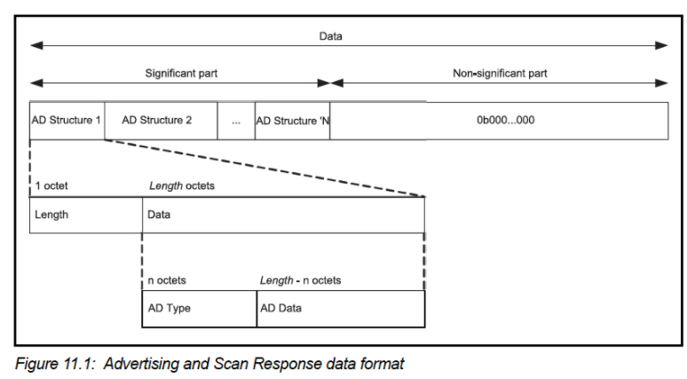
TLV Format
Type – Length – Value
Actually, BLE does the length part first
Scanner can hop through length/type pairs to find what interests it

Slide 44
Payload types
Listed in the Core Specification Supplement [Supplement v9]
Each might have their own considerations about AD Data format
Flags (supported modes: BLE and Bluetooth) required by Apple?
Name
Service UUID
TX Power Level
Manufacturer-specific data
And about twenty others

Slide 45
Outline
BLE Background
BLE Layers
Physical Layer
Link Layer
BLE roles
Advertising
Scanning

Slide 46
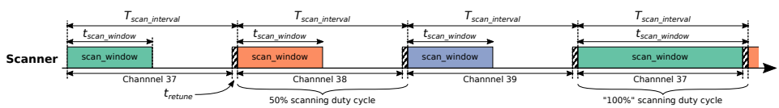
Scanning Pattern
Iterate through channels, listening for advertisements
T_{scan_interval} controls rate at which channels are changes
T_{scan_window} controls duty cycle of listening
Why listen at a low duty cycle?

Slide 47
Scanning Pattern
Iterate through channels, listening for advertisements
T_{scan_interval} controls rate at which channels are changes
T_{scan_window} controls duty cycle of listening
Why listen at a low duty cycle? Save energy

Slide 48
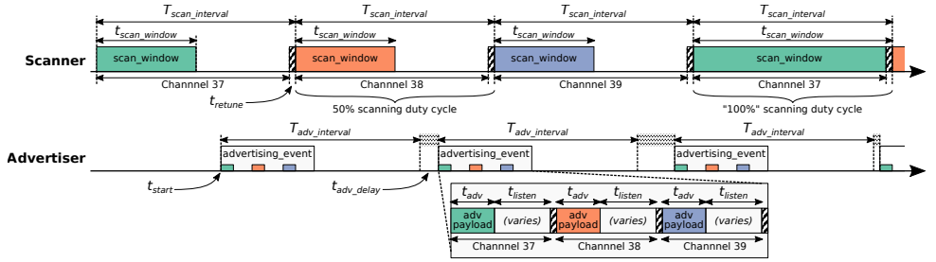
Putting it all together
Advertisements are received when the channel of the scan window and the channel of the advertisement overlap in time (and space)

Slide 49
A warning about scanning expectations
Scanners will NOT receive 100% of packets sent
Even ignoring range issues
Packets are lost due to (in roughly descending order):
Duty cycle
Sharing 2.4 GHz antenna with WiFi
Retune period after each scanning interval
Dropped packets in the receive software
Packet collisions

Slide 50
Outline
BLE Background
BLE Layers
Physical Layer
Link Layer
BLE roles
Advertising
Scanning

