Slide 1
Lecture 15 LPWANs Challenges
CS397/497 – Wireless Protocols for IoT
Branden Ghena – Spring 2022
Materials in collaboration with Pat Pannuto (UCSD)
With images from Swarun Kumar (CMU)

Slide 2
Today’s Goals
Consider LPWAN use cases, looking at a particular automotive study
Explore academic research improving LoRaWAN capabilities
Deep-dive into challenges LPWANs face

Slide 3
Outline
LPWAN Use Cases
Improving LoRaWAN
LPWAN Challenges

Slide 4
Project Background
Research project with automotive company (circa 2019)
LPWAN protocols are potentially interesting for automotive uses
New design points allow trading bandwidth, range, power, and cost.
Could these enable new valuable applications?

Slide 5
Problem Statement
Is there an opportunity to complement existing high-bandwidth low-latency networks, with emerging low-cost long-range networks for certain automotive use cases?
What new uses cases can be realized by the addition of these new communications capabilities?
How would future vehicle architectures change to support these networks?

Slide 6
Low-Power Applications
Now
Asset Tracking
Report location of vehicle prior to sale even when off
Parked Status
Monitor and report several sensors when vehicle is parked and off
Near
Vehicle Security
Detect suspicious behavior near the vehicle and report to user
Far
Distributed Data Collection
Collect sensor data from vehicles throughout a city

Slide 7
Asset Tracking Application
Track the vehicle’s location in real time from factory to point-of-sale.
Envision a web application that can label each vehicle on a dealer’s lot.
Could be useful to owner as well for theft-tracking purposes.
Would utilize:
GPS
Accelerometers (detect if vehicle is in motion)

Slide 8
Parked Status Application
Alert the user of flat tires, dead batteries, or other issues that can occur while the vehicle is parked and off.
Envision a smartphone app that could send owners a notification if something goes wrong.
Would utilize:
Tire pressure sensors
Battery status sensors
Door, trunk, window, and roof opened/closed sensors
Fuel level sensor
Accelerometers (collision detection)

Slide 9
Vehicle Security Application
Detect suspicious activity around the vehicle and send notifications to the owner.
Envision a smartphone app that notifies the owner with a picture of the nearby activity.
Would be enabled by sensors already in place for vehicle autonomy purposes.
Would utilize:
Cameras
Motion sensors
Door, trunk, window, and roof opened/closed sensors
Accelerometers

Slide 10
Distributed Data Collection Application
Collect and collate various sensor data from cars parked throughout a region.
Parked vehicles can be used as a city-scale sensor network to determine various phenomena.
Track weather down to local levels.
Measure air quality throughout a city.
Sense and report nearby traffic congestion.
This is a little further-term than other applications, but cities and researchers could benefit greatly from available data.

Slide 11
Project Takeaways
Unlicensed LPWANs seem limited in applicability to vehicles
Coverage areas and bandwidth capabilities are too limited
Cellular LPWANs can enable inactive vehicle applications
Applications have long lifetimes, even using a backup battery
Architecture changes to support low-power communications appear feasible
Low-power, inactive-vehicle applications are worth further investigation
Asset tracking and parked vehicle status are realizable in near-term
What would the costs of realizing these applications be?
How much value would they add for customers and company

Slide 12
Break + Brainstorm
Other applications for automotive use?

Slide 13
Outline
LPWAN Use Cases
Improving LoRaWAN
LPWAN Challenges

Slide 14
Resources
Swarun Kumar (CMU) - https://swarunkumar.com/lpwan.html
Choir
https://swarunkumar.com/papers/choir-sigcomm2017.pdf
https://swarunkumar.com/slides/choir-sigcomm2017.pdf
Charm
https://swarunkumar.com/papers/charm-ipsn2018.pdf
Opportunistic Packet Recovery
https://swarunkumar.com/papers/opr-mobisys2020.pdf

Slide 15
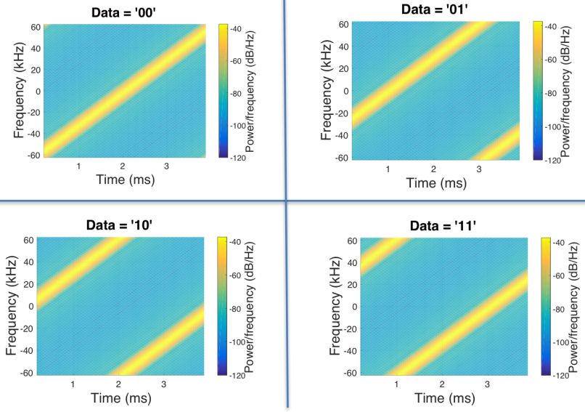
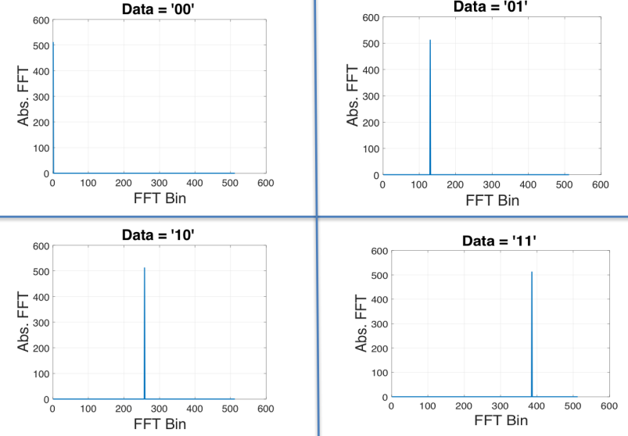
Choir concept
Can we distinguish data from LoRa chirps that have collided?
Yes! By applying signal processing to the problem
Data in time domain
Data in frequency domain

Slide 16
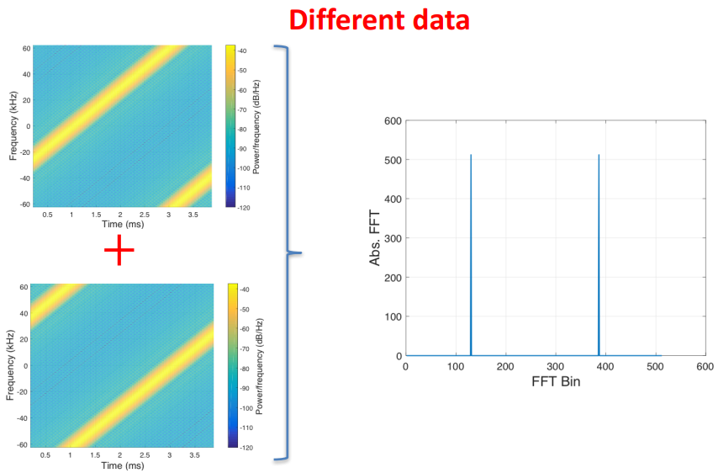
What happens when LoRa chirps collide?

Slide 17
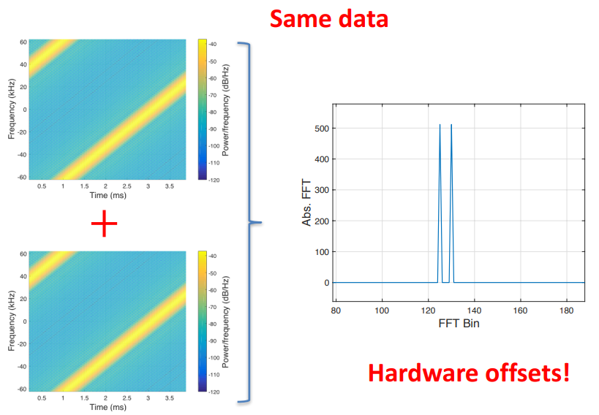
What happens when LoRa chirps collide?

Slide 18
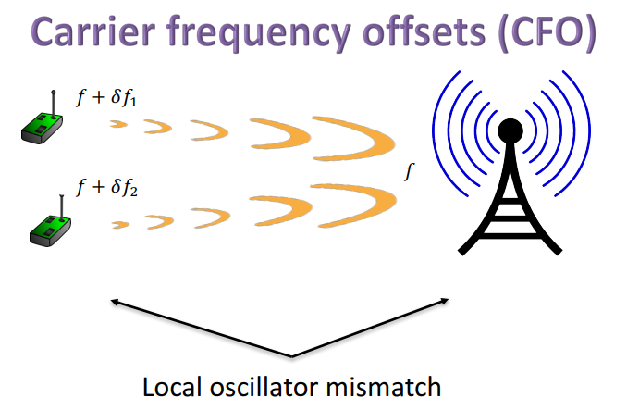
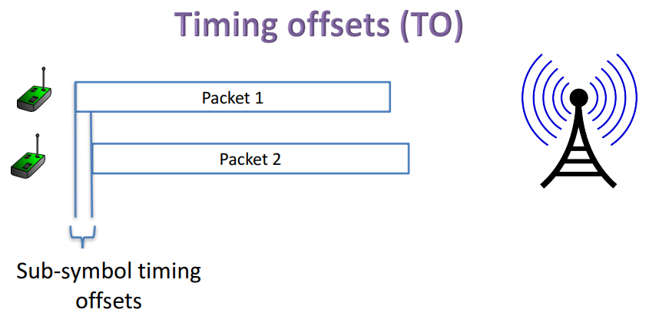
Imperfections in hardware create offsets

Slide 19
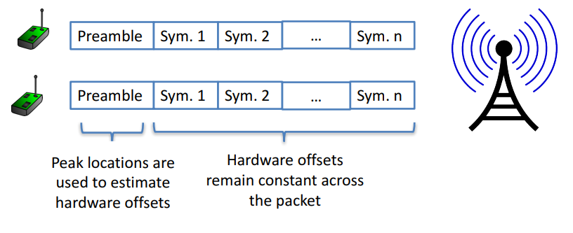
Decoding colliding packets

Slide 20
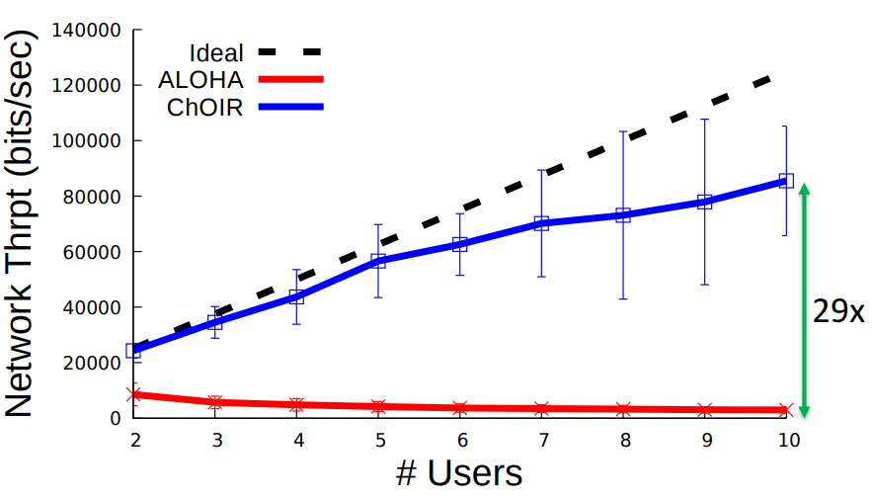
Choir results
Recovering collided packets resolves losses due to Aloha transmission!
Increases maximum throughput on the network considerably!
Does require modifications to hardware on gateways though

Slide 21
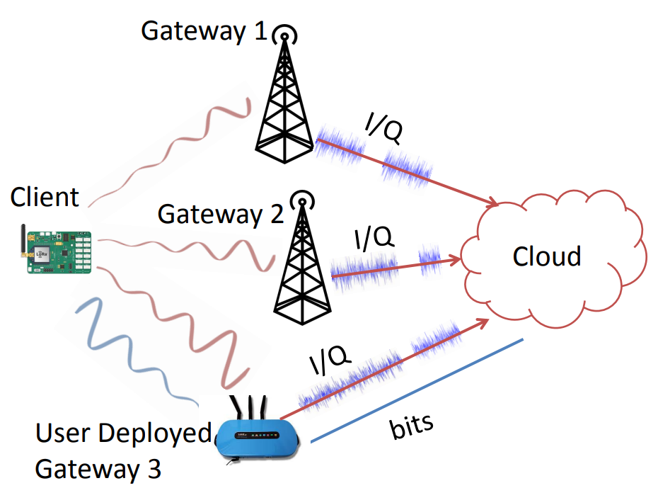
Charm
Take advantage of multiple gateways in range of a device
Combine signals received at each gateway to recover packets that weren’t received cleanly
Particularly useful at decoding weak signals

Slide 22
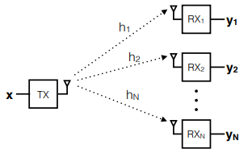
Coherent combining
Signal received at each receiver is a combination of
Signal
Wireless channel
Random noise
Signal and wireless channel are similar at all receivers
Noise is different though! Independent
When combined, signals are coherent (build in strength) whereas noise is incoherent (spreads out)

Slide 23
Charm uses coherent combining across gateways
Gateways send signal data to the cloud
The cloud can perform combining on the data and recover signals
Challenges
Only send the data when it’s needed
Tight time synchronization on the data
Gateway hardware changes

Slide 24
Opportunistic Packet Recovery (OPR)
Can we recover packets that have bad CRCs?
What if we have some information about where the interference might have occurred during the signal transmission?
OPR demonstrates that we can recover packets!
Process
Receive bits even for bad packets
Measure RSSI for each bit along the way
Look for changes in RSSI that signals interference
Try different values for the effected bits until the CRC succeeds!

Slide 25
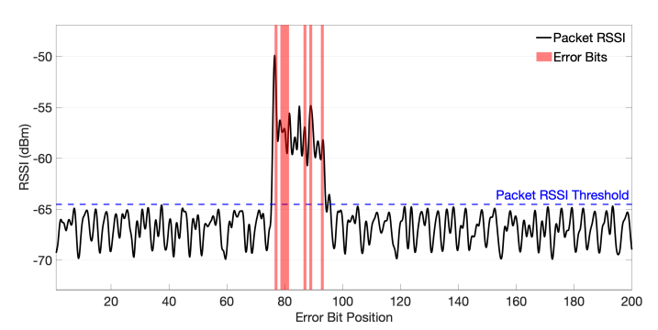
Detecting error bits in transmitted packets
Correctly identifies 83% of the corrupted bits with 17% false positives

Slide 26
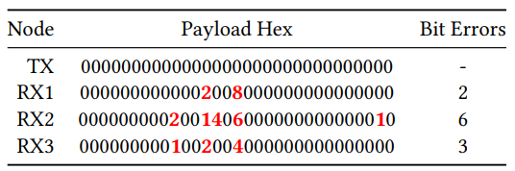
Multiple gateways do even better
If multiple gateways receive the packet, they can compare their received data
Common bits are likely correct, while differences are likely interference

Slide 27
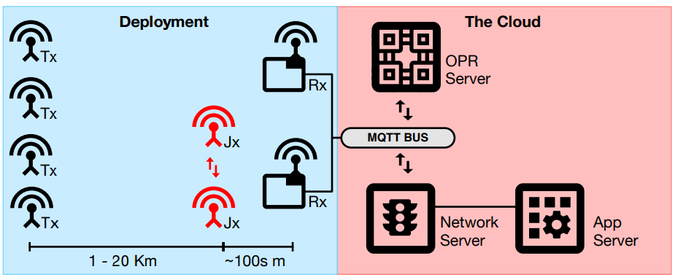
OPR total design
Bad packets are sent to the OPR Server for handling along with RSSI data
OPR server attempts to reconstruct the packet
In practice, system can correct up to 72% of CRC errors!
Also completes correction in time for the ACK response (within 1 second)

Slide 28
Break + Open Question
What are the challenges in translating this research into real-world use?

Slide 29
Break + Open Question
What are the challenges in translating this research into real-world use?
Improve gateway hardware: how do people buy/make it?
Needs a manufacturer to be interested
Multiple gateways are necessary
Not applicable to very small deployments
Network operators (TTN or Helium) would be good targets
They also have backend stuff running anyways, so adding OPR should be possible!

Slide 30
Outline
LPWAN Use Cases
Improving LoRaWAN
LPWAN Challenges

Slide 31
Do novel networks meet application needs?
How do we compare varied requirements and capabilities?
Networks have throughput per gateway and range of gateway.
Applications have throughput per device and deployment area.
Each gateway must support throughput for all devices in its coverage area.
Deployment areas are often wider than a single gateway’s range.
Solution: compare the density of communication.
Data communication rate per unit area.

Slide 32
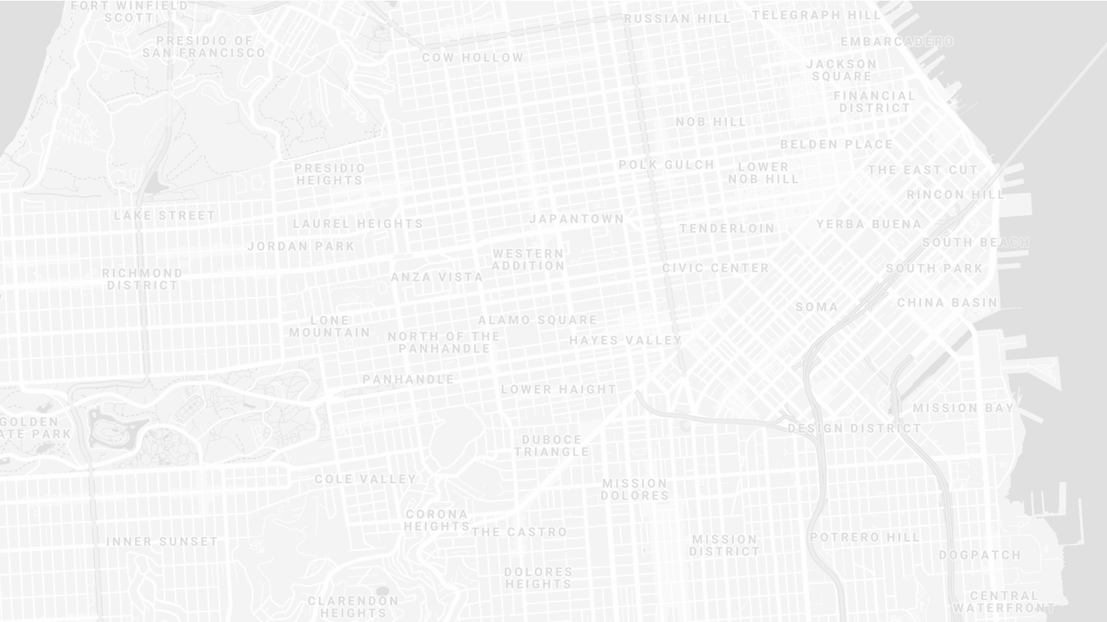
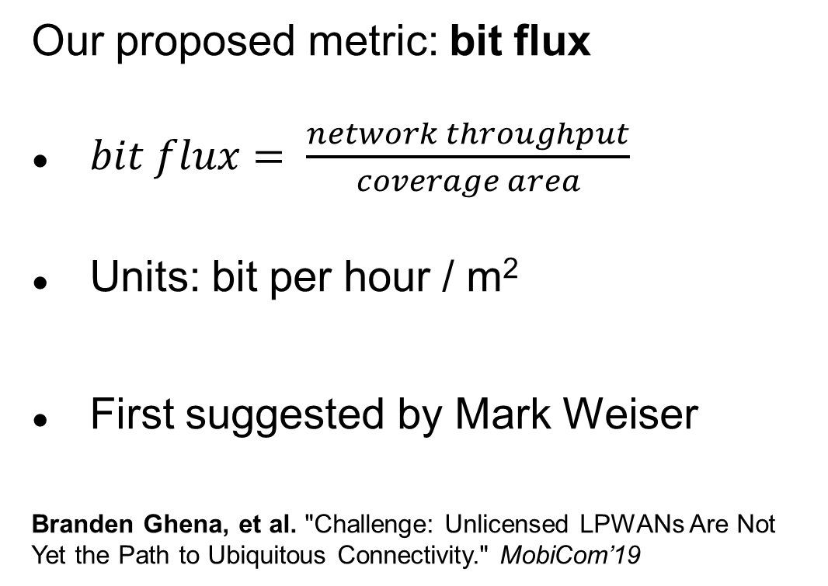
New metric for wide-area communication.
Our proposed metric: bit flux
$bit flux= \frac{network throughput}{coverage area}$
Units: bit per hour / m²
First suggested by Mark Weiser
Branden Ghena, et al. "Challenge: Unlicensed LPWANs Are Not Yet the Path to Ubiquitous Connectivity." MobiCom’19
Notes:
bit flux is our metric for data density
throughput divided by coverage area
As with many ideas, this was first suggested by Mark Weiser

Slide 33
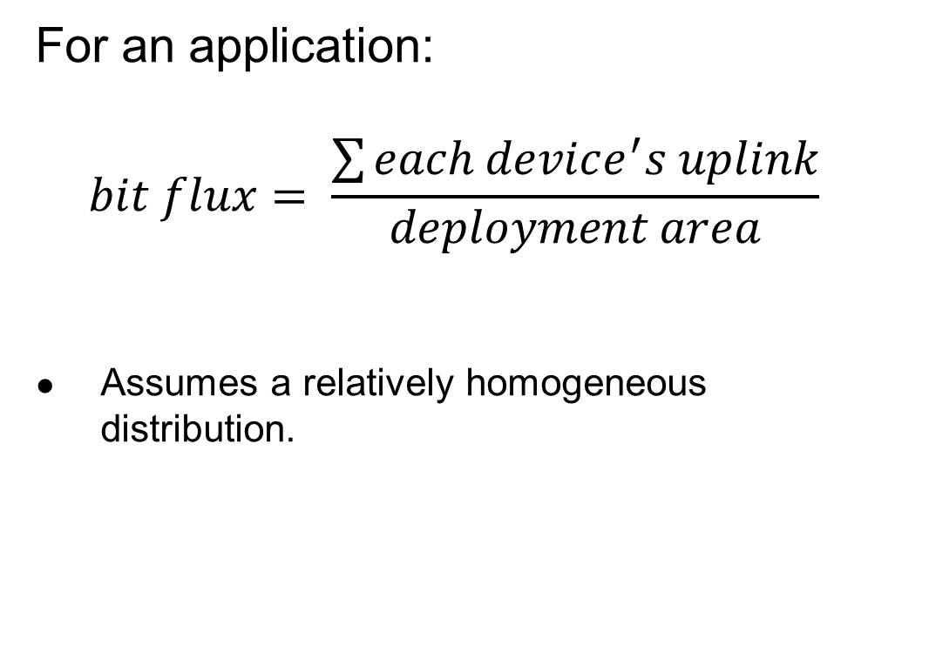
Bit flux can measure application needs.
For an application:
$$bit flux= \frac{\sum{each device^{′}s uplink}}{deployment area}$$
Assumes a relatively homogeneous distribution.
Notes:
For applications, bit flux sums the data needs for each device in the deployment
And divides by the total deployment area
To determine the application uplink density

Slide 34
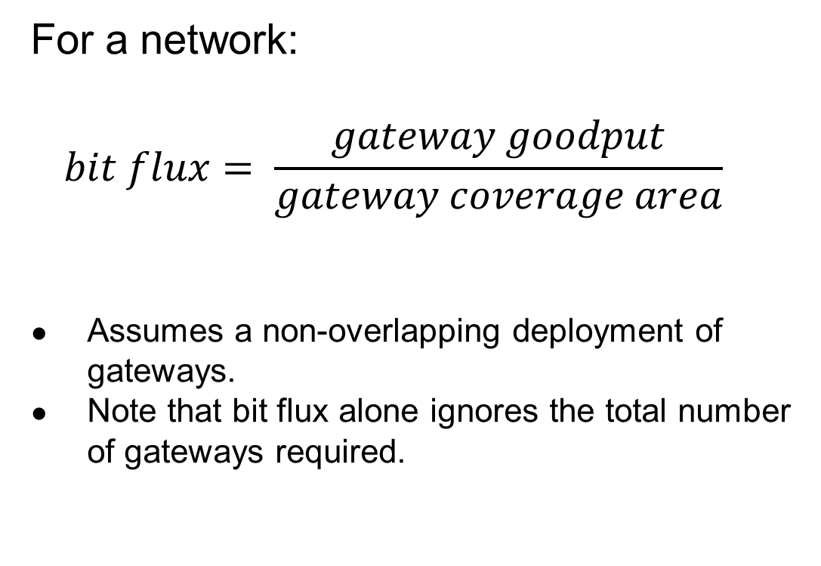
Bit flux can measure network capabilities.
For a network:
$$bit flux= \frac{gateway goodput}{gateway coverage area}$$
Assumes a non-overlapping deployment of gateways.
Note that bit flux alone ignores the total number of gateways required.
Notes:
For networks, we divide the goodput of a network
By the coverage area of a single gateway
This gives us a number that represents the data density that a network can support, at any width of deployment

Slide 35

Bit flux accounts for spatial reuse.
Reducing coverage area and deploying additional gateways improves capacity.
$bit flux↑ = \frac{gateway goodput}{coverage area↓}$
Notes:
Bit flux also accounts for spatial reuse in networks
Reducing range (and deploying more gateways), reduces the coverage area for each gateway, increasing the network bit flux

Slide 36
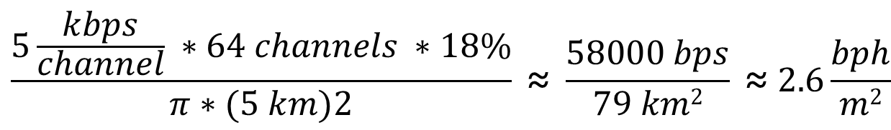
Bit flux measurement for LoRaWAN.
ALOHA access control
$$\frac{5\frac{kbps}{channel} ∗64 channels ∗18\%}{π∗(5 km)2} \text{≈} \frac{58000 bps}{79 km2} \text{≈} 2.6\frac{bph}{m2}$$
Hata model
Notes:
Here is the bit flux measurement for a LoRaWAN network
In the US, LoRaWAN has 64 channels for uplink
But it relies on an ALOHA access control mechanism, so packet collisions reduce throughput significantly

Slide 37
Networks differ in capability by orders of magnitude.
Notes:
We can calculate bit flux for each of the networks we’re interested in
We note that there are several orders of magnitude difference in the throughput capability of each network
Particularly between cellular communication and unlicensed LPWANs

Slide 38
Range reduction results in a bit flux curve for each network.
Notes:
These points are at the maximum range for each network, but they have the ability to perform power control and reduce range
This creates a curve for each network, where we can reduce range (and install more gateways) in order to increase network capability

Slide 39
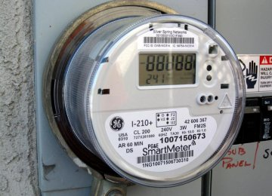
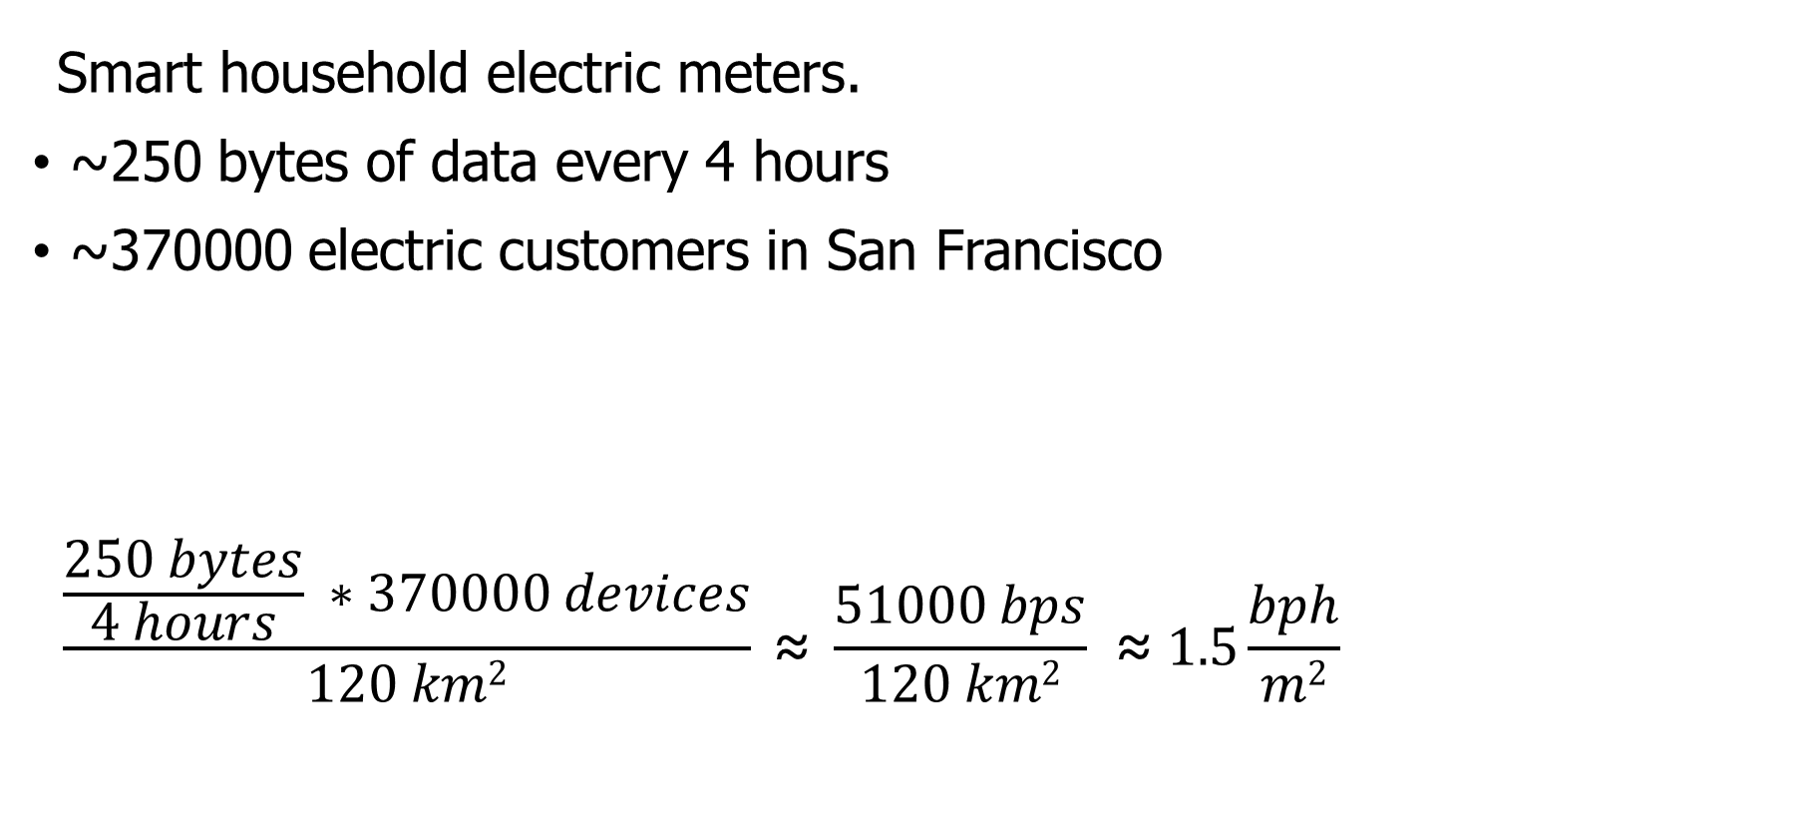
Let’s compare network capabilities to a real-world application.
Smart household electric meters.
~250 bytes of data every 4 hours
~370000 electric customers in San Francisco
$$\frac{\frac{250 bytes}{4 hours} ∗370000 devices}{120 km2} \text{≈} \frac{51000 bps}{120 km2} \text{≈} 1.5\frac{bph}{m2}$$
Notes:
Now that we can measure the capability of each network, lets compare that to the needs of an application
The example I’ll be talking through is Electricity Metering, there are about a dozen others in the paper
PG&E smart meters send about 250 bytes every 4 hours
This isn’t a lot of data, but smart meters are densely deployed, with three hundred thousand across San Francisco

Slide 40
All networks are capable of meeting the data needs of electricity metering.
Electricity Metering Application
Notes:
We can plot the need of the Electricity Metering application as a line on our bit flux figure
Any network above this line is capable of serving the application’s needs
Sigfox needs range reduction, but all networks are capable of serving this application’s needs
So, great! Networks can serve ubiquitous applications. Problem solved, right?

Slide 41
Unlicensed LPWANs lag behind Cellular IoT in ability to support applications.
2G < 0.03% utilized
Notes:
Let’s visualize this instead as the number of gateways deployed and the proportion of network utilized.
Again, because of power control, there is a tradeoff here. We could deploy a single gateway for everything, or many gateways with reduced range to increase capacity.
Cellular networks have no problem with this application
With a single gateway, LTE-M could spend 1% of its capacity to service this app.
Unlicensed LPWANs, however, have choices to make on how many gateways they deploy and how much capacity they are willing to spend on this one application

Slide 42
Sigfox requires range reduction to meet application needs.
Capacity Problem
Throughput capability of Sigfox is insufficient to support application needs
It can only support the application with reduced range and additional gateways
Notes:
There are two particular problems we can see with the unlicensed LPWANs
The first is a capacity issue:
Sigfox can’t satisfy the application at all without power control.
Range is sufficient for a single gateway to cover the city, but it wouldn’t be able to keep up with the data.

Slide 43
Capacity solutions are relatively straightforward.
Better access control mechanisms. Explore CSMA?
Recover simultaneous transmissions (Choir and Charm).
Increase bandwidth (TV white spaces).
All likely come at the cost of increased energy usage…
Results in a protocol that looks pretty similar to cellular…
Adwait Dongare, et al. "Charm: exploiting geographical diversity through coherent combining in low-power wide-area networks.“ IPSN’18
Rashad Eletreby, et al. "Empowering low-power wide area networks in urban settings." SIGCOMM’17
Abusayeed Saifullah, et al. "SNOW: Sensor network over white spaces." SenSys’16
Notes:
Solving these capacity problems is relatively straightforward
And a lot of research from our community has begun that path
One solution would be better access control mechanisms than the ALOHA
We could also significantly increase the available bandwidth through the use of TV white spaces

Slide 44
LoRaWAN devotes most of its network capacity to a single application.
Coexistence Problem
LoRaWAN can meet application needs
But only by using 50% of the 915 MHz unlicensed-band spectrum
Notes:
But there is a second problem, that of coexistence
LoRaWAN could handle the application with only 2 or 3 gateways
Remember, that we are calculating bit flux for LoRaWAN using all available channels
As long as you are willing to commit 50% of the 915 MHz spectrum to electricity metering

Slide 45
Coexistence is inevitable in urban areas.
Urban environments and long range lead to many overlapping deployed networks.
Capacity problems worsen coexistence by devoting more bandwidth to one application.
It’s not just electricity metering…
Notes:
You might try to say it’s fine to dedicate so much of a network to a single application. I dedicate 50% of my home WiFi to Netflix all the time…
But coexistence cannot be ignored in urban areas
There won’t just be one network, but two, or three, or more
And they all have to share the same bandwidth for all deployed applications

Slide 46
Coexistence in unlicensed bands is a more difficult problem.
No methods for inter-network negotiation so far.
Without buy-in from most deployments, all access control becomes uncoordinated.
Cellular IoT does not have this problem
Notes:
Solving these coexistence problems are more difficult
We need methods for coordination and negotiation between deployed networks
And without buy-in from all networks, collisions are inevitable
It doesn’t matter that you are using a wonderful scheduling TDMA algorithm to send data without collisions if your neighbor is transmitting whenever they want
And a really important point is that cellular IoT doesn’t face this problem

Slide 47
Cellular may dominate future deployments.
LTE-M and NB-IoT are now deployed in the US (and worldwide).
Licensed bandwidth avoids the coexistence problem.
Cellular may solve many applications but is not a perfect solution.
Still has higher energy and monetary costs for use.
Also limited to where service is already available.
Notes:
Occupying licensed bands means LTE-M and NB-IoT don’t have multiple overlapping networks to coordinate with
So coexistence isn’t a concern
And they already have more capacity than the unlicensed protocols
Without solutions for unlicensed LPWANs, deployments will move to cellular networks
And when the applications leave, research will leave as well
Without real solutions to the problems they face, we’re in danger of losing an exciting research domain
We pose this as a challenge to the community to develop coexistence and capacity solutions for unlicensed LPWANs

Slide 48
Unlicensed LPWANs are still useful for some scenarios.
Controlled or unoccupied regions have reduced coexistence concerns.
Industrial factories, farms, parks and forests.
Unlicensed networks are very exciting for research.
Anyone can deploy a network wherever they want.
Much easier to explore protocol modifications and new technologies.
Research suffers without real-world applications.
Problem areas are strong recommendations for new research.
New research is only useful if they will have real-world impacts.

Slide 49
Implications – Low-Power Wide-Area Networks.
Existing unlicensed LPWANs face significant challenges in supporting urban applications.
Best suited for industrial or agricultural uses in controlled environments.
Research directions for unlicensed LPWANs:
improve network capacity,
and enable coexistence.
Cellular IoT networks (LTE-M and NB-IoT) are positioned to solve the needs of city-scale sensing.
If the money and energy costs are there.

Slide 50
Outline
LPWAN Use Cases
Improving LoRaWAN
LPWAN Challenges

