Slide 1
Lecture 09 ZigBee
CS397/497 – Wireless Protocols for IoT
Branden Ghena – Winter 2021

Slide 2
Today’s Goals
Introduce ZigBee as another 802.15.4 implementation
Discuss ZigBee application layer and interoperability

Slide 3
Outline
ZigBee overview
ZigBee PHY and MAC
ZigBee application layer
Interoperability

Slide 4
ZigBee goals
Enable automatic communication between devices
Low complexity
Low power
Focus on home automation and industrial control/monitoring
From our perspective
802.15.4 PHY and MAC
Plus well-defined Server/Client interactions
Similar to BLE (actually, BLE is similar to ZigBee)
Designed for higher-power devices than Thread or BLE
Although still relatively low power

Slide 5
ZigBee history
Intertwined with the creation of 802.15.4
Both are founded around the same time
ZigBee Alliance involved in the original 802.15.4 specification
Original plan: 802.11/WiFi <-> 802.15.4/ZigBee
Original specification 2004 (following 802.15.4 in 2003)
Updated 2006, 2007, 2015, (2017?)
2015 version is also known as ZigBee Pro
We’ll focus on 2015, but look at previous stuff too
Application layer stuff hasn’t changed considerably

Slide 6
ZigBee resources
ZigBee Specification (2015)
ZigBee Cluster Library Specification (2016)
Useful resources
ZigBee overview: https://www.cse.wustl.edu/~jain/cse574-14/ftp/j_13zgb.pdf
NXP library guides (include overview on ZigBee)
ZigBee Protocol: https://www.nxp.com/docs/en/user-guide/JN-UG-3113.pdf
ZigBee Cluster Library: https://www.nxp.com/docs/en/user-guide/JN-UG-3115.pdf
ZigBee Home Automation: https://www.nxp.com/docs/en/user-guide/JN-UG-3076.pdf

Slide 7
Outline
ZigBee overview
ZigBee PHY and MAC
ZigBee application layer
Interoperability

Slide 8
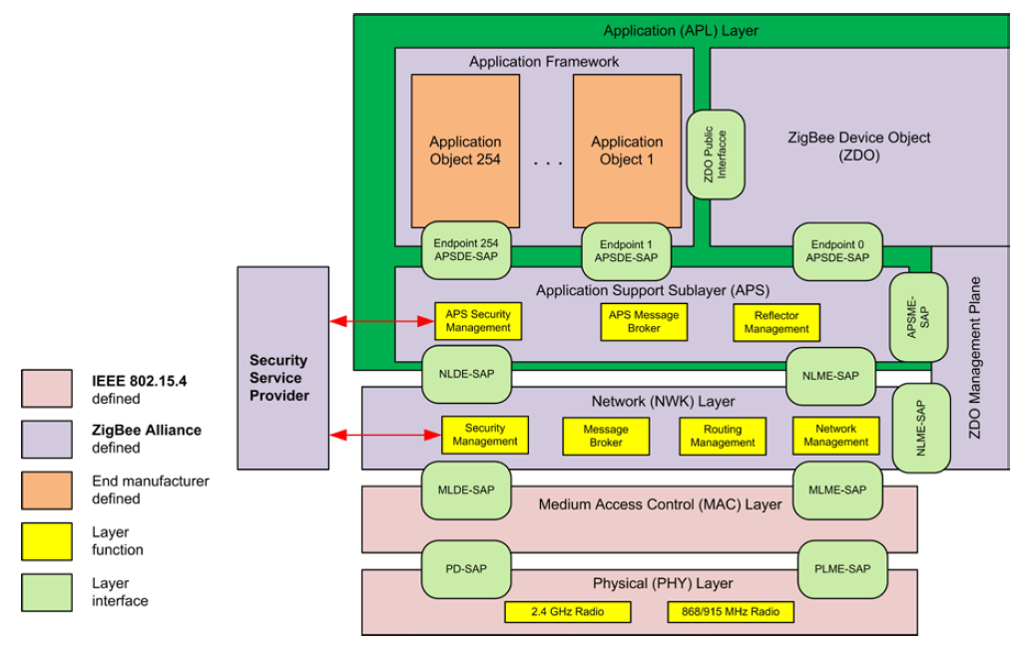
ZigBee stack

Slide 9
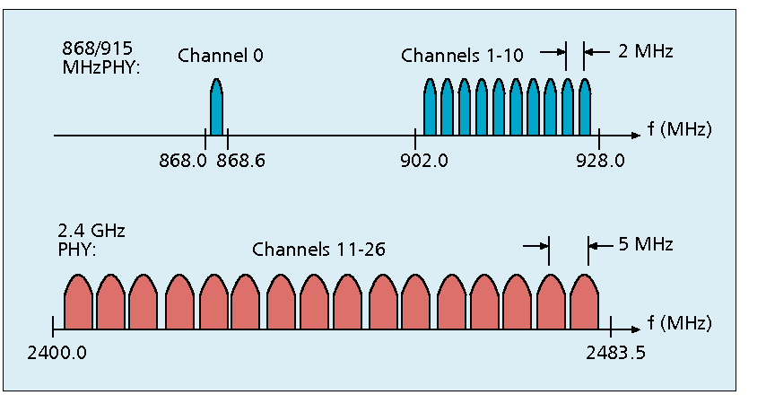
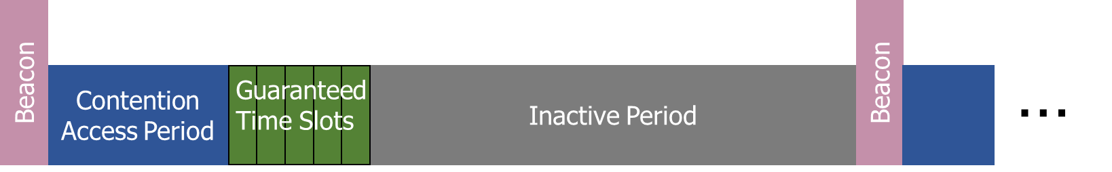
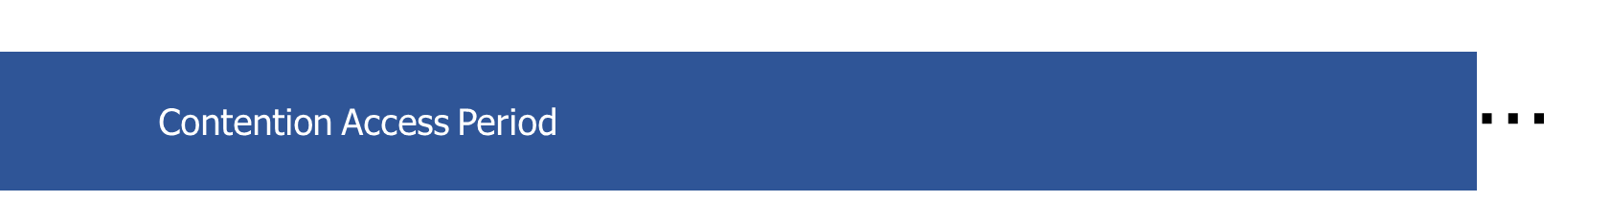
Use of 802.15.4
Basic answer: everything
Reuse all of PHY (including non-2.4 GHz channels)
Reuse all of MAC (including beacon-enabled network and GTS)
Same CSMA/CA mechanism

Slide 10
ZigBee devices (same roles as 802.15.4 defines)
ZigBee Coordinator (ZC)
Starts the network and decides on key parameters
Is also a Router
ZigBee Router (ZR)
Higher-power, more-capable devices
Radios always on (except during inactive superframe)
Connect to one or more children
Connect to one or more routers
ZigBee End Device (ZED)
Lower-power, less-capable devices
Always a child of one router

Slide 11
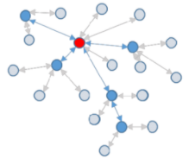
Older ZigBee - tree networks
Original preferred topology
Uses beacon-enabled network
Synchronization via beacon superframes
Can reduce power requirements for routers
Some things get simpler
Address assignment is simple
If you restrict network size
Routing is straightforward
But likely more hops for router-to-router communication

Slide 12
ZigBee tree network complications
Distributed routing scheme limits topologies
There is a limit on number of routers
Each router has a maximum number of children
There is a maximum limit for router depth
Note: Thread has device count limits too!
Needs a beacon scheduling mechanism
Each parent must both participate in a superframe
And also send their own superframe beacons
Need to keep inactive period large if there is significant router depth
Each beacon includes a TX offset field specifying parent beacon time
Helps prevent hidden terminal problem

Slide 13
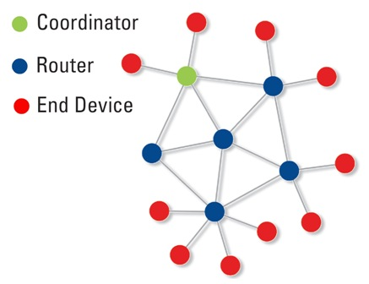
Modern ZigBee – mesh networks
Presently preferred topology
Uses non-beacon-enabled network
All routers are always-on devices
Allows arbitrary communication between routers
Some tradeoffs
Likely higher power routers
Routing more complicated (potentially better algorithms though)
Addressing more complicated
Assign random addresses to each node
Include a method for address conflict resolution

Slide 14
ZigBee End Device polling
Packets are held in ZigBee Routers for up to 7.68 seconds
Compare to undefined duration for Thread (at least minutes)
Reduction in “low energy” capability for end devices
Limiting timeouts makes Router design simpler
ZigBee codifies polling behavior for End Devices
Long Polling - steady state polling period, example: 7.5 seconds
Short Polling – polling period while waiting on data, example: 1 second

Slide 15
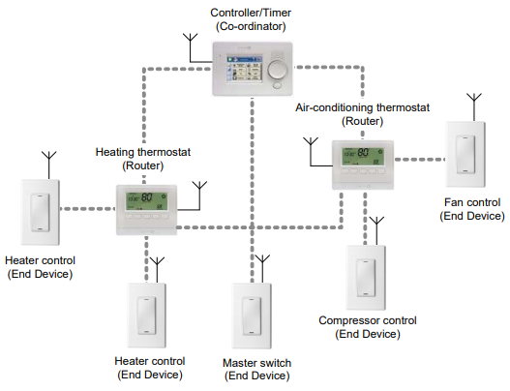
Example ZigBee network

Slide 16
Outline
ZigBee overview
ZigBee PHY and MAC
ZigBee application layer
Interoperability

Slide 17
ZigBee application-layer terms
Devices act as servers and clients
Profiles – details application-level features
Includes network configurations
For example: security or reliability
Includes definitions of various Device Types
Specify a collection mandatory and optional Clusters
Clusters – collection of Attributes and Commands
Attributes – information, readable and/or writable
Commands – control, writable, may elicit a response

Slide 18
Analogies between BLE and ZigBee
No analogy
BLE Profile
BLE Service
BLE Characteristic
ZigBee Profile
ZigBee Profile + Device
ZigBee Cluster
ZigBee Attribute
Also ~ZigBee Commands

Slide 19
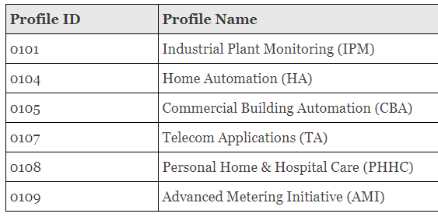
ZigBee profiles
Broad classes of device purposes
Contains multiple Device Type definitions
Define more features of device than the profiles from BLE
Pick various optional network/MAC features, like security or commissioning

Slide 20
ZigBee Device Types
A collection of Clusters
Some mandatory and some optional
Lists Clusters as Server side or Client Side
Server side Cluster is an input
Client side Cluster is an output
Example: light bulbs implement server, switches implement client

Slide 21
ZigBee Clusters
A collection of Attributes and Commands
Analogous to BLE Services
Can be optional or mandatory
ZigBee Cluster Library defines standard Clusters
Lists Attributes and Commands for each
Attributes
Type – uint8, enum, bitmap, string, etc.
Permissions - Read/Write/Report (receive automatic updates)
How to interpret meaning of value
Commands
Field(s), Type of each, Interpretation of each

Slide 22
Example ZigBee profile: Home Automation Device Types
Generic Devices
On/Off Switch
On/Off Output
Remote Control
Door Lock
Door Lock Controller
Simple Sensor
Smart Plug
Intruder Alarm System Devices
IAS Control and Indicating
IAS Ancillary Control
IAS Zone
IAS Warning Device
Lighting
On/Off Light
Dimmable Light
Colour Dimmable Light
On/Off Light Switch
Dimmer Switch
Colour Dimmer Switch
Light Sensor
Occupancy Sensor
HVAC Devices
Thermostat
Each bullet point is a Device Type
Which is a list of mandatory and optional Clusters

Slide 23
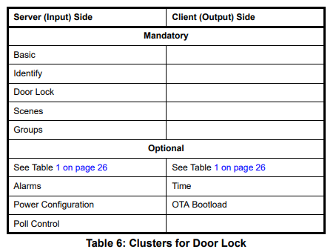
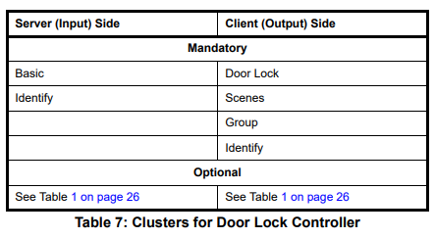
Example Device Types: door lock and door lock controller

Slide 24
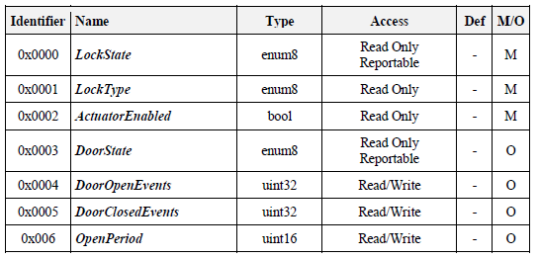
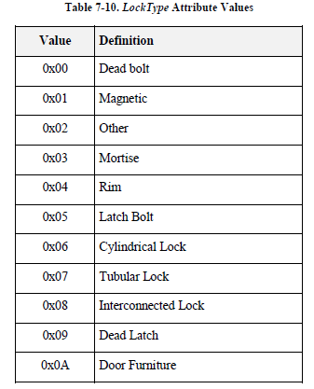
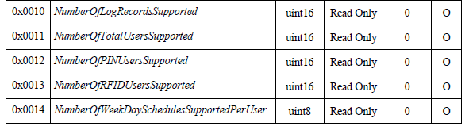
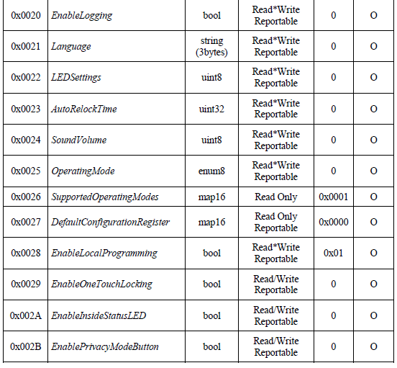
Example Cluster: door lock attributes

Slide 25
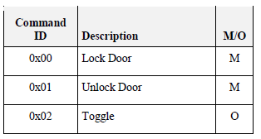
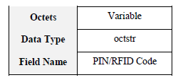
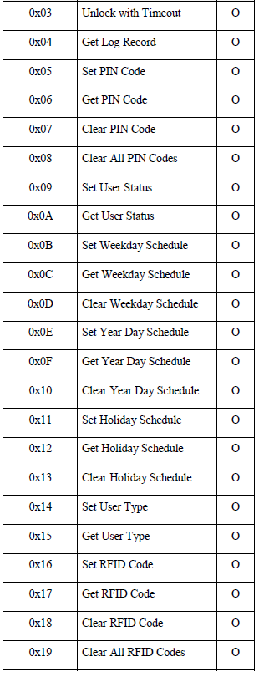
Example Cluster: door lock commands (client side)
Server-side
Performs actions when it receives these commands
Client-side
Capable of sending these commands

Slide 26
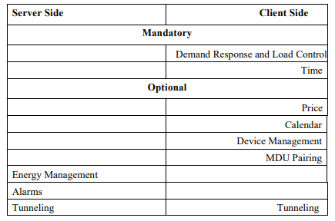
Example ZigBee profile: Smart Energy
Interactions with energy providers for efficiency and cost savings
Devices
Energy service interface
Metering device
Load control device
Clusters
Demand response
Metering
Price
Key establishment (e.g. security)

Slide 27
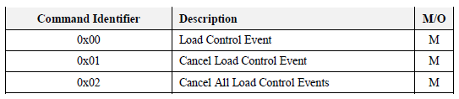
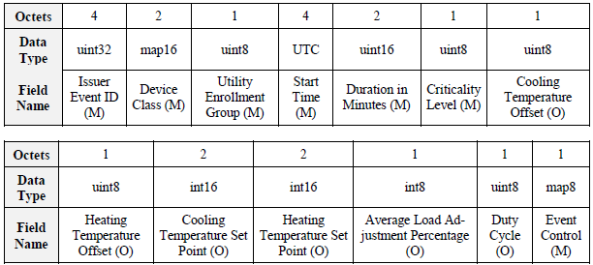
Example: demand response cluster
No attributes, only commands
Load Control Command Payload

Slide 28
Endpoints
Each ZigBee device has a number of Endpoints (up to 240)
Number by which remote applications can contact it
Analogous to a Port in TCP/UDP
Each Endpoint has one Device Type attached to it
Communication refers to the Endpoint number,
Then the Cluster ID within it,
Then the Attribute/Command ID within that
Endpoints can be queried to determine what they provide
Special case: Endpoint 0 – ZigBee Device Object
All devices must implement the ZigBee Device Object
Attributes and Commands for controlling a network device
Network parameters are configured just like a light or door lock

Slide 29
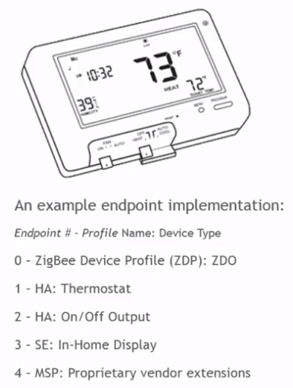
Example Endpoints for a device
Even simple devices hopefully have three endpoints:
ZigBee Device Object
<Their functionality>
Over The Air Bootloader (code updates)

Slide 30
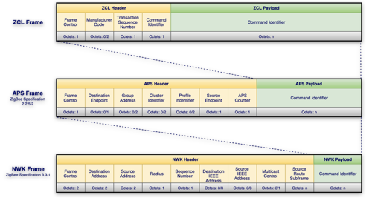
ZigBee application layer packets

Slide 31
Outline
ZigBee overview
ZigBee PHY and MAC
ZigBee application layer
Interoperability

Slide 32
ZigBee application layer on other networks
The specification for how to interact with devices is far above anything network-specific
dotdot is a recent effort to spread ZigBee Clusters more widely
Runs same application-layer on top of various lower layers
ZigBee, BLE, Thread, WiFi, Ethernet

Slide 33
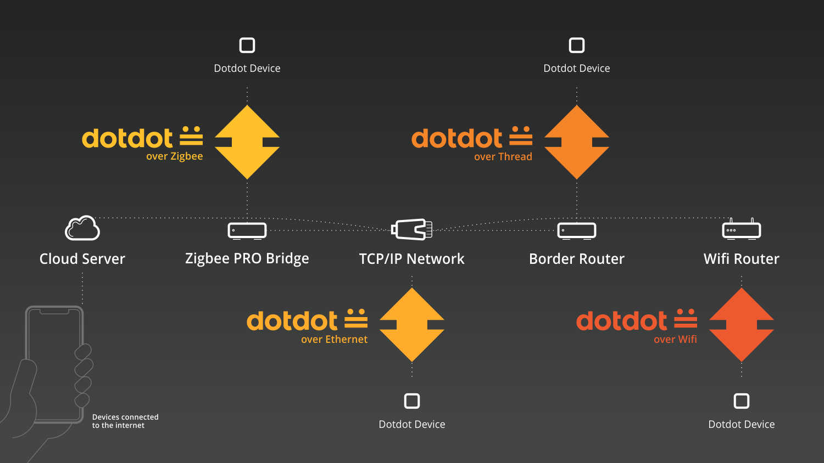
dotdot provides ZigBee-style control over various networks

Slide 34
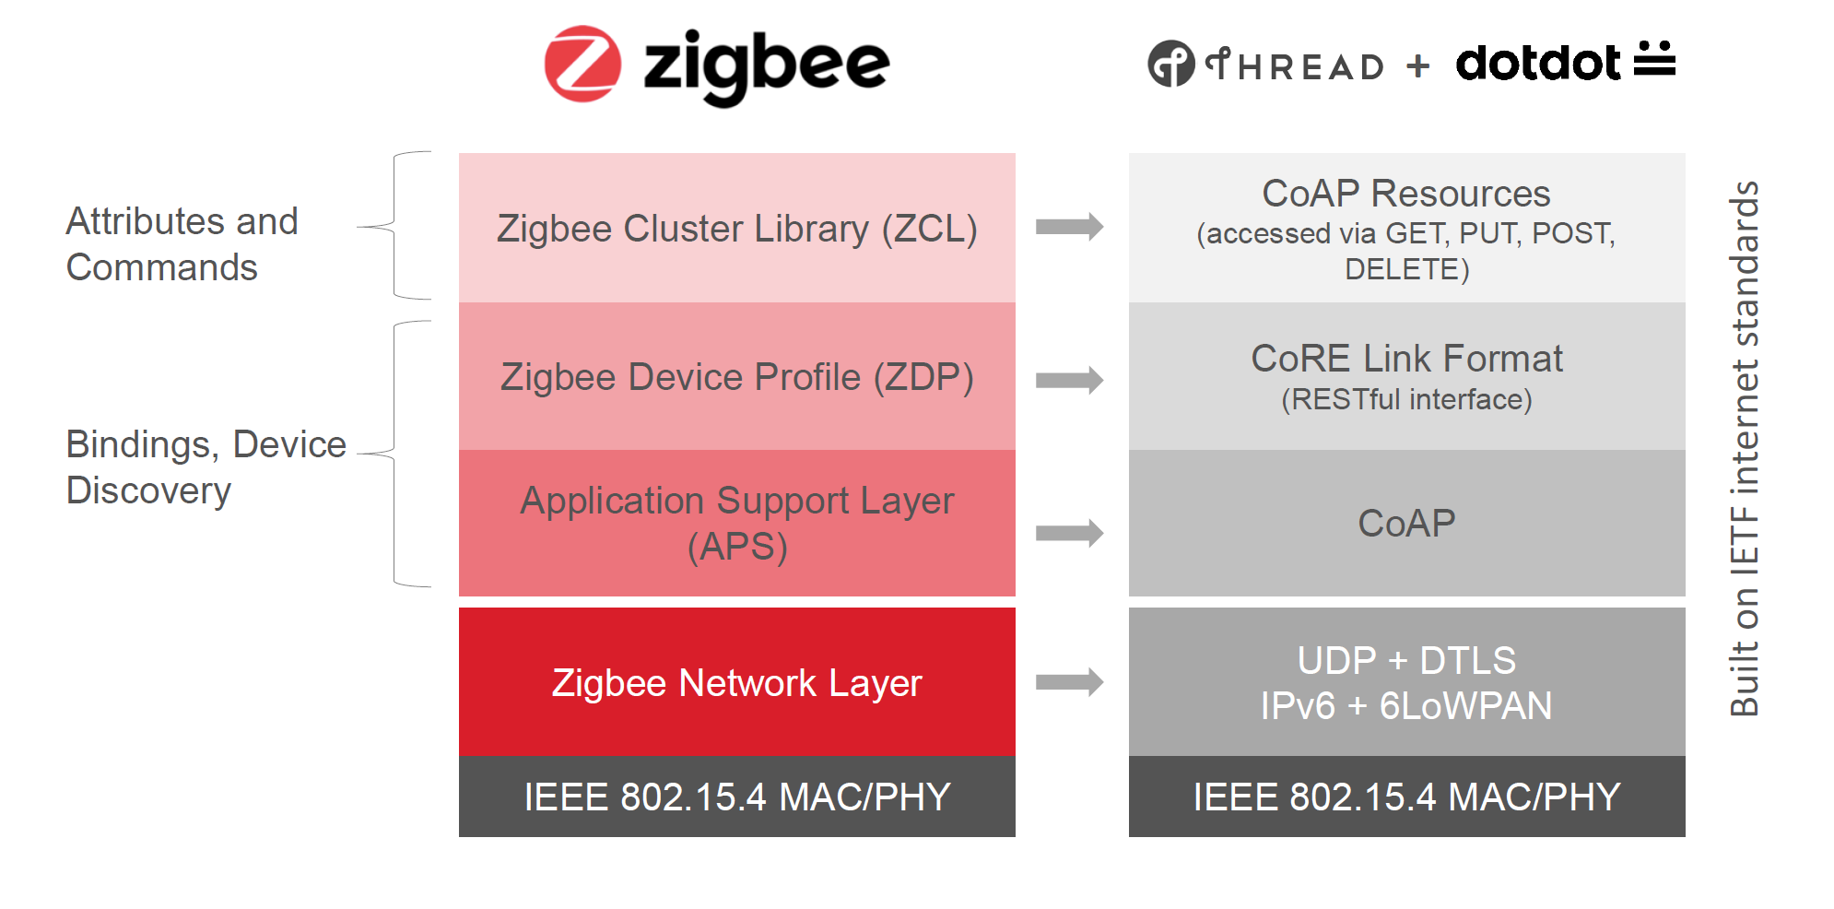
Example dotdot over Thread

Slide 35
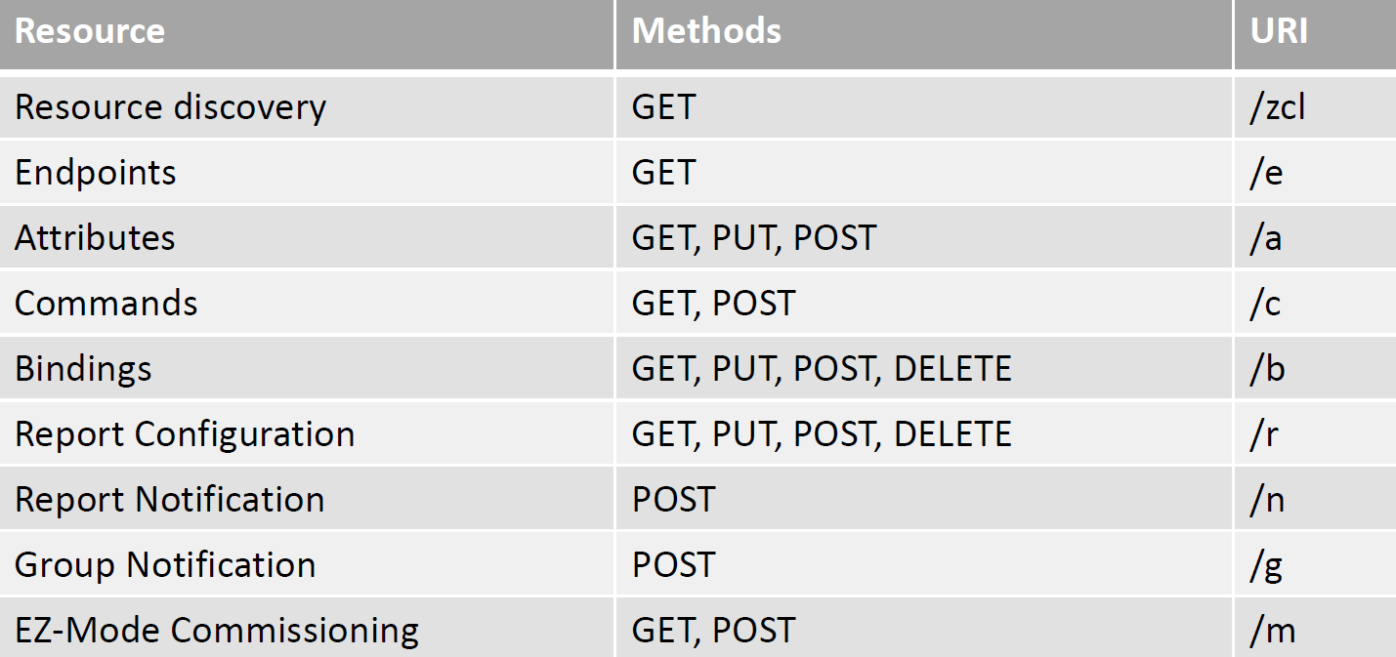
ZCL to CoAP mappings

Slide 36
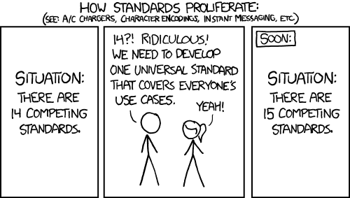
Is ZCL the right standard for device interactions?
Seems better than making something new from scratch
https://xkcd.com/927/

Slide 37
Outline
ZigBee overview
ZigBee PHY and MAC
ZigBee application layer
Interoperability

