Slide 1
Lecture 1: Introduction
CS343 – Operating Systems
Branden Ghena – Fall 2020
Some slides borrowed from: Stephen Tarzia (Northwestern), Jaswinder Pal Singh (Princeton), and UC Berkeley CS162

Slide 2
Today’s Goals
Welcome to Operating Systems!
How will this class operate?
What is an Operating System?
What will you learn in this course?

Slide 3
Course Overview
What is an OS?
Operating Systems History
CS343 Focus

Slide 4
Course Overview
What is an OS?
Operating Systems History
CS343 Focus

Slide 5
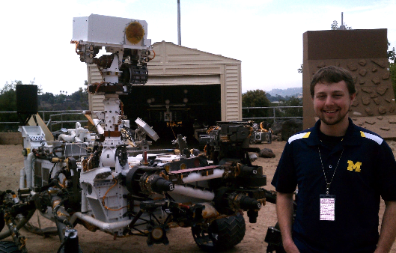
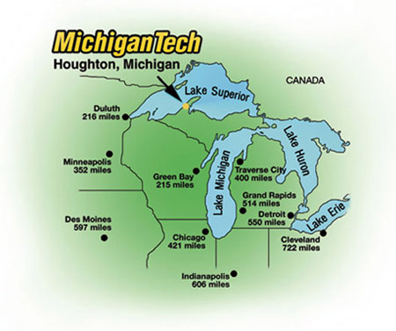
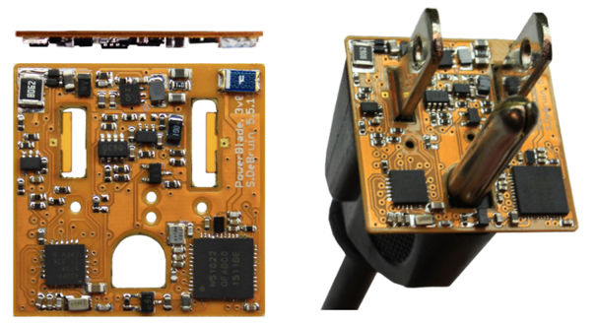
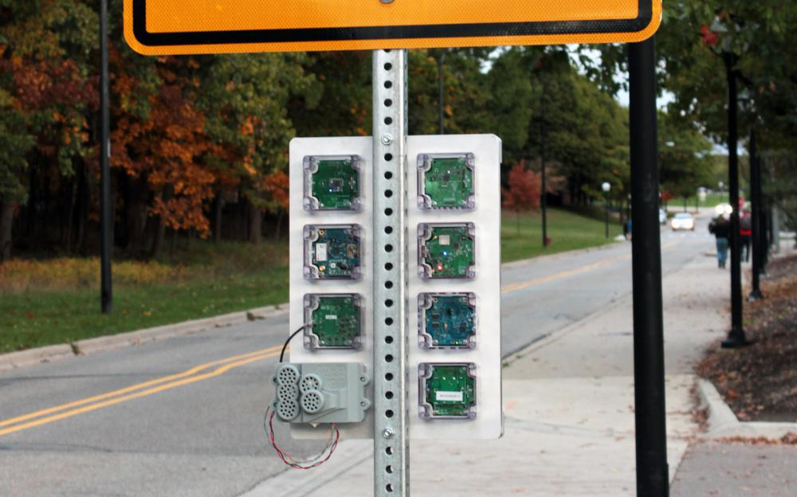



Branden Ghena (he/him)
Assistant Faculty of Instruction
Education
Undergrad: Michigan Tech
Master’s: University of Michigan
PhD: University of California, Berkeley
Research
Resource-constrained sensing systems
Low-energy wireless networks
Embedded operating systems
Teaching
Computer Systems
Intro to Computer Systems
Operating Systems
Microprocessor System Design
Things I love

Slide 6
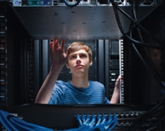
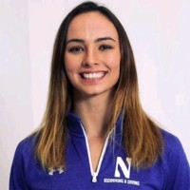
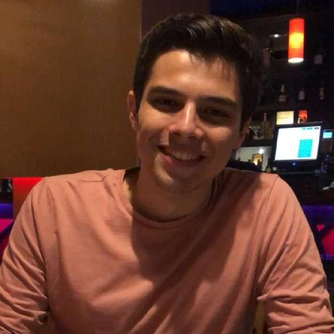
Course Staff
Teaching Assistant
Conor Hetland
PhD student working with Peter Dinda
TA’d for W20 version of OS
Peer Mentors
Calypso McDonnell
Senior, Computer Science
Michael Cuevas
Senior, Computer Science
Both took W20 version of OS

Slide 7
Class Format
Lecture
Pre-recorded and available on canvas
Questions and Answer Sessions
Zoom call during class time
Come having watched lecture already
Ask questions and get more in-depth on topics

Slide 8
Staff Roles
Office Hours
12 hours per week (3 per person including professor)
At a variety of times to work for many timezones
Lab Discussion
1 hour per week
Focused on tools and tips for doing the labs
C, Unix tools, Debugging, Specific lab advice
Piazza
All week long, but not necessarily any time of the day

Slide 9
Course Grade
20% Midterm (first half of the course)
20% Final (second half of the course)
60% Labs
This class is NOT curved

Slide 10
Lab Logistics
Getting Started Lab – 05%
Learn how everything works
Producer-Consumer Lab – 10%
Concurrency and locks
Queuing/Scheduling Lab – 10%
OS application scheduling
Device Driver Lab – 20%
Driver for a GPU
Paging Lab – 15%
Memory management
Getting started lab is special
One week deadline (due 09/24)
Must do alone
All-or-nothing grading
Normally teams of 2 or 3 students
Find partners now!

Slide 11
Lab Deadlines
Labs are normally due at 11:59:59 pm Central Time
20% lost points per day late
Slip days
Everyone gets two slip days
Used to extend a project deadline by a full 24 hours with no penalty
Automatically applied as best helps your grade
Warning: cannot be used on Getting Started Lab

Slide 12
These labs can be very challenging
Dealing with C code
Handling a large code base
Dealing with concurrency!!
Give yourself enough time to get the lab done on time
You’ll learn a lot through the challenge

Slide 13
Quarantine quarters continue
I am new to remote teaching
Let us know what could change to help you learn
If you are having a hard time keeping up with the class for any reason, let us know

Slide 14
Course Overview
What is an OS?
Operating Systems History
CS343 Focus

Slide 15
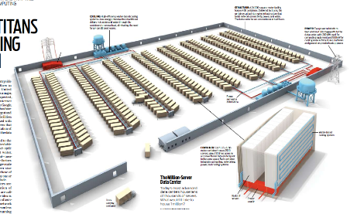
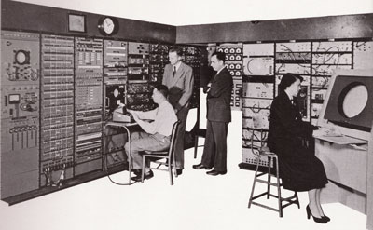
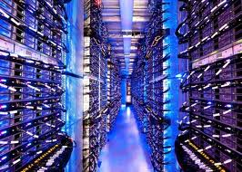
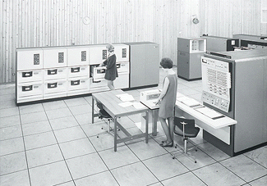
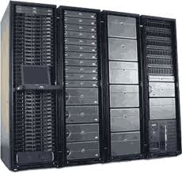
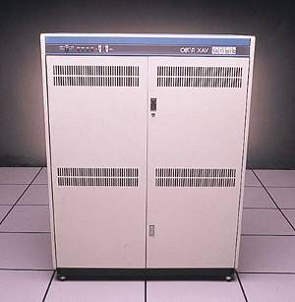
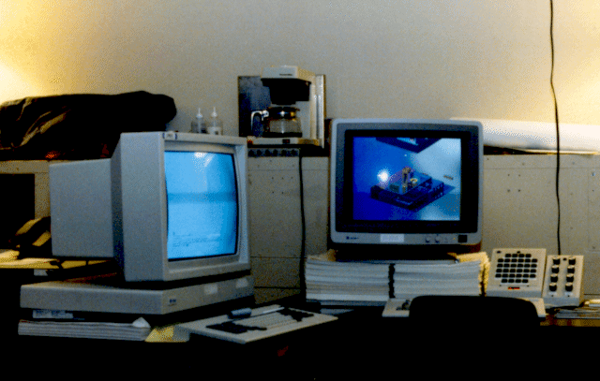
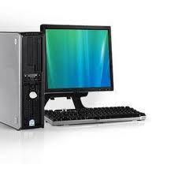
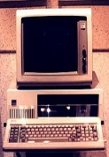
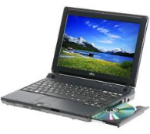
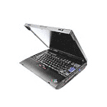
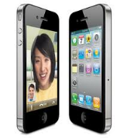


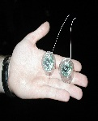
Computers come in incredible diversity
Ratio of Computers to People
Number crunching, Data Storage, Massive Internet Services,
ML, …
1:10⁶
Mainframe
Bell’s Law: New computer class every 10 years
Mini
1:10³
Workstation
Productivity,
Interactive
PC
Laptop
1:1
PDA
Cell
Streaming from/to the physical world
10³:1
Motes
years

Slide 16
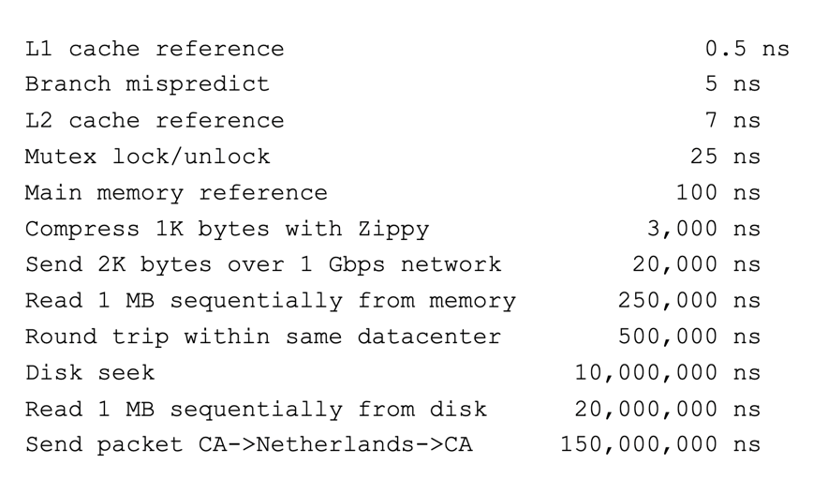
Computing timescales are increasingly large
Jeff Dean (Google AI): “Numbers Everyone Should Know”

Slide 17
Operating systems are at the heart of these challenges
OSes make advancing technology available to rapidly evolving applications.
Provide abstractions to applications to enable hardware compatibility
Manage sharing of resources across many applications
Good operating systems do these quickly, efficiently, and securely

Slide 18
What is an operating system?
User processes
Spotify
Powerpoint
Steam
Chrome
QEMU
Physical computer
Hardware

Slide 19
What is an operating system?
User processes
Spotify
Powerpoint
Steam
Chrome
QEMU
Operating System
Physical computer
Hardware

Slide 20
What is an operating system?
User processes
Spotify
Powerpoint
Steam
Chrome
QEMU
File System
Virtual Memory
Process Manager
Network
Operating System
Device Drivers
Interrupt Handlers
Boot and Init
Physical computer
Hardware

Slide 21
What is an operating system?
User processes
Spotify
Powerpoint
Steam
Chrome
QEMU
Application Interface
File System
Virtual Memory
Process Manager
Network
Operating System
Device Drivers
Interrupt Handlers
Boot and Init
Hardware Abstraction Layer
Physical computer
Hardware

Slide 22
What’s part of the OS?
OS kernel – the only code without security restrictions
Process scheduling (who uses CPU)
Memory allocation (who uses RAM)
Accesses hardware devices
Outputs graphics
Reads/writes to network
Read/write to disks
Handles boot-up and power-down
OS distribution – the kernel + lots of other useful stuff
GUI / Window manager
Command shell
Software package manager
“app store”, yum, apt, brew
Common software libraries
Useful apps:
Text editor, compilers, web browser, web server, SSH, anti-virus, file-sharing, media libraries,

Slide 23
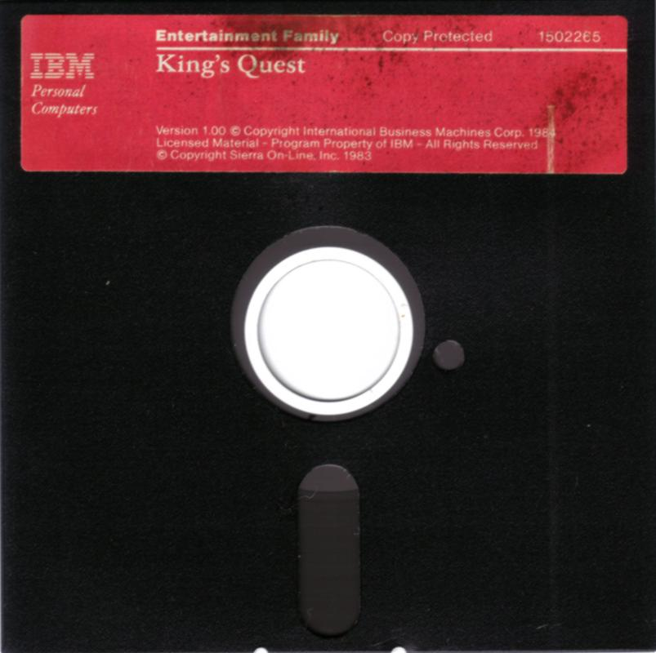
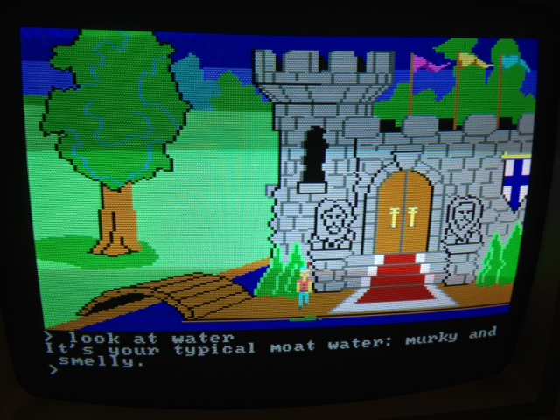
Before operating systems
User could only run one program at a time.
Had to insert the program disk before booting the machine.
Program had to control the hardware directly
This is a nuisance because hardware is complicated
Program will only be compatible with one set of hardware
For example (at right) 1983 “King’s Quest” game for IBM PC Jr.

Slide 24
Embedded systems often run without operating systems
“Bare-metal” embedded systems
Application must handle:
Boot and initialization
All hardware it wants to interact with
Applications are not portable
Rewrite, mostly from scratch, for new microcontroller
No malloc, no segfaults

Slide 25
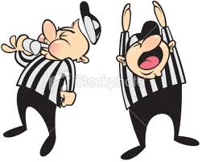


What is an Operating System?
Referee
Manage protection, isolation, and sharing of resources
Resource allocation and communication
Illusionist
Provide clean, easy-to-use abstractions of physical resources
Infinite memory, dedicated machine
Higher level objects: files, users, messages
Masking limitations, virtualization
Glue
Common services
Storage, Window system, Networking
Sharing, Authorization
Look and feel

Slide 26
Example: File Systems
Referee
Prevent users from accessing other’s files without permission
Illusionist
Files can grow infinitely large
Where a file exists in memory or disk isn’t important!
Glue
Default file system types, named directories

Slide 27
Course Overview
What is an OS?
Operating Systems History
CS343 Focus

Slide 28
Computer History
Actually check out the textbook!
In-depth history
Entertaining writing with just the right amount of sarcasm
This isn’t a computer history course
But there is a good reason to understand the lineage of the techniques we explore in this course

Slide 29
Early evolution of computing systems – Batch
1955: Batch systems
Collect a bunch of program punch cards and write them all one magnetic tape.
Run the tape through the mainframe to execute all the jobs in sequence.
OS responsibility
Libraries for I/O
Problems
I/O is VERY slow. 80-90% of total time just waiting.

Slide 30
Early evolution of computing systems – Multiprogramming
1960s: Multiprogramming (IBM OS/360)
Keep multiple runnable jobs in memory at once.
Allows overlap I/O of one job with computing of another.
Uses asynchronous I/O and interrupts or polling to detect I/O completion
OS responsibility
Schedule jobs
Monitor I/O
Problems
Still need to submit all jobs in advance

Slide 31
Early evolution of computing systems – Timesharing
1960s-70s: Timesharing (MULTICS, Unix)
Multiple user terminals connected to one machine
Allows interactive use of machine to be efficient (because another user’s job can run while you’re thinking).
OS responsibility
Multiple users (with permissions!)
Scheduling processes
Application interface
Shell tools

Slide 32
Later evolution of computer systems – PC
1980s-90s: Personal Computers (IBM PC, Macintosh)
Graphical user interfaces were developed
Mainframe OS concepts (like networking) were applied to PCs
Magnetic disks (hard drives) become huge, but still slow
OS responsibility
Look and feel of a system, particularly for non-experts
Tools that were distributed with the OS had significant business results

Slide 33
Later evolution of computer systems – Mobile and Cloud
2000s-10s: Mobile and pervasive computing, Cloud Computing
Slow hardware is once again common (phones & wearables)
OS manages sensitive information like location and internet behavior
Fast flash storage is common.
Server hardware is shared by many different cloud computing customers
OS responsibility
Diverse hardware drivers
Security
Massive parallelism

Slide 34
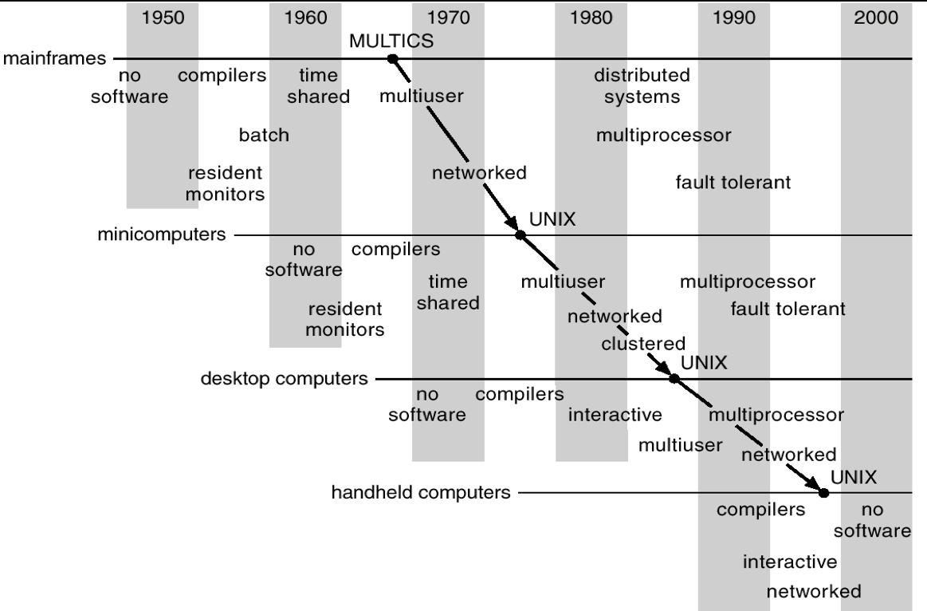
Operating systems have evolved with hardware in a cycle
Sophisticated operating systems first arose on mainframes.
OS ideas migrated to smaller machines as those machines became more powerful.
In 2019, a smart watch has 1gb RAM, 16gb SSD storage, two CPU cores, and a real OS.

Slide 35
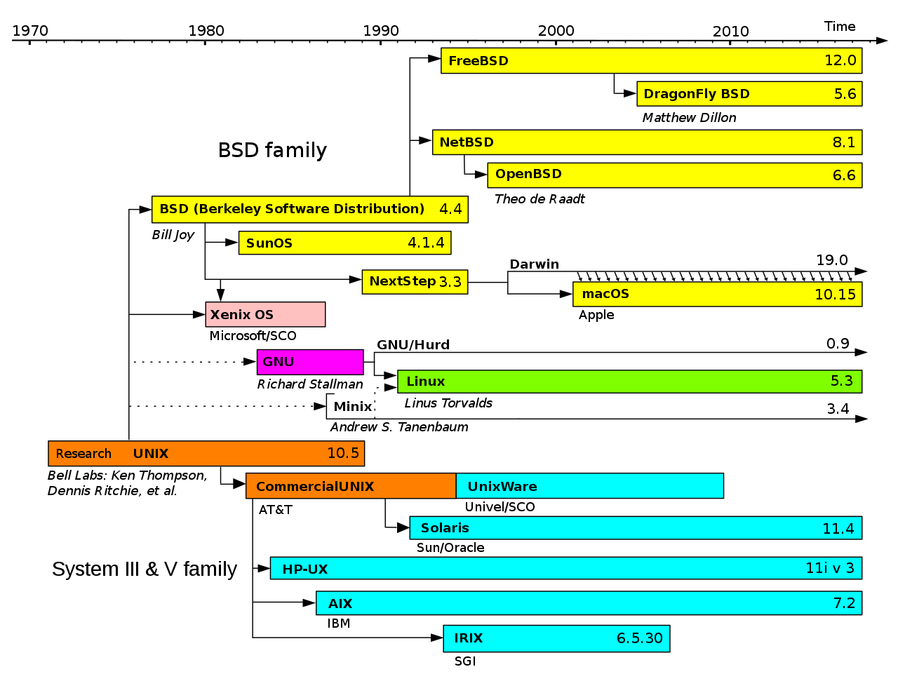
Simplified History of Unix-like Operating Systems
Operating systems are very interconnected

Slide 36
Course Overview
What is an OS?
Operating Systems History
CS343 Focus

Slide 37
Schedule for first half of the course
Concurrency
Dealing with the realities of modern-day computing
Sources, Control, Challenges
Scheduling
Managing CPU utilization
Workload, Queuing, Real-time

Slide 38
Schedule for second half of the course
Device Drivers
Management and abstraction of devices
Interrupts, DMA, Abstractions
Virtual Memory
Management and abstraction of memory
Paging, Allocation, Security
File Systems
Management and abstraction of data
Principles, Examples

Slide 39
Why do we care about OS?
Performance
Speed is influenced by
Parallelism, resource contention, memory management
Generally OS overhead
Security
Process and data isolation when actually all running together
The biggest security vulnerabilities break abstractions
Meltdown and Spectre

Slide 40
Course Overview
What is an OS?
Operating Systems History
CS343 Focus

Slide 41
Your first tasks
Getting Started Lab (due Thursday, September 24)
Fill out survey on Piazza
Find project partners for future labs

