Slide 1
Lecture 2: Processes and Threads
CS343 – Operating Systems
Branden Ghena – Fall 2020
Some slides borrowed from: Stephen Tarzia (Northwestern), Jaswinder Pal Singh (Princeton), Harsha Madhyastha (Michigan), and UC Berkeley CS61C and CS162

Slide 2
Today’s Goals
Understand the operating system’s view of a process.
How does a process communicate with the OS?
Explore a few process creation system calls.
What are threads and why are they useful?

Slide 3
Outline
Processes
System Calls
Process Creation Calls
Threads

Slide 4
Outline
Processes
System Calls
Process Creation Calls
Threads

Slide 5
Definitions
Program
Code (instructions + data)
Process
A program in execution
Program code, execution context, one or more threads

Slide 6
Process Contents
Address Space
Registers (x86-64 pictured)
Program Counter
~ FFFF FFFF_{hex}
stack
%rax
%r8
%eax
%r8d
%rbx
%r9
%ebx
%r9d
%rcx
%r10
%ecx
%r10d
%rdx
%r11
%edx
%r11d
%rsi
%r12
%esi
%r12d
%rdi
%r13
%edi
%r13d
heap
%rsp
%r14
%esp
%r14d
%rbp
%r15
static data
%ebp
%r15d
code
PC
~ 0_{hex}
This is all an illusion of course…
Notes:
Illusionist role

Slide 7
POSIX processes have file descriptors
Integers specifying a file the process is interacting with
Process contains a table linking integers to files (and permissions)
Default file descriptors
0 - Standard input (stdin)
1 - Standard output (stdout)
2 - Standard error (stderr)
Function calls to interact with files
int open (const char *path, int oflag, ... );
ssize_t read (int fildes, void *buf, size_t nbyte);
ssize_t write (int fildes, const void *buf, size_t nbyte);

Slide 8
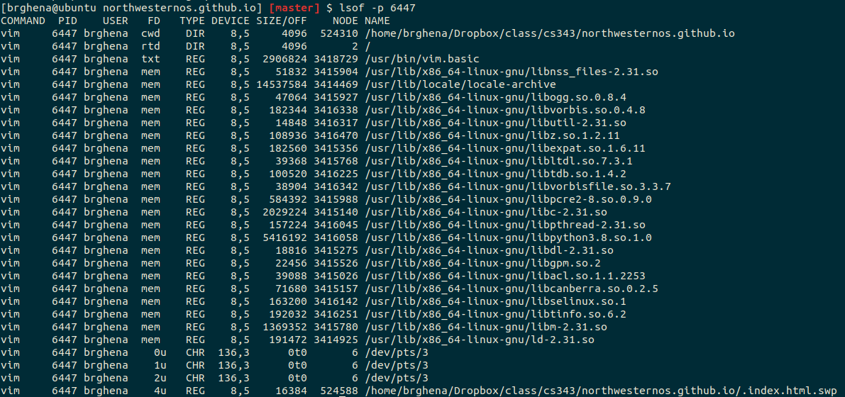
Example file descriptors

Slide 9
Also all of the code in the address space

Slide 10
Additional Process Contents
Whatever else the OS thinks is useful
Process ID
Priority
Time Used
Process State

Slide 11
Check your understanding
Is it safe for two processes to have the same code section?

Slide 12
Check your understanding
Is it safe for two processes to have the same code section?
Usually yes!
The code section is marked read-only.
Multiple instances of a terminal all share the same code.
Self-modifying code would be a problem…

Slide 13
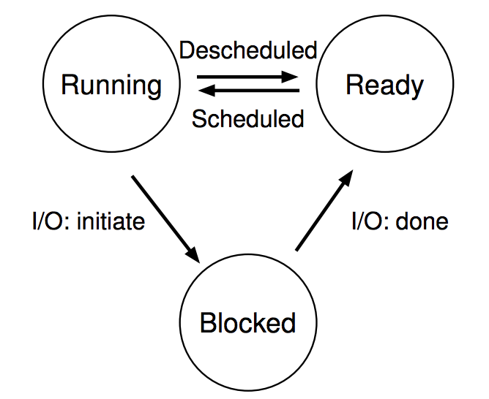
Processes don’t run all the time
The three basic process states:
OS schedules processes
Decides which of many competing processes to run.
A blocked process is not ready to run.
I/O means input/output – anything other than computing.
For example, reading/writing disk, sending network packet, waiting for keystroke, updating display.
While waiting for results, the process often cannot do anything, so it blocks, telling the OS to let someone else run.

Slide 14
Multiprogramming processes
The three basic process states:
When one process is Blocked, OS can schedule a different process that is Ready
Even with a single processor, the OS can provide the illusion of many processes running simultaneously
OS usually sets a maximum runtime before switching limit for processes (timeslice)

Slide 15
Key difference between kernel and processes: privilege
Processes have limited access to the computer
Hardware supports different “modes” of execution (kernel and user)
They run when the OS lets them
They have access to the memory the OS gives them
They cannot access many things directly
Must ask the OS to do so for them

Slide 16
Outline
Processes
System Calls
Process Creation Calls
Threads

Slide 17
Things a program cannot do itself
Print “hello world”
because the display is a shared resource.
Download a web page
because the network card is a shared resource.
Save or read a file
because the filesystem is a shared resource, and the OS wants to check file permissions first.
Launch another program
because processes are managed by the OS
Send data to another program
because each program runs in isolation, one at a time

Slide 18
How does a process ask the OS to do something?
Certain things can only be accessed from kernel mode
All of memory, I/O devices, etc.
Bad Idea to allow processes to switch into kernel mode
We do NOT trust processes
Requirements
Switch execution to the kernel
Change into kernel mode
Inform the kernel what you want it to do

Slide 19
Hardware can save us!
Solution: hardware instruction – trap
Also known as exception or fault
When instruction runs:
PC is moved to a known location in the kernel
Mode is changed to kernel mode
Same mechanism is used for other exceptions
Division by zero, invalid memory access
Also very similar to hardware interrupts

Slide 20
System call steps (simplification)
Process loads parameters into registers (just like a function call)
Process executes trap instruction (int, syscall, svc, etc.)
Hardware changes PC to “handler” and switches to kernel mode
OS checks what the process wants to do from registers
OS decides whether the process is allowed to do so
OS sets process state to blocked

Slide 21
Returning from a system call (simplification)
After OS finishes whatever operation it was asked to do
And when the process is scheduled to run again
OS places return result in a register (just like a function call)
OS sets process state to running
OS changes mode to user mode (and sets virtual memory stuff)
OS sets PC to instruction after the system call

Slide 22
Check your understanding
After OS finishes whatever operation it was asked to do
And when the process is scheduled to run again
OS places return result in a register (just like a function call)
OS sets process state to running
OS changes mode to user mode (and sets virtual memory stuff)
OS sets PC to instruction after the system call
Why doesn’t the OS need a special instruction to change mode and run the process?

Slide 23
Returning from a system call (simplification)
After OS finishes whatever operation it was asked to do
And when the process is scheduled to run again
OS places return result in a register (just like a function call)
OS sets process state to running
OS changes mode to user mode (and sets virtual memory stuff)
OS sets PC to instruction after the system call
Why doesn’t the OS need a special instruction to change mode and run the process?
It has privilege to change mode and is trusted to start the process

Slide 24
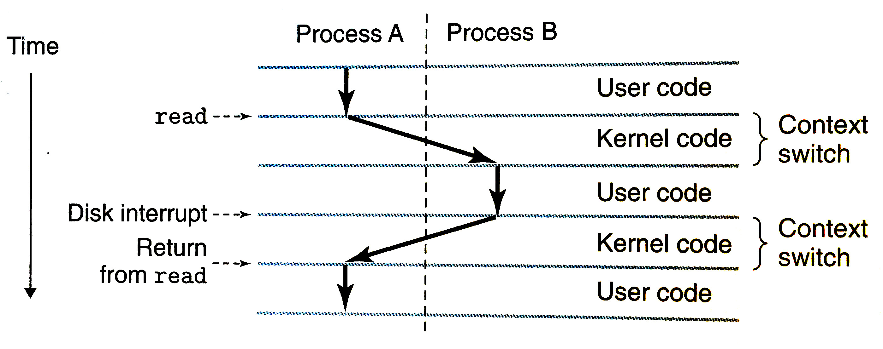
System calls trigger context switches
Diagram from Bryant & O’Hallaron book

Slide 25
Example Linux system calls
https://man7.org/linux/man-pages/man2/syscalls.2.html
Managing processes
Fork
Exec
Waitpid
Exit
Managing files
Open
Close
Read
Write
Seek

Slide 26
Outline
Processes
System Calls
Process Creation Calls
Threads

Slide 27
Process system calls
pid_t fork(void);
Create a new process that is a copy of the current one
Returns either PID of child process (parent) or 0 (child)
void _exit(int status);
Exit the current process (exit(), the library call cleans things up first)
pid_t waitpid(pid_t pid, int *status, int options);
Suspends the current process until a child (pid) terminates
int execve(const char *filename, char *const argv[], char *const envp[]);
Execute a new program, replacing the existing one

Slide 28
Creating a new process
#include <stdio.h>
#include <unistd.h>
int main(){
if(fork() == 0) {
printf("Child!\n");
} else {
printf("Parent!\n");
}
printf("Both!\n");
return 0;
}

Slide 29
Creating a new process
#include <stdio.h>
#include <unistd.h>
int main(){
if(fork() == 0) {
printf("Child!\n");
} else {
printf("Parent!\n");
}
printf("Both!\n");
return 0;
}
Existential crisis

Slide 30
Executing a new program
#include <stdio.h>
#include <unistd.h>
int main(){
if(fork() == 0) {
execve("/bin/python", ...);
} else {
printf("Parent!\n");
}
printf("Only parent!\n");
return 0;
}

Slide 31
Creating your own shell
https://danishpraka.sh/2018/01/15/write-a-shell.html
void execute(char** args) {
if (strcmp(args[0], "exit") == 0) {
exit(); // exit the shell when requested
}
pid_t cpid = fork();
if (cpid == 0) {
if (execvp(args[0], args) < 0) { // child, execute new process
printf("command not found: %s\n", args[0]); }
} else {
waitpid(cpid, & status, WUNTRACED); // parent, wait for process to be complete
}}
int main(){
char** args;
while(1){
printf("> ");
args = parse_incoming_text(); // complicated in C unfortunately
execute(args);
}}

Slide 32
Creating your own shell
https://danishpraka.sh/2018/01/15/write-a-shell.html
void execute(char** args) {
if (strcmp(args[0], "exit") == 0) {
exit(); // exit the shell when requested
}
pid_t cpid = fork();
if (cpid == 0) {
if (execvp(args[0], args) < 0) { // child, execute new process
printf("command not found: %s\n", args[0]); }
} else {
waitpid(cpid, & status, WUNTRACED); // parent, wait for process to be complete
}}
int main(){
char** args;
while(1){
printf("> ");
args = parse_incoming_text(); // complicated in C unfortunately
execute(args);
}}

Slide 33
Many other system calls
POSIX contains many others, for example time()
And especially lots of old ones
Windows or other operating systems will have entirely different system call infrastructures

Slide 34
Outline
Processes
System Calls
Process Creation Calls
Threads

Slide 35
Software Tasks: Threads
Unit of execution within a process
Processes discussed so far have a single thread
They “have a single thread of execution”
They “are single-threaded”
But a single process could have multiple threads

Slide 36
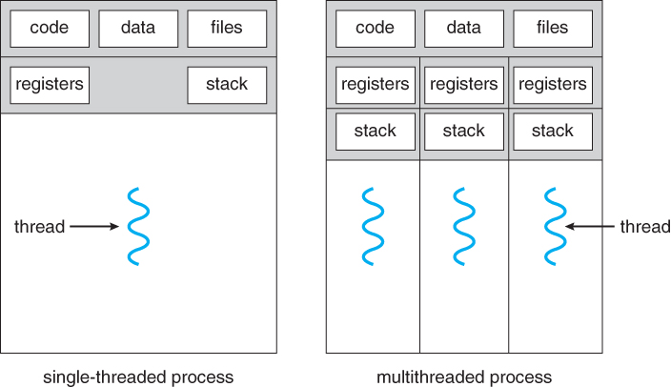
Thread Memory
Threads have separate:
PC
Registers
Stack memory
Threads share:
Code memory
Global variables (static memory)
File descriptors

Slide 37
Process address space with threads
Stack (T1)
Thread 1
Thread 2
Stack (T2)
Stack (T3)
Thread 3
Data
Segment
Heap
Static Data
PC (T3)
PC (T2)
Code
PC (T1)

Slide 38
Thread use case: web browser
Let’s say you’re implementing a web browser:
You want a tab for each web page you open:
The same code loads each website (shared code section)
The same global settings are shared by each tab (shared static section)
Each tab does have separate state (separate stack and registers)
Disclaimer: Actually, browsers use separate processes for each tab for a variety of reasons including performance and security

Slide 39
Thread use case: user interfaces
Even if there is only a single processor core, threads are useful
Single-threaded User Interface
While processing actions, the UI is frozen
main() {
while(true) {
check_for_UI_interactions();
process_UI_actions();
}
}

Slide 40


Thread use case: web server
Example: Web server
Receives multiple simultaneous requests
Reads web pages from disk to satisfy each request

Slide 41
Web server option 1: handle one request at a time
Request 1 arrives
Server reads in request 1
Server starts disk I/O for request 1
Request 2 arrives
Disk I/O for request 1 finishes
Server responds to request 1
Server reads in request 2
Easy to program, but slow
Can’t overlap disk requests with computation
Can’t overlap either with network sends and receives
time

Slide 42
Web server option 1: event-driven model
Issue I/Os, but don’t wait for them to complete
Request 1 arrives
Server reads in request 1
Server starts disk I/O for request 1
Request 2 arrives
Server reads in request 2
Server starts disk I/O for request 2
Disk I/O for request 1 completes
Server responds to request 1
Fast, but hard to program
Must remember which requests are in flight and which I/O goes where
Lots of extra state
time

Slide 43
Web server option 3: multi-threaded web server
One thread per request. Thread handles only that request.
Easy to program (maybe), and fast!
State is stored in the stacks of each thread and the thread scheduler
Simple to program if they are independent…
Main Thread
Request 1 arrives
Create thread
Request 2 arrives
Create thread
Thread 1
Read in request 1
Start disk I/O
Disk I/O finishes
Respond to request 1
Exit
Thread 2
Read in request 2
Start disk I/O
time

Slide 44
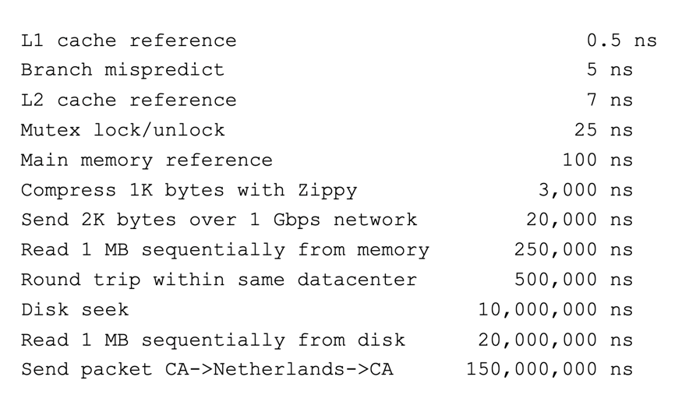
More Practical Motivation
Back to Jeff Dean’s “Numbers Everyone Should Know”
Handle I/O in separate thread, avoid blocking other progress

Slide 45

Models for thread libraries: user threads
Thread scheduling is implemented within the process
OS only knows about the process, not the threads
Upsides
Works on any hardware or OS
Performance is better when creating and switching
Downsides
A system call in any thread blocks all threads
Processes
Thread Library
OS Kernel
Scheduler

Slide 46
Models for thread libraries: kernel threads
Thread scheduling is implemented by the operating system
OS manages the threads within each process
Upsides
Other threads can continue while one blocks on I/O
No additional scheduler
Downsides
Higher overhead
Hybrid models are possible
Processes
OS Kernel
Scheduler

Slide 47
Threads versus Processes
Threads
pthread_create()
Creates a thread
Shares all memory with all threads of the process.
Scheduled independently of parent
pthread_join()
Waits for a particular thread to finish
Can communicate by reading/writing (shared) global variables.
Processes
fork()
Creates a single-threaded process
Copies all memory from parent
Can be quick using copy-on-write
Scheduled independently of parent
waitpid()
Waits for a particular child process to finish
Can communicate by setting up shared memory, pipes, reading/writing files, or using sockets (network).

Slide 48
POSIX Threads Library: pthreads
https://man7.org/linux/man-pages/man7/pthreads.7.html
int pthread_create(pthread_t *thread, const pthread_attr_t *attr, void *(*start_routine)(void*), void *arg);
thread is created executing start_routine with arg as its sole argument.
return is implicit call to pthread_exit
void pthread_exit(void *value_ptr);
terminates the thread and makes value_ptr available to any successful join
int pthread_join(pthread_t thread, void **value_ptr);
suspends execution of the calling thread until the target thread terminates.
On return with a non-NULL value_ptr the value passed to pthread_exit() by the terminating thread is made available in the location referenced by value_ptr.

Slide 49
Pthread system call example
What happens when pthread_create() is called in a process?
Library:
int pthread_create(…) {
Do some work like a normal function
asm code … syscall # into %eax
put args into registers %ebx, …
special trap instruction
Linux uses the clone() syscall to do this
Kernel:
get args from regs
do the work to spawn the new thread
store return value in %eax
get return values from regs
Do some more work like a normal function
};

Slide 50
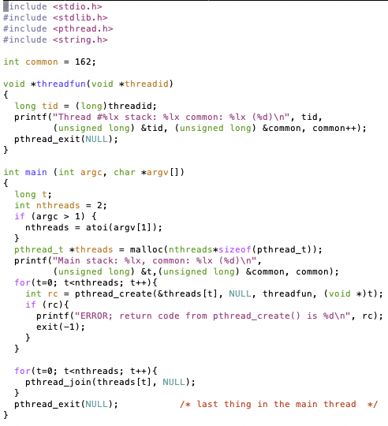
Threads Example

Slide 51
Threads Example
Reads N from process arguments
Creates N threads
Each one prints a number, then increments it, then exits
Main process waits for all of the threads to finish

Slide 52

Threads Example

Slide 53
Check your understanding
How many threads are in this program?
Does the main thread join with the threads in the same order that they were created?
Do the threads exit in the same order they were created?
If we run the program again, would the result change?

Slide 54
Check your understanding
How many threads are in this program? Five
Does the main thread join with the threads in the same order that they were created? Yes
Do the threads exit in the same order they were created? Maybe??
If we run the program again, would the result change? Possibly!

Slide 55
Outline
Processes
System Calls
Process Creation Calls
Threads

