Slide 1
Lecture 03: Concurrency Sources and Challenges
CS343 – Operating Systems
Branden Ghena – Fall 2020
Some slides borrowed from: Stephen Tarzia (Northwestern), and UC Berkeley CS61C and CS162

Slide 2
Today’s Goals
Describe where and why concurrency and parallelism are involved in computing.
Be disappointed by performance limits on concurrency.
Understand purpose and challenges of interrupts and signals.
Introduce concept of data races as a concurrency problem.

Slide 3
Parallelism versus Concurrency
Two processes A and B
A
B
time
Serial execution
Parallel execution
Concurrent execution
A
B
time
A
B
time
time
A
OR
B

Slide 4
Parallelism versus Concurrency
Parallelism
Two things happen strictly simultaneously
Concurrency
More general term
Two things happen in the same time window
Could be simultaneous, could be interleaved
Concurrent execution occurs whenever two processes are both active
time
time
time
A
OR
B
OR

Slide 5
Outline
Performance through concurrency
Concurrency introduced by the processor
Amdahl’s Law – limits on performance
Interrupts and Signals
A problem with concurrency: data races

Slide 6
Outline
Performance through concurrency
Concurrency introduced by the processor
Amdahl’s Law – limits on performance
Interrupts and Signals
A problem with concurrency: data races

Slide 7
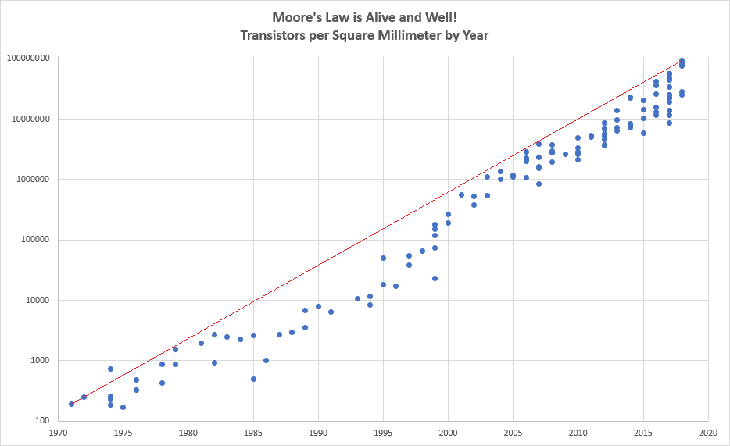
Moore’s Law
“Every two years, the number of transistors on a chip of a fixed size doubles”

Slide 8
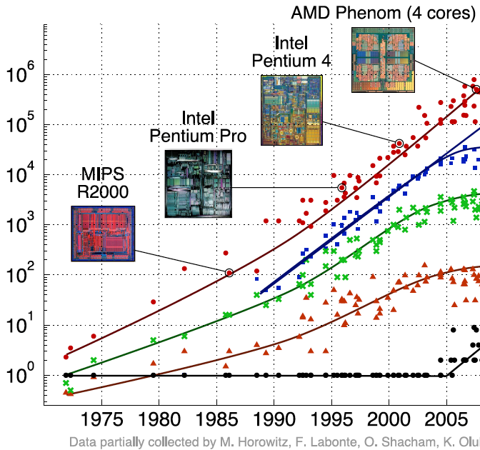
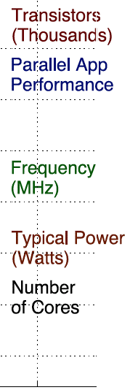
Processors kept getting faster too

Slide 9
Denard Scaling
Moore’s Law corollary: As transistors get smaller, the power density stays the same.
If Moore’s Law holds true, we also get a doubling of “performance per watt” every two years!
Manufacturers could raise the clock frequency between generations without more power consumption

Slide 10
It’s the mid 1990s and you work at Microsoft.
You need to double the speed of Excel in two years time or you’re fired.
What do you do?

Slide 11
It’s the mid 1990s and you work at Microsoft.
You need to double the speed of Excel in two years time or you’re fired.
What do you do?
Take a vacation

Slide 12
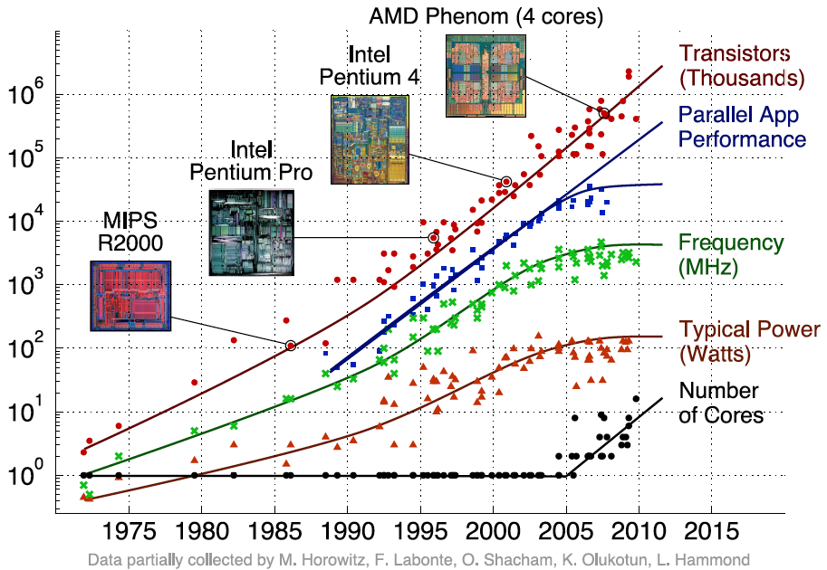
Then they stopped getting faster
~2006: Leakage current becomes significant
Now smaller transistors don’t mean lower power

Slide 13
So… now what?
In summary:
We can’t make transistors faster due to current leakage,
and because of that, we can’t reliably make performance better by waiting for clock speeds to increase,
but we have literally billions of transistors available to use.
How do we continue to get better performing computation?

Slide 14
Exploit parallelism!
In reality the cause-and-effect of parallelism isn’t so simple. Key points:
we can’t just increase frequency
we do have a lot of transistors available
parallelism is one approach to improve performance again

Slide 15
Outline
Performance through concurrency
Concurrency introduced by the processor
Amdahl’s Law – limits on performance
Interrupts and Signals
A problem with concurrency: data races

Slide 16
Model of a processor
CPU
Updated
Registers and
Memory
Instructions,
Registers,
Memory
CPU
Instruction Fetch
Instruction Decode
Execute
Memory
Writeback

Slide 17
But instructions don’t always have to be executed in order
movq (%rdi), %rax movq (%rsi), %rdx movq %rdx, (%rdi) movq %rax, (%rsi) addq %rcx, %rbx
We can apply the multiprogramming approach of executing this addq while the movq is waiting on memory.
Doesn’t have to go after the movq instructions because it uses different registers

Slide 18
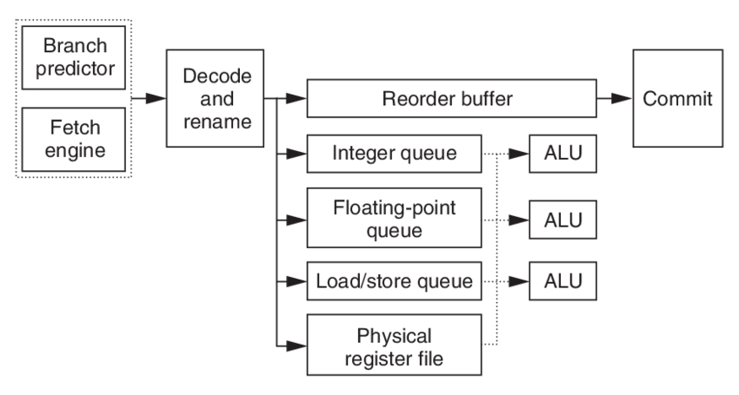
Out-of-order machines
Reorder instructions to make best use of CPU
Commit, or “write back” data to memory and regfile in the order the programmer expects
Fetch many instructions at once!
Read register file, handle data dependencies with register renaming
Generally: looks for independent instructions it can execute early

Slide 19
Out-of-order processors obey normal execution results
Initial thoughts on out-of-order execution
😱
The processor could be executing my program in order it feels like?!!
How do I possibly reason about anything?
Answer: the processor promises to have the same results as if things were done in the normal order.
CPU
Updated
Registers and
Memory
Instructions,
Registers,
Memory

Slide 20
Multiple processes might rely on memory ordering
The processor can’t account for multiple processes though
If memory results are shared by two threads, the processor might mess something up for you.
What will Thread 1 print?
f = 0;
x = 0;
// split into threads
Thread 1
Thread 2
while (f == 0);
printf(“%d\n”, x);
x = 42;
f = 1;

Slide 21
Multiple processes might rely on memory ordering
The processor can’t account for multiple processes though
If memory results are shared by two threads, the processor might mess something up for you.
What will Thread 1 print? Could be 42. Could be 0.
f = 0;
x = 0;
// split into threads
Thread 1
Thread 2
while (f == 0);
printf(“%d\n”, x);
x = 42;
f = 1;
This can be addressed with memory barriers

Slide 22
How else do processors employ concurrency?
Goal: Make computer faster by performing multiple tasks
Solutions:
Use multiple cores to run multiple tasks in parallel
Run multiple tasks on a single core concurrently

Slide 23
How else do processors employ concurrency?
Goal: Make computer faster by performing multiple tasks
Solutions:
Use multiple cores to run multiple tasks in parallel
Run multiple tasks on a single core concurrently

Slide 24
Multiprocessor Systems (in pictures)
Processor 0
Memory
Processor 0 Memory Accesses
Input
Control
Datapath
PC
Bytes
Registers
(ALU)
Processor 1
Control
Processor 1 Memory Accesses
Datapath
Output
PC
Registers
(ALU)
I/O-Memory Interfaces

Slide 25
Multiprocessor Systems (in words)
A computer system with at least 2 processors or cores
Each core has its own PC and registers
Each core executes independent instruction streams
Processors share the same system memory
But use different parts of it
Communication possible through loads and stores to a common location
Deliver high throughput for independent jobs via task-level parallelism

Slide 26
Multiprocessor Example
Run Chrome and Minecraft simultaneously
Each are separate programs
Each has a different memory space
Each can run on a separate core
Don’t even need to communicate...
Note: OS can fake this by interleaving processes, but hardware can make it actually simultaneous

Slide 27
How else do processors employ concurrency?
Goal: Make computer faster by performing multiple tasks
Solutions:
Use multiple cores to run multiple tasks in parallel
Run multiple tasks on a single core concurrently

Slide 28
Multithreading processors
Basic idea: Processor resources are expensive and should not be left idle
Long memory latency to memory on cache miss?
Hardware switches threads to bring in other useful work while waiting for cache miss
Cost of thread context switch must be much less than cache miss latency
Switching threads is less expensive than processes because they share memory

Slide 29
Hardware support for multithreading
Processor
Memory
Control
Input
Datapath
PC 0
PC 1
Registers 0
Registers 1
(ALU)
Bytes
Two copies of PC and Registers inside processor hardware
Looks like two processors to software (hardware thread 0, hardware thread 1)
Control logic decides which thread to execute an instruction from next
Output
I/O-Memory Interfaces
29

Slide 30
Multithreading versus Multicore
Multithreading => Better utilization
≈5% more hardware for ≈1.3x better performance?
Gets to share ALUs, caches, memory controller
Multicore => Duplicate processors
≈50% more hardware for ≈2x better performance?
Share some caches (L2 cache, L3 cache), memory controller
Modern machines do both
multiple cores with multiple threads per core

Slide 31
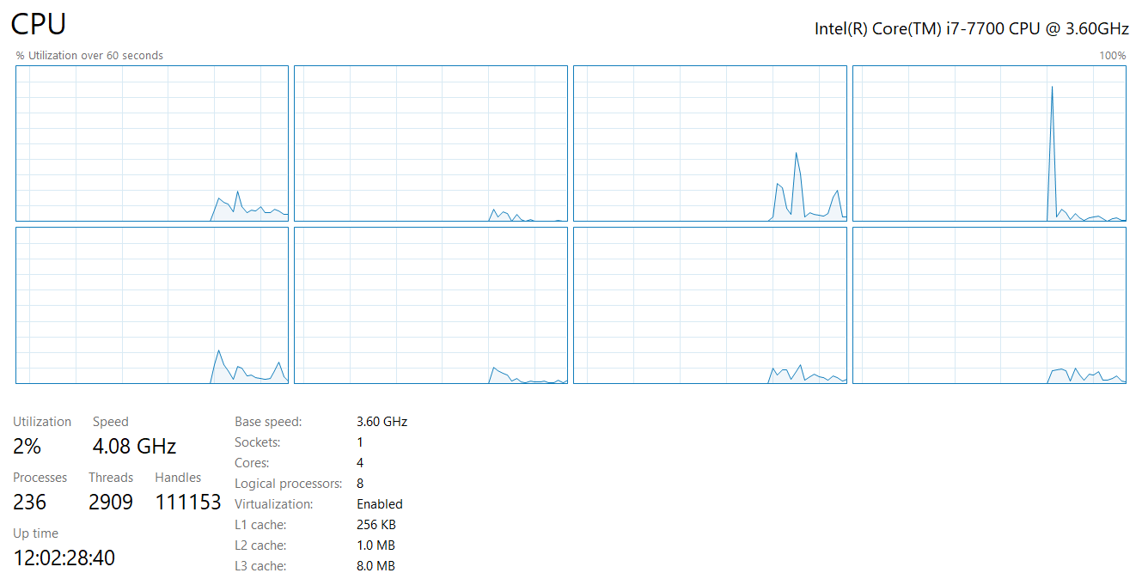
My desktop computer
4 total cores
Each capable of 2 threads
≈ 8 processors

Slide 32
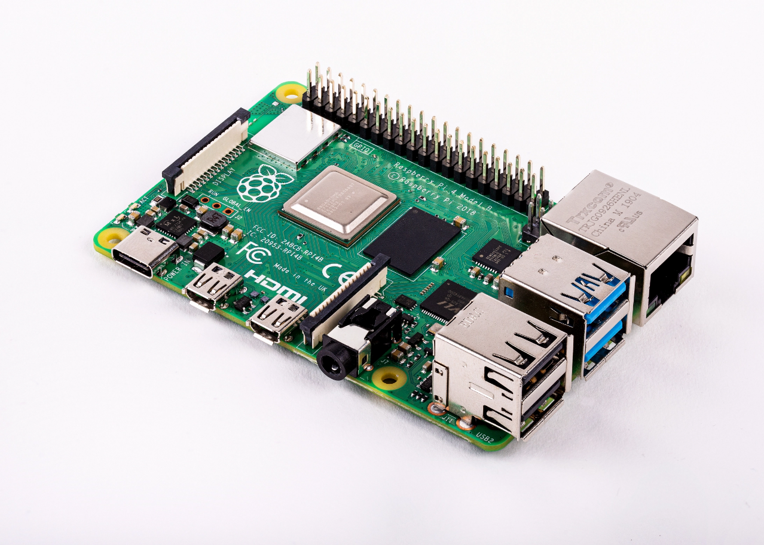
Raspberry Pi 4
Quad core processor
One thread per core
3-way superscalar pipeline
L1 Cache
32 KiB 2-way set associative data cache
48 KiB 3-way set associative instruction cache
Per core
L2 Cache
512 KiB to 4 MiB (shared)
RAM 1-4 GB
$35
Literally all computers are doing parallelism these days

Slide 33
Back up to the OS perspective
Modern operating systems must manage concurrency
Both parallel operation and interleaving operations
Concurrency is worth it
Performance gains are the reason

Slide 34
Outline
Performance through concurrency
Concurrency introduced by the processor
Amdahl’s Law – limits on performance
Interrupts and Signals
A problem with concurrency: data races

Slide 35
Challenges to concurrency
Concurrency is great! We can do so many things!!
But what’s the downside…?
How much speedup can we get from it?
How hard is it to write parallel programs?

Slide 36
Challenges to concurrency
Concurrency is great! We can do so many things!!
But what’s the downside…?
How much speedup can we get from it?
How hard is it to write parallel programs?

Slide 37
Speedup Example
95 s | 5 s
Imagine a program that takes 100 seconds to run
95 seconds in the blue part
5 seconds in the green part

Slide 38
Speedup from improvements
Speedup with Improvement | = | Execution time without improvement
 |  | Execution time with improvement
95 s | 5 s
5 s -> 2.5 s: Speedup = 100/97.5 = 1.026
5 s -> 1 s: Speedup = 100/96 = 1.042
5 s -> 0.001s: Speedup = 100/95.001 = 1.053
The impact of a performance improvement is relative to the importance of the part being improved!

Slide 39
Amdahl’s Law
Equivalent to prior equation
1
Speedup =
F = Fraction of execution time speed up S = Scale of improvement
(1 - F) + F
Non-speed-up part
S
Speed-up part
Example: 2x improvement to 25% of the program
1
1
=
=
1.14
0.75 + 0.25
0.75 + 0.125
2

Slide 40
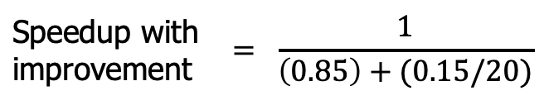
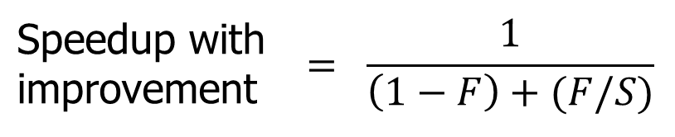
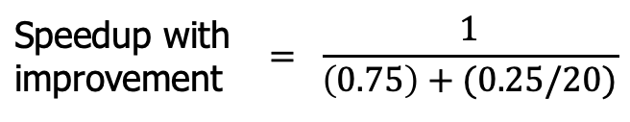
Parallel speedup example
Speedup with improvement | $$= \frac{1}{\left(1−F\right)+(F/S)}$$
Consider an improvement which runs 20 times faster but is only usable 15% of the time
Speedup with improvement | $$= \frac{1}{\left(0.85\right)+(0.15/20)}$$
= 1.166
Nowhere near 20x speedup!
What if it’s usable 25% of the time?
Speedup with improvement | $$= \frac{1}{\left(0.75\right)+(0.25/20)}$$
= 1.311

Slide 41
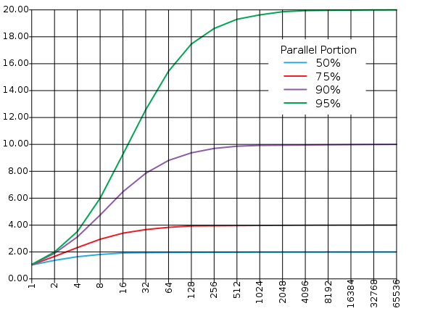
Amdahl’s (heartbreaking) Law (in pictures)
The amount of speedup that can be achieved through parallelism is limited by the non-parallel portion of your program!
Time
Speedup
Parallel
portion
Serial
portion
1
2
3
4
5
Number of Processors
Number of Processors

Slide 42
Amdahl’s (heartbreaking) Law (in words)
Amdahl’s Law tells us that to achieve linear speedup with more processors:
none of the original computation can be serial (non-parallelizable)
To get a speedup of 90 from 100 processors, the percentage of the original program that could be scalar would have to be 0.1% or less
Speedup = 1/(.001 + .999/100) = 90.99

Slide 43
Check your understanding
Speedup with improvement | $$= \frac{1}{\left(1−F\right)+(F/S)}$$
50% | 50%
Suppose a program spends 50% of its time in a square root routine.
How much must you speed up square root to make the program run 2x faster?
(A)
10
(B)
20
(C)
100
(D)
None of the above

Slide 44
Check your understanding
Speedup with improvement | $$= \frac{1}{\left(1−F\right)+(F/S)}$$
50% | 50%
Suppose a program spends 50% of its time in a square root routine.
How much must you speed up square root to make the program run 2x faster?
Speedup = 1 / [ (1 - F) + (F/S) ]
2 = 1 / [ (1 - 0.5) + (0.5/S)]
S = 0.5 / ((1/2) – 0.5) = ∞
(A)
10
(B)
20
(C)
100
The square root would need to decrease to nothing before you got 2x speedup
(D)
None of the above

Slide 45
Outline
Performance through concurrency
Concurrency introduced by the processor
Amdahl’s Law – limits on performance
Interrupts and Signals
A problem with concurrency: data races

Slide 46
Where else does concurrency come from?
Processors introduce it for performance reasons by running multiple processes and threads
Interactions with the outside world introduce it because events occur whenever they feel like it
Network request arriving
User presses a key
Motion sensor triggers
Also, we need some way to deal with errors the occur when executing instructions
No pathway for returning an error from an instruction

Slide 47
Interrupts
A way for the CPU to be, well, interrupted.
CPU hardware switches to privileged mode
Now any instruction can be executed, including privileged ones.
Execution jumps to a predefined location
Handler specified in the CPU’s interrupt vector table
Lets the kernel deal with whatever the event was
Used to support asynchronous I/O
Lets a hardware device tell the CPU that some data is ready
Remember that a disk operation is millions of times slower than an add.
CPU has an electrical pin for hardware interrupts.
There is also an instruction for software interrupts (like traps!)

Slide 48
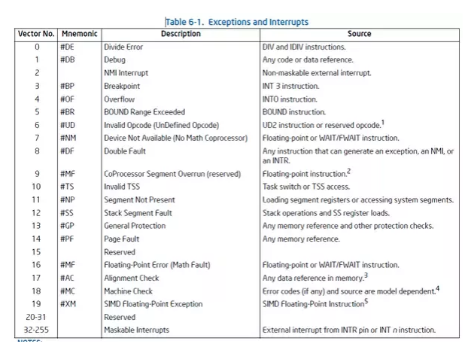
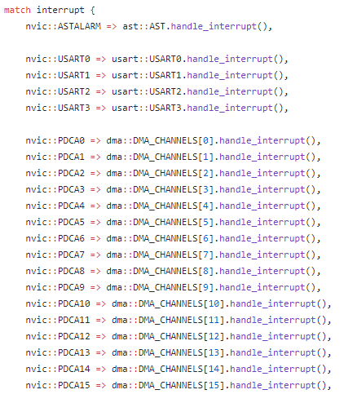
Interrupt Vector Table
Table actually lives in memory somewhere, with function pointers for each vector number
Example from Tock for SAM4L chip (in Rust)

Slide 49
Interrupt Vector Table
Table actually lives in memory somewhere, with function pointers for each vector number
Example from Tock for SAM4L chip (in Rust)

Slide 50
Differences from traps
When we performed a system call:
We knew it was about to happen.
Set up our registers in advance.
Performed what looked sort of like a function call.
Interrupts can happen whenever.
This can get extremely complicated on modern systems with out-of-order execution, multiple cores and threads, and caches

Slide 51
Interrupt handlers
Interrupt context
Can’t just enter the kernel like we did with system calls
Interrupt could have occurred while we were in the kernel
Handler code
Execute some quick processing to deal with the interrupt
Return so the hardware can bring us back to our normal operation
Cannot pause to wait for something else to finish first because the entire core jumped to handling this interrupt
Handled by the operating system
Processes are interrupted, but otherwise not normally involved

Slide 52
Signals are asynchronous messages to processes
Sometimes the OS wants to send something like an interrupt to a process
Your child process completed
You tried to use an illegal instruction
You accessed invalid memory
You are terminating now
In POSIX systems, this idea is called “Signals”
1) SIGHUP 2) SIGINT 3) SIGQUIT 4) SIGILL 5) SIGTRAP
6) SIGABRT 7) SIGBUS 8) SIGFPE 9) SIGKILL 10) SIGUSR1
11) SIGSEGV 12) SIGUSR2 13) SIGPIPE 14) SIGALRM 15) SIGTERM
16) SIGSTKFLT 17) SIGCHLD 18) SIGCONT 19) SIGSTOP 20) SIGTSTP
21) SIGTTIN 22) SIGTTOU 23) SIGURG 24) SIGXCPU 25) SIGXFSZ
26) SIGVTALRM 27) SIGPROF 28) SIGWINCH 29) SIGIO 30) SIGPWR
31) SIGSYS ...

Slide 53
Signals are asynchronous messages to processes
Sometimes the OS wants to send something like an interrupt to a process
Your child process completed
You tried to use an illegal instruction
You accessed invalid memory
You are terminating now
In POSIX systems, this idea is called “Signals”
1) SIGHUP 2) SIGINT 3) SIGQUIT 4) SIGILL 5) SIGTRAP
6) SIGABRT 7) SIGBUS 8) SIGFPE 9) SIGKILL 10) SIGUSR1
11) SIGSEGV 12) SIGUSR2 13) SIGPIPE 14) SIGALRM 15) SIGTERM
16) SIGSTKFLT 17) SIGCHLD 18) SIGCONT 19) SIGSTOP 20) SIGTSTP
21) SIGTTIN 22) SIGTTOU 23) SIGURG 24) SIGXCPU 25) SIGXFSZ
26) SIGVTALRM 27) SIGPROF 28) SIGWINCH 29) SIGIO 30) SIGPWR
31) SIGSYS ...
Process Errors

Slide 54
Signals are asynchronous messages to processes
Sometimes the OS wants to send something like an interrupt to a process
Your child process completed
You tried to use an illegal instruction
You accessed invalid memory
You are terminating now
In POSIX systems, this idea is called “Signals”
1) SIGHUP 2) SIGINT 3) SIGQUIT 4) SIGILL 5) SIGTRAP
6) SIGABRT 7) SIGBUS 8) SIGFPE 9) SIGKILL 10) SIGUSR1
11) SIGSEGV 12) SIGUSR2 13) SIGPIPE 14) SIGALRM 15) SIGTERM
16) SIGSTKFLT 17) SIGCHLD 18) SIGCONT 19) SIGSTOP 20) SIGTSTP
21) SIGTTIN 22) SIGTTOU 23) SIGURG 24) SIGXCPU 25) SIGXFSZ
26) SIGVTALRM 27) SIGPROF 28) SIGWINCH 29) SIGIO 30) SIGPWR
31) SIGSYS ...
Process Termination

Slide 55
Sending signals
OS sends signals when it needs to
Processes can ask the OS send signals with a system call
int kill(pid_t pid, int sig);
Users send signals through OS from command line or keyboard
Shell command: kill -9 pid (SIGKILL)
CTRL-C (SIGINT)

Slide 56
Handling signals
Programs can register a function to handle individual signals
signal(int sig, sighandler_t handler);
What are you supposed to do about it?
Do some quick processing to handle it
Be careful, not all functions are safe to call here (re-entrant functions only)
Reset the process and try again
Quit the process (default handler)

Slide 57
Signals Examples

Slide 58
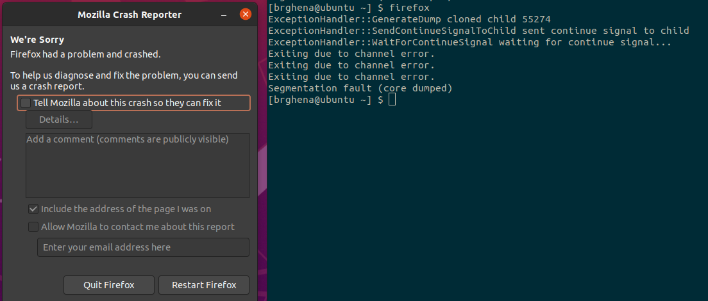
Examples: sending a signal
> kill -11 pid

Slide 59
Example: catching a signal
#include <stdio.h>
#include <unistd.h>
#include <stdlib.h>
#include <signal.h>
void sighandler (int signum) {
printf("HA HA You can't kill me!\n");
}
int main (void) {
signal(SIGINT, sighandler);
printf("Starting\n");
while(1) {
printf("Going to sleep for a second...\n");
sleep(1);
}
return(0);
}

Slide 60
Example: catching a segfault
#include <stdio.h>
#include <unistd.h>
#include <stdlib.h>
#include <signal.h>
int* pointer = 0x00000000;
void sighandler (int signum) {
printf("Oops, that pointer wasn't valid. Let's try a different one\n");
pointer++;
printf("About to read from pointer 0x%08lX\n", (long)pointer);
}
int main (void) {
signal(SIGSEGV, sighandler);
printf("About to read from pointer 0x%08lX\n", (long)pointer);
int test = *pointer;
return(0);
}

Slide 61
Systems software needs to deal with concurrency
Reliable processes need to handle signals
OS kernels need to handle interrupts
This time it’s not just about performance
It’s also about handling errors
And interacting with the outside world
Challenges are similar
Processor concurrency: shared state between multiple processes/threads
Interrupts/Signals: shared state between a process and interrupt context

Slide 62
Outline
Performance through concurrency
Concurrency introduced by the processor
Amdahl’s Law – limits on performance
Interrupts and Signals
A problem with concurrency: data races

Slide 63
Challenges to concurrency
Concurrency is great! We can do so many things!!
But what’s the downside…?
How much speedup can we get from it?
How hard is it to write parallel programs?

Slide 64
Concurrency problem: data races
Consider two threads with a shared global variable: int count = 0
count could end up with a final value of 1 or 2. How?
Thread 1:
void main(){
count += 1;
}
Thread 2:
void main(){
count += 1;
}

Slide 65
Concurrency problem: data races
Consider two threads with a shared global variable: int count = 0
count could end up with a final value of 1 or 2. How?
These instructions could be interleaved in any way.
Assuming “count” is in memory location 0x8049a1c
Thread 1:
void main(){
mov 0x8049a1c, %eax
add $0x1, %eax
mov %eax, 0x8049a1c
}
Thread 2:
void main(){
mov 0x8049a1c, %eax
add $0x1, %eax
mov %eax, 0x8049a1c
}

Slide 66
Data race example
Assuming “count” is in memory location 0x8049a1c
Thread 1 | Thread 2
mov 0x8049a1c, %eax
add $0x1, %eax
mov %eax, 0x8049a1c
 | mov 0x8049a1c, %eax
 | add $0x1, %eax
 | mov %eax, 0x8049a1c
Thread 1 | Thread 2
mov 0x8049a1c, %eax
 | mov 0x8049a1c, %eax
 | add $0x1, %eax
 | mov %eax, 0x8049a1c
add $0x1, %eax
mov %eax, 0x8049a1c
Time
Final value of count: 2
Final value of count: 1

Slide 67
Data race explanation
Thread scheduling is non-deterministic
There is no guarantee that any thread will go first or last or not be interrupted at any point
If different threads write to the same variable
The final value of the variable is also non-deterministic
This is a data race

Slide 68
Check your understanding: data races with multiple threads
Consider three threads with a shared global variable: int count = 0
What are the possible values of count?
Thread 1:
void main(){
count += 1;
}
Thread 2:
void main(){
count -= 1;
}
Thread 3:
void main(){
count += 2;
}

Slide 69
Check your understanding: data races with multiple threads
Consider three threads with a shared global variable: int count = 0
What are the possible values of count? -1, 0, 1, 2, 3
How are you supposed to reason about this?! Need mechanisms for sharing memory.
Thread 1:
void main(){
count += 1;
}
Thread 2:
void main(){
count -= 1;
}
Thread 3:
void main(){
count += 2;
}

Slide 70
Outline
Performance through concurrency
Concurrency introduced by the processor
Amdahl’s Law – limits on performance
Interrupts and Signals
A problem with concurrency: data races

