Slide 1
Lecture 02: Processes and Threads
CS343 – Operating Systems
Branden Ghena – Spring 2022
Some slides borrowed from: Stephen Tarzia (Northwestern), Jaswinder Pal Singh (Princeton), Harsha Madhyastha (Michigan), and UC Berkeley CS61C and CS162

Slide 2
Administrivia
Getting Started Lab
Due on Thursday
Purpose is to make sure that you’ve got everything set up right
SSH login for EECS servers
Github account and Git SSH access
Ability to build the Nautilus Kernel
Let us know if you’re having problems with this
Should be easy to complete

Slide 3
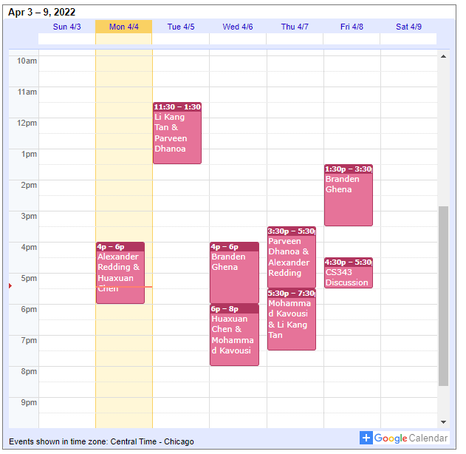
Office Hours
14 hours planned per week
All on gather.town
Fill out queue form on Canvas homepage
Can schedule office hours with my by request as well
If times don’t work or for special circumstances

Slide 4
Administivia part 2
Campuswire
Everyone should have access to it
If you don’t, this is the exception when you should email me
Canvas
Most important information is on the Canvas homepage
I’m posting slides there too

Slide 5
Today’s Goals
Understand the operating system’s view of a process.
How does a process communicate with the OS?
Explore a few process creation system calls.
What are threads and why are they useful?

Slide 6
Outline
Processes
System Calls
Process Creation
Signals
Threads

Slide 7
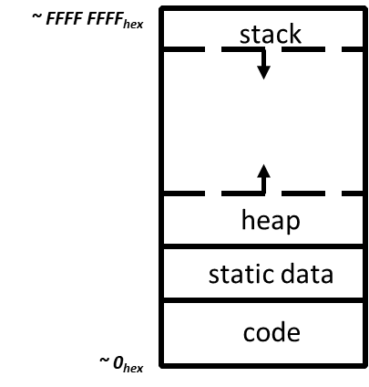
View of a process
Process: program that is being executed
Contains code, data, and a thread
Thread contains registers, instruction pointer, and stack
Code and Data
Registers
Instruction Pointer
Condition Codes
Stack
%rax
%r8
%eax
%r8d
%rbx
%r9
%ebx
%r9d
%rcx
%r10
%ecx
%r10d
%rdx
%r11
%edx
%r11d
%rsi
%r12
%esi
%r12d
%rdi
%r13
%edi
%r13d
%rsp
%r14
%esp
%r14d
%rbp
%r15
%ebp
%r15d

Slide 8
POSIX processes have file descriptors
Integers specifying a file the process is interacting with
Process contains a table linking integers to files (and permissions)
Default file descriptors
0 - Standard input (stdin)
1 - Standard output (stdout)
2 - Standard error (stderr)
Function calls to interact with files
int open (const char *path, int oflag, ... );
ssize_t read (int fildes, void *buf, size_t nbyte);
ssize_t write (int fildes, const void *buf, size_t nbyte);

Slide 9
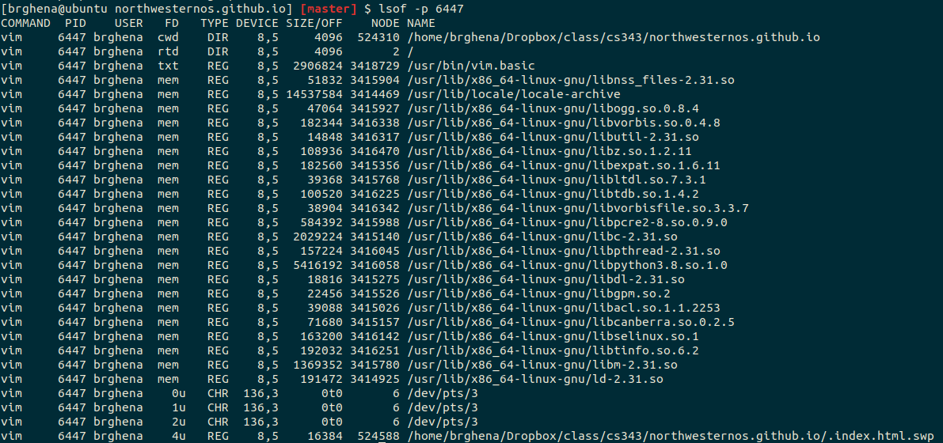
Example file descriptors

Slide 10
Also all of the code in the address space

Slide 11
Additional Process Contents
Whatever else the OS thinks is useful
Process ID
Priority
Time Used
Process State

Slide 12
Processes are an abstraction provided by the OS
The machine itself usually doesn’t support processes
Just has a processor and a set of registers
Memory is just arbitrary memory
OS provides the abstraction
Multiple processes can run at the “same time”
Each has its own registers
Each has its own isolated memory
Processes enable
Multiple functionalities on a computer
Multiprogramming of a system

Slide 13
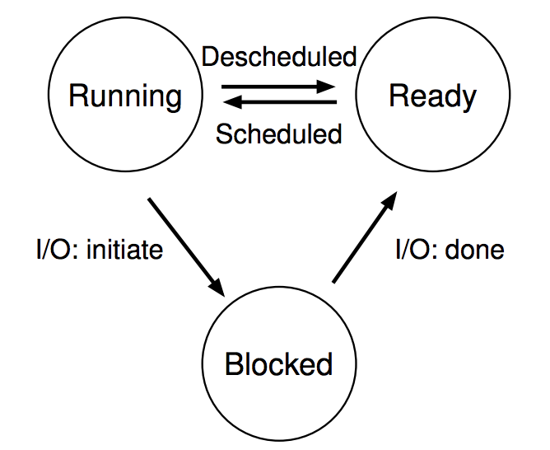
Processes don’t run all the time
The three basic process states:
OS schedules processes
Decides which of many competing processes to run.
A blocked process is not ready to run.
I/O means input/output – anything other than computing.
For example, reading/writing disk, sending network packet, waiting for keystroke, updating display.
While waiting for results, the process often cannot do anything, so it blocks, and the OS schedules a different process to run.

Slide 14
Multiprogramming processes
The three basic process states:
When one process is Blocked, OS can schedule a different process that is Ready
Even with a single processor, the OS can provide the illusion of many processes running simultaneously
OS usually sets a maximum runtime before switching limit for processes (timeslice)

Slide 15
Key difference between kernel and processes: privilege
Processes have limited access to the computer
Hardware supports different “modes” of execution (kernel and user)
Kernel mode has access to physical memory and special instructions
They run when the OS lets them
They have access to the memory the OS gives them
They cannot access many things directly
Must ask the OS to do so for them

Slide 16
Break + Question
Is it safe for two processes to have the same code section?

Slide 17
Break + Question
Is it safe for two processes to have the same code section?
Usually yes!
The OS can mark the code section as read-only
Example: multiple instances of a shell share the same code
Self-modifying code would be a problem…

Slide 18
Outline
Processes
System Calls
Process Creation
Signals
Threads

Slide 19
Things a program cannot do itself
Print “hello world”
because the display is a shared resource.
Download a web page
because the network card is a shared resource.
Save or read a file
because the filesystem is a shared resource, and the OS wants to check file permissions first.
Launch another program
because processes are managed by the OS
Send data to another program
because each program runs in isolation, one at a time

Slide 20
How does a process ask the OS to do something?
Certain things can only be accessed from kernel mode
All of memory, I/O devices, etc.
Bad Idea to allow processes to switch into kernel mode
We do NOT trust processes
So there shouldn’t be any instruction that switches to kernel mode…
Requirements
Switch execution to the kernel
Change into kernel mode
Inform the kernel what you want it to do

Slide 21
Hardware can save us!
Solution: hardware instruction – trap
Also known as exception or fault
When instruction runs:
Mode is changed to kernel mode
AND
Instruction Pointer is moved to a known location in the kernel
Same mechanism is used for other exceptions
Division by zero, invalid memory access
Also very similar to hardware interrupts

Slide 22
System call example
System call: making a request of the OS from a process
Uses exceptional control flow to enter OS kernel
Returns back to process when complete
Instruction after the system call
Kernel code
User code
Exception
syscall
next instruction
Do the thing
Returns

Slide 23
System call steps (simplification)
Process loads parameters into registers (just like a function call)
Process executes trap instruction (int, syscall, svc, etc.)
Hardware changes PC to “handler” and switches to kernel mode
OS checks what the process wants to do from registers
OS decides whether the process is allowed to do so
OS sets process state to blocked

Slide 24
Returning from a system call (simplification)
After OS finishes whatever operation it was asked to do
And when the process is scheduled to run again
OS places return result in a register (just like a function call)
OS sets process state to running
OS changes mode to user mode (and sets virtual memory stuff)
OS sets Instruction Pointer to instruction after the system call
Process continues and can use results of system call

Slide 25
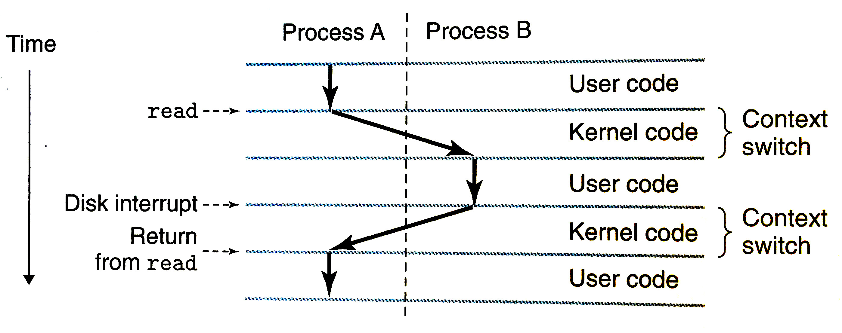
System calls trigger context switches
Context switch: the action of storing the state of a process so it can be resumed later and entering into the kernel
Diagram from Bryant & O’Hallaron book

Slide 26
Linux system calls
Example system calls
https://man7.org/linux/man-pages/man2/syscalls.2.html
Number | Name | Description
0 | read | Read file
1 | write | Write file
2 | open | Open file
3 | close | Close file
4 | stat | Get info about file
57 | fork | Create process
59 | execve | Execute a program
60 | _exit | Terminate process
62 | kill | Send signal to process

Slide 27
Many other system calls
POSIX contains many others, for example time()
And especially lots of old ones
Windows or other operating systems will have entirely different system calls
Same basic idea though

Slide 28
Outline
Processes
System Calls
Process Creation
Signals
Threads

Slide 29
Example system call usage
Create new processes with system calls
From process view:
Just look like regular C functions
Take arguments, return values
Underneath:
Function uses special assembly instruction to trigger exception

Slide 30
Process system calls
pid_t fork(void);
Create a new process that is a copy of the current one
Returns either PID of child process (parent) or 0 (child)
void _exit(int status);
Exit the current process (exit(), the library call cleans things up first)
pid_t waitpid(pid_t pid, int *status, int options);
Suspends the current process until a child (pid) terminates
int execve(const char *filename, char *const argv[], char *const envp[]);
Execute a new program, replacing the existing one

Slide 31
Creating a new process
#include <stdio.h>
#include <unistd.h>
int main(){
if(fork() == 0) {
printf("Child!\n");
} else {
printf("Parent!\n");
}
printf("Both!\n");
return 0;
}

Slide 32
Creating a new process
#include <stdio.h>
#include <unistd.h>
int main(){
if(fork() == 0) {
printf("Child!\n");
} else {
printf("Parent!\n");
}
printf("Both!\n");
return 0;
}
Existential crisis

Slide 33
Executing a new program
#include <stdio.h>
#include <unistd.h>
int main(){
if(fork() == 0) {
execve("/bin/python3", ...);
} else {
printf("Parent!\n");
}
printf("Only parent!\n");
return 0;
}

Slide 34
Creating your own shell
https://danishpraka.sh/2018/01/15/write-a-shell.html
void execute(char** args) {
if (strcmp(args[0], "exit") == 0) {
exit(); // exit the shell when requested
}
pid_t cpid = fork();
if (cpid == 0) {
if (execvp(args[0], args) < 0) { // child, execute new process
printf("command not found: %s\n", args[0]); }
} else {
waitpid(cpid, & status, WUNTRACED); // parent, wait for process to be complete
}}
int main(){
char** args;
while(1){
printf("> ");
args = parse_incoming_text(); // complicated in C unfortunately
execute(args);
}}

Slide 35
Creating your own shell
https://danishpraka.sh/2018/01/15/write-a-shell.html
void execute(char** args) {
if (strcmp(args[0], "exit") == 0) {
exit(); // exit the shell when requested
}
pid_t cpid = fork();
if (cpid == 0) {
if (execvp(args[0], args) < 0) { // child, execute new process
printf("command not found: %s\n", args[0]); }
} else {
waitpid(cpid, & status, WUNTRACED); // parent, wait for process to be complete
}}
int main(){
char** args;
while(1){
printf("> ");
args = parse_incoming_text(); // complicated in C unfortunately
execute(args);
}}

Slide 36
Break + Question
What does the following code do?
#include <stdio.h>
#include <sys/types.h>
int main() {
while(1){
fork();
}
return 0;
}

Slide 37
Break + Question
What does the following code do?
#include <stdio.h>
#include <sys/types.h>
int main() {
while(1){
fork();
}
return 0;
}
Creates a new process
Then each process creates a new process
Then each of those creates a new process…
Known as a Fork bomb!
Machine eventually runs out of memory and processing power and will stop working
Defense: limit number of processes per user

Slide 38
Fork bombs in various languages
Python fork bomb
import os
while 1:
os.fork()
Rust fork bomb
#[allow(unconditional_recursion)]
fn main() {
std::thread::spawn(main);
main();
}
Bash fork bomb
:(){ :|:& };:
With spacing and a clearer function name
fork() {
fork | fork &
}
fork

Slide 39
Outline
Processes
System Calls
Process Creation
Signals
Threads

Slide 40
Alerting processes of events
How do we let a process know there was an event?
Errors
Termination
User commands (like CTRL-C or CTRL-\)
Events could happen whenever
Need to interrupt process control flow and run an event handler
Linux mechanism to do so is called “signals”

Slide 41
Signals are asynchronous messages to processes
Sometimes the OS wants to send something like an interrupt to a process
Your child process completed
You tried to use an illegal instruction
You accessed invalid memory
You are terminating now
In POSIX systems, this idea is called “Signals”
1) SIGHUP 2) SIGINT 3) SIGQUIT 4) SIGILL 5) SIGTRAP
6) SIGABRT 7) SIGBUS 8) SIGFPE 9) SIGKILL 10) SIGUSR1
11) SIGSEGV 12) SIGUSR2 13) SIGPIPE 14) SIGALRM 15) SIGTERM
16) SIGSTKFLT 17) SIGCHLD 18) SIGCONT 19) SIGSTOP 20) SIGTSTP
21) SIGTTIN 22) SIGTTOU 23) SIGURG 24) SIGXCPU 25) SIGXFSZ
26) SIGVTALRM 27) SIGPROF 28) SIGWINCH 29) SIGIO 30) SIGPWR
31) SIGSYS ...

Slide 42
Signals are asynchronous messages to processes
Sometimes the OS wants to send something like an interrupt to a process
Your child process completed
You tried to use an illegal instruction
You accessed invalid memory
You are terminating now
In POSIX systems, this idea is called “Signals”
1) SIGHUP 2) SIGINT 3) SIGQUIT 4) SIGILL 5) SIGTRAP
6) SIGABRT 7) SIGBUS 8) SIGFPE 9) SIGKILL 10) SIGUSR1
11) SIGSEGV 12) SIGUSR2 13) SIGPIPE 14) SIGALRM 15) SIGTERM
16) SIGSTKFLT 17) SIGCHLD 18) SIGCONT 19) SIGSTOP 20) SIGTSTP
21) SIGTTIN 22) SIGTTOU 23) SIGURG 24) SIGXCPU 25) SIGXFSZ
26) SIGVTALRM 27) SIGPROF 28) SIGWINCH 29) SIGIO 30) SIGPWR
31) SIGSYS ...
Process Errors

Slide 43
Signals are asynchronous messages to processes
Sometimes the OS wants to send something like an interrupt to a process
Your child process completed
You tried to use an illegal instruction
You accessed invalid memory
You are terminating now
In POSIX systems, this idea is called “Signals”
1) SIGHUP 2) SIGINT 3) SIGQUIT 4) SIGILL 5) SIGTRAP
6) SIGABRT 7) SIGBUS 8) SIGFPE 9) SIGKILL 10) SIGUSR1
11) SIGSEGV 12) SIGUSR2 13) SIGPIPE 14) SIGALRM 15) SIGTERM
16) SIGSTKFLT 17) SIGCHLD 18) SIGCONT 19) SIGSTOP 20) SIGTSTP
21) SIGTTIN 22) SIGTTOU 23) SIGURG 24) SIGXCPU 25) SIGXFSZ
26) SIGVTALRM 27) SIGPROF 28) SIGWINCH 29) SIGIO 30) SIGPWR
31) SIGSYS ...
Process Termination

Slide 44
Sending signals
OS sends signals when it needs to
Processes can ask the OS send signals with a system call
int kill(pid_t pid, int sig);
Users send signals through OS from command line or keyboard
Shell command: kill -9 pid (SIGKILL)
CTRL-C (SIGINT)

Slide 45
Handling signals
Programs can register a function to handle individual signals
signal(int sig, sighandler_t handler);
OS keeps track of signal handlers for each signal
Calls that function when a signal occurs
What is the process supposed to do about it?
Do some quick processing to handle it
Reset the process and try again
Quit the process (default handler)

Slide 46
Example: catching a signal
#include <stdbool.h>
#include <stdlib.h>
#include <stdio.h>
#include <unistd.h>
#include <signal.h>
void sighandler (int signum) {
printf("HA HA You can't kill me!\n");
}
int main (void) {
signal(SIGINT, sighandler);
printf("Starting\n");
while(true) {
printf("Going to sleep for a second...\n");
sleep(1);
}
return 0;
}

Slide 47
Outline
Processes
System Calls
Process Creation
Signals
Threads

Slide 48
Software Tasks: Threads
Unit of execution within a process
Processes discussed so far have a single thread
They “have a single thread of execution”
They “are single-threaded”
But a single process could have multiple threads

Slide 49
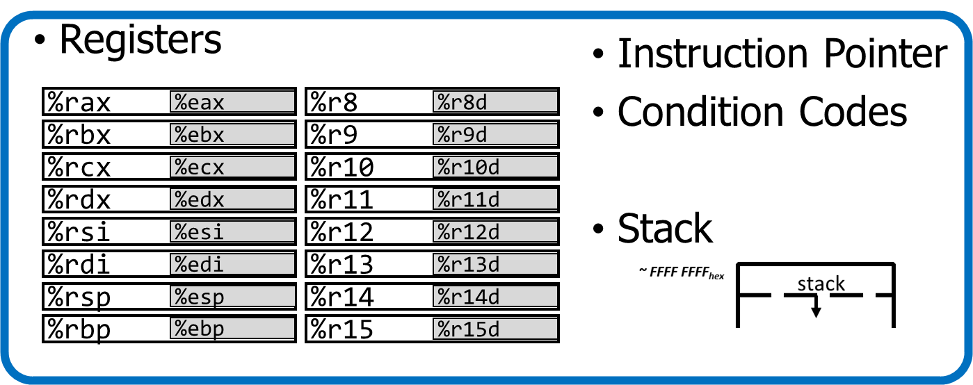
Alternate view of a process
A process could have multiple threads
Each with its own registers and stack
Threads have separate:
Instruction Pointer
Registers
Stack Memory
Condition Codes
Threads share:
Code
Global variables
Code and Data

Slide 50
Process address space with threads
Stack (T1)
Thread 1
Thread 2
Stack (T2)
Stack (T3)
Thread 3
Data
Segment
Heap
Static Data
%RIP (T3)
%RIP (T2)
Code
%RIP (T1)

Slide 51
Thread use case: web browser
Let’s say you’re implementing a web browser:
You want a tab for each web page you open:
The same code loads each website (shared code section)
The same global settings are shared by each tab (shared data section)
Each tab does have separate state (separate stack and registers)
Disclaimer: Actually, modern browsers use separate processes for each tab for a variety of reasons including performance and security. But they used to use threads.

Slide 52
Thread use case: user interfaces
Even if there is only a single processor core, threads are useful
Single-threaded User Interface
While processing actions, the UI is frozen
main() {
while(true) {
check_for_UI_interactions();
process_UI_actions(); // UI freezes while processing
}
}

Slide 53


Thread use case: web server
Example: Web server
Receives multiple simultaneous requests
Reads web pages from disk to satisfy each request

Slide 54
Web server option 1: handle one request at a time
Request 1 arrives
Server reads in request 1
Server starts disk I/O for request 1
Request 2 arrives
Disk I/O for request 1 finishes
Server responds to request 1
Server reads in request 2
Easy to program, but slow
Can’t overlap disk requests with computation
Can’t overlap either with network sends and receives
time

Slide 55
Web server option 1: event-driven model
Issue I/Os, but don’t wait for them to complete
Request 1 arrives
Server reads in request 1
Server starts disk I/O for request 1
Request 2 arrives
Server reads in request 2
Server starts disk I/O for request 2
Disk I/O for request 1 completes
Server responds to request 1
Fast, but hard to program
Must remember which requests are in flight and which I/O goes where
Lots of extra state
time

Slide 56
Web server option 3: multi-threaded web server
One thread per request. Thread handles only that request.
Easy to program (maybe), and fast!
State is stored in the stacks of each thread and the thread scheduler
Simple to program if they are independent…
Main Thread
Request 1 arrives
Create thread
Request 2 arrives
Create thread
Thread 1
Read in request 1
Start disk I/O
Disk I/O finishes
Respond to request 1
Exit
Thread 2
Read in request 2
Start disk I/O
time

Slide 57
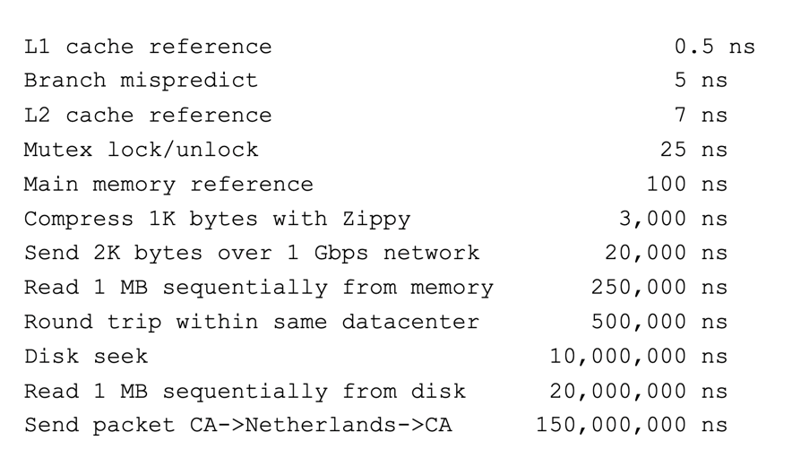
More Practical Motivation
Back to Jeff Dean’s “Numbers Everyone Should Know”
Handle I/O in separate thread, avoid blocking other progress

Slide 58

Models for thread libraries: User Threads
Thread scheduling is implemented within the process
OS only knows about the process, not the threads
Upsides
Works on any hardware or OS
Performance is better when creating and switching
Downsides
A system call in any thread blocks all threads
Processes
Thread Library
OS Kernel
Scheduler

Slide 59
Models for thread libraries: Kernel Threads
Thread scheduling is implemented by the operating system
OS manages the threads within each process
Upsides
Other threads can continue while one blocks on I/O
No additional scheduler
Downsides
Higher overhead
This is what we’ll focus on in CS343
Processes
OS Kernel
Scheduler

Slide 60
Threads versus Processes
Threads
pthread_create()
Creates a thread
Shares all memory with all threads of the process.
Scheduled independently of parent
pthread_join()
Waits for a particular thread to finish
Can communicate by reading/writing (shared) global variables.
Processes
fork()
Creates a single-threaded process
Copies all memory from parent
Can be quick using copy-on-write
Scheduled independently of parent
waitpid()
Waits for a particular child process to finish
Can communicate by setting up shared memory, pipes, reading/writing files, or using sockets (network).

Slide 61
POSIX Threads Library: pthreads
https://man7.org/linux/man-pages/man7/pthreads.7.html
int pthread_create(pthread_t *thread, const pthread_attr_t *attr, void *(*start_routine)(void*), void *arg);
thread is created executing start_routine with arg as its sole argument.
return is implicit call to pthread_exit
void pthread_exit(void *value_ptr);
terminates the thread and makes value_ptr available to any successful join
int pthread_join(pthread_t thread, void **value_ptr);
suspends execution of the calling thread until the target thread terminates.
On return with a non-NULL value_ptr the value passed to pthread_exit() by the terminating thread is made available in the location referenced by value_ptr.

Slide 62
Pthread system call example
What happens when pthread_create() is called in a process?
Library:
int pthread_create(…) {
Do some work like a normal function
Put syscall number into register
Put args into registers Special trap instruction
clone (56) syscall on Linux
Kernel:
Get args from regs
Do the work to spawn the new thread
Store return value in %eax
Get return values from regs
Do some more work like a normal function
};

Slide 63
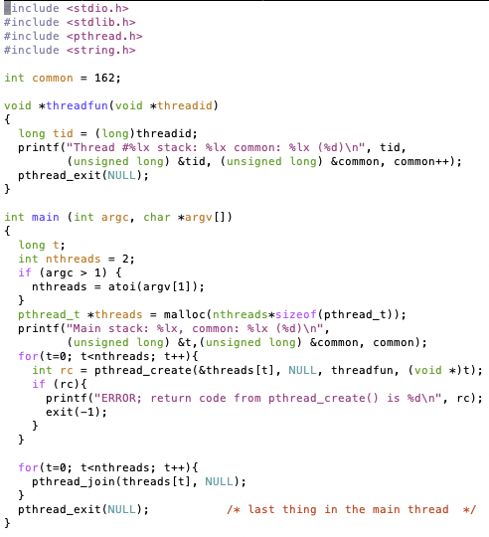
Threads Example

Slide 64
Threads Example
Reads N from process arguments
Creates N threads
Each one prints a number, then increments it, then exits
Main process waits for all of the threads to finish

Slide 65

Threads Example

Slide 66
Check your understanding
How many threads are in this program?
Does the main thread join with the threads in the same order that they were created?
Do the threads exit in the same order they were created?
If we run the program again, would the result change?

Slide 67
Check your understanding
How many threads are in this program? Five
Does the main thread join with the threads in the same order that they were created? Yes
Do the threads exit in the same order they were created? Maybe??
If we run the program again, would the result change? Possibly!

Slide 68
Outline
Processes
System Calls
Process Creation
Signals
Threads

