Slide 1
Lecture 11: Virtual Memory
CS343 – Operating Systems
Branden Ghena – Spring 2022
Some slides borrowed from: Stephen Tarzia (Northwestern), Shivaram Venkataraman (Wisconsin), and UC Berkeley CS61C and CS162

Slide 2
Resources the OS manages
Processor
Scheduling
Devices
Device Drivers
Memory
Virtual Memory
Files
File systems

Slide 3
Today’s Goals
Discuss OS management of process memory with virtual memory
Understand two virtual memory mechanisms: segmentation and paging
Explore optimizations to memory paging

Slide 4
Outline
Address Spaces
Methods of address translation
Segmentation
Paging
Paging improvements
Improving translation speed
Improving table storage size

Slide 5
The reality of memory in a computer
DISK
Process A
Process B
Process A
RAM
Process C
CPU
Process B
Process C

Slide 6
A process’s view of the memory
The Address Space of the process
The illusion:
Processes run alone on the computer
They have full access to every memory address
2⁶⁴ bytes of memory available to them
The reality:
There are many processes
There is only so much RAM available
~ FFFF FFFF_{hex}
stack
heap
static data
code
~ 0_{hex}

Slide 7
Virtual memory enables this illusion
Virtual Addresses
Physical Addresses
~ FFFF FFFF_{hex}
stack
~ FFFF FFFF_{hex}
Process A
Address Space
RAM
Process B
heap
static data
code
OS
~ 0_{hex}
~ 0_{hex}

Slide 8
Why is this illusion important?
We want to compile our programs at set addresses
There are alternatives to this, such as Position Independent code
But those alternatives often have performance costs
But we can’t know which addresses will be available
How would developers know which addresses Chrome could use safely or which addresses Powerpoint intended to use?
Plus, the amount of RAM on systems varies widely
Old laptop with 512 MB, Desktop with 16 GB, Server with 256 GB
If they run x86-64 Linux, the same program will work on all of them
Specialized systems, like embedded, might not need this requirement

Slide 9
Goals of virtual memory
Independence from other programs running
Independence from machine hardware
Security
Applications shouldn’t be able to even read other memory much less write
Efficiency
Allow reuse of some parts of memory
Code sections for threads, duplicate processes, or shared libraries
Don’t slow down the system too much by enabling the above

Slide 10
Virtual memory is how the OS controls memory accesses
I/O operations are controlled by system calls
CPU usage is controlled by the scheduler (and interrupts)
How can the OS control memory accesses?
Context switch for each memory read/write is too high of a cost
Hardware needs to automatically handle most requests

Slide 11
Memory Management Unit (MMU) supports virtual memory
Translation: hardware support for common case reads/writes
Configured by the OS
Faults: trap to OS to handle uncommon errors
Virtual Addresses
RAM
Physical Addresses
CPU
Translation and Faults
Memory Management Unit

Slide 12
Short Break + Question
Which is bigger in practice: virtual memory or physical memory?

Slide 13
Short Break + Question
Which is bigger in practice: virtual memory or physical memory?
2⁶⁴ bytes worth of addresses in both
Both could hold up to 18 Exabytes (~18000 Petabytes, ~18000000 Terabytes)
Virtual memory: practically there isn’t a limit
Physical memory: practically limited to amount of RAM installed
So, likely measured in Gigabytes
Virtual Memory is MUCH larger (2¹⁸ vs 2⁹)

Slide 14
Outline
Address Spaces
Methods of address translation
Segmentation
Paging
Paging improvements
Improving translation speed
Improving table storage size

Slide 15
Share memory by splitting between whole processes
Virtual Addresses
Physical Addresses
~ FFFF FFFF_{hex}
stack
~ FFFF FFFF_{hex}
Process A
MMU
Address Space
RAM
Process B
heap
static data
code
OS
~ 0_{hex}
~ 0_{hex}

Slide 16
Address translation with a base register
Divide RAM into segments, each with a separate “base” address
Processes each get their own individual segment
Takes advantage of processes usually being smaller than RAM
To get a physical address from a virtual one, add to base value
Memory Management Unit
mode == user?
Virtual Address
No
Physical Address
Yes
+ base

Slide 17
Adding protection creates “Base and Bound” translation
Add a “bound” register with maximum value of the segment
Memory accesses greater than bound trigger a fault
No need to worry about lower bound, since minimum address is 0+base
Memory Management Unit
mode == user?
Virtual Address
No
Physical Address
Yes
> bound?
No
+ base
Fault
Yes

Slide 18
Base and bounds evaluation
Advantages
Provides protection between address spaces
Supports dynamic relocation of processes (even at runtime)
Simple, inexpensive hardware implementation
Disadvantages
Process must be allocated contiguous physical memory
Including memory between sections that might never be used
Large allocations end up wasting a lot of space through fragmentation
No partial sharing of memory

Slide 19
Check your understanding – base and bound
What are the results of the following memory reads? (16-bit)
Base: 0xC000 Bound: 0x1FFF
Read 0x0010
Read 0x1400
Read 0xD000

Slide 20
Check your understanding – base and bound
What are the results of the following memory reads? (16-bit)
Base: 0xC000 Bound: 0x1FFF
Read 0x0010 -> 0xC010
Read 0x1400 -> 0xD400
Read 0xD000 -> Fault

Slide 21
What if we split the code into multiple base/bound segments?
Physical Addresses
stack
~ FFFF FFFF_{hex}
code
MMU
stack
Address Space
RAM
heap
heap
static data
static data
code
OS
~ 0_{hex}
~ 0_{hex}

Slide 22
Segmentation design
Select some number of “segments” that processes may have
Separate base and bound register for each one
Need to distinguish which accesses correspond to which segment
Solution: use top few bits of the virtual address
00 -> segment 0
01 -> segment 1
etc.
Only add remaining lower bits to the base register

Slide 23
Memory Management Unit for segmentation
Similar comparison and addition hardware as before
New segment table to select correct base and bounds
Bits from virtual address decide on the correct segment
Segment decides the proper base and bound selection
Can also apply permissions to individual segments
Segment | Base | Bound | Permissions
0 | 0x2000 | 0x06FF | Read/Execute
1 | 0x0000 | 0x04FF | Read/Write
2 | 0x3000 | 0x0FFF | Read/Write
3 | 0x0000 | 0x0000 | None
Example
Code
Stack
Data
Unused

Slide 24
OS management of processes with segmentation
On context switch
Hardware changes to kernel mode and deactivates the MMU
Save process’s segment table with the rest of the process data
Load new process’s segment table into the MMU
Change to user mode and jump to new process
x86 example
No table, but rather registers for each segment
Stack Segment, Code Segment, Data Segment
Extra Segment, F Segment, G Segment

Slide 25
Segmentation evaluation
Advantages
Sparse allocation of address space
Stack and heap segments can grow
Different protection for different segments
Only execute or write where it makes sense to
Still possible to do dynamic relocation and hardware still relatively simple
Disadvantages
Still results in fragmentation of memory
Entire section must fit
But sections are irregularly sized

Slide 26
Quick question – segmentation (16 bit)
How many bits are used for the segment?
Segment | Base | Bound | Permissions
0 | 0x0000 | 0x06FF | Read/Execute
1 | 0x0700 | 0x02FF | Read/Write
2 | 0x1C00 | 0x01FF | Read/Write
3 | 0x1800 | 0x01FF | Read/Execute
4 | 0x1200 | 0x0400 | Read/Execute
5 | 0x0000 | 0x0000 | None
6 | 0x0000 | 0x0000 | None
7 | 0x0000 | 0x0000 | None

Slide 27
Quick question – segmentation (16 bit)
How many bits are used for the segment?
Three bits (8 choices)
Placed as most significant bits
Lower 13 bits are added to base
Segment | Base | Bound | Permissions
0 | 0x0000 | 0x06FF | Read/Execute
1 | 0x0700 | 0x02FF | Read/Write
2 | 0x1C00 | 0x01FF | Read/Write
3 | 0x1800 | 0x01FF | Read/Execute
4 | 0x1200 | 0x0400 | Read/Execute
5 | 0x0000 | 0x0000 | None
6 | 0x0000 | 0x0000 | None
7 | 0x0000 | 0x0000 | None

Slide 28
Break + Practice – segmentation (16 bit)
Translate the following
Read 0x0200
Read 0x0500
Write 0x0410
Read 0x4004
Write 0x5004
Segment | Base | Bound | Permissions
0 | 0x0000 | 0x06FF | Read/Execute
1 | 0x0700 | 0x02FF | Read/Write
2 | 0x3C00 | 0x01FF | Read/Write
3 | 0x1800 | 0x01FF | Read/Execute
4 | 0x4200 | 0x0400 | Read/Execute
5 | 0x0000 | 0x0000 | None
6 | 0x0000 | 0x0000 | None
7 | 0x0000 | 0x0000 | None
Upper 3 bits of address are the segment
Lower 13 bits of address are appended to Base

Slide 29
Break + Practice – segmentation (16 bit)
Translate the following
Read 0x0200 -> 0x0200
Read 0x0500 -> 0x0500
Write 0x0410 -> Fault (Permission)
Read 0x4004 -> 0x3C04
Write 0x5004 -> Fault (Bound) [0x1004 > 0x01FF]
Segment | Base | Bound | Permissions
0 | 0x0000 | 0x06FF | Read/Execute
1 | 0x0700 | 0x02FF | Read/Write
2 | 0x3C00 | 0x01FF | Read/Write
3 | 0x1800 | 0x01FF | Read/Execute
4 | 0x4200 | 0x0400 | Read/Execute
5 | 0x0000 | 0x0000 | None
6 | 0x0000 | 0x0000 | None
7 | 0x0000 | 0x0000 | None
Segment 0
Segment 2
Upper 3 bits of address are the segment
Lower 13 bits of address are appended to Base

Slide 30
Outline
Address Spaces
Methods of address translation
Segmentation
Paging
Paging improvements
Improving translation speed
Improving table storage size

Slide 31
Improving upon segmentation
Segmentation had some good features
Address space does not need to be contiguous
Segments can grow when needed
But irregularly-sized segments lead to fragmentation
RAM
Many processes created
Some processes complete
New process doesn’t fit!
RAM is available, but only in fragments.

Slide 32
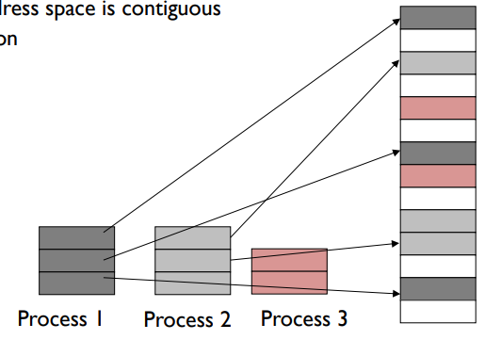
Solution to fragmentation: pages of memory
Divide memory into small, fixed-sized pages
Pages of virtual memory map to pages of physical memory
Like segments were mapped, but many more pages than segments
Processes and their sections can be mapped to any place in memory

Slide 33
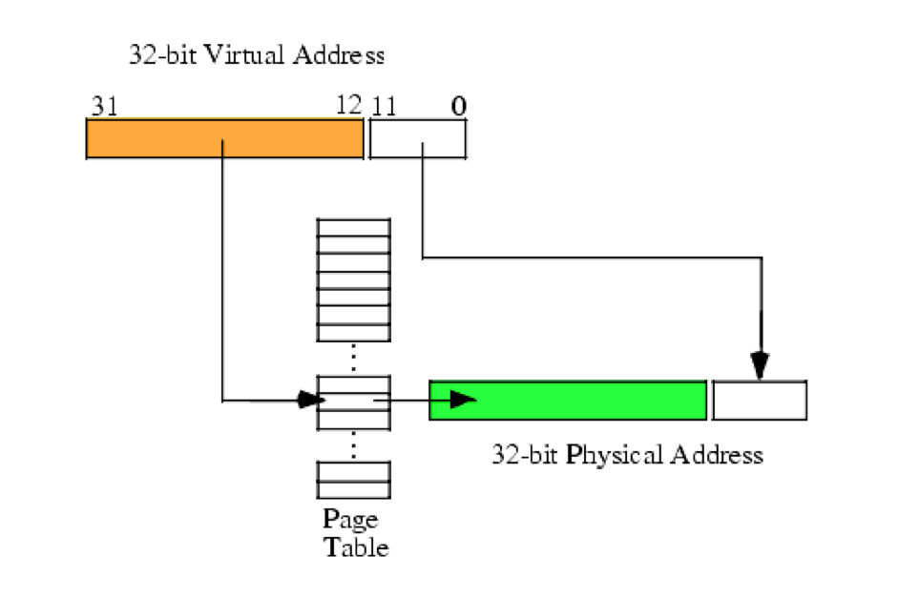
Page table translates virtual addresses to physical addresses
Use topmost bits of virtual address to select page table entry
One page table entry per each virtual page
Add address at page table entry to bottommost bits
Actually just concatenate the two
Just like segment tables, there will be a different page table for each process

Slide 34
Paging versus segmentation
Every page of virtual memory maps to a page of physical memory
No need for a bound anymore
Above a bound would just be the next page
We don’t pick the number of pages, we pick page size
Number of pages = Size of memory / Size of Page
Way more pages than there were segments
4 kB pages with 4 GB of RAM -> ~1 million pages
Need to keep page table in memory rather than hardware registers
Hardware register points at the base of the page table

Slide 35
Virtual Memory
(Process B Only!)
Process A
Process B
0
1
2
3
4
5
6
7
8
Process B
Process B Page Table
VPN | PPN | Valid?
0
1
2
3
4
5
6
7
8
Process B
CPU
Process B

Slide 36
Virtual Memory
(Process B Only!)
Process A
Physical Memory (RAM)
Shared
Process B
0
1
2
3
4
5
6
7
8
Process A
0
1
2
3
4
5
6
Process B
Process A
Process B Page Table
Process B
VPN | PPN | Valid?
0 | 2 | 1
1
2
3 | 6 | 1
4
5
6
7 | 4 | 1
8
Process B
CPU
Process A
Process B
Process A
Process B
Process B

Slide 37
Virtual Memory
(Process B Only!)
Process A
Physical Memory (RAM)
Shared
Process B
0
1
2
3
4
5
6
7
8
Process A
0
1
2
3
4
5
6
Process B
Process A
Process B Page Table
Process B
VPN | PPN | Valid?
0 | 2 | 1
1 | X | 0
2 | X | 0
3 | 6 | 1
4 | X | 0
5 | X | 0
6 | X | 0
7 | 4 | 1
8 | X | 0
Process B
CPU
Process A
Process B
Process A
Process B
Process B

Slide 38
Check your understanding – virtual address translation
Virtual Address
Do we need to translate the lower bits of a virtual address?
Virtual Page Number
Offset
Page table lookup!
?
Physical Page Number
Offset
Physical Address

Slide 39
Check your understanding – virtual address translation
Virtual Address
Do we need to translate the lower bits of a virtual address?
No. Those are used to determine word/byte within the page.
Virtual Page Number
Offset
Page table lookup!
Physical Page Number
Offset
Physical Address

Slide 40
Steps to translating virtual addresses with paging
Virtual Address:
VPN
offset
Page Table
3) Combine PPN and offset
V | AR | PPN
X | XX
. . .
+
1) Index into PT using VPN
2) Check Valid and Access Rights bits
Physical
Address
4) Use PA to access memory
Important: This is all done in hardware!! OS is not involved unless it faults

Slide 41
How the OS deals with memory in a paging system
How do the OS and program agree on addresses?
Each program can use any virtual addresses it wants
OS controls physical memory layout in RAM and maps the two
How does the OS move memory around without messing up programs?
Just update the record in the page table
Process doesn’t know the difference
How to protect OS and process memory from other processes?
Ensure that virtual pages from a process never map to physical pages for another
But we can share physical pages for threads or shared libraries if we want!

Slide 42
Dealing with processes bigger than memory
Paging allows the OS to support processes larger than RAM
Just leave the virtual pages unmapped
When a load occurs to the unmapped page, a fault triggers the OS
Which can then load the needed page into RAM from disk
(and push some other page onto disk)

Slide 43
Virtual Memory
(Process B Only!)
Physical Memory (RAM)
Shared
Process B
0
1
2
3
4
5
6
7
8
Process A
Process B
0
1
2
3
4
5
6
Process B
Process B
Process B
Process B
Process B
Process B
DISK
CPU
Process B
Process B
Process B
Process B
Process B
Process B
Process B

Slide 44
OS management of processes with paging
When loading a process
OS places actual memory into physical pages in RAM
OS creates page table for the process
OS decides access permissions to different pages
OS connects to shared libraries already in RAM
When a context switch occurs
OS changes which page table is in use (%CR3 register in x86)
When a fault occurs
OS decides how to handle it. (Invalid access or missing page?)

Slide 45
Paging evaluation
Advantages
Still sparse allocation of address space and growing segments as needed
Still different protection for different segments
Only execute or write where it makes sense to
Still possible to do dynamic relocation and hardware still relatively simple
No fragmentation of main memory
Pages can fit anywhere they need to
Can load processes bigger than main memory!

Slide 46
Paging evaluation (continued)
Disadvantages
More work on the part of the OS to set up a process
Only a problem if we create processes frequently
Page tables are slow to access
Page tables need to be stored in memory due to size
MMU only holds the base address of the page table and reads from it
Two memory loads per load!!!
Going to have to fix this…
Page tables require a lot of storage space
Mapping must exist for each virtual page, even if unused
Becomes a serious issue on 64-bit systems

Slide 47
Break + Virtual Memory Practice
Assume `a` starts at 0x3000 (virtual)
Ignore instruction fetches and access to `i` and `sum` (they’re in registers)
Virtual Address Accesses
load 0x3000
load 0x3004
load 0x3008
load 0x300C
Physical Address Accesses
load 0x100C
load 0x7000
load 0x100C
load 0x7004
load 0x100C
load 0x7008
load 0x100C
load 0x700C
Code
int sum = 0;
for(int i=0; i<N; i++){
sum += a[i]; }
What physical address is the page table for this process at?
At what physical address does `a` start?

Slide 48
Break + Virtual Memory Practice
Assume `a` starts at 0x3000 (virtual)
Ignore instruction fetches and access to `i` and `sum` (they’re in registers)
Virtual Address Accesses
load 0x3000
load 0x3004
load 0x3008
load 0x300C
Physical Address Accesses
load 0x100C
load 0x7000
load 0x100C
load 0x7004
load 0x100C
load 0x7008
load 0x100C
load 0x700C
Code
int sum = 0;
for(int i=0; i<N; i++){
sum += a[i]; }
What physical address is the page table for this process at? 0x100C
At what physical address does `a` start? 0x7000

Slide 49
Administrivia
Get started on DriverLab early
PMs are in agreement that it is the hardest lab
Lots to do, big code base, need to understand what’s going on
Discussion from last Friday covers DriverLab insights
Recording available on Canvas under Panopto tab

Slide 50
Outline
Address Spaces
Methods of address translation
Segmentation
Paging
Paging improvements
Improving translation speed
Improving table storage size

Slide 51
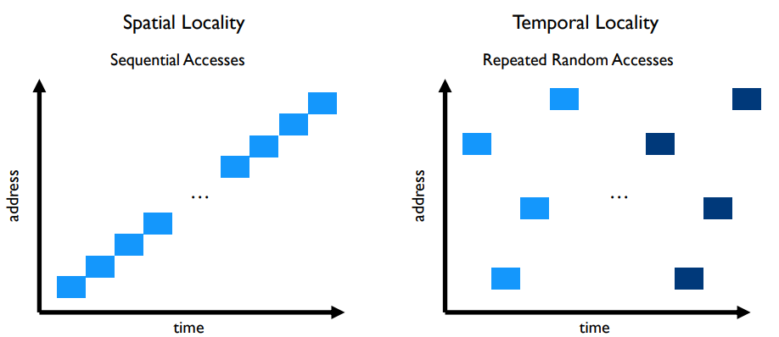
Caching can speed up page table access
How do we make page table access faster?
How do we make memory access faster?
Cache it!
Code and Stack have very high spatial locality

Slide 52
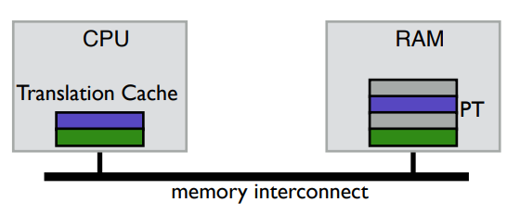
TLB caches page table entries
Translation Lookaside Buffer
Fully-associative cache (only compulsory misses)
Holds a subset of the page table (VPN->PPN mapping and permissions)
On a TLB miss, go check the real page table (done in hardware)

Slide 53
Address translation with TLB
Virtual Address
hardware
hardware or software
software
TLB
Lookup
TLB Miss
TLB Hit
Page Table
“Walk”
Protection
Check
Page not
in Mem
Page
in Mem
Access
Denied
Access
Permitted
Page Fault
(OS loads page)
Update
TLB
Protection
Fault
Physical
Address
Find in Disk
Find in Mem
SEGFAULT
Check cache

Slide 54
Context switches with a TLB
A process must only access its own page table entries in the TLB!
Otherwise, the mapping is wrong, and it accesses another process…
OS needs to manage the TLB
Option 1: Flush TLB on each context switch
Costly to lose recently cached translations
Option 2: Track with process each entry corresponds to
x86-64 Process Context Identifiers (12-bit -> 4096 different processes)
Extra state for the OS to manage if it has more processes than that

Slide 55
Software controlled TLBs
Some RISC CPUs have a software-managed TLB
TLB still used for translation, but a miss causes a fault for OS to handle
OS looks in page table for proper entry
OS evicts an existing entry from TLB
OS inserts correct entry into TLB
Special instruction allows OS to write to TLB
Hardware is simpler and OS has control over the TLB functionality
Can prefetch page table entries it thinks might be important
Can flush entries relevant to other processes
TLB misses take longer to complete, however

Slide 56
Outline
Address Spaces
Methods of address translation
Segmentation
Paging
Paging improvements
Improving translation speed
Improving table storage size

Slide 57
Paging disadvantages
Page tables are slow to access
Memory access for page table before any other memory access
TLB can speed this up considerably for common execution
Page tables require a lot of storage space
Mapping must exist for each virtual page, even if unused
Becomes a serious issue on 64-bit systems

Slide 58
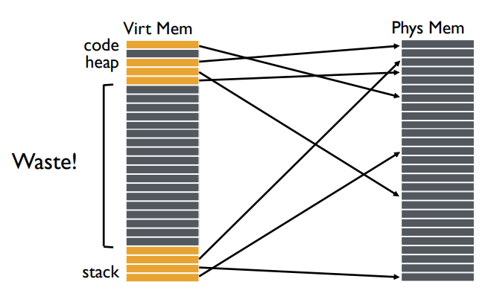
Why do page tables take so much storage space?
For every virtual page, there must exist an entry in the page table
Even though most virtual addresses aren’t used!
32-bit address space with 4 kB pages -> 1 million entries
At least 8 MB of storage
64-bit address space would require 36 exabytes of page table storage…

Slide 59
Create multiple page tables, each with useful mappings only
How do we eliminate extraneous entries from the page tables?
Virtual Page Number | Valid? | Physical Page Number
0 | 1 | 2
1 | 1 | 3
2 | 0
3 | 0
4 | 0
5 | 1 | 7
6 | 0
7 | 0

Slide 60
Create multiple page tables, each with useful mappings only
Collect groups of page table entries (call them “page table entry pages”?)
Virtual Page Number | Valid? | Physical Page Number
0 | 1 | 2
1 | 1 | 3
2 | 0
3 | 0
4 | 0
5 | 1 | 7
6 | 0
7 | 0

Slide 61
Create multiple page tables, each with useful mappings only
Collect groups of page table entries
Only keep groups that have valid mappings in them
Virtual Page Number | Valid? | Physical Page Number
0 | 1 | 2
1 | 1 | 3
4 | 0
5 | 1 | 7

Slide 62
Create multiple page tables, each with useful mappings only
Collect groups of page table entries
Only keep groups that have valid mappings in them
Remaining groups are now separate tables
Virtual Page Number | Valid? | Physical Page Number
0 | 1 | 2
1 | 1 | 3
Virtual Page Number | Valid? | Physical Page Number
4 | 0
5 | 1 | 7

Slide 63
Create multiple page tables, each with useful mappings only
Collect groups of page table entries
Only keep groups that have valid mappings in them
Remaining groups are now separate tables
Create a directory of page tables to collect existing page tables
Virtual Page Number | Valid? | Physical Page Number
0 | 1 | 2
1 | 1 | 3
Virtual Page Number | Valid? | Physical Page Number
4 | 0
5 | 1 | 7
Virtual Page Number Range | Valid? | Page Table Address
0-1 | 1
2-3 | 0
4-5 | 1
6-7 | 0

Slide 64
Multilevel page tables
Virtual Address
31
22
21
12
11
0
p1 p2 offset
10-bit
L1 index
10-bit
L2 index
Root of the Current
L1 Page Table (Hardware register)
offset
Physical Memory
p2
p1
Valid page table
Level 1
Page Table
(Directory)
Invalid page table
Valid page
Level 2
Page Tables
Invalid page
Unused RAM
Valid data in RAM
Data Pages

Slide 65
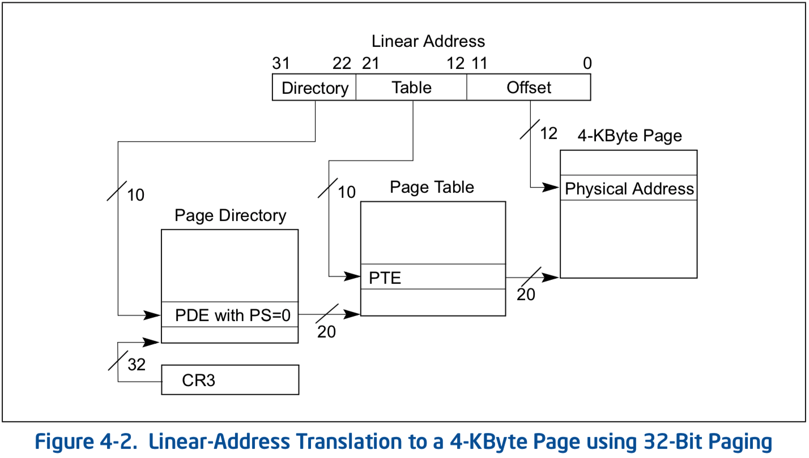
Multilevel page table logistics
Virtual address is broken down into three or more parts
Highest bits index into highest-level page table
A missing entry at any level triggers a page fault
Size of tables in memory proportional to number of pages of virtual memory used
Small processes can have proportionally small page tables

Slide 66
Multilevel page tables can keep nesting
Even page table directory is often sparse, so break it up too
x86-64
Four levels of page table
48-bit addresses (256 TB RAM ought to be enough for everyone right?)
9 bits
9 bits
9 bits
9 bits
12 bits
48-bit Virtual
Address:
Virtual
P1 index
Virtual
P2 index
Virtual
P3 index
Virtual
P4 index
Offset
PageTablePtr
8 bytes
4096-byte pages (12 bit offset) Page tables also 4k bytes (pageable)
Physical
Address:
(40-50 bits)
Physical Page #
12bit Offset

Slide 67
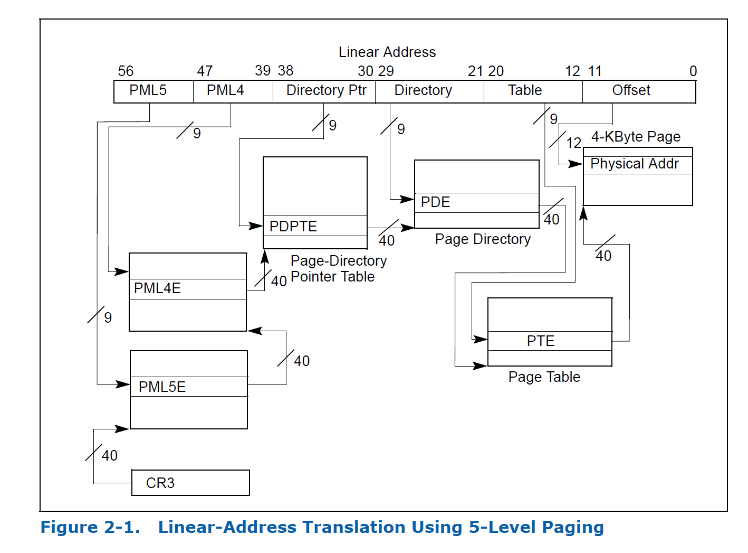
Intel Ice Lake (2019): 5 layers!!

Slide 68
Check your understanding – multilevel page table
How many memory loads per read are there now?

Slide 69
Check your understanding – multilevel page table
How many memory loads per read are there now?
6
As in each memory access takes six times as long
TLB is extremely important

Slide 70
Additional optimization: large pages
Always using large pages results in wasted memory
Example: 1 MB page where only 1 KB is used
Always using small pages results in unnecessary page table entries
Example: 250 entries in a row to represent 1 MB of memory
Can we mix in larger pages opportunistically?
Small pages normally
Large pages occasionally
Huge pages rarely

Slide 71
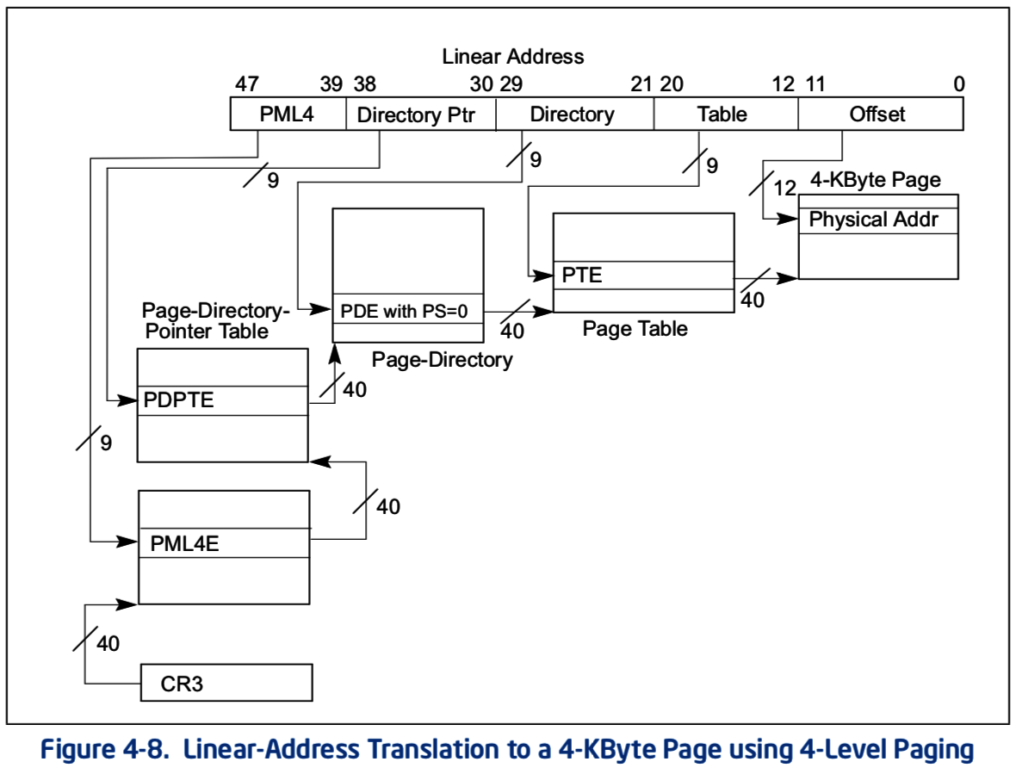
x86-64 allows multiple-sized pages: 4 KB
Normal x86-64 paging

Slide 72
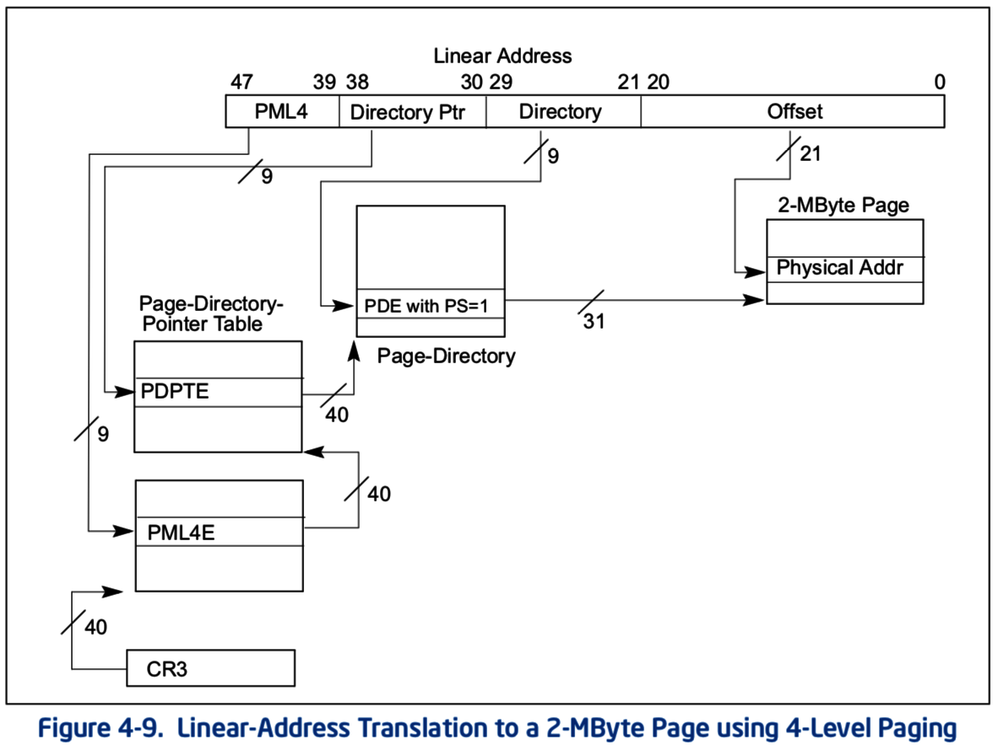
x86-64 allows multiple-sized pages: 2 MB
Page Size bit triggers walk to skip next table and go straight to 2 MB page in memory
Remaining address bits are used as offset into larger page

Slide 73
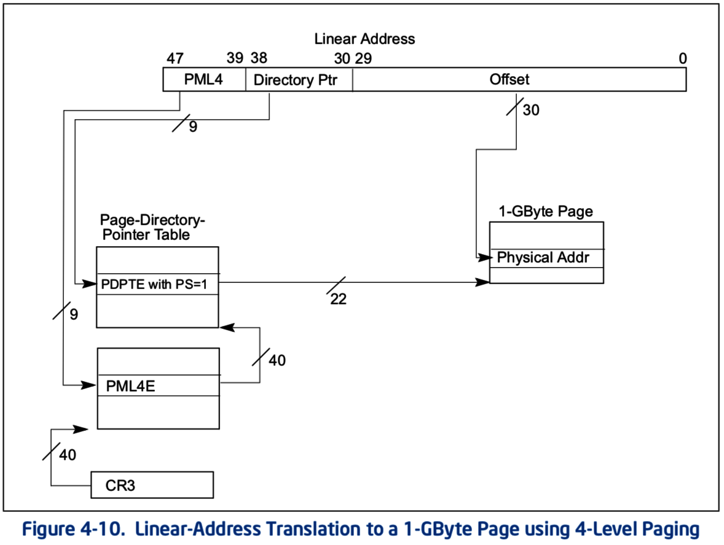
x86-64 allows multiple-sized pages: 1 GB
Can also skip straight to 1 GB pages
With a bit of extra hardware, TLB can hold large page entries
Occupies a single TLB entry for 1 GB of data (250000 normal entries)

Slide 74
Other data structures for paging
If hardware handles TLB misses
Need a regular structure it can “walk” to find page table entry
x86-64 needs to use multilevel page tables
If software handles TLB misses
OS can use whatever data structure it pleases
Example: inverted page tables
Only store entries for virtual pages with valid physical mappings
Use hash of VPN+PCID to find the entry you need

Slide 75
Outline
Address Spaces
Methods of address translation
Segmentation
Paging
Paging improvements
Improving translation speed
Improving table storage size

