Slide 1
Lecture 02 Microcontrollers
CE346 – Microcontroller System Design
Branden Ghena – Fall 2025
Some slides borrowed from: Josiah Hester (Northwestern), Prabal Dutta (UC Berkeley)

Slide 2
Class Updates
No “official” lab this Friday
Personal Software Setup will be posted tonight
At some point
Gotta finish updating it
Office hours should start sometime next week
If you need help with the software setup, always feel free to reach out on Piazza!

Slide 3
Today’s Goals
Explore microcontrollers
How do they compare to computers?
Purpose, capabilities, tradeoffs
Explore the microcontroller(s) on the Microbit
Describe history and state-of-the-art for microcontrollers

Slide 4
Outline
Microcontrollers and Computers
Microcontroller Components
Processor
Memory
Peripherals
Pins & Other stuff
Microbit microcontroller
Microcontroller History

Slide 5
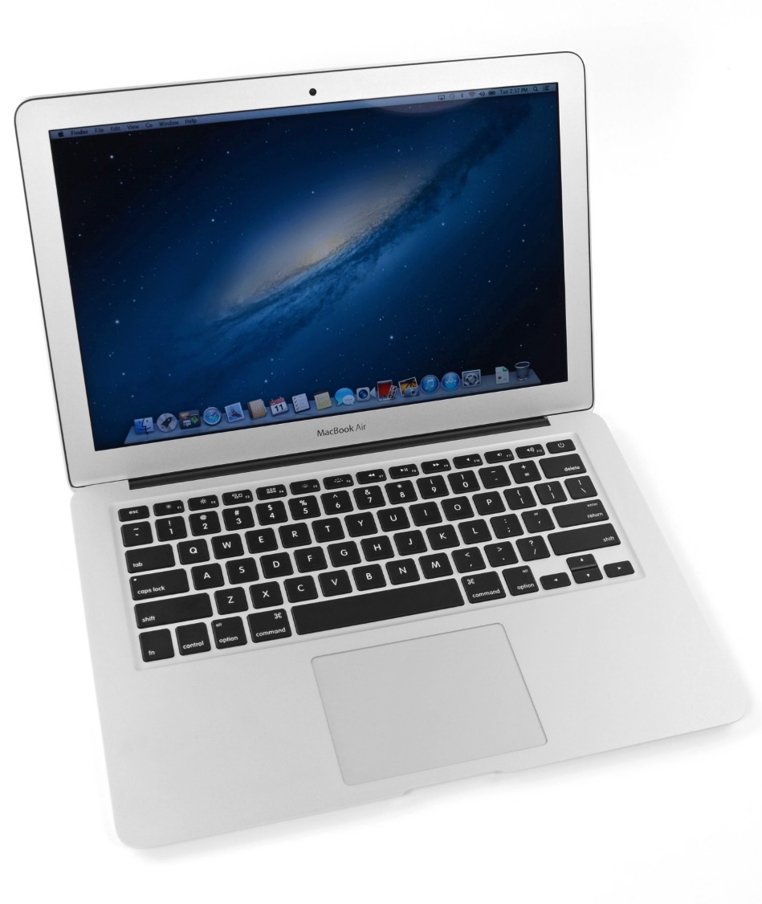
What’s inside a computer?
Macbook Air (circa 2013, 2nd gen)
Modern computers are mostly similar
Intel Core i5 processor
128 GB Flash storage
4 GB DDR3 RAM
1440x900 pixel display
Picked because there is a teardown I like of an embedded device from the same year
https://www.ifixit.com/Teardown/MacBook+Air+13-Inch+Mid+2013+Teardown/15042

Slide 6
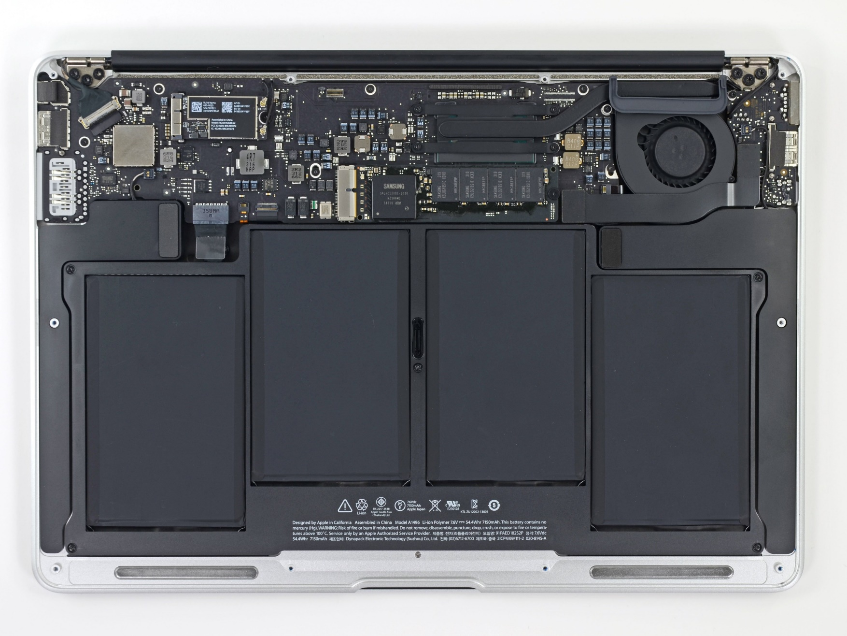
Unscrewing the bottom cover
Top half is the motherboard
Holds and connects all the parts of the computer
Bottom half are battery packs

Slide 7
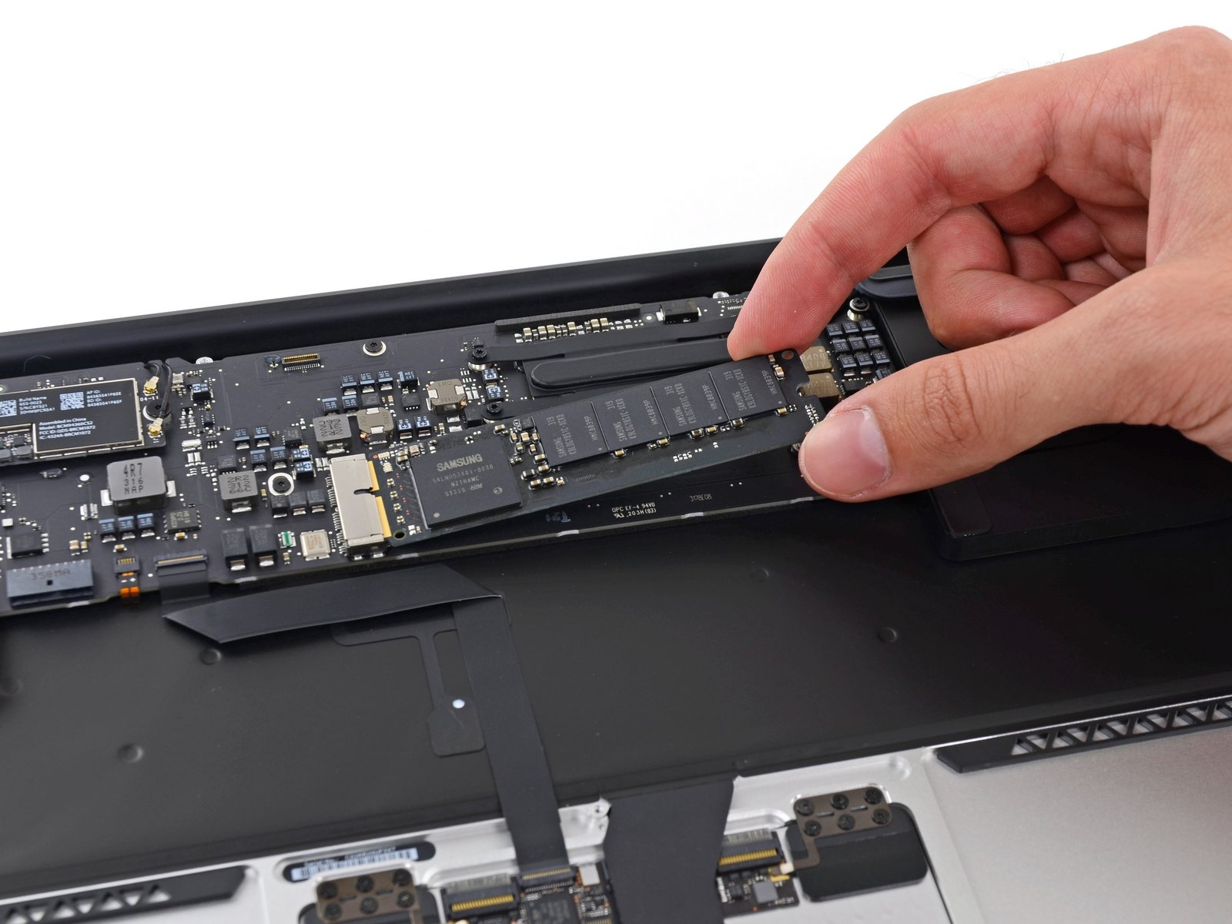
Non-volatile long-term storage: SSD
The SSD is a module that connects through PCIe
In modern laptops the SSD is often soldered directly onto the motherboard

Slide 8
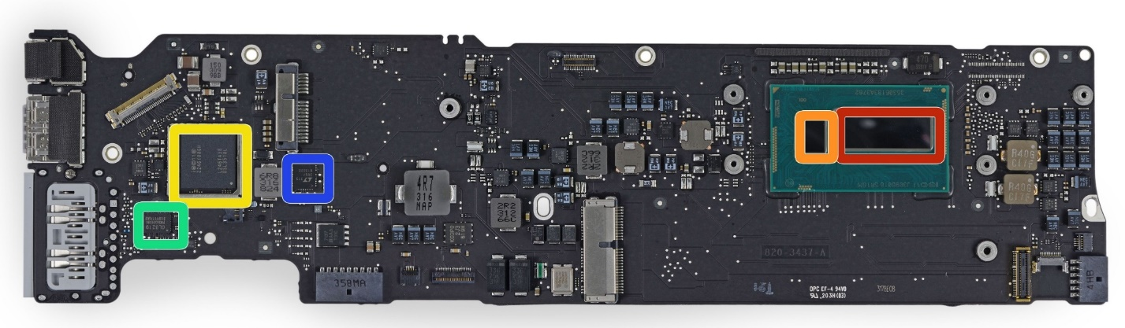
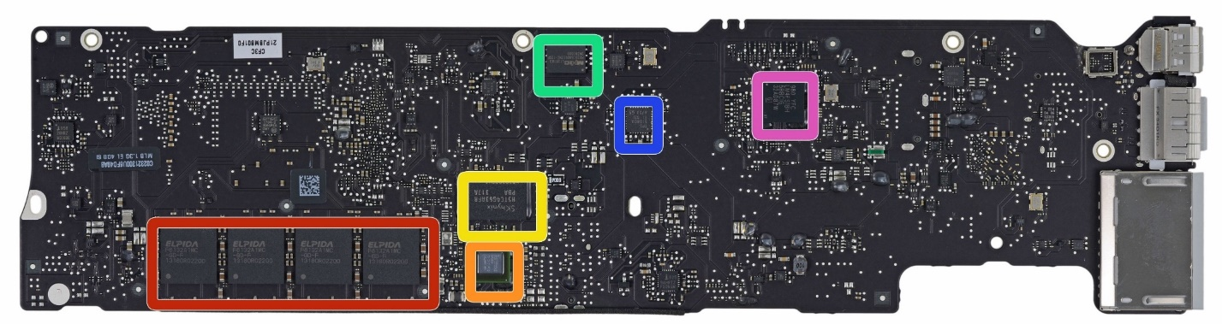
Investigating the motherboard
Red (front, right)
Intel core i5 processor
Red (bottom, left)
Elpida LPDDR3 RAM, 4 GB
Other stuff are mostly radios, USB/Thunderbolt controllers, and power supply
Front
Back

Slide 9
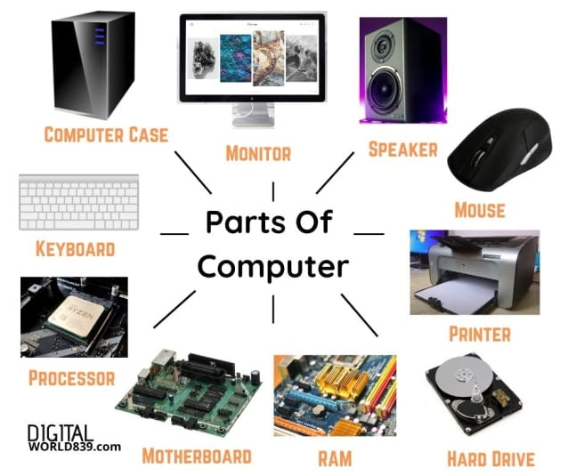
Generalizing computer design
Computers usually need
Processor
Memory (RAM)
Storage (Flash/SSD)
External communication
USB, Thunderbolt, SATA, HDMI, WiFi
Power management
Maybe batteries and charging
Something to connect it all: motherboard

Slide 10
What’s inside a Fitbit?
Fitbit flex (circa 2013)
Features
Counts your steps
Reports via Bluetooth Low Energy
Lights up some LEDs based on your goals
Vibrates when its battery is low
https://www.ifixit.com/Teardown/Fitbit+Flex+Teardown/16050
Notes:
Fitbit, Wearables, microcontrolles

Slide 11
Fitbit teardown
Notes:
Fitbit, Wearables, microcontrolles

Slide 12
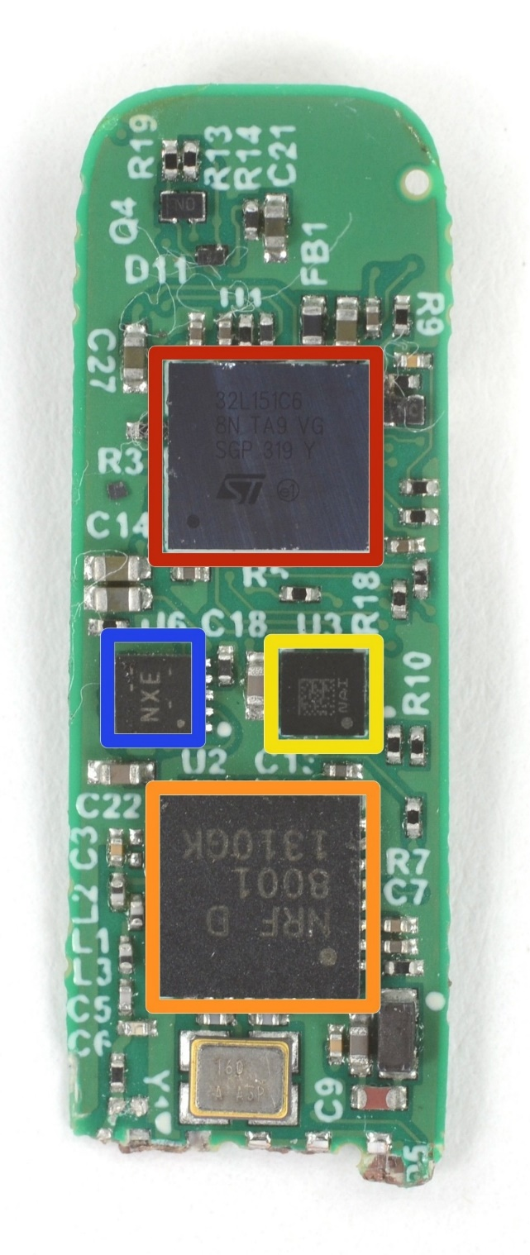
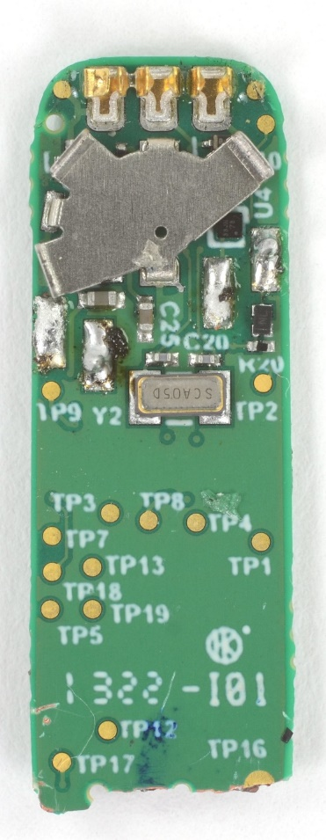
Fitbit circuit board front
The back is uninteresting
Red (top)
STMicro 32L151C6 Microcontroller
Blue (left)
TI BQ24040 Battery Charger
Yellow (right)
STMicro LIS2DH Accelerometer
Orange (bottom)
Nordic nRF8001 Bluetooth Low Energy Radio

Slide 13
Fitbit as a computer
Computers usually need
Processor
Memory (RAM)
Storage (Flash/SSD)
External communication
USB, Thunderbolt, SATA, HDMI, WiFi
Power management
Maybe batteries and charging
Something to connect it all: motherboard
Microcontroller
Bluetooth radio
Vibratory motor
Battery and power management
Circuit board

Slide 14
Sidebar: you could make a Fitbit yourself
All those parts are commercially available, so you could make your own Fitbit if you wanted to
Make a circuit board
Buy those parts and solder them on
Write some embedded software
Make a plastic case
… build a big software backend for everything
You’ve got a Fitbit!

Slide 15
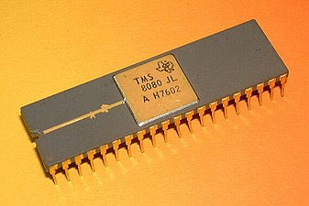
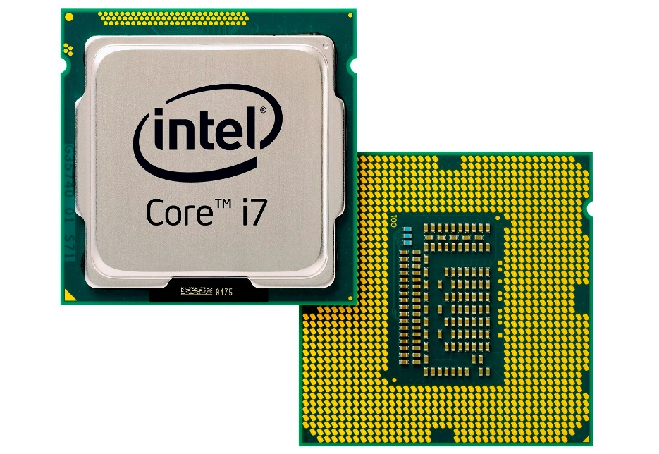
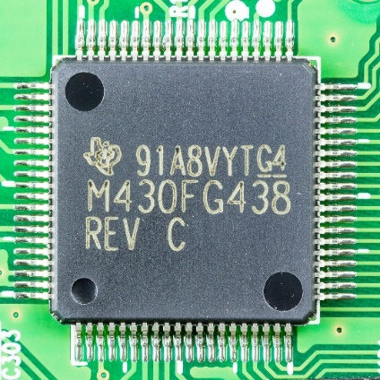
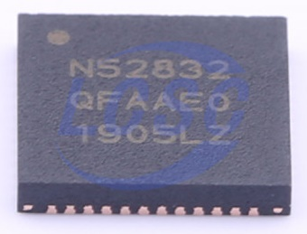
Categories of computer chips
Microprocessor (MPU or Processor)
CPU
Most memory and peripherals are external
Microcontroller (MCU)
CPU + Memory + Peripherals
Peripherals: separate hardware units within chip
Often I/O interfaces
Essentially, a microcontroller is almost an entire computer within a single chip

Slide 16
Break + Question
Why do laptops/desktops use external memory chips instead of building it into the processor (like a microcontroller)?

Slide 17
Break + Question
Why do laptops/desktops use external memory chips instead of building it into the processor (like a microcontroller)?
Flexibility
If it’s built into the processor, you’re limited to whatever they picked
Fabrication issues
DRAM and CMOS gates are somewhat different manufacturing processes (affects yield and costs)
DRAM takes up a lot of space (multiple chips for many GBs of RAM)
Some systems are doing this
Apple M4 includes separate RAM silicon dies in the same processor package

Slide 18
Modern Chips
System on a Chip (SoC)
Processor with extensive peripherals
Example: Radios or ML Accelerators
Essentially multiple chips combined into one
Evolution of increased complexity over time
Basically everything is an SoC these days
What we call Microcontrollers are still mostly self-contained and targeted and simpler, cheaper devices
What we call Microprocessors are more expensive, more performant, and usually require external memory

Slide 19
Outline
Microcontrollers and Computers
Microcontroller Components
Processor
Memory
Peripherals
Pins & Other stuff
Microbit microcontroller
Microcontroller History

Slide 20
Generic microcontroller block diagram
Microcontroller
Processor
Peripherals
Pins
Memory

Slide 21
Processor
Microcontroller needs to execute software instructions
Probably just one single-core processor
Newest chips might have multiple (we’ll come back to that)
Often a fairly basic processor like you’d learn in CE361 (Comp Arch)
Usually running a 1-100 MHz clock speeds
Compare to 3000-5000 MHz for modern desktop processors
A point of consideration for microcontroller processors is what architecture they are

Slide 22
Background: Instruction Set Architecture
ISA defines the actual instructions as well as the model for how the computer interacts with memory
ISA also includes the native word size (8, 16, 32, or 64-bit)
Defines size of registers and pointers
Also defines the limit of memory available to a system
Does the ISA for a microcontroller matter if you’re not programming in assembly? (and I promise we won’t)

Slide 23
Background: Instruction Set Architecture
ISA defines the actual instructions as well as the model for how the computer interacts with memory
ISA also includes the native word size (8, 16, 32, or 64-bit)
Defines size of registers and pointers
Also defines the limit of memory available to a system
Does the ISA for a microcontroller matter if you’re not programming in assembly? (and I promise we won’t)
Yes
Differences in instruction efficiency and amount are important
Differences in compiler support are VERY important

Slide 24
ARM and RISC-V are common microcontroller architectures
Common architectures
ARM (usually 32-bit) – also used in all smartphones, new Apple hardware
RISC-V (32-bit) – newer, free, open-source architecture
Previously common
Various custom architectures created by companies
8-bit or 16-bit on older systems
Still found in some microcontrollers
Original ESP32 used a 32-bit Xtensa architecture
New ESP32s mostly use a 32-bit RISC-V architecture

Slide 25
Other processor choices
Some operations may or may not be supported depending on the processor
Multiplication/Division
Floating-point
Atomic operations
Vector / DSP operations

Slide 26
ARM Cortex M Series
Arm Core | Cortex | Cortex | Cortex | Cortex | Cortex | Cortex | Cortex
 | M0 | M0+ | M3 | M4 | M7 | M23 | M33
ARM architecture | ARMv6-M | ARMv6-M | ARMv7-M | ARMv7E-M | ARMv7E-M | ARMv8-M | ARMv8-M
Computer architecture | Von | Von | Harvard | Harvard | Harvard | Von | Harvard
 | Neumann | Neumann |  |  |  | Neumann
Instruction pipeline | 3 stages | 2 stages | 3 stages | 3 stages | 6 stages | 2 stages | 3 stages
Multiply instructions | Yes | Yes | Yes | Yes | Yes | Yes | Yes
32×32 = 32-bit result
Multiply instructions | No | No | Yes | Yes | Yes | No | Yes
32×32 = 64-bit result
Divide instructions | No | No | Yes | Yes | Yes | Yes | Yes
32/32 = 32-bit quotient
Saturated math instructions | No | No | Some | Yes | Yes | No | Yes
DSP instructions | No | No | No | Yes | Yes | No | Optional
Single-Precision (SP) | No | No | No | Optional | Optional | No | Optional
floating-point instructions
Double-Precision (DP) | No | No | No | No | Optional | No | No
floating-point instructions
ARM processors commonly used in microcontrollers
A number of options for increasing capabilities
In practice:
Cortex-M0+ for low-end systems
Cortex-M7 for high capability systems
Cortex-M23 and M33 are newer replacements for those
https://en.wikipedia.org/wiki/ARM_Cortex-M

Slide 27
Outline
Microcontrollers and Computers
Microcontroller Components
Processor
Memory
Peripherals
Pins & Other stuff
Microbit microcontroller
Microcontroller History

Slide 28
Generic microcontroller block diagram
Microcontroller
Processor
Peripherals
Pins
Memory

Slide 29
Multiple types of memory are needed
Systems often have two types of memory
Volatile memory
Cheap and fast
Loses values without power
Non-volatile memory
Keeps values without power
Slower to access and modify
On normal computers, these are RAM and Disk
Usually DRAM and Flash SSDs

Slide 30
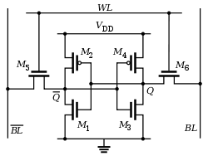
Volatile memory: SRAM
Same design as registers in traditional computer systems
No need to refresh it -> lower energy costs
Embedded systems use SRAM for all of their memory (no DRAM)
Tradeoffs:
Way less energy cost
Faster to access
More expensive and physically larger
So we have less of it in total

Slide 31
Non-Volatile memory: Flash (usually)
Same design as SSDs and Flash drives
Memory is stored with no energy costs
Reading is lowish energy and quick
Writing is high energy and very slow
Writing also has to occur in blocks (e.g. 512 bytes)
Concern: Flash has a limited lifetime ~10,000 writes
Only writing to Flash when you load code? Essentially forever
Recording data to Flash every second? 2.8 hours
Result: most embedded systems don’t modify their own Flash memory

Slide 32
SRAM (RAM) versus Flash (ROM) memory
Size and time difference between non-volatile and volatile memory is significantly reduced from traditional computing
Non-volatile store 2-10x larger than volatile
Single-cycle RAM. Maybe two-cycles to Flash (to read)
Major difference: energy and writability
SRAM is low-energy to read and write (no refresh needed)
Flash is lowish-energy to read, but very high energy to write
Use by software
Stack/Heap/Data sections (variables) in SRAM
Code goes in Flash (also const variables)

Slide 33
Memory design choices
How much memory can we fit without making the microcontroller too high cost or too high power?
The answer has slowly increased over time
20 years ago: 2 KB RAM – 32 KB Flash
Today: 256 KB RAM – 1024 KB Flash
That’s enough memory that you usually don’t need to think about it
But not enough memory to never think about it

Slide 34
Differences from memory in standard computers
How to provide memory safety?
Usually no virtual memory (all addresses are real addresses)
Nothing stops arbitrary memory overwriting
Modern systems: Memory Protection Unit
Specify a small number of ranges and permissions
Hierarchical structure is not enforced
Same address space for RAM and Flash (very different from traditional)
Run instructions right inside of Flash
Keep variables in RAM (or const variables in Flash)

Slide 35
What about caches?
Often no caches
Caches are about improving performance
But embedded systems are not often performance-constrained
AND caches can make timing unreliable
They exist in some high-end microcontrollers
Often instruction caches only
Often disabled by default

Slide 36
Break + Open Question
How little memory (RAM and/or ROM) can a computer have and still be useful?

Slide 37
Break + Open Question
How little memory (RAM and/or ROM) can a computer have and still be useful?
If we want to run C code, we need a stack and a global data section
Function calls may require local variables to be placed in the stack
To use less memory, we’d need to write applications in registers
Most variables could probably fit in registers?
So the limit could get very low
Enough ROM space for some useful code + a tiny bit of RAM

Slide 38
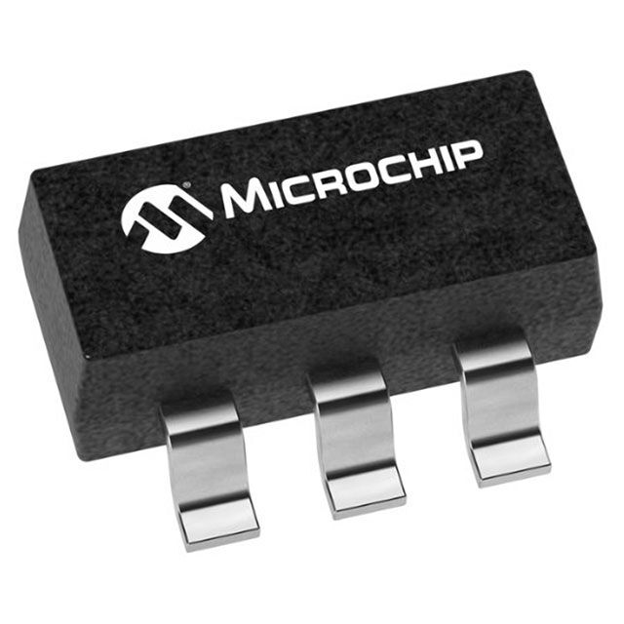
Fall 2025: least memory
How little memory might a microcontroller have?
PIC10F200
384 Bytes of ROM,
16 Bytes of RAM
Still actively produced and for sale on Digikey
$0.58 a piece

Slide 39
Outline
Microcontrollers and Computers
Microcontroller Components
Processor
Memory
Peripherals
Pins & Other stuff
Microbit microcontroller
Microcontroller History

Slide 40
Generic microcontroller block diagram
Microcontroller
Processor
Peripherals
Pins
Memory

Slide 41
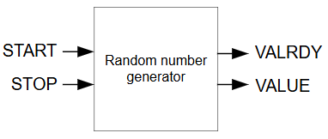
Peripherals
Hardware modules that perform some action
Specifically, modules within the microcontroller chip
NOT a separate chip, sensor, or inpu
Examples
Random Number Generator (RNG)
Processor can request a random number
The RNG peripheral does some kind of actions to generate one
The RNG provides the random number to the processor

Slide 42
What kinds of peripherals exist?
External connections
Used by processor to interact with outside world
Examples
Read from buttons and switches
Turn on/off LEDs
Measure a voltage
Connect to external sensors chips
Internal systems
Used by processor to speedup or provide some action it’s not capable of
Examples:
Request random numbers
Encrypt or decrypt some information
Check the current time

Slide 43
What do microcontrollers usually have?
Common examples
Digital inputs and outputs
Analog inputs and outputs
Messages over various communication protocols: UART, I2C, SPI
Set and check timers
Less common (but not rare) examples
Cryptography accelerators
Complicated wire protocols (USB, CAN)
Wireless radios (BLE, 802.15.4, WiFi)
We’ll spend most of class learning various peripherals

Slide 44
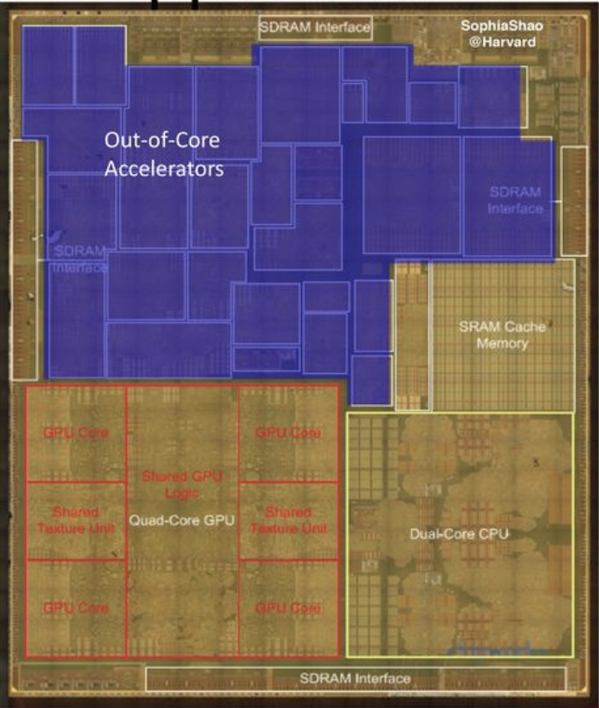
Peripheral design choices
More peripherals mean more capabilities
But also means more cost for the chip
Peripherals occupy silicon
Most peripherals will go unused for a given application…
Flexibility tradeoffs within a given peripheral
One capability is easier to use
Many capabilities are more useful
Apple A8 SoC

Slide 45
Outline
Microcontrollers and Computers
Microcontroller Components
Processor
Memory
Peripherals
Pins & Other Stuff
Microbit microcontroller
Microcontroller History

Slide 46
Generic microcontroller block diagram
Microcontroller
Processor
Peripherals
Pins
Memory

Slide 47
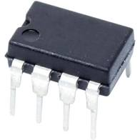
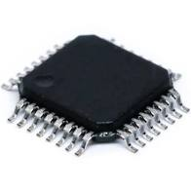
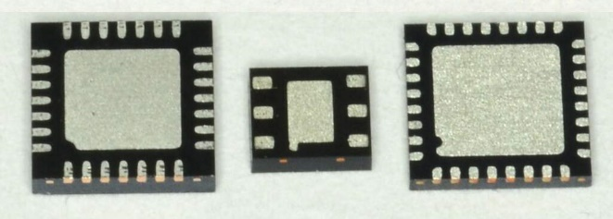
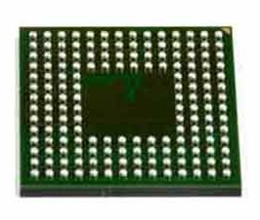
Pins
Peripherals need to electrically connect to outside world
Attach to pins on the exterior of the chip
More pins allow for more connections
At increased cost and size
Pin layouts can add more pins for cheaper
But make soldering and debugging difficult

Slide 48
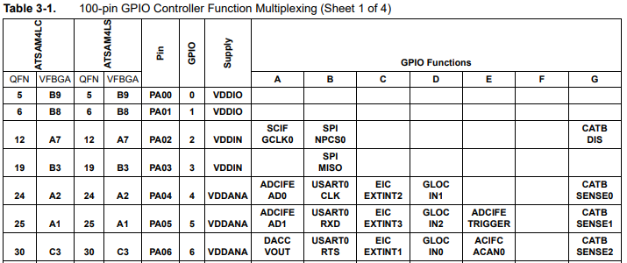
Internal connections to pins
Peripherals need to be connected to external pins
Can any peripheral connect to any pin, or are there limited mappings?
Modern microcontrollers allow any-to-any connections
Older MCUs had mapping tables and pin selection was more challenging

Slide 49
What haven’t we talked about?
Power
Programming
Others?
Clocks
Antennas
Microcontroller
Processor
Peripherals
Pins
Memory

Slide 50
Powering microcontrollers
Usually require a specific voltage
E.g. 5 volts, 3.3 volts, 1.8 volts
Must be stable and supply enough current (or MCU “browns out”)
Noisy power supply can be an issue
Some microcontrollers have wider ranges of acceptable voltages
Need to pay attention to acceptable range on I/O though

Slide 51
Programming microcontrollers
JTAG (Joint Test Action Group)
Hardware built into the microcontroller for testing purposes
Can arbitrarily read/write memory
Can single step process too, at runtime!
GDB can connect to it! (sort of)
Bootloaders
Software runs on the microcontroller at boot that waits a short time for someone to contact it and upload code
Via I/O pins
Convenient, but sometimes unreliable

Slide 52
Outline
Microcontrollers and Computers
Microcontroller Components
Processor
Memory
Peripherals
Pins & Other stuff
Microbit microcontroller
Microcontroller History

Slide 53
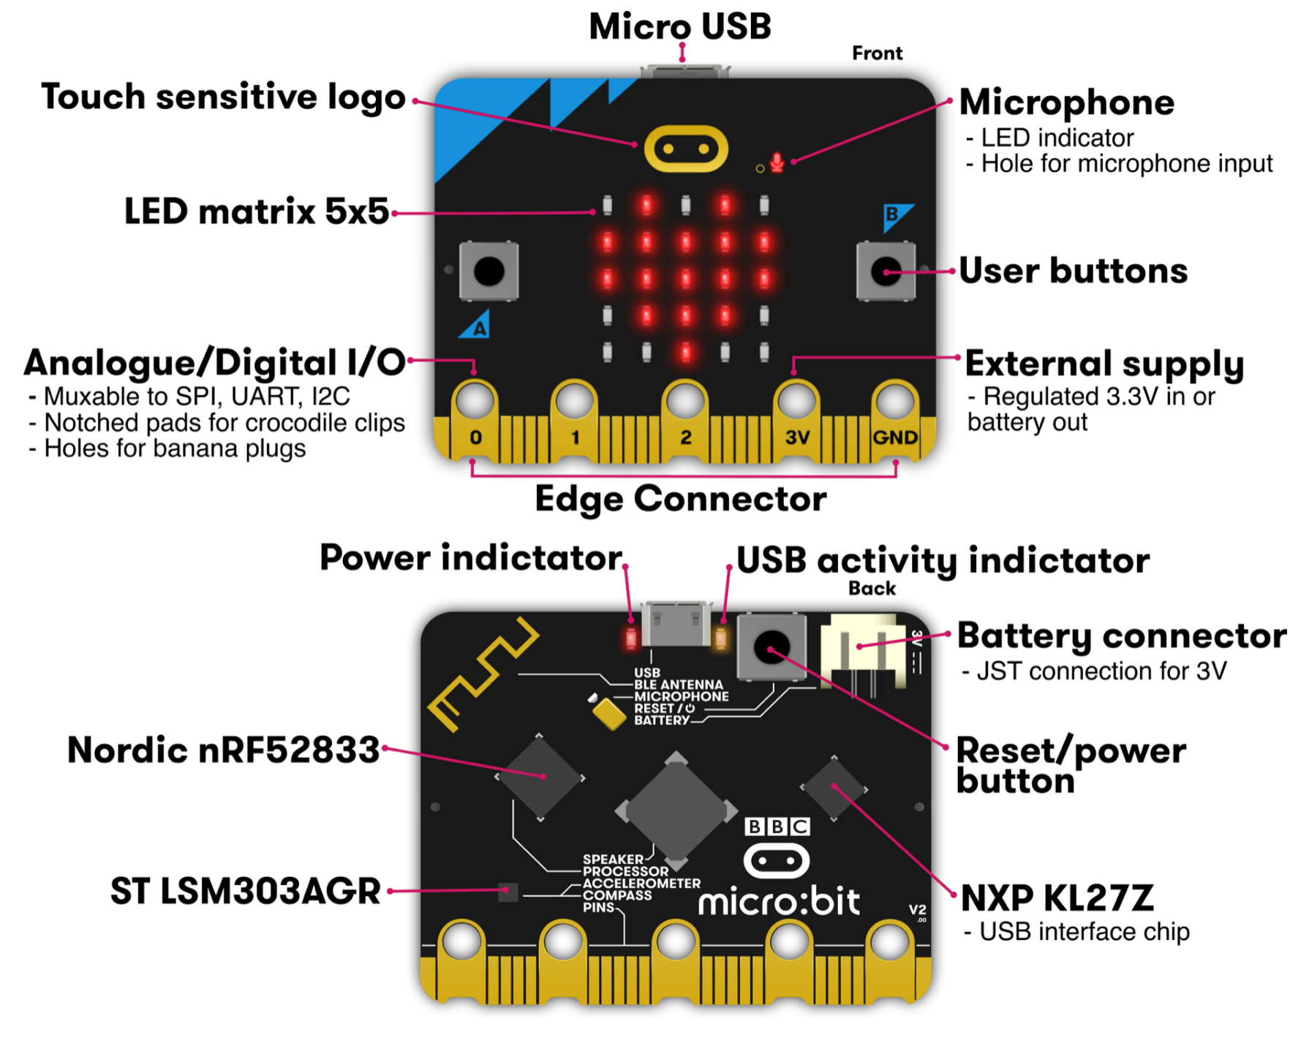
Micro:bit v2
Circuit board
Entire thing
a.k.a “Dev Board”
a.k.a PCB (Printed Circuit Board)
Microcontroller
The computer on it
Microbit has two
One as a programmer for the nRF (USB->JTAG)
One for applications that we will use
Microcontrollers

Slide 54
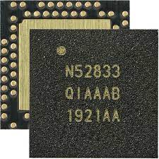
nRF52833 – Microcontroller on the Micro:bit v2
Processor: 32-bit ARM Cortex-M4F
32-bit registers and pointers, Floating-point support
64 MHz clock frequency
Memory:
128 KB SRAM
512 KB Flash
Peripherals:
Various peripherals
ADC, PWM
I2C, UART, SPI, USB
RNG, 32-bit Timers, Watchdog, Temperature
2.4 GHz Radio: Bluetooth Low energy / 802.15.4
Pins:
73 total pins, up to 42 I/O pins that can connect to peripherals

Slide 55
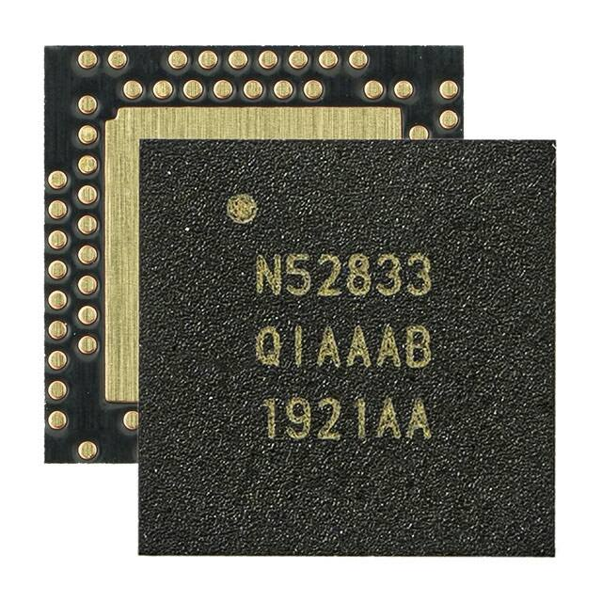
Pins on the nRF52833
Pins
73 individual pins
Plus a big ground pad
Some are used for special purposes
Power (16)
External Oscillator (2)
Debugging (2)
RF Antenna (1)
USB (2)
Not connected at all (8)
Remaining 42 pins can be used as General Purpose I/O (GPIO)
Digital I/O
Or connected to other peripherals

Slide 56
Accessing nRF52833 pins in software
Pins are collected into “Ports”
Each Port has 32 pins
42 total GPIO pins
Port 0 – pins 0-31
Port 1 – pins 0-9
Referred to as P[port].[pin]
For example: P0.20, P1.08, P0.00

Slide 57
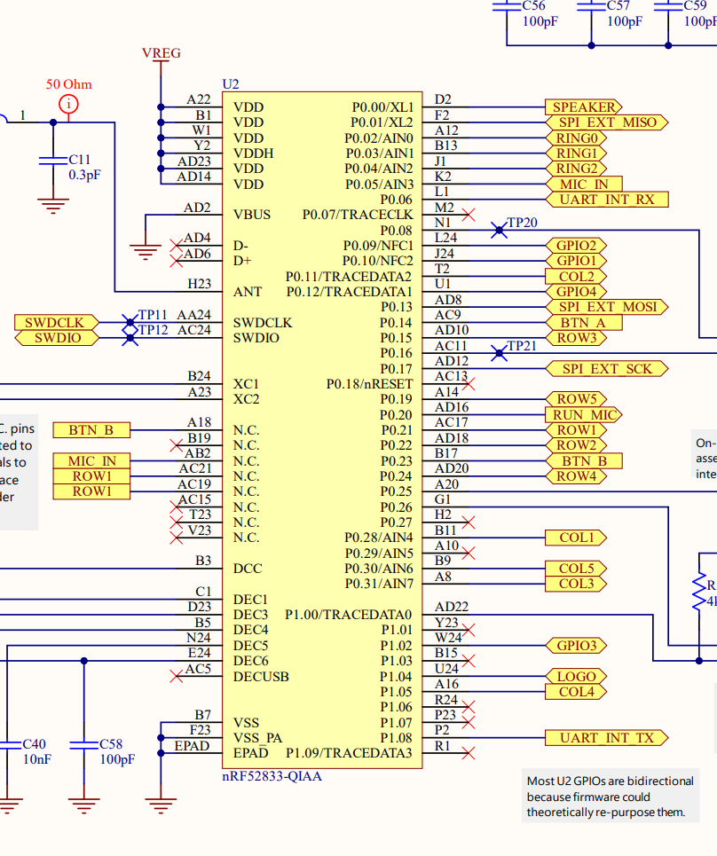
Pins on the Microbit
The Microbit uses the nRF52833, and then connects individual pins from the Microcontroller to certain parts of the board
Every board does this
The only way to know this connections is to look at the documentation
For example:
BTN_A connects to P0.14
BTN_B connects to P0.23

Slide 58
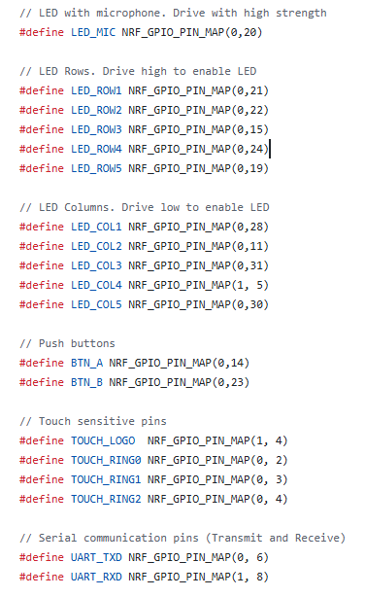
In our software library
Header file gives names to each pin based on how the Microbit uses it
https://github.com/nu-ce346/nu-microbit-base/blob/main/software/boards/microbit_v2/microbit_v2.h
You can use these names directly in your code where you need the pin number

Slide 59
To the datasheet!
nRF52833 Product Specification
Online: https://docs.nordicsemi.com/bundle/ps_nrf52833/page/keyfeatures_html5.html
PDF: https://docs-be.nordicsemi.com/bundle/ps_nrf52833/attach/nRF52833_PS_v1.7.pdf

Slide 60
Outline
Microcontrollers and Computers
Microcontroller Components
Processor
Memory
Peripherals
Pins & Other stuff
Microbit microcontroller
Microcontroller History

Slide 61
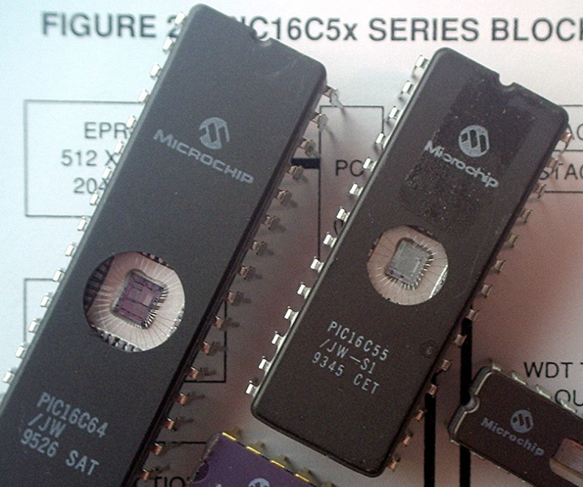
Older microcontrollers (90s-00s)
Focus: cheap, small computer systems
PIC
8, 16, and 24-bit MIPs architecture
PICAXE available with Basic interpreter
AVR
8-bit custom architecture (AVR architecture)
Used in Arduinos
AT Tiny 4: $0.30 per unit
4 I/O pins, 32 Bytes RAM, 512 Bytes ROM

Slide 62
More capable microcontrollers (00s-10s)
Focus: diversify into extreme low power and more capable systems
MSP430
16-bit custom architecture (MSP430 architecture)
Capable, but also extremely low power
<1 μA sleep current
STM32, Atmel SAM series (Cortex-M0, M3, M4, M4F)
32-bit ARM architecture (ARMv7)
Leverage success of ARM on smartphones
Every peripheral under the sun. Plus a variety of memory choices

Slide 63
Modern system-on-chips (10s-20s?)
Focus: increase memory and capability
Include radios in the same chip
nRF51 and nRF52 series
32-bit ARM microcontrollers (Cortex M)
Include 2.4 GHz radio: Bluetooth Low Energy and 802.15.4/Thread
Others have followed this same path
TI CC26XX
Apollo3
STM32WL

Slide 64
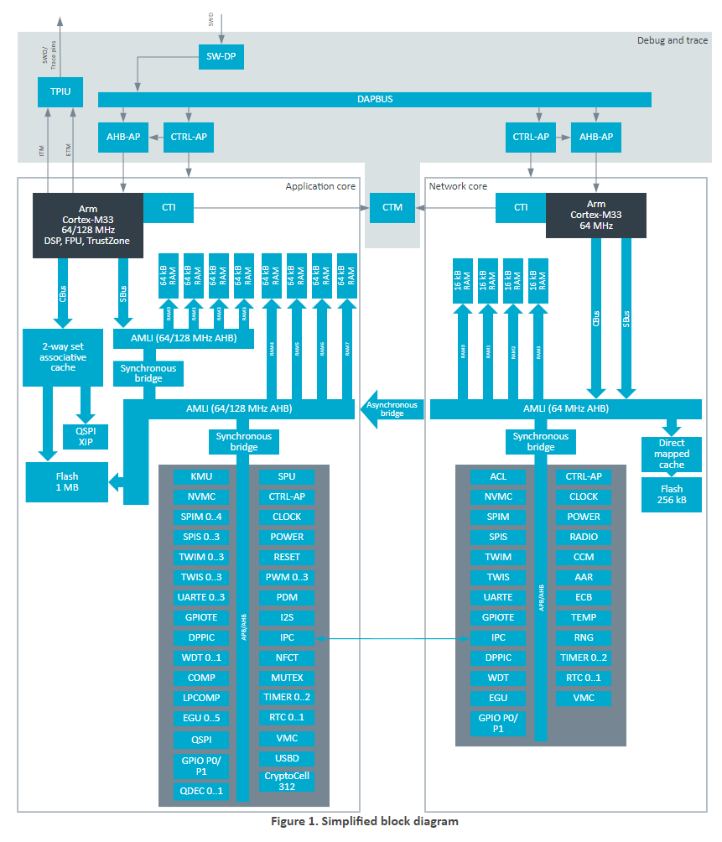
Future microcontrollers (20s and beyond)
Multi-core systems
Not for performance, but for separation of concerns
Run radio code on one core
Application code goes on the other core
Also allows BIG.little architecture
Higher performance core when interpreting data
Lower performance core for sampling sensors
nRF54 series really emphasizes this
Multiple BIG ARM processors and little RISC-V processors

Slide 65
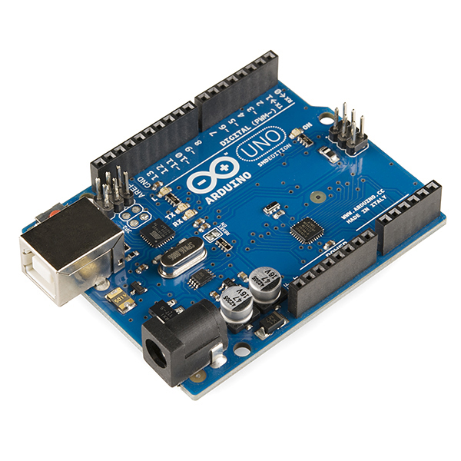
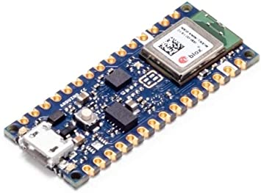
Popular components rarely die
Majority of popular older options still exist
Designers can trade off cost, capability, and efficiency alongside “modern features”
Upgrading for an existing product is unlikely
Large cost, little benefit
Example: Arduino still primarily uses AVR
Works just fine for its needs
Also releases new boards with nRF52s (Arduino Nano 33 BLE)

Slide 66
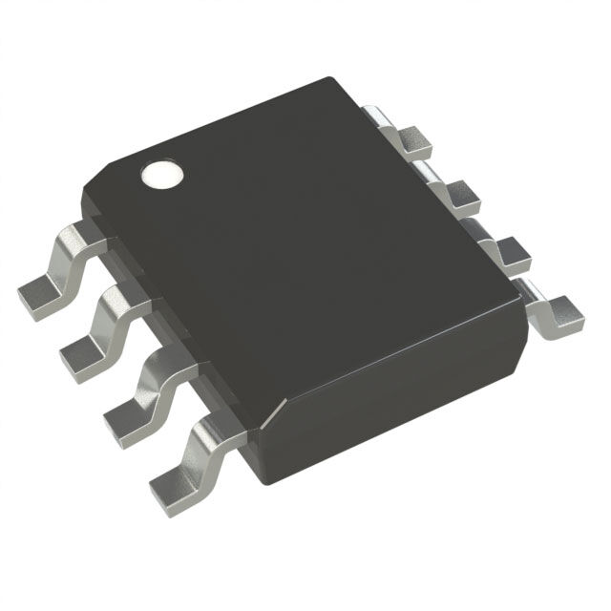
Fall 2025: cheapest microcontroller
PIC16F15213
16-bit custom architecture running at 32 MHz
256 KB of RAM
3.5 KB of Flash
8 pins (5 for I/O)
$0.38 per microcontroller
Still an “active” chip being manufactured
Can get significantly cheaper prices buying at scale

Slide 67
Outline
Microcontrollers and Computers
Microcontroller Components
Processor
Memory
Peripherals
Pins & Other stuff
Microbit microcontroller
Microcontroller History

