Slide 1
Lecture 05 Prototyping & Digital Circuits
CE346 – Microcontroller System Design
Branden Ghena – Fall 2025
Some slides borrowed from: Josiah Hester (Northwestern), Prabal Dutta (UC Berkeley)

Slide 2
Administrivia
Labs
See schedule of Lab hours available on Canvas for checkoffs
Due by end-of-day Thursday (but last office hours ends at 6pm)
Quiz
Today at end of class! (tell your friends who aren’t here yet)
Someone remind me at ~4:30 if I don’t stop

Slide 3
Today’s Goals
Understand the basics of digital circuitry
Enough to be able to interact with the Microbit
Inputs: Switches and Buttons
Ouptuts: LEDs
Discuss prototyping methods such as breadboarding
And where to find sensors
Introduce final project goals and requirements

Slide 4
Outline
Digital Circuits
Inputs
Outputs
Prototyping
Project Overview

Slide 5
Digital signals
Exist in two states:
High (a.k.a. Set, a.k.a. 1)
Low (a.k.a. Clear, a.k.a. 0)
Simpler to interact with
Constrained to two voltages
With quick transitions between the two
No math for voltage level
Either high or low

Slide 6
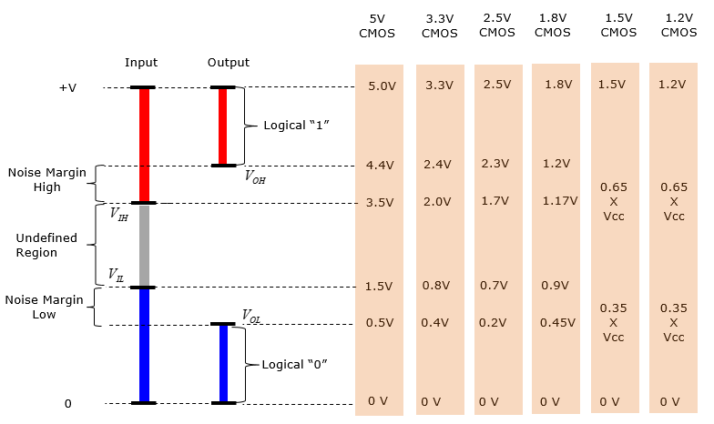
Digital signals map to voltage ranges
Upper range is high signal
~0.7*VDD
Bottom range is low signal
~0.3*VDD
Middle is undefined
Only exists during transitions
http://www.sharetechnote.com/html/Electronics_CMOS.html

Slide 7
Digital circuits
Connecting components together with digital signals
Mostly ICs
Also buttons/switches and LEDs
Way simpler than analog circuits
Mostly connecting boxes with wires
Plus a few resistors here and there
An abstraction
Not sufficient for fully understanding electronics behavior, but close

Slide 8
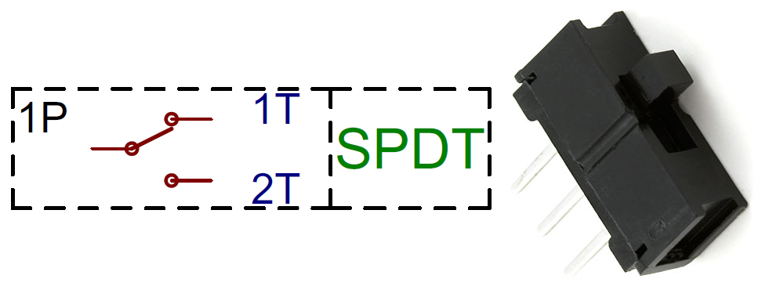
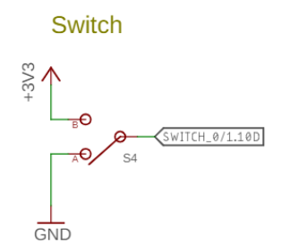
Switches
Single Pole, Double Throw switch
Middle pin (Pole) connects to one of two outer pins (Throws)
For controlling microcontrollers
Often connect outer pins to VCC and Ground respectively
Input then goes High or Low depending on switch state
https://learn.sparkfun.com/tutorials/button-and-switch-basics/

Slide 9
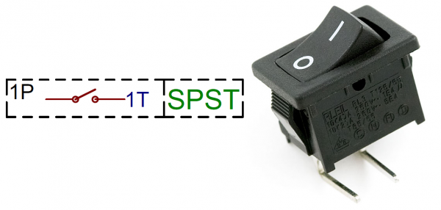
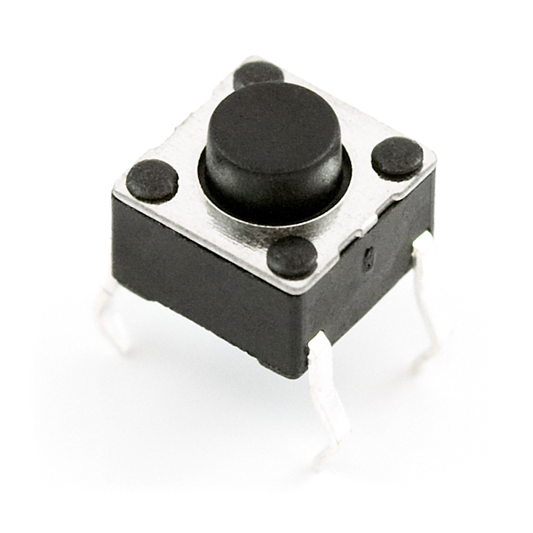
Buttons
Single Pole, Single Throw switch
Pole pin either connects to Throw pin or is disconnected
Come in normally-closed (connected) and normally-open (disconnected)

Slide 10
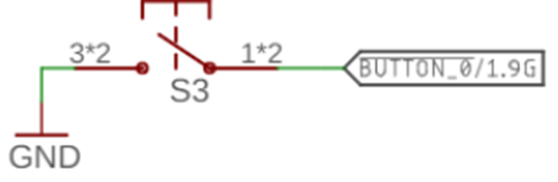
Disconnected circuits
When button is pushed, input signal is low
What is the value of the input when the button is unpressed?

Slide 11
Disconnected circuits
When button is pushed, input signal is low
What is the value of the input when the button is unpressed?
Floating! Could be any voltage
Solution: need to connect weakly to either high or low voltage

Slide 12
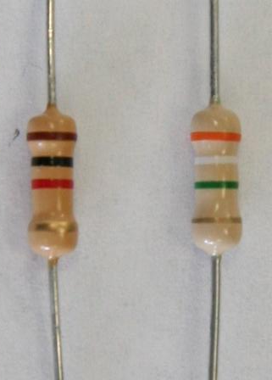
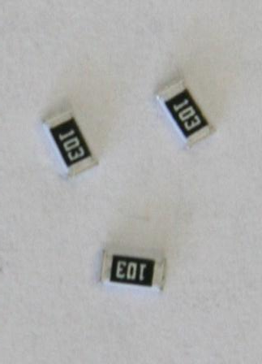
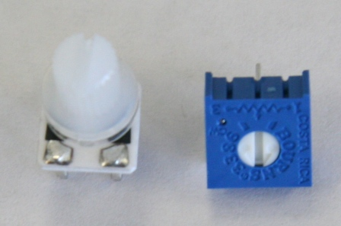

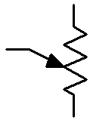
Resistors
Carbon Film Resistors
Surface Mount Resistors
Variable Resistors
(potentiometer)
4 Bands
Resistors are not directional
Either orientation is fine and works identically

Slide 13
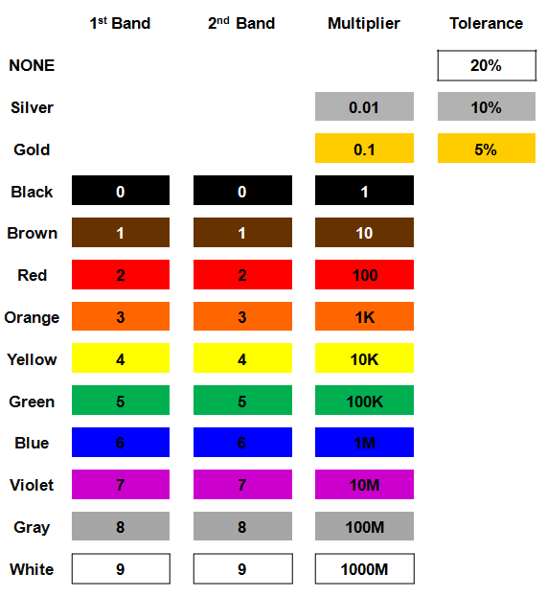
Resistor color codes
Colored bands on resistors label the resistance value of the part
First and second bands are the digits
Third band is multiplier
Fourth band is tolerance
Usually gold: +/- 5%

Slide 14
Break + Determine the resistor

Slide 15
Break + Determine the resistor
56 x 10 Ω = 560 Ω (±5%)

Slide 16
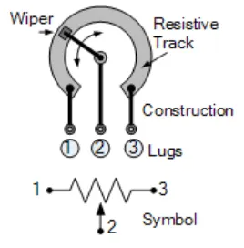
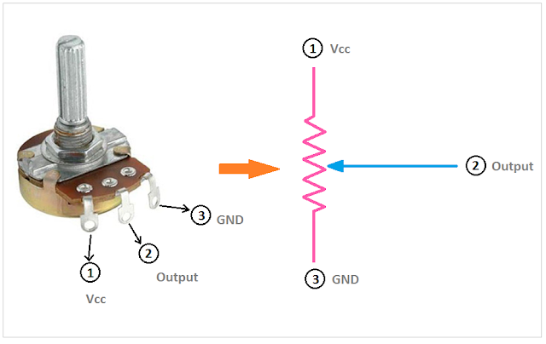
Potentiometers
Vary resistance between zero and some maximum
1 kΩ, 10 kΩ, 100 kΩ common
Connect middle and an edge for just a changeable resistor
Middle terminal is a movable resistor divider
Knob changes middle output if outer pins are VCC and Ground

Slide 17
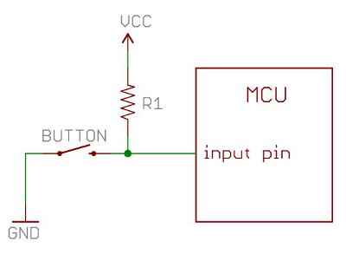
Current flows through the “path of least resistance”
Simplification
Works well for the types of circuits we use
Pull-up resistor
When button is open (disconnected), the only path is through the resistor
When button is closed (connected) the least resistance path is through the button to Ground

Slide 18
Pull-up resistors and pull-down resistors
Resistor sets the “default” value of a wire
Pull-up connects to VCC
Pull-down connects to Ground
Usually 10-100 kΩ
When button is open (disconnected)
Connection through the resistor sets signal
When button is closed (connected)
Signal is directly connected to a voltage source
Much lower resistance means that signal dominates

Slide 19
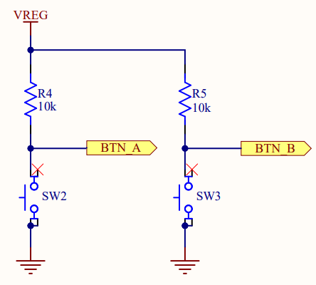
Buttons on the Microbit
Signal going to the Microcontroller
Normally open buttons
Disconnected by default
Active low signal
Activating (pushing) button creates a low signal
Pull-up resistors
Set button signal high by default

Slide 20
Outline
Digital Circuits
Inputs
Outputs
Prototyping
Project Overview

Slide 21
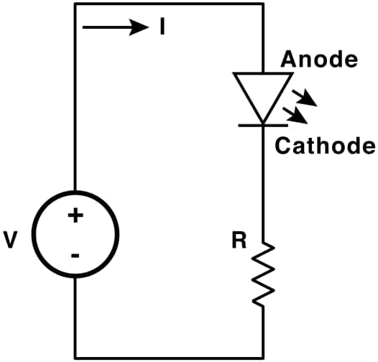
LEDs
Light Emitting Diodes
Generate light as current passes through them
Various colors available
Diodes
Only allow current to go through one way
Not particularly relevant for LEDs
Treat as a digital component
Connect anode to high voltage and cathode to ground
Plus a resistor to limit the total amount of current
https://learn.sparkfun.com/tutorials/light-emitting-diodes-leds

Slide 22
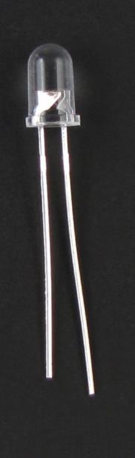
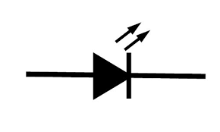
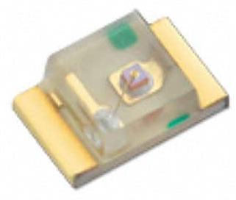
LEDs
Directional component: only allows current to flow one way
Shorter side is the negative one
i.e. where current flows to
Larger metal component
inside of case or case flat spot is cathode or
negative (-) lead
Negative ( - ) lead
Schematic Symbol
Shorter wire is cathode or
negative (-) lead
Surface-mount LED

Slide 23
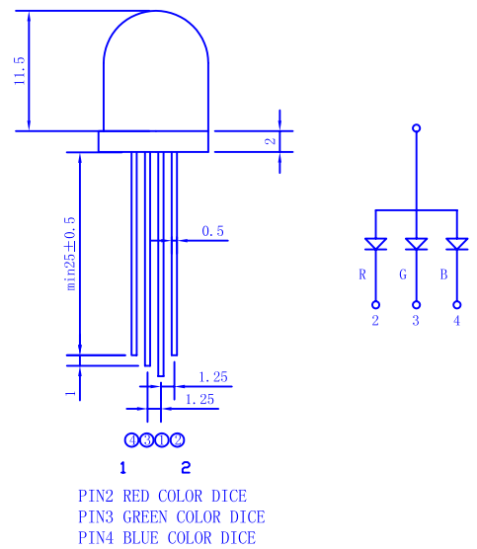
RGB LED
Three different colors of LED in a single large diffuser
Short leads are negative ends
One for each color
Long lead is common power
Common anode
Combinations of LEDs give other colors
Cyan, Yellow, Violet, White
https://cdn-shop.adafruit.com/datasheets/FLR-100WAS-RGB.pdf

Slide 24
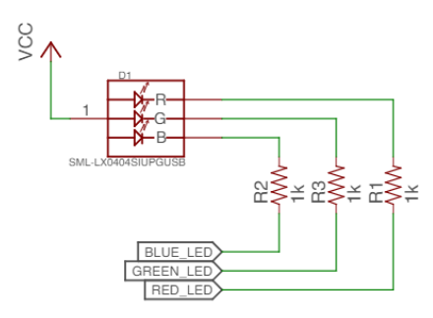
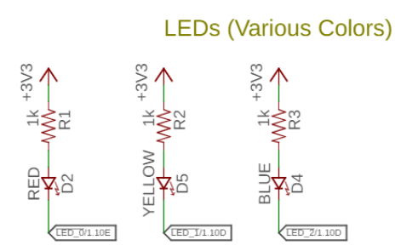
Active state for LEDs
LEDs can be active high or active low depending on configuration
Active high is how people assume they work
Active low is often used instead
GPIO pins can usually sink more current than they can source

Slide 25
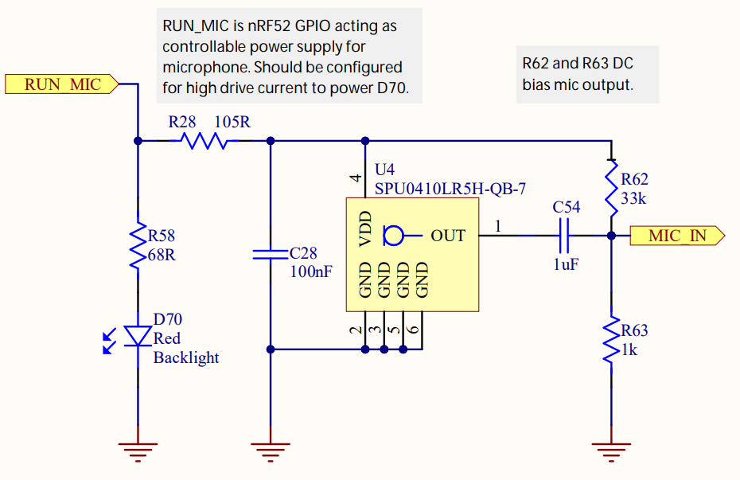
LEDs on the Microbit
Microphone LED
Active high
Simple to use, just set the GPIO high to enable it
Ignore this other part for now

Slide 26
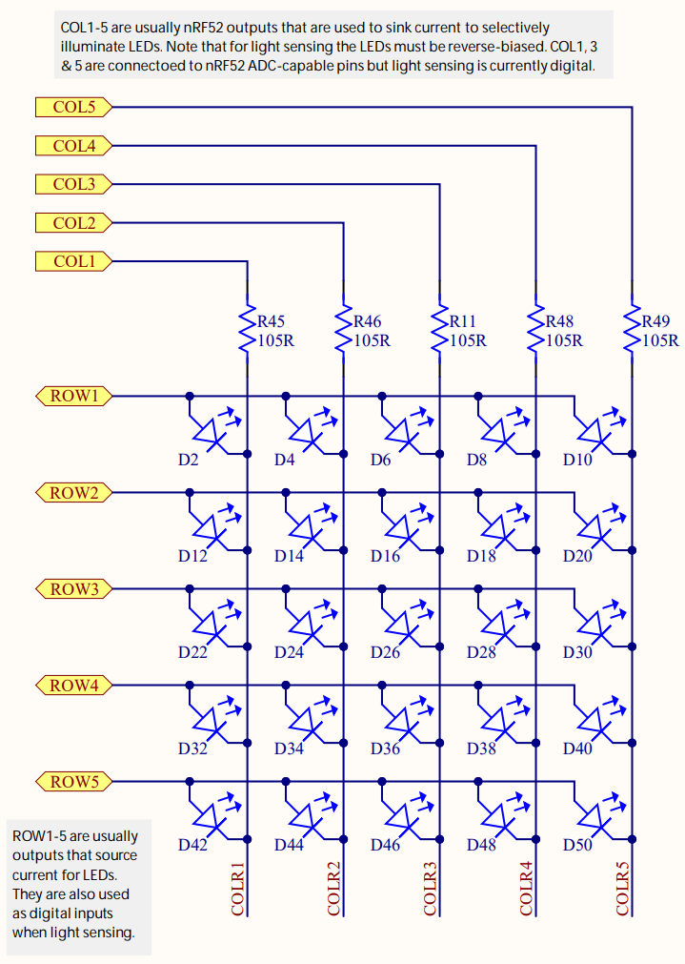
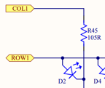
LEDs on the Microbit
Use two GPIO pins to control each LED
Row high as VDD
Column low as Ground
Connections on circuit schematics only exist where there are dots

Slide 27
Controlling the LED matrix
Cannot individually control all LEDs simultaneously
Need to light one row at a time
Iterate rows quickly to make them appear on all the time
We’ll have a lab on these later
Combines GPIO and timers

Slide 28
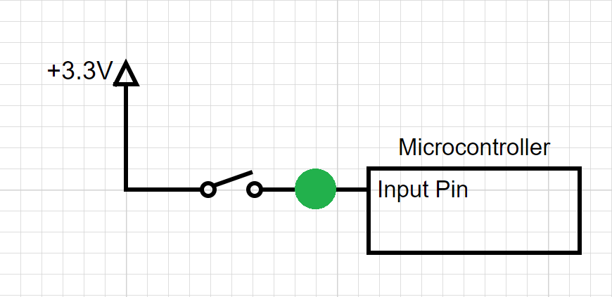
Break + Question
Should the spot in green have?
Pull-up Resistor
Pull-down Resistor
Either
Neither

Slide 29
Break + Question
Should the spot in green have?
Pull-up Resistor
Pull-down Resistor (needs to pull input low by default)
Either
Neither

Slide 30
Outline
Digital Circuits
Inputs
Outputs
Prototyping
Project Overview

Slide 31
Prototyping goals
Does this thing work at all?
Particular IC
Circuit layout
Software design
etc.
Sometimes before doing something more serious with it
Design a PCB, Make a product, etc.
Not uncommon that the prototype is as far as you’ll get

Slide 32
Isolating tests
The goal when prototyping is to isolate the question at hand
Do consider
New sensor/IC/component/whatever
Do not consider
Power
Interference
Enclosure
Stable microcontroller
Soldering skills

Slide 33
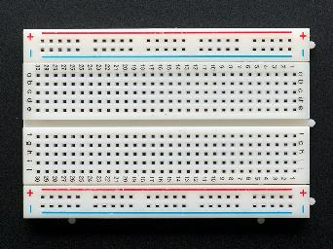
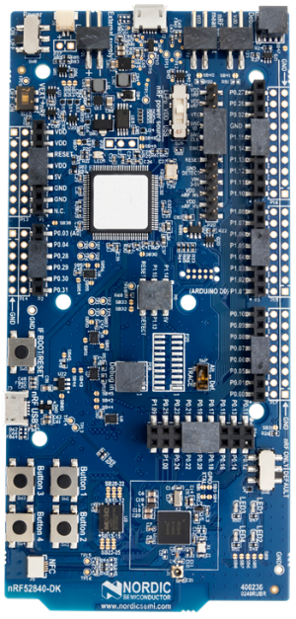
Prototyping methods
Breadboarding
Plug and connect components as needed
Build up arbitrarily complex designs from nothing
Development kits
Pre-fabricated systems design for testing components
Small-scale test PCBs
Design a PCB that demonstrates the thing you’re interested in
Making a PCB is less hard than some might think (Eagle, Fritzing, etc.)
$20-30 for small, low-speed PCBs from batch services like OSHPark

Slide 34
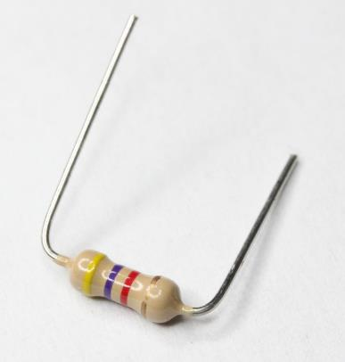
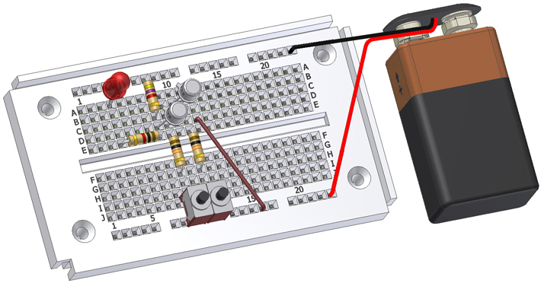
Breadboards for prototyping
Reusable platform for temporary circuits
Plug in jumper wires and through-hold components

Slide 35
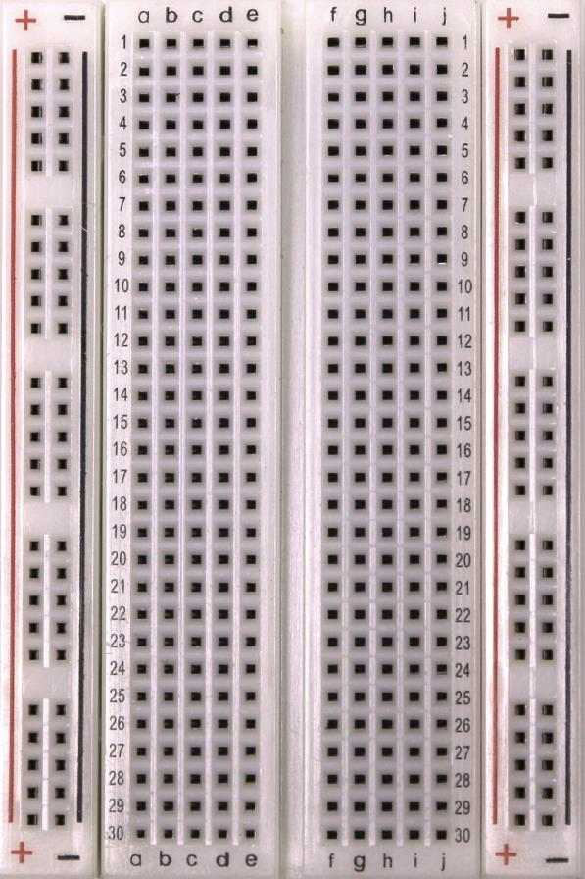
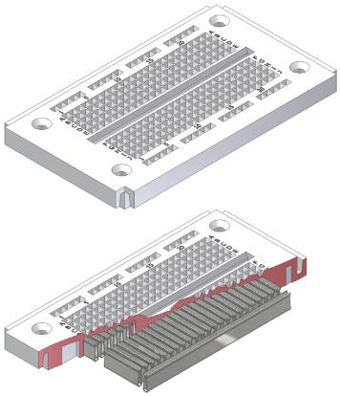
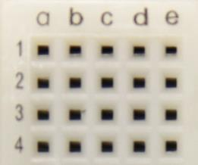
How a breadboard works
Component leads and wires are inserted into holes in the breadboard
Half-rows of five holes are connected
Vertical columns are connected for power/ground
Holes to
insert wires

Slide 36
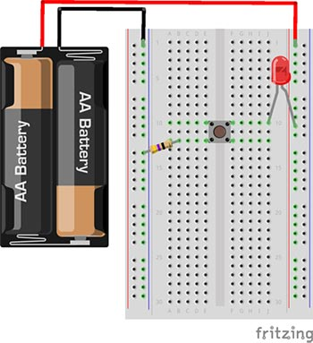
Breadboard LED example
Uses button to control LED

Slide 37
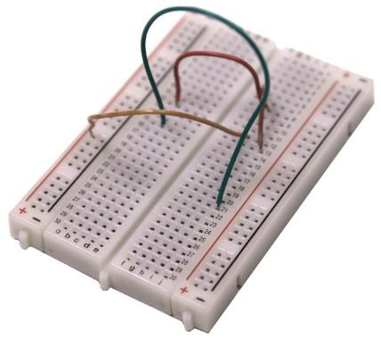
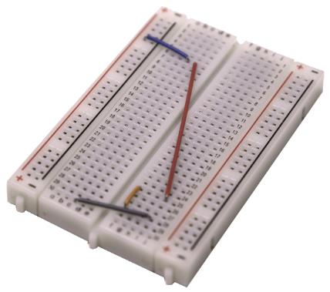
Breadboard guidelines
Long wires in large bird nests makes debugging very difficult
Shorter, constrained wires are easier to understand
In this class, we’ll only have large jumper wires though…
Use the minimum jumpers necessary, mostly use breadboard for connections
Bad
Better

Slide 38
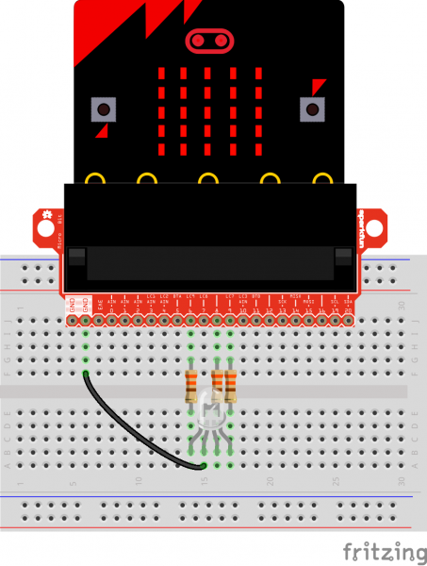

Microbit breakout
Connects Microbit pins to breadboard
Need to consult table to know which pins
https://tech.microbit.org/hardware/schematic/
Always connect LED matrix side up
https://www.sparkfun.com/products/13989
https://learn.sparkfun.com/tutorials/microbit-breakout-board-hookup-guide

Slide 39
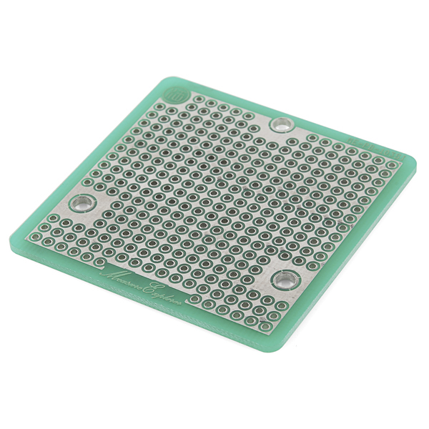
More permanent breadboards
Breadboards are also known as “Solderless Breadboards”
Protoboard allows configurable circuits
Solder jumper wires between locations
Solder adjacent pads to form connection
Usually not worth it (just make a PCB)
Does solve core problem of breadboards: things getting unintentionally unplugged
Might be useful for some projects!

Slide 40
When to not use breadboards
Breadboards work great for digital circuits and simple analog!
High voltage/current are bad for breadboards
Honestly, anything above 12 volts DC shouldn’t be in a breadboard
Also avoid high-power applications above a few Watts
Never put AC in a breadboard!
Sensitive analog circuits
Particularly anything sensitive to capacitance may not work right
Sets of metal holes with strips connecting them function as capacitors
Anything in long term use

Slide 41
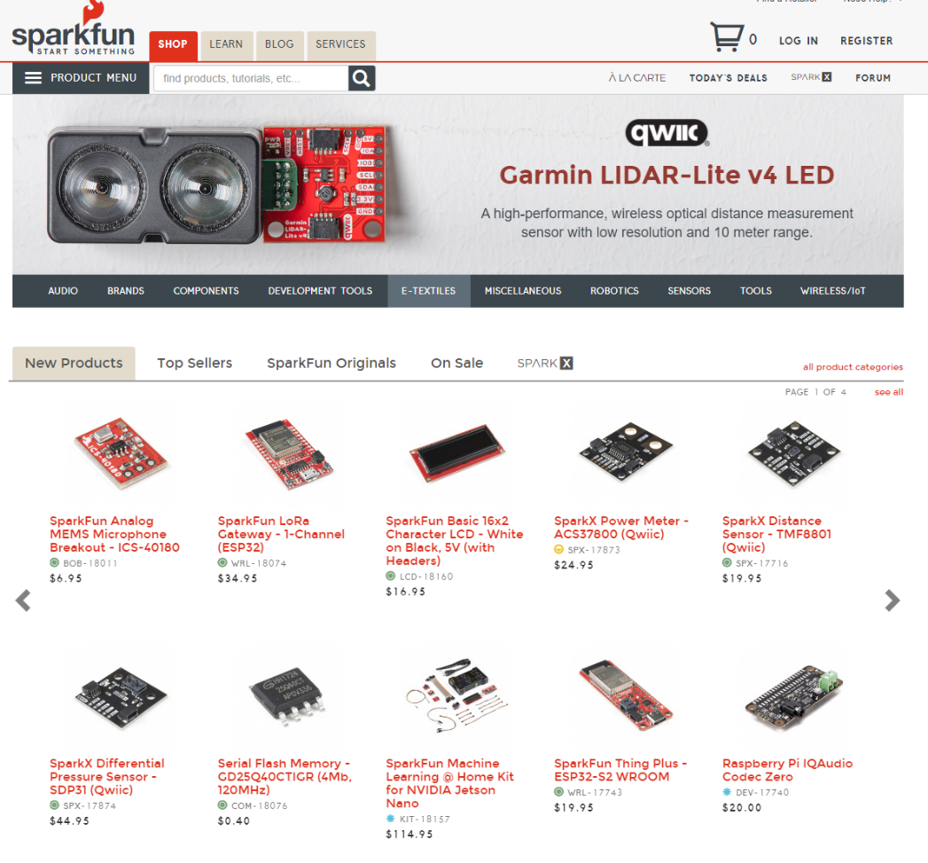
Buying Parts
Prototyping vendors
Where you look for cool stuff to buy
Sparkfun
Adafruit
NOT Amazon for prototyping parts if possible
Electronics vendors
Where you buy raw parts when you know what you need
Digikey
Mouser

Slide 42
QWIIC sensors
https://www.sparkfun.com/qwiic
Adafruit has compatible parts it calls “STEMMA” https://www.adafruit.com/category/620
Sensors have a standard, wired interface
Power, Ground, I2C (wired communication protocol)
Removes electrical/wiring issues
Transforms into a software issue of what the correct commands to send to the device are
Our usual plan: use an existing driver to guide creation of our own

Slide 43
Outline
Digital Circuits
Inputs
Outputs
Prototyping
Project Overview

Slide 44
Project Proposals
It is time to start forming teams and working on Proposals
Due next week Friday! (10/10)
Project and proposal details will be posted to Piazza tomorrow
1-2 pages, with some specific items you MUST include
Project teams are 2-3 students (4 under rare occasions)
You may NOT work alone
There is a partnership survey if you want us to match you with someone
Due by end-of-day Sunday

Slide 45
What are the rules for a final project?
Minimum: anything with at least two inputs and one output
Where none of those three were developed for lab
Rule of thumb, not a precise limit
Goals:
Pick something interesting to you
Applies course knowledge to creating the project
Often also includes some knowledge beyond this class
Takes some serious effort to complete and is a well-polished demo
40% of your course grade is from the project
Proportional expectations to size of group

Slide 46
Specific rules
2-3 group members
Or 4 if you come talk to me first and it’s justified for a big project
Uses the Microbit and C code
Although it could use additional systems if needed
Banned projects:
Plant Monitoring/Care
Home Security System

Slide 47
Judging projects
Two key metrics: difficulty and quality
Grade is a combination of the two
Essentially we’re considering:
All the work that went into the parts of the project
Making all the parts work together as a cohesive demo
Either extreme can still be a good project:
A project that’s really hard to get working, and the demo is kinda jank
A project that’s simple to get working, and the demo is fantastic

Slide 48
Project collaboration
Challenge: working on hardware/software projects as a team
Make sure you communicate with each other about plans and expectations
Proposal will ask you to put some small consideration in how best to do this
Remember that things can be different difficulties and help each other

Slide 49
Navigating proposals
Find some people to work with
Brainstorm ideas that might be interesting to all of you
Do just a little bit of googling to figure out if that seems like a plausible project
Write up the proposal
Looking for like 70% baked ideas
I’ll give you feedback if I think the project would be a bad fit (too easy OR too hard)

Slide 50
Outline
Digital Circuits
Inputs
Outputs
Prototyping
Project Overview

