Slide 1
Lecture 16: Embedded OS
CE346 – Microcontroller System Design
Branden Ghena – Fall 2025

Slide 2
Administrivia
See you all tomorrow for project check-ins
Last quiz this coming Tuesday
I promise to grade Quiz 3 this weekend. Sorry about the delay

Slide 3
Today’s Goals
Introduce embedded OS concerns and how they are different from general-purpose computing, particularly in security.
Describe Tock Operating System goals and design
Introduce Rust programming language
Explore example OS device driver stackup from Tock
Sidebar: I promise not to quiz you on specific Tock details
Although I might ask you about embedded OS in general

Slide 4

General Tock resources
https://github.com/tock/tock
https://www.tockos.org/
“Multiprogramming a 64 kB Computer Safely and Efficiently” Levy et al. 2017. Symposium on Operating Systems Principles. https://brandenghena.com/projects/tock/levy17multiprogramming.pdf
"Tock: From Research to Securing 10 Million Computers“ Schuermann et al. 2025. Symposium on Operating System Principles. https://brandenghena.com/projects/tock/2025-sosp-tock-decade.pdf

Slide 5
Outline
Embedded Operating Systems
Embedded Security Challenges
Tock Overview
Rust Programming
Tock Driver Design

Slide 6
What is an operating system?
User processes
Spotify
Powerpoint
Steam
Chrome
QEMU
Physical computer
Hardware

Slide 7
What is an operating system?
User processes
Spotify
Powerpoint
Steam
Chrome
QEMU
Operating System
Physical computer
Hardware

Slide 8
What is an operating system?
User processes
Spotify
Powerpoint
Steam
Chrome
QEMU
File System
Virtual Memory
Process Manager
Network
Operating System
Device Drivers
Interrupt Handlers
Boot and Init
Physical computer
Hardware

Slide 9
What is an operating system?
User processes
Spotify
Powerpoint
Steam
Chrome
QEMU
Application Interface
File System
Virtual Memory
Process Manager
Network
Operating System
Device Drivers
Interrupt Handlers
Boot and Init
Hardware Abstraction Layer
Physical computer
Hardware

Slide 10
Operating systems goals
OSes make advancing technology available to rapidly evolving applications. They do so with two major goals:
Provide abstractions to applications to enable hardware compatibility
Why: allow reuse of common features, avoid low-level details
Challenges: What are the correct abstractions?
Manage sharing of resources across many applications
Why: protect applications, enforce fair access
Challenges: What are the mechanisms and what are the policies?
Good operating systems do these quickly, efficiently, and securely

Slide 11
How does this differ from what we’ve been doing?
Often our application and driver logic were coordinated and in some cased co-mingled
We didn’t consider “sharing” of resources between multiple stakeholders
We did abstract away interfaces to hardware
But we didn’t consider how to do so in a way that allowed hardware to be interchangeable

Slide 12
Userspace versus kernel distinction
Kernel has full control over the system
Manages resources
Userspace has partial control (whatever the kernel allows it)
Uses resources granted to achieve some goal
When userspace wants access to something, it needs to request it from the kernel
Uses “system calls” to do so
Trigger a software interrupt, with some values to describe what it wants
Kernel takes action (or denies action) and returns back to application

Slide 13
Linux system calls
Example system calls
https://man7.org/linux/man-pages/man2/syscalls.2.html
Number | Name | Description
0 | read | Read file
1 | write | Write file
2 | open | Open file
3 | close | Close file
4 | stat | Get info about file
57 | fork | Create process
59 | execve | Execute a program
60 | _exit | Terminate process
62 | kill | Send signal to process

Slide 14
Embedded needs its own operating systems
Can’t use normal Linux!
Too little memory and processing in embedded hardware
Too much concern about power in embedded applications
Microcontrollers don’t have the necessary hardware features (virtual memory)
Important: Linux is never going to be the solution
Capabilities of general computers are orders of magnitude better
Embedded systems are gaining more capabilities
But new lower-power, lower-cost systems keep emerging too

Slide 15
Linux is useful for many edge devices though
Raspberry Pi is a great example
If your device is powerful enough to run Linux, maybe that’s a good idea!
Essentially gives you a normal computer platform to run stuff on
Easier to do big things: Webcam -> Python -> OpenCV
But there will always be smaller, cheaper, less capable devices where Linux doesn’t make sense
Or even bigger, capable systems that need to be precisely controlled

Slide 16


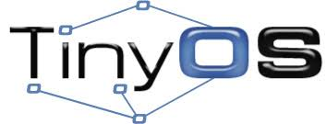

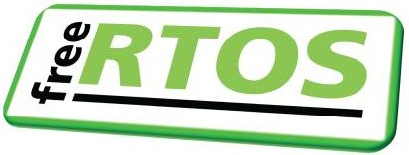
A variety of embedded OSes exist with different designs
TinyOS (2000-2012-ish) was designed to support extremely low-capability devices with 2 KB of RAM total
FreeRTOS (2003-today) was designed to real-time tasks with a very small kernel, around 8 source files

Slide 17
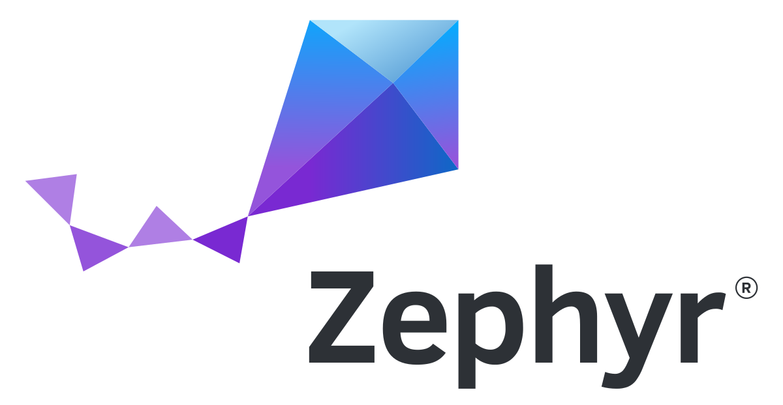
Zephyr (2016-today)
Linux Foundation embedded OS project
Developed in C
Lots of industry buy-in
Features (in their words)
Extensive suite of kernel services
Multi-threading, memory allocation, IPC, power management, etc.
Multiple scheduler choices
Highly configurable and modular
Cross architecture

Slide 18
Outline
Embedded Operating Systems
Embedded Security Challenges
Tock Overview
Rust Programming
Tock Driver Design

Slide 19
Two needs not met by traditional embedded OSes
Security
Protect the core platform from applications
Multiprogramming
Run multiple, unrelated applications (securely)

Slide 20
Challenge for secure embedded: no virtual memory
No hardware support for virtual memory
So all addresses on the system are real physical addresses
Nothing prevents applications from
Manipulating kernel data structures
Directly accessing hardware
All applications on the system must be trusted
Devices do have one single purpose
But any weak link leaves the whole system broken

Slide 21
Embedded devices are a weak link
Custom, application-specific code written in C
Limited code-reuse
Low testing coverage
All code on the system is trusted
No isolation: any code can directly access hardware registers
Little distinction between “kernel” and “application”

Slide 22
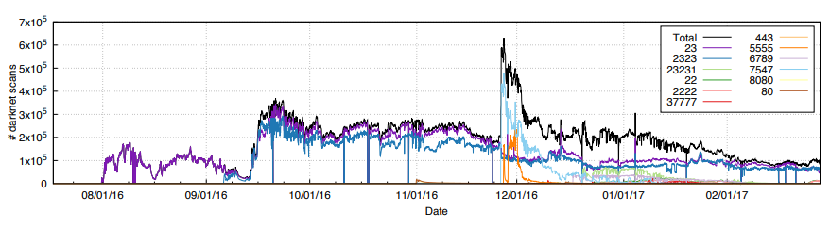
Reminder: Mirai botnet (2016)
Takes control of up to 600,000 insecure connected devices
IP-attached cameras, DVRs, routers, printers

Slide 23
Weak devices provide network entry points
IoT devices can be used as a network entry point
Step one: hack the device
Step two: use the device to access information on the private network
Example: casino high-rollers database obtained through an IoT fish tank thermostat
https://interestingengineering.com/a-casinos-database-was-hacked-through-a-smart-fish-tank-thermometer
See also: Mirai botnet

Slide 24
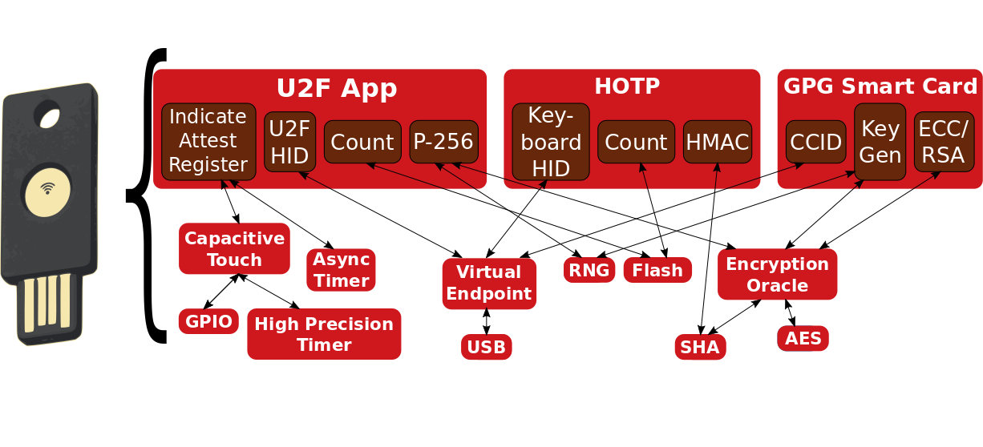
Modern systems increasingly need support for multiprogramming
Example: USB authentication key
Universal Second Factor (U2F)
HMAC One-time Password (HOTP)
GPG Key (GNU Privacy Guard)

Slide 25
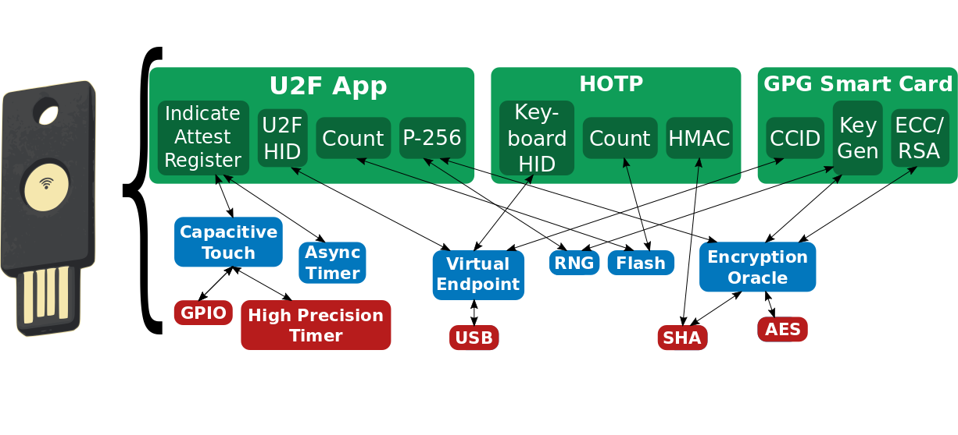
Security layering is desirable
Different domains with different expectations
Applications, services, and platform

Slide 26
Platform layer
Core kernel plus microcontroller-specific code
~10 developers
Trusted compute base
Goal: possible to correctly and safely extend

Slide 27
Services layer
Device drivers, networking, libraries
~100 developers
Auditable, but possibly still buggy
Goal: protect kernel from safety violations

Slide 28
Applications layer
End-user functionality
~1000 developers
Third-party applications, potentially malicious
Goal: end-users can install 3rd-party apps

Slide 29
Break + Question
What are challenges for updating IoT device firmware?

Slide 30
Break + Question
What are challenges for updating IoT device firmware?
Manufacturer needs to create update (still exist AND care)
Software is usually closed source, so others can’t update it
Update needs to get to the device
Either the device needs an internet connection to check
Or consumer needs to be aware of update and have a mechanism to upload it

Slide 31
Outline
Embedded Operating Systems
Embedded Security Challenges
Tock Overview
Rust Programming
Tock Driver Design

Slide 32
Tock
Embedded OS designed for secure multiprogramming
Kernel written in Rust programming language
Applications written in any language
Runs on multiple hardware platforms
Open-source research project
2015 collaboration between Stanford, UC Berkeley, and Michigan
Since expanded to 6-7 universities (Princeton, UCSD, Northwestern)
Plus several companies (Google, Microsoft, Western Digital)
https://github.com/tock/tock
https://tockos.org/

Slide 33
Tock Features
A preemptive embedded OS (runs on microcontrollers)
ARM Cortex-M and RISC-V supported now
Has separate kernel and user space
Most embedded OS have the one piece software philosophy
Runs untrusted apps in user space
Uses memory protection on applications (hardware support required)
Kernel (and drivers) written in Rust
Apps written in C/C++ or Rust (any language is possible)

Slide 34

Tock software organization
C App Ported to Tock
App written in Rust
[Service] BLE Environmental Sensing Profile
while(1)
😈
Untrusted
(isolated by the MPU and preemptively scheduled)
Syscall Interface
libtock
libtock-rs
libtock
libnrf
Kernel (Rust)
System Calls
Thread
Virt. Timer
BLE
Temp. Sensor
Untrusted
(unsafe forbidden)
Capsules
6LoWPAN
SD Card
Console
SI7021
Core Kernel
Scheduler, Process management, etc.
Standardized Hardware Interface Layer (HIL)
Trusted
(unsafe allowed for MMIO, PIC, etc.)
Microcontroller-specific Peripheral Drivers
SPI
RNG
Timer
ADC
GPIO
I2C
UART
AES
DAC
USB
Hardware
CPU
SPI
RNG
Timer
ADC
GPIO
I2C
UART
AES
DAC
USB

Slide 35
Tock’s isolation mechanisms
Totally untrusted
Trusted for liveness, not safety
Processes
Standalone executable in any language
C, C++, Rust, Lua
Isolation enforced at runtime
Higher overhead
Applications
Capsules
Rust code linked into kernel
Isolation enforced at compile-time
Lower overhead
Used for device drivers, protocols, timers...

Slide 36
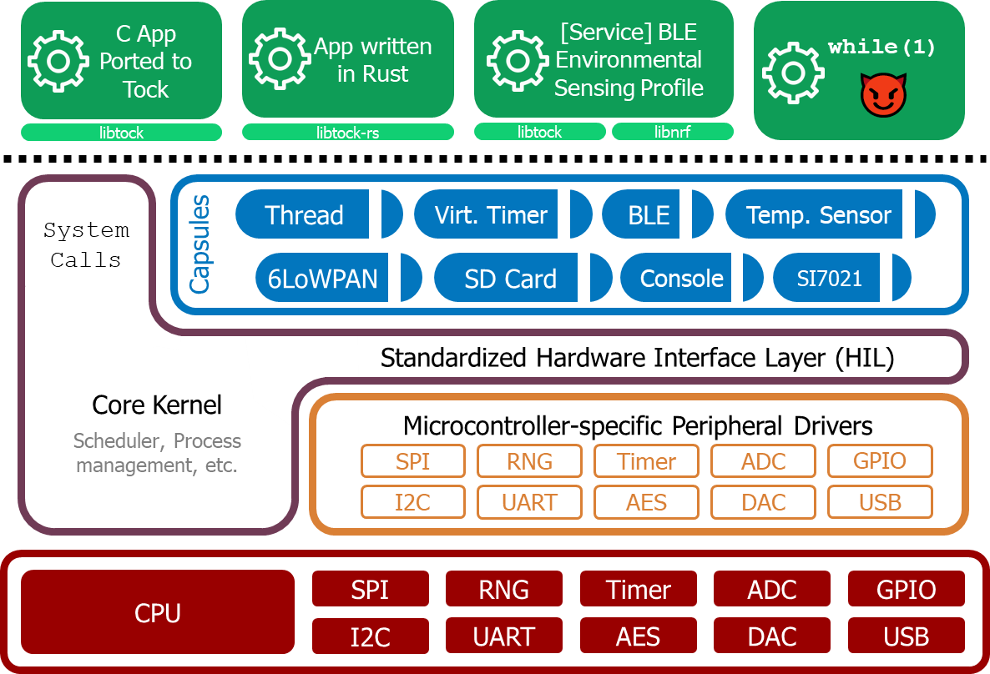
What does the Tock core kernel include?
Managing Processes
Loading, stopping
Scheduling
Determining which process is running at which time
Handling hardware events
Memory Management
Mostly giving chunks to processes
Also memory protections
Syscalls
Connecting processes to device drivers

Slide 37
Device drivers
Much larger percentage of the code in Tock
Split into groups
Capsules are microcontroller-agnostic (above the core kernel)
Syscall drivers connect syscalls to specific devices
Control for generic systems: GPIO, LED, Timers, etc.
External devices: connected over buses
I2C: Temperature, Pressure, Humidity, Light, IMU
SPI: Screen, Memory
Chip drivers are microcontroller-specific (below the core kernel)
Implement various peripherals within those microcontrollers

Slide 38
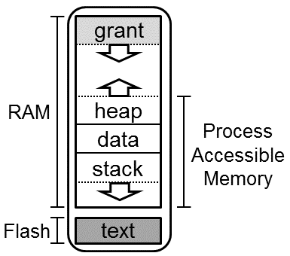
Userspace applications
Written and compiled entirely separately from the kernel
Load the kernel into flash
Individually write each application to flash as as well
Written in any language
C is the major one, Rust also big
C++ and Lua exist
System calls to the kernel to make device requests

Slide 39
How do applications access devices?
System calls are used to access devices
All device interactions are non-blocking (start now, finish later)
Three generic syscalls
Command – takes a 32-bit numerical argument
Allow – takes a pointer to a buffer to read/write
Subscribe – takes a pointer to a function to callback
First two arguments to all syscalls
Driver number (the driver it wants to interact with)
Minor number (driver-specific identifier)

Slide 40
Example: console capsule (driver number: 1)
Command syscall values
Transmit from buffer, argument is length
Receive into buffer, argument is length
Cancel request
Allow syscall values
Pointer to buffer for sending
Pointer to buffer for receiving
Subscribe syscall values
Send complete handler
Receive complete handler
Writing bytes to console:
uint8_t buffer[20] = {…data…}
Allow(1, 1, buffer)
Command(1, 1, 20)

Slide 41
Event-driven programming
Tock adopts an event-driven model to avoid concurrency issues
Single core system, so the source of concurrency is interrupts
Exposed to applications through “subscribe” callbacks
Callbacks never occur during normal operation
Even if application is descheduled due to timeslice
Additional syscall: yield – no arguments
Application pauses until a callback is ready for it
Once one or more events are ready
Call the callback handlers, one at a time
Return from yield statement

Slide 42
Yield example
void sensor_callback (int value) { printf("Got sensor reading %i\n", value); }
int main () { sensor_register(sensor_callback); // calls allow sensor_sample(); // calls command yield(); }

Slide 43
Real Tock applications
Practically, these syscalls are wrapped in library code rather than exposed raw like that
Except for yielding
Libtock-C design (C userspace)
Libtock – async libraries
Libtocksync – sync libraries (built using async libraries)

Slide 44
Example Tock application
https://github.com/tock/libtock-c/blob/master/examples/tests/microbit_v2/main.c

Slide 45
Outline
Embedded Operating Systems
Embedded Security Challenges
Tock Overview
Rust Programming
Tock Driver Design

Slide 46
Tock threat model
Kernel security
Secrets may not be accessed by applications or capsules.
Applications and capsules may not modify kernel data except through exposed APIs.
In normal operating systems, drivers are run in kernel mode
Full access to memory and hardware on the system
So how do we do better than that without moving drivers into userspace applications

Slide 47

Tock solution: use language features
Tock uses the Rust programming language for the kernel
Systems language
Represents how hardware actually interacts
Strong type system and memory safety
Runtime behavior similar to C
Result: capsules cannot access memory they do not own
Cannot access application secrets
Cannot modify other kernel structures (even by accident)

Slide 48
Basic Rust syntax
let a: i32 = 1;
Creates a variable a which is a 32-bit signed integer. Sets value to 1
let mut b: u8 = 0;
Creates a variable b which is an 8-bit unsigned integer. Sets value to 0
Mutable variables can be modifed later in code
fn add2(x: f64, y: f64) -> f64 {
// implicit return (no semicolon)
x + y
}
Function that takes two double arguments and returns a double

Slide 49
Rust Structs and Impl
// Define a struct named 'Point' with fields 'x' and 'y'
struct Point {
x: f64,
y: f64,
}
// Implementation block for the 'Point' struct
impl Point {
// Define a method that calculates the distance between two points
fn distance_to(&self, other: &Point) -> f64 {
// Calculate the distance using the Euclidean distance formula
((self.x - other.x).powi(2) + (self.y - other.y).powi(2)).sqrt()
}
}
let distance = point1.distance_to(&point2);
Later in code:

Slide 50
What problems is Rust trying to solve?
Memory lifetime
Use-after-free
Common example: pass a reference into a function, then free it
Data races
Multiple access to data and at least one modifies it
Problems we were solving with locks
Generally: have the compiler handle for you whatever it can

Slide 51
Rust has a strong notion of “ownership”
Ownership is a notion of managing memory and sharing.
Rust ownership rules
Each value has a variable that’s called its owner.
There can only be one owner at a time.
When the owner goes out of scope, the value is dropped.
Last one is straightforward:
Values on the stack go away at the end of the function (or any block { })
This lifetime works just like C or C++

Slide 52
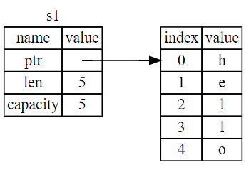
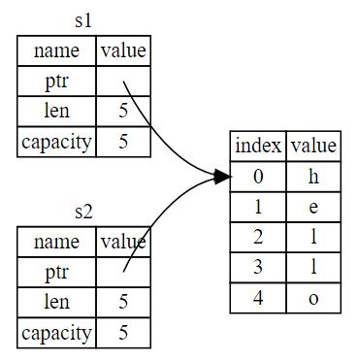
Example: ownership with strings
Rust ownership rules
Each value has a variable that’s called its owner.
There can only be one owner at a time.
let s1 = String::from("hello");
let s1 = String::from("hello"); let s2 = s1;

Slide 53
Ownership is transferred through function calls
fn main() { let s = String::from("hello"); // s comes into scope takes_ownership(s); // s's value moves into the function... // s is no longer valid here } // Here, s goes out of scope. But because s's value // was moved, nothing special happens.
fn takes_ownership(some_string: String) { // some_string comes into scope println!("{}", some_string); } // Here, some_string goes out of scope and `drop` is called. // The backing memory is freed.

Slide 54
Ownership model prevents data races
References allow multiple read-only access to a value
For example: passing a value into a function by reference
Any number of references may exist to a value
Requesting a writable (mutable) reference requires sole ownership
No other references may exist
Original owner cannot access value
This is enforced by the compiler!!!
So there is no runtime cost
And programmers cannot do bad things by accident

Slide 55
My feelings about writing code in Rust
Three steps of Rust acceptance
You are confused about little weird syntax things.
You are frustrated by so many compilation errors.
You realize your code mostly works if it compiles.

Slide 56
Tock downside: all drivers must be written in Rust
Why hasn’t every OS taken the “language support” path?
Primarily, it wasn’t really available. C or C++ were the only real options.
Also, the vast majority of developers know C but not Rust
And the vast majority of existing code is in C and not Rust
One of Tock’s major challenges is that things like networking stacks need to be re-written in Rust
BLE, 802.15.4, WiFi

Slide 57
Sidebar: the future of Rust
Rust is still growing in popularity but still fairly young
Many people are excited to have a safe alternative to C
But there is a steep learning curve to using Rust
And a vast body of existing code already in C
How dominant would it have to be to switch our curriculum?
Unclear. We’ve taught C for decades.
Certainly considering it for CS211, but no immediate plan to change
Still can’t stop teaching C (too useful)
Rust in 5 weeks at the end of CS211 would be much harder than C++

Slide 58
Learning Rust
Slowly creeping into the Systems curriculum at Northwestern
You’ll likely need to learn it on your own
https://www.rust-lang.org/learn
https://doc.rust-lang.org/book/
https://serokell.io/blog/learn-rust
https://learnxinyminutes.com/docs/rust/ (5 minute overview)

Slide 59
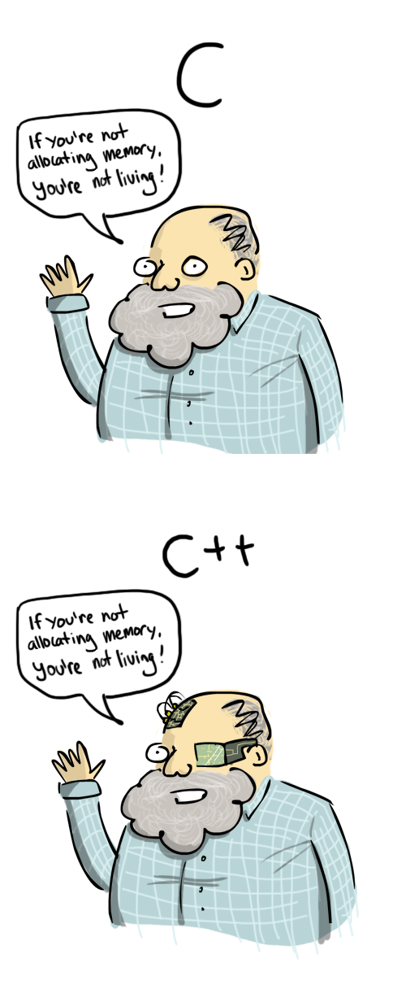
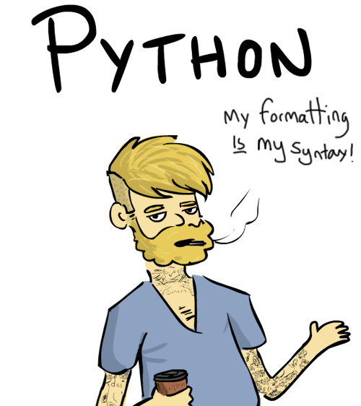
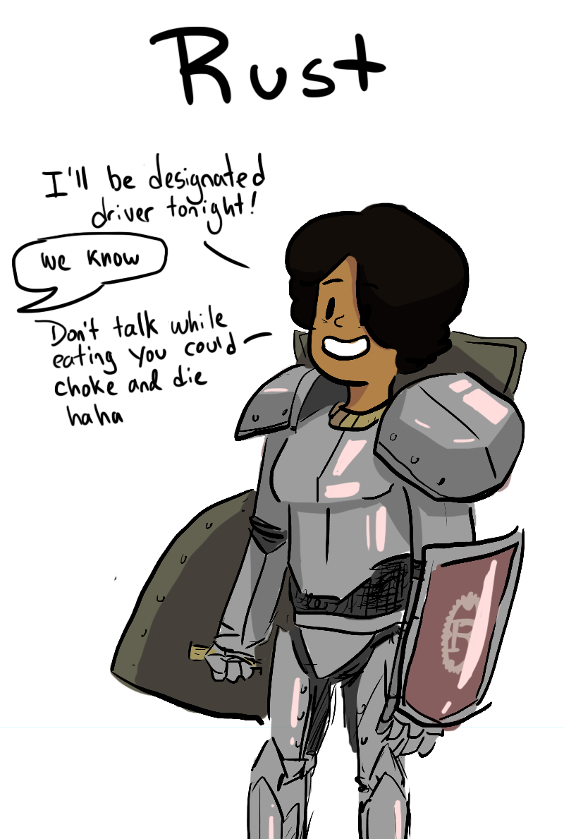
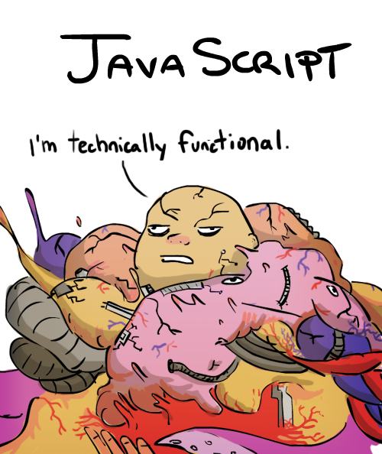
Break + Programming languages personified
https://leftoversalad.com/c/015_programmingpeople/

Slide 60
Outline
Embedded Operating Systems
Embedded Security Challenges
Tock Overview
Rust Programming
Tock Driver Design

Slide 61
Driver “stack”
Driver code does a lot of work internally
Externally provides a simpler abstract interface to the device
Some drivers build on top of other drivers
Snake game
Builds on top of LED Matrix driver
Builds on top of GPIO and Timers

Slide 62
Typical software stack in Tock
Application(s)
Libtock-c Library
Syscall Driver
Additional Capsules (zero or more)
Hardware Interface Layer (HIL)
Chip Driver

Slide 63
Layer connections
Each layer can communication with the one above and below it
Within the kernel each layer
Has a reference to the thing below and can call functions on it directly
Has a “client” reference to thing above
Allows responding upwards when action is complete
Usually one function: callback()
Application(s)
Libtock-c Library
Syscall Driver
Additional Capsules (zero or more)
Hardware Interface Layer (HIL)
Chip Driver

Slide 64
Example: Tock temperature stack on Microbit
Let’s revisit our favorite temperature sensor
Degrees Celsius in 0.25 degree increments
Register interface
TASKS_START
Start a measurement
INTENSET
Enable interrupts
EVENTS_DATARDY
Check if temperature value is ready
TEMP
Read temperature value
Application(s)
Libtock-c Temperature
Temperature Capsule
Sensors HIL (TemperatureDriver)
nRF52 TEMP Driver

Slide 65
Temperature chip driver
https://github.com/tock/tock/blob/master/chips/nrf5x/src/temperature.rs
Accesses registers to interact with Temperature peripheral
Demonstrates Tock register interface
Implements the TemperatureDriver HIL
Application(s)
Libtock-c Temperature
Temperature Capsule
Sensors HIL (TemperatureDriver)
nRF52 TEMP Driver

Slide 66
Senors Hardware Interface Layer
Rust “trait” that a struct can implement
Allows shared behavior by multiple underlying implementations
TemperatureDriver
set_client(&TemperatureClient)
read_temperature() -> Result<(), ErrorCode>
TemperatureClient
callback(Result<i32, ErrorCode>)
https://github.com/tock/tock/blob/master/kernel/src/hil/sensors.rs
Application(s)
Libtock-c Temperature
Temperature Capsule
Sensors HIL (TemperatureDriver)
nRF52 TEMP Driver

Slide 67
Temperature capsule
https://github.com/tock/tock/blob/master/capsules/extra/src/temperature.rs
Implements Syscall driver
Commands
0 – check if this exists
1 – read temperature
Subscribe
Get callbacks with temperature values
Tracks “busy” status of sensor
But allows multiple applications to be notified when value is ready
Application(s)
Libtock-c Temperature
Temperature Capsule
Sensors HIL (TemperatureDriver)
nRF52 TEMP Driver

Slide 68
Libtock-c Temperature Library
https://github.com/tock/libtock-c/blob/master/libtock/sensors/temperature.c
libtock_temperature_read(callback)
Actual syscalls in a separate file
https://github.com/tock/libtock-c/blob/master/libtock/sensors/syscalls/temperature_syscalls.c
Application(s)
Libtock-c Temperature
Temperature Capsule
Sensors HIL (TemperatureDriver)
nRF52 TEMP Driver

Slide 69
Example: Microbit Inertial Measurement Unit (IMU)
Capsule for LSM303AGR chip
Uses generic I2C capsule below it
Provides interface for Ninedof above it
Allows LSM303AGR driver to be reused on multiple boards
Each which could have different microcontrollers
Application(s)
Libtock-c Ninedof
Ninedof Capsule
Sensors HIL (Ninedof)
LSM303AGR Capsule
I2C HIL (I2CDevice)
…

Slide 70
Full LSM303AGR stack
Application(s)
Libtock-c Ninedof
Libtock-c Temperature
LSM303AGR provides two interfaces
Ninedof
Temperature!
Beneath it gets a bit messy
I2CDevice
Concept of a device with an address
I2CMaster
Implementation
Ninedof Capsule
Temperature Capsule
Sensors HIL (Ninedof)
Sensors HIL (TemperatureDriver)
LSM303AGR Capsule
I2C HIL (I2CDevice)
Virtual I2C Capsule
I2C HIL (I2CMaster)
nRF52 I2C Driver

Slide 71
Capsules can have multiple drivers beneath them too
Application(s)
Libtock-c SDCard
SDCard Capsule
SPI HIL (SpiMasterDevice)
Time HIL (Alarm)
GPIO HIL (InterruptPin)
Virtual SPI Capsule
nRF52 Timer Driver
nRF52 GPIO Driver
SPI HIL (SpiMaster)
nRF52 SPI Driver

Slide 72
General Tock resources
https://github.com/tock/tock
https://www.tockos.org/
“Multiprogramming a 64 kB Computer Safely and Efficiently” Levy et al. 2017. Symposium on Operating Systems Principles. https://brandenghena.com/projects/tock/levy17multiprogramming.pdf
"Tock: From Research to Securing 10 Million Computers“ Schuermann et al. 2025. Symposium on Operating System Principles. https://brandenghena.com/projects/tock/2025-sosp-tock-decade.pdf

Slide 73
Outline
Embedded Operating Systems
Embedded Security Challenges
Tock Overview
Rust Programming
Tock Driver Design

