Slide 1
Lecture 01 Introduction
CE346 – Microcontroller System Design
Branden Ghena – Spring 2026
Some slides borrowed from: Josiah Hester (Northwestern), Prabal Dutta (UC Berkeley)

Slide 2
Welcome to CE346/CS346!
Focus on hardware/software systems and their design
Hardware/Software co-design
How do you write software that interacts with hardware?
How do you choose hardware to support software needs?
Sensors and Sensing
What can sensors do and how do they work?
How do you write applications that sense the world?

Slide 3
Outline
Who and Why
Embedded Systems
Microcontrollers
Course Overview
Class Hardware
Project Ideas

Slide 4
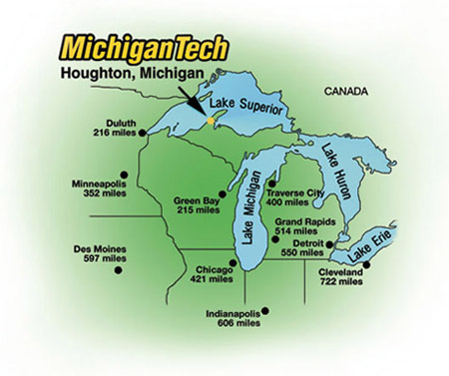
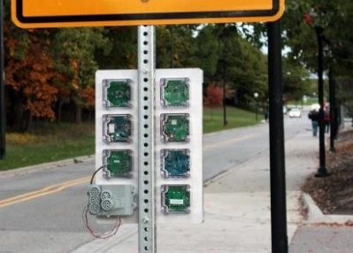
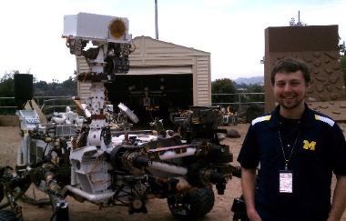
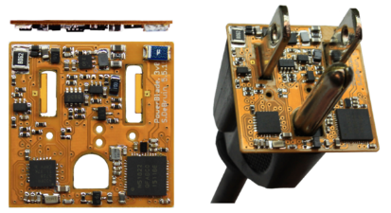







Branden Ghena (he/him)
Assistant Faculty of Instruction
Education
Undergrad: Michigan Tech
Master’s: University of Michigan
PhD: University of California, Berkeley
Research
Resource-constrained sensing systems
Low-energy wireless networks
Embedded operating systems: Tock
Teaching
Computer Systems
CS213: Intro to Computer Systems
CS343: Operating Systems
CE346: Microprocessor System Design
CS433: Wireless Protocols for the IoT
Things I love

Slide 5

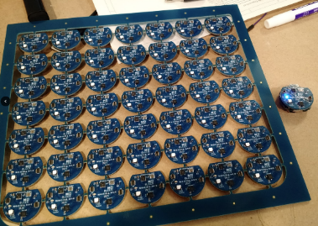
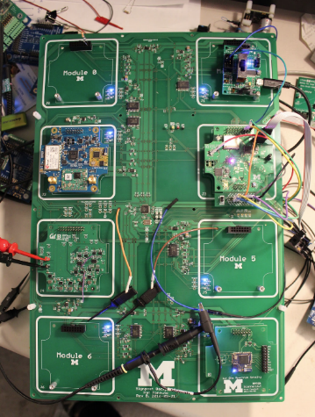
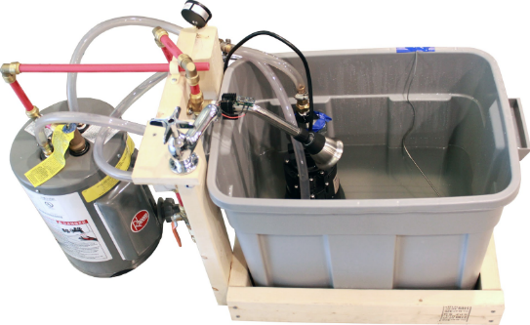
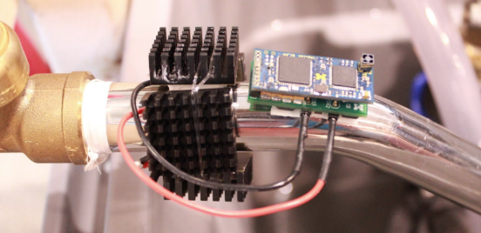
Research area: resource-constrained embedded systems
Most interesting to me: the interfaces
Hardware and software
Applications and OS
Communication

Slide 6
Faculty: now I can choose what to teach!
Goal: provide classes that teach more advanced embedded systems topics
Hopefully, generally useful to other nearby domains of CS and ECE too!
Result: this course!
Course goal: introduce students to hardware-software interactions
Practical hands-on experience with microcontrollers and sensors
Open-ended project where students can choose their specific focus

Slide 7
Today’s Goals
What are the goals of this course?
Why do I think embedded systems are so important?
How is the course going to operate?
Discuss hardware used for the course and some project ideas.

Slide 8
Asking questions, four ways
You can always ask questions during lecture!
I’ll let you know if I need to move on for now and answer you after class
We’ll take breaks during lecture
I’ll pause after each break to see if any questions came up
I will hang out after class for questions
Plenty of time to answer everyone
You can always ask questions on Ed Discussion too
The class message board app

Slide 9
Outline
Who and Why
Embedded Systems
Microcontrollers
Course Overview
Class Hardware
Project Ideas

Slide 10
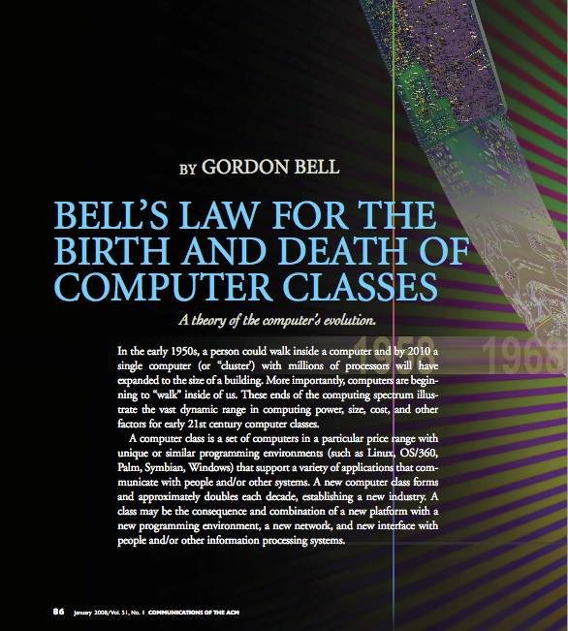
Bell’s Law: A new computer class every decade
“Roughly every decade a new, lower priced computer class forms based on a new programming platform, network, and interface resulting in new usage and the establishment of a new industry.”
- Gordon Bell [1972,2008]

Slide 11
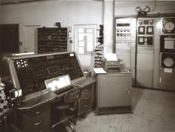
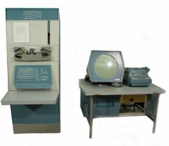
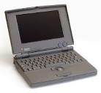
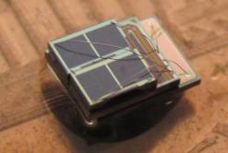

Classes of computation
Mainframe
[Bell et al. Computer, 1972, ACM, 2008]
Workstation
Laptop
Smart Sensors
Mini Computer
Ubiquitous
Personal Computer
Smartphone

Slide 12
Number of computers per person grows over time
Mainframe
1 per Enterprise
[Bell et al. Computer, 1972, ACM, 2008]
Workstation
1 per Engineer
Laptop
1 per Professional
log (people per computer)
Smart Sensors
Mini Computer
Ubiquitous
1 per Company
Personal Computer
100 – 1000’s per person
1 per Family
1 per person
Smartphone

Slide 13
Computer volume shrinks by 100x every decade
Mainframe
1 per Enterprise
100x smaller every decade
Workstation
1 per Engineer
[Nakagawa08]
Laptop
1 per Professional
Smart Sensors
Mini Computer
Ubiquitous
1 per Company
Personal Computer
100 – 1000’s per person
1 per Family
1 per person
Smartphone

Slide 14

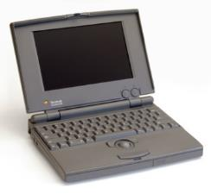


Price falls dramatically, enabling new applications
Mainframe
Workstation
Number Crunching
Data Storage
Laptop
productivity
interactive
Mini Computer
streaming
information
to/from the
physical
world
Smart Sensors
Personal Computer
Smartphone

Slide 15
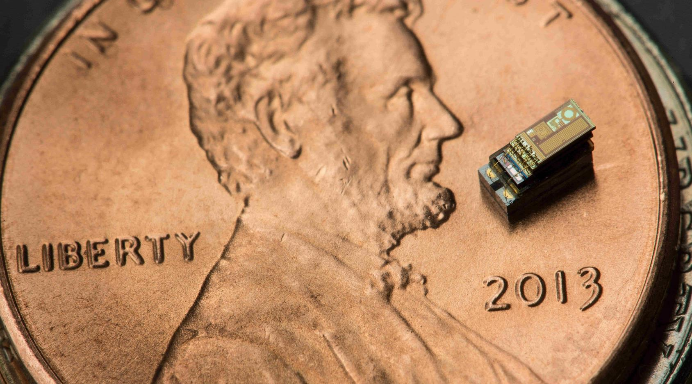
Michigan Micro Mote (2015)

Slide 16
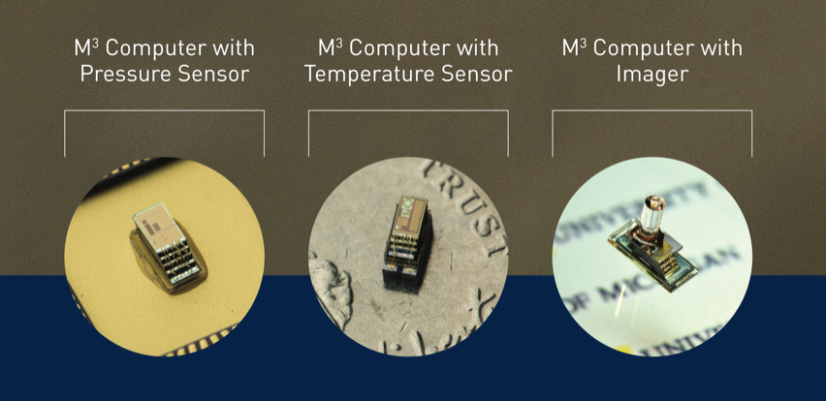
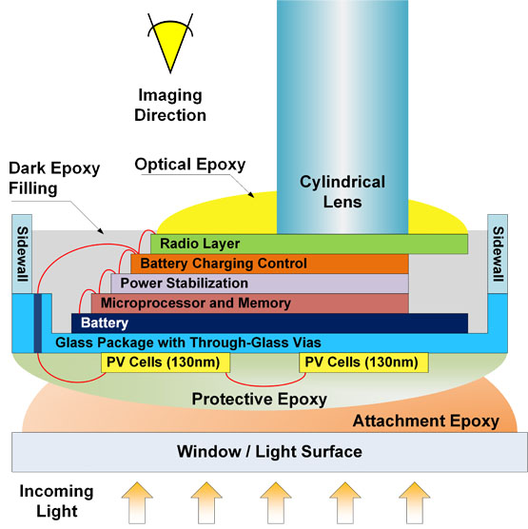
M³ Use cases and design
https://ece.engin.umich.edu/stories/michigan-micro-mote-m3-makes-history-as-the-worlds-smallest-computer

Slide 17
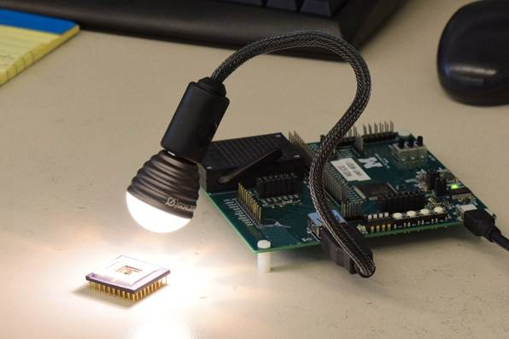
Powering and Programming the Mote

Slide 18
Key idea: computers can be built into other things
Computers have become small enough that they don’t need their own rooms or even their own boxes to house them
They can be built into other things we use in everyday life

Slide 19
What is an embedded system?
A computer built into a device such that the device is interacted with, not the computer
E.g., not a desktop or laptop
(although many of those deal with overlapping hardware/software issues)
Includes many domains
Robotics
Industrial processes
Smart home
Smart city
Wearables and health sensing
Internet of Things

Slide 20
Discussion: identify some embedded systems
What devices that you might not usually consider as computers actually have embedded computers in them?
Talk with the others around you
Goal: come up some unique ideas
We’ll share ideas with the class afterwards

Slide 21
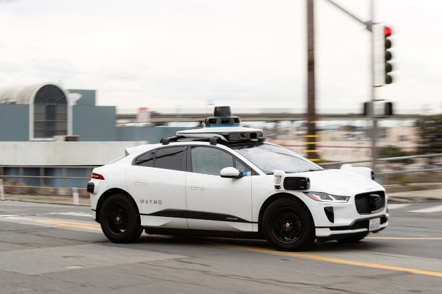
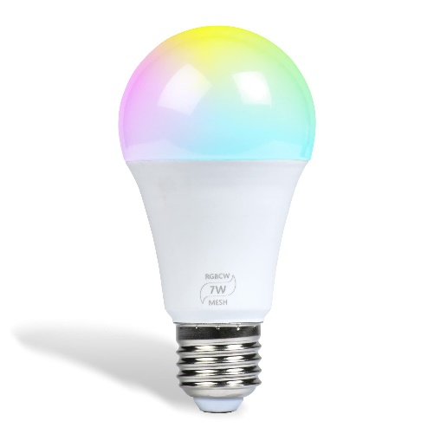
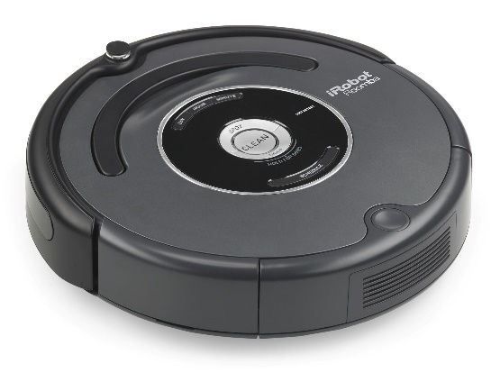
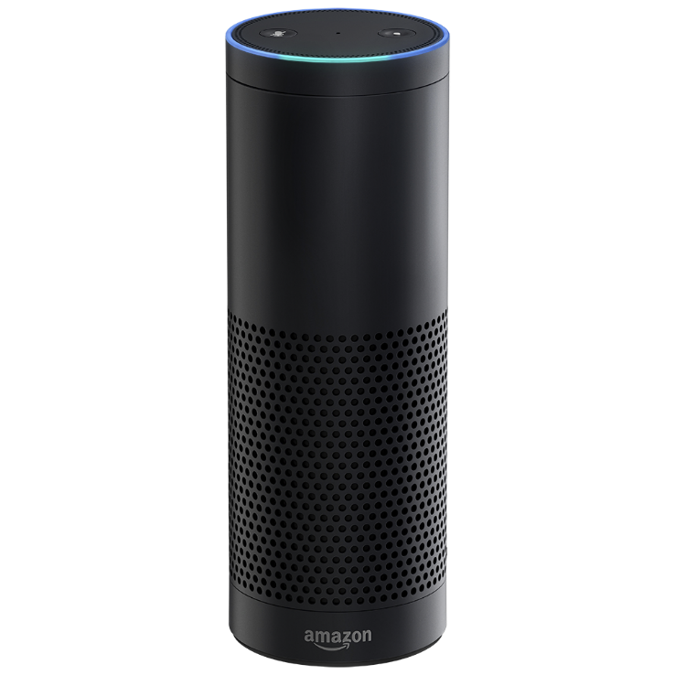
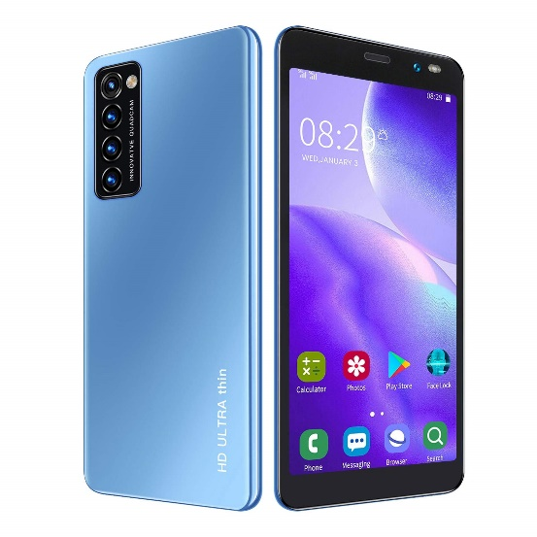
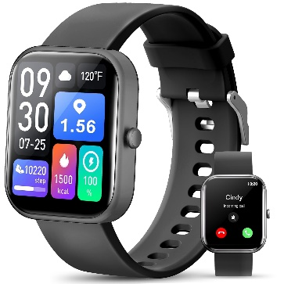
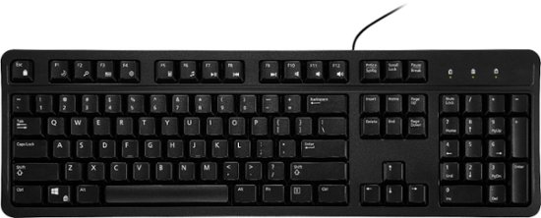
What does and does not count
Is _____ an embedded system? Why or why not?
Smart lightbulb
Roomba
Autonomous vehicle
Smartwatch
Smartphone
Voice-assistant (Alexa)
Keyboard

Slide 22
Thought experiment: high-capability computing
What if the smart lightbulb was powered by an entire desktop?
16-core x86-64 processor, 64 GB RAM, 1 TB SSD
Could that still be an embedded system?
Why don’t we see that in practice?

Slide 23
Thought experiment: high-capability computing
What if the smart lightbulb was powered by an entire desktop?
16-core x86-64 processor, 64 GB RAM, 1 TB SSD
Could that still be an embedded system?
Yes
Why don’t we see that in practice?
Cost

Slide 24
Trend: embedded computers instead of custom hardware
Some embedded devices could be a state machine in custom hardware instead
However, computers are increasingly common in those cases
Embedded computers are increasingly cheap
More software developers than hardware developers
Example: thermostats existed without computers
But are cheaper to make with computers these days

Slide 25
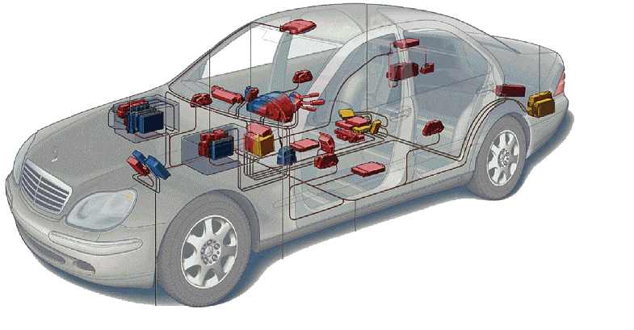
Related area: Cyber-Physical Systems
Systems that are part computational and part real-world
Example: autonomous vehicles
Combines multiple fields to handle this problem
Embedded Systems
Electronics
Controls
Software Engineering
Computer Theory
Automotive

Slide 26
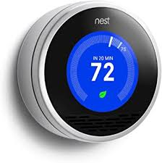
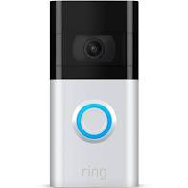
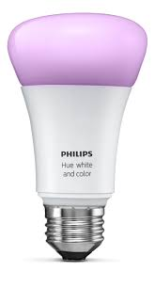

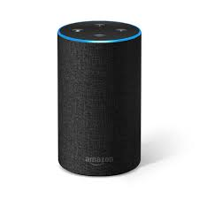
Related area: Internet-of-Things devices
Device + Computation + Networking

Slide 27
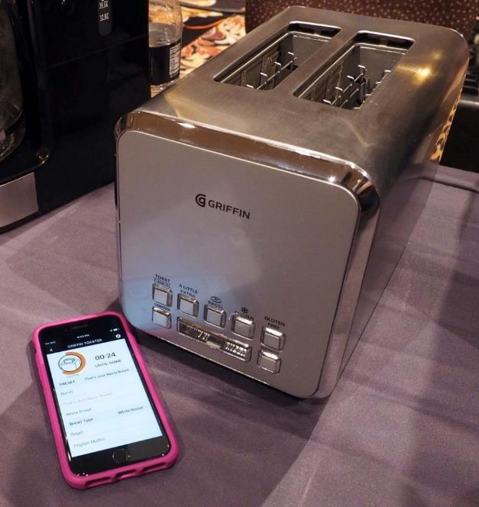
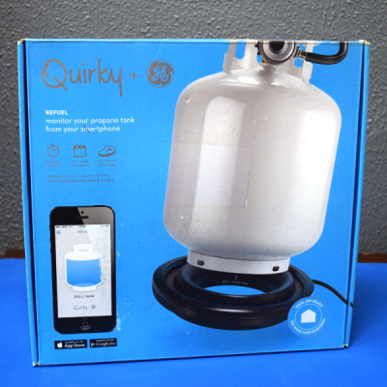
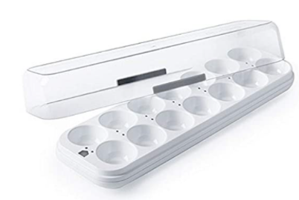
Warning: Internet of Crap

Slide 28
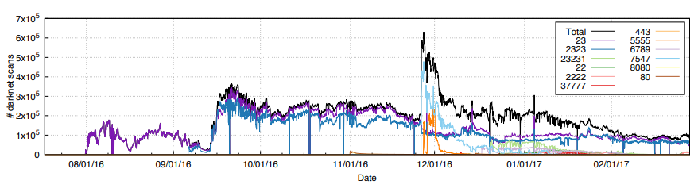
Internet of Insecure Crap
Mirai botnet (2016)
Takes control of up to 600,000 insecure connected devices
IP-attached cameras, DVRs, routers, printers
Used to DoS websites

Slide 29
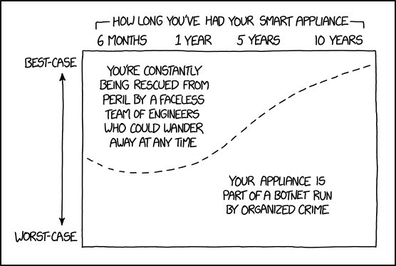
Break + xkcd
https://xkcd.com/1966/

Slide 30
What makes resource-constrained embedded systems interesting?
Focus on the real world
You can actually see the purpose and effects of your applications
Easily explainable to non-engineer humans
Challenging limitations
Limited memory and processing
Energy concerns

Slide 31
What makes resource-constrained embedded systems frustrating?
Challenging limitations
Limited memory and processing
Energy concerns
Full-stack development means problems could be anywhere
Hardware problems
Firmware problems
Software problems

Slide 32
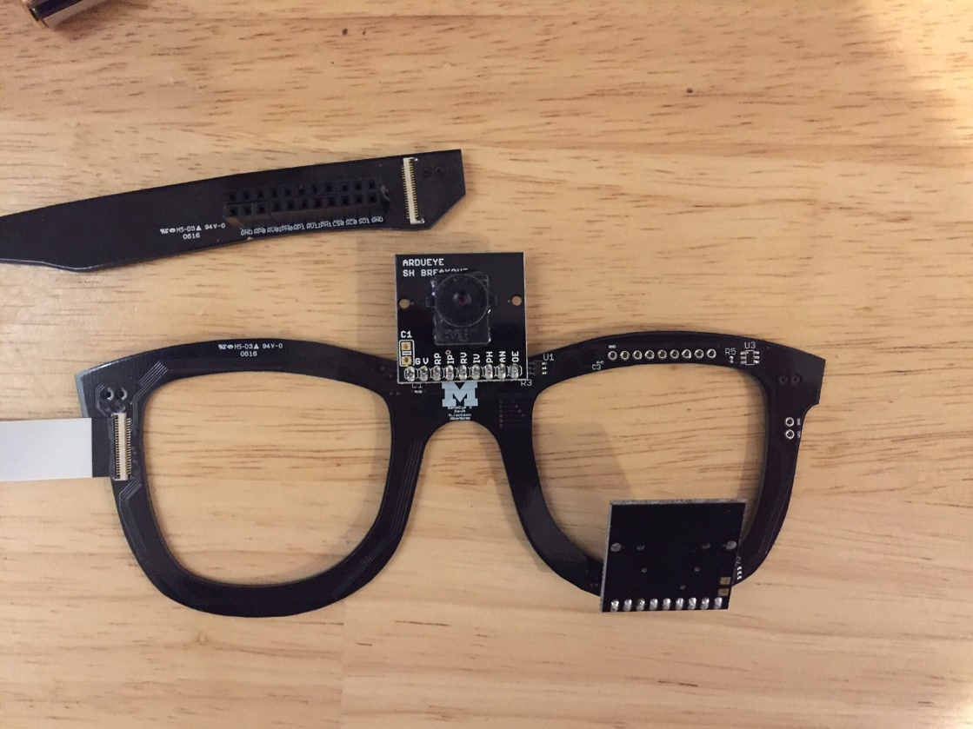
What makes resource-constrained embedded systems frustrating?
Example: my first grad project, eye-tracking glasses
Captured images of eyes and world, display on a nearby desktop
System stack-up:
Camera -> Analog-to-Digital Converter -> FPGA (hardware to manage camera) -> Linux driver -> Linux app -> Network -> Visualizer app
One morning, I came to lab and nothing worked…
This WILL happen to you

Slide 33
Break + Architecture of a lecture
Full
Administrivia
+ stretch break
Open Question
Summary
+ Bonus
Attention
0
20
25
50
53
78
80
Time (minutes)

Slide 34
Outline
Who and Why
Embedded Systems
Microcontrollers
Course Overview
Class Hardware
Project Ideas

Slide 35
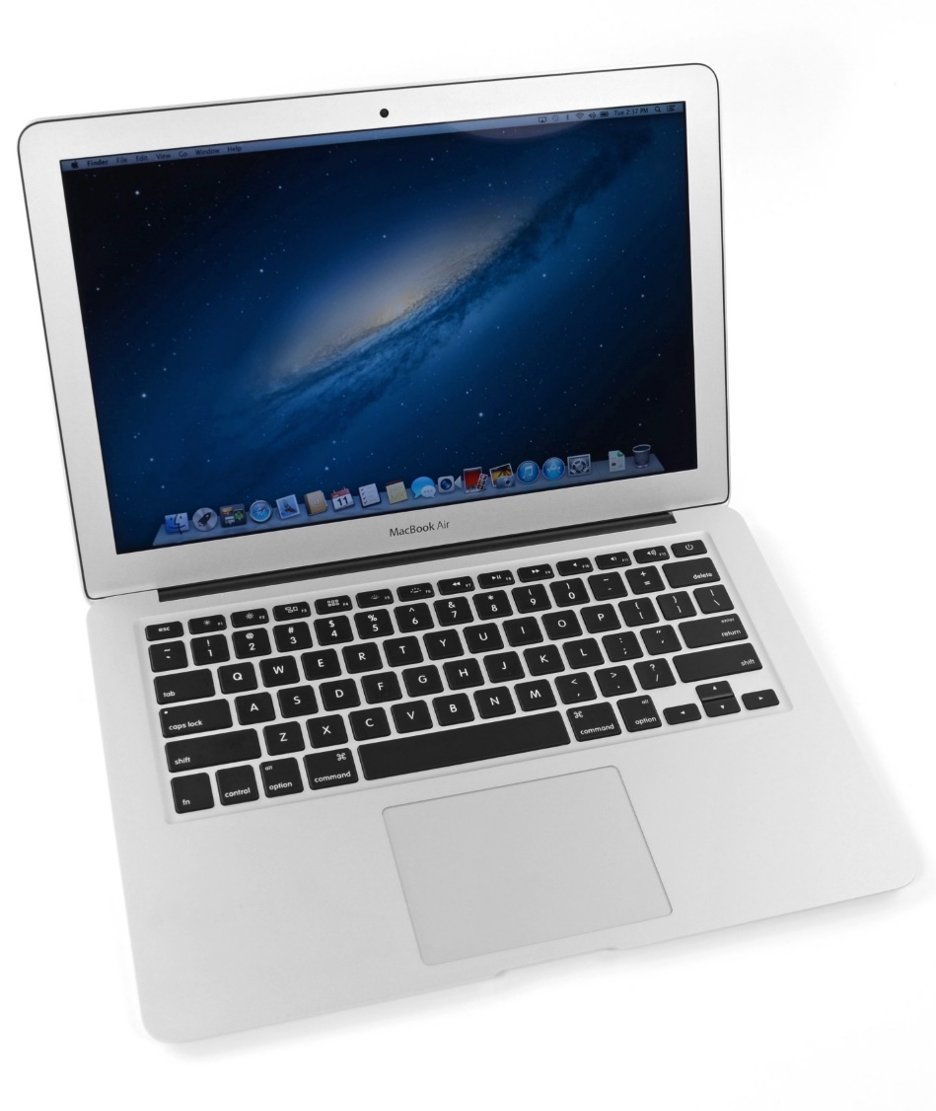
What’s inside a computer?
Macbook Air (circa 2013, 2nd gen)
Modern computers are mostly similar
Intel Core i5 processor
128 GB Flash storage
4 GB DDR3 RAM
1440x900 pixel display
Picked because there is a teardown I like of an embedded device from the same year
https://www.ifixit.com/Teardown/MacBook+Air+13-Inch+Mid+2013+Teardown/15042

Slide 36
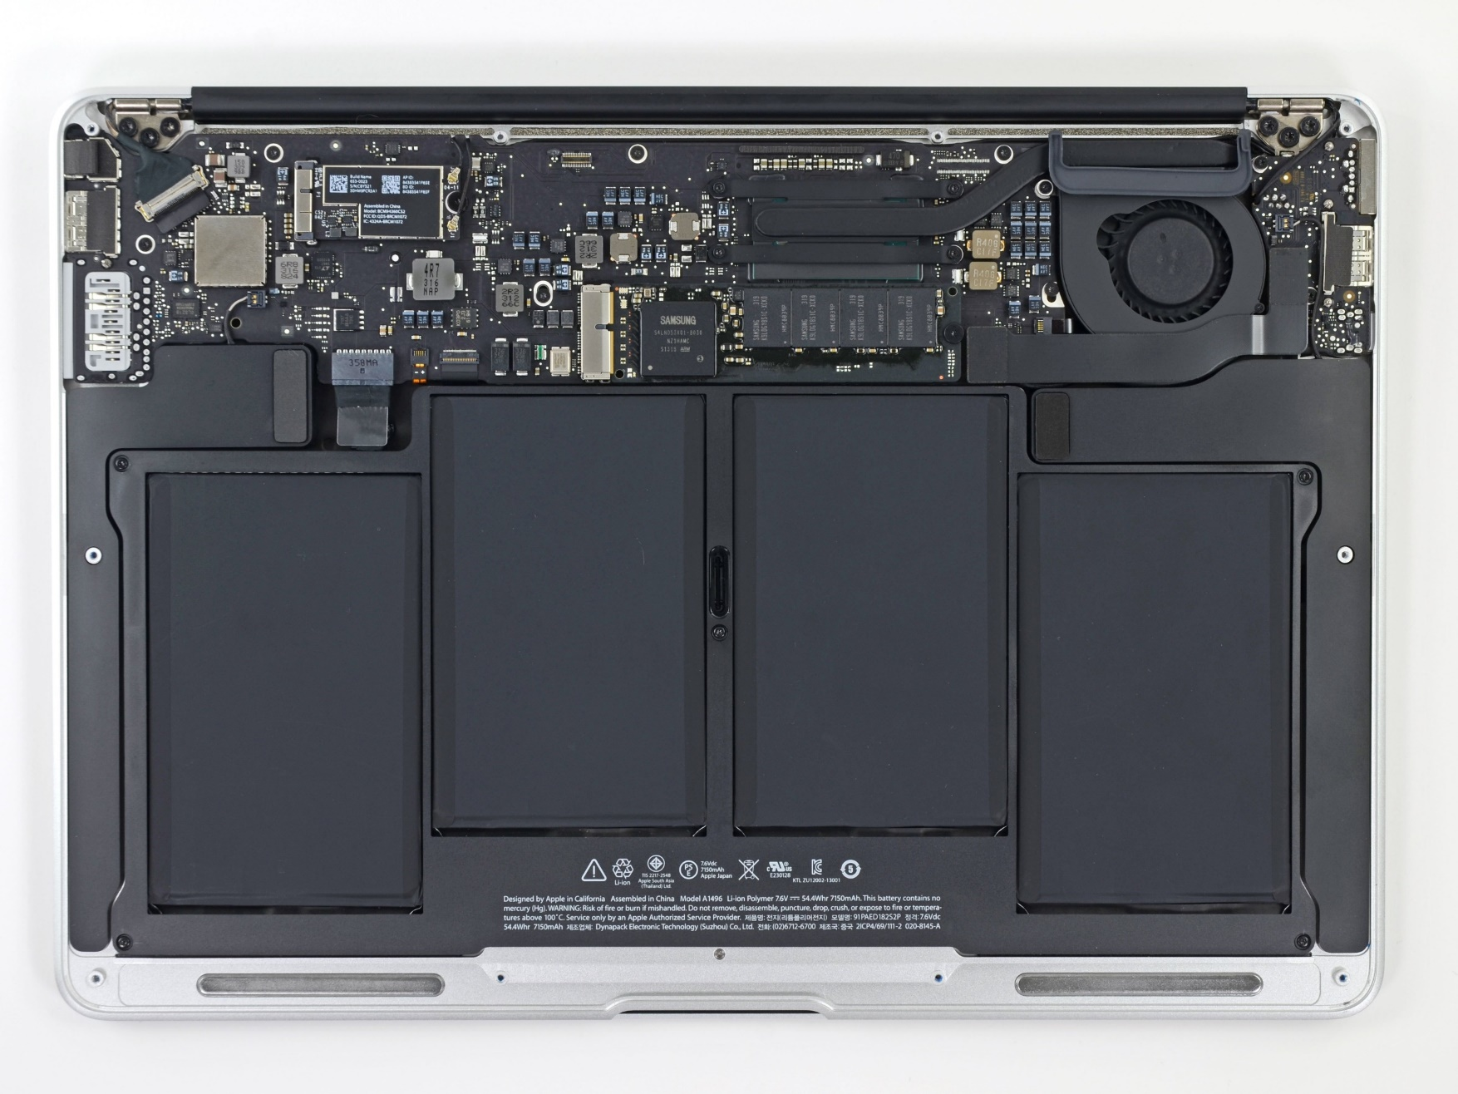
Unscrewing the bottom cover
Top half is the motherboard
Holds and connects all the parts of the computer
Bottom half are battery packs

Slide 37
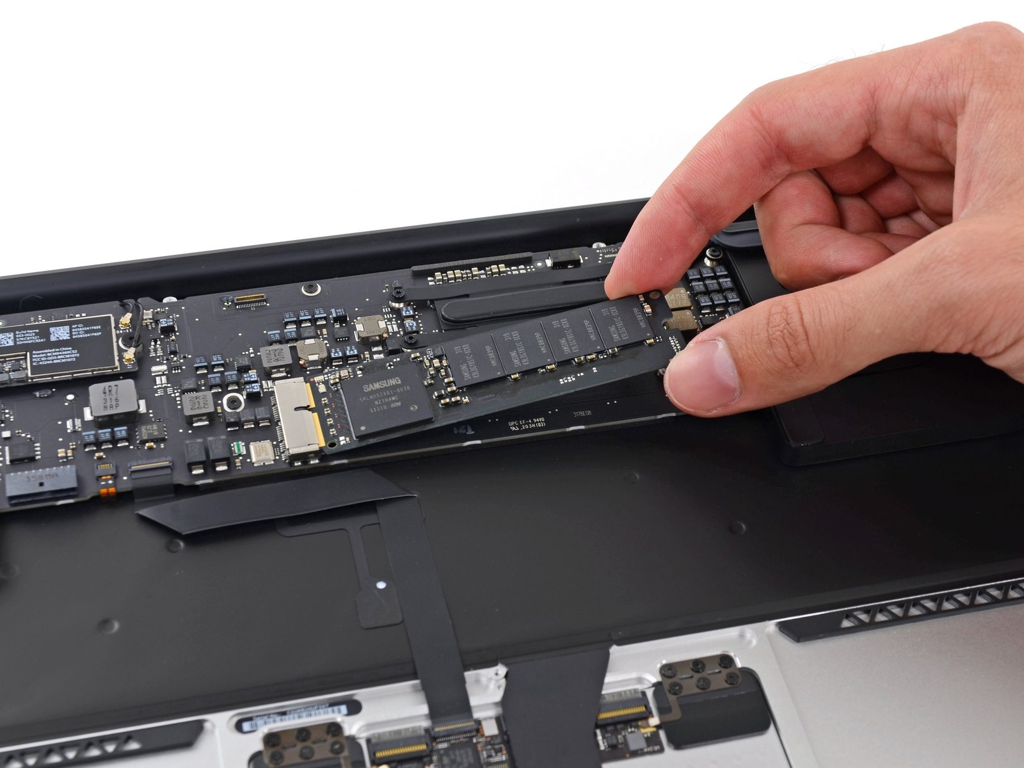
Non-volatile long-term storage: SSD
The SSD is a module that connects through PCIe
In modern laptops the SSD is often soldered directly onto the motherboard

Slide 38
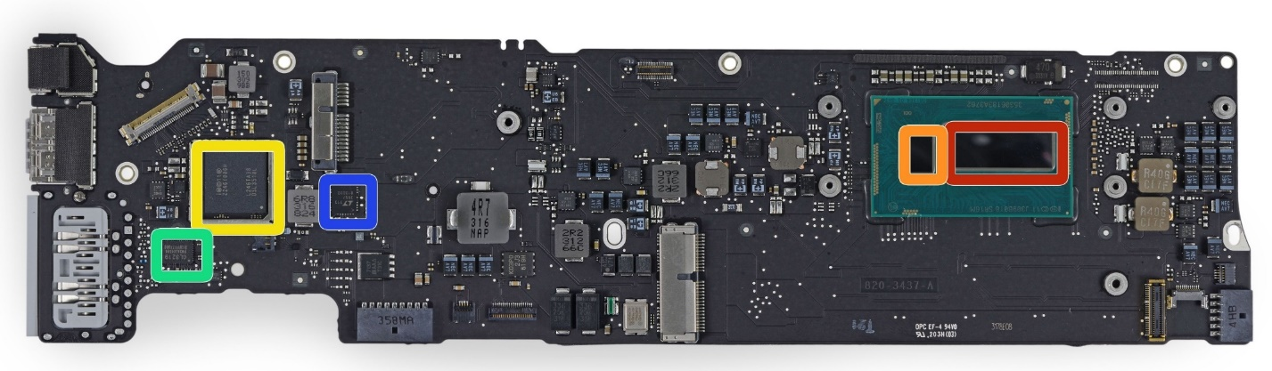
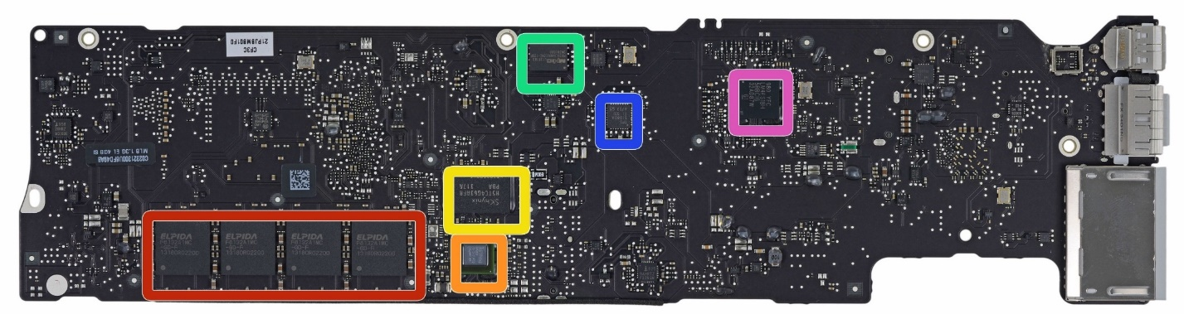
Investigating the motherboard
Red (front, right)
Intel core i5 processor
Red (bottom, left)
Elpida LPDDR3 RAM, 4 GB
Other stuff are mostly radios, USB/Thunderbolt controllers, and power supply
Front
Back

Slide 39
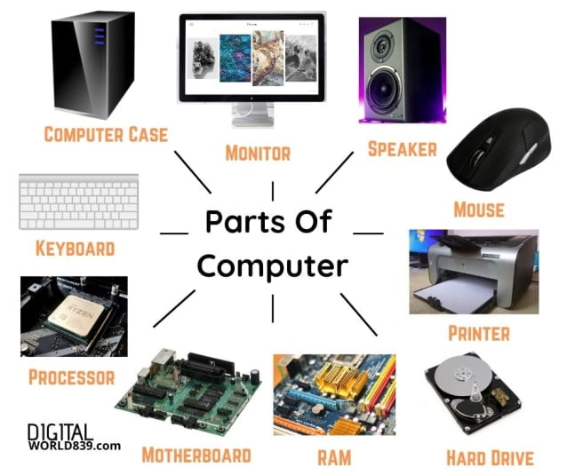
Generalizing computer design
Computers usually need
Processor
Memory (RAM)
Storage (Flash/SSD)
External communication
USB, Thunderbolt, SATA, HDMI, WiFi
Power management
Maybe batteries and charging
Something to connect it all: motherboard

Slide 40
What’s inside a Fitbit?
Fitbit flex (circa 2013)
Features
Counts your steps
Reports via Bluetooth Low Energy
Lights up some LEDs based on your goals
Vibrates when its battery is low
https://www.ifixit.com/Teardown/Fitbit+Flex+Teardown/16050
Notes:
Fitbit, Wearables, microcontrolles

Slide 41
Fitbit teardown
Notes:
Fitbit, Wearables, microcontrolles

Slide 42
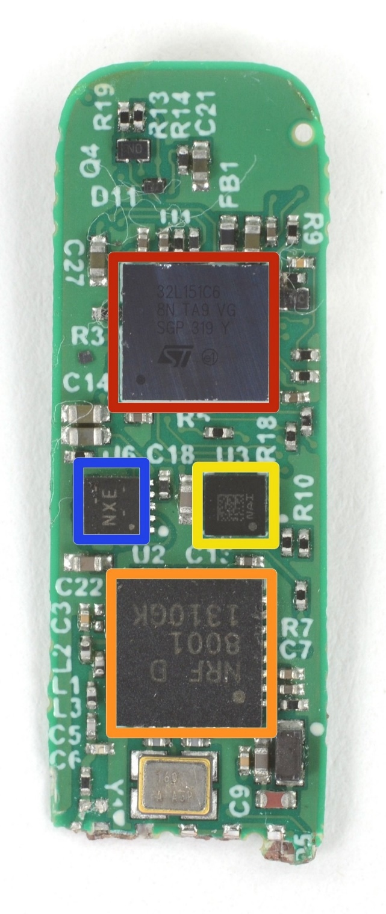
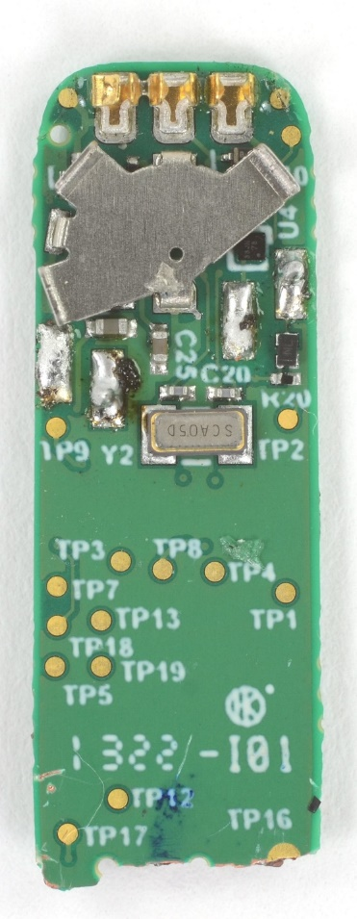
Fitbit circuit board front
The back is uninteresting
Red (top)
STMicro 32L151C6 Microcontroller
Blue (left)
TI BQ24040 Battery Charger
Yellow (right)
STMicro LIS2DH Accelerometer
Orange (bottom)
Nordic nRF8001 Bluetooth Low Energy Radio

Slide 43
Fitbit as a computer
Computers usually need
Processor
Memory (RAM)
Storage (Flash/SSD)
External communication
USB, Thunderbolt, SATA, HDMI, WiFi
Power management
Maybe batteries and charging
Something to connect it all: motherboard
Microcontroller
Bluetooth radio
Vibratory motor
Battery and power management
Circuit board

Slide 44
Sidebar: you could make a Fitbit yourself
All those parts are commercially available, so you could make your own Fitbit if you wanted to
Make a circuit board
Buy those parts and solder them on
Write some embedded software
Make a plastic case
… build a big software backend for everything
You’ve got a Fitbit!

Slide 45
Generic microcontroller block diagram
Microcontroller
Processor
Peripherals
Pins
Memory

Slide 46
Peripherals
Hardware modules that perform some action
Common examples
Control digital input and output pins
Read analog inputs
Send messages over various simple wire protocols (UART, SPI, I2C)
Set and check timers
Less common examples
Cryptography accelerators
Complicated wire protocols (USB, CAN)
Wireless radios (BLE, 802.15.4, WiFi)
We’ll spend most of class learning various peripherals

Slide 47
How is a microcontroller different?
A very constrained computer
Simple processor
16 or 32 bits (usually 32-bit these days)
Processor speed in MHz
Single core, pipelined processor
No cache, or maybe a very small instruction cache
Memory measured in kB
Code executes right from read-only Flash (which is part of the address space)
Sometimes no OS support at all
“bare-metal” programming
More focus on peripherals for interacting with the world

Slide 48
Break + Question
Why do laptops/desktops use external memory chips instead of building it into the processor (like a microcontroller)?

Slide 49
Break + Question
Why do laptops/desktops use external memory chips instead of building it into the processor (like a microcontroller)?
Flexibility
If it’s built into the processor, you’re limited to whatever they picked
Fabrication issues
DRAM and CMOS gates are somewhat different manufacturing processes (affects yield and costs)
DRAM takes up a lot of space (multiple chips for many GBs of RAM)
Some systems are doing this
Apple M4 includes separate RAM silicon dies in the same processor package

Slide 50
Outline
Who and Why
Embedded Systems
Microcontrollers
Course Overview
Class Hardware
Project Ideas

Slide 51
Course Staff and Office Hours
Four PMs who previously took the class
Satviki Madaan
Konrad Lukasiewicz
Katie Jiang
Jayden Wool
They will help out during labs and also provide lab office hours
Office Hours: TBD
We’ll post a schedule soonish (should be M, T, W, and R)
Also by request! (especially during projects)

Slide 52
Course details – how to learn stuff
Lecture: Tuesdays and Thursdays 3:30-4:50pm
Tech LR4
Provides background on everything we’ll be doing in labs
So stay up-to-date on them!
Lectures are automatically recorded so you can review them
Slides are posted to the Canvas homepage right before class
No textbook for this class
Nobody seems to write a good one
The datasheet for our microcontroller (nRF52833) will be important though!

Slide 53
Asking Questions
Class and office hours are always an option!
We can do extra questions right after class too
Ed Discussion:
Post questions
Answer each other’s questions
Find posts from the course staff
Post private info just to course staff
Post on Ed – do NOT send me emails
Messages are kept in one place and stay “unanswered”
You can post “Private” to just go to course staff
Use that feature to request office hour appointments if desired
Or to tell me that you’re sick and can’t attend lab

Slide 54
Course grade components
42% Labs
6 labs at ~7% each
Guided exploration of course concepts
Staff gives checkoffs as you complete parts
20% Quizzes
Four timed quizzes at 5% each
Covers lecture material from last two weeks
In-class at the end of class, schedule on Canvas
38% Final Project
Open-ended group project (will explain in a minute)

Slide 55
Class lab sessions
Lab: Fridays 1:00-2:50pm OR 3:00-4:50pm, Frances Searle 3220
Mandatory attendance for these (part of your lab grade)
Let me know ASAP if you’re sick and will miss
Labs start next week Friday and are weekly from there
Six labs total
When labs run out, I’ll use the time for project meetings with groups
Optional lab this Friday for software setup
Warning: labs won’t usually be finished during the lab sessions
You’ll have to work on them on your own time too
We’ll have office hours for checkoffs

Slide 56
Labs
MMIO and Interrupts
Virtual Timers
LED Matrix
Breadboarding
Audio Input/Output
I2C Accelerometer/Magnetometer
Labs will be partner work
You choose, but different partner each week
MUST work with a partner
Due one week from start of lab
You’ll need to get checkoffs in lab or during office hours

Slide 57
Show up to lab session on time
Labs start right away forming partnerships and starting work
So showing up late is a problem
And I will deduct lab points for it if I have to

Slide 58
Late (assignment) Penalties
10% reduction in maximum points per day late
Just applies to the labs. Quizzes and Projects can’t be late
Sometimes stuff just doesn’t work. Especially when we’re working with hardware. We can be flexible about deadlines
If you’re having problems and tell us
Less flexible if you don’t communicate or if you started late
In general, communicate for any problems outside of your control and we can provide flexibility

Slide 59
Quizzes
In-class, on-paper, closed notes quizzes
Usually about 15 minutes and held at the end of lecture
Cover the last two weeks worth of material (give or take)
So make sure you’re up-to-date on what we’re talking about
First quiz is Tuesday, April 14th (third week of classes)

Slide 60
Final projects
Opportunity for you to apply your interests to this course
In groups of 2-3 students (maybe 4 for a really big idea)
Groups of three is encouraged
Demonstrate course knowledge through any application
Microbit (99% required) in our C software system (99.9% required)
Various hardware I’ll have on hand
Decent per-team budget for purchasing additional stuff (usually around $40 per person in team)

Slide 61
Project Logistics
Week 4: Proposals due
I’ll get feedback to teams I’m concerned about
Week 6: Project Design Presentations
Short presentations in class about your proposed project and design
Chance to give each other useful feedback about how to proceed
Week 8-10: Labs are done and Fridays are used for project office hours
And a required project check-in, probably week 9
Exam Week: Live project demos!!
Public demo session (invite friends!)
Tuesday of exam week (usually half of the class at a time for a 2-3 hour block)
Required attendance for project demos

Slide 62
Let’s talk about Generative AI
Generative AI tools MAY NOT be used to develop LAB code
Rationale:
Want you to practice working on systems code
Want you to be significantly better than AI tools
We will help you complete the labs (in lab session and office hours)
You may use AI tools for studying and understanding course material outside of labs
You may use AI tools for the final project as long as the source is properly documented

Slide 63
Break + Details about who is in the class
58 total students
Grad: 6
Undergrad: 52
Majors
Computer Science: 39
Computer Engineering: 11
Electrical Engineering: 8
Mechanical Engineering: 4
Data Science: 1
Music: 2
You don’t all know the same things, and that’s okay!!
This class thrives on a variety of backgrounds
Software
Hardware
Data Interpretation
Applications
The best projects often have a mix of backgrounds

Slide 64
Outline
Who and Why
Embedded Systems
Microcontrollers
Course Overview
Class Hardware
Project Ideas

Slide 65
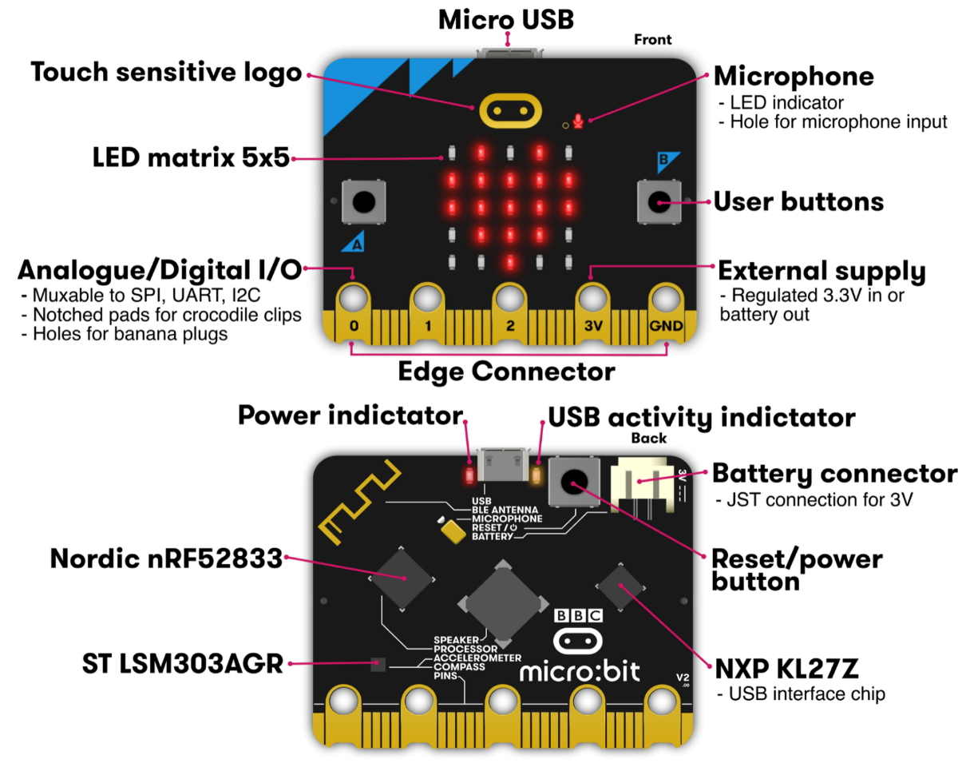
Micro:bit v2
Legacy from 1980s “BBC Computer Literacy Project”
Reimagined today
Around $20
Modern microcontroller AND sensors
Plan for class:
Explore most of its functionality

Slide 66
Getting your own Microbit
You do NOT need to buy your own Microbit
I have enough for everyone in the class to borrow one for the quarter
If you want your own though, they’re pretty cheap:
$17.95 Adafruit: https://www.adafruit.com/product/4781
$16.50 Sparkfun: https://www.sparkfun.com/products/17287
$21.95 Amazon: https://www.amazon.com/BBC-Micro-Programming-Include-Battery/dp/B0BSF5KTLT

Slide 67
Labs will use your own laptops
All labs will use your own computers
In the past we used the computers in CG50
About one computer would crash per lab session
Super crammed in there with no elbow room or walking room
And you had to physically go there to work on labs
Setup for your own computers won’t be that hard
Native MacOS or Linux works great
For Windows, VMWare Workstation + Ubuntu is pretty easy, but requires ~20 GB
Concern of mine: equal access to labs
If you don’t have a laptop or don’t think it’ll work, let me know!

Slide 68
Poll of the room
MacOS users
Linux users
Windows users
WSL users?
Other?

Slide 69
Lab0: Software Setup
Is posted now on the Canvas homepage!
Due next Thursday
I’ll be at the lab sessions on Friday if you want help with your setup
If you have a weird computer setup
Or if you feel uncomfortable installing a bunch of tooling
I will also have hardware to hand out some Microbits!
Will hand out more next week if you don’t come on Friday
If you feel comfortable with it, you’re welcome to do this first “lab” on your own
And you don’t have to attend lab this Friday
But please feel free to come by!

Slide 70
Outline
Who and Why
Embedded Systems
Microcontrollers
Course Overview
Class Hardware
Project Ideas

Slide 71
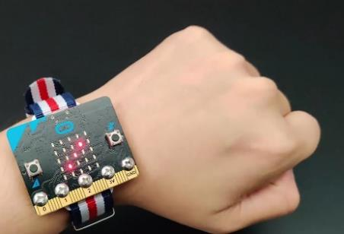
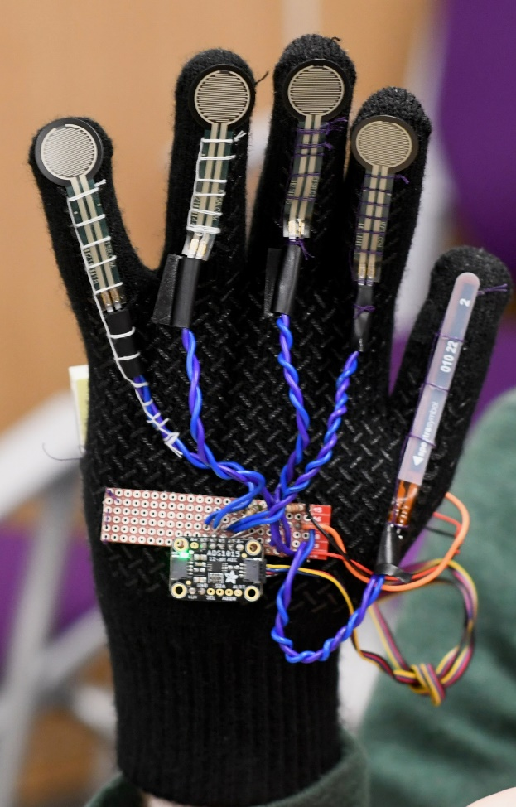
Project Ideas
Some ideas to get you thinking
Game with interesting control mechanism
Smart gloves
Smartwatch
Simple robotic systems
Projects can use
Multiple Microbits
A personal computer for some amount of coordination
Small screens and displays
Lots of different sensors or actuators
Go explore Sparkfun and Adafruit

Slide 72
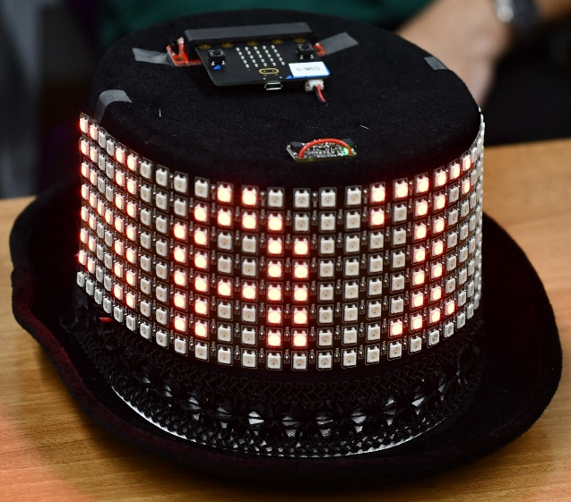
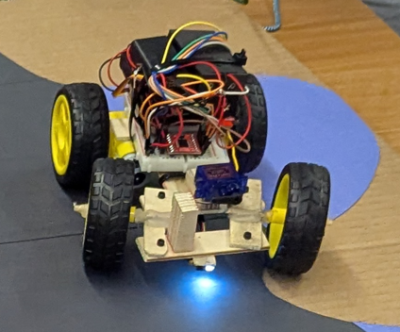
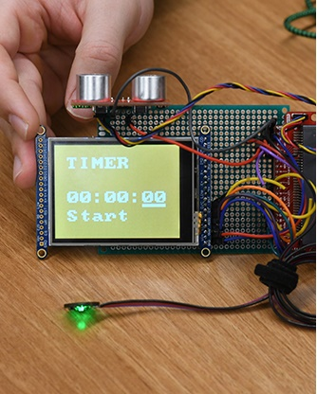



Some awesome projects – interactable objects

Slide 73





Some awesome projects – electronic music

Slide 74






Some awesome projects – playable games

Slide 75





Some awesome projects – interactable art and robotics

Slide 76
Outline
Who and Why
Embedded Systems
Microcontrollers
Course Overview
Class Hardware
Project Ideas

