Slide 1
Lecture 03 Digital I/O and Interrupts
CE346 – Microprocessor System Design
Branden Ghena – Spring 2026
Some slides borrowed from: Josiah Hester (Northwestern), Prabal Dutta (UC Berkeley)

Slide 2
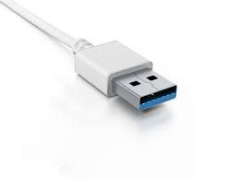
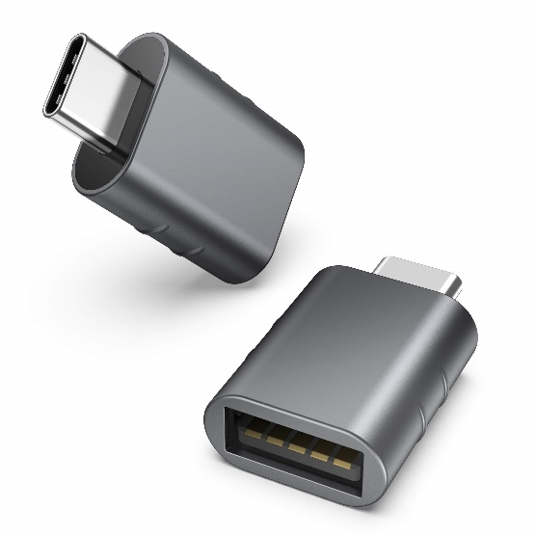
Administrivia
Lab on Friday!
Frances Searle room 3220
See you all there!!
Show up on-time. We are going to get started right away
None of this 5-10 minutes late nonsense
Bring a USB-C adapter if you need one
Remember that you need to attend the section you registered for in CAESAR
If you need to switch for a day, ask me for permission in advance on Piazza

Slide 3
Quiz coming soon
First quiz is next week Tuesday! (April 14)
15-minute quiz, taken in-class on paper
Last fifteen minutes of class
Bring a pencil
No notes, no calculator
Covers material from the last two weeks, including today. Both lecture and lab are relevant.
Goals:
The quiz is not meant to be difficult. It’s meant to keep you involved
Do review class material and make sure you actually understand it
If you have an accommodation, I emailed you earlier today

Slide 4
Today’s Goals
Two major parts today:
1. How does a microcontroller interact with peripherals?
Already discussed Memory-Mapped I/O
Interrupt and DMA mechanisms today
2. How do we interact with digital inputs and outputs?
GPIO peripheral for Digital I/O
GPIOTE peripheral for interrupts

Slide 5
Outline
I/O Motivation
Interrupts
DMA (Direct Memory Access)
Controlling digital signals: GIPO peripheral
Digital input interrupts: GPIOTE peripheral

Slide 6
Devices are the point of computers
Traditional systems need to receive input from users and output responses
Keyboard/mouse
Disk
Network
Graphics
Audio
Various USB devices
Embedded systems have the same requirement, just more types of IO
Computer
Processor
Memory
Devices
Control
Input
Datapath
Output

Slide 7
Devices are core to useful general-purpose computing
Input
Output
Mouse
Monitor
Computer
Keyboard
Headphones
Ethernet
Ethernet
Bluetooth
Bluetooth

Slide 8
Devices are essential to cyber-physical systems too
Input
Output
Lidar
Throttle Control
Computer
Inertial Measurement Unit
Brake Control
Camera
Wheel Rotation
CAN
CAN

Slide 9
Device access rates vary by many orders of magnitude
Rates in bit/sec
System must be able to handle each of these
Sometimes needs low overhead
Sometimes needs to not wait around
Device | Behavior | Partner | Data Rate (Kb/s)
Keyboard | Input | Human | 0.2
Mouse | Input | Human | 0.4
Microphone | Output | Human | 700.0
Bluetooth | Input or Output | Machine | 20,000.0
Hard disk drive | Storage | Machine | 100,000.0
Wireless network | Input or Output | Machine | 300,000.0
Solid state drive | Storage | Machine | 500,000.0
Wired LAN network | Input or Output | Machine | 1,000,000.0
Graphics display | Output | Human | 3,000,000.0

Slide 10
Outline
From last time: MMIO Wrap-up

Slide 11
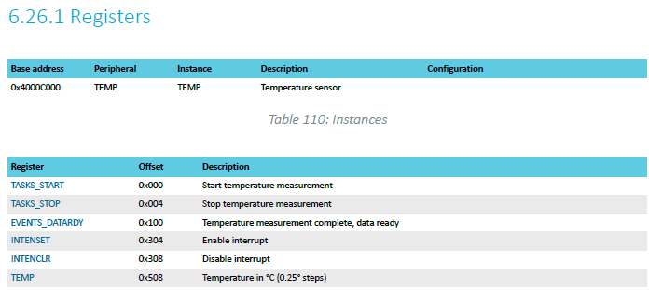
TEMP on nRF52833 example
Internal temperature sensor
0.25° C resolution
Range equivalent to microcontroller IC (-40° to 105° C)
Various configurations for the temperature conversion (ignoring)
https://docs.nordicsemi.com/bundle/ps_nrf52833/page/temp.html

Slide 12
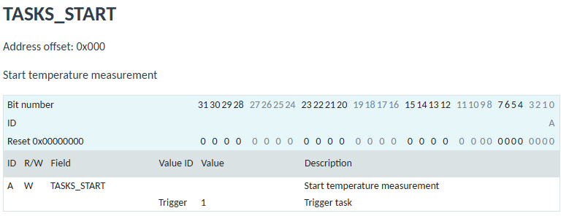
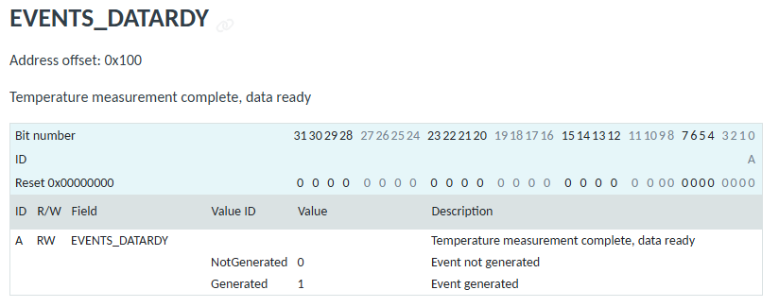
Interacting with the temperature peripheral

Slide 13
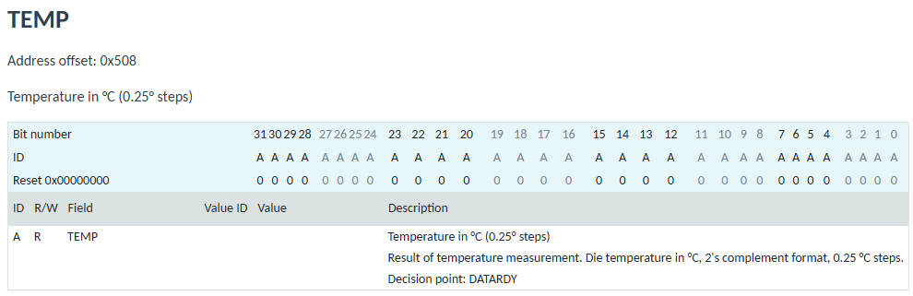
Reading a temperature value
32-bit value
2’s complement (i.e., signed)
0.25 ℃ steps (so 0 = 0℃, 4 = 1℃, etc.)

Slide 14
MMIO addresses for TEMP
What addresses do we need? (ignore interrupts for now)
0x4000C000 – TASKS_START
0x4000C100 – EVENTS_DATARDY
0x4000C508 - TEMP

Slide 15
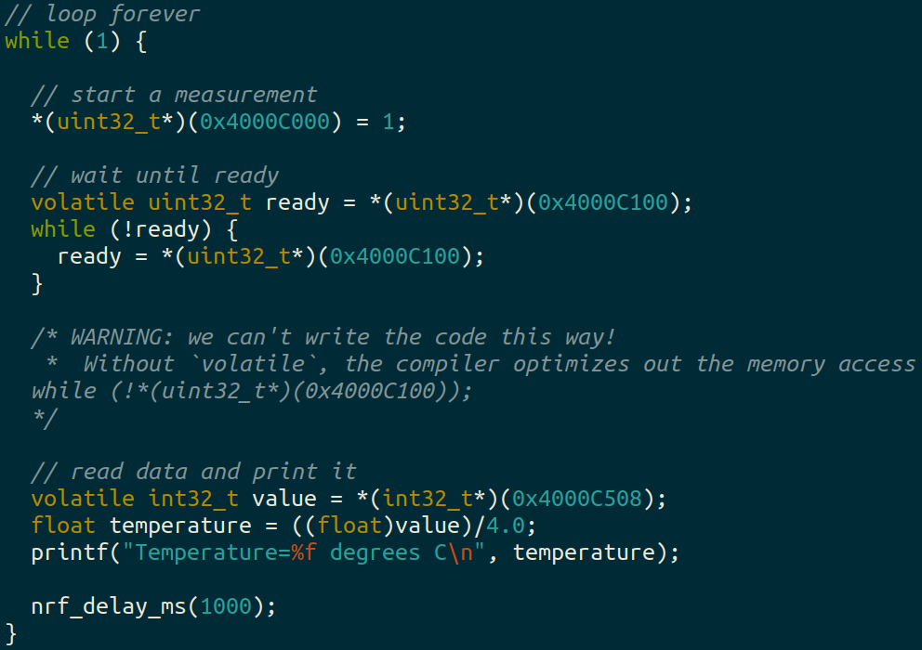
Example code (temp_mmio app)

Slide 16
Using structs to manage MMIO access
Writing simple C code and accessing peripherals is great!
Problems:
Need to remember all these long addresses
Need to make sure compiler doesn’t stop us!
Solution:
Wrap entire access in a struct!
Compilers turn it into the same thing in the end anyways

Slide 17
C structs
Collection of variables placed together in memory
typedef struct {
uint32_t variable_one;
uint32_t variable_two;
uint32_t array[2];
} example_struct_t;
Placement rules - Variables are placed adjacent to each other in memory except:
Fields are always aligned to a multiple of their size
Padding added to the end to make the total size a multiple of the biggest member
Microcontrollers can usually ignore these: all registers are the same size!

Slide 18
Temperature peripheral MMIO struct
typedef struct {
uint32_t TASKS_START;
uint32_t TASKS_STOP;
uint32_t _unused_A[62];
uint32_t EVENTS_DATARDY;
uint32_t _unused_B[0x204/4 - 1];
uint32_t INTENSET;
uint32_t INTENCLR;
uint32_t _unused_C[(0x508 – 0x308)/4 – 1];
uint32_t TEMP;
} temp_regs_t;
volatile temp_regs_t* TEMP_REGS = (temp_regs_t*)(0x4000C000);
With increasingly verbose ways to write the size of the “unused” space (any of these will do, but don’t forget the -1)

Slide 19
Temperature peripheral MMIO struct
typedef struct {
uint32_t TASKS_START;
uint32_t TASKS_STOP;
uint32_t _unused_A[62];
uint32_t EVENTS_DATARDY;
uint32_t _unused_B[0x204/4 - 1];
uint32_t INTENSET;
uint32_t INTENCLR;
uint32_t _unused_C[(0x508 – 0x308)/4 – 1];
uint32_t TEMP;
} temp_regs_t;
volatile temp_regs_t* TEMP_REGS = (temp_regs_t*)(0x4000C000);
// code to access
TEMP_REGS->TASKS_START = 1;
while (TEMP_REGS->EVENTS_DATARDY == 0);
float temperature = ((float)TEMP_REGS->TEMP)/4.0;
Accessing the struct accesses the individual memory locations where the registers live!

Slide 20
Using MMIO structs
Note: structs still don’t get you individual bits, they only get you the 32-bit registers themselves
You’ll need to do bit manipulations to get the read/write fields you want
Bit fields are an option in C that can allow access to individual bits, but are generally not used
Implementation-specific details for how they actually work
What if you need to change multiple fields simultaneously?

Slide 21
Break + Question
Are compiled binaries portable to other types of microcontrollers?

Slide 22
Break + Question
Are compiled binaries portable to other types of microcontrollers?
Definitely not
1) Each microcontroller has its own layout of Flash and RAM, so we might need to put our code in different locations
2) Each microcontroller has its own MMIO addresses and devices And every device works at least slightly differently
Can sometimes get away with it for microcontrollers in the same family
I.e., class code might work on an nRF52840 instead of our nRF52833

Slide 23
Outline
I/O Motivation
Interrupts
DMA (Direct Memory Access)
Controlling digital signals: GIPO peripheral
Digital input interrupts: GPIOTE peripheral

Slide 24
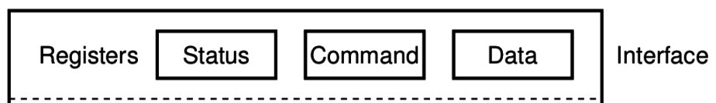
What do interactions with devices look like?
while STATUS==BUSY; Wait
(Need to make sure device is ready for a command)
Write value(s) to DATA
Write command(s) to COMMAND
while STATUS==BUSY; Wait
(Need to make sure device has completed the request)
Read value(s) from Data
This is the “polling” model of I/O.
“Poll” the peripheral in software repeatedly to see if it’s ready yet.

Slide 25
Waiting can be a waste of CPU time
while STATUS==BUSY; Wait
(Need to make sure device is ready for a command)
Write value(s) to DATA
Write command(s) to COMMAND
while STATUS==BUSY; Wait
(Need to make sure device has completed the request)
Read value(s) from Data
Problem: imagine a keyboard device
CPU could be waiting for minutes before data arrives
Need a way to notify CPU when an event occurs
Interrupts!

Slide 26
Interrupts
What is an interrupt?
Some event which causes the processor to stop normal execution
The processor instead jumps to a software “handler” for that event
Then returns back to what it was doing afterwards
What causes interrupts?
Hardware exceptions
Divide by zero, Undefined Instruction, Memory bus error
Software
Syscall, Software Interrupt (SWI)
External hardware
Input pin, Timer, various “Data Ready”

Slide 27
Interrupts, visually
Some code that’s executing

Slide 28
Interrupts, visually
Some code that’s executing
Interrupt triggers!
Interrupt handler code

Slide 29
Interrupts, visually
Some code that’s executing
Interrupt triggers!
Interrupt handler code
Continue original code

Slide 30
ARM Nested Vectored Interrupt Controller (NVIC)
Handles interrupt entry and exit
Stacking
Unstacking
Priorities
Interrupts can preempt other interrupts!
Jump directly to the interrupt handler
Manages interrupt requests (IRQ)
Stores all caller-saved registers on the stack
So the handler code doesn’t overwrite them
Moves execution to proper handler, a.k.a. Interrupt Service Routine (ISR)
Restores registers after handler returns and moves execution back

Slide 31
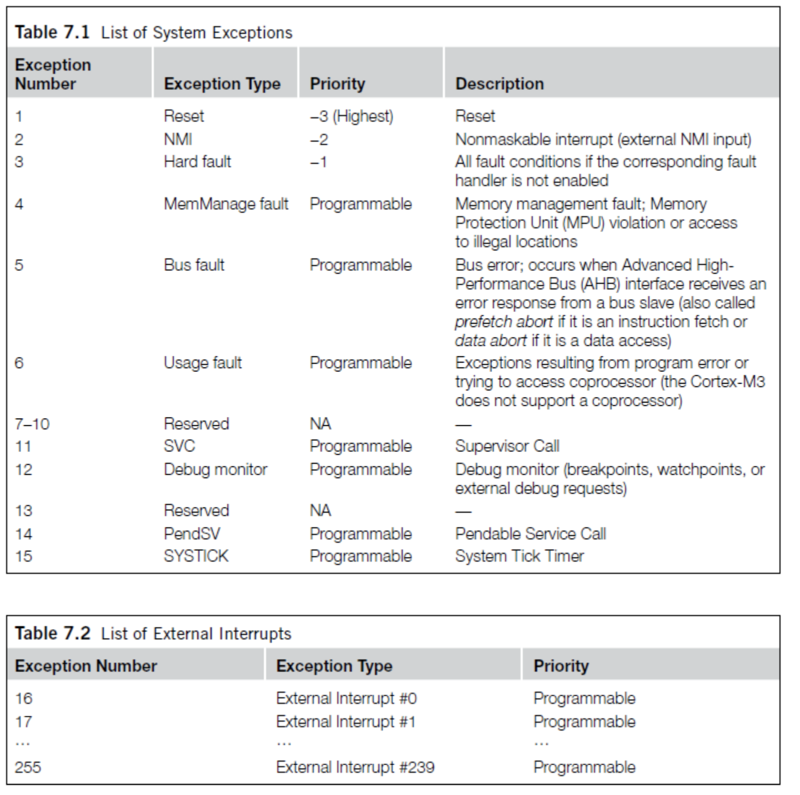
ARM Vector table
List of function pointers to handler for each interrupt/exception
First 15 are architecture-specific exceptions
After that are microcontroller interrupt signals

Slide 32
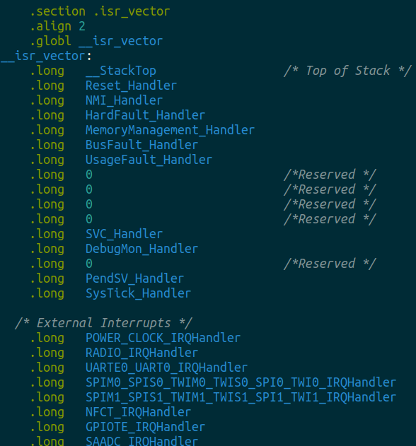
Vector table in software
Placed in its own section
LD file puts it first in Flash
Reset_Handler determines where software starts executing
After that are all exception and interrupt handlers
All function pointers to some C code somewhere matched by function name

Slide 33
ARM NVIC functionality
NVIC functions
NVIC_EnableIRQ(number)
NVIC_DisableIRQ(number)
NVIC_SetPriority(number, priority)
Technically 256 priorities
Only 8 are implemented
Must enable interrupts in two places!
Enabling event in the peripheral will generate the signal
Enabling interrupt in the NVIC will act on the signal, calling handler function
Priority determines which interrupt goes first
And determines how interrupts are nested

Slide 34
Nested interrupts, visually
Some code that’s executing
Interrupt triggers!
Interrupt handler
Higher priority Interrupt triggers!
Interrupt handler
continues
Continue original code

Slide 35
Generating interrupts on the nRF52
Peripherals can generate “events”
1-bit fields that get set when action occurs
There are Event registers that store the value
Peripherals can enable interrupts
Which connects the Event to the NVIC
ALSO has to be enabled in the NVIC to actually get an Interrupt
Advanced feature: Events can chain directly into Tasks
Tasks are 1-bit actions that a peripheral can take
Something occurring can automatically trigger something else to happen
PPI is the peripheral that makes these connections
(this is advanced stuff though, we’ll rarely use it if ever)

Slide 36
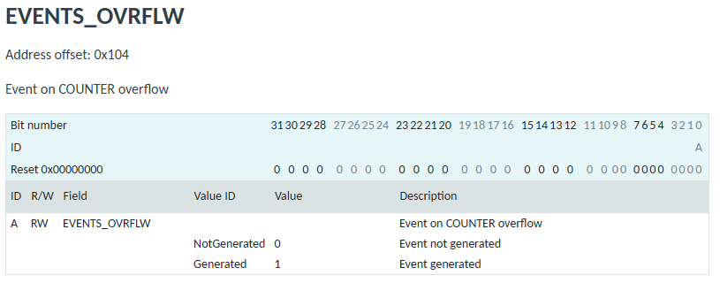
Example “EVENT” register
nRF-specific concept
Event registers record if some action has occurred
They are always 1-bit, with a 1 meaning “the action has occurred”
Up to the software to clear this register back to 0

Slide 37
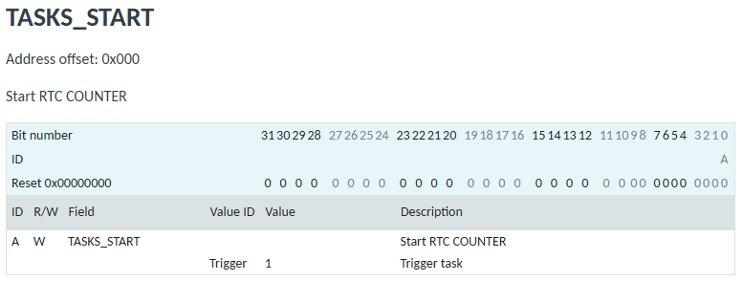
Example “TASK” register
nRF-specific concept
Task registers start some action
They are always 1-bit, with a 1 meaning “start the task”

Slide 38
Break + Open Question
When should a system use polling versus interrupts?

Slide 39
Break + Open Question
When should a system use polling versus interrupts?
Polling
Great if the device is going to respond immediately (like 1 cycle)
Important if we need to respond very quick (less than a microsecond)
Interrupts
Great if we’ll need to wait a long time for status to change
Still responds pretty quickly, but not immediately
Needs to context switch from running code to interrupt handler

Slide 40
Outline
I/O Motivation
Interrupts
DMA (Direct Memory Access)
Controlling digital signals: GIPO peripheral
Digital input interrupts: GPIOTE peripheral

Slide 41
Direct Memory Access (DMA)
Even with interrupts, providing data to the peripheral is time consuming for transferring lots of data
Need to be interrupted every byte, to copy the next byte over
DMA is an alternative method that uses hardware to do the memory transfers for the processor
Software writes address of the data and the size to the peripheral
Peripheral reads data directly from memory
Processor can go do other things while read/write is occurring

Slide 42
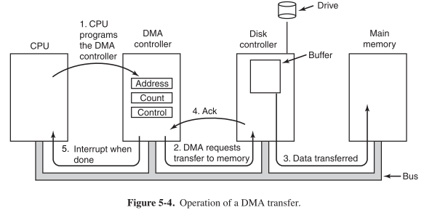
General-purpose DMA

Slide 43
Full peripheral interaction pattern
Configure the peripheral
Enable peripheral interrupts
Set up peripheral DMA transfer
Start peripheral
Continue on to other code
Interrupt occurs, signaling DMA transfer complete
Set up next DMA transfer
Continue on to other code, and repeat

Slide 44
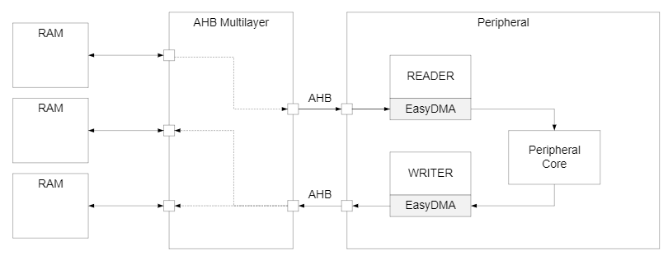
Special-purpose DMA
nRF52 uses “EasyDMA”, which is built into individual peripherals
Only capable of transferring data in/out of that peripheral
Easier to set up and use in practice
Only available on some peripherals though (no DMA for TEMP or GPIO)
Warning: addresses for DMA buffer MUST be in RAM!

Slide 45
Break + Question
What kinds of peripherals/devices should you use the DMA for?

Slide 46
Break + Question
What kinds of peripherals/devices should you use the DMA for?
Anything where there is a lot of data coming in over a period of time
Either a big buffer of lots of data, like a radio message
Or a bunch of individual samples, coming in quickly
Devices
Messages to/from other devices (radios, wired busses)
Sensor readings (if read quickly/continuously)
Canonical example from general computing: disks (HDD/SSD)

Slide 47
Outline
I/O Motivation
Interrupts
DMA (Direct Memory Access)
Controlling digital signals: GIPO peripheral
Digital input interrupts: GPIOTE peripheral

Slide 48
Digital signals
Simplest form of I/O
Exist in two states:
High (a.k.a. Set, a.k.a. 1)
Low (a.k.a. Clear, a.k.a. 0)
Simpler to interact with
Constrained to two voltages
With quick transitions between the two
No math for voltage level
Either high or low

Slide 49
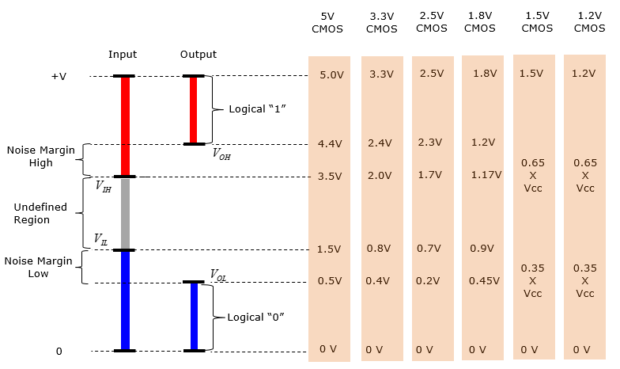
Digital signals map to voltage ranges
Upper range is high signal
~0.7*VDD
Bottom range is low signal
~0.3*VDD
Middle is undefined
Only exists during transitions
http://www.sharetechnote.com/html/Electronics_CMOS.html

Slide 50
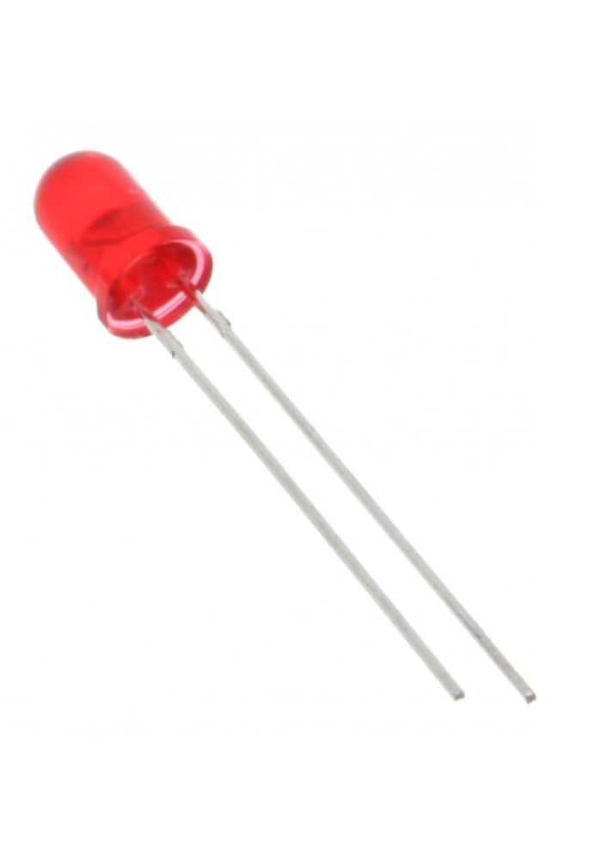
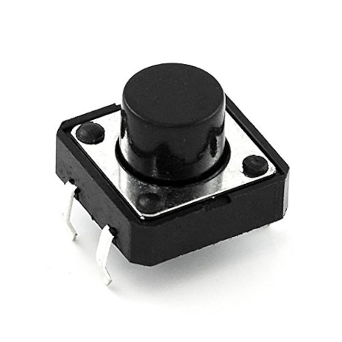
Digital Input/Output
Read/write from/to external pins on the microcontroller
Two possible values: high (1) or low (0)
Basic unit of operation for microcontrollers
Allows them to interact with buttons and LEDs
Many computer-to-computer wired protocols are digital
Every microcontroller has Digital I/O

Slide 51
Some terminology
Pins can be inputs or outputs
Output pins can be:
High or Set or 1
Low or Cleared or 0
Input pins can read an externally connected value
Which is translated into either High or Low
Middle remains undefined. It’ll be High or Low though

Slide 52
Controlling Digital I/O
Outputs
Configure pin as an output
Set or Clear it
Inputs
Configure pin as an input
Read it
That’s about it. Digital I/O peripherals all look something like this
Every Digital I/O peripheral also has some “special features” of some kind or another, which vary with the Microcontroller

Slide 53
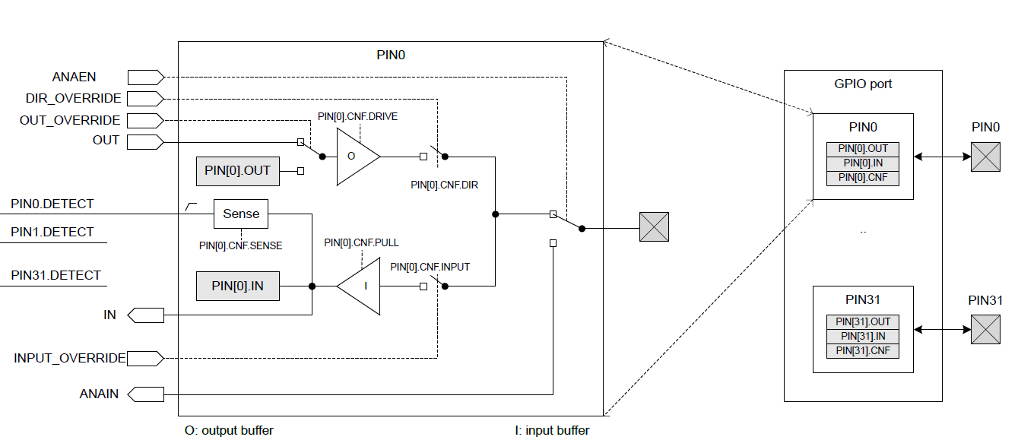
nRF52833 GPIO Peripheral

Slide 54
nRF52 GPIO Output
Outputs a high or low signal
Output configurations
High drive output (either for high, low, or both)
Sources or sinks additional current
For powering external devices
Normal drive: ~2 mA
High drive: ~10 mA
Disconnect (a.k.a. High Impedance or High-Z)
Wired-OR or Wired-AND scenarios (we’ll talk about these later in class)

Slide 55
nRF52 GPIO Input
Reads in a signal as either high or low
Input Configurations
Input buffer connect/disconnect
Allows the pin to be completely disabled if not being read from
Pull
Disabled, Pulldown, Pullup (we’ll discuss in a future lecture)
Connects an internal pull up/down resistor (~13 kΩ)
Sets default value of input

Slide 56
Electrical specifications
High voltage range: 0.7*VDD to VDD (~2.3 volts)
Low voltage range: Ground to 0.3*VDD (~1 volt)
GPIO are extremely fast
Transition time is <25 ns
Connected directly to memory bus for faster interactions
This allows complicated signal patterns to be replicated in software
If they aren’t implemented as a hardware peripheral
Known as “bit-banging”

Slide 57
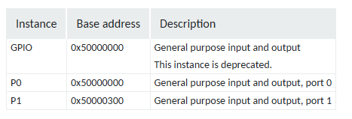
GPIO Instances
The nRF52833 has two GPIO peripheral “instances”
Several peripherals have multiple instances. For example, multiple timers
Each instance functions independently
Each instance has its own copy of MMIO registers
For the GPIO, each instance controls one Port
Port 0 with 32 pins
Port 1 with 10 pins

Slide 58
Accessing nRF52833 pins in software
Pins are collected into “Ports”
Each Port has 32 pins
42 total GPIO pins
Port 0 – pins 0-31
Port 1 – pins 0-9
Referred to as P[port].[pin]
For example: P0.20, P1.08, P0.00

Slide 59
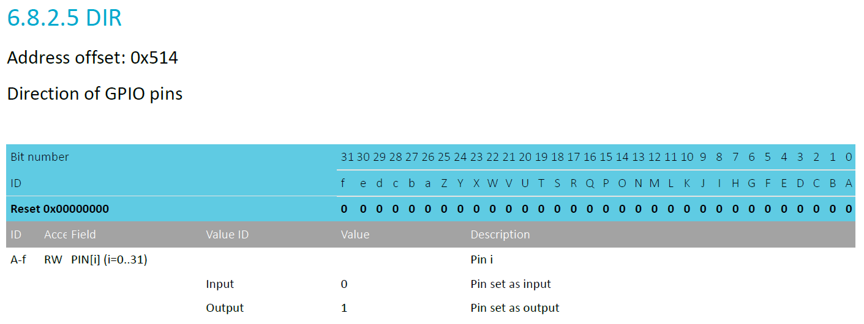
Pin configuration
DIR register controls direction (input or output) for each pin
Each bit 0-31 corresponds to pin 0-31
Reset value: 0x00000000 -> all pins are inputs by default

Slide 60
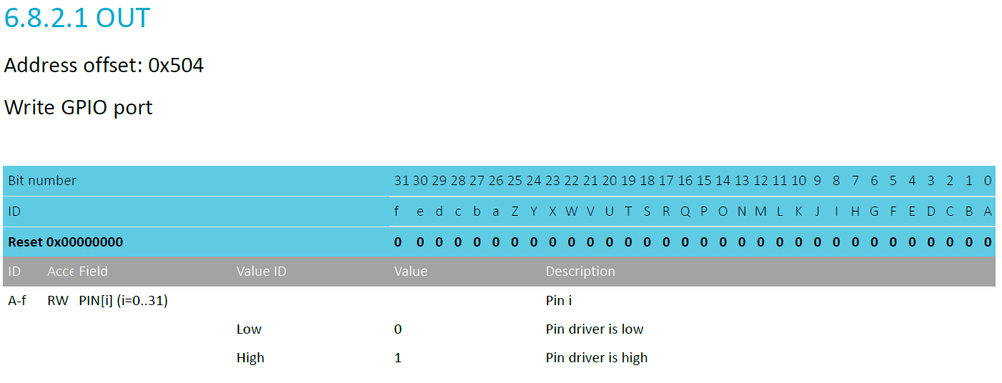
Controlling output level
OUT register controls whether each pin is high or low
Only meaningful if the pin is configured as an Output
Again, each bit is a single pin and reset is 0x00000000 (all pins low)

Slide 61
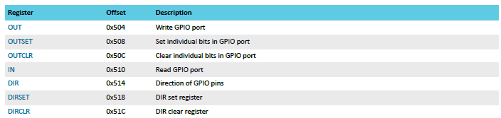
*Set/*Clear registers
OUT works traditionally: write a 1 for high, 0 for low
OUTSET write a 1 to set that pin (high) zero has no effect
OUTCLR write a 1 to clear that pin (low) zero has no effect
Lets you modify a pin without modifying the others (or reading first)

Slide 62
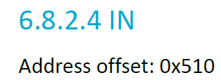
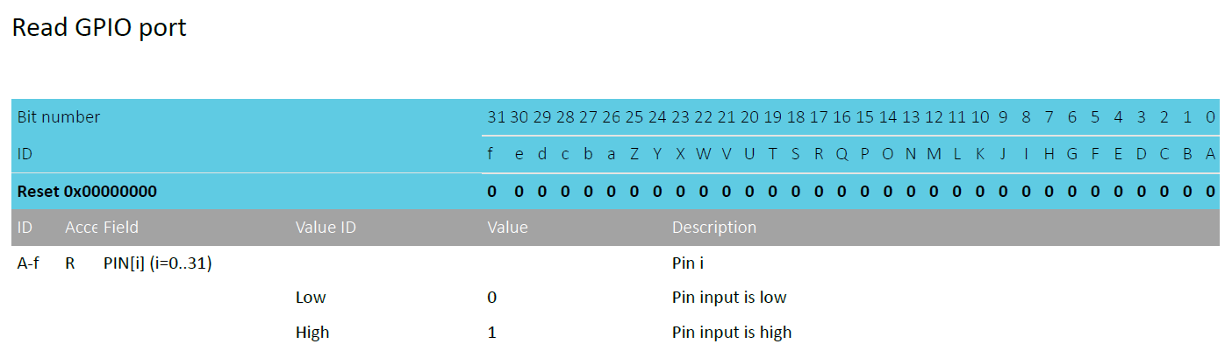
Reading input levels
IN register allows you to read the value for an input pin
Each bit 0-31 corresponds to pin 0-31
Read-only register. Writing has no effect
For Port1, pins >= 10 are undefined (data sheet doesn’t mention it)

Slide 63
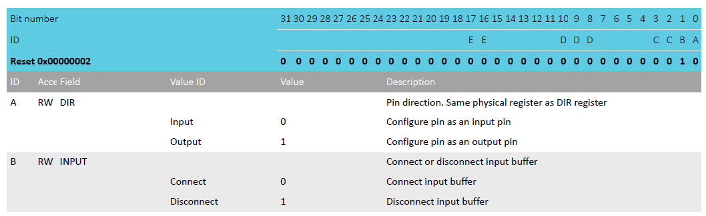
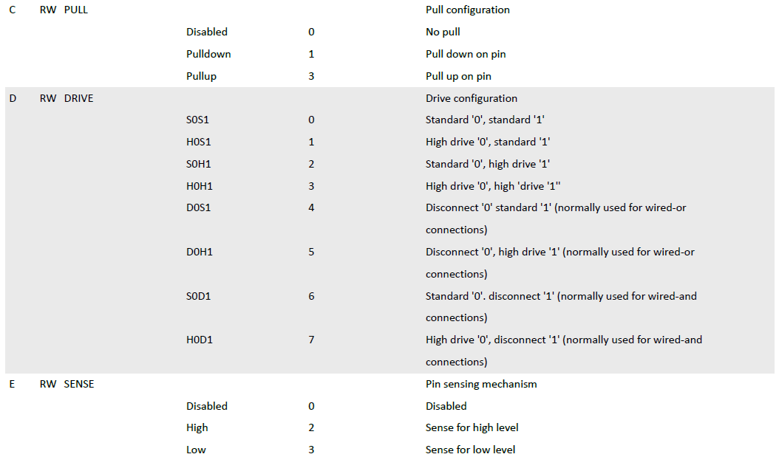
Complex configuration
If you want to change other pin configurations, you do so per pin with the PIN_CNF[n] registers
There are 32 of them, one per pin
Various fields correspond to different groups of bits
Direction, Input buffer, Pullup/down, Drive strength, Sensing mechanism
Bits not part of a field should be ignored
Do not modify them

Slide 64
Break + Question
Reset value is 0x2
What are the default configurations here?

Slide 65
Break + Question
Reset value is 0x2
What are the default configurations here?
DIR: Input
INPUT: Disconnected
PULL: Disabled
DRIVE: Standard 0/1
SENSE: Disabled

Slide 66
Outline
I/O Motivation
Interrupts
DMA (Direct Memory Access)
Controlling digital signals: GIPO peripheral
Digital input interrupts: GPIOTE peripheral

Slide 67
Handling interrupts from GPIO
Separate peripheral, GPIOTE (GPIO Task/Event)
Manages up to 8 individual pins (8 “channels”)
Can read input pins and trigger Events
Also has Tasks for setting/clearing outputs pins
Unclear to me why this is a separate peripheral
Presumably too complicated/expensive to have 42 of them
Newest nRF54 series still does the same thing

Slide 68
Configuring individual input interrupts
Pick an available GPIOTE channel (0-7)
Configure it
Port and Pin number
Task (output), Event (input), or Disabled
Polarity for input events
Low-to-high
High-to-low
Toggle (both directions)
Enable interrupts for channel in GPIOTE (and in NVIC!)
Clear event in interrupt handler
Doesn’t happen automatically!

Slide 69
What if you need more than 8 interrupt sources?
Can trigger interrupts for a “Port event” as well
Any pin in the Port can trigger the interrupt
Software checks which pin(s) caused the event to occur
Very low power operation (works with system clocks off)
Whereas normal GPIOTE operations are not low power

Slide 70
Sensing port events
A Port event is a coordination between GPIO and GPIOTE peripherals
GPIO can configure pins with a SENSE option
Disabled
Trigger on High level
Trigger on Low level
GPIOTE port event will occur if one or more pins matches their SENSE configuration
Software will get an interrupt (if the NVIC is configured)
Software checks each pin to determine which one caused the event

Slide 71
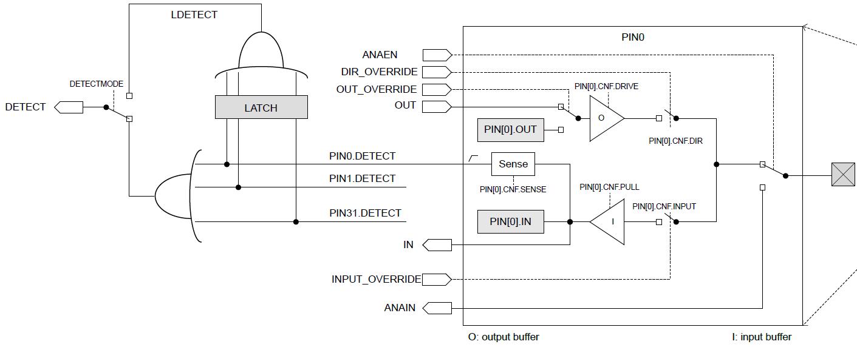
Port events can also be “latched”
Latching saves the value unless cleared

Slide 72
GPIO vs GPIOTE
GPIO peripheral is used to
Configure, set/clear, and read pins normally from software
GPIOTE peripheral is used to
Get an interrupt when an input pin changes
Advanced feature: also able modify output pins based on some event occurring
Hardware event triggers hardware task (again, rarely used)

Slide 73
Outline
I/O Motivation
Interrupts
DMA (Direct Memory Access)
Controlling digital signals: GIPO peripheral
Digital input interrupts: GPIOTE peripheral

