Slide 1
Lecture 06 Sensors
CE346 – Microcontroller System Design
Branden Ghena – Spring 2026
Some slides borrowed from: Josiah Hester (Northwestern), Prabal Dutta (UC Berkeley)

Slide 2
Administrivia
Project Proposals due later this week
Feel free to chat with me if you’ve got any questions about ideas
Emailed project groups already
If you’re still looking for a group, or another group member, let me know
Goal to get you feedback next week
Will likely focus on groups I’m concerned about though
No news is good news

Slide 3
Campus resources for prototyping
Ford Prototyping Lab has lots of resources that could be useful
Machine shop and hand tools
Laser cutters
3D printing
https://design.northwestern.edu/about/design-facilities/prototyping-lab.html
Mudd Library has 3D printing support as well
Often free to use for classes
https://www.library.northwestern.edu/use-the-libraries/technology-multimedia/makerlab-3d-printing/

Slide 4
Today’s Goals
Think about sensing and sensors
Explore a variety of sensor types, how they are made, and what their capabilities are
Discuss output devices as well: actuators
Generally: do an overview of what exists and how it works
Embedded systems is a mile wide and an inch deep
Goal is to have a basic understanding of many things
And then build a deeper understanding of the stuff you use

Slide 5
Outline
Sensing Overview
Types of Sensors
Temperature
Light
Inertial
Others
Capacitive Touch Sensing
Actuators

Slide 6
Definitions
A sensor is a device that measures a physical quantity
Temperature sensor
Light sensor
Microphone
An actuator is a device that modifies a physical quantity
Heater
Motor
Speaker

Slide 7
Analog signals
Exist in infinite states
From a maximum to a minimum
Often used for interactions with the real world
Sensors usually generate analog signals
Microbit example: microphone

Slide 8
Sensors transform quantity into an electric signal
Microcontrollers can interact with analog signals
Generating an analog signal proportional to physical quantity makes the quantity able to be sensed
Microcontrollers will transform this analog signal into a binary value with an analog-to-digital converter
How do we generate an electrical signal?
Ohm’s Law: V = I * R (Voltage = Current * Resistance)
Vary any one of these three and an analog signal is created
Resistive sensors are common
As are sensors that produce a voltage/current

Slide 9
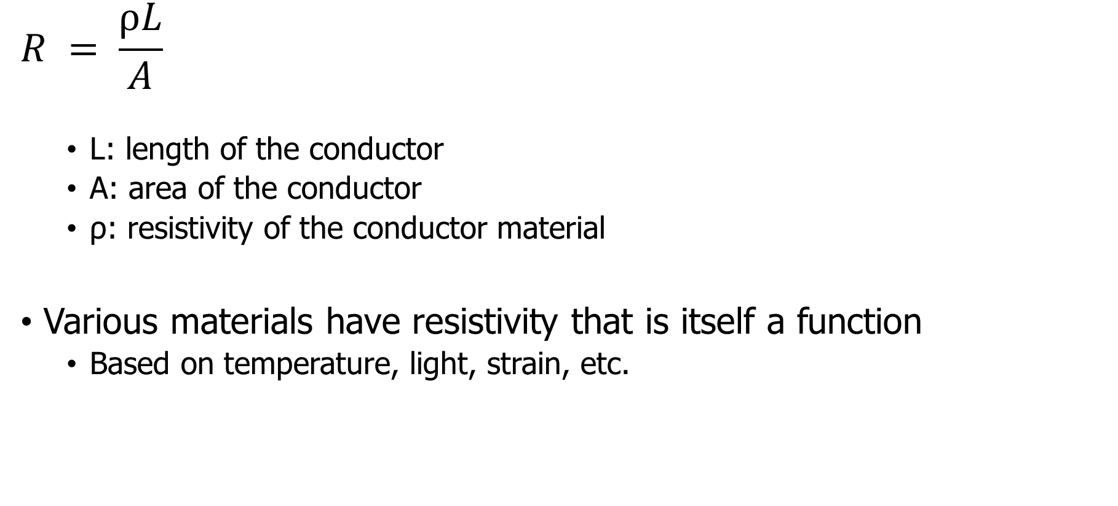
Resistive sensors
$$R = \frac{ρL}{A}$$
L: length of the conductor
A: area of the conductor
ρ: resistivity of the conductor material
Various materials have resistivity that is itself a function
Based on temperature, light, strain, etc.

Slide 10
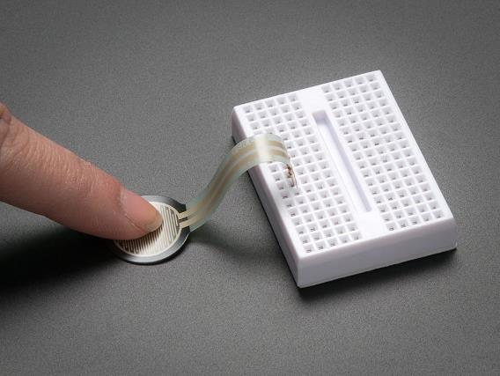
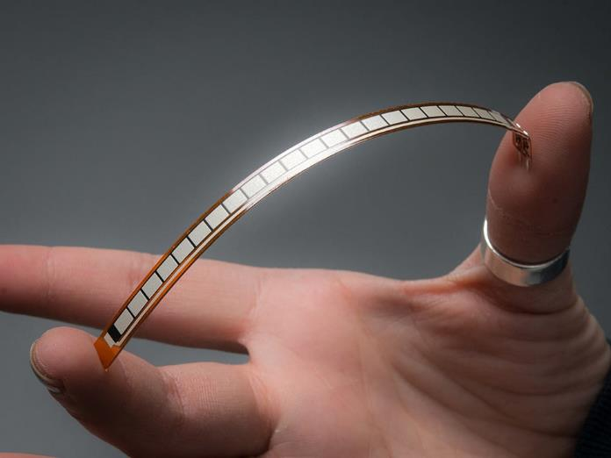
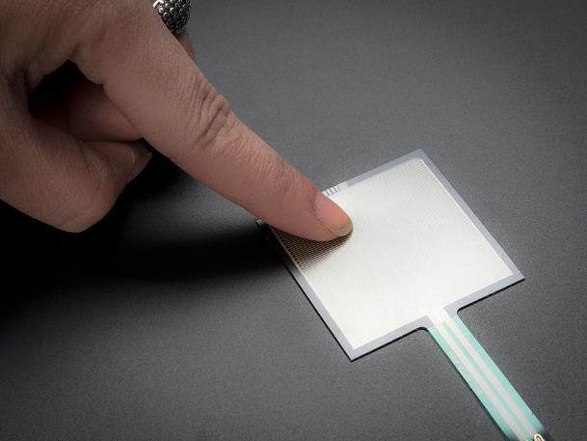
Force-sensitive resistor
Vary resistance based on pressure or flex
Various shapes and sizes

Slide 11
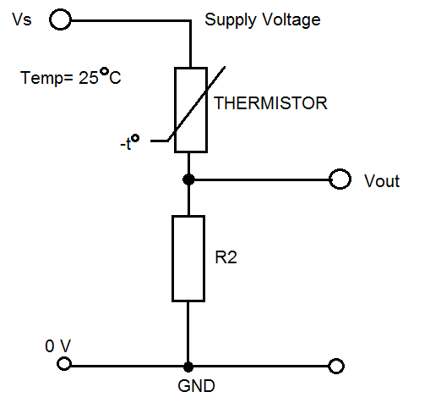
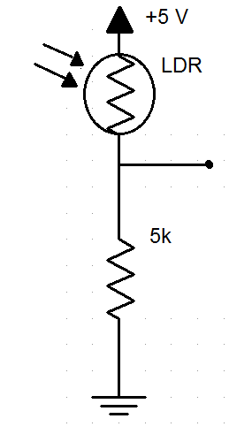
Using a resistive sensor
Place in series with another resistor
Between VCC and ground
Measure voltage between the two relative to ground
Forms a “voltage divider”

Slide 12
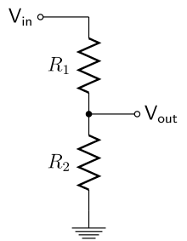
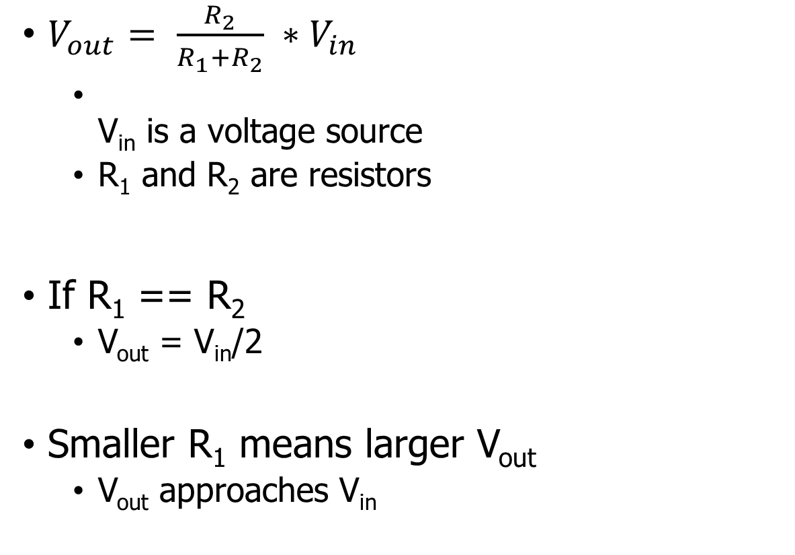
Voltage divider
Important! Learn this
$V_{out}= \frac{R_{2}}{R_{1}+R_{2}} ∗V_{in}$
V_{in} is a voltage source
R₁ and R₂ are resistors
If R₁ == R₂
V_{out} = V_{in}/2
Smaller R₁ means larger V_{out}
V_{out} approaches V_{in}

Slide 13
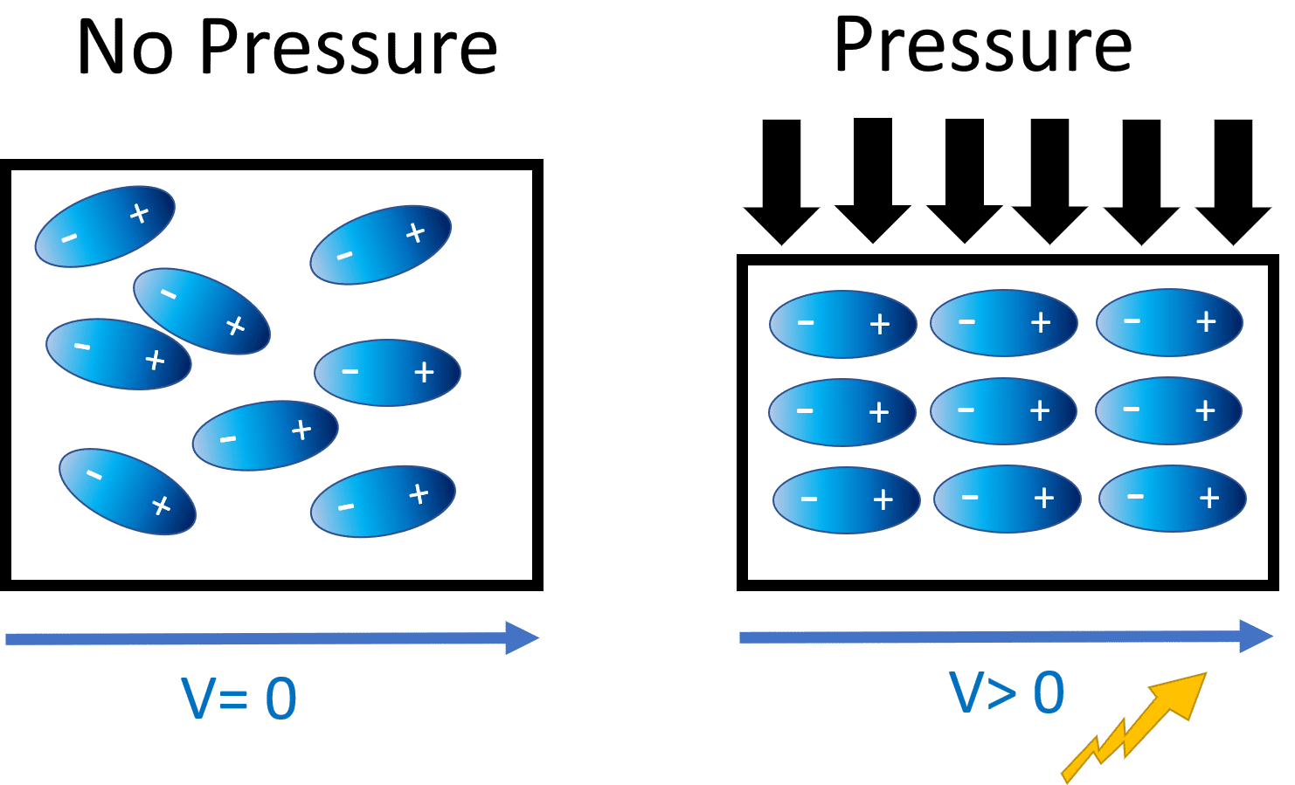
Generating voltage via piezoelectric effect
Compression of the material generates a voltage
Various sources of compression:
Air Pressure
Acceleration
Strain
Alternative to resistive sensors. But, a voltage is still the output

Slide 14
Understanding sensor voltage
Once you get a voltage, what do you do with it?
Need to understand the transfer function between voltage and the sensed quantity
Examples for an accelerometer: senses acceleration
Hopefully, function is linear
Frequently, function is NOT

Slide 15
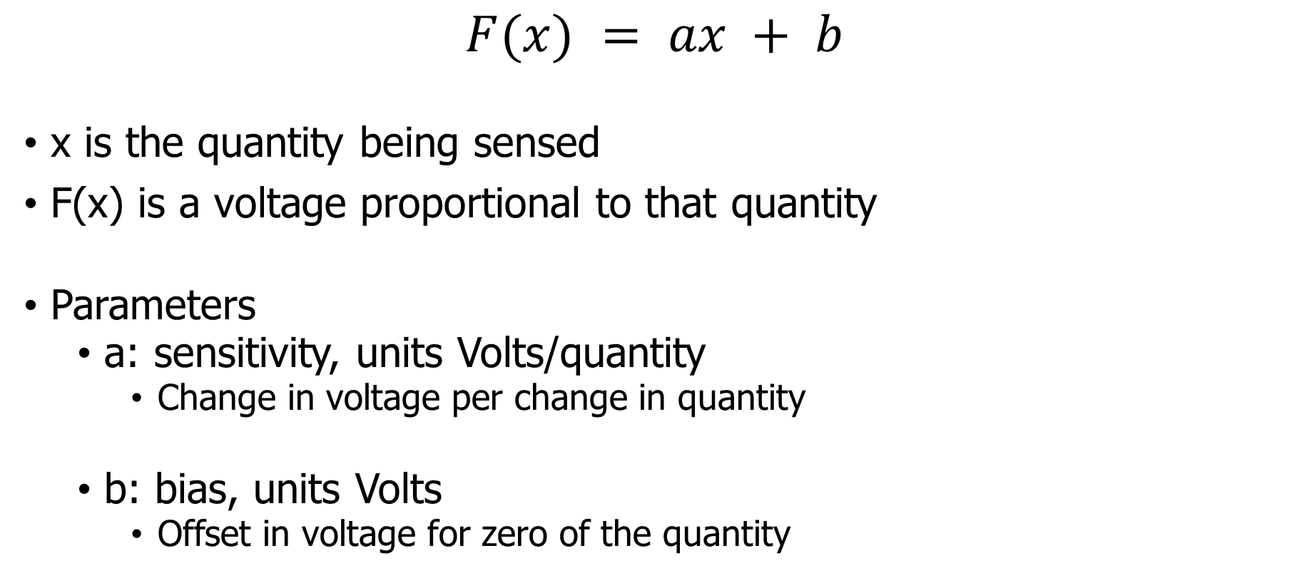
Affine sensor model (for linear sensors)
$$F(x) = ax + b$$
x is the quantity being sensed
F(x) is a voltage proportional to that quantity
Parameters
a: sensitivity, units Volts/quantity
Change in voltage per change in quantity
b: bias, units Volts
Offset in voltage for zero of the quantity

Slide 16
Bias and sensitivity example
Accel
x(g)
-3.6
0
3.6
0
1.5
3.0
V_{readout} (V)
F(x)
F(x) = ax+b
b = 1.5
a = 1.5/3.6 = 0.417 V/g

Slide 17

Break + Question
$$F(x) = ax + b$$
x is the quantity being sensed
F(x) is a voltage proportional to that quantity
a: sensitivity, units Volts/quantity
Change in voltage per change in quantity
b: bias, units Volts
Offset in voltage for zero of the quantity
Accelerometer
Measures 0-5 g
Over a 0-5v range
What is sensitivity?
What is bias?
What acceleration is the voltage reading 3.5 volts?

Slide 18

Break + Question
$$F(x) = ax + b$$
x is the quantity being sensed
F(x) is a voltage proportional to that quantity
a: sensitivity, units Volts/quantity
Change in voltage per change in quantity
b: bias, units Volts
Offset in voltage for zero of the quantity
Accelerometer
Measures 0-5 g
Over a 0-5v range
What is sensitivity? 1 v/g
What is bias? 0 v
What acceleration is the voltage reading 3.5 volts?
3.5 v = 1v/g * x + 0v -> 3.5 g

Slide 19
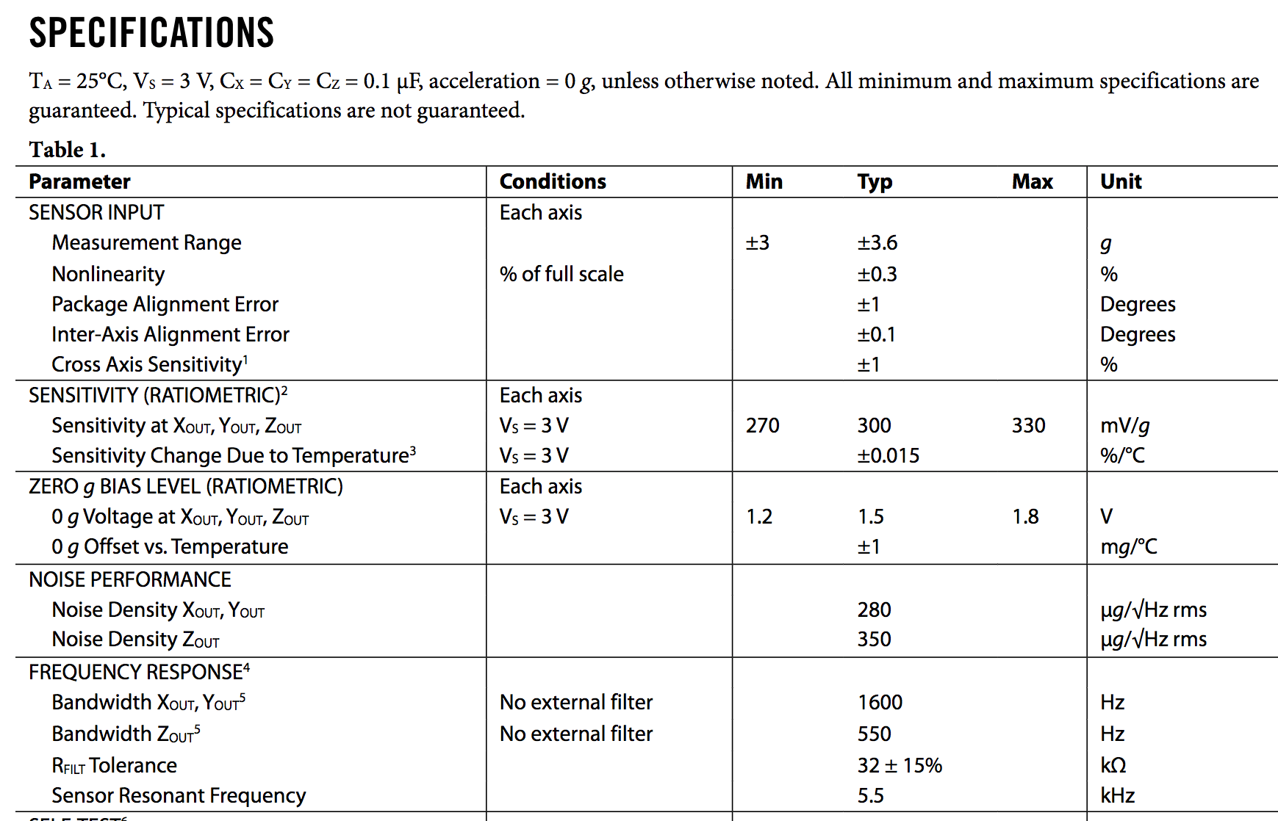
Understanding transfer function: ADXL330 datasheet
Sensitivity and Bias are listed values
Ratiometric
Relative to voltage the system is powered at

Slide 20
Understanding transfer function: ADXL330 datasheet
Bandwidth
≈Data update speed of the sensor
Data changes above 1600 Hz are less detectable
Various other features listed that you may or may not care about

Slide 21
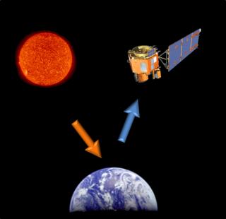
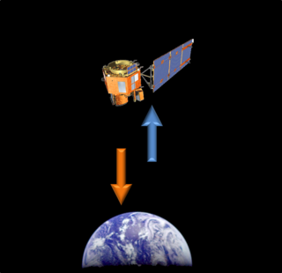
Active and passive sensing
Passive Sensing
Active Sensing

Slide 22
Active and passive sensing
We usually focus on passive sensing
Cheaper and lower energy costs!
Active sensing examples
Flash photography
Ultrasonic distance sensing
Lidar and Radar

Slide 23
Outline
Sensing Overview
Types of Sensors
Temperature
Light
Inertial
Others
Capacitive Touch Sensing
Actuators

Slide 24
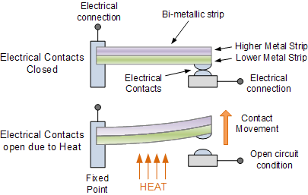
Digital temperature sensor
Thermostat
Original meaning of the word
Heat bends a strip of two different metals
Switches circuit on/off based on the temperature

Slide 25
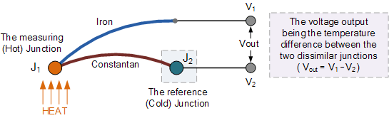
Thermo-electric temperature sensing
Thermocouple generates a voltage based on temperature
Can be used to harvest energy to run system

Slide 26
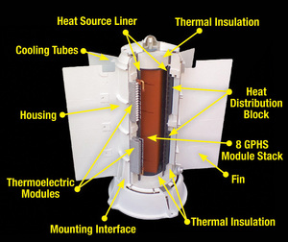
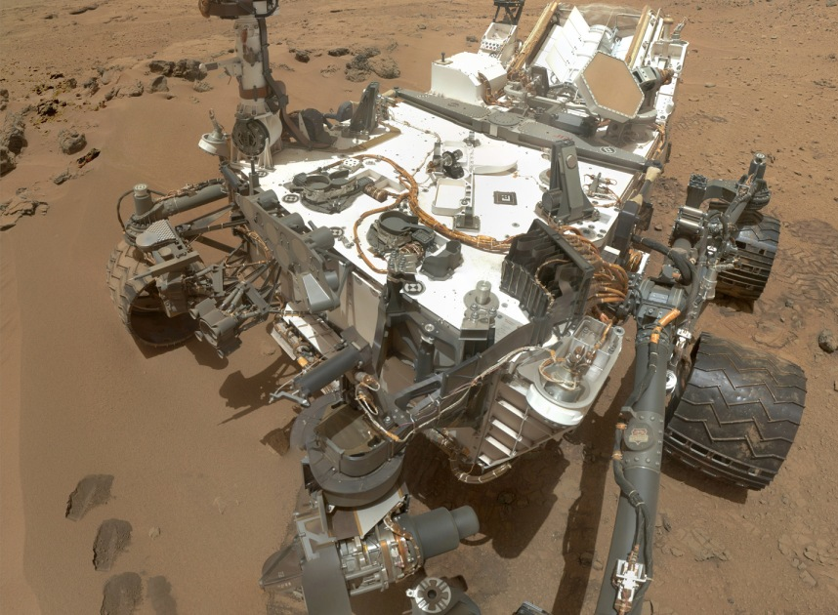
Thermocouples are used in an RTG to power Mars rovers
Radioisotope Thermoelectric Generator
Nuclear source creates heat
Thermocouples convert heat to electricity
Reliable energy source for space!
Solar panels get dusty on Mars, and sunlight has reduced energy at great distances
In first year: 125 W
After 14 years: 100 W
Curiosity has been running this long
Used for other deep-space missions too
Voyager, New Horizons, Cassini, Dragonfly
http://large.stanford.edu/courses/2012/ph240/belanger2/
https://en.wikipedia.org/wiki/Multi-mission_radioisotope_thermoelectric_generator

Slide 27
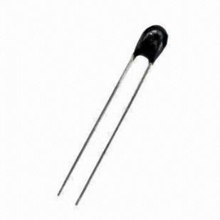
Resistive temperature sensing
Thermistor varies resistance based on temperature
Set up as a voltage divider to measure
Advantages: extremely cheap and easy to use
Disadvantages: non-linear transfer function

Slide 28
Outline
Sensing Overview
Types of Sensors
Temperature
Light
Inertial
Others
Capacitive Touch Sensing
Actuators

Slide 29
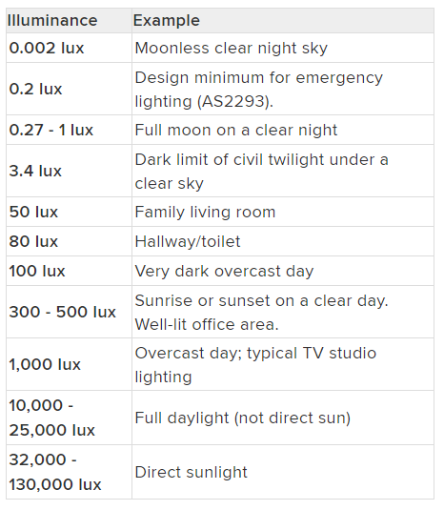
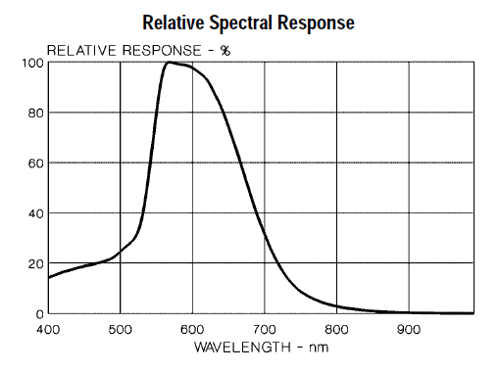
Measuring light
Lux: unit of illuminance
Beware spectrum sensitivity

Slide 30
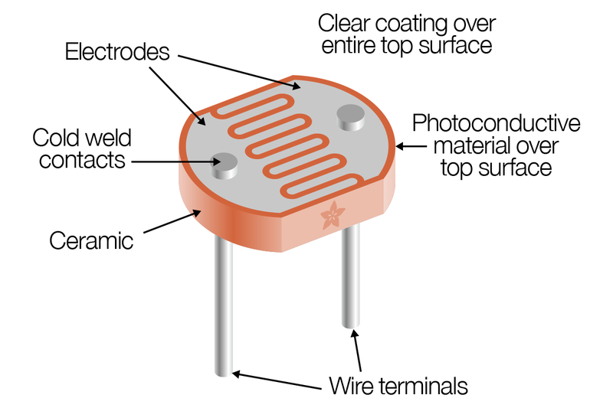
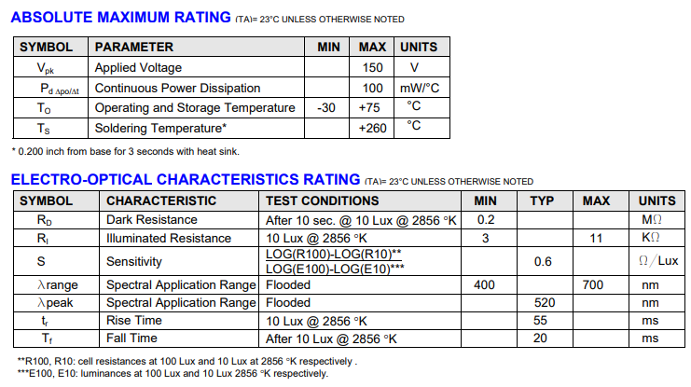
Resistive light sensing
Photocell changes resistance with light (non-linear)
Kit version:
10 kΩ when dark
1 kΩ when light

Slide 31
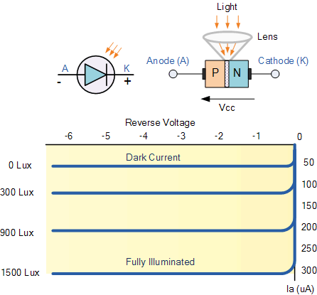
Photodiodes leak current based on light levels
When voltage is applied in reverse to an ideal diode, no current flows
But some small amount of current leaks for real-world diodes
Proportional to light levels!
LEDs can be used as (crappy) photodiodes as well!
Apply reverse voltage
Read in leak current as voltage across a resistor using ADC
https://wiki.analog.com/university/courses/electronics/electronics-lab-led-sensor

Slide 32
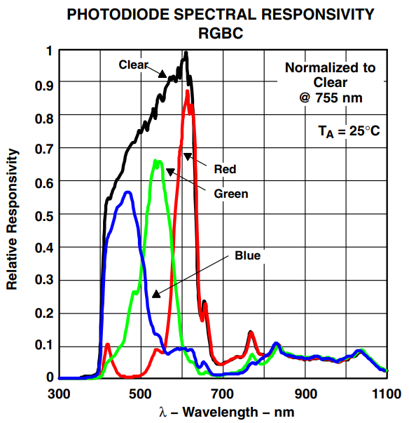
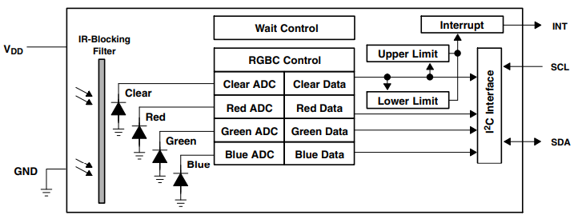
Light color sensing
Respond to specific light colors separately
Intelligent sensor: photodiodes combined with ADCs and a wired interface (I2C)
Allows interrupting based on comparator too

Slide 33
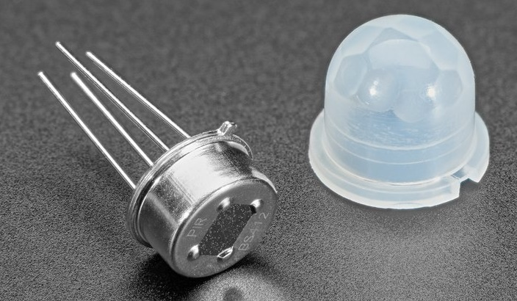
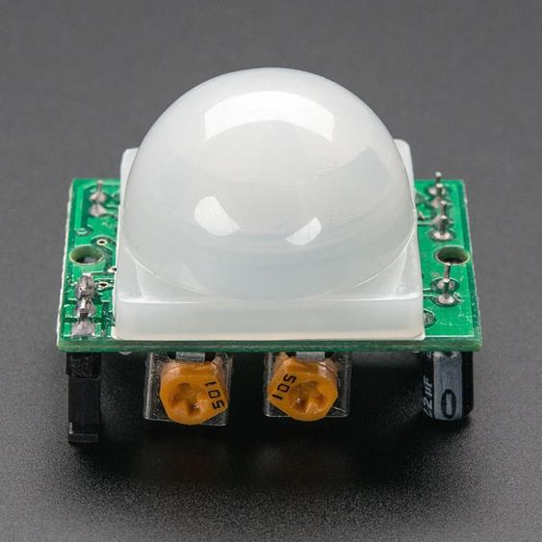
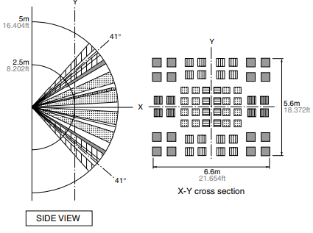
Passive Infrared (PIR) sensor
Detect movement in the environment
By detecting change in IR levels
“Motion” sensor
Often come with plastic lens cover to improve field of view and range

Slide 34
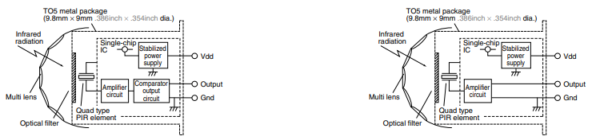
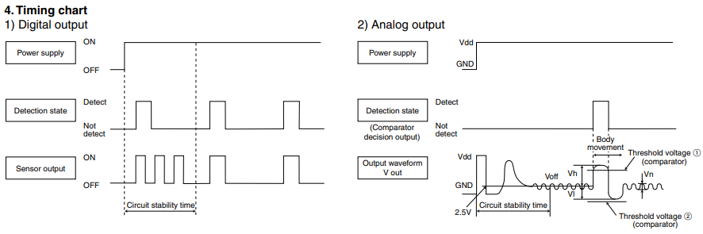
PIR sensors come in digital and analog forms
Digital includes a preconfigured comparator

Slide 35
Outline
Sensing Overview
Types of Sensors
Temperature
Light
Inertial
Others
Capacitive Touch Sensing
Actuators

Slide 36
Inertial Measurement Unit (IMU)
IMUs (a.k.a 9 degree-of-freedom, 9DOF) are used for tracking motion of a device
Acceleration (X, Y, Z axes)
Rotation (X, Y, Z axes)
Magnetism (X, Y, Z axes)
Sometimes 6DOF with Acceleration + one of the others
Intelligent sensing: combines multiple sensors, ADCs, and computation with a wired interface
9 analog inputs would otherwise be too many
Can be used to track motion, determine transportation method
Smartphones, Robotics, etc.

Slide 37
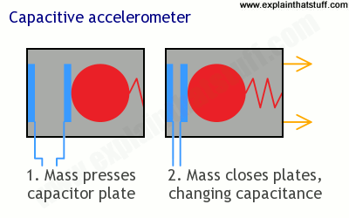
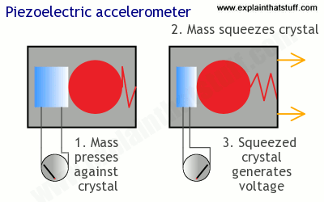
Sensing acceleration
Goal: create a voltage that changes based on force

Slide 38
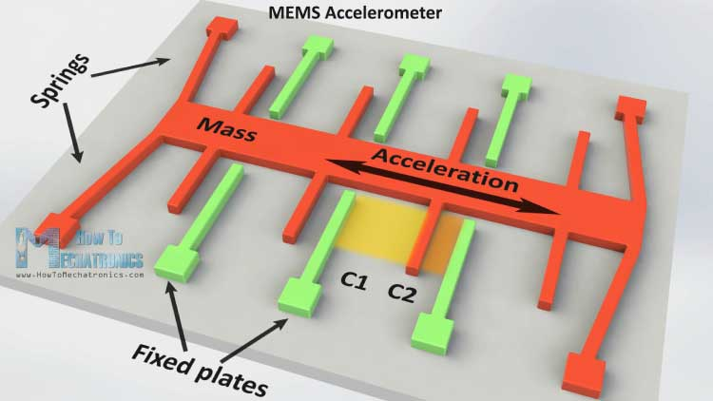
Microelectromechanical Systems (MEMS)
Same concept, but within an IC and 1 to 100 micrometers in size

Slide 39
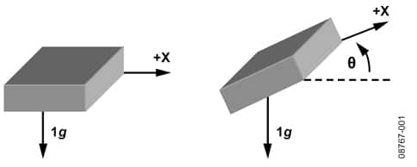
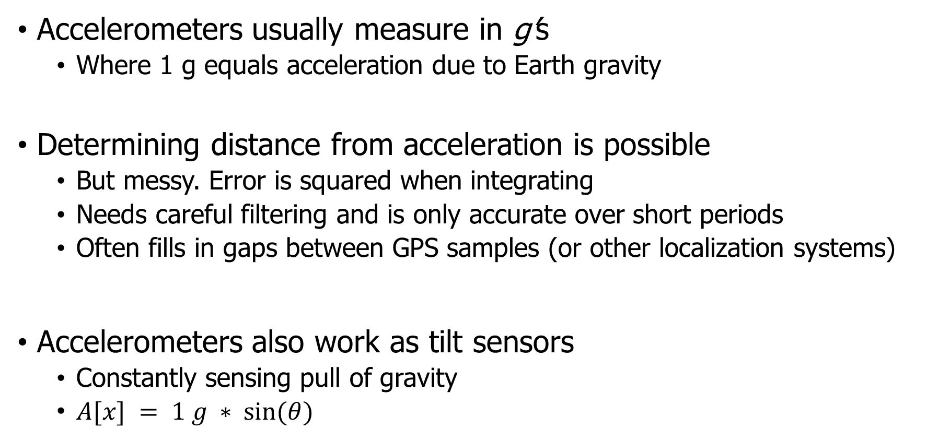
Using accelerometers
Accelerometers usually measure in g’s
Where 1 g equals acceleration due to Earth gravity
Determining distance from acceleration is possible
But messy. Error is squared when integrating
Needs careful filtering and is only accurate over short periods
Often fills in gaps between GPS samples (or other localization systems)
Accelerometers also work as tilt sensors
Constantly sensing pull of gravity
$A[x] = 1 g ∗ sin⁡(θ)$

Slide 40
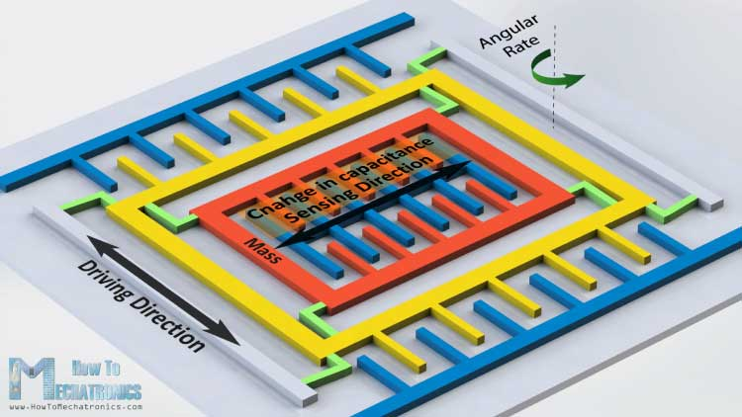
Gyroscopes
Measures angular velocity
Usually lower limit than you might hope
<10 rotations per second
Usually, we want angle instead of rotation speed
Integrate signal to determine current angle
Combine noise and DC bias with integration and you get a continuously accumulating error: drift

Slide 41
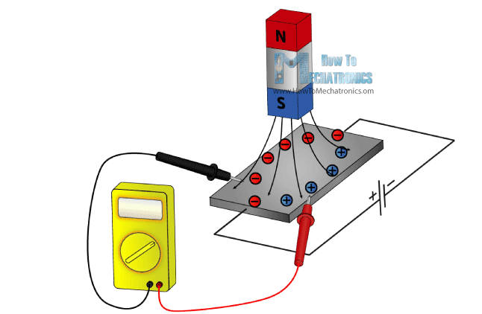
Magnetometer
Measures the magnetic field
Usually used in devices as a compass
Detect Earth’s magnetic field orientation
Problem: Earth’s magnetic field often overwhelmed by local magnetism when indoors
Large chunks of metal in walls, for example
Or other metal parts nearby on the circuit board!!
Satellites can use magnetometers for localization

Slide 42
Outline
Sensing Overview
Types of Sensors
Temperature
Light
Inertial
Others
Capacitive Touch Sensing
Actuators

Slide 43
Intelligent sensors
Many embedded sensors are more intelligent than simple analog
Combine it with a built-in ADC (analog-to-digital converter)
Can be more finely tuned and calibrated for accuracy
Now gives digital output over some wired communication mechanism
Combine it with additional circuitry / computation
Automatically filter data
Detect specific signal patterns and interrupt
I point most groups at intelligent sensors for projects
More expensive but easier to use

Slide 44
Example of Intelligent Sensor: QWIIC sensors
https://www.sparkfun.com/qwiic
Adafruit has compatible parts it calls “STEMMA” https://www.adafruit.com/category/620
Sensors have a standard, wired interface
Power, Ground, I2C (wired communication protocol)
Removes electrical/wiring issues
Transforms into a software issue of what the correct commands to send to the device are
Our usual plan: use an existing driver to guide creation of our own

Slide 45
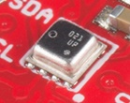
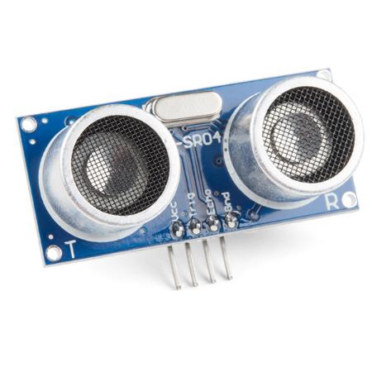
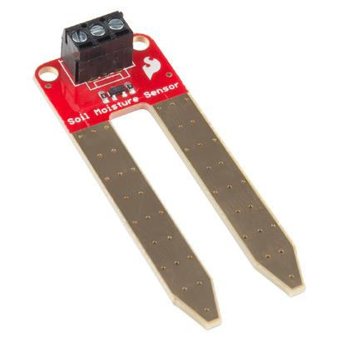
Other sensors (may or may not be intelligent)
Environment: Pressure, Humidity, Air Velocity, Air Quality
Distance: Ultrasonic, Lidar, or Radar
Biometric: Pulse Oximeter, Heart Rate
Agricultural: Soil moisture
Let’s do a quick tour of some more!

Slide 46
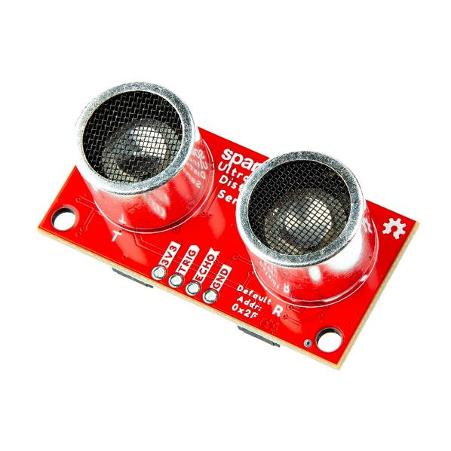
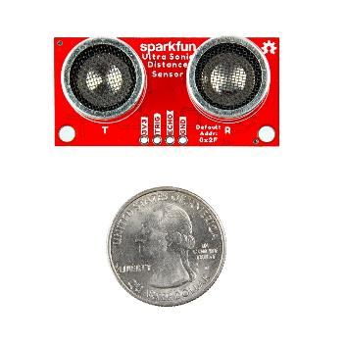
Distance measurement with ultrasonic
Sound travels much slower than light
About one foot per millisecond
Ultrasonic transmitters use high-frequency sound that humans can’t hear
And measure the time for it to bounce off an object and return
Gives centimeter accurate distance
But works best for solid objects

Slide 47
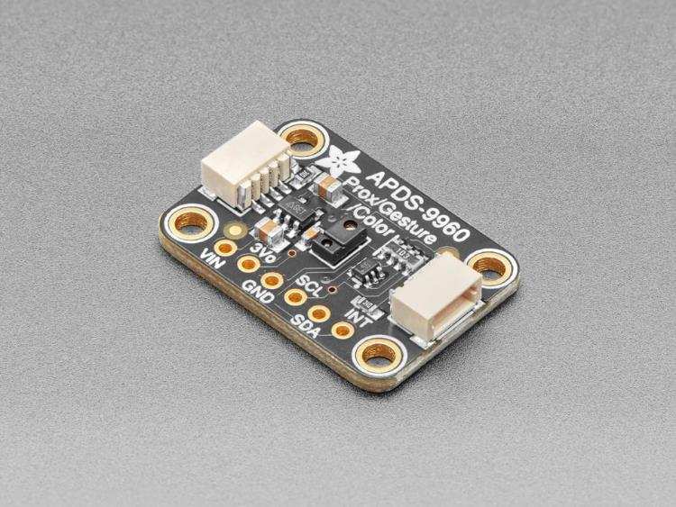
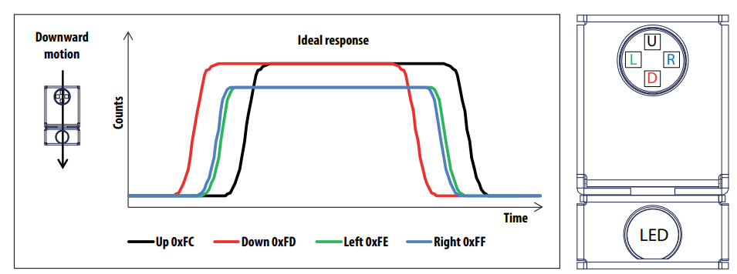
Gesture sensor
Actually senses light colors (RGB channels)
Four sensors aligned in a pattern
Comes with an LED that shines
Uses reflections to determine direction a hand is moving over it

Slide 48
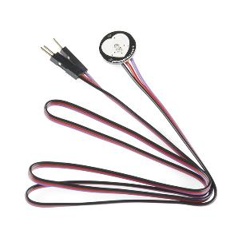
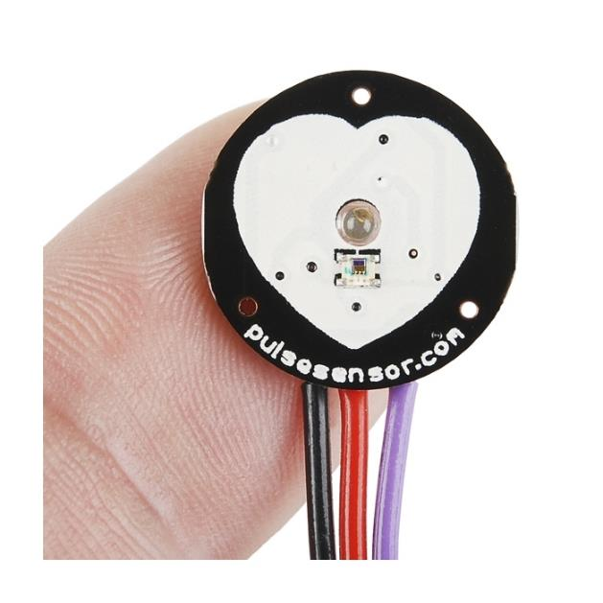
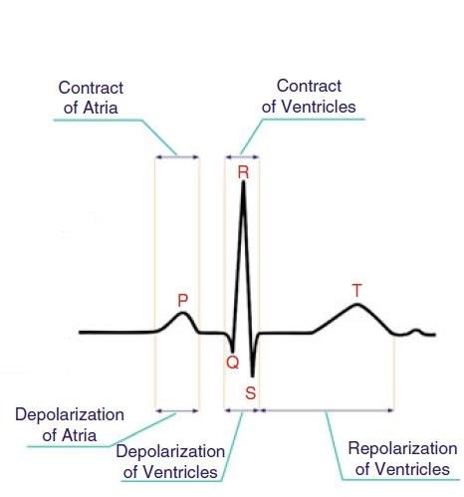
Pulse sensor
Photo sensor that provides an analog output
When pressed tightly against a finger, the blood flow is detectable and corresponds with your pulse
Counting peaks gives heartrate

Slide 49
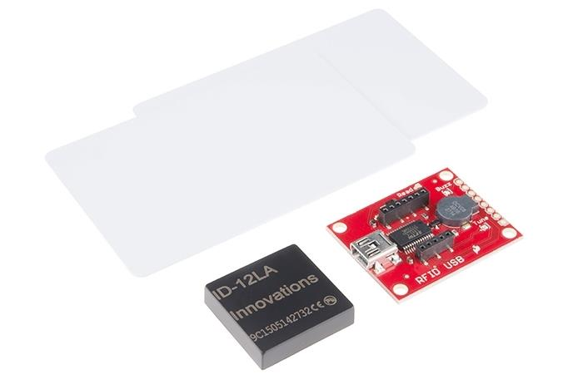
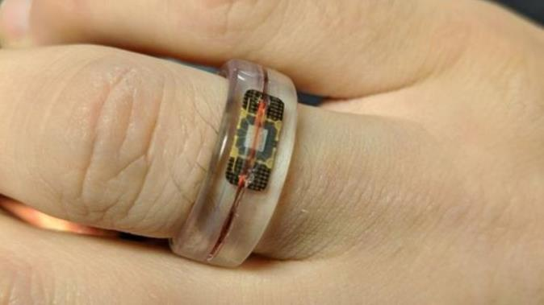

RFID Cards and Readers
Not a sensor at all, just a radio
Provides energy to the tag and gets a wireless data packet in response
Useful for projects as it can distinguish between different RFID tags
Usually cards
Also capsules that can be embedded in various objects

Slide 50
Break + Open Question
How are new sensors discovered/created?

Slide 51

Water Quality Sensor
https://hackaday.com/2021/02/18/internet-of-clams/

Slide 52
Outline
Sensing Overview
Types of Sensors
Temperature
Light
Inertial
Others
Capacitive Touch Sensing
Actuators

Slide 53


Capacitive Touch Sensor
Pull-up resistors connected to metal pads
Also connected to GPIO pin
Acts as a capacitor connected to ground

Slide 54


The touch pad recharges on its own
If you drive the GPIO pin attached to it low, touchpad clears low
If you make the GPIO pin an input (high impedance)
The touchpad gets pulled high, which takes some amount of time
Low Capacitance
High Capacitance
The more capacitance the longer this takes!
And fingers are GIANT capacitors

Slide 55
Capacitive touch sensing method
Drive GPIO pin low
Connects the pad to ground
Set GPIO pin as input and enable low-to-high interrupt
Gets an interrupt when the pad finally becomes high on its own
Use a timer to determine time until interrupt
~70 μs with no finger, <= milliseconds with finger
Needs to timeout after a few milliseconds to declare “touched” as there might be enough capacitance to never go fully high
Repeat periodically (a few times a second is probably good enough)
Sudden large increase in rise time ⇨ someone is touching!
Finger acts as a large capacitor

Slide 56
Capacitive touch works on any metal surface
Idea: Microbit door handle sensor
Connect a wire and a pull-up resistor to a metal door handle to sense when someone is touching it!
Timing will be very different from capacitive pad, but should be repeatable and capable of distinguishing human touch

Slide 57
Outline
Sensing Overview
Types of Sensors
Temperature
Light
Inertial
Others
Capacitive Touch Sensing
Actuators

Slide 58
What if you want to make an output?
More varied in their nature
Typically: send an electrical signal in some form
Actuator transforms electrical signal into some other mechanism
Movement, heat, light, sound, etc.
Can also be intelligent actuators
Communicate bits/bytes over some protocol about which actions to take
Example: displays
Let’s do an overview of some outputs too

Slide 59

Audio outputs
Microbit can do this natively! It has a speaker
We’ll use it in lab 5
Not a very good speaker…
Great for beeps
Bad at being loud or higher-quality audio
Alternative:
External speaker driver hardware
You provide it an audio signal (future lecture)
It amplifies it and sends it to speakers
Often supports multiple channels
Left and Right channel audio

Slide 60



Light outputs
Microbit has the 5x5 LED Matrix
But we can use additional LEDs
High-power, super-bright LEDs
RGB LED rings and strips
Challenge: need additional power
Usually an external 5v supply
LED strips use a custom control protocol too (future lecture)

Slide 61



Screens
Various sizes and capabilities
Biggest are a couple inches and color
Expect a LOW refresh rate
Intelligent systems with complicated protocols for initializing and transferring data
Probably the most complicated devices teams use
But also, many teams use them successfully each quarter

Slide 62


Motors
Simplest form are little buzzers that vibrate
“Vibratory motors” for haptic feedback
Controlling more complicated motors usually gets in the real of electrical engineering
H-bridge to drive the motors
Pretty well-documented online at least
Motors often need external power
It takes a lot of energy to move a motor and a load

Slide 63

Servos
Simpler motors that come with built-in control
Some can spin like motors
Others move to fixed angles on command
We’ll control a simple servo in Lab4

Slide 64

Thermal printer
Common use case: printing receipts
Just an arbitrary printer though
Operation
Special paper darkens if heated
Print head has a row of dots that can be individually heated as paper moves over them
Communication
Usually a UART (serial) protocol
With a library of commands for positioning and selecting characters
https://www.dfrobot.com/product-1799.html

Slide 65
Outline
Sensing Overview
Types of Sensors
Temperature
Light
Inertial
Others
Capacitive Touch Sensing
Actuators

Slide 66
Bonus
Research case study

Slide 67


PowerBlade current sensing
Example of creating a custom sensor
PowerBlade goals
Sense current and voltage in real-time
Be small enough to be deployable
Problem
To measure current, you usually have to break the circuit
But PowerBlade attaches in parallel

Slide 68

Measuring current
Coil of wire in a changing electric/magnetic field produces a voltage
One way to make inductors is as a coil of wire wrapped horizontally around a magnetic core
Re-purpose horizontally wire-wound inductor as current sensor!

Slide 69

Sensor placement
Is in the middle or close to a prong the best choice?
Turns out it’s closer to a prong
Decreases with distance squared
Angled like the magnetic field is

Slide 70

Measuring sensor values
Sensor output is very small
Amplify to make output large enough to accurately measure with ADC
Need to pick sampling rate
AC: 60 cycles per second in US
Need N * 60 measurements per second
N=42 (as fast as we can measure)
2520 measurements per second

Slide 71

At first, our output signal was this green line

Slide 72


Measurement into current
Search coil measures the derivative of current!!
Need to integrate to get signal and apply sensitivity and bias

