Slide 1
Lecture 08 Analog Input
CE346 – Microcontroller System Design
Branden Ghena – Spring 2026
Some slides borrowed from: Josiah Hester (Northwestern), Prabal Dutta (UC Berkeley)

Slide 2
Administrivia
Labs continue as normal
This week: Breadboarding
Next week: Design Presentations
Details will be posted tomorrow
Proposal feedback is coming when I’m able
Schedule will be up in the next day or two
Half the class on Tuesday next week, half the class on Thursday
Quiz today
Tell your friends

Slide 3
Today’s Goals
Explore methods for sensing analog signals
Comparators
Analog-to-Digital Converters
Discuss nRF implementation of these peripherals
Apply analog sensing to a task: heartbeat detection

Slide 4
Outline
Comparators (and nRF implementations)
General ADC Design
nRF ADC Implementation
Heartbeat Sampling

Slide 5
Analog signals
Exist in infinite states
From a maximum to a minimum
Often used for interactions with the real world
Sensors usually generate analog signals
Microbit example: microphone

Slide 6
Interacting with analog signals
Microcontrollers are inherently digital
Need a method for translating analog signal into a digital one
Options:
Determine if signal is higher or lower than some amount (Boolean)
Determine voltage value of signal (N-bit number)

Slide 7
Interacting with analog signals
Microcontrollers are inherently digital
Need a method for translating analog signal into a digital one
Options:
Determine if signal is higher or lower than some amount (Boolean)
Determine voltage value of signal (N-bit number)
Determination is done by a Comparator

Slide 8
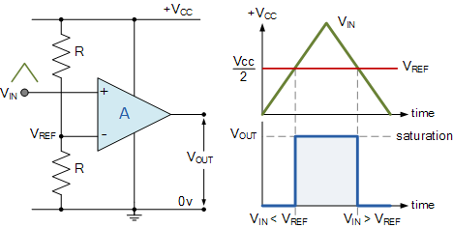
General comparator design
Compares an analog input signal to a reference voltage
V_{OUT} digital signal
High: V_{IN} > V_{REF}
Low: V_{IN} < V_{REF}
Advantages:
Simple (handful of transistors)
Low power

Slide 9
Comparator design questions
What reference voltages are available?
A few internal voltages
Usually also allows external references from input pins
When is an output generated?
Usually when status changes
Low-to-high, High-to-low, Both (like GPIO interrupts)

Slide 10
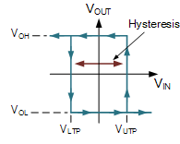
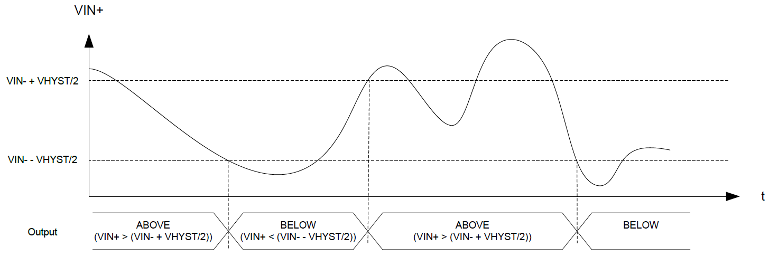
Hysteresis
A window added around signal state changes to prevent small amounts of noise from changing the output

Slide 11
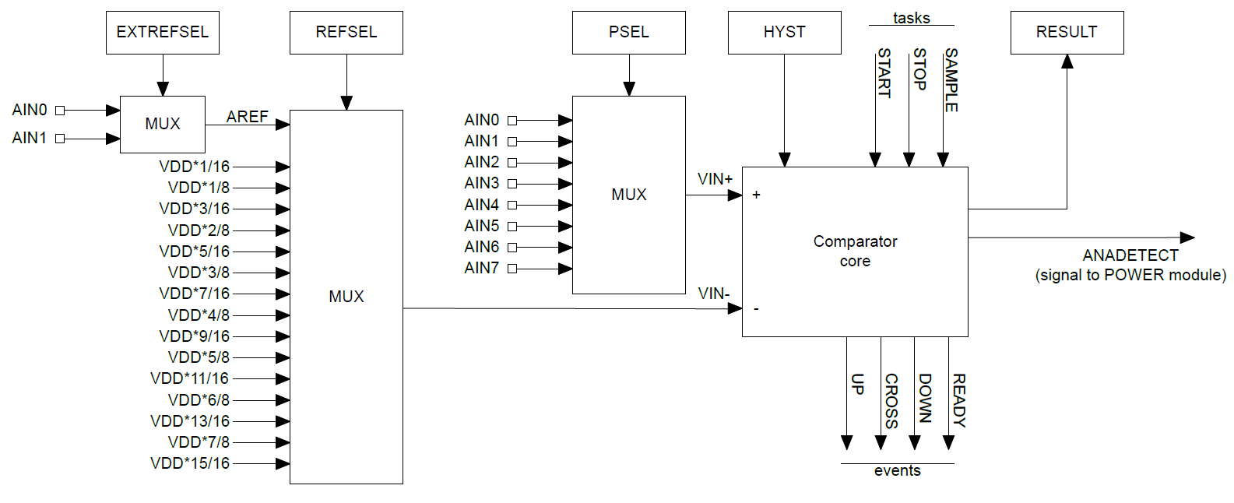
nRF low-power comparator (LPCOMP)

Slide 12
nRF low-power comparator (LPCOMP)
Input: one of eight analog input pins

Slide 13
nRF low-power comparator (LPCOMP)
Reference: one of two analog inputs or selection of VDD * N/16
VDD: Input voltage of the system

Slide 14
nRF low-power comparator (LPCOMP)
Hysteresis: +/- 50 mV range around VIN- when enabled

Slide 15
nRF low-power comparator (LPCOMP)
Events: transition signals + ready (~150 μs startup time)

Slide 16
nRF low-power comparator (LPCOMP)
Can also request what the current comparison state is (high/low)

Slide 17
nRF low-power comparator (LPCOMP)
Can be used for low-power wakeup of microcontroller

Slide 18
nRF COMP peripheral
Analog Comparator (not low power)
More advanced version of a comparator (otherwise similar)
What advantages would a more capable comparator have?
Configurable hysteresis
LPCOMP: +/- 50 mV COMP: any of the N/64 voltage levels
Faster detection
LPCOMP: 5 μs COMP: 0.1-0.6 μs (depends on power mode)
More possible reference voltages
LPCOMP: VDD or input COMP: VDD, 1.2v, 1.8v, 2.4v, or input
LPCOMP: 16 levels COMP: 64 levels

Slide 19
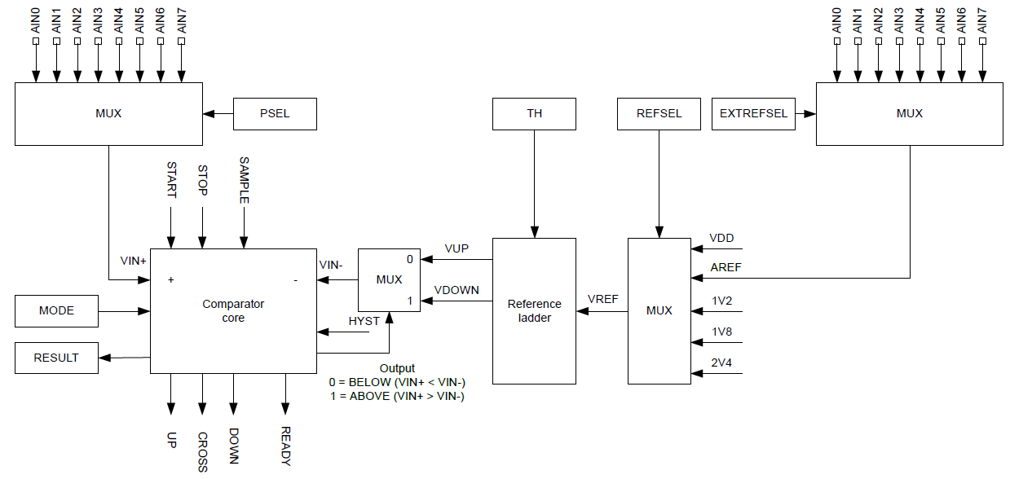
nRF COMP peripheral

Slide 20
Break + Question: Internal reference voltages
Why have internal voltage references other than the system voltage (VDD)? (i.e, fixed 1.2v or 2.4v)

Slide 21
Break + Question: Internal reference voltages
Why have internal voltage references other than the system voltage (VDD)? (i.e, fixed 1.2v or 2.4v)
What if want you want to measure is VDD?
Battery voltage
Did someone just unplug me?
etc.
What if VDD isn’t stable?
Battery voltage
Energy-harvesting system
Hard to know what any particular value means…

Slide 22
Outline
Comparators (and nRF implementations)
General ADC Design
nRF ADC Implementation
Heartbeat Sampling

Slide 23
Interacting with analog signals
Microcontrollers are inherently digital
Need a method for translating analog signal into a digital one
Options:
Determine if signal is higher or lower than some amount (Boolean)
Determine voltage value of signal (N-bit number)
Translation is done by an Analog-to-Digital Converter (ADC)

Slide 24
Quantization
Analog voltages are represented by discrete voltage levels
Comparators are 1-bit ADCs
Split into two regions
Good ADCs split into 4000-16000 regions
More levels gives a more accurate representation of the signal

Slide 25
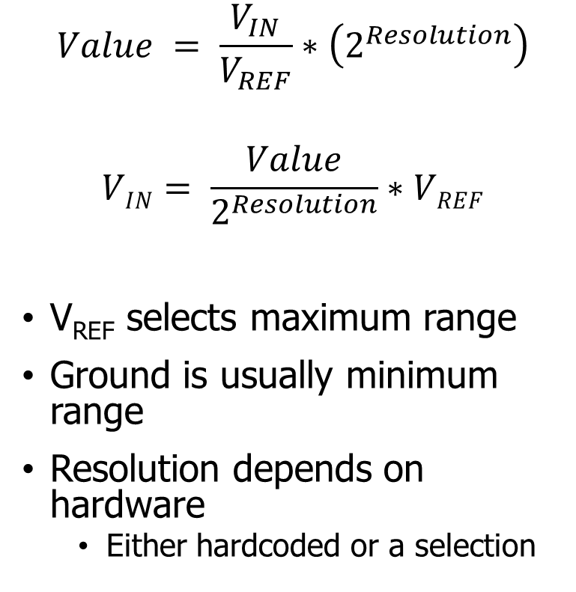
Translating voltage and ADC counts
Analog
Digital (8-bit)
Digital (12-bit)
$$Value = \frac{V_{IN}}{V_{REF}}∗\left(2^{Resolution}\right)$$
$$VIN= \frac{Value}{2^{Resolution}}∗VREF$$
V_{REF} selects maximum range
Ground is usually minimum range
Resolution depends on hardware
Either hardcoded or a selection
3.3 V
255
4095
232
3723
3 V
155
2482
2 V
77
1241
1 V
0 V
0 V
0
0

Slide 26
Wait, shouldn’t that range have a -1 somewhere?
TLDR: no
https://electronics.stackexchange.com/questions/286949/what-value-to-use-to-convert-adc-value-to-voltage
Each bit pattern represents a range of analog values
Using 2^{Resolution} minimizes the error for each bit within that range
Alternative important point:
The error in an ADC will be +/- at least one bit anyways, so this doesn’t matter

Slide 27
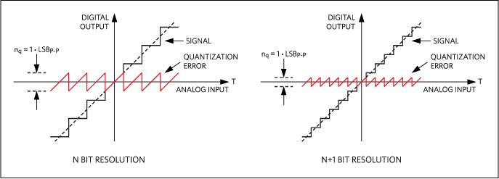
Quantization error
Resolution choice determines magnitude of error
Each extra bit halves the magnitude of error

Slide 28
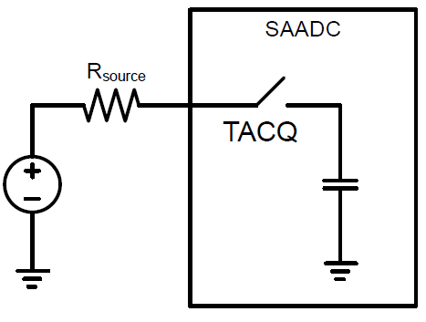
Analog to digital translation process
Two steps:
Acquisition
Read in signal for some amount of time
Signal connected to a capacitor
Fills capacitor up to voltage level
Speed depends on input resistance
1-100 μs is common
Conversion
Determine which digital value the read signal corresponds to

Slide 29
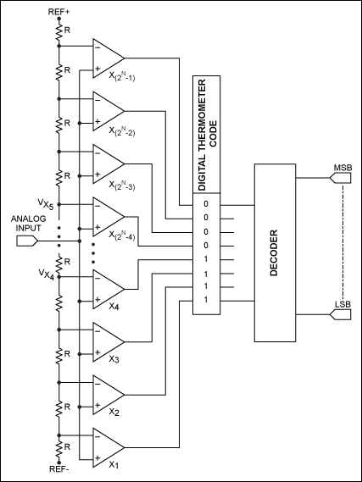
Direct-conversion ADC
Chain comparators together
Each with a separate reference voltage
Digital value determined immediately
Also known as “Flash” ADCs
Downside: needs 2^{n}-1 comparators
Reserved for expensive applications

Slide 30
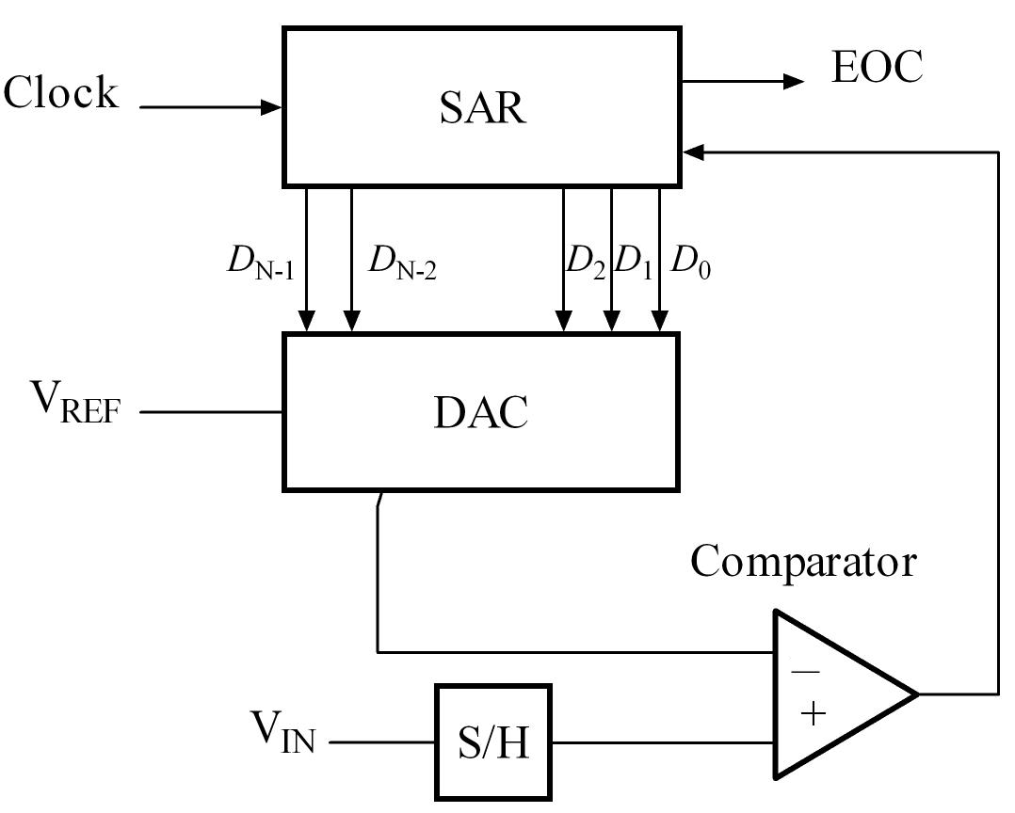
Successive-Approximation ADC
Method: Binary Search
Compare signal to generated reference
Increase or decrease reference as needed
Repeat
DAC creates reference (Digital-to-Analog Converter)
Final value of DAC is the ADC value

Slide 31
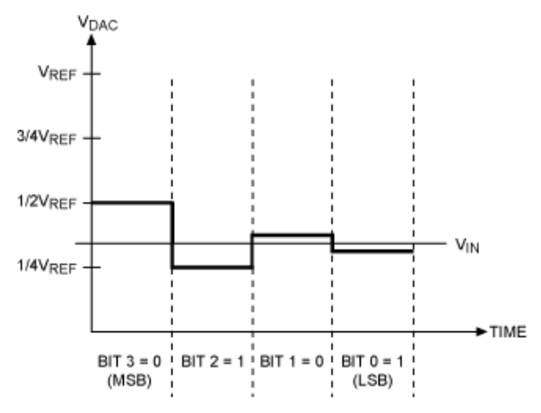
Successive Approximation Example
4-bit ADC with an input signal V_{IN}

Slide 32
Successive Approximation Example
Compare ½ V_{REF} (0b????) to V_{IN}
If V_{IN} is greater, bit is 1. Else 0

Slide 33
Successive Approximation Example
Compare ½ V_{REF} (0b0???) to V_{IN}
If V_{IN} is greater, bit is 1. Else 0
V_{IN} is less. So set that bit to zero

Slide 34
Successive Approximation Example
2. Compare 1/4 V_{REF} (0b0???) to V_{IN}
If V_{IN} is greater, bit is 1. Else 0

Slide 35
Successive Approximation Example
2. Compare 1/4 V_{REF} (0b01??) to V_{IN}
If V_{IN} is greater, bit is 1. Else 0
V_{IN} is greater. So set that bit to one

Slide 36
Successive Approximation Example
3. Compare 3/8 V_{REF} (0b01??) to V_{IN}
If V_{IN} is greater, bit is 1. Else 0

Slide 37
Successive Approximation Example
3. Compare 3/8 V_{REF} (0b010?) to V_{IN}
If V_{IN} is greater, bit is 1. Else 0
V_{IN} is less. So set that bit to zero

Slide 38
Successive Approximation Example
4. Compare 5/16 V_{REF} (0b010?) to V_{IN}
If V_{IN} is greater, bit is 1. Else 0

Slide 39
Successive Approximation Example
4. Compare 5/16 V_{REF} (0b0101) to V_{IN}
If V_{IN} is greater, bit is 1. Else 0
V_{IN} is greater. So bit is one

Slide 40
Successive Approximation Example
5. Output is 5/16 V_{REF} (0b0101)
Slight underestimate of the real value, but as close as we can get
More bits would get us even closer

Slide 41
Successive Approximation Example
Performs a binary search to determine correct reference signal value
https://en.wikipedia.org/wiki/Successive-approximation_ADC

Slide 42
Tradeoffs in ADC design
Direct-Conversion: more expensive (more silicon)
SAADC: more time consuming (more binary search time)
Most microcontrollers land on successive-approximation designs
The slowdown isn’t an issue for slowly changing signals
Quickly changing signals might need special hardware anyways

Slide 43
Break + Critical Thinking
How much ADC resolution is needed?

Slide 44
Break + Critical Thinking
How much ADC resolution is needed?
Resolution requirement depends on signal being sensed
Temperature sensor probably doesn’t need 16-bit ADC
Difference between 30.001℃ and 30.002℃ is usually irrelevant
Microphone might though!
Differences are audible until they are small enough
16-bit or 24-bit tend to be common choices for audio data

Slide 45
Outline
Comparators (and nRF implementations)
General ADC Design
nRF ADC Implementation
Heartbeat Sampling

Slide 46
nRF SAADC (Successive Approximation ADC)
Only one actual ADC peripheral in the chip
One measurement at any given time
However, provides 8 different “channels” with unique configurations
Virtualization in hardware!
Typical setup is to sample each channel one-after-the-other

Slide 47
SAADC Resolution and Sampling
Resolution is selectable (for the whole peripheral)
8, 10, 12, or 14 bits
Result stored as 16-bit value regardless
Sampling time is selectable (for each channel)
3-40 μs
Longer sampling time is important for very low-current signals

Slide 48
nRF SAADC Inputs
Can read the system voltage directly
Or read one of 8 different analog input pins
These pins ARE fixed and not totally reconfigurable
Analog signals are more susceptible to interference
Need to make sure that you’re connecting to an analog input pin

Slide 49
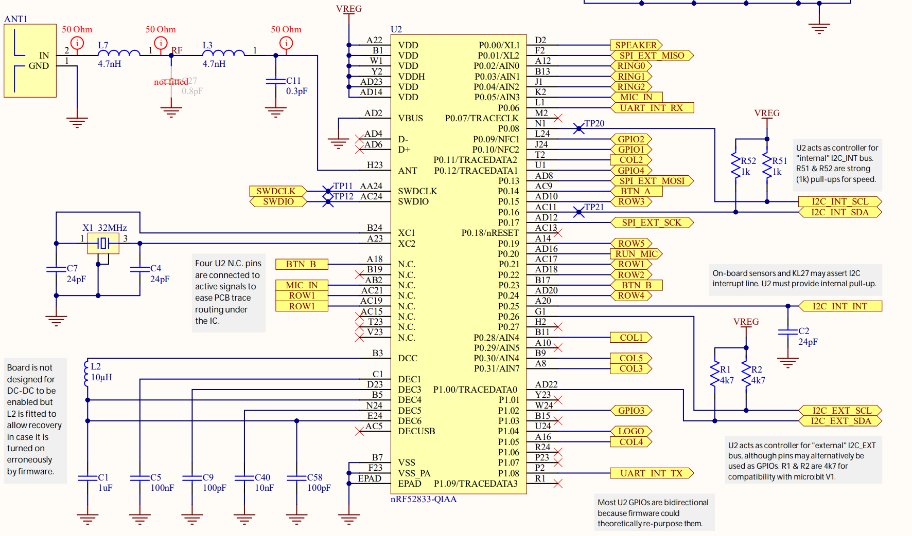
Analog inputs on the Microbit
Of the 8 analog input pins
One for microphone
One is not connected
Three are repurposed for the LED matrix
Three are available as external inputs
For projects, students sometimes end up with external ADCs
P0.30 is actually AIN6

Slide 50
Triggering sample collection
Can be triggered with TASK_START on demand
Including through EVENT->TASK chaining
Includes a timer within itself to automatically trigger sampling
Rate = 16 MHz / (2^{Scale}) where scale is 11 bits
Maximum rate is 7.8 kHz

Slide 51
EasyDMA on the SAADC
There is no register to read ADC results from
Instead, you must use DMA to collect samples
At configuration time, provide:
Pointer to RAM
Must be RAM, not Flash
Maximum count of 16-bit samples to be written starting at address
Up to 32768
When complete, a register tells you the amount of samples written to RAM

Slide 52
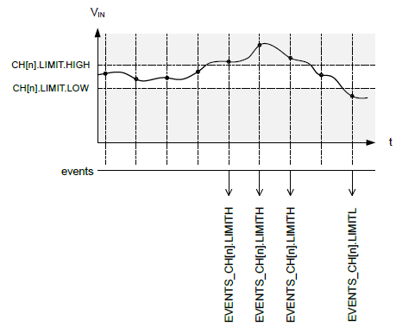
Analog signal monitoring
Includes two comparators for each channel
High and Low limits
Generates events whenever transitioning above High or below Low
Events can generate interrupts if desired

Slide 53
Temperature sensitivity
ADCs are often temperature sensitive
nRF SAADC: 0.02% per degree C
Recommends recalibrating every change of 10 degrees C or more
Automatic task for calibration
Real concern for deployed devices
Outdoors
Wearable

Slide 54
SAADC nRF SDK Library
Initialization functions
Initializing driver takes a callback function
Initializing a channel enables and configures that channel
nrfx_saadc_sample_convert(channel, value*)
Blocking function
Reads a single value from channel and places it into value
nrfx_saadc_buffer_convert(buffer*, size)
Non-blocking function - callback when buffer is full
Configures sampling for all initialized channels
Only starts on a separate call to nrfx_saadc_sample()
nrfx_saadc_is_busy()
Returns Boolean value for whether sampling is in progress
Could be used to build event-driven model (only check buffer after busy is false)

Slide 55
Outline
Comparators (and nRF implementations)
General ADC Design
nRF ADC Implementation
Heartbeat Sampling

Slide 56
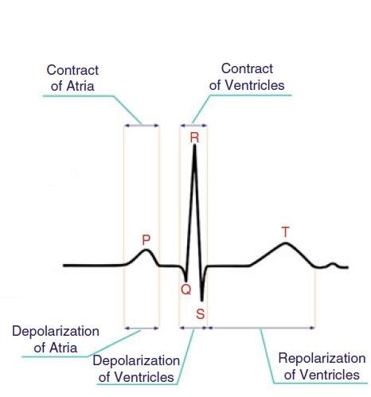
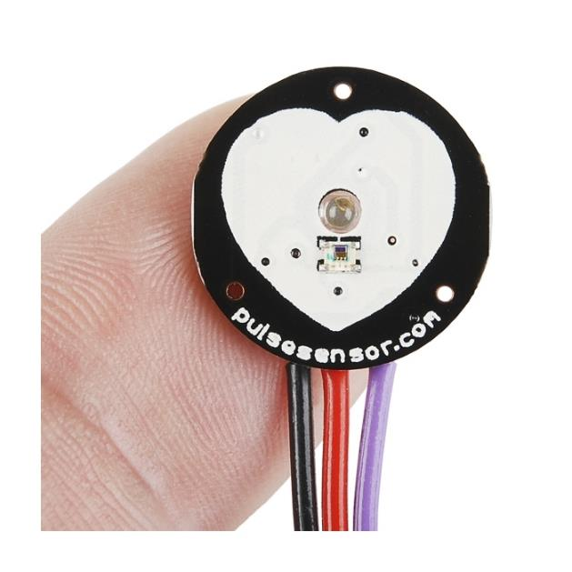
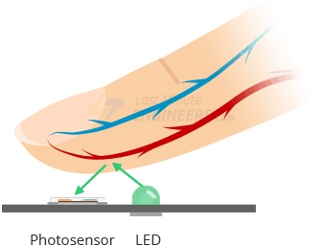
Pulse sensor
Photo sensor that provides an analog output
When pressed tightly against a finger, the blood flow is detectable and corresponds with your pulse
Counting peak rate gives heartrate

Slide 57
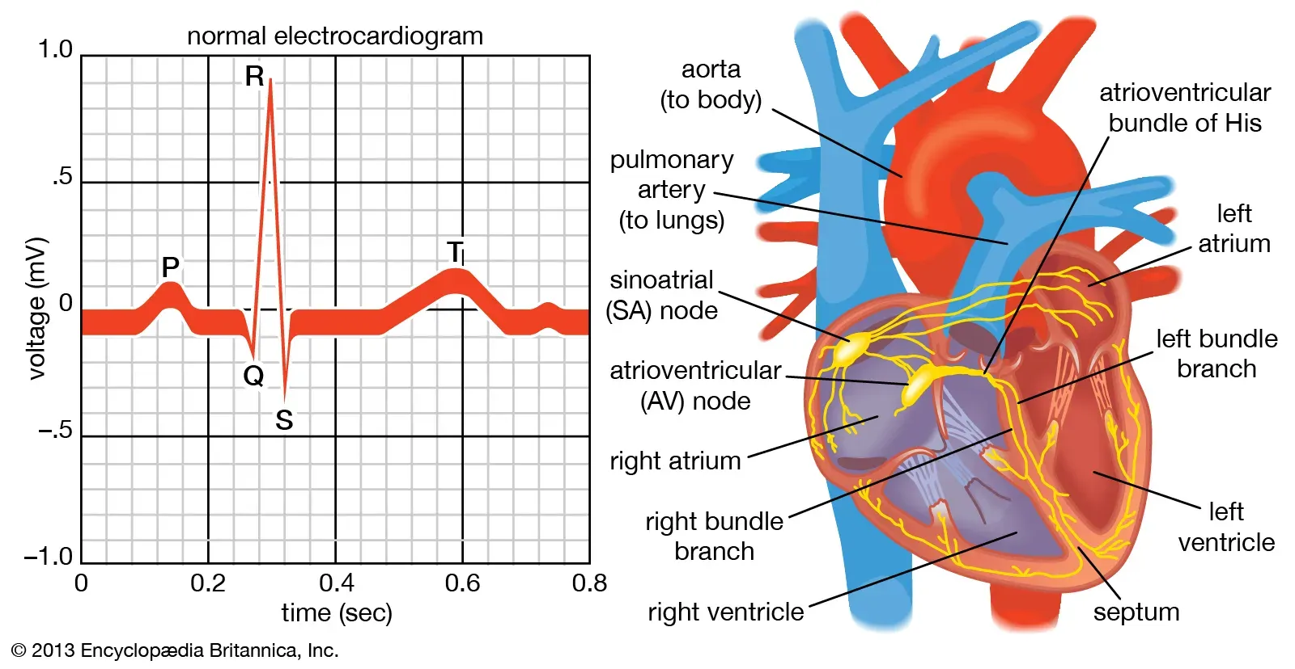
How quickly do we need to sample?
Goal: sample fast enough to catch the “R” pulse
Need at least two samples per duration of R pulse

Slide 58
Determining sampling rates
Do the math: what sampling rate is needed?

Slide 59
Determining sampling rates
Do the math: what sampling rate is needed?
Each box is about 0.04 seconds (0.4-0.2)/5
So at least 2 samples / 0.04 seconds
= at least 50 samples per second (i.e., 50 Hz)
More is better though, especially for finding the top
As an engineer, I’d give a decent margin on this
100 Hz should be fine (4 samples per R pulse) more is better
Research says 250 Hz is the standard for analysis

Slide 60
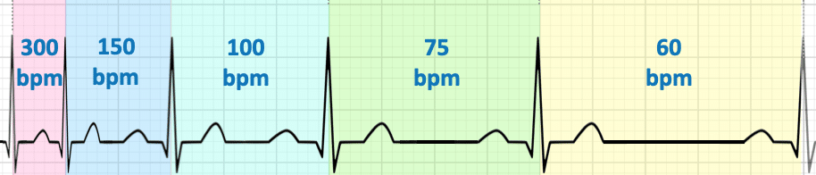
What do you do with the data?
Measure time from peak-to-peak to determine pulse rate
(Hearts normally stay constant for a while, not like the diagram above)
Mostly-equivalent alternative:
Count number of peaks per some unit of time
Measure for 10 seconds and count number of peaks in that period
Both of these will require a timer peripheral too

Slide 61
Comparator would also work fine for this
We needed to sample at 100 Hz to collect sufficient data to detect peaks
But we didn’t really care about the rest of the data, just the peaks
Instead, we could use a comparator to generate interrupts
When signal goes above a threshold, count that as a peak detected
Add a timer peripheral to get the pulse rate

Slide 62
Break + Design question
How many analog samples can the Microbit hold?
Assumptions:
Only store samples in RAM (128 KB of total RAM on nRF52833)
5 KB for Data (apart from sample storage)
8 KB for Heap
8 KB for Stack

Slide 63
Break + Design question
How many analog samples can the Microbit hold?
Total Memory: 128 KB RAM
@ 2 bytes per sample = 64,000 samples
Available Memory: 128 KB – (5 + 8 + 8) KB = 107 KB RAM
@ 2 bytes per sample = 54,784 samples
Are they packed or padded to 16-bit?
Could double the samples at the trade of less resolution and increased processing
Note: audio sampling rate is typically 44.1 kHz -> 1.25 seconds of audio

Slide 64
Outline
Comparators (and nRF implementations)
General ADC Design
nRF ADC Implementation
Heartbeat Sampling

