Slide 1
Lecture 15 Nonvolatile Memory & Energy Management
CE346 – Microcontroller System Design
Branden Ghena – Spring 2026
Some slides borrowed from: Josiah Hester (Northwestern), Prabal Dutta (UC Berkeley)

Slide 2
Administrivia
Project check-ins this Friday
Signup linked on Ed and Canvas
Come prepared to talk about
Project overview/goals
Progress so far
What still needs to be worked on
Any major concerns
Hardware you still need to order
Project demos in two weeks from today!

Slide 3
Today’s Goals
Discuss uses of memory, especially nonvolatile memory, in embedded systems
Introduce internal flash peripheral and SD cards
Discuss matters of energy on embedded systems
Where to gain energy?
How much does the Microbit use?
How do we write software for very low energy systems?

Slide 4
Outline
Nonvolatile Memory
Memory in Computing
nRF52 Non-Volatile Memory Controller
SD Card Interface
Energy Management
Energy Sources
Microbit Energy Use
Intermittent Computing

Slide 5
Memory in computing
Various different memories serve different purposes in computing
Needs
Fast, infinite-lifetime memory to keep things like stack memory
Nonvolatile memory that can be read from
Desires
Fast, infinite-lifetime nonvolatile memory

Slide 6
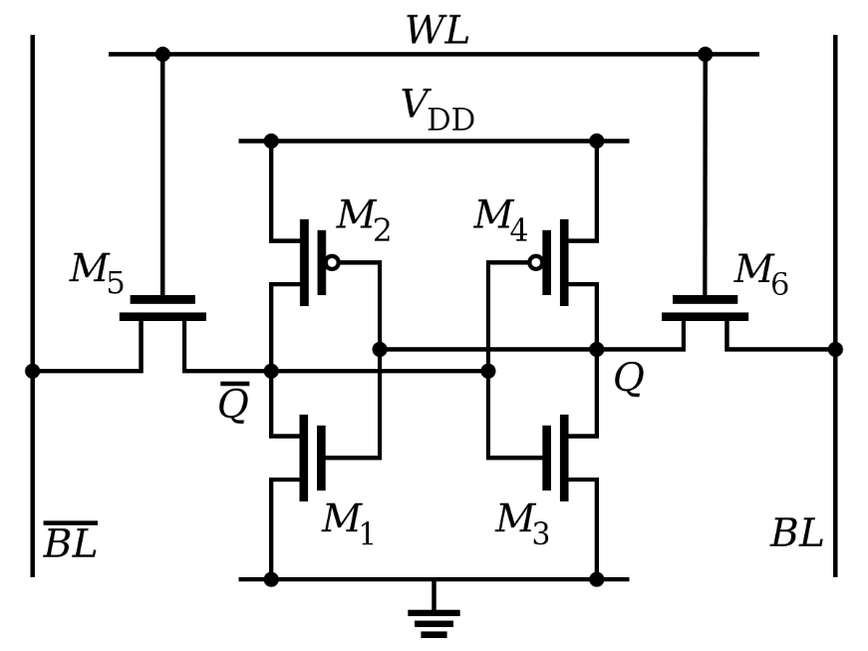
Register technology: SRAM
Static RAM (SRAM)
Each cell stores a bit in a bi-stable circuit, typically a six-transistor circuit
Static – no need for periodic refreshing; keeps data while powered
Relatively insensitive to disturbances such as electrical noise
Energetic particles (alpha particles, cosmic rays) can flip stored bits
Fastest memory on computer
Also most expensive and takes up most space per bit
Typically used for registers and cache memories

Slide 7
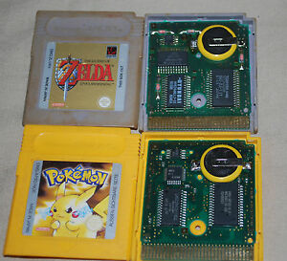
SRAM can be used a permanent memory in a pinch
Gameboy and Gameboy Color used batteries to save state
Gameboy Advanced games used batteries for an internal clock
PSA: old Gameboy games have likely lost their save files

Slide 8
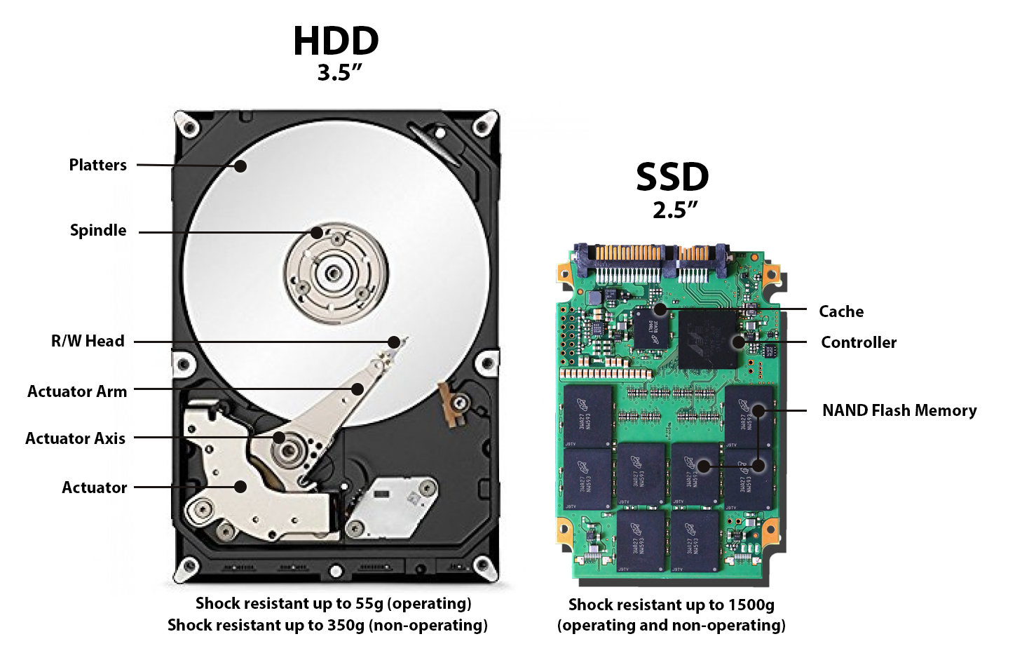
Disk drive storage

Slide 9
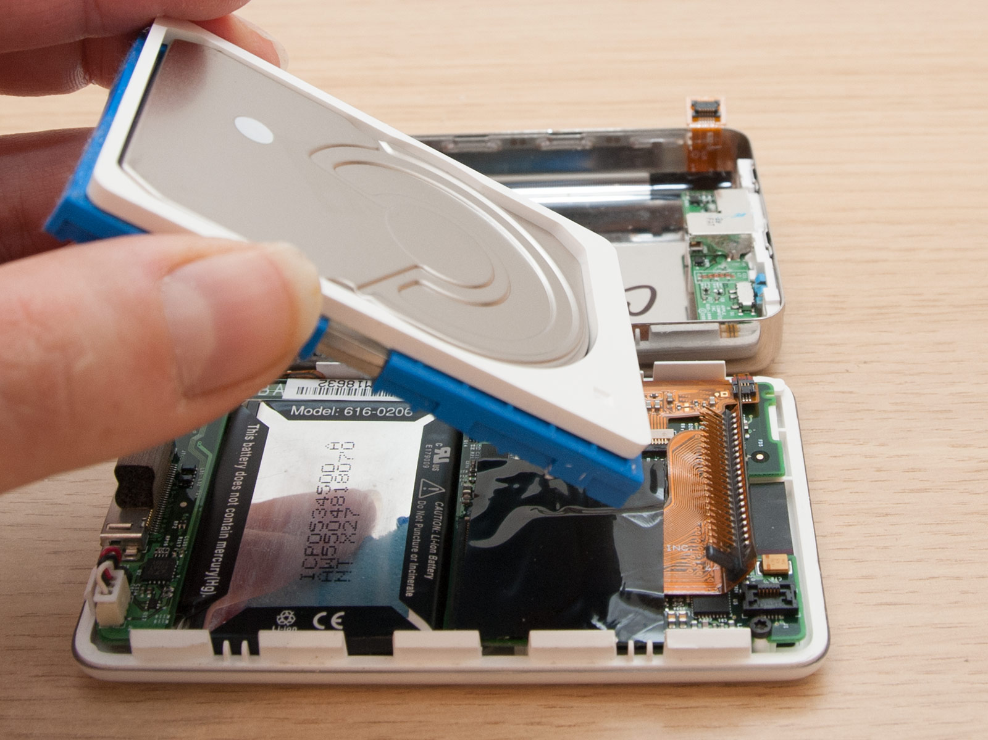
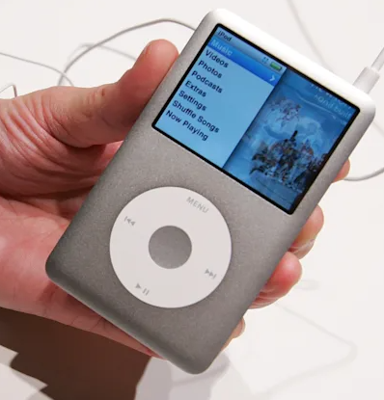
Necessity breeds creativity
Original iPod used a small disk drive

Slide 10
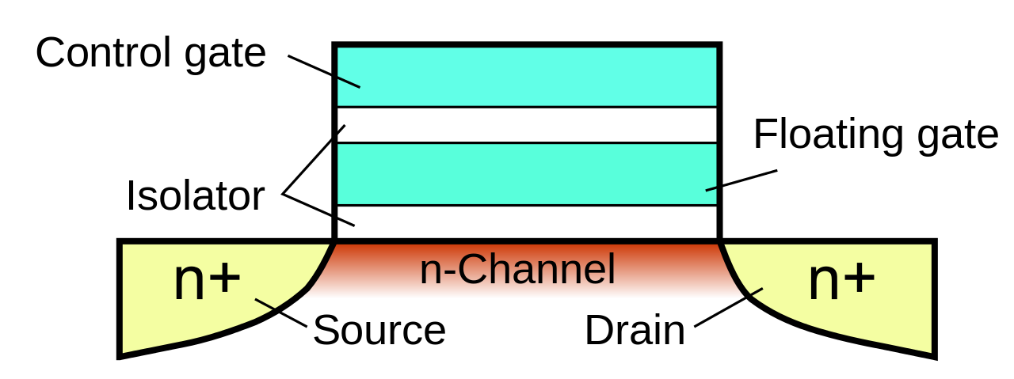
Floating-gate transistors
Concept behind transistor-based non-volatile memory
EPROM, EEPROM, and Flash
High voltage on control gate creates charge on floating gate
Charge on floating gate activates/deactivates transistor
High voltage degrades the structure, leading it to eventually fail after enough writes

Slide 11
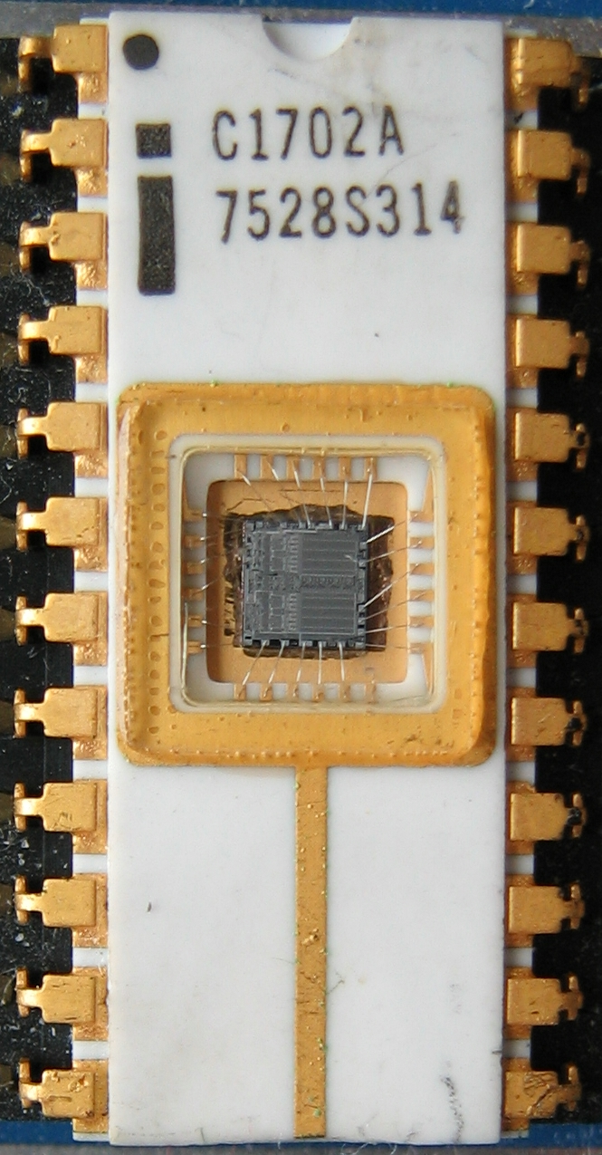
EPROM
Erasable programmable read-only memory
Erasable
If you shine UV light directly on the IC
Needed a window to expose the IC
Programmable
With high voltage (25-50 volts)
Typically acted as read-only memory in circuits

Slide 12
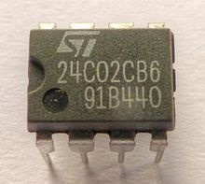
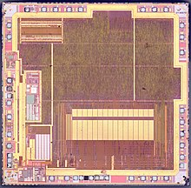
EEPROM
Electrically-erasable programable read-only memory
Same concept as EPROM, but includes internal circuitry to allow rewriting under normal conditions
Slow and high-power to write
Has a longer lifetime compared to flash, ~100k writes
Can be built into other ICs
Example: AT90USB162 microcontroller (512 bytes)

Slide 13
Flash
Similarly based on floating-gate transistors
But with a different design that allows for faster erase of entire blocks
More limited lifetime, ~1k-100k writes (10k common for embedded)
Cannot erase individual bytes, must erase in units of blocks
Read can happen in units of bytes though
Heavily used in commercial devices
Flash drives
SSDs
Smartphone storage
Microcontroller non-volatile storage!

Slide 14
More exotic memories
FRAM and MRAM are both rising protentional Flash replacements
Non-volatile
Writable at the byte level
Very high to infinite write/erase cycles
Lower energy costs for writing and reading
They use unrelated magnetic techniques for data storage
Starting to appear in microcontrollers
TI MSP430s have used 16 kB FRAM
Apollo4 (ARM Cortex-M4F) has 2 MB of MRAM

Slide 15
Outline
Nonvolatile Memory
Memory in Computing
nRF52 Non-Volatile Memory Controller
SD Card Interface
Energy Management
Energy Sources
Microbit Energy Use
Intermittent Computing

Slide 16
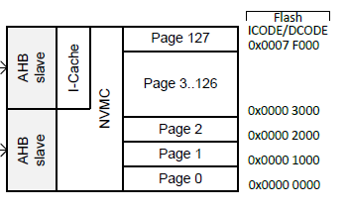
Flash memory on the nRF52833
512 kB total Flash memory
128 pages each 4 kB in size
Non-Volatile Memory Controller (NVMC) controls access
Enables writing to flash
Enables erasing flash
Manages status of flash

Slide 17
Writing to Flash
Configurable, disabled by default
Enable with configuration register
Rules for writing to Flash
Must write word-aligned 32-bit values
Can only write 0 values, not ones
Can only write 2 times before erasing (even if there are still 1 bits)
Takes 42.5 μs to write a 32-bit word
64 MHz clock ⇨ 2720 cycles per 32-bit write

Slide 18
Erasing Flash
Lifetime: 10000 erase cycles per page
At once-a-second writes, that’s <3 hours…
Options
Erase a single page (4 kB): 87.5 ms
Erase all of flash (512 kB): 173 ms
CPU is halted if executing code from Flash during the erase
That’s 5.6 million cycles…
Code can execute from SRAM instead
Can also be split into a series of partial erases
Which must add up to a complete erase time before writing

Slide 19
Factory Information Configuration Registers
Read-only memory
Chip-specific information and configuration
Code size
Unique device ID
Production IDs
Temperature conversion functions

Slide 20
User Information Configuration Registers
Additional Flash memory for non-volatile user configurations
Writable and erasable through NVMC processes described earlier
32 words of customer information (128 bytes total)
Special configurations
Reset pin
NFC pin enable/disable
Debug configuration

Slide 21
Break + Question
Could you run a system entirely within Flash?
Could you run a system entirely within RAM?

Slide 22
Break + Question
Could you run a system entirely within Flash?
Yes, but it would go _very_ slowly
Local variables would be pretty hard to manage
87.5 ms of code pause every time you write to a variable…
Could you run a system entirely within RAM?
Yes, but code would need to be loaded from somewhere else
Need initial state that is nonvolatile
Would run just as fast and be lower energy, actually

Slide 23
Outline
Nonvolatile Memory
Memory in Computing
nRF52 Non-Volatile Memory Controller
SD Card Interface
Energy Management
Energy Sources
Microbit Energy Use
Intermittent Computing

Slide 24
SD card references
ChaN
Embedded systems engineer in Japan (and is amazing)
http://elm-chan.org/docs/mmc/mmc_e.html
http://elm-chan.org/fsw/ff/00index_e.html
Various others
http://users.ece.utexas.edu/~gerstl/ee445m_s15/lectures/Lec08.pdf
http://alumni.cs.ucr.edu/~amitra/sdcard/Additional/sdcard_appnote_foust.pdf
https://luckyresistor.me/cat-protector/software/sdcard-2/
http://users.ece.utexas.edu/~valvano/EE345M/SD_Physical_Layer_Spec.pdf
https://github.com/tock/tock/blob/master/capsules/src/sdcard.rs

Slide 25
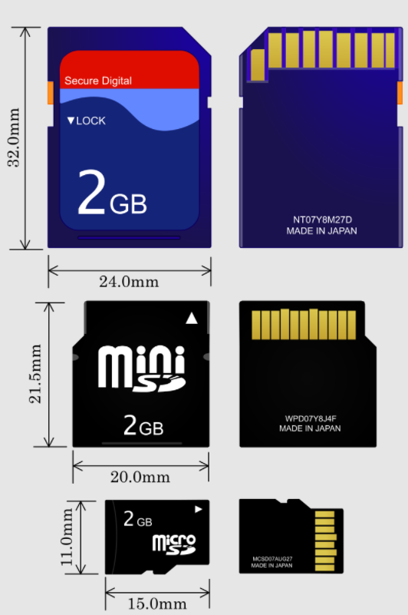
SD cards
“Secure Digital” Card
Includes various formfactors
Flash memory
Capacities from 8 MB to 128 TB
512 byte blocks
Supports 1-bit SPI interface
As well as 4-bit SD bus protocol
Easy to support in embedded systems
Cheap but high power

Slide 26
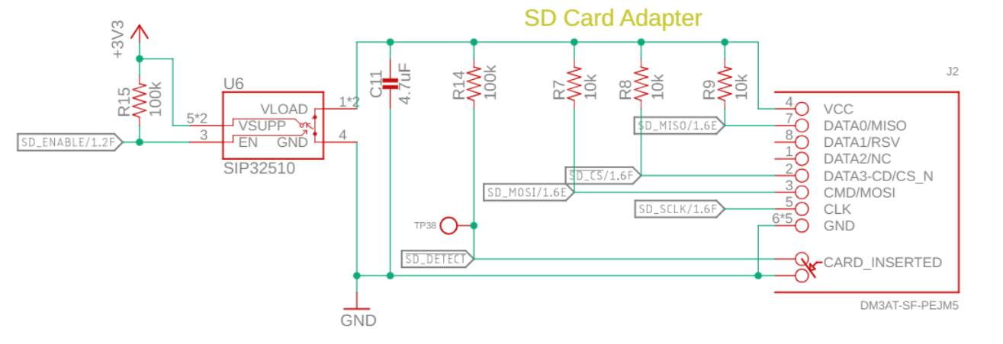
Electrical connections for an SD card
SD Card connections
SPI SDI, SDO, CS, SCLK
Plus a switch to enable/disable the SD card and a detect signal

Slide 27
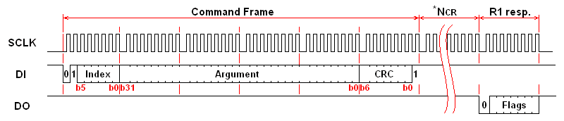
Controlling the SD card
Index: 6-bit value of command being sent
Argument: 32-bit value that may be arguments to commands
CRC: checks for bit errors
Response (after delay)

Slide 28
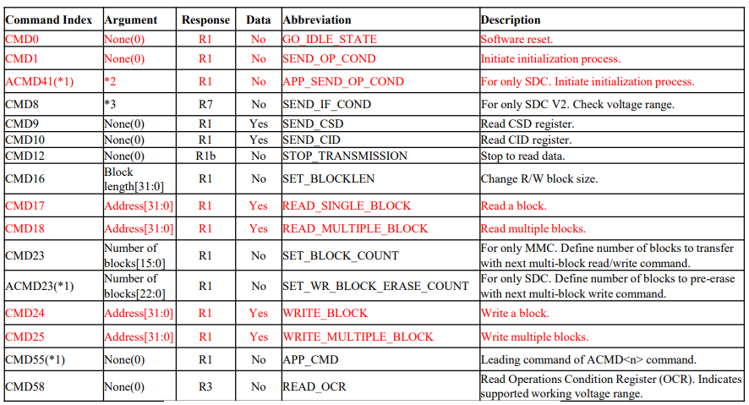
SD card SPI commands

Slide 29
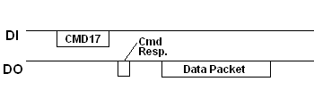
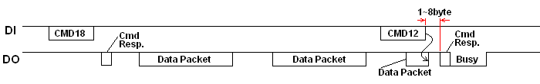
Reading from the SD card
Single block read: CMD17
Multiple block read: CMD18 (CMD12 – Stop Transmission)

Slide 30
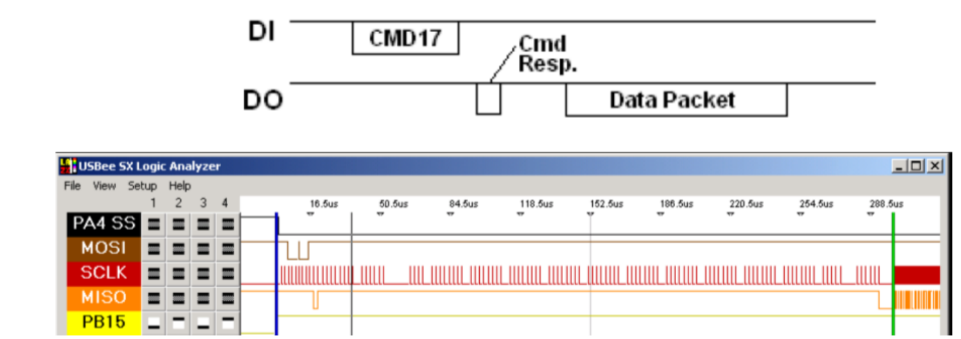
SD card delays can be significant
Performing a single byte read
Almost 300 μs before the SD card starts sending data
~200 μs additional time to send the 512 bytes (20 Mbps data, 8 Mbps total)

Slide 31
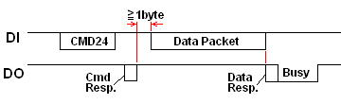
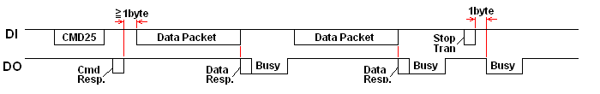
Writing to the SD card
Single block write: CMD24
Multiple block write: CMD25

Slide 32
SD Card Example Generic Driver
https://github.com/1nv1/ulibSD
Handles the logic of SD card interactions
Based on a generic SPI device
User has to provide the following functions
void SPI_Init();
BYTE SPI_RW(BYTE);
void SPI_CS_LOW()
void SPI_CS_HIGH();
…
Idea: provide some narrow interface to allow reuse of software
Code below are microcontroller-specific SPI implementations
Code above is generic SD card control logic

Slide 33
Hardware Abstraction Layers (HALs)
Idea: enable hardware-agnostic software on top of hardware-aware implementations
Hardware Abstraction Layers allow code reuse on multiple platforms by decoupling higher-level software from the implementation specifics
Example: generic LED
Generic functionality: Activate or Deactivate
Hardware-specific implementation:
Active-high or active-low
Simple LED or complex NeoPixel RGB LED

Slide 34
Higher-level software uses a HAL
I2C devices are great examples of higher-level software
There is device-specific code that decides which registers to read or write
But the code does not rely on any particular microcontroller
As long as you’ve got an I2C system that can read/write
We can reuse device drivers across various platforms
At the cost of needing to separate out microcontroller-specific behavior

Slide 35
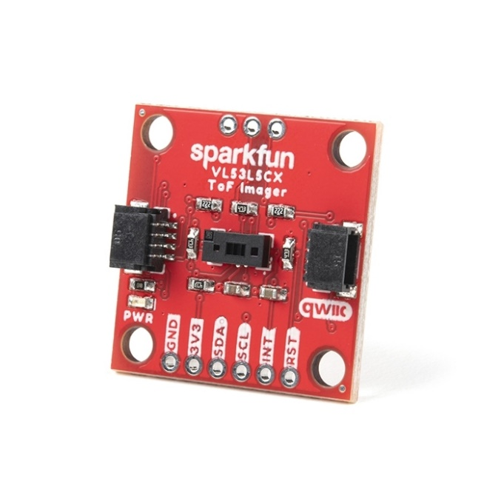

Abstraction layer example
Example of abstraction layer: Infrared Time-of-Flight Ranging chip
Rather complicated device that can provide an 8x8 array of distance measurements
Chip manufacturer created a generic C driver for the chip
User has to implement
Reset sensor
Wait milliseconds
I2C read
I2C write

Slide 36
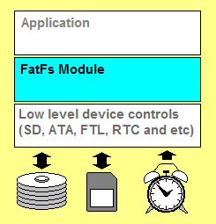
Layering a filesystem on top of an SD card
FatFs library implements the filesystem agnostic of application and storage medium
Enables the use of file system calls:
Open, Close, Read, Seek
Connects to generic interface for low-level implementation
disk_status, disk_init, disk_read, disk_write

Slide 37
Outline
Nonvolatile Memory
Memory in Computing
nRF52 Non-Volatile Memory Controller
SD Card Interface
Energy Management
Energy Sources
Microbit Energy Use
Intermittent Computing

Slide 38
Measuring energy use
Base equations
Power = Current * Voltage (Watts)
Energy = Power * Time (Joules)
Energy = volts * amps * seconds
Voltage is usually constant for a system
Time is how long you are running for / measurement period
Current changes based on activities being done
Often energy is presented as a current draw
Maybe an average current draw
With Voltage and Time implicit

Slide 39
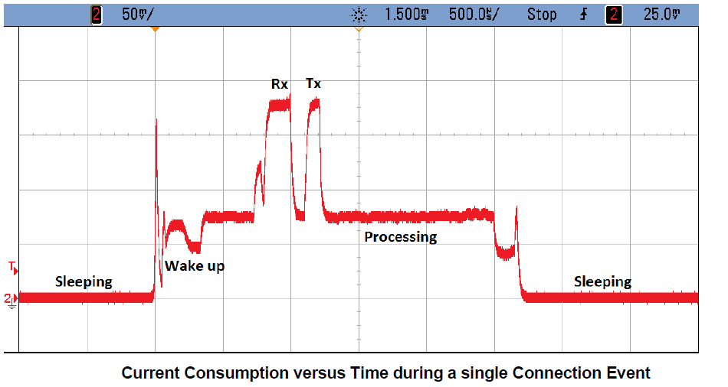
Example current trace during wireless communication

Slide 40
Wired power through USB
Provides 5v at up to 500 mA (USB 2.0) or 900 mA (USB 3.0)
Or power delivery specifications, which can do far more power
Must be converted to different voltage to use
Voltage regulator takes in 5v and spits out 3.3v
Has its own maximum current!
System is limited by the minimum of USB or regulator power
Microbit: regulator gives 3.3v at up to 600 mA = 1.98 W
USB 2.5 Watts, Regulator 1.98 Watts ⇨ System 1.98 Watts
This is a max! Stay 15-30% below regulator limit

Slide 41
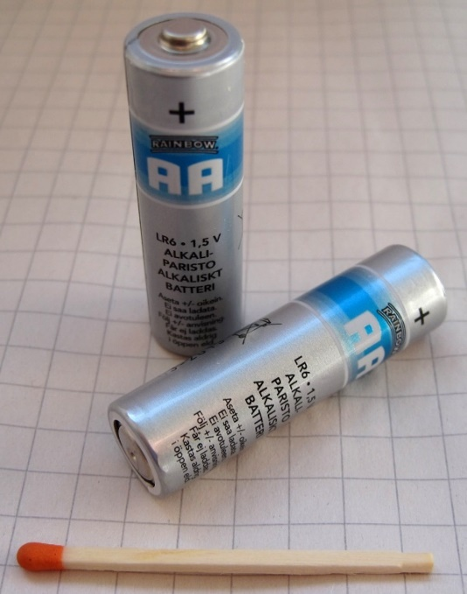
Thinking about energy
Batteries often list energy in mA*h (milliamp – hours)
Coin cell battery: 3v at 220 mAh
2x AA battery: 3v at 2000 mAh
iPhone 11 battery: 3.7v at 3000 mAh
Also usually limited by regulator
Sometimes just directly connected to system
We can run at 3v just fine! (3.7v is no good though)
Voltage can vary with charge
But only a little, right before battery is depleted
Example: coin cell goes down to ~2.7 volts

Slide 42
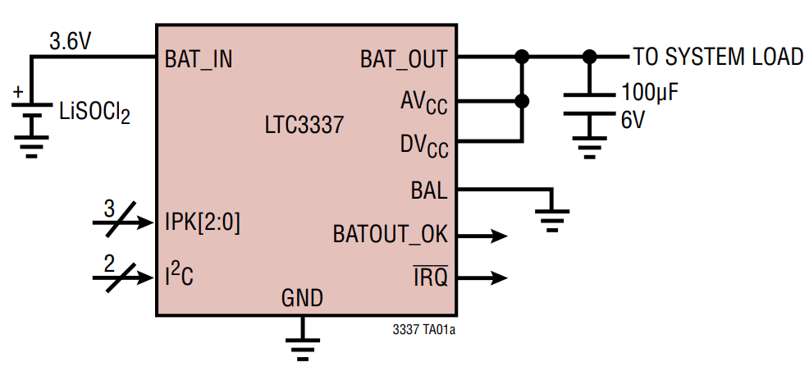
How are batteries measured?
Measuring energy remaining is a difficult problem
Many questions to be handled
How much did it start with?
How much energy has been used?
What type of battery is it?
Energy is not as constant a quantity as one would hope
Pulling out lots at once has an overhead penalty
Coulomb Counter (aka Battery Fuel Gauge)
Designed for a specific battery “chemistry”
Monitors charge flowing in each direction
I2C interface for reading battery state
Accuracy is not exact, more of an educated guess

Slide 43
How are batteries managed?
Usually a dedicated IC for charging and managing battery packs
Recharges battery with appropriate amount of current
Monitors issues of battery health
Various status monitoring
Overcharge, undercharge
Overcurrent
Overtemperature, undertemperature
Will go so far as to cut off the system to protect the battery
Takeaway: complicated problem, approach with caution!
Best to reuse an existing design, if possible

Slide 44
Microbit only uses battery energy in a simple way
Battery input connects directly to regulator
No protection for battery health
No battery charging capabilities
Usually this is fine for simple, low-power systems
It means that the input voltage can vary though
Makes the reference voltages for the ADC/Comparator more important

Slide 45
Energy harvesting
Grab energy from the environment and use that!
Could augment with a battery and use energy to recharge
Could go entirely batteryless and live on harvested energy alone
Sources
Light (outdoor or indoor. most successful)
Airflow (outdoor or air vents)
Motion (on human body)
Temperature differential (difficult in practice)
RF (very low energy source)

Slide 46
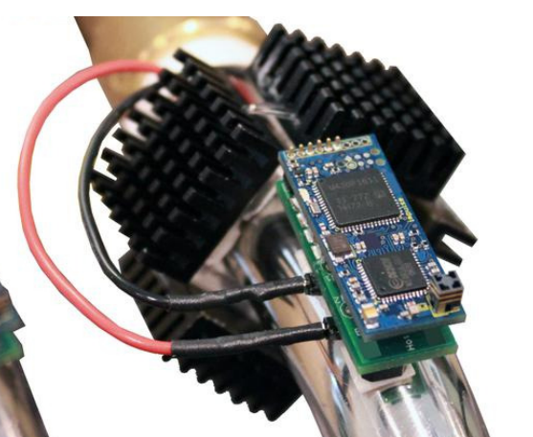
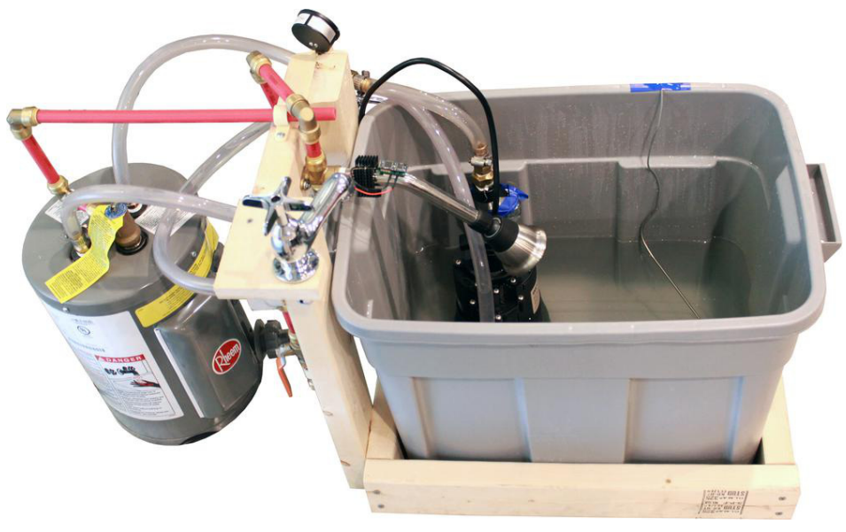
Temperature harvesting from hot pipes
Peltier junctions create a voltage from temperature differential
Challenge: needs a large differential for more energy

Slide 47
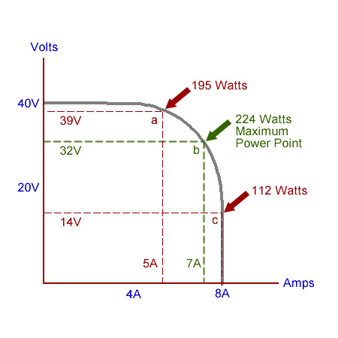
Managing harvested energy
Often uses an IC to pull in energy and provide to system
Harvested voltage/current are often very small
Signal in millivolts is pretty common
Need to accumulate over time to power system
Fill up a capacitor
Need particular load for maximum power
ICs often implement Maximum Power Point Tracking (MPPT)
Varies load automatically to always harvest the most possible energy

Slide 48
Break + Question
System configuration
System current draw: 280 mA
Battery capacity: 1000 mAh
How long can you run the system for?

Slide 49
Break + Question
Microbit max current draw
System configuration
System current draw: 280 mA
Battery capacity: 1000 mAh
How long can you run the system for?
1000 mAh / 280 mA ≈ 3.5 hours
That’s not great battery life. Would need a much bigger battery to keep this running for a long time, or need to reduce average current consumption
Typical AAA battery energy

Slide 50
Outline
Nonvolatile Memory
Memory in Computing
nRF52 Non-Volatile Memory Controller
SD Card Interface
Energy Management
Energy Sources
Microbit Energy Use
Intermittent Computing

Slide 51
Thinking about energy
Battery energy
Coin cell battery: 3v at 220 mAh
2x AAA battery: 3v at 1000 mAh
2x AA battery: 3v at 2000 mAh
iPhone 11 battery: 3.7v at 3000 mAh
nRF52833 active current: 5.6 mA (at 3v)
Coin cell: 40 hours -> ~2 days
2x AAA: 180 hours -> ~7 days
2x AA: 360 hours -> ~15 days
iPhone 11: 535 hours -> ~22 days
So how does any of this work???

Slide 52
Sleep mode power draw

Slide 53
Microcontroller sleep modes
Sleep mode
Processor stops running but memory values are preserved
Most peripherals are disabled
Continues until an interrupt occurs and wakes the microcontroller
Usually a timer or GPIO input
nRF52833 sleep mode current: 1.8 μA (GPIO port event only)
Coin cell: 122222 hours -> ~5000 days -> ~14 years
Low-power systems shoot for less than 1% duty cycle
Average current of ~100 μA or less
Warning: other stuff on the board counts!!
LEDs are 1-10 mA each… Power is not a concern of the Microbit

Slide 54
Microbit current draw (microcontroller)
Active CPU
5.6 mA (executing from Flash)
1.8 μA (sleep mode with RAM retention)
Transmitting RF packet
15.5 mA (+8 dBm)
Other peripherals
SAADC: 1.37 mA
Timer: 729 μA (for any Timer peripheral)
I2C: 6.6 mA (pull-down resistors when transmitting 0 bit)
Everything else is handfuls of μA

Slide 55
Microbit current draw (non-microcontroller)
KL27 (JTAG interface microcontroller)
2 μA sleep, 8 mA active
Speaker
0-27.5 mA (changes with input signal)
Microphone
0-120 μA (activated with GPIO pin)
Accelerometer/Magnetometer
2-212 μA (depends on sensing rates, 200 is magnetometer)
LEDs
0-230 mA (can be activated individually)
Everything else
0-1 mA (mostly due to pull-up resistors)

Slide 56
Max and min current for Microbit
Maximum current: 280 mA at 3.3 volts (~1 W)
With everything active
Well within limits of regulator
Minimum current
~15 mA (always-on power LED)
If you removed the power LED:
<100 μA (with everything off)

Slide 57

nRF52 sleep mode
Triggered with assembly instruction
WFI (Wait For Interrupt) or WFE (Wait For Event)
Stops processor until woken by interrupt, exception, or event
On nRF52 automatically disables high frequency clock if unneeded

Slide 58
Outline
Nonvolatile Memory
Memory in Computing
nRF52 Non-Volatile Memory Controller
SD Card Interface
Energy Management
Energy Sources
Microbit Energy Use
Intermittent Computing

Slide 59
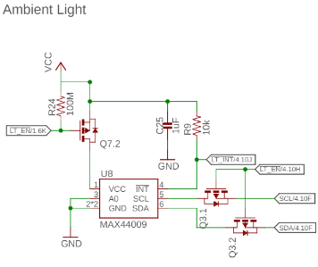
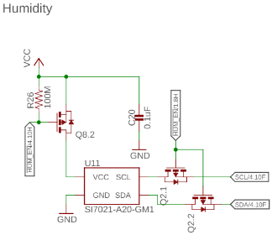
Reducing energy consumption even further
If sleep isn’t enough, you can power things off completely
Transistor can be used to turn off the sensor

Slide 60
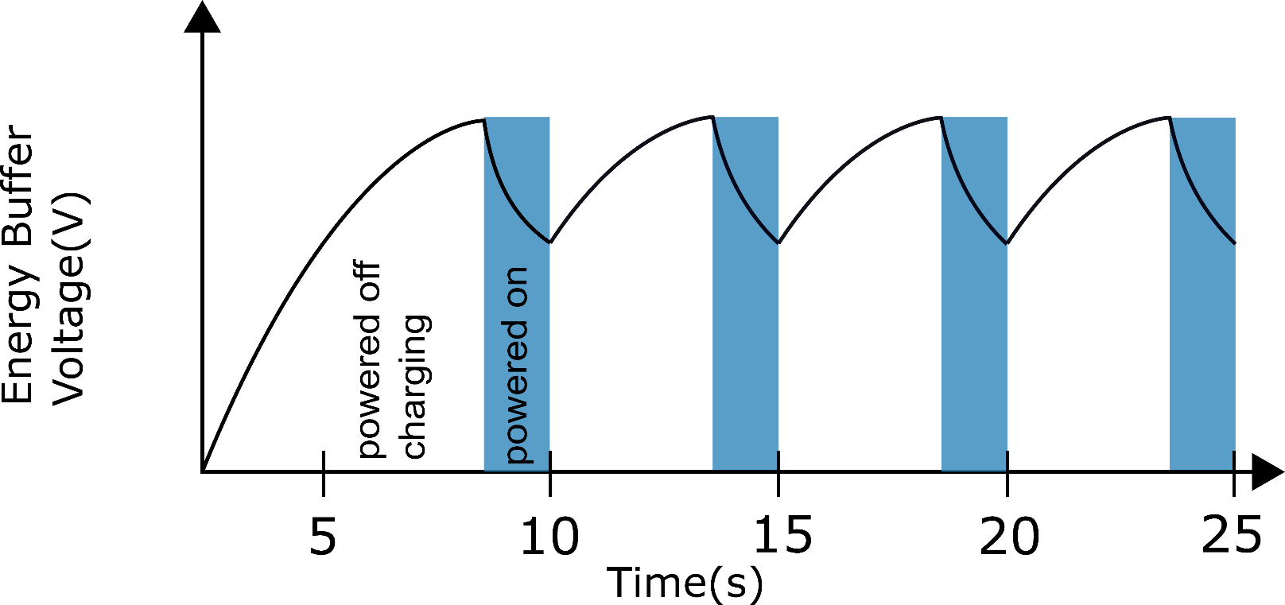

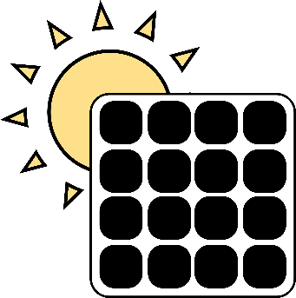

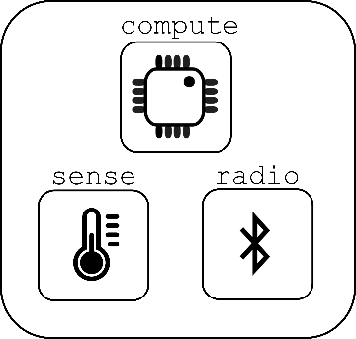

Energy harvesting can lead to intermittent computing

Slide 61
Disabling the microcontroller
Even 2 μA sleep current might be too much for energy harvesting
Can turn off microcontroller periodically
Enable it again once VCC returns
Problem: how do you write software to deal with intermittency?
Run-to-completion with relatively quick code
Initialize, sample sensor, send packet, turn off again
Code checkpointing
Save state from code and restore when power resumes
Might be as little as which state the system is in, plus some samples
Might be as much as saving entire stack state
Needs low-energy, nonvolatile storage (FRAM or MRAM help!)

Slide 62
Programs may not finish
int process() {
count++;
buf[count] = accel();
avg = sum(buf)/count;
transmit(avg);
}
count++
buf[count] = accel()
Power fail
Execution Time
Notes:
More detailed explanation WHY volatile/non-volatile etc. Perhaps split to two slides
Add callout saying we need latch, etc.
Make capy bigger

Slide 63
Programs may not finish
int process() {
count++;
buf[count] = accel();
avg = sum(buf)/count;
transmit(avg);
}
count++
buf[count] = accel()
Power fail
Execution Time
count++;
buf[count] = accel()
Power fail
.
.
.
Notes:
More detailed explanation WHY volatile/non-volatile etc. Perhaps split to two slides
Add callout saying we need latch, etc.

Slide 64
Programs may not finish
int process() {
count++;
buf[count] = accel();
avg = sum(buf)/count;
transmit(avg);
}
count++
buf[count] = accel()
Power fail
Execution Time
count++;
buf[count] = accel()
Power fail
.
.
.
Need to latch execution state periodically!
Notes:
More detailed explanation WHY volatile/non-volatile etc. Perhaps split to two slides
Add callout saying we need latch, etc.

Slide 65
Checkpointing enables progress
int process() {
count++;
buf[count] = accel();
avg = sum(buf)/count;
transmit(avg);
}
Execute with checkpoints
count++
buf[count] = accel()
count++
buf[count] = accel()
Checkpoint
Power fail
Power fail
Execution Time
count++;
buf[count] = accel()
Power fail
.
.
.
Need to latch execution state periodically!
Notes:
More detailed explanation WHY volatile/non-volatile etc. Perhaps split to two slides
Add callout saying we need latch, etc.

Slide 66
Checkpointing enables progress
int process() {
count++;
buf[count] = accel();
avg = sum(buf)/count;
transmit(avg);
}
Execute with checkpoints
count++
buf[count] = accel()
count++
buf[count] = accel()
Checkpoint
Power fail
Power fail
Execution Time
count++;
buf[count] = accel()
buf[count] = accel()
avg = sum(buf)/count
transmit-
Power fail
Checkpoint
Power fail
.
.
.
Need to latch execution state periodically!
Notes:
More detailed explanation WHY volatile/non-volatile etc. Perhaps split to two slides
Add callout saying we need latch, etc.

Slide 67
Checkpointing enables progress
int process() {
count++;
buf[count] = accel();
avg = sum(buf)/count;
transmit(avg);
}
Execute with checkpoints
count++
buf[count] = accel()
count++
buf[count] = accel()
Checkpoint
Power fail
Power fail
Execution Time
count++;
buf[count] = accel()
buf[count] = accel()
avg = sum(buf)/count
transmit-
Power fail
Checkpoint
Power fail
.
.
.
Need to latch execution state periodically!
transmit(avg)
Notes:
More detailed explanation WHY volatile/non-volatile etc. Perhaps split to two slides
Add callout saying we need latch, etc.

Slide 68
Checkpointing goals
Have the compiler automatically insert checkpoints as needed
Human doesn’t have to think about them when programming
Limit checkpointing overhead while maximizing forward progress
Checkpointing will take time to perform, so want to do it rarely
Rarer checkpoints mean more progress is lost in average outage
Need to compromise on the two based on available energy

Slide 69
Outline
Nonvolatile Memory
Memory in Computing
nRF52 Non-Volatile Memory Controller
SD Card Interface
Energy Management
Energy Sources
Microbit Energy Use
Intermittent Computing

Slide 70
Outline
Bonus: Task/Event Chaining with PPI

Slide 71
Software stops when the processor does, but peripherals continue
Problem: when the processor is off, no code is running
Solutions
Peripherals can wake it up again
Can probably go for milliseconds to minutes without any actions
Timer interrupt can wake processor to do things
Have hardware handle some parts in the background without the processor’s involvement
DMA
PPI

Slide 72
Controlling peripherals while processor sleeps
DMA (Direct Memory Access)
Set up a pointer to memory and a length
Peripheral can load/store memory without processor’s involvement
Usually use completion interrupt to wake processor
PPI (Programmable Peripheral Interconnect)
Any Event can be tied to any Task within the nRF52
Allows for complicated actions to be chained together

Slide 73
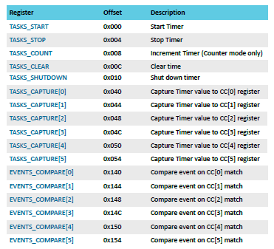
nRF52 Tasks and Events
Example: Timer peripheral
Tasks are used to perform some operation
Often written to by software
Events change value when some change in status occurs
Often used to trigger interrupts
PPI peripheral can connect any TASK to any EVENT

Slide 74
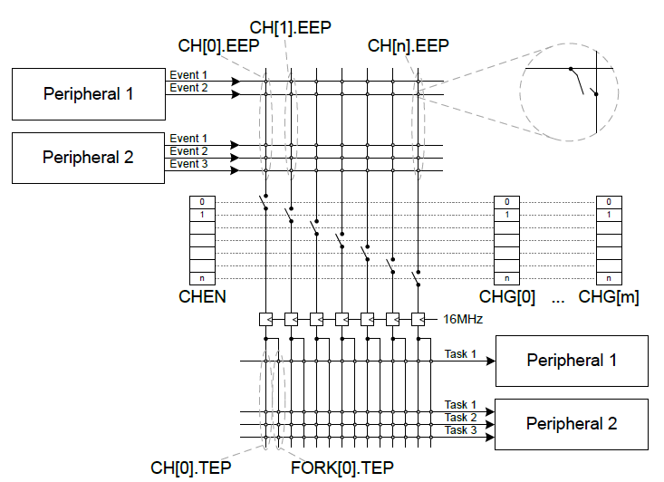
nRF52 PPI peripheral
Connects Events to Tasks via hardware
Each channel gets one Event pointer and up to two Task pointers
Must point to Event/Task registers

Slide 75
Example PPI use case
Automatic high-speed ADC sampling
Software configures and sleeps
ADC (buffer and enable)
Timer (prescaler, compare value, short from compare to clear, and start)
PPI: When Timer fires (EVENTS_COMPARE[0]),
Sample ADC (TASKS_SAMPLE)
PPI: When ADC buffer full (EVENTS_END),
Stop Timer (TASKS_STOP)
Fork: wake processor (via software interrupt from EGU)

