Slide 1
Lecture 03: Concurrency Sources and Challenges
CS343 – Operating Systems
Branden Ghena – Fall 2025
Some slides borrowed from: Stephen Tarzia (Northwestern), and UC Berkeley CS61C and CS162

Slide 2
Administrivia
Getting Started Lab
Let us know if you’re having problems with this
Should not take long to complete
61/120 of you have finished already
Office Hours
Coming soon…
PCLab Partnership Survey
Out now. Sign up if you do not have a partner

Slide 3
Today’s Goals
Understand threads as a software design mechanism.
Describe where and why concurrency and parallelism are involved in computing.
Discuss multiple sources of concurrency on computing systems
Be disappointed by performance limits on concurrency.

Slide 4
Outline
Processes
Context Switching
Running a Process
Exceptions
Running the Kernel
System Calls
Signals
Threads

Slide 5
Exceptional control flow
Mechanisms that could cause exceptional control flow
Exceptions: events cause execution to jump to OS handler
System calls: request from process causes execution to jump to OS
Signals: OS causes process to jump to process handler
Running process
Other code (usually OS)
Event
I_current
Exception
I_next
Exception processing
by exception handler
Return to I_next

Slide 6
Alerting processes of events
How do we let a process know there was an event?
Errors
Termination
User commands (like CTRL-C or CTRL-\)
Events could happen whenever
Need to interrupt process control flow and run an event handler
Linux mechanism to do so is called “signals”

Slide 7
Signals are asynchronous messages to processes
Sometimes the OS wants to send something like an interrupt to a process
Your child process completed
You tried to use an illegal instruction
You accessed invalid memory
You are terminating now
In POSIX systems, this idea is called “Signals”
1) SIGHUP 2) SIGINT 3) SIGQUIT 4) SIGILL 5) SIGTRAP
6) SIGABRT 7) SIGBUS 8) SIGFPE 9) SIGKILL 10) SIGUSR1
11) SIGSEGV 12) SIGUSR2 13) SIGPIPE 14) SIGALRM 15) SIGTERM
16) SIGSTKFLT 17) SIGCHLD 18) SIGCONT 19) SIGSTOP 20) SIGTSTP
21) SIGTTIN 22) SIGTTOU 23) SIGURG 24) SIGXCPU 25) SIGXFSZ
26) SIGVTALRM 27) SIGPROF 28) SIGWINCH 29) SIGIO 30) SIGPWR
31) SIGSYS ...

Slide 8
Signals are asynchronous messages to processes
Sometimes the OS wants to send something like an interrupt to a process
Your child process completed
You tried to use an illegal instruction
You accessed invalid memory
You are terminating now
In POSIX systems, this idea is called “Signals”
1) SIGHUP 2) SIGINT 3) SIGQUIT 4) SIGILL 5) SIGTRAP
6) SIGABRT 7) SIGBUS 8) SIGFPE 9) SIGKILL 10) SIGUSR1
11) SIGSEGV 12) SIGUSR2 13) SIGPIPE 14) SIGALRM 15) SIGTERM
16) SIGSTKFLT 17) SIGCHLD 18) SIGCONT 19) SIGSTOP 20) SIGTSTP
21) SIGTTIN 22) SIGTTOU 23) SIGURG 24) SIGXCPU 25) SIGXFSZ
26) SIGVTALRM 27) SIGPROF 28) SIGWINCH 29) SIGIO 30) SIGPWR
31) SIGSYS ...
Process Errors

Slide 9
Signals are asynchronous messages to processes
Sometimes the OS wants to send something like an interrupt to a process
Your child process completed
You tried to use an illegal instruction
You accessed invalid memory
You are terminating now
In POSIX systems, this idea is called “Signals”
1) SIGHUP 2) SIGINT 3) SIGQUIT 4) SIGILL 5) SIGTRAP
6) SIGABRT 7) SIGBUS 8) SIGFPE 9) SIGKILL 10) SIGUSR1
11) SIGSEGV 12) SIGUSR2 13) SIGPIPE 14) SIGALRM 15) SIGTERM
16) SIGSTKFLT 17) SIGCHLD 18) SIGCONT 19) SIGSTOP 20) SIGTSTP
21) SIGTTIN 22) SIGTTOU 23) SIGURG 24) SIGXCPU 25) SIGXFSZ
26) SIGVTALRM 27) SIGPROF 28) SIGWINCH 29) SIGIO 30) SIGPWR
31) SIGSYS ...
Process Termination

Slide 10
Sending signals
OS sends signals when it needs to
Processes can ask the OS send signals with a system call
int kill(pid_t pid, int sig);
Users send signals through OS from command line or keyboard
Shell command: kill -9 pid (SIGKILL)
CTRL-C (SIGINT)

Slide 11
Handling signals
Programs can register a function to handle individual signals
signal(int sig, sighandler_t handler);
OS keeps track of signal handlers for each signal
Calls that function when a signal occurs
What is the process supposed to do about it?
Do some quick processing to handle it
That needs to be “reentrant” safe
Reset the process and try again
Quit the process (default handler)

Slide 12
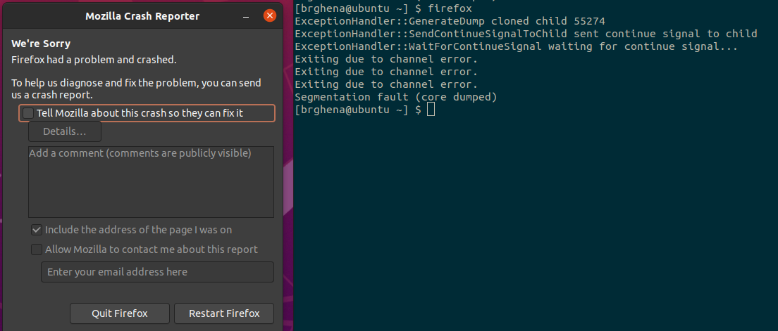
Examples: sending a signal
> kill -11 pid (11 is SIGSEGV – a.k.a segfault)

Slide 13
Outline
Threads
Need for Parallelism
Processor Concurrency
Instruction-level parallelism
Task parallelism
Interrupts
Concurrency Challenges
Amdahl’s Law

Slide 14
Software Tasks: Threads
Unit of execution within a process
Processes discussed so far have a single thread
They “have a single thread of execution”
They “are single-threaded”
But a single process could have multiple threads

Slide 15
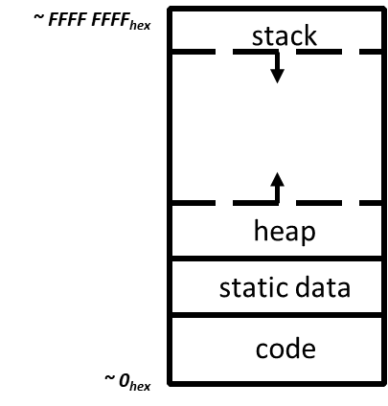
View of a process
Process: program that is being executed
Contains code, data, and a thread
Thread contains registers, instruction pointer, and stack
Code and Data
Registers
Instruction Pointer
Condition Codes
Stack
%rax
%r8
%eax
%r8d
%rbx
%r9
%ebx
%r9d
%rcx
%r10
%ecx
%r10d
%rdx
%r11
%edx
%r11d
%rsi
%r12
%esi
%r12d
%rdi
%r13
%edi
%r13d
%rsp
%r14
%esp
%r14d
%rbp
%r15
%ebp
%r15d

Slide 16
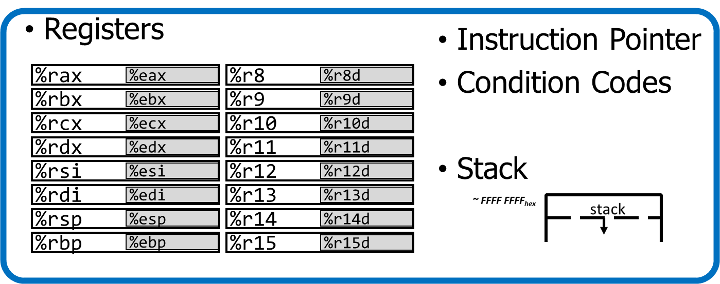
Processes and threads
A process could have multiple threads
Each with its own registers and stack
Threads have separate:
Instruction Pointer
Registers
Stack Memory
Condition Codes
Threads share:
Code
Global variables
Code and Data

Slide 17
Process address space with threads
Stack (T1)
Thread 1
Thread 2
Stack (T2)
Stack (T3)
Thread 3
Data
Segment
Heap
Static Data
%RIP (T3)
%RIP (T2)
Code
%RIP (T1)

Slide 18
Thread use case: web browser
Let’s say you’re implementing a web browser:
You want a tab for each web page you open:
The same code loads each website (shared code section)
The same global settings are shared by each tab (shared data section)
Each tab does have separate state (separate stack and registers)
Disclaimer: Actually, modern browsers use separate processes for each tab for a variety of reasons including performance and security. But they used to use threads.

Slide 19
Thread use case: user interfaces
Even if there is only a single processor core, threads are useful
Single-threaded User Interface
While processing actions, the UI is frozen
main() {
while(true) {
check_for_UI_interactions();
process_UI_actions(); // UI freezes while processing
}
}

Slide 20


Thread use case: web server
Example: Web server
Receives multiple simultaneous requests
Reads web pages from disk to satisfy each request

Slide 21
Web server option 1: handle one request at a time
Request 1 arrives
Server reads in request 1
Server starts disk I/O for request 1
Request 2 arrives
Disk I/O for request 1 finishes
Server responds to request 1
Server reads in request 2
Easy to program, but slow
Can’t overlap disk requests with computation
Can’t overlap either with network sends and receives
time

Slide 22
Web server option 1: event-driven model
Issue I/Os, but don’t wait for them to complete
Request 1 arrives
Server reads in request 1
Server starts disk I/O for request 1
Request 2 arrives
Server reads in request 2
Server starts disk I/O for request 2
Disk I/O for request 1 completes
Server responds to request 1
Fast, but hard to program
Must remember which requests are in flight and which I/O goes where
Lots of extra state
time

Slide 23
Web server option 3: multi-threaded web server
One thread per request. Thread handles only that request.
Easy to program (maybe), and fast!
State is stored in the stacks of each thread and the thread scheduler
Simple to program if they are independent…
Main Thread
Request 1 arrives
Create thread
Request 2 arrives
Create thread
Thread 1
Read in request 1
Start disk I/O
Disk I/O finishes
Respond to request 1
Exit
Thread 2
Read in request 2
Start disk I/O
time

Slide 24
How are threads implemented?
Two major possibilities
User Threads
Kernel Threads
(There are other options that mix these)

Slide 25

Models for thread libraries: User Threads
Thread scheduling is implemented within the process
OS only knows about the process, not the threads
Upsides
Works on any hardware or OS
Performance is better when creating and switching
Downsides
A system call in any thread blocks all threads
Processes
Thread Library
OS Kernel
Scheduler

Slide 26
Models for thread libraries: Kernel Threads
Thread scheduling is implemented by the operating system
OS manages the threads within each process
Upsides
Other threads can continue while one blocks on I/O
No additional scheduler
Downsides
Higher overhead
This is what we’ll focus on in CS343
Processes
OS Kernel
Scheduler

Slide 27
POSIX Threads Library: pthreads
https://man7.org/linux/man-pages/man7/pthreads.7.html
int pthread_create(pthread_t *thread, const pthread_attr_t *attr, void *(*start_routine)(void*), void *arg);
thread is created executing start_routine with arg as its sole argument.
return is implicit call to pthread_exit
void pthread_exit(void *value_ptr);
terminates the thread and makes value_ptr available to any successful join
int pthread_join(pthread_t thread, void **value_ptr);
suspends execution of the calling thread until the target thread terminates.
On return with a non-NULL value_ptr the value passed to pthread_exit() by the terminating thread is made available in the location referenced by value_ptr.

Slide 28
Pthread system call example
What happens when pthread_create() is called in a process?
Library:
int pthread_create(…) {
Do some work like a normal function
Put syscall number into register
Put args into registers Special trap instruction
clone (56) syscall on Linux
Kernel:
Get args from regs
Do the work to spawn the new thread
Store return value in %eax
Get return values from regs
Do some more work like a normal function
};

Slide 29
Threads versus Processes
Threads
pthread_create()
Creates a thread
Shares all memory with all threads of the process.
Scheduled independently of parent
pthread_join()
Waits for a particular thread to finish
Can communicate by reading/writing (shared) global variables.
Processes
fork()
Creates a single-threaded process
Copies all memory from parent
Can be quick using copy-on-write
Scheduled independently of parent
waitpid()
Waits for a particular child process to finish
Can communicate by setting up shared memory, pipes, reading/writing files, or using sockets (network).

Slide 30
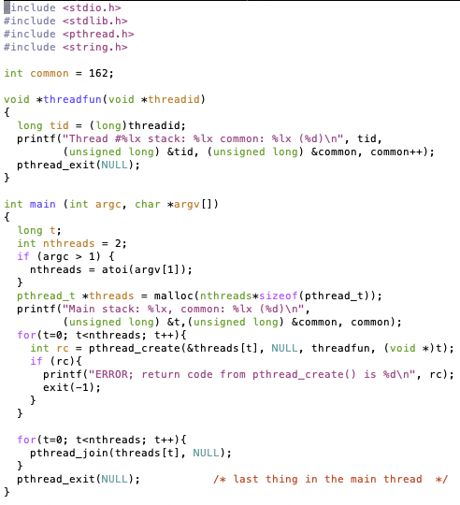
Threads Example

Slide 31
Threads Example
Reads N from process arguments
Creates N threads
Each one prints
Thread number
Memory address of its stack
Memory address of global variable
Global value, starting at 162, which it increments
Main process waits for all of the threads to finish

Slide 32

Threads Example

Slide 33
Threads Example
Left: Every thread has its own stack
Right: Every thread shares global memory

Slide 34
Break + Check your understanding
How many threads are in this program?
Does the main thread join with the threads in the same order that they were created?
Do the threads exit in the same order they were created?
If we run the program again, could the result change?

Slide 35
Break + Check your understanding
How many threads are in this program? Five
Does the main thread join with the threads in the same order that they were created? Yes
Do the threads exit in the same order they were created? Maybe??
If we run the program again, could the result change? Possibly!

Slide 36
Outline
Threads
Need for Parallelism
Processor Concurrency
Instruction-level parallelism
Task parallelism
Interrupts
Concurrency Challenges
Amdahl’s Law

Slide 37
It’s the mid 1990s and you work at Microsoft.
You need to double the speed of Excel in two years.
What do you do?

Slide 38
It’s the mid 1990s and you work at Microsoft.
You need to double the speed of Excel in two years.
What do you do? Take a vacation

Slide 39

Moore’s Law – CPU transistors counts
“Number of transistors in a chip doubles every 18 months”
How? Transistors are getting exponentially smaller!
How small? Today: <7nm! (maybe smaller, kind of complicated)
< ½ the size of most viruses!
Notes:
Gordon Moore – first version of the law – ’65: double every year; restated in ‘75: double every two years
Was simplified to “every 18 months”

Slide 40
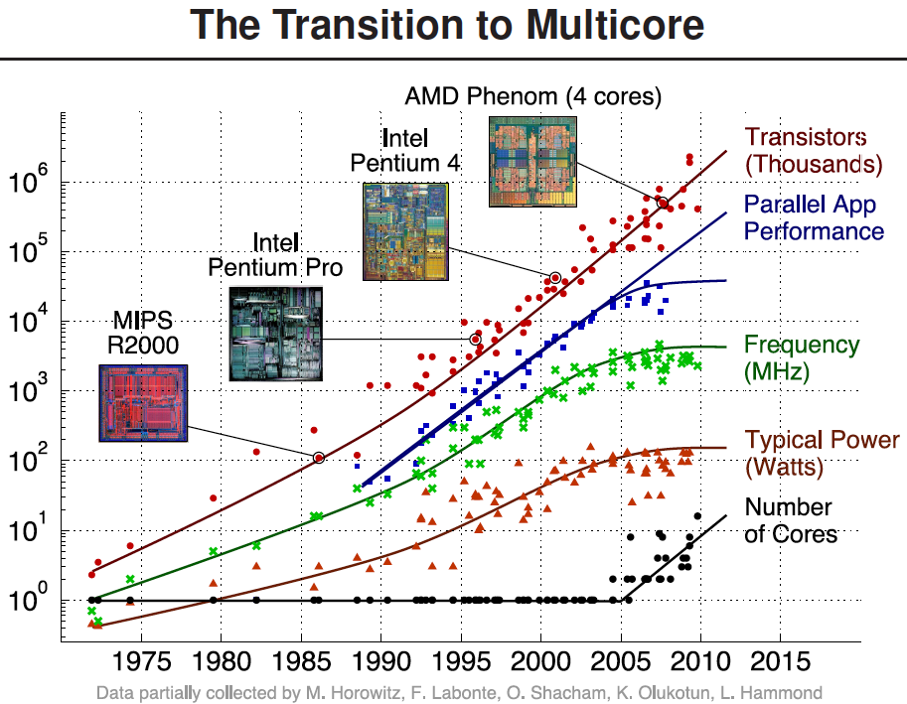
Processors kept getting faster too

Slide 41
Power is a major limiting factor on speed
We could make processors go very fast
But doing so uses more and more power
More power means more heat generated
And chips typically work up to around 100°C
Hotter than that and things stop working
We add heat sinks and fans and water coolers to keep chips cool
But it’s hard to remove heat quickly enough from chips
So, power consumption ends up limiting processor speed

Slide 42
Denard Scaling
Moore’s Law corollary: Denar Scaling
As transistors get smaller, the power density stays the same
Which is to say that the power-per-transistor decreases!
Making the processor clock speed faster uses more power
But the two balance out for roughly net even power
So not only do we get more transistors, but chip speed can be faster too
From our Excel example:
In two years, new hardware would run the existing software twice as fast

Slide 43
Then they stopped getting faster
~2006: Leakage current becomes significant
Now smaller transistors doesn’t mean lower power

Slide 44
So… now what?
In summary:
Making transistors smaller doesn’t make them lower power,
so if we were to make them faster, they would take more power,
which will eventually lead to our processors melting…
and because of that, we can’t reliably make performance better by waiting for clock speeds to increase.
How do we continue to get better computation performance?

Slide 45
Exploit parallelism!

Slide 46
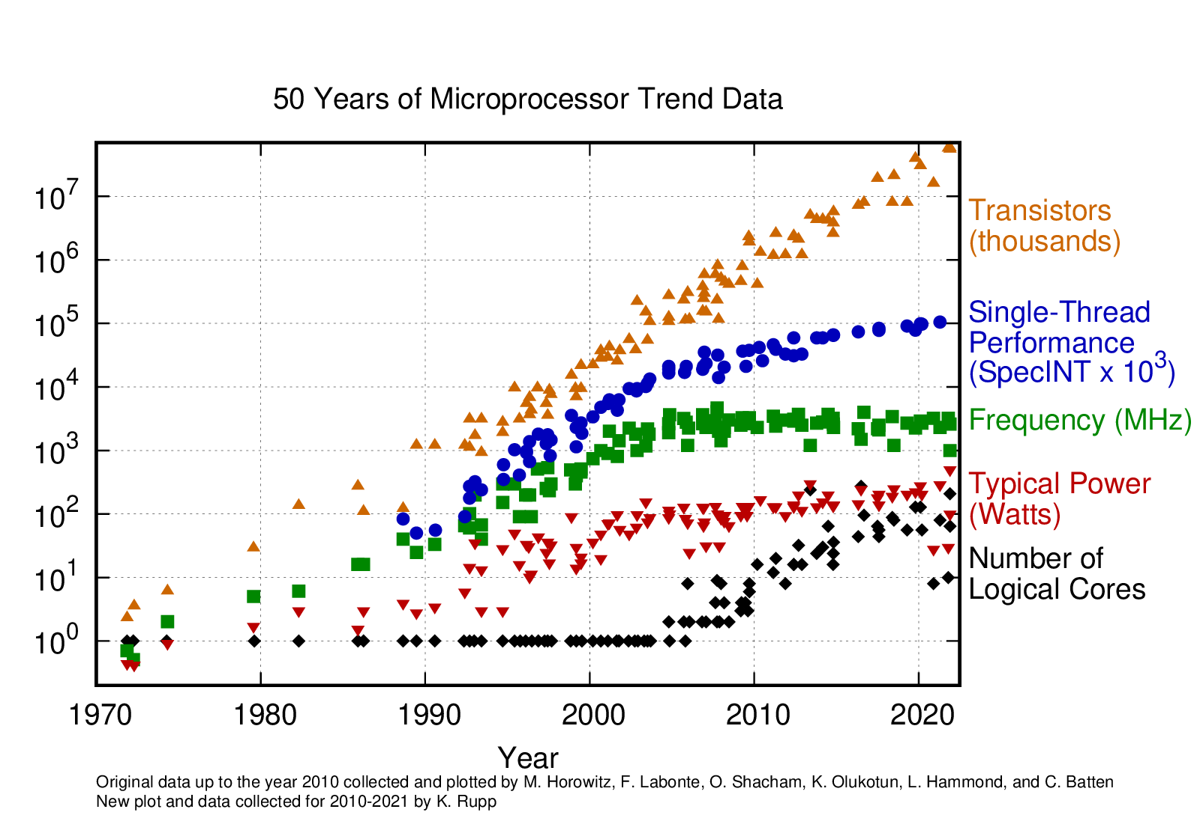
Update: 2010-2021
Still growing!
Small improvement
Stable
Stable
Still growing for servers

Slide 47
Key question: how do we use all these cores?

Slide 48
Break + Parallelism Analogy
I want to peel 100 potatoes as fast as possible:
I can learn to peel potatoes faster
OR
I can get 99 friends to help me
Whenever one result doesn’t depend on another, doing the task in parallel can be a big win!

Slide 49
Parallelism versus Concurrency
Two processes A and B
A
B
time
Serial execution
Parallel execution
Concurrent execution
A
B
time
A
B
time
time
A
OR
B

Slide 50
Parallelism versus Concurrency
Parallelism
Two things happen strictly simultaneously
Concurrency
More general term
Two things happen in the same time window
Could be simultaneous, could be interleaved
Concurrent execution occurs whenever two processes are both active
time
time
time
A
OR
B
OR

Slide 51
Outline
Threads
Need for Parallelism
Processor Concurrency
Instruction-level parallelism
Task parallelism
Interrupts
Concurrency Challenges
Amdahl’s Law

Slide 52
Hardware sources of concurrency
Instruction-level parallelism
Task parallelism
Multiple processes
Multiple threads
Interrupts

Slide 53
Model of a processor
CPU
Updated
Registers and
Memory
Instructions,
Registers,
Memory
CPU
Instruction Fetch
Instruction Decode
Execute
Memory
Writeback

Slide 54
But instructions don’t always have to be executed in order
movq (%rdi), %rax movq (%rsi), %rdx movq %rdx, (%rdi) movq %rax, (%rsi) addq %rcx, %rbx
We can apply the multiprogramming approach of executing this addq while the movq is waiting on memory.
Doesn’t have to go after the movq instructions because it uses different registers

Slide 55
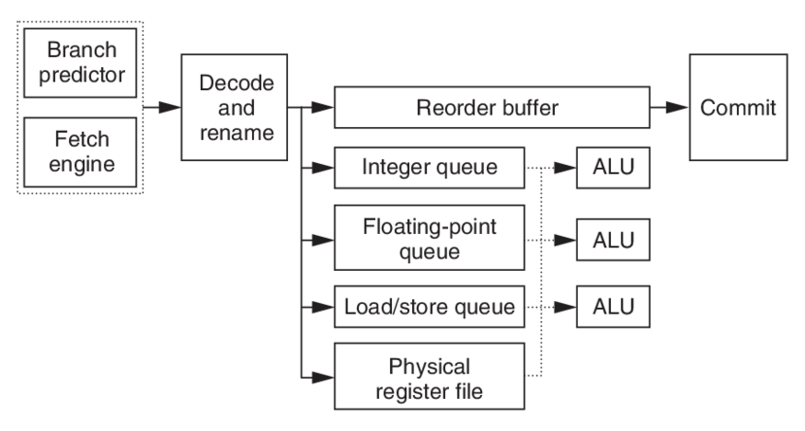
Out-of-order processors
Reorder instructions to make best use of CPU
Commit, or “write back” data to memory and regfile in the order the programmer expects
Fetch many instructions at once!
Read register file, handle data dependencies with register renaming
Generally: looks for independent instructions it can execute early

Slide 56
Out-of-order processors obey normal execution results
Initial thoughts on out-of-order execution
😱
The processor could be executing my program in order it feels like?!!
How do I possibly reason about anything?
Answer: the processor promises to have the same results as if things were done in the normal order.
CPU
Updated
Registers and
Memory
Instructions,
Registers,
Memory

Slide 57
Multiple threads might rely on memory ordering
The processor can’t account for multiple threads though
If memory results are shared by two threads, the processor might mess something up for you.
What will Thread 1 print?
f = 0;
x = 0;
// split into threads
Thread 1
Thread 2
while (f == 0);
printf(“%d\n”, x);
x = 42;
f = 1;

Slide 58
Multiple threads might rely on memory ordering
The processor can’t account for multiple threads though
If memory results are shared by two threads, the processor might mess something up for you.
What will Thread 1 print? Could be 42. Could be 0.
f = 0;
x = 0;
// split into threads
Thread 1
Thread 2
while (f == 0);
printf(“%d\n”, x);
x = 42;
f = 1;
This can be addressed with memory barriers

Slide 59
Outline
Threads
Need for Parallelism
Processor Concurrency
Instruction-level parallelism
Task parallelism
Interrupts
Concurrency Challenges
Amdahl’s Law

Slide 60
Task parallelism use case
Run Chrome and Spotify simultaneously
Each are separate programs
Each has a different memory space
Each can run on a separate core
Don’t even need to communicate...
Note: OS can fake this by interleaving processes, but hardware can make it actually simultaneous

Slide 61
Multicore Systems (in pictures)
Core 0
Memory
Processor 0 Memory Accesses
Control
Datapath
RIP
Bytes
Registers
(ALU)
Core 1
Control
Processor 1 Memory Accesses
Datapath
RIP
Registers
(ALU)
Actually parallel!

Slide 62
Multicore Systems (in words)
A computer system with at least 2 processor cores
Each core has its own registers
Each core executes independent instruction streams
Cores share the same system memory
But usually use different parts of it
Communication possible through memory accesses
Deliver high throughput for independent jobs via task-level parallelism

Slide 63
Multithreading processors
Basic idea: Processor resources are expensive and should not be left idle
So have multiple threads ready to run at all times
Long memory latency to memory on cache miss?
Hardware switches threads to bring in other useful work while waiting for cache miss
Cost of thread context switch must be much less than cache miss latency
Switching threads is less expensive than processes because they share memory
Cache is still valid
Page Table for virtual memory doesn’t have to change

Slide 64
Multithreading processor
Processor
Control
Memory
Datapath
RIP 0
RIP 1
Registers 0
Registers 1
(ALU)
Bytes
Two copies of RIP and Registers inside processor hardware
Looks like two processors to software (hardware thread 0, hardware thread 1)
Control logic decides which thread to execute an instruction from next (concurrent, but NOT parallel)
64

Slide 65
Multithreading versus Multicore
Multithreading => Better utilization
≈5% more hardware for ≈1.3x better performance?
Gets to share ALUs, caches, memory controller
Multicore => Duplicate cores
≈50% more hardware for ≈2x better performance?
Share some caches (L2 cache, L3 cache), memory controller
Modern processors might do both!
Multiple cores with multiple threads per core
Not all do though, some focus on better single-thread performance

Slide 66
Multithreading, multicore processors
Combine capabilities of both designs
Run two processes each with two threads
Or run one process with four threads
Processor
Memory
Control
Processor 0 Memory Accesses
Datapath
RIP 0
RIP 1
Registers 0
Registers 1
Bytes
(ALU)
Processor
Control
Processor 1 Memory Accesses
Datapath
RIP 0
RIP 1
Registers 0
Registers 1
(ALU)

Slide 67
Clearing up vocabulary
Core: computation unit within the CPU
ALU, Registers, etc.
Capable of running one or more threads
CPU (processor): the chip that goes in your computer
Contains one or more cores
Computers could have multiple CPU chips as well
Sometimes people equate processors and cores, which is confusing
I’ll definitely do it by mistake at some point if I haven’t already. Sorry!

Slide 68
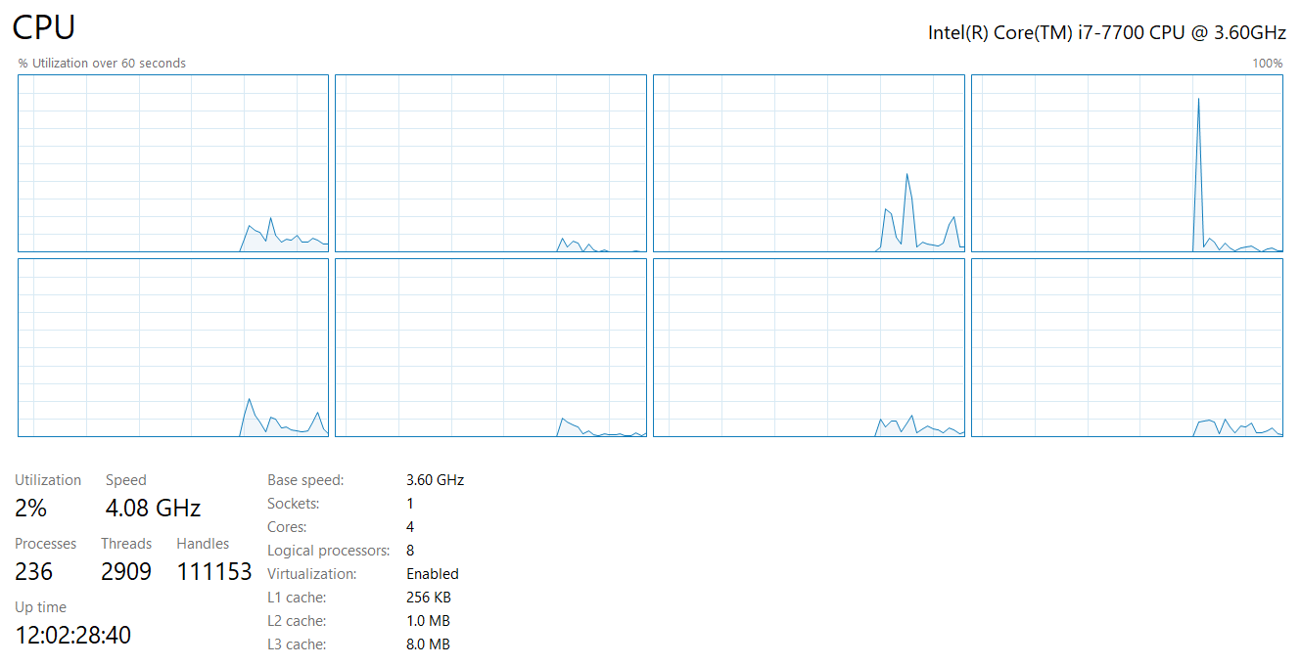
My desktop computer
4 total cores
Each capable of 2 threads
≈ 8 jobs at once

Slide 69
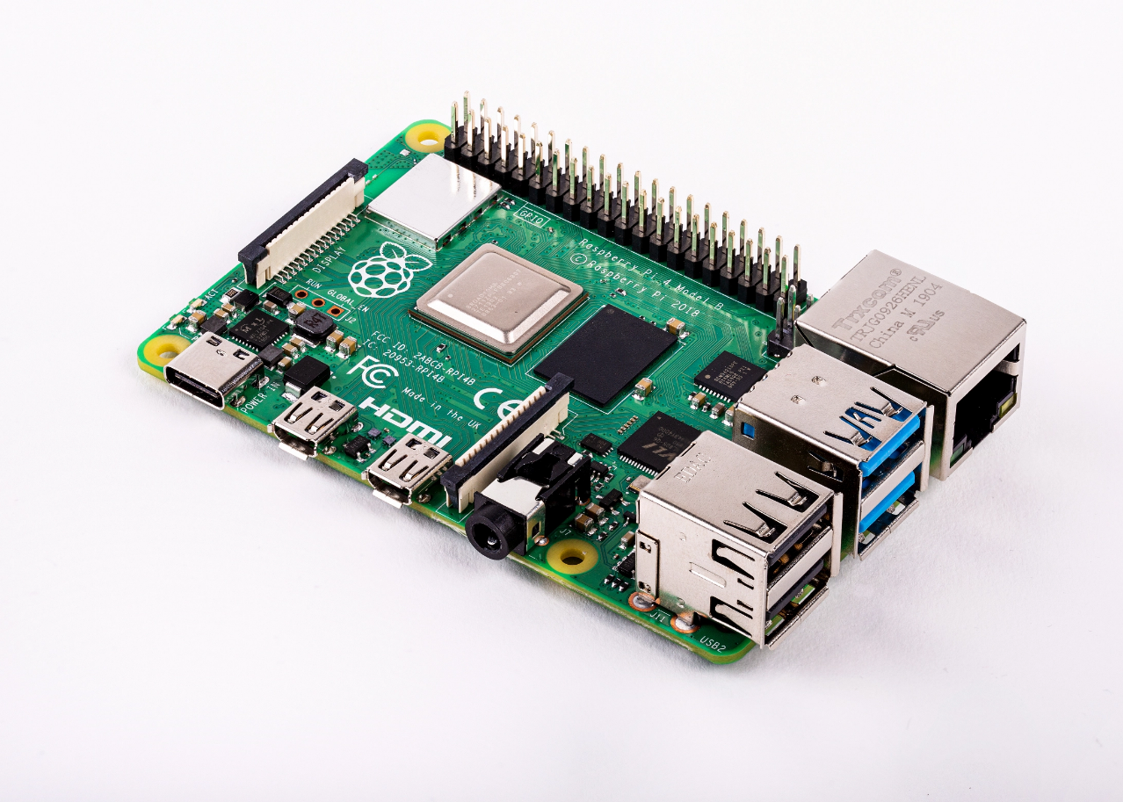
Raspberry Pi 4
Quad core processor
One thread per core
3-way superscalar pipeline
L1 Cache
32 KiB 2-way set associative data cache
48 KiB 3-way set associative instruction cache
Per core
L2 Cache
512 KiB to 4 MiB (shared)
RAM 1-4 GB
$35
Literally all computers are doing parallelism these days

Slide 70
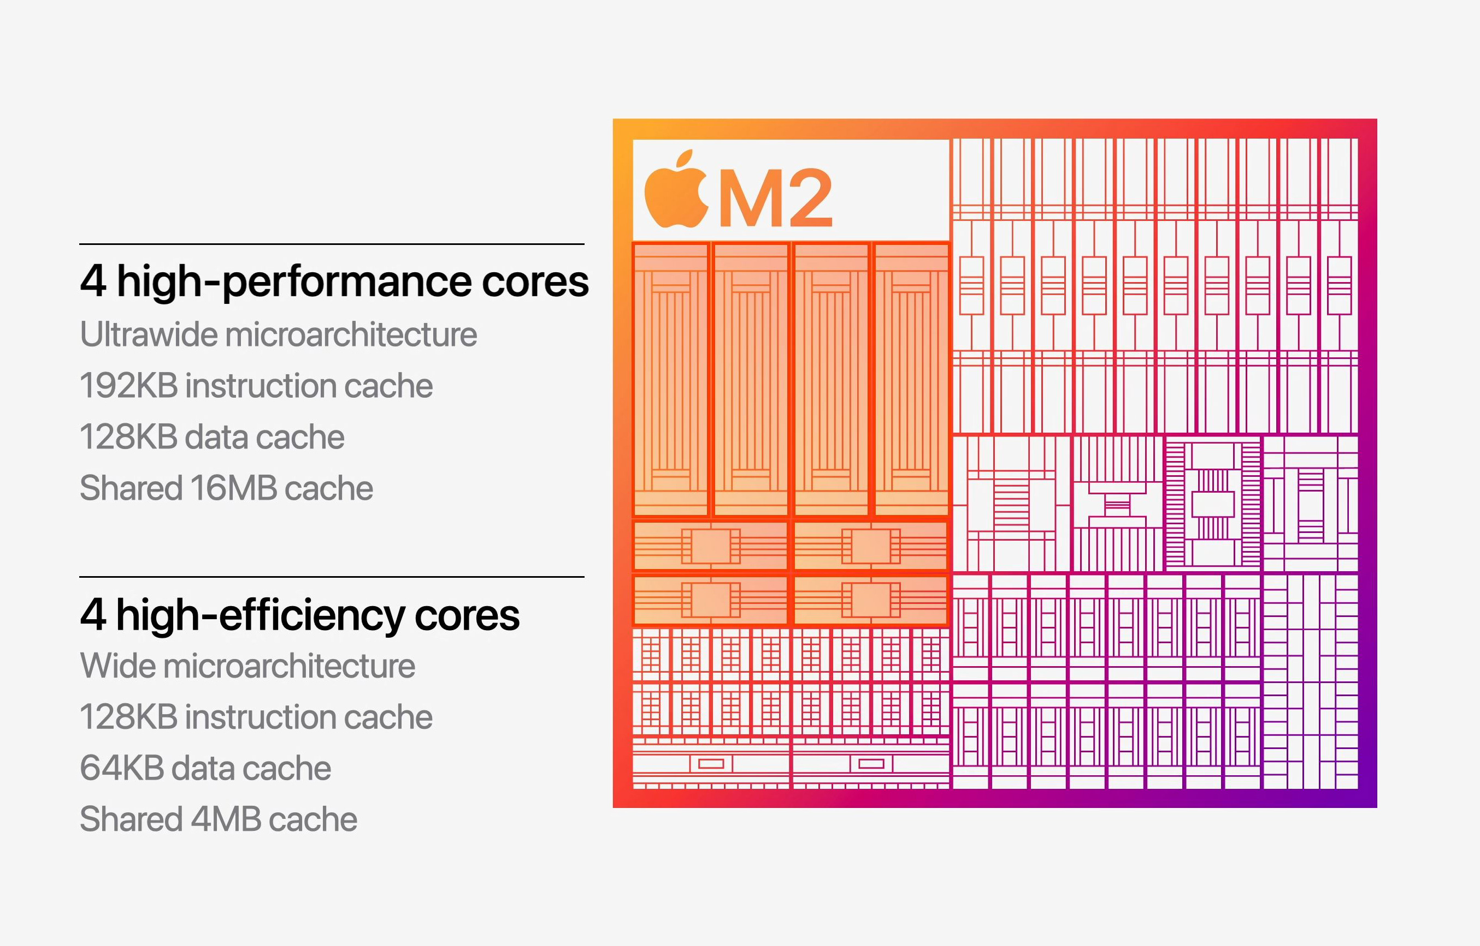
Other modern multicore designs
Heterogeneous multicore
Not all cores are necessarily identical
Enables scheduler to make complicated choices of performance or energy savings
At the cost of a complicated scheduler…

Slide 71
Break + Real-world Connection
How many cores/threads does your processor support?
Windows: Task Manager -> Performance -> CPU
MacOS: About this Mac -> System Report -> Hardware
Apple ARM M processors only do 1 thread per core
Linux: In terminal: lscpu
Android/iOS: You’ll need to google it

Slide 72
Outline
Threads
Need for Parallelism
Processor Concurrency
Instruction-level parallelism
Task parallelism
Interrupts
Concurrency Challenges
Amdahl’s Law

Slide 73
Interrupts
An event that the processor handles by running special OS handler code
Timer expiration, Keyboard event, Network packet, etc.
Necessary for asynchronous event handling
Don’t wait around for the event, just handle it whenever it happens
Very similar to Exceptions
Might be synonyms, depending on the system
A system call is a way to generate a software interrupt

Slide 74
Interrupt handlers
Interrupt context
Running code in a special mode
Pauses whatever was running previously (kernel or process) until finished
Handler code
Execute some quick processing to deal with the interrupt
Return so the hardware can bring us back to our normal operation
Cannot pause to wait for something else to finish first because the entire core jumped to handling this interrupt
Handled by the operating system kernel
Processes are interrupted, but otherwise not normally involved

Slide 75
Differences from system calls
Interrupts and exceptions are basically (maybe literally) the same hardware mechanism
But when we performed a system call:
We knew it was about to happen
Set up our registers in advance
Performed what looked sort of like a function call
And we were always switching from process to kernel
Interrupts can happen whenever.
This can get extremely complicated on modern systems with out-of-order execution, multiple cores and threads, and caches

Slide 76
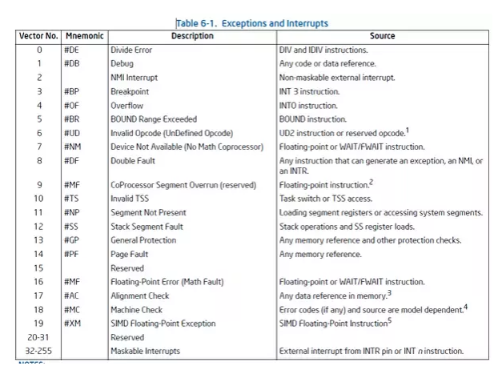
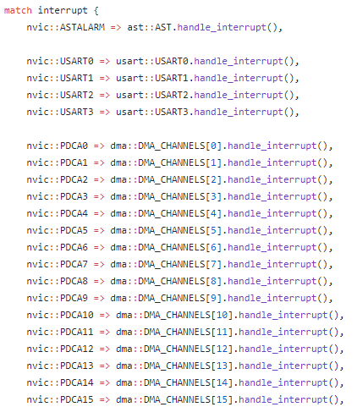
Interrupt Vector Table
Table actually lives in memory somewhere, with function pointers for each vector number
Example from Tock for SAM4L chip (in Rust)

Slide 77
Interrupt Vector Table
Table actually lives in memory somewhere, with function pointers for each vector number
Example from Tock for SAM4L chip (in Rust)

Slide 78
Why are interrupts important to concurrency?
Interrupts are a case where the kernel could have a data race with itself!!
Imagine being in the middle of an operation on a device
When an interrupt comes in for that same device
Data structures for the device could end up messed up
Takeaway: concurrency isn’t just about processes and threads
Many different software designs need to deal with it

Slide 79
OS outcomes
Threads are a useful programming model
Whether concurrent or parallel
Parallelism is necessary for performance improvement
Hardware introduces concurrency
Result: OS is going to have to deal with concurrency
Both interleaving and true parallelism

Slide 80
Outline
Threads
Need for Parallelism
Processor Concurrency
Instruction-level parallelism
Task parallelism
Interrupts
Concurrency Challenges
Amdahl’s Law

Slide 81
Challenges to concurrency
Concurrency is great! We can do so many things!!
But what’s the downside…?
How much speedup can we get from it?
How hard is it to write parallel programs?

Slide 82
Challenges to concurrency
Concurrency is great! We can do so many things!!
But what’s the downside…?
How much speedup can we get from it?
How hard is it to write parallel programs?

Slide 83
Speedup Example
95 s | 5 s
Imagine a program that takes 100 seconds to run
95 seconds in the blue part
5 seconds in the green part

Slide 84
Speedup from improvements
Speedup with Improvement | = | Execution time without improvement
 |  | Execution time with improvement
95 s | 5 s
5 s -> 2.5 s: Speedup = 100/97.5 = 1.026
5 s -> 1 s: Speedup = 100/96 = 1.042
5 s -> 0.001s: Speedup = 100/95.001 = 1.053
The impact of a performance improvement is relative to the importance of the part being improved!

Slide 85
Amdahl’s Law
Equivalent to prior equation
1
Speedup =
F = Fraction of execution time speed up S = Scale of improvement
(1 - F) + F
Not improved part
S
Improved part
Example: 2x improvement to 25% of the program
1
1
=
=
1.14
0.75 + 0.25
0.75 + 0.125
2

Slide 86
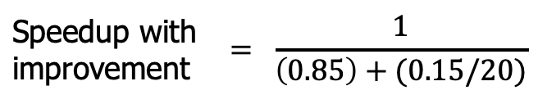
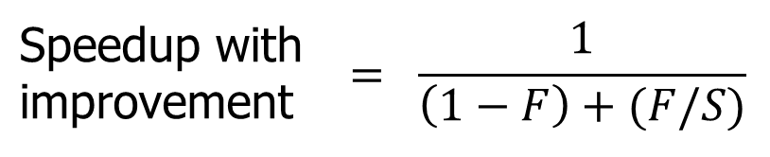
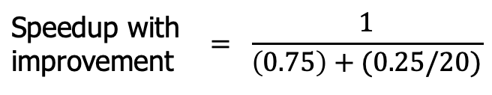
Parallel speedup example
Speedup with improvement | $$= \frac{1}{\left(1−F\right)+(F/S)}$$
Consider an improvement which runs 20 times faster but is only usable 15% of the time
Speedup with improvement | $$= \frac{1}{\left(0.85\right)+(0.15/20)}$$
= 1.166
Nowhere near 20x speedup!
What if it’s usable 25% of the time?
Speedup with improvement | $$= \frac{1}{\left(0.75\right)+(0.25/20)}$$
= 1.311

Slide 87
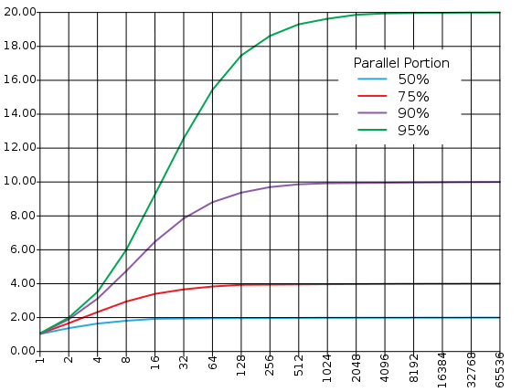
Amdahl’s (heartbreaking) Law (in pictures)
The amount of speedup that can be achieved through parallelism is limited by the non-parallel portion of your program!
And every program has at least some non-parallel parts
Time
Speedup
Parallel
portion
Serial
portion
1
2
3
4
5
Number of Processors
Number of Processors

Slide 88
Amdahl’s (heartbreaking) Law (in words)
Amdahl’s Law tells us that to achieve linear speedup with more processors:
none of the original computation can be serial (non-parallelizable)
To get a speedup of 90 from 100 processors, the percentage of the original program that could be scalar would have to be 0.1% or less
Speedup = 1/(.001 + .999/100) = 90.99

Slide 89
Break + Question
Speedup with improvement | $$= \frac{1}{\left(1−F\right)+(F/S)}$$
50% | 50%
Suppose a program spends 50% of its time in a square root routine.
How much must you speed up square root to make the program run 2x faster?
(A)
10
(B)
20
(C)
100
(D)
None of the above

Slide 90
Break + Question
Speedup with improvement | $$= \frac{1}{\left(1−F\right)+(F/S)}$$
50% | 50%
Suppose a program spends 50% of its time in a square root routine.
How much must you speed up square root to make the program run 2x faster?
Speedup = 1 / [ (1 - F) + (F/S) ]
2 = 1 / [ (1 - 0.5) + (0.5/S)]
S = 0.5 / ((1/2) – 0.5) = ∞
(A)
10
(B)
20
(C)
100
The square root would need to decrease to nothing before you got 2x speedup
(D)
None of the above

Slide 91
Outline
Threads
Need for Parallelism
Processor Concurrency
Instruction-level parallelism
Task parallelism
Interrupts
Concurrency Challenges
Amdahl’s Law

