Slide 1
Lecture 15: Device Input and Output
CS343 – Operating Systems
Branden Ghena – Fall 2025
Some slides borrowed from: Stephen Tarzia (Northwestern), Shivaram Venkataraman (Wisconsin), Jaswinder Pal Singh (Princeton), and UC Berkeley CS61C and CS162

Slide 2
Administrivia
Paging Lab due today
It is okay to use your slip days if you need to
Filesystems Lab goes out today
This is going to be a little less polished than other labs
Let us know if things don’t make sense
Small possibility there’s a bug in the code
Larger probability that the writeup or code comments could use more clarification or explanation
No lecture on Thursday this week (November 13)
We’ll pick up device drivers next week Tuesday

Slide 3
Today’s Goals
Discuss I/O devices and how a computer connects to them.
Understand two different methods of reading/writing device data.
Explore patterns for device interaction:
Synchronous versus Asynchronous
Programmed I/O versus Direct Memory Access

Slide 4
Outline
Overview of Device I/O
Connecting to devices
Buses on a computer
Talking to devices
Port-Mapped I/O and Memory-Mapped I/O
Device interactions
Synchronous versus Asynchronous Events
Programmed I/O versus Direct Memory Access

Slide 5
Devices are the point of modern computers
Computation was sufficient for batch systems
Even then, tape or disk was the input and output mechanism
But interactive systems need to receive input from users and output responses
Keyboard/mouse
Disk
Network
Graphics
Audio
Various USB devices
Computer
Processor
Memory
Devices
Control
Input
Datapath
Output

Slide 6
Devices are core to useful general-purpose computing
Input
Output
Mouse
Monitor
Computer
Keyboard
Headphones
Ethernet
Ethernet
Bluetooth
Bluetooth

Slide 7
Devices are essential to cyber-physical systems too
Input
Output
Lidar
Throttle Control
Computer
Inertial Measurement Unit
Brake Control
Camera
Wheel Rotation
CAN
CAN

Slide 8
Device access rates vary by many orders of magnitude
Rates in bit/sec
System must be able to handle each of these
Sometimes needs low overhead
Sometimes needs to not wait around
Device | Behavior | Partner | Data Rate (Kb/s)
Keyboard | Input | Human | 0.2
Mouse | Input | Human | 0.4
Microphone | Output | Human | 700.0
Bluetooth | Input or Output | Machine | 20,000.0
Hard disk drive | Storage | Machine | 100,000.0
Wireless network | Input or Output | Machine | 300,000.0
Solid state drive | Storage | Machine | 500,000.0
Wired LAN network | Input or Output | Machine | 1,000,000.0
Graphics display | Output | Human | 3,000,000.0

Slide 9
Handling devices appropriately
OS concerns
Communicating with devices needs to be fast and efficient
Devices are shared resources that need to be access controlled and shared
Devices are wildly variable and need some common interfaces for application software
General solution pattern
Access I/O devices similarly to memory
Read device state and write commands to it
With interrupts to inform kernel of events

Slide 10
Outline
Overview of Device I/O
Connecting to devices
Buses on a computer
Talking to devices
Port-Mapped I/O and Memory-Mapped I/O
Device interactions
Synchronous versus Asynchronous Events
Programmed I/O versus Direct Memory Access

Slide 11
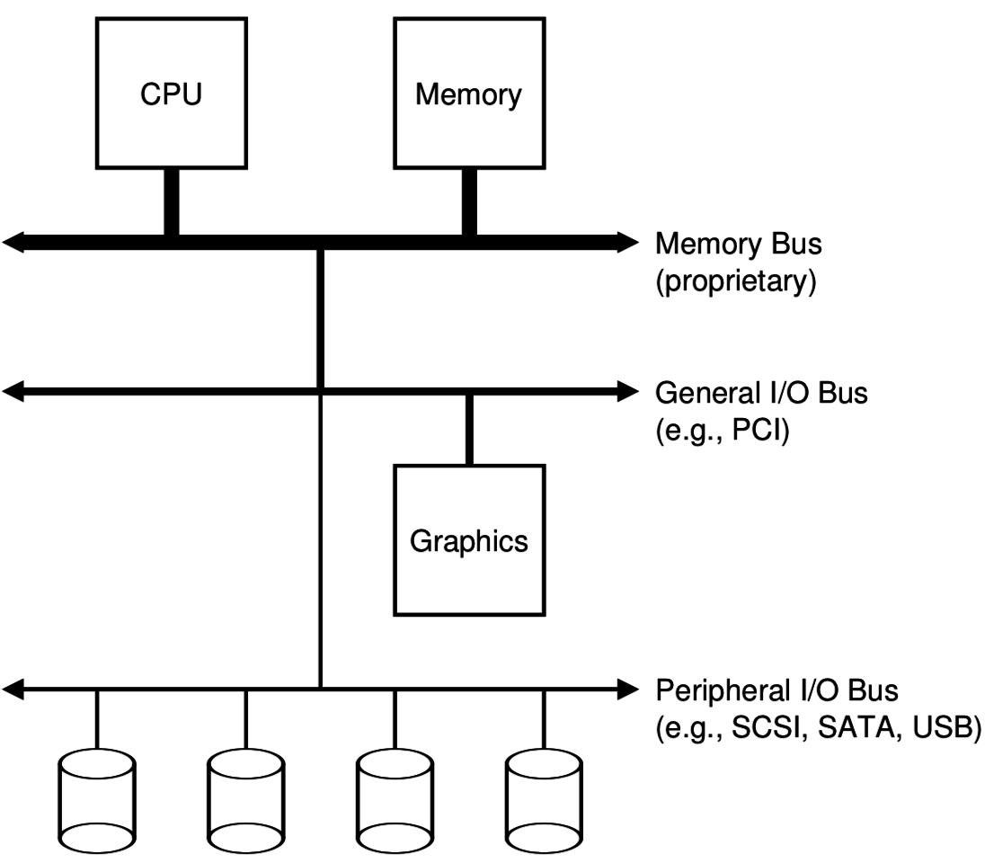
Devices connect to buses on the computer
I/O Hierarchy
Close to the CPU are very fast connections
Farther from CPU are slower but more flexible protocols
Fast connections are literally physically close to the CPU
Electrical signals are limited by speed of light
1 nanosecond ~= 1 foot

Slide 12
What is a bus anyways?
Common set of wires for communication between two or more components
Lets one set of wires connect to N devices
Standardized buses have a specific set of wires and protocol for communicating over them (DMI, PCI, SATA, USB)
Example wires: 64 address wires, 64 data wires, ~10 control wires
Concerns
How many wires in the bus?
Single controller or multiple with arbitration?
Half-duplex (one direction of communication at a time) or full-duplex?

Slide 13
Computer networks also run over buses
Ethernet is a bus too!
Network protocols specify how two computers communicate, very similarly to these buses
Compared to networks, internal computer busses are:
Higher speed
Very high reliability
Accessed cooperatively (often with only one controller: the CPU)

Slide 14
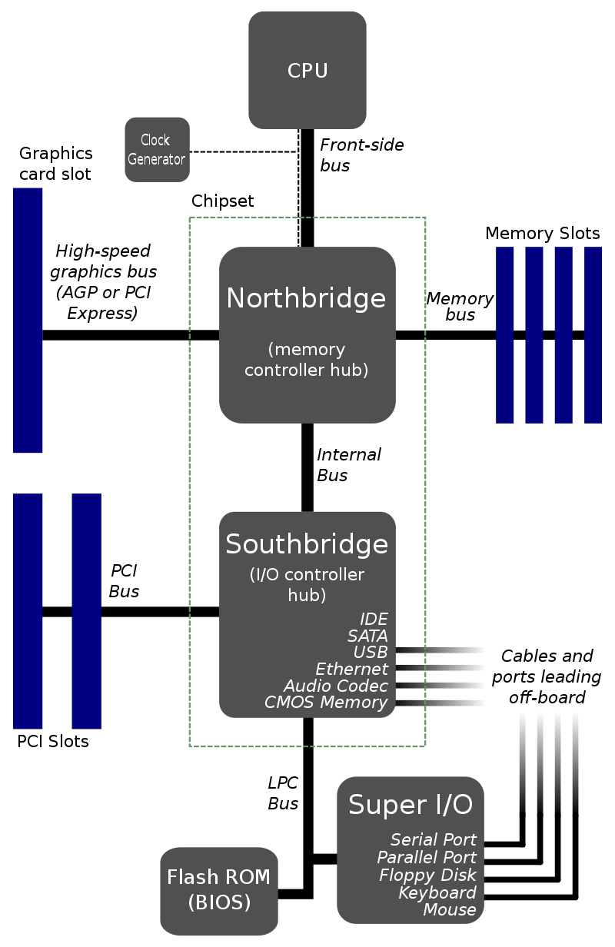
Old version of I/O hierarchy
Hub architecture
Northbridge
High speed memory control
RAM + Graphics
Southbridge
Low speed peripherals
Disk, Network, USB

Slide 15
Check your understanding – physical layout
Which is going to be physically closer to the CPU?
Northbridge or Southbridge
Why?

Slide 16
Check your understanding – physical layout
Which is going to be physically closer to the CPU?
Northbridge or Southbridge
Why?
Need accesses to be fast
Electrical signals are limited by speed of light
1 nanosecond ~= 1 foot

Slide 17
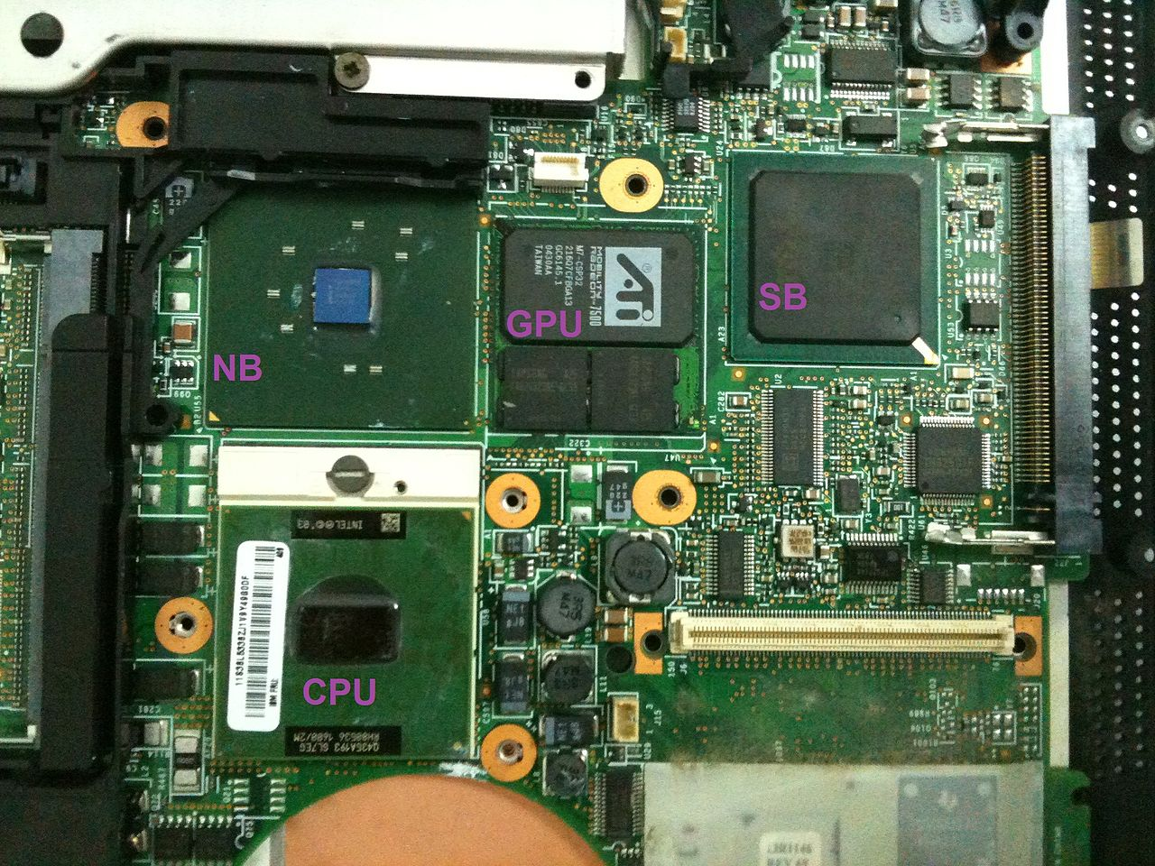
Physical layout of an old motherboard
Note physical distance from CPU

Slide 18
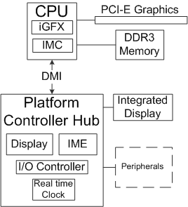
Platform Controller Hub (PCH) architecture
Enables faster communication high-throughput peripherals
Memory and Graphics

Slide 19
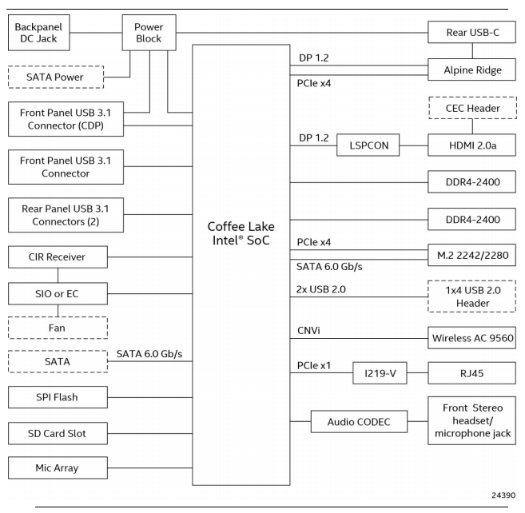
My office “desktop”
Small form factor desktop
Intel NUC 8
CPU includes I/O Controller and GPU in single package
CPU implements many connections directly
USB
SATA
Some have hardware controllers
Ethernet (RJ45)
Thunderbolt (Rear USB-C)
3.5mm Audio (Front stereo headset…)

Slide 20
Some important buses
Legacy
Parallel Port
Serial Port
USB
SATA
PCIe
Device driver software usually talks to bus controller
Which sends appropriate signals to device

Slide 21
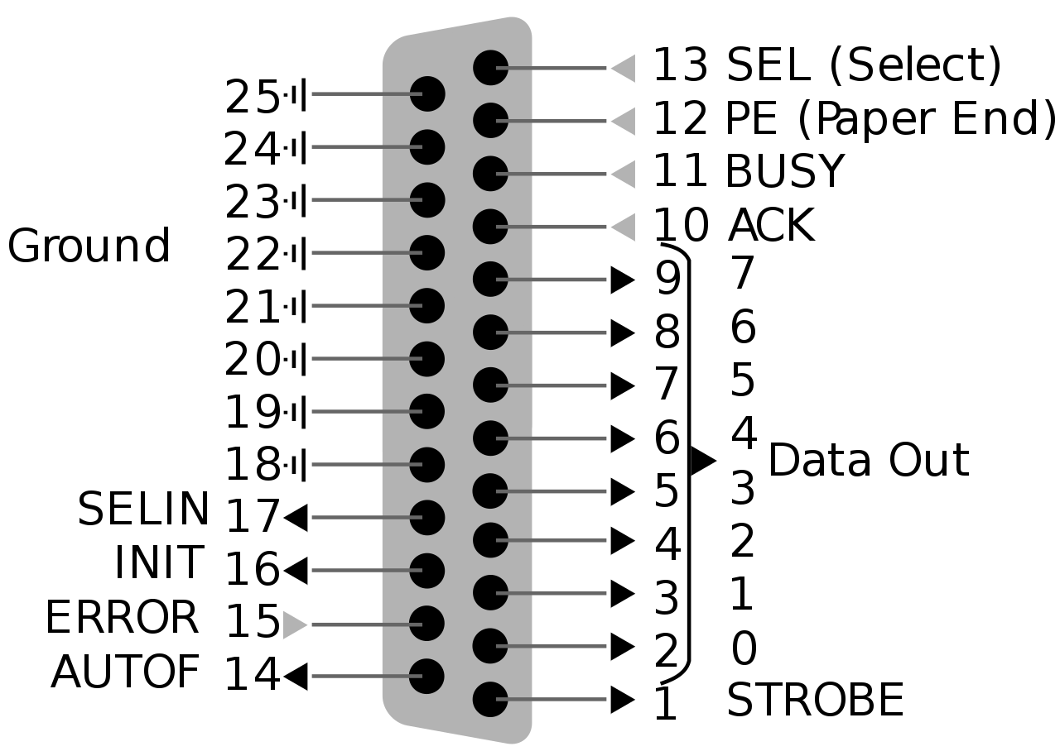
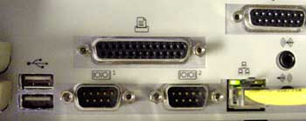
Parallel Port – “Printer Port” or Centronics Port
“That big long one you might have seen once”
8 data bits plus control signals
Up to 2.5 Mbps!!
Very simple to implement
Write 8 bits of data
Set STROBE low
BUSY goes low in response
When BUSY goes high
Set STROBE high
Repeat

Slide 22
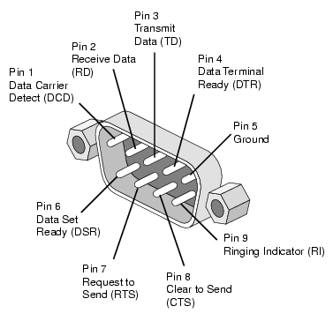
Serial Port – RS-232
“That one we used to use before USB”
RS-232 serial protocol
One wire for Transmit, one wire for receive
Bits go one after another at a certain speed (“baudrate”)
Up to 256 Kbps
Used to connect modems
Still occasionally used for old devices (via a USB to RS-232 converter)

Slide 23
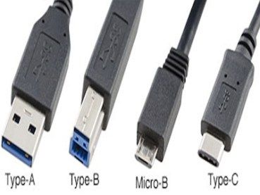
USB – Universal Serial Bus
“That one you are familiar with already”
Connect and power external devices
Comes in multiple form-factors and versions
USB 3.x and type C connectors are the fast ones
Speed has increased greatly
1.5 Mbps
12 Mbps
480 Mbps
5 Gbps
10 Gbps
40 Gbps

Slide 24
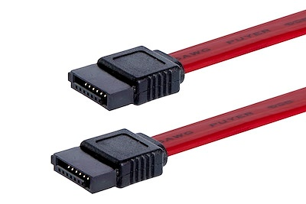
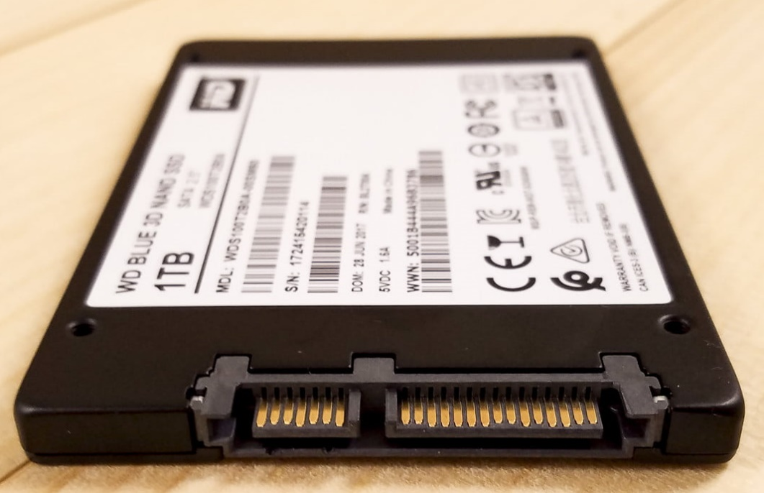
SATA – Serial ATA – AT Attachment – “Advanced Technology”
“That cable you plug an SSD/HDD in with”
Long evolution as you might have guessed from the name
6 Gbps
One transmit and one receive single
Two wires for each in twisted pair
Short connection length for high speed
SATA
Power

Slide 25
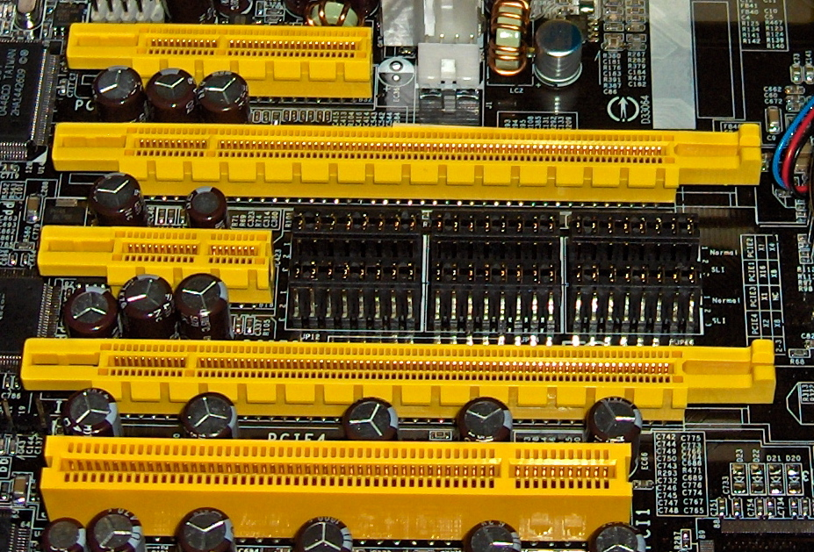
PCIe – Peripheral Component Interconnect Express
“That slot you put a graphics card into”
Or WiFi card, or some SSDs
Collection of point-to-point connections
Motherboard and CPU support N “lanes” in various configurations
Different sizes for different number of bits in parallel
Order 10s Gbps

Slide 26
Using a bus
When the kernel wants to talk to a device that’s connected over a bus, what it actually talks to directly is the bus
Requests the bus to send commands to the device or request info from the device
So direct device communication on a computer is actually to a bus itself
And then indirectly to the specific device in question
Example: software to control a webcam is really all about sending the proper messages over USB
What those messages are depends on the webcam

Slide 27
Live Demo: List devices on a Linux computer
lsusb
List USB devices
lspci
List PCI devices
Combine with –s flag to select a single device
Combine with -v flag for verbose mode with more information

Slide 28
Break + Question
Why do we need all of these busses?
Isn’t USB enough for everything?

Slide 29
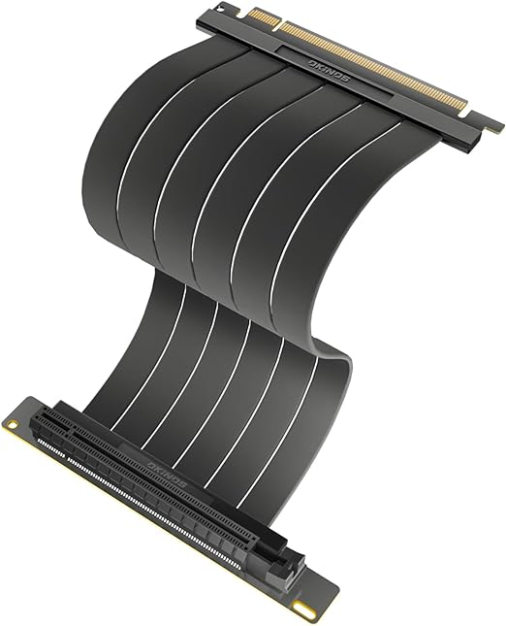
Break + Question
Why do we need all of these busses?
Isn’t USB enough for everything?
Different tools for different purposes!
USB is more general-purpose, short range, powers devices
PCIe is for LOTS of data, but very short range and cables would be crazy
Ethernet is for long-range, lots of data, no power
https://www.reddit.com/r/explainlikeimfive/comments/uf4efj/comment/i6rmv15

Slide 30
Outline
Overview of Device I/O
Connecting to devices
Buses on a computer
Talking to devices
Port-Mapped I/O and Memory-Mapped I/O
Device interactions
Synchronous versus Asynchronous Events
Programmed I/O versus Direct Memory Access

Slide 31
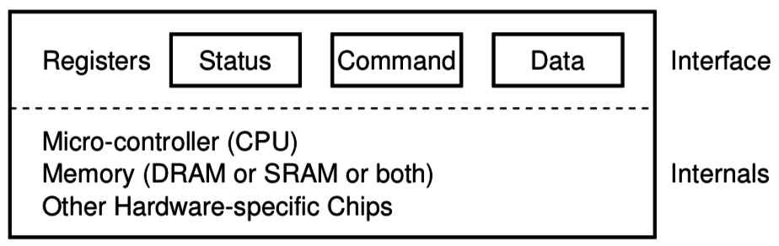
How does an OS talk with I/O devices?
A device is really a miniature computer-within-the-computer
Has its own processing, memory, software
We can mostly ignore that and deal with its interface
Called registers (similar to processor registers in that they hold data)
Read/Write like they’re data
How do we read/write them?
Special assembly instructions
Treat like normal memory

Slide 32
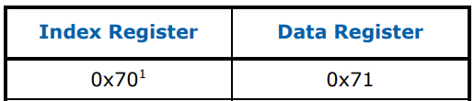
Example powered device: Real Time Clock
Battery-backed up clock on computer motherboard
Keeps sense of time when computer is off
Resynchronized when the computer is awake
Index | Contents | Range
0x00 | Seconds | 0-59
0x02 | Minutes | 0-59
0x04 | Hours | 0-23 in 24-hour mode, 1-12 in 12-hour mode, highest bit set if PM
0x06 | Weekday | 1-7, Sunday =1
0x07 | Day of Month | 1-31
0x08 | Month | 1-12
0x09 | Year | 0-99
https://www.singlix.com/trdos/archive/pdf_archive/real-time-clock-nmi-enable-paper.pdf

Slide 33
Port-Mapped I/O (PMIO): special assembly instructions
x86 IN and OUT instructions
Privileged instructions (kernel mode only)
Two arguments: destination and data register
Each device is mapped to some port address
IN and OUT instructions interact with interface
IN <PORT NUMBER>, <REGISTER>
OUT <REGISTER>, <PORT NUMBER>

Slide 34
Example powered device: Real Time Clock
Example: read current value from real-time clock
// read seconds
mov $0, %al out %al, $0x70 in $0x71, %al
Index | Contents | Range
0x00 | Seconds | 0-59
0x02 | Minutes | 0-59
0x04 | Hours | 0-23 in 24-hour mode, 1-12 in 12-hour mode, highest bit set if PM
0x06 | Weekday | 1-7, Sunday =1
0x07 | Day of Month | 1-31
0x08 | Month | 1-12
0x09 | Year | 0-99
Port Address
https://www.singlix.com/trdos/archive/pdf_archive/real-time-clock-nmi-enable-paper.pdf

Slide 35
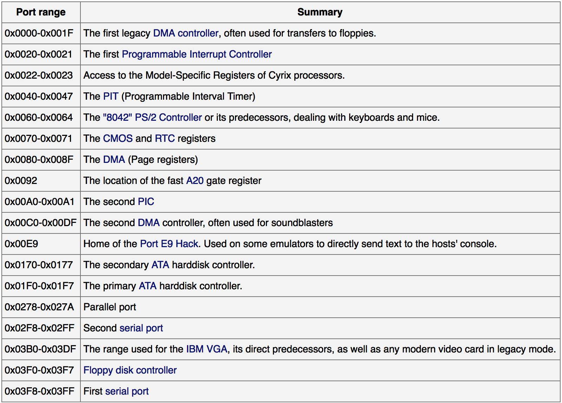
Example I/O port map
This isn’t standardized, but these are some typical values.
https://wiki.osdev.org/Can_I_have_a_list_of_IO_Ports

Slide 36
Check your understanding – PMIO in C
How would you access PMIO from a C program?

Slide 37
Check your understanding – PMIO in C
How would you access PMIO from a C program?
Need to use assembly!
Hopefully with C function wrapper, like System Calls

Slide 38
Annoying parts of Port-Mapped I/O
Special assembly instructions are hard to write in C
Need some wrapper function that actually calls them
Not really that big of an issue, but a little weird
Feels sort of like memory read/write, but isn’t
Why not?
Can we just put the “port address space” somewhere in memory?
Could be a problem if we don’t have enough memory
But today we have tons of extra physical address space laying around

Slide 39

Memory-mapped I/O (MMIO): treat devices like normal memory
Certain physical addresses do not actually go to RAM
Instead, they correspond to I/O devices
And any instruction that accesses memory can access them too!
x86 being the historical amalgamation that it is, uses both PMIO or MMIO depending on the device
Address
0xFFFFFFFF
0xFFFF0000
control reg.
data reg.
0x00000000

Slide 40
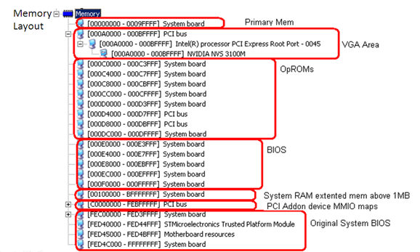
Example memory map (from an old 32-bit computer)
PCI devices are mapped here

Slide 41
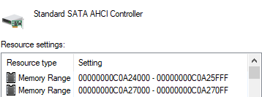
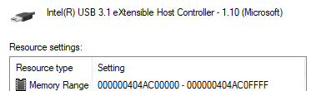
Example devices on my windows computer
SATA controller is mapped into memory at two places
USB controller is mapped into a much higher memory region
Regions are large because they contain multiple control/data “registers”

Slide 42
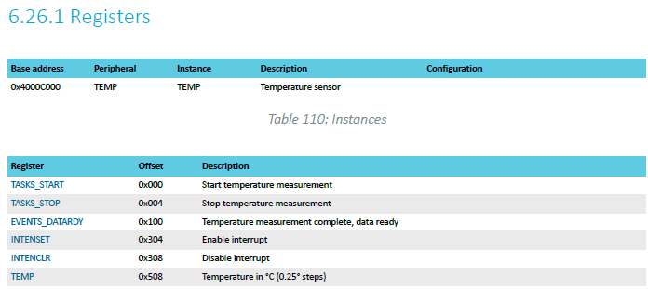
Microcontroller example: reading temperature
Internal temperature sensor
0.25° C resolution
Range equivalent to microcontroller IC (-40° to 105° C)
Various configurations for the temperature conversion (ignoring)
nRF52833

Slide 43
MMIO addresses for TEMP device
What addresses do we need? (ignore interrupts for now)
0x4000C000 – TASKS_START
0x4000C100 – EVENTS_DATARDY
0x4000C508 - TEMP
nRF52833

Slide 44
Accessing addresses in C
What does this C code do?
*(uint32_t*)(0x4000C000) = 1;

Slide 45
Accessing addresses in C
What does this C code do?
*(uint32_t*)(0x4000C000) = 1;
0x4000C000 is cast to a uint32_t*
Then dereferenced
And we write 1 to it
“There are 32-bits of memory at 0x4000C000. Write a 1 there.”

Slide 46
Other details about MMIO
Devices are mapped into physical memory
Usually only accessible by the kernel
But could be directly placed in virtual memory for a process in very special cases
Devices are NOT memory though
Need to be careful not to cache them
Values being read could change, or reading could have an effect
Cannot let compiler mess with our reads/writes either
volatile keyword in C
Conceptually not really very different from PMIO
Both just read/write to specific addresses the device is mapped to

Slide 47
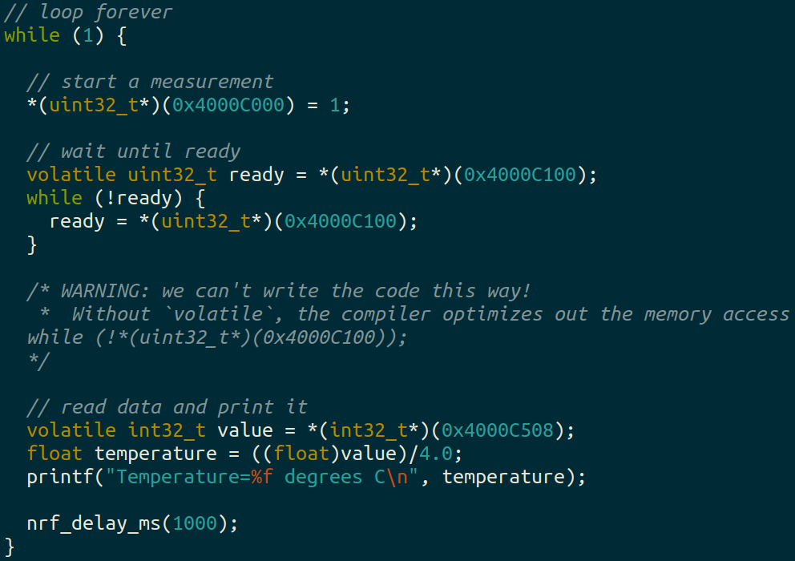
Break + example code to read and print temperature value

Slide 48
Outline
Overview of Device I/O
Connecting to devices
Buses on a computer
Talking to devices
Port-Mapped I/O and Memory-Mapped I/O
Device interactions
Synchronous versus Asynchronous Events
Programmed I/O versus Direct Memory Access

Slide 49
What do interactions with devices look like?
while STATUS==BUSY; Wait
(Need to make sure device is ready for a command)
Write value(s) to DATA
Write command(s) to COMMAND
while STATUS==BUSY; Wait
(Need to make sure device has completed the request)
Read value(s) from Data
This is the “polling” model of I/O.
“Poll” the peripheral in software repeatedly to see if it’s ready yet.

Slide 50
Waiting can be a waste of CPU time
while STATUS==BUSY; Wait
(Need to make sure device is ready for a command)
Write value(s) to DATA
Write command(s) to COMMAND
while STATUS==BUSY; Wait
(Need to make sure device has completed the request)
Read value(s) from Data
Imagine a keyboard device
CPU could be waiting for minutes before data arrives
Need a way to notify CPU when an event occurs
Interrupts!

Slide 51
Interrupts, visually
Some code that’s executing
Could be kernel code or some application
Interrupt triggers!
Interrupt handler code
Continue original code

Slide 52
An example of an interrupt
The exception() function in paginglab is exceptional control flow just like interrupts are
Some event happens
Code stops running whichever instruction is happening
exception() function runs until it’s finished
Code restarts at interrupted instructions

Slide 53
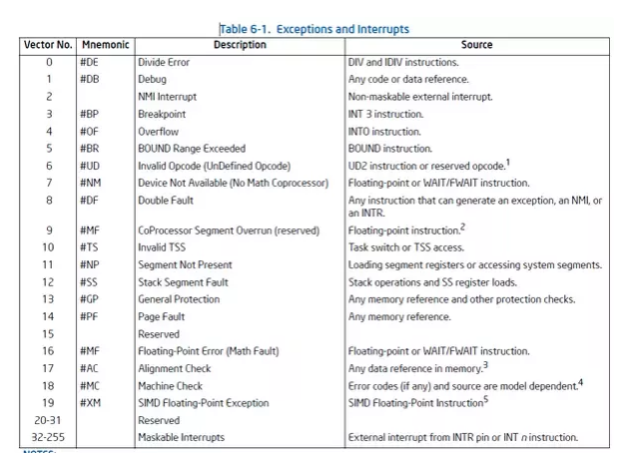
Hardware devices can generate interrupts
Each device maps to some number of hardware interrupts
Done at system boot time
Discover devices
Map devices into address space
Map interrupts for devices

Slide 54
Interrupts allow waiting to happen asynchronously
Prior code example was synchronous
Nothing else continued on the processor until access was complete
Good for very fast devices (like the real-time clock, that just returns data)
We call this “Polling”
Might make sense in applications which can Block
With interrupts, device handling is now asynchronous
Access occurs in the background and processor can do something else
Good for very slow devices (Disk)
Comes with all the downsides of concurrency though…

Slide 55
Microcontroller TEMP device supports interrupts!
Can either wait on the EVENTS_DATARDY register
Or could enable an interrupt from the device
And only bother reading data when it is ready

Slide 56
Driver implementation types
Blocking
Driver function doesn’t return until the action is complete
Kernel ends up waiting, either in a loop or on something like a condvar
Probably only makes sense if the kernel can have multiple threads
Non-blocking
Driver function returns as soon as it starts the action
Kernel can do other work for a while
Interrupt signals that the action is complete

Slide 57
Device driver interrupt pattern: non-blocking
Kernel requests driver to perform some action
Driver writes to the hardware device
Sets the status of the driver to be busy
Function returns so the kernel can keep running
Likely returns to Scheduler and runs a process/thread
Interrupt occurs when action is completed
Change the status of the driver to be ready
Kernel can now make a new request whenever it wants to

Slide 58
Device driver interrupt pattern: blocking
Kernel requests driver to perform some action
Driver writes to the hardware device
Sets the status of the driver to be busy
Function returns so the kernel can keep running
Kernel waits on a signal that the device is ready
Interrupt occurs when action is completed
Change the status of the driver to be ready
Signal that the device is ready
Kernel can now make a new request whenever it wants to

Slide 59
Outline
Overview of Device I/O
Connecting to devices
Buses on a computer
Talking to devices
Port-Mapped I/O and Memory-Mapped I/O
Device interactions
Synchronous versus Asynchronous Events
Programmed I/O versus Direct Memory Access

Slide 60
Programmed I/O (PIO)
while STATUS==BUSY; Wait (possibly on interrupt)
(Need to make sure device is ready for a command)
Write value(s) to DATA
Write command(s) to COMMAND
while STATUS==BUSY; Wait (possibly on interrupt)
(Need to make sure device has completed the request)
Read value(s) from Data
How do we read and write those values? (could be a lot)
With normal CPU memory accesses: Programmed I/O
Literally: you write a program to do the input and output

Slide 61
Check your understanding – writing to GPU
Let’s say that a GPU has MMIO registers for an entire 4 KB page
Takes 100 ns to write each word (8 bytes) of memory
Assuming that we’re just writing all zeros (ignore reading from memory), how long does it take to write a page to MMIO?

Slide 62
Check your understanding – writing to GPU
Let’s say that a GPU has MMIO registers for an entire 4 KB page
Takes 100 ns to write each word (8 bytes) of memory
Assuming that we’re just writing all zeros (ignore reading from memory), how long does it take to write a page to MMIO?
4 KB / 8 B = 500 writes * 100 ns / write = 50 µs
(For a 3 GHz processor, that’s ~150,000 cycles)

Slide 63
Direct Memory Access (DMA)
Even with interrupts, just providing data to the peripheral is time consuming
The processor is involved in writing/reading each byte
DMA is an alternative method that uses hardware to do the memory transfers for the processor
Software writes address of the data and the size to the peripheral
Device reads data directly from memory
Processor can go do other things while read/write is occurring

Slide 64
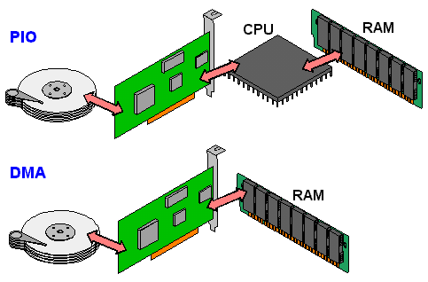
Programmed I/O versus Direct Memory Access
SATA Controller
Disk
SATA Controller
Disk

Slide 65
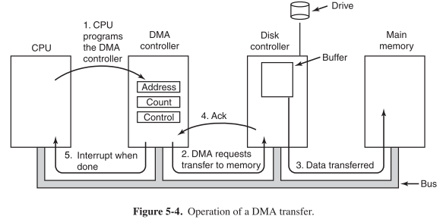
Disk access with DMA

Slide 66
DMA considerations
Need to be careful about letting devices access arbitrary memory
Should devices be trusted?
This random flash drive that’s plugged in shouldn’t be able to read all of RAM
Often a hardware “DMA controller” does the transfer for the device
IOMMU can even set up virtual memory spaces for devices

Slide 67
Interaction pattern with Interrupts and DMA
Configure the peripheral
Enable peripheral interrupts
Set up peripheral DMA transfer
Start peripheral
Continue on to other code
Interrupt occurs, signaling DMA transfer complete
Set up next DMA transfer
Continue on to other code, and repeat
Kernel is in charge of keeping a queue of hardware requests

Slide 68
Returning to the variety of devices
Interrupts support high-latency devices and time-sensitive devices
DMA supports high-throughput devices
Device | Behavior | Partner | Data Rate (Kb/s)
Keyboard | Input | Human | 0.2
Mouse | Input | Human | 0.4
Microphone | Output | Human | 700.0
Bluetooth | Input or Output | Machine | 20,000.0
Hard disk drive | Storage | Machine | 100,000.0
Wireless network | Input or Output | Machine | 300,000.0
Solid state drive | Storage | Machine | 500,000.0
Wired LAN network | Input or Output | Machine | 1,000,000.0
Graphics display | Output | Human | 3,000,000.0

Slide 69
Outline
Overview of Device I/O
Connecting to devices
Buses on a computer
Talking to devices
Port-Mapped I/O and Memory-Mapped I/O
Device interactions
Synchronous versus Asynchronous Events
Programmed I/O versus Direct Memory Access

