Slide 1
Lecture 03 Data Link Layer + BLE Introduction
CS433 – Wireless Protocols for IoT
Branden Ghena – Spring 2025
Materials in collaboration with Pat Pannuto (UCSD) and Brad Campbell (UVA)

Slide 2
Administrivia
Hw: Background
Goal: brush up on some embedded systems and networks background
Due tonight
Submit on Gradescope
Lab: Wireshark
Goal: familiarize yourself with Wireshark
Install it, do some basic scanning, explore a little
We’ll do checkoffs during lab time tomorrow
Friday 11:00-12:30 pm in Frances Searle 2370
See you all there!

Slide 3
Partnership survey
Labs (after this first one) will be in groups of exactly three
I’m trying to
Figure out what the groups are
Match up students who need groups
Please fill out the survey posted on Piazza
I’ll go through this weekend and match up groups

Slide 4
Today’s Goals
Overview of concerns for the Data link layer
Speak the “lingo” of wireless communication
Present technology aspects that we will return to in specific protocols
Describe Medium Access Control mechanisms
Introduction to Bluetooth Low Energy
What are the goals of the protocol?
What do the lower layers look like?

Slide 5
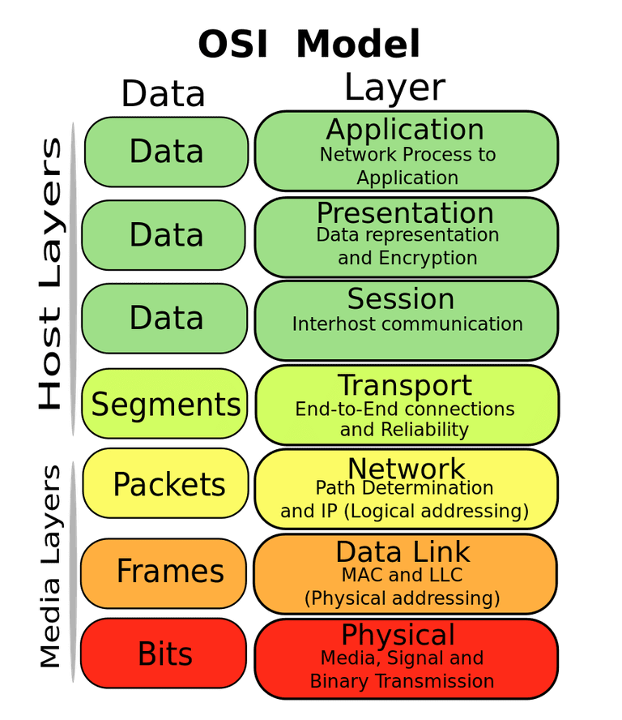
Review: OSI model of communication layers
Open Systems Interconnection (OSI)
Transport
Sending data between applications
TCP and UDP
Network
Sending data between networked computers
IP
Data Link
Sending collections of bits
Ethernet, WiFi
Physical
Sending individual bits
Ethernet, WiFi

Slide 6
Review: A programmer’s view of the internet
1. Hosts are mapped to a set of 32-bit IP addresses
129.105.7.30
2. The set of IP addresses is mapped to a set of identifiers called Internet domain names
129.105.7.30 is mapped to moore.wot.eecs.northwestern.edu
3. A process on one Internet host can communicate with a process on another Internet host over a connection

Slide 7
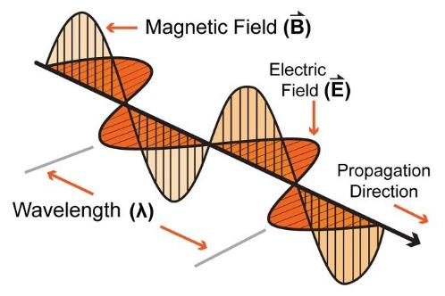
Review: Signal qualities
Signal strength
The amount of energy transmitted/received
Signal frequency and bandwidth
Which “channel” the signal is sent on
Signal modulation
How data is encoded in the signal

Slide 8

Review: Signal strength
We will use the nrf52840 in lab:
Max BLE transmit power for nRF52840: 8 dBm (6.31 mW)
Min BLE receive sensitivity for nRF52840: -95 dBm (316.2 fW)
2 m
46 dB path loss!
0.00016 mW

Slide 9
Big Idea: many RF factors are interconnected
Energy, Distance, Throughput, and Reliability are all interconnected in communication
Protocols make choices of some and get the results on the others
To get more distance, choose one or more:
Increase energy
Communicate slower
Accept a higher error rate

Slide 10
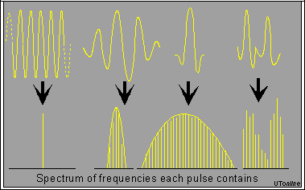
Review: frequency and bandwidth
A pure sinusoid is energy at exactly one frequency
A messy sinusoid with data layered on top of it has nearby energy
There’s a center of the signal energy
Plus some amount of width, which depends on how complicated the data layered on top is

Slide 11
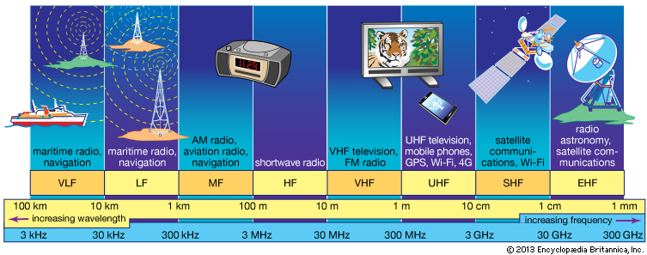
Review: RF communication frequencies
IoT focus

Slide 12
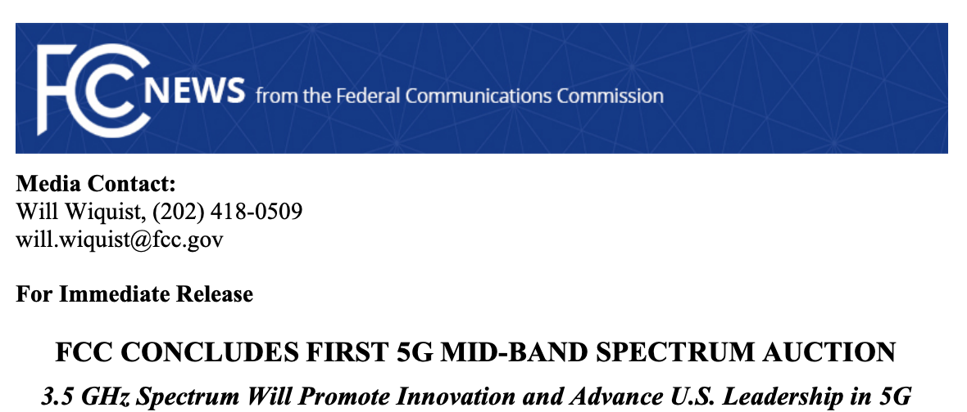
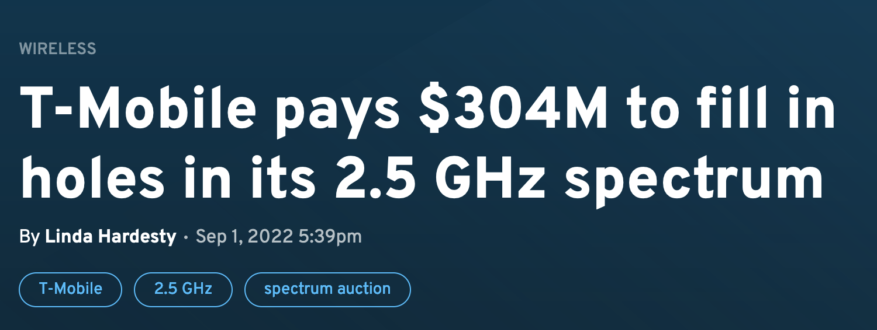
Wireless spectrum is limited...and valuable
FCC auctioned off 3.5 GHz spectrum in August 2020
70 MHz
$4.6 billion
FCC auctioned off 2.5 GHz spectrum in 2022
$427 million
https://www.fiercewireless.com/wireless/t-mobile-pays-304m-fill-holes-its-25-ghz-spectrum

Slide 13
Outline
Physical Layer
Overview
Signal Strength
Signal Frequency and Bandwidth
Signal Modulation
Data Link Layer
BLE Background

Slide 14
Signal qualities
Signal strength
The amount of energy transmitted/received
Signal frequency and bandwidth
Which “channel” the signal is sent on
Signal modulation
How data is encoded in the signal

Slide 15
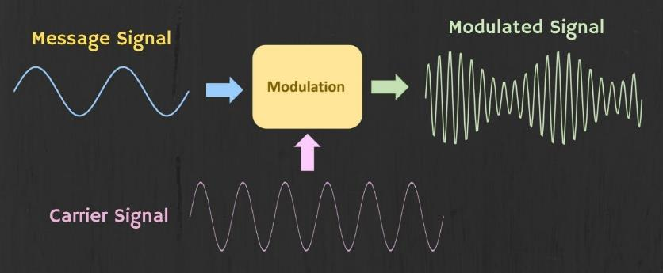
Modulation
Encoding signal data in an analog “carrier” signal
Carrier signal defines the frequency
Modulation scheme + data define bandwidth required

Slide 16
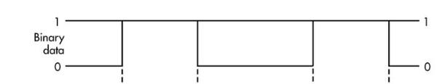
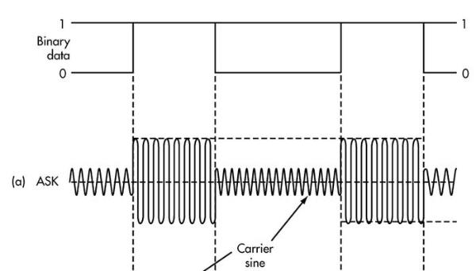
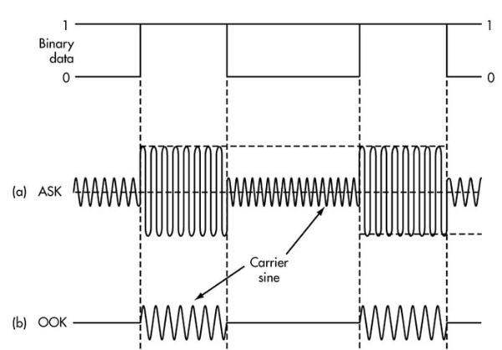
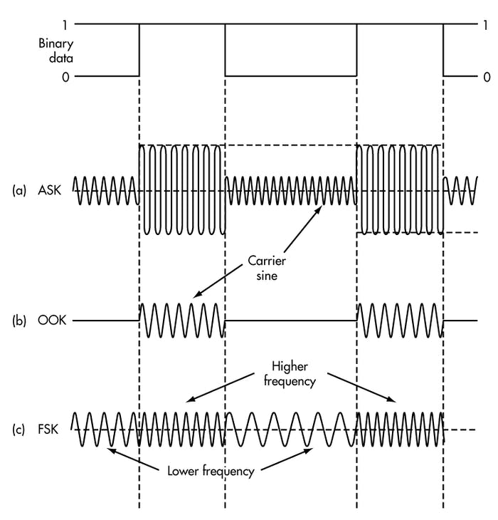
Modulation types
Encoding binary data on a signal
Amplitude-shift Keying (ASK)
Modify amplitude of carrier signal
On-Off Keying (OOK) is an extreme example
Frequency-shift Keying (FSK)
Modify frequency of carrier signal

Slide 17
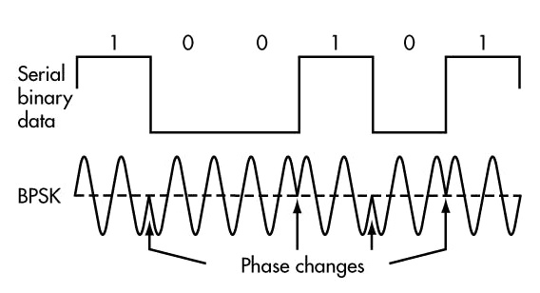
Modulation types
Phase-shift keying (PSK)
Modify phase of carrier signal
Often differential: the change signifies data
More complicated possibilities exist
QAM (Quadrature Amplitude Modulation) combines amplitude and phase shift keying
Allows for more than one bit per “symbol”

Slide 18
Modulation tradeoffs
Various tradeoffs between different modulation schemes
Bandwidth requirements, transceiver hardware, immunity to noise, etc.
ASK (amplitude) is simple but susceptible to noise
Noise exists in the real world
FSK (frequency) is relatively simple and robust to noise, but uses more bandwidth
Bandwidth is limited, but this modulation is still commonly used
PSK (phase) energy efficient and robust, but more complex hardware
More expensive hardware, but very commonly used

Slide 19
Break + Video
Excellent explanation of modulation techniques: https://youtu.be/0faCad2kKeg?si=kK6l0g63XGVPdut9&t=240
Listen for 3.5 minutes until 7:30 in the video
“How Cell Service Actually Works” by Wendover Productions

Slide 20
Outline
Physical Layer
Overview
Signal Strength
Signal Frequency and Bandwidth
Signal Modulation
Data Link Layer
BLE Background

Slide 21
Data Link Layer
Framing
Combine arbitrary bits into a “packet” of data
Logical link control
Manage transfer between transmitter and receiver
Error detection and correction
Media access
Controlling which device gets to transmit next
Inherently coupled to PHY and its decisions

Slide 22
Framing
Typical packet structure
Preamble - Existence of packet and synchronization of clocks
Header - Addresses, Type, Length
Data - Payload plus higher layer headers (e.g. IP packet)
Trailer - Padding, CRC
Possible wireless considerations
Control information for Physical Layer
Ensure robustness for header
Explicit multi-hop routing
Possibly different data rates for different parts of packet
Preamble | Destination Address | Source Address | Type and Length | Data | CRC

Slide 23
Error control: detection and recovery
Detection: only detect errors
Make sure corrupted packets get discarded
Cyclical Redundancy Checks
Detect single bit errors
Detect “burst” errors of several contiguous bits
Recovery: also try to recover from small bit errors
Forward error correction
Retransmissions
Far more important for wireless because the cost of transmission is higher

Slide 24
Medium Access Control
How does a network determine which transmitter gets to transmit?
Remember: the wireless medium is inherently broadcast
Two simultaneous transmitters may lose both packets

Slide 25
Analogy: wireless medium as acoustic
How do we determine who gets to speak?
Two simultaneous speakers also lose both “transmissions”
Task: Break into groups of 5 students each
In a minute I’m going to ask each group a question
Everyone in the group needs to answer correctly
Fastest group to have everyone answer wins
If two people talk at the same time, that group loses

Slide 26
Analogy: wireless medium as acoustic
How do we determine who gets to speak?
Two simultaneous speakers also lose both “transmissions”
Eye contact (or raise hand) -> out-of-band communication
Wait until it’s quiet for some time -> carrier sense multiple access
Strict turn order -> time division multiple access
Just speak and hope it works -> ALOHA
Everybody sing at different tones -> frequency division multiple access (stretching the metaphor)
Everyone speak in different languages -> code division multiple access (sort of, but not really)
Others?

Slide 27
MAC protocol categorization
Medium Access Control Protocols
Contention-Based Protocols
Contention-Free Protocols
ALOHA
CSMA
FDMA
TDMA
CDMA

Slide 28
MAC protocol categorization
Medium Access Control Protocols
Contention-Based Protocols
Contention-Free Protocols
ALOHA
CSMA
FDMA
TDMA
CDMA

Slide 29
ALOHA
ALOHAnet (1971)
University of Hawaii – Norman Abramson
First demonstration of wireless packet network
Rules
If you have data to send, send it
Two (or more) simultaneous transmissions will collide and be lost
Wait a duration of time for an acknowledgement
If transmission was lost, try sending again “later”
Want some kind of exponential backoff scheme here

Slide 30
Packet collisions
Each packet transmission has a window of vulnerability
Twice the on-air duration of a packet
Transmissions during the packet are bad
Transmissions before packet can also be bad
My transmission
Other transmission
My transmission
Other transmission

Slide 31
Slotted ALOHA
Split time into synchronized “slots”
Any device can transmit whenever it has data
But it must transmit at the start of a slot
And its transmission cannot be longer than a slot
Removes half of the possibilities for collisions!
At the cost of some synchronization method
My transmission
My transmission
Other transmission
Other transmission
time

Slide 32
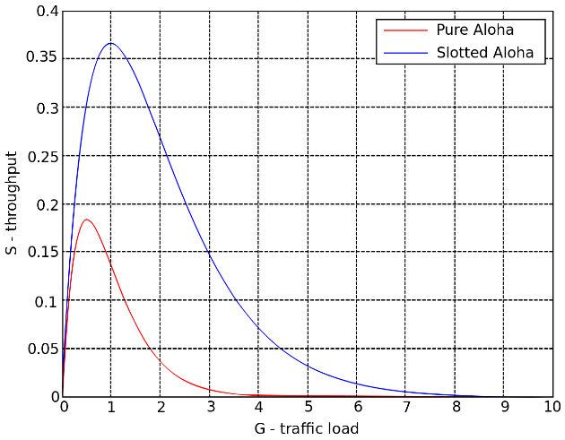
ALOHA throughput
It can be shown that traffic maxes out at
ALOHA: 18.4%
Slotted ALOHA: 36.8%
Assuming Poisson distribution of transmission attempts
Slotted throughput is double because the “before” collisions can no longer occur

Slide 33
Capture effect
Actually, two packets at once isn’t always a total loss
The louder packet can still sometimes be heard if loud enough
How much louder?
Ballpark 12-14 dB
When does this work?
Depends on the radio hardware
Louder packet first almost always works
Louder packet second sometimes works

Slide 34
MAC protocol categorization
Medium Access Control Protocols
Contention-Based Protocols
Contention-Free Protocols
ALOHA
CSMA
FDMA
TDMA
CDMA

Slide 35
CSMA/CA – Carrier Sense Multiple Access with Collision Avoidance
First listen for a duration and determine if anyone is transmitting
If idle, you can transmit
If busy, wait and try again later
“listen before send”
Can be combined with notion of slotting
If current slot is idle, transmit in next slot
If current slot is busy, follow some algorithm to try again later

Slide 36
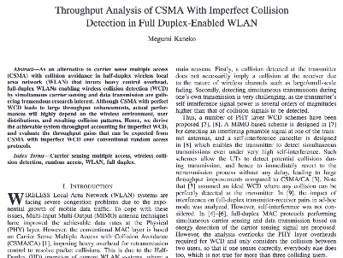
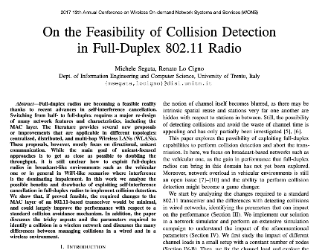
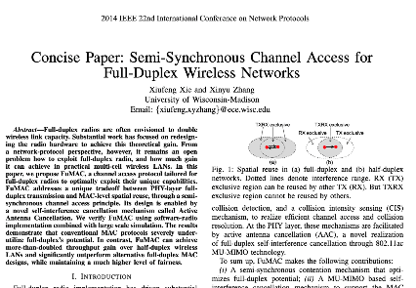
CSMA/CD – CSMA with Collision Detection
Detect collisions during your own transmission
Works great on wired mediums (Ethernet, I2C)
Very challenging for wireless systems
Transmit and receive are usually the same antenna
Receiving while transmitting would be drowned out by transmission
Remember: TX at 8 dBm and RX at -95 dBm
Area of active research!

Slide 37
Hidden terminal problem
Device C
Device A
Device B

Slide 38
CSMA with RTS/CTS
Hidden terminal problem means that two transmitters might never be able to detect each other’s transmissions
A partial solution
When channel is idle, transmitter sends a short Request To Send (RTS)
Receiver will send a Clear To Send (CTS) to only one node at a time
RTS collisions are faster and less wasteful than hidden terminal collisions
Downside: overhead is high for waiting for CTS when contention is low
Not always worth it

Slide 39
MAC protocol categorization
Medium Access Control Protocols
Contention-Based Protocols
Contention-Free Protocols
ALOHA
CSMA
FDMA
TDMA
CDMA

Slide 40
Contention-free access control protocols
Goal: split up communication such that devices will not conflict
Can be predetermined or reservation-based
Devices might request to join the schedule and be given a slot
Devices lose their slot if it goes unused for some amount of time
Reservations often occur during a dedicated CSMA contention slot
Assignment of schedules can be complicated
Really efficient at creating a high-throughput network
Assuming they are all following the same protocol
Otherwise, interference can be very problematic

Slide 41
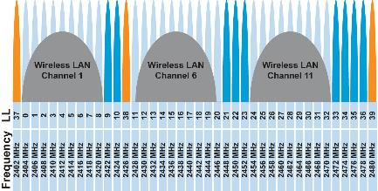
FDMA – Frequency Division Multiple Access
Split transmissions in frequency
Different carrier frequencies are independent
Fundamentally how RF spectrum is split
Usually in conjunction with another scheme (but not always)
Technically, each device uses a separate, fixed frequency
Walkie-talkies
Conceptually, how RF channels work
WiFi networks pick different bands
802.15.4 picks a channel to communicate on

Slide 42
TDMA – Time Division Multiple Access
Split transmissions in time
Devices share the same channel
Splits time into fixed-length windows
Each device is assigned one or more windows
Can build a priority system here with uneven split among devices
Requires synchronization between devices
Often devices must listen periodically to resynchronize
Less efficient use of slots reduce synchronization
Large guard windows. E.g. 1.5 second slot for a 1 second transmission

Slide 43
CDMA – Code Division Multiple Access
Split transmissions in ‘codes’
Not new; original applications in radar and early satellite communications
Analogy: Multiple speakers in the same room all in different languages
[The human brain is crazy good at ignoring what it doesn’t understand ☺]
Requires signal power coordination
[everyone needs to speak ~the same volume]
Can be hard in uncontrolled / dynamic environments
Also can be more performant with highly synchronized clocks
i.e. if the code clock is known to both devices

Slide 44
Break + Question
What is an advantage of Aloha over TDMA?

Slide 45
Break + Question
What is an advantage of Aloha over TDMA?
Simplicity! It’s really easy to implement Aloha
No required centralization
TDMA time schedule needs to be decided by something
That thing is “in charge”
Aloha can be entirely distributed

Slide 46
Real-world protocol access control
ALOHA
BLE advertisements
Unlicensed LPWANs: Sigfox, LoRaWAN
CSMA
WiFi (slotted, CSMA/CA)
TDMA
BLE connections
Cellular LPWANs: LTE-M and NB-IoT

Slide 47
Outline
Physical Layer
Overview
Signal Strength
Signal Frequency and Bandwidth
Signal Modulation
Data Link Layer
BLE Background

Slide 48
Bluetooth Low Energy Resources
Good walkthrough of BLE:
https://www.silabs.com/documents/public/user-guides/ug103-14-fundamentals-ble.pdf
[5.2 specification] [4.2 specification] (link to PDF download)
Also: [Supplement v9]
I used a mix of 5.2 and 4.2 for this
Will talk about BLE 5 differences as part of next lecture

Slide 49
Basics of Bluetooth Low Energy (BLE)
Direct device-to-device communication
Usually: Computer to Thing
Smartphone to device, Laptop to device, etc.
Focus on making the “Thing” really low energy
Push energy-intensive requirements onto “Computer”
Devices (Computer or Thing) are servers with accessible fields
Not the traditional send-explicit-packets interface you might be expecting
Lower layers are still exchanging packets to make it work

Slide 50
A note on outdated notation
Master/Slave paradigm
Master is the “Computer” and is in charge of interaction
Slave is the “Device” and has little control over interaction parameters
Really common notation in EE side of the world.
Not intended to be harmful, but also literally inconsiderate.
Field is changing for the better. It’s going to take some time.
Central/Peripheral
Device/Peripheral
Controller/Peripheral
Master/Minion
Primary/Secondary

Slide 51
BLE development
Protocol development
Research product
Specification
Hardware support
Usefulness and iteration
Bluetooth Low Energy
Research in early 2000s: Bluetooth Low End Extension and Wibree
Specification in 2009: Bluetooth version 4.0
Hardware support in 2011/12: iPhone 4s, nRF51 series
4.1 and 4.2 (2014), 5.0 (2016, first in phones 2017, really 2019 though)

Slide 52
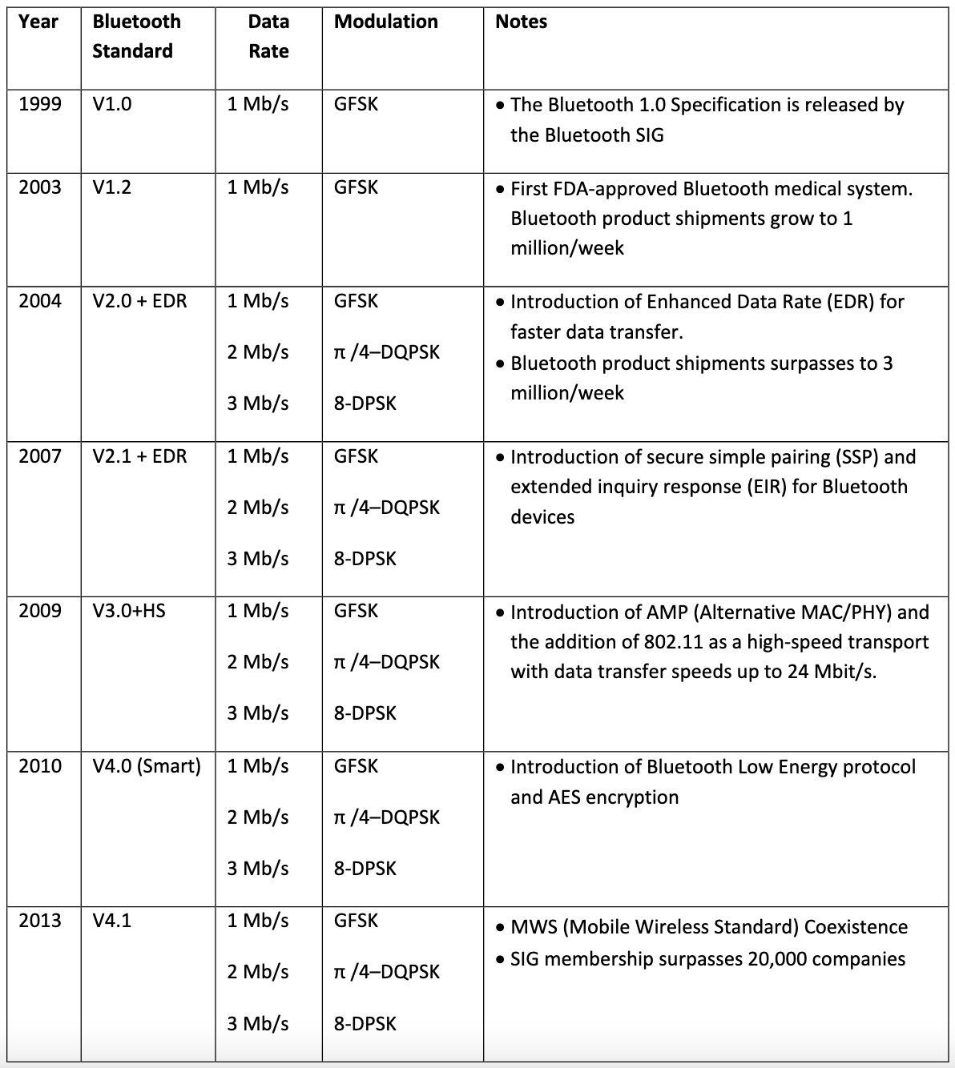
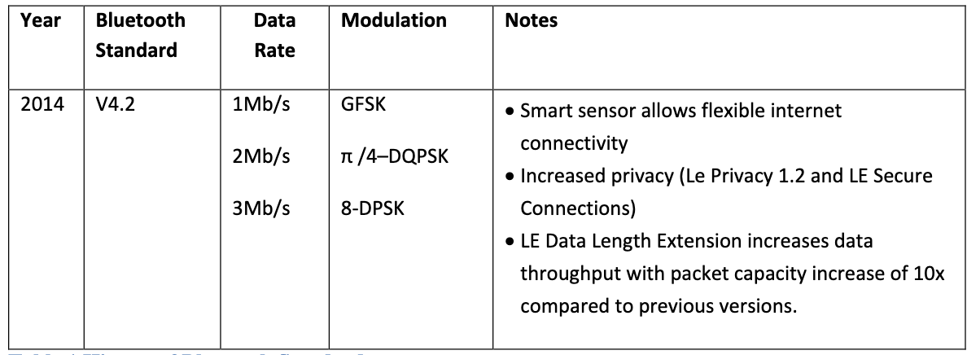
Bluetooth has a long history — the IoT is near-exclusively BLE (Bluetooth 4.0+) as opposed to Bluetooth Classic (<4.0)

Slide 53
Bluetooth Specification
Problem: a bit overwhelming…
5.2 spec: 3256 pages
We only care about Vol 6: Low Energy Controller
Part A: Physical Layer Specification
Part B: Link Layer Specification
CSS: Part A: Data Types Specification
So ~250 pages
Tip: be willing to just ignore things when skimming specs
5.2 spec covers BLE and Bluetooth Classic and a bunch of upper layer stuff that we never have to care about

Slide 54
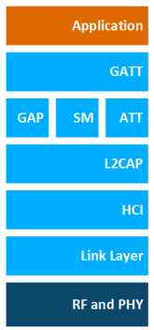
BLE Layers
GAP
Host – Configuration and Server
GAP – Generic Access Profile
Configure advertising
GATT – Generic ATTribute profile
Configure connections
HCI - Host Controller Interface (sigh)
Controller - Communication
Link Layer – send packets
RF and PHY – send bits
Host
Controller

Slide 55
BLE mechanisms
Advertising
Discovery
Advertisements – broadcast messages indicating device details
Ephemeral, uni-directional communication from Advertiser to Scanner(s)
ALOHA access control
Connections
Interaction
Bi-directional communication between Peripheral and Central
Maintained for some duration
TDMA access control

Slide 56
BLE network topology
Peripheral
Connection
Central & Scanner
Scanner
Connection
Peripheral
Advertisement
Advertisement
Advertisement
Advertisement
Advertiser
Advertiser
Advertiser

Slide 57
Multiple roles at the same time
Topology picture is a simplification of roles
A single device can have multiple roles simultaneously
Scanning and Advertising simultaneously
Peripheral and Scanner and Advertiser simultaneously
Peripheral and Scanner and Central and Advertiser simultaneously
Getting a bit out of hand though
One Peripheral can even be connected to multiple Centrals
Not in the original design though: you’ll find old docs saying you can’t
And it’s not a normal use-case for BLE

Slide 58
Break + Check your understanding
Which roles is each device likely to have?
Keyboard
Laptop
Smartphone

Slide 59
Break + Check your understanding
Which roles is each device likely to have?
Keyboard
Advertiser and Peripheral
Laptop
Scanner and Central
Smartphone
Advertiser, Peripheral, Scanner, and Central

Slide 60
Outline
Physical Layer
Overview
Signal Strength
Signal Frequency and Bandwidth
Signal Modulation
Data Link Layer
BLE Background

