Slide 1
Lecture 05 BLE Connections
CS433 – Wireless Protocols for IoT
Branden Ghena – Spring 2025
Materials in collaboration with Pat Pannuto (UCSD) and Brad Campbell (UVA)

Slide 2
Administrivia
Lab: Wireshark
Get checkoffs during office hours today from 5:00-7:00 in Tech L160
Homework: BLE Packets
Due next week Friday
Individual work
Practice interacting with protocol specifications
Also good practice interpreting payload data

Slide 3
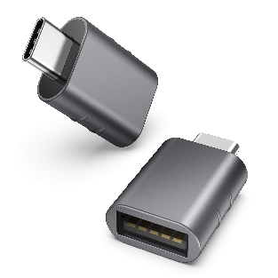
Administrivia
Lab: BLE
On Friday!
Group work. I emailed everyone about groups
I’ll pass out hardware boards for people to borrow
Bring a USB-C to USB-A adapter if you need one
Quiz1 next week Tuesday
Covers material in lectures 1-5 (includes today)
15 minutes, on paper
No notes or calculator all you need is a pencil (and class knowledge)

Slide 4
Today’s Goals
Explore how connections work
What does the link layer look like?
How do higher layers interact to share data?
Investigate network questions about connections
Overview of additions in BLE 5.0

Slide 5
Useful documentation
[5.2 specification] [4.2 specification] (link to PDF download)
https://www.novelbits.io/deep-dive-ble-packets-events/
Thinking about BLE connection data transfer rates
https://punchthrough.com/maximizing-ble-throughput-on-ios-and-android/
https://punchthrough.com/maximizing-ble-throughput-part-2-use-larger-att-mtu-2/
https://punchthrough.com/maximizing-ble-throughput-part-3-data-length-extension-dle-2/

Slide 6
Outline
Connection PHY and Link Layer
Connection Investigations
GATT
BLE 5

Slide 7
Recall: BLE advertisements lead to connections
Advertisement:
“I’m the Living Room Light”
Connection Request
Central
Connected (stops advertising)
Peripheral
“Set light brightness to 50%”
(note: this is highly simplified)
We’ll explore what happens here!
Notes:
Advertiser
Scanner
Central
Peripheral
https://community.nxp.com/t5/Wireless-Connectivity/A-view-on-Bluetooth-Low-Energy-stack-roles/m-p/380310

Slide 8
Overview of connections
Connections are for bi-directional communication with higher throughput than advertisements
Half-duplex: only one direction at a time
Simple view
A peripheral is either advertising or in a connection
A central is scanning and in one or more connections
Not quite accurate: devices can have several roles simultaneously
While in a connection both devices act like servers
Either device can read/write fields available on the other device

Slide 9
Once a connection is established, BLE has more PHY options
LE 1M (default)
1 Msym/s
BLE encodes 1 bit / symbol, so this is also 1 Mbit/s
LE 2M (added in BLE 5.0)
2 Msym/s
LE Coded (added in BLE 5.0)
1 Msym/s + Forward Error Correction
S = 2
~2x range, ½ effective data rate – 500 Kbit/s goodput
S = 8
~4x range, 125 Kbits/s goodput
1
0
1
0
1
Each of these are symbols
FSK Example

Slide 10
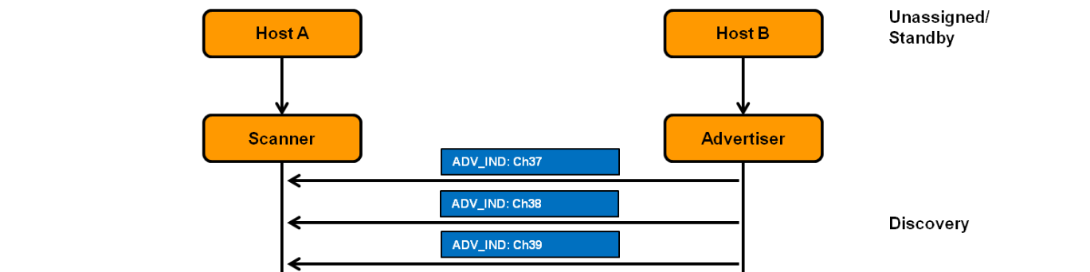
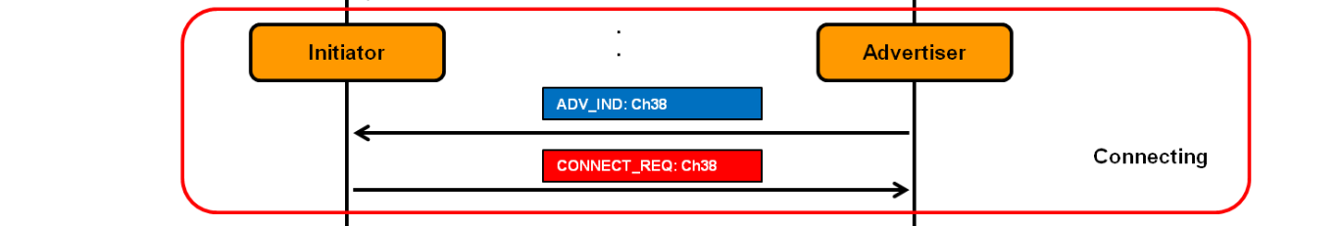
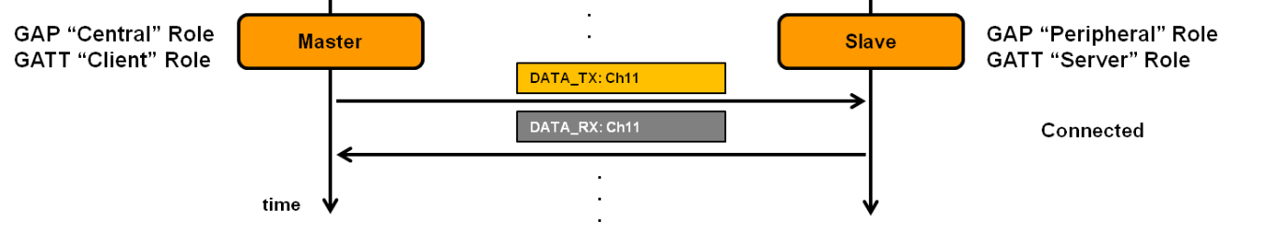
Connection Timeline
Peripheral advertises
Central sends a connection request packet on advertising channel just after receiving advertisement
Peripheral stops advertising
Central and peripheral switch to a data channel
Central
Peripheral
Notes:
- Animate
- Change text to annotations

Slide 11
BLE uses 2.4 GHz ISM Band with Data and Advertisement Channels
Recall: Each BLE channel is 2 MHz wide, 40 channels (0-39)
3 channels for advertising (37, 38, 39)
37 channels for connections (0 - 36)
Notes:
Source: https://i0.wp.com/embeddedcentric.com/wp-content/uploads/2019/03/bluetooth_ble_spectrum.png?ssl=1

Slide 12
Choosing a data channel for communication
Why do you switch from advertising channel to data channel?
How to pick a channel out of the 37 data channels?
What if two pairs pick same channel?

Slide 13
Choosing a data channel for communication
Why do you switch from advertising channel to data channel?
For better reliability and to improve quality of service
How to pick a channel out of the 37 data channels?
Randomize for reduced chance of collision
What if two pairs pick same channel?
Higher chance of collision occurring
Some way to not be tied to the same data channel is needed

Slide 14
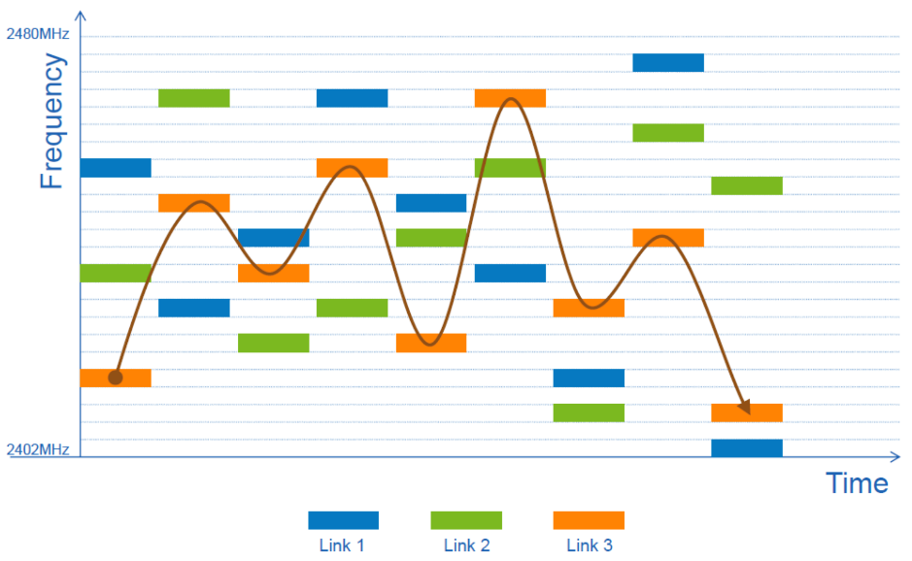
Frequency Hopping Spread Spectrum (FHSS)
Recall: Each BLE channel is 2 MHz wide, 40 channels,
3 are used for advertising, remaining 37 are for connections
Frequency hopping: f_{n+1} = (f_{n} + hop) mod 37
Which exact channels are used and in what order might vary
“Adaptive Frequency Hopping” avoids bad channels

Slide 15
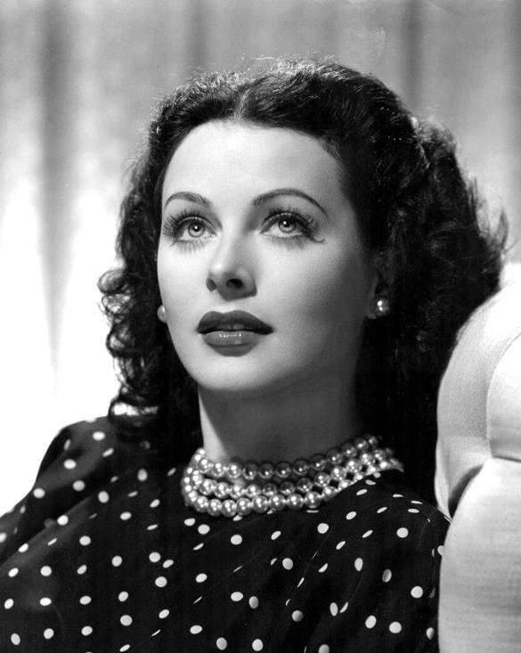
Sidebar: inventor of FHSS – Hedy Lamarr
Actress, inventor, and all-around badass
Designed FHSS with George Antheil during WWII based on music ideas
Idea: torpedo control can’t be easily jammed if it jumps around
https://en.wikipedia.org/wiki/Hedy_Lamarr#Inventing_career

Slide 16
How do the Central and Peripheral agree on things?
For a packet to be received:
Central and peripheral should be listening and sending on same data channel
For the hopping to be successful, both must:
Follow same hop sequence
Which channels to use and the order to follow
Hop at a given time schedule
Agree on when to schedule their first communication
Some synchronization is needed!

Slide 17
Break + Group Discussion
For a packet to be received:
Central and peripheral should be listening and sending on same data channel
For the hopping to be successful, both must:
Follow same hop sequence
Which channels to use and the order to follow
Hop at a given time schedule
Agree on when to schedule their first communication
Some synchronization is needed!
How do we solve this problem?
What would a protocol look like to handle this? What information needs to be shared?

Slide 18
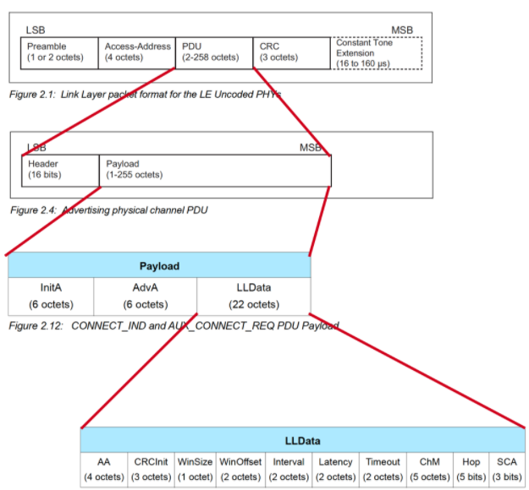
Connection request packet
Scanner waits until it sees an advertisement from a device it wants to connect to
Requesting a connection (in higher layers) just starts this search process
Sends connection request payload in response to advertisement

Slide 19

Connection request parameters examined
Specifies parameters of the connection
Peripheral must either agree or totally reject the connection
Peripheral can later propose a change to the connection parameters
Interval is how frequently connection events occur (7.5ms – 4s)
Notes:
Figure from video would be good

Slide 20
Steady-state connection timing
Connection Interval
Central to Peripheral
Peripheral to Central
Central to Peripheral
Peripheral to Central
Central to Peripheral
Peripheral to Central
Central to Peripheral
Peripheral to Central
Central to Peripheral
Peripheral to Central
Hop to next data channel
Hop to next data channel
Optional packets
Some data can be exchanged at each interval
Might just be acknowledgements
Additional packets can be sent if there is a lot to transmit
Each interval is on the next channel in the hopping sequence
Peripheral can skip a number of intervals to save energy
Defined by the Latency connection request parameter

Slide 21
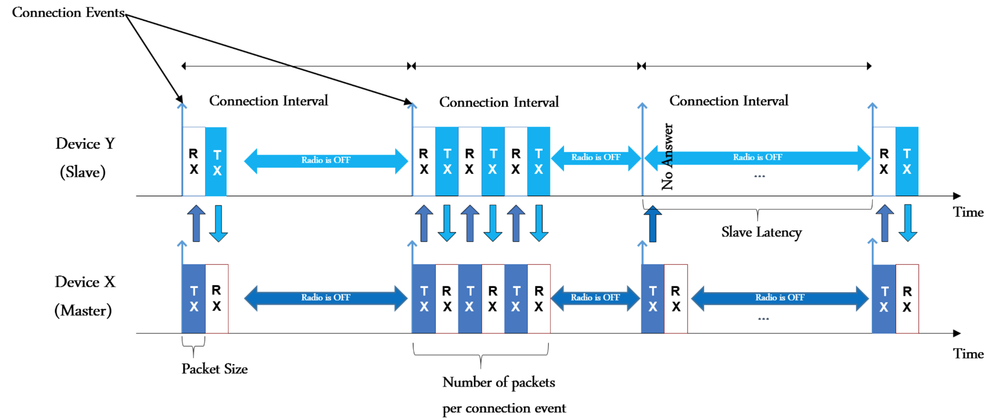
BLE connection “events” happen at periodic intervals
Hop to next data channel
(Peripheral)
(Central)
Notes:
Source: https://embeddedcentric.com/introduction-to-bluetooth-low-energy-bluetooth-5/
During a connection
Central sends a packet each “connection interval”
Peripheral immediately responds with a packet
Multiple packets may be exchanged this way until done
Repeat at next connection interval
Ending a connection
Either device sends termination packet
Timeout occurs on either device

Slide 22
How do you schedule the very first connection event?
WinSize and WinOffset specify start of the first connection event
First connection event: first exchange after CONNECT_REQ packet)
Starts the TDMA communication schedule
Allows Central to avoid prior, existing connections in time
Repeats based on the interval after the first event
WinOffset: Time from now until first event
Analogy: “Let’s meet 2 hours from now”
WinSize: Flexible window of time to expect first transmission
Analogy: “I might be up to 15 minutes late”
Notes:
Figure from video would be good

Slide 23
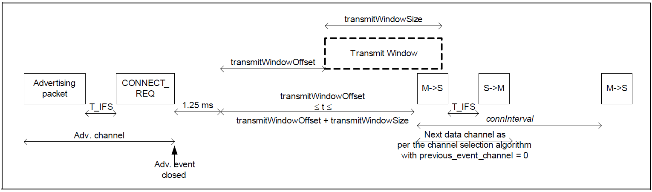
The Central schedules the first connection event
Place an “anchor point” that defines the TDMA schedule for this device
Interval specifies duration between connection events starting at anchor
Recall that initial advertisement was random compared to other devices
Anchor allows Central to avoid prior, existing connections in time
Central to Peripheral
Peripheral to Central
Central to Peripheral

Slide 24
How do you agree on hopping pattern?
Channel Map (ChM) and Hop define the FHSS pattern
Channel Map (ChM): Map of which channels to use
Hop: next hop increment
Next hop channel c_{n+1} = (c_{n} + hop) mod 37
Notes:
Figure from video would be good

Slide 25
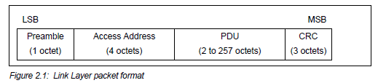
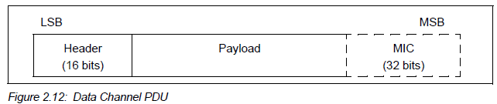
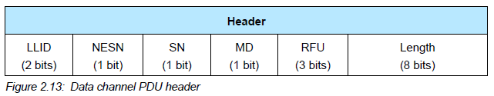
Connection packet layering
LLID – link layer ID
Empty data / Fragment
Data
Control
MD – more data (continues connection event)
Optional authentication
[Next Expected] Sequence Number – acknowledgements

Slide 26
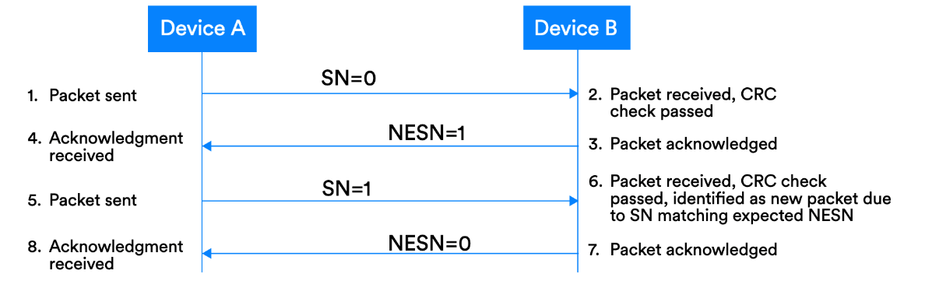
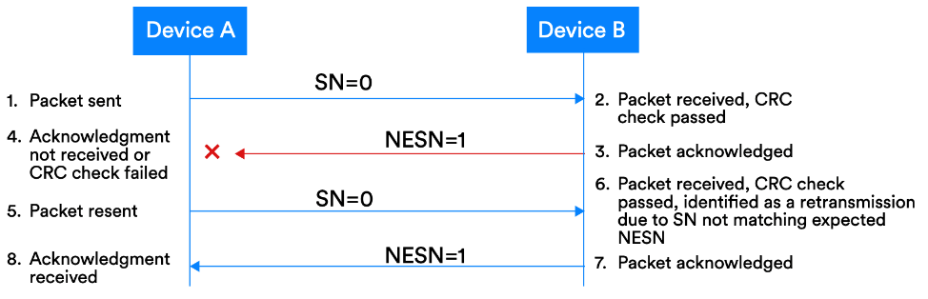
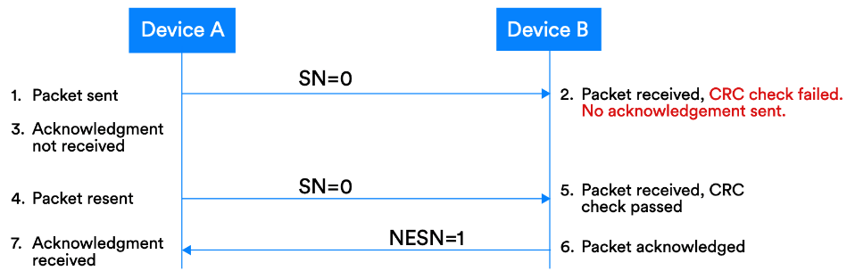
Acknowledgement protocol
See §4.2.3 of Reliability Doc for more

Slide 27
Now that a connection exists, packets can be exchanged over it
Next step: actually communicate between devices
Either sending data, or sending “control” messages
“Control” and “Data” separation: very common networking theme
LLID – link layer ID
Empty data / Fragment
Data
Control

Slide 28
Link Layer header length
Question: What is the maximum possible payload size?
Notes:
Expectation: They look at “length” and say 2^8 = 255 (or maybe 256; why is that wrong?)

Slide 29
Link Layer header length
Question: What is the maximum possible payload size?
251 Bytes
= 257 - header - MIC
Notes:
Expectation: They look at “length” and say 2^8 = 255 (or maybe 256; why is that wrong?)

Slide 30
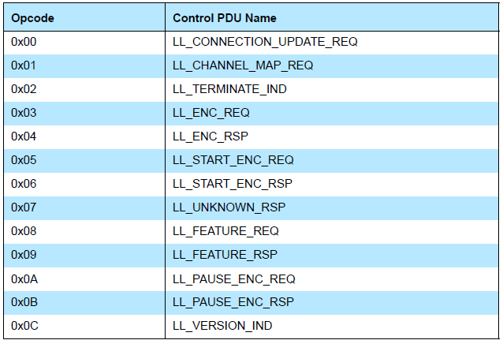
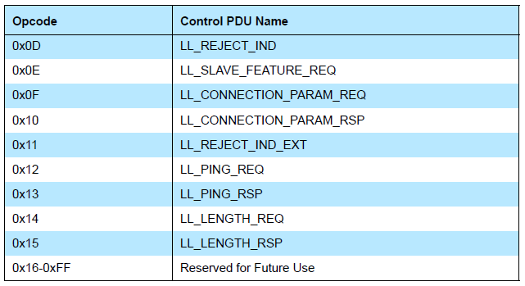
Control payloads
Examples:
Request update to connection parameters like interval (by peripheral)
Begin encrypting communication
Terminate a connection
Note: Control payloads can all be handled by the link layer – not passed up to applications!

Slide 31
Data payloads
SDU – Service Data Unit
Logical packet that may be split into several physical packets
Channel ID
Destination for data
ATTributes or Security
Can also make custom endpoints
Length (16 bits) | Channel ID (16 bits) | L2CAP SDU Length* (16 bits) | Information Payload (0 to 249 octets)

Slide 32
Summarizing what’s sent in a BLE connection
Control packets
Version
Bluetooth version, Company ID of Software Stack
Features
Various connection features supported by the device
Encryption, Ping, Channel selection algorithms, Various 5.0 features
Etc.
Extended packet length, Various 5.0 features (change PHY)
Various “procedures” for setting up changes in the connection
Data packets
Attribute discovery
Attribute reading

Slide 33
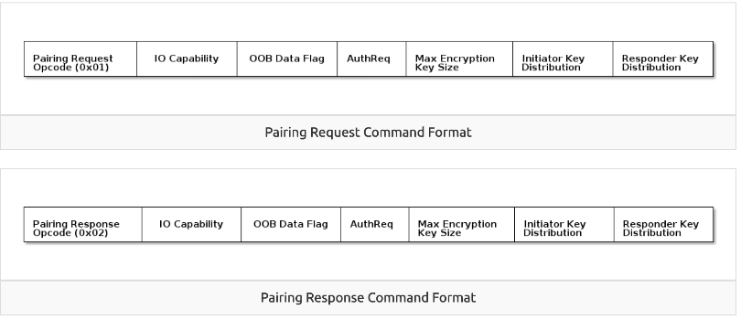
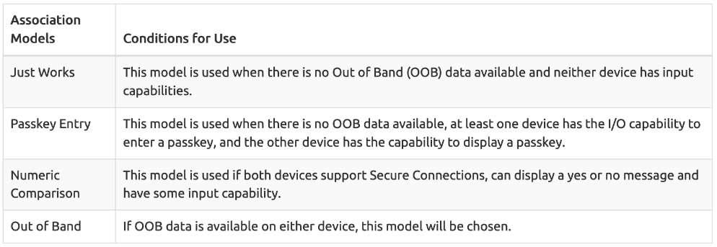
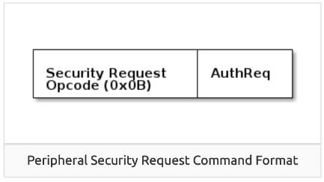
Very briefly: security in connections
Either side can request secure connection [central -> Pairing; peripheral -> Security Req]
“Bonding” saves pairing info between connections
Excellent TI resource here for more details: https://dev.ti.com/tirex/explore/node?node=AOPOY.GDApakIOYjiwoY6A__pTTHBmu__LATEST

Slide 34
Very briefly: security in addresses
All devices have a unique, hardware “Identity Address”, but may not share it
Public Address - Use the Identity Address. (The BDA never changes.)
Random Static Address - Generate a random address per power cycle. The address cannot be regenerated at any other time. Can be used as an Identity Address.
Resolvable Private Address (RPA) - Generate a random address with a given time interval. Generated using Identity Resolving Key (IRK) which can also be used by trusted peers (bonded devices) to resolve the Random Address to the Identity Address.
Non-resolvable Private Address - Generate a random address with a given time interval. Generated randomly. Cannot be resolved to an Identity Address.

Slide 35
Ending connections
Termination control packet exists
Also a Timeout parameter from connection parameters
Human-based devices may just wander away from each other
Or be shut off, or reprogrammed, etc.

Slide 36
Break + Check your understanding
What makes connections more reliable than advertisements?
How does a Peripheral send data to a Central in a connection?
Why is a “termination” control packet useful?

Slide 37
Break + Check your understanding
What makes connections more reliable than advertisements?
Each packet sent is acknowledged or resent
TDMA schedule and FHSS means less likely to collide
How does a Peripheral send data to a Central in a connection?
Wait until next connection interval
Respond to packet from Central with a data payload
Why is a “termination” control packet useful?
Timeout could delay for a while
Enables re-connection if desired

Slide 38
Summary: Connection timeline
Initiating a connection
Peripheral is sending broadcast advertisements
Central is scanning and receives an advertisement
Central sends connection request
During a connection
Central sends a packet each “connection interval”
Peripheral immediately responds with a packet
Multiple packets may be exchanged this way until done
Repeat at next connection interval
Ending a connection
Either device sends termination packet
Timeout occurs on either device

Slide 39
Outline
Connection PHY and Link Layer
Connection Investigations
GATT
BLE 5

Slide 40
Let’s analyze this type of network
Things we care about:
Robustness
Performance
Scalability
Consideration: what are the figures of merit?
What variables do we want to maximize/minimize?

Slide 41
Questions about how a connection “network” works
How does TDMA MAC for connections work?
Implies a schedule
Implies synchronization
How many devices can be in a network?
Figure of merit: Number of devices
How much throughput can a device have?
Figure of merit: Data rate (bits/second)

Slide 42
Questions about how a connection “network” works
How does TDMA MAC for connections work?
Implies a schedule
Implies synchronization
How many devices can be in a network?
Figure of merit: Number of devices
How much throughput can a device have?
Figure of merit: Data rate (bits/second)

Slide 43
How is the TDMA schedule created/managed?
Only the central needs to know the schedule
It controls interactions with the peripheral(s) it is connected to
Anchor point and connection interval determines the schedule for a specific device
Central to Peripheral
Peripheral to Central
Central to Peripheral

Slide 44
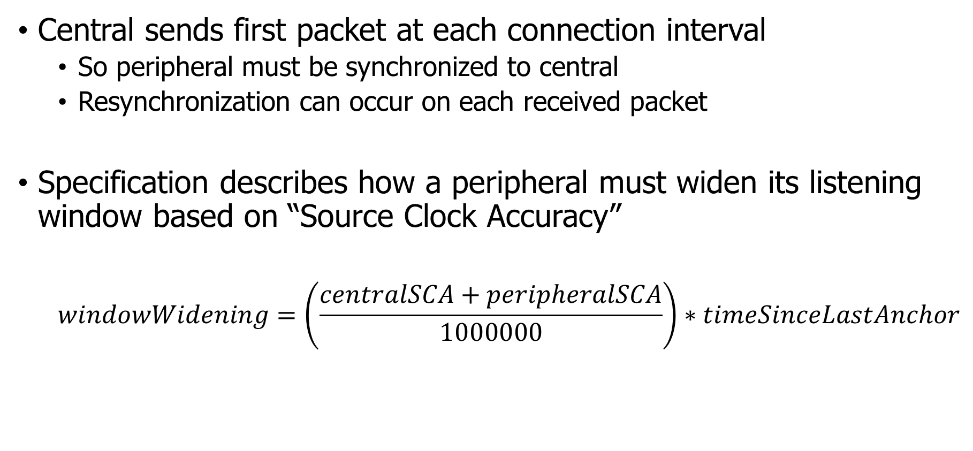
How is synchronization managed?
Central sends first packet at each connection interval
So peripheral must be synchronized to central
Resynchronization can occur on each received packet
Specification describes how a peripheral must widen its listening window based on “Source Clock Accuracy”
$$windowWidening=\left(\frac{centralSCA+peripheralSCA}{1000000}\right)∗timeSinceLastAnchor$$

Slide 45
Clock drift is an energy burden due to large guard bands and energy cost of precise timekeeping
CC2520 Radio + AM18xx RTC:
300s * 2ppm * 2 = 1.2 ms guard
1.2 ms * 60 mW = 36 μJ (RF loss)
300s * 150nW = 45 μJ (RTC loss)
≈ 100 μJ loss / packet @ 300 s
1200 μs
@ 2ppm
Guard
Device time
(CC2520 is a 15.4 radio, but same idea applies) Max connection interval in BLE is 4 seconds
Static Power:
100 nW+
300 s
Wall time

Slide 46
Questions about how a connection “network” works
How does TDMA MAC for connections work?
Implies a schedule
Implies synchronization
How many devices can be in a network?
Figure of merit: Number of devices
How much throughput can a device have?
Figure of merit: Data rate (bits/second)

Slide 47
How many devices can be connected?
We can schedule with granularity of at least 1.25 ms (offset steps)
That’s at least 800 devices per second
Intervals go up to 4 seconds, so multiply by four
That’s 3200 devices per max interval
Plus central can skip intervals on occasion without dropping the connection
And really the offset defines a window. More granularity is available
Answer: thousands of devices
Although each is sending minimum-sized packets each interval

Slide 48
How many devices can be connected in the real world?
The limit is much much lower on real devices
Example: Android sets a limit at around 4-15
nRF52 s140 softdevice allows up to 20
Nintendo Switch: 8 controllers (which counts controller halves)
Connection management is often done in firmware
Softdevice for nRF, firmware on the radio chip in smartphones
Limited by memory and complexity

Slide 49
Questions about how a connection “network” works
How does TDMA MAC for connections work?
Implies a schedule
Implies synchronization
How many devices can be in a network?
Figure of merit: Number of devices
How much throughput can a device have?
Figure of merit: Data rate (bits/second)

Slide 50
How much throughput can a device have?
1 Mbps? That’s the PHY data rate

Slide 51
How much throughput can a device have?
1 Mbps? That’s the PHY data rate
Not even close. Packet overhead plus timing delays
Step 1: decrease connection interval as much as possible
More connection events per second mean more data
Range: 7.5 ms to 4.0 s
Somewhat device-specific configuration
Android allows 7.5 ms
iOS allows 15 ms

Slide 52
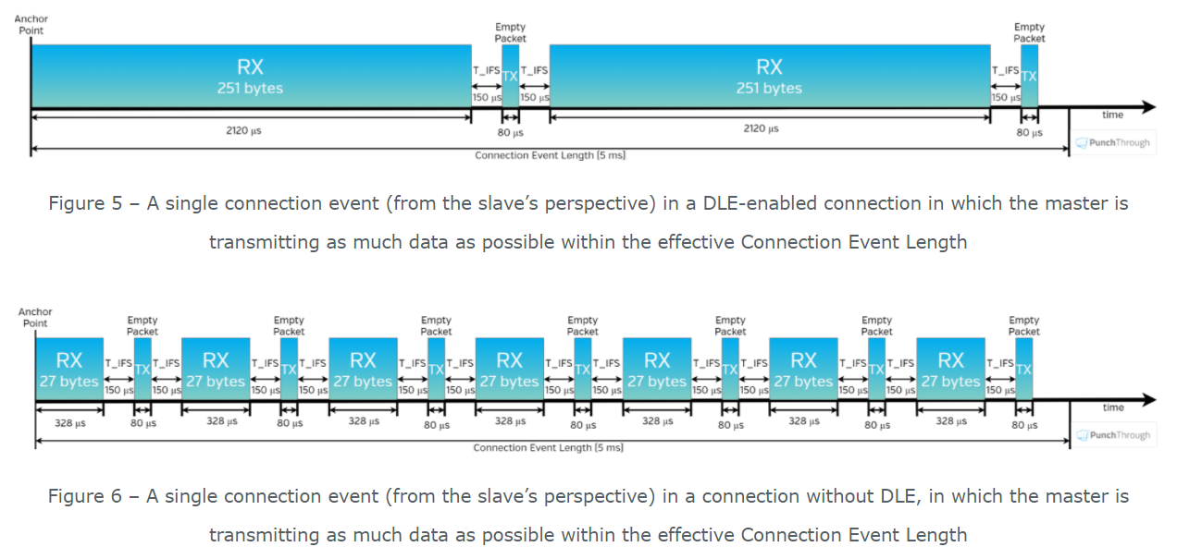
How much throughput can a device have?
Step 2, increase packet size

Slide 53
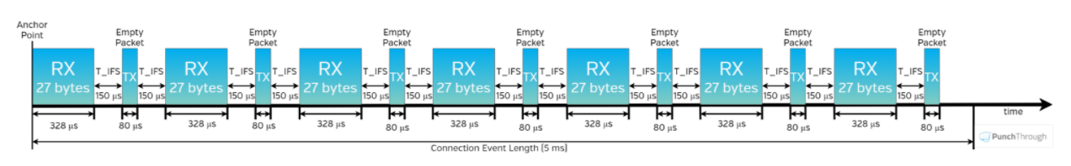
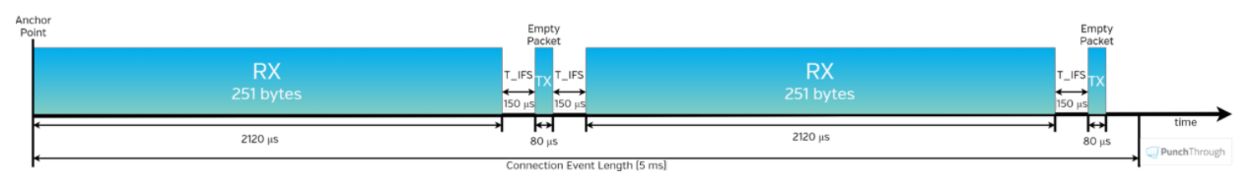
How much throughput can a device have?
Step 2, increase packet size
Using maximum-sized payloads has less overhead
Notes:
https://punchthrough.com/maximizing-ble-throughput-part-3-data-length-extension-dle-2/
Connection event length = time duration where tx happens (different from connection interval)

Slide 54
How much throughput goodput can a device have?
488 bytes of useful data per connection event
Maximum sized packets, discounting headers and timing delays
Connection event every 7.5 ms
Result: 520 kbps (65 kilobytes per second)
iOS result 260 kbps
Original BLE 4.1 result on Android: 128 kbps
A little lower in practice due to lost packets
Modern results will be better, but a similar ballpark
This is roughly half of the PHY rate!

Slide 55
Break + Question
This powerpoint presentation is roughly 8 MB
At 520 kbps (65 kB per second) of goodput, how long would it take to send over a BLE connection?

Slide 56
Break + Question
This powerpoint presentation is roughly 8 MB
At 520 kbps (65 kB per second) of goodput, how long would it take to send over a BLE connection?
8 MB / 65 kB per second = 123 seconds…

Slide 57
Outline
Connection PHY and Link Layer
Connection Investigations
GATT
BLE 5

Slide 58
How is data actually exchanged between central and peripheral?
Attribute Protocol
Central
Peripheral
ATT Client
ATT Server
Attribute Protocol (ATT) and Generic Attribute Profile (GATT) used for this!
ATT is the underlying framework for GATT
Two roles: Client and Server
Data that the server exposes is structured as attributes

Slide 59
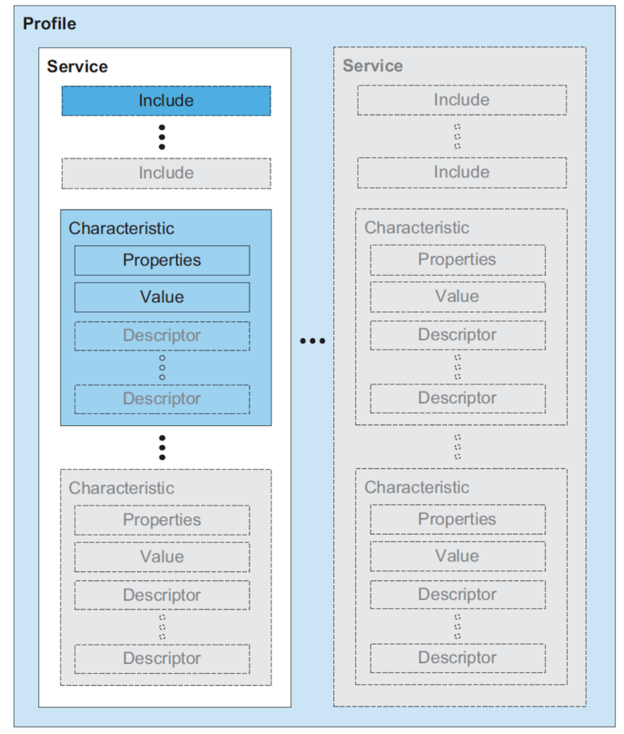
Attribute server keywords
Characteristic
A field with properties and a value
Descriptor: metadata about the characteristic (readable, writeable, notifications when it updates)
Service
Collection of characteristics
Profile
Collection of services

Slide 60
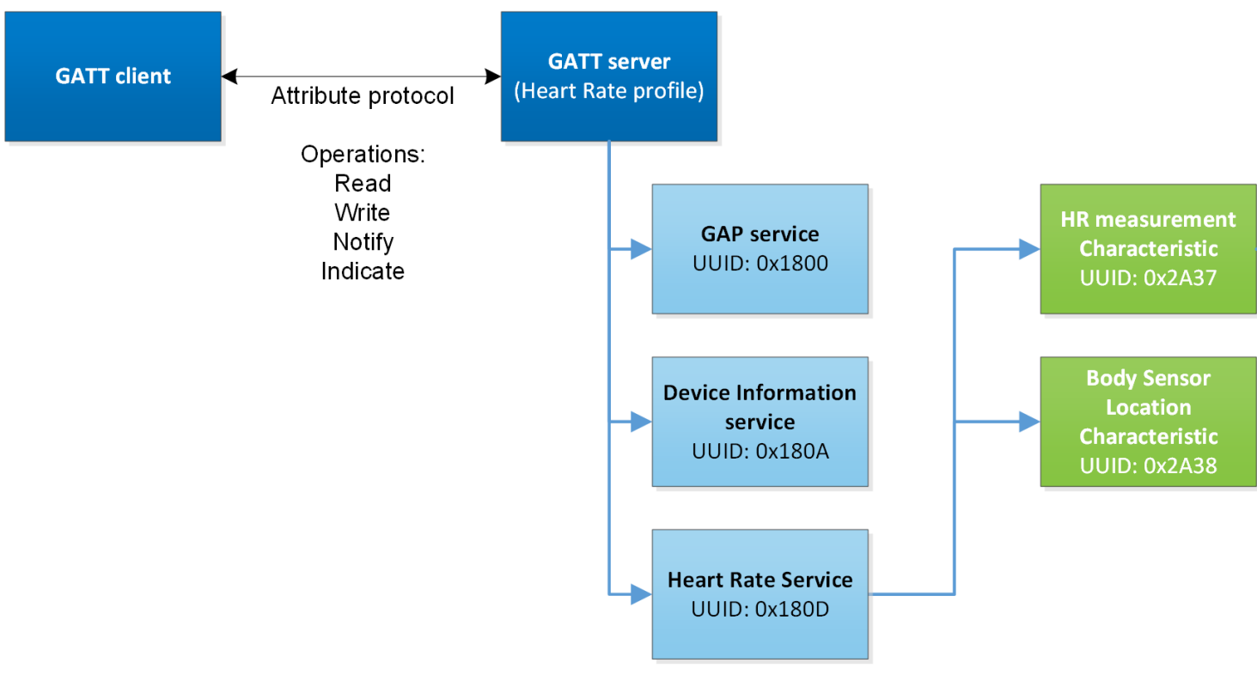
Overview of Generic Attribute Profile (GATT)
Attribute Type is specified as a UUID

Slide 61
UUIDs and handles
Universally Unique Identifiers
128-bit, mostly random with a few bits for versioning
Example: 00000000-0000-1000-8000-00805F9B34FB
This is the default BLE UUID for known services
You can generate your own UUID for custom services
Handles
Too long to pass around all the time, so pick 16 bits that mean that UUID
Must be unique among services/characteristics on that device
Taken from UUID: 0000xxxx-0000-1000-8000-00805F9B34FB
Handle often sequentially incremented for each new characteristic within a service
Resource: Useful stackoverflow post on identifying handles in the wild

Slide 62
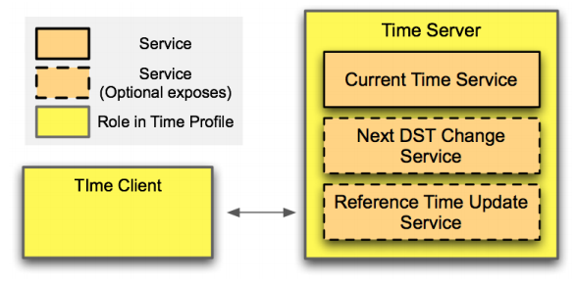
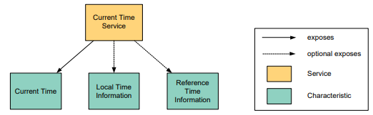
Example: Time Profile

Slide 63
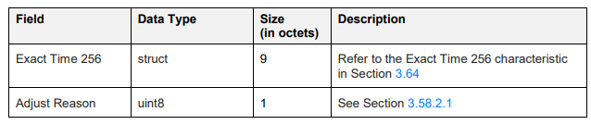
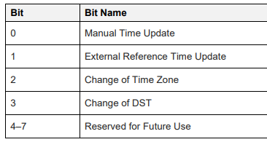
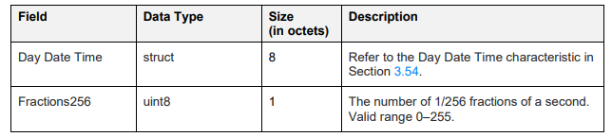
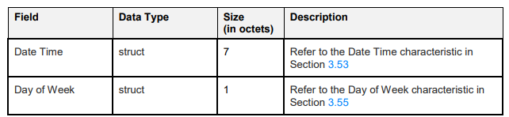
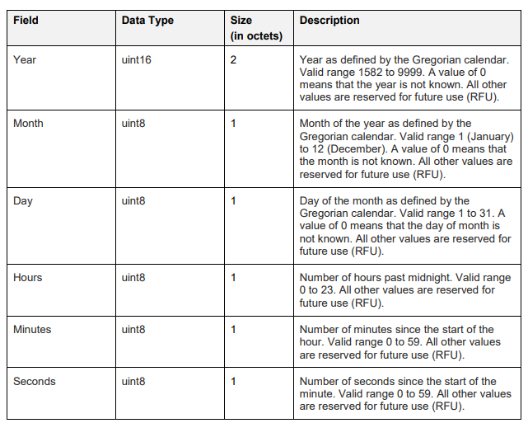
Current time characteristic
The Bluetooth SIG are pedantic people
But details matter for interoperability!

Slide 64
Interacting with characteristics
Depends on their permissions
Readable, Writable, Notify-able, etc.
Notify
Automatically get a message sent whenever the characteristic value updates
Note: have to enable this on both sides, it’s not the default behavior
Long characteristics are automatically fragmented across multiple packets and/or connection events
Lower layers are in charge of this without the application having to consider it

Slide 65
Discovery
When a connection first occurs, each device can query the other for a list of services
And can further query for a list of characteristics in that service
Gets a list of handles/UUIDs
Standardized UUIDs can be interpreted immediately
Custom services/characteristics need documentation from the manufacturer

Slide 66
Documentation of GATT standards
https://www.bluetooth.com/specifications/gatt/
Various profiles and services that have been standardized
GATT Specification Supplement
Various characteristic definitions that have been standardized
Both incredibly specific and woefully inexhaustive

Slide 67
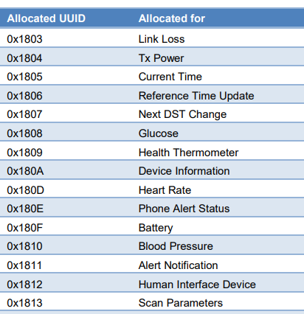
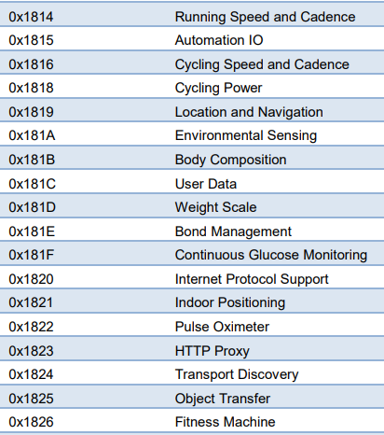
Break + Example Services
https://btprodspecificationrefs.blob.core.windows.net/assigned-values/16-bit%20UUID%20Numbers%20Document.pdf

Slide 68
Outline
Connection PHY and Link Layer
Connection Investigations
GATT
BLE 5

Slide 69
Changes in BLE 5
Major changes
Multiple physical layers
Advertising extensions
Localization extensions (will discuss later with localization)
Minor changes
Various quality of life improvements
Examples:
Advertise on channels in any order
Better data channel hopping algorithm

Slide 70
Revised physical layers
2 Mbps PHY
Transmit data faster
Transmit more data in the same time
Coded PHY
Forward Error Correction in the data stream
1 bit -> 2 symbols or 8 symbols
Makes bits more reliable -> longer distance
500 kbps and 125 kbps modes
Connections can switch to these PHYs after creation
Advertisements can use these, but only in a special “extended” mode

Slide 71
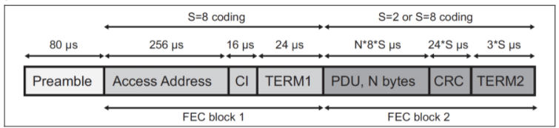
Coded PHY mixes physical and link layers
Different PHY settings at different times
Make beginning headers extra-reliable
Data might be slightly less reliable as a trade for faster speed
Packet sent with coded PHY

Slide 72
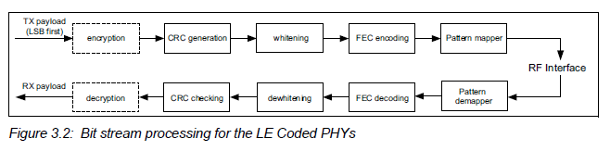
Revised processing path

Slide 73
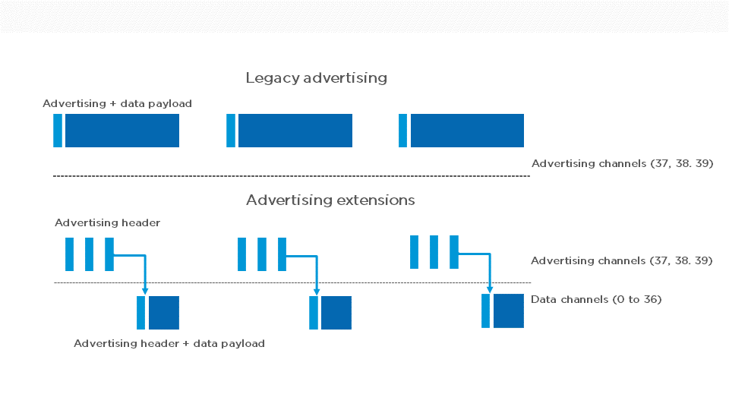
Extended advertising
Allow bigger payloads and/or different PHYs
Uses Data Channels to do so. Why?
Regular advertisements point to extended advertisements

Slide 74
Extended advertising
Allow bigger payloads and/or different PHYs
Uses Data Channels to do so. Why? Packet collisions!
Regular advertisements point to extended advertisements

Slide 75
Procedure for scanning extended advertisements
Scan on 3 primary channels for advertising packets.
If ADV_EXT_IND is scanned, record the secondary channel information (which channel and when etc.)
Scan the specific secondary channel at the given time.

Slide 76
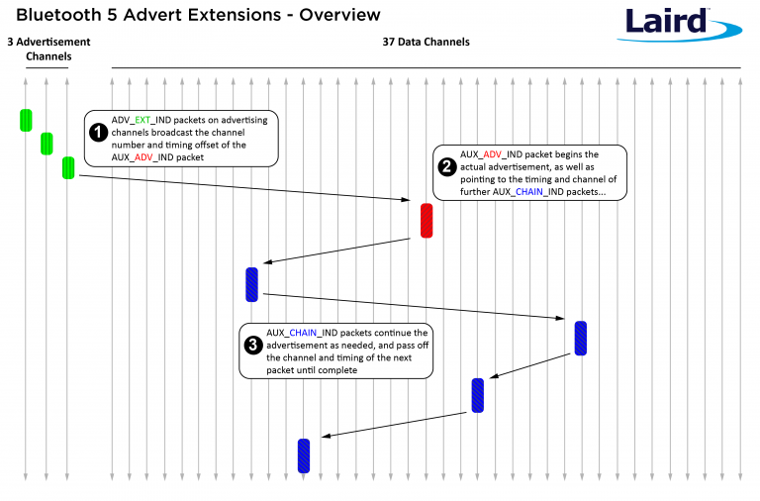
Extended advertisement train on data channels
Use case: long advertisements that need to be fragmented
Up to 1650 bytes total

Slide 77
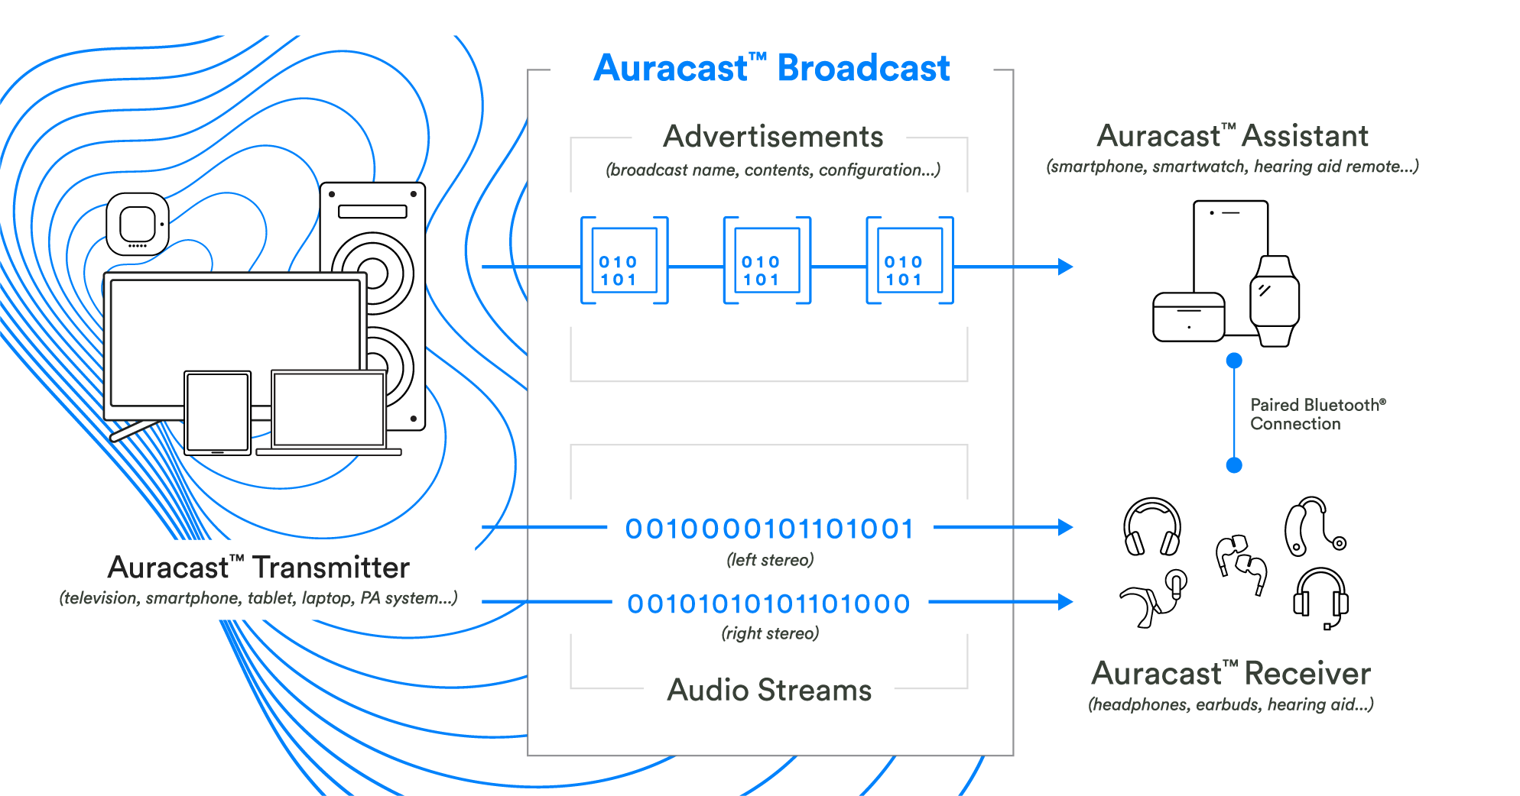
BLE “Auracast”

Slide 78
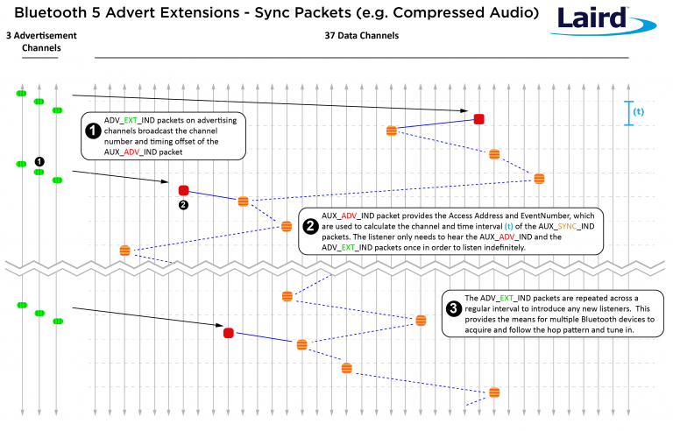
Periodic advertising on data channels
Use case: publicly-available localized audio sources
TV in a bar
Commentary in a museum
Broadcast analogy of a connection
Probably only able to follow one of these at a time

Slide 79
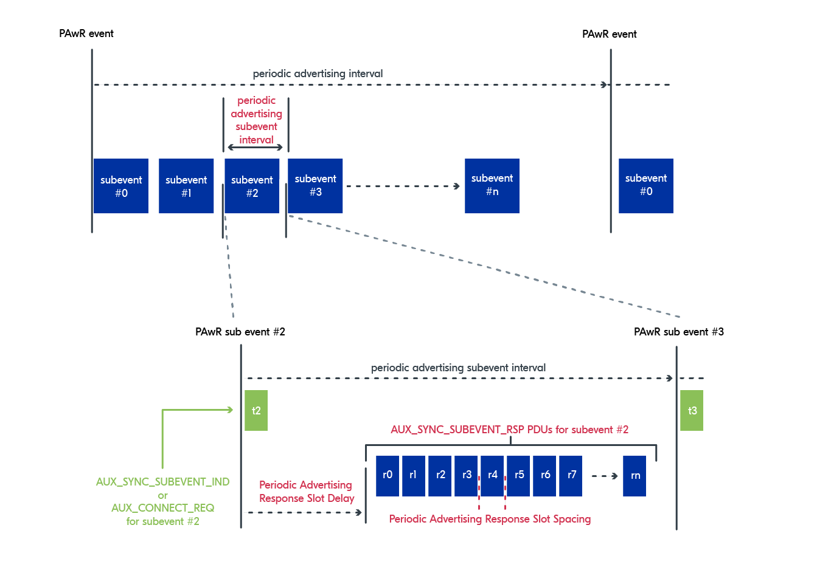
Bi-directional “Periodic Advertisement with Responses”
BLE 5.4 addition
Between advertisements send a “subevent indication” packet, followed by a number of reception windows
A scanner can transmit back to advertiser during one of those windows
Up to the application to determine which window each scanner should use

Slide 80
Outline
Connection PHY and Link Layer
Connection Investigations
GATT
BLE 5

