Slide 1
Lecture 06 802.15.4
CS433 – Wireless Protocols for IoT
Branden Ghena – Spring 2025
Materials in collaboration with Pat Pannuto (UCSD) and Brad Campbell (UVA)

Slide 2
Assignment Schedule
Hw: BLE Packets
Due Friday
Lab: BLE
Due next week Thursday
Goal: Wireshark parts by Thursday this week
Quiz today
We’ll stop at around 1:30 pm to do a 15-minute quiz
Tell your friends if they’re not here

Slide 3
Office Hours update
Tuesday office hours (with me) moved
Now in Tech L251
From 5:00-6:30 pm
I wanted a bigger room with a little more time

Slide 4
Today’s Goals
Introduction to 802.15.4
Overview of physical layer details
Exploration of link layer
Network topologies
Communication structure
Access control
Packet structure

Slide 5
References
802.15.4 Specification [2006]
“Part 15.4: Wireless Medium Access Control (MAC) and Physical Layer (PHY) Specifications for Low-Rate Wireless Personal Area Networks (WPANs)”
Other helpful references:
Paper introducing the 802.15.4 draft
NXP 802.15.4 Stack User Guide
2005 presentation on 802.15.4

Slide 6
Outline
Overview
Physical Layer
Link Layer
Packet Structure

Slide 7
Comparison of networks
Data
Throughput
Range

Slide 8
Comparison of networks
WiFi
Cellular
Data
Throughput
Bluetooth
BLE
802.15.4
Range

Slide 9
Comparison of networks
WiFi
Cellular
Data
Throughput
Bluetooth
BLE
802.15.4
There are some missing qualities here. Why be closer to the origin?
Range

Slide 10
Comparison of networks
WiFi
Cellular
Higher Power & Higher Cost
Data
Throughput
Bluetooth
BLE
802.15.4
Lower Power & Lower Cost
Range

Slide 11
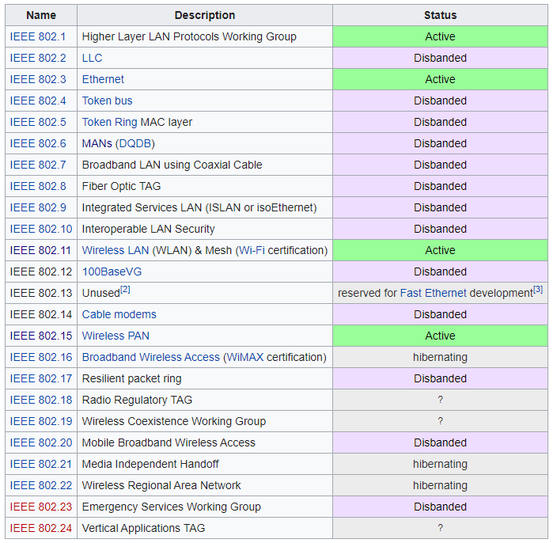
IEEE 802
Network standards for variable-sized packets
Ethernet
WiFi
WPANs
E.g. not networks that send periodic constant-sized packets
Specifies PHY and Link layers
Another example standard:
IEEE 754: Floating Point

Slide 12
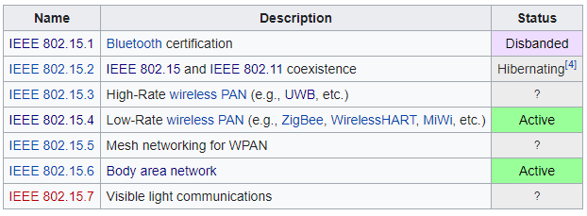
IEEE 802.15
Wireless Personal-Area Networks (WPAN)
All the things within the workspace of a person
Conceptually smaller domain that the Local Area Network
Realistically about the same thing as a LAN
Formerly included a Bluetooth spec
Bluetooth SIG took over governance

Slide 13
802.15.4 (LR-WPANs) Overview “Low-Rate Wireless Personal Area Networks”
Goals
“The IEEE 802.15 TG4 was chartered to investigate a low data rate solution with multi-month to multi-year battery life and very low complexity.” [TG4]
Applications
“Potential applications are sensors, interactive toys, smart badges, remote controls, and home automation.” [TG4]
Ultimately home automation, industrial control/monitoring, vehicular sensing, agriculture; really most machine-to-machine (M2M) sensor applications
Other contemporary technologies
WiFi 802.11b and Bluetooth Classic
Too complex in specification and overachieving in capability

Slide 14
IEEE 802.15.4
Low-Rate Wireless PAN
250 kbps, ~100 m range
Radio hardware available with low-power and low-cost
Specification: 2003
Also 2006, 2011, 2015, and 2020 revisions
Mostly various added capabilities such as extra PHY layers
Also define optional security, scheduling, and larger frame sizes
We’ll mostly work off of the 2006 version
Thread is based on 2006 version
Zigbee is based on the original 2003 version
Roughly 200 pages of meaningful specification (100 of appendices)
Compare to 3000 pages of Bluetooth/BLE

Slide 15
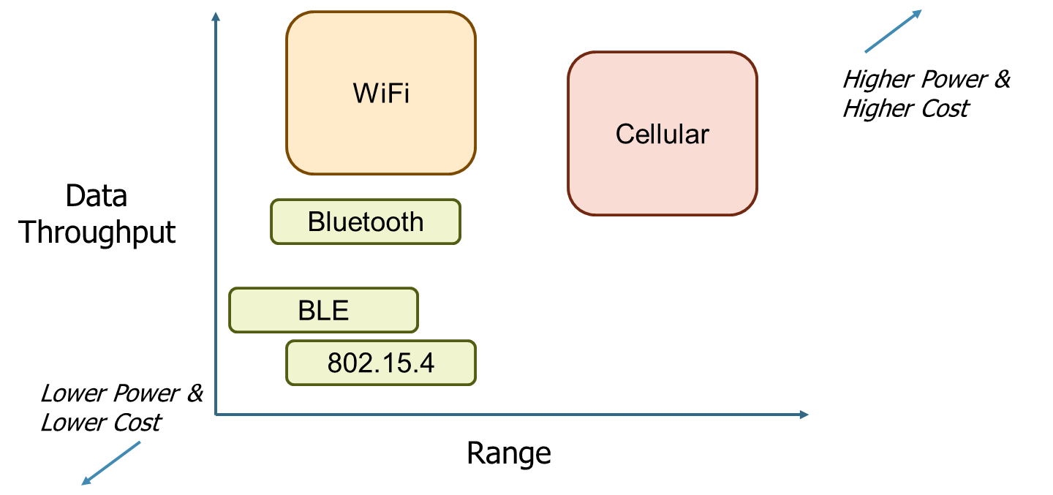
Break + Open Question
Given 802.15.4’s placement in terms of throughput, range, power, and cost: what are use-case constraints?

Slide 16
Break + Open Question
Given 802.15.4’s placement in terms of throughput, range, power, and cost: what are use-case constraints?
Not human-centric communication
Would need higher throughput
Still lower-energy and low-cost (similar to BLE)
Plausible for battery-operated devices
Range is focused on local-area (household-ish)
Bonus: long-term network, rather than ad-hoc point-to-point like BLE

Slide 17
Outline
Overview
Physical Layer
Link Layer
Packet Structure

Slide 18
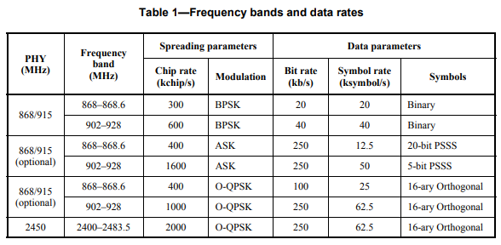
802.15.4 Physical Layers
Multiple options of physical layers are supported
We’ll focus on 2.4 GHz (2400 MHz)

Slide 19
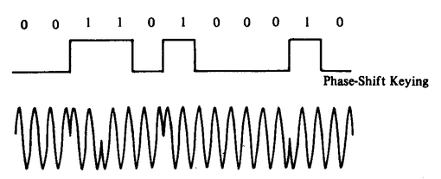
Physical Layer
O-QPSK modulation
Offset Quadrature Phase-Shift Keying
4 bits per symbol
Twice the data rate of BPSK for same Bit-Error Rate
Cost: more complicated design of receivers
Which is pretty minimal with all the transistors we’ve got
Plus the ability to reuse previous designs
Symbols versus bits
A symbol is the unit of data transfer for a modulated signal
Does not necessarily correspond 1:1 with bits
The rate of symbols per second is a baudrate
62.5 kBaud = 62500 symbols/second = 250000 bits/second = 250 kbps

Slide 20
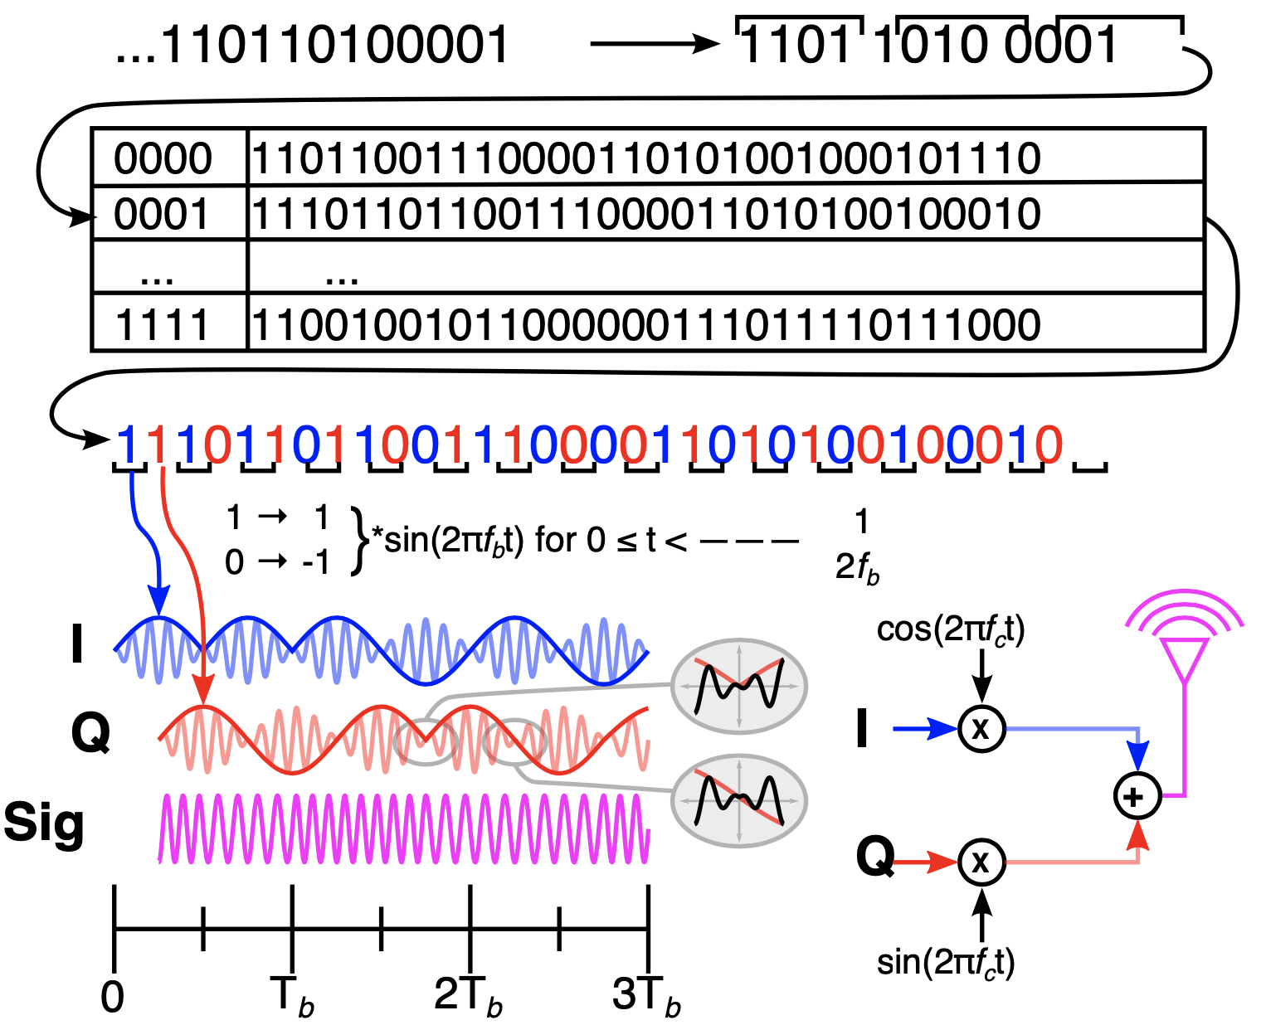


802.15.4 Modulation (@2.4 GHz f_{c}) O-QPSK with half-sine shaping is MSK!
Broken into 4-bit symbols
Each symbol maps to a 32-bit pseudo-noise code (PN-code) or sometimes pseudo-random sequence
Input bit stream
Each bit of the PN code is called a chip
I and Q half-sines are baseband, which are mixed with the carrier
Each chip encodes half a sine wine
I and Q carriers are combined to create the final on-air signal
Chips alternate in-phase and quadrature
Signal is MSK, which is a special, optimal case of FSK!
Quadrature component is offset π/2
Notes:
https://www.dsprelated.com/showarticle/1016.php – For reconvincing myself that yes, it really does boil down to MSK (a subset of FSK) on the air, which is insane.
https://arxiv.org/pdf/1611.03482.pdf – Also this for the same

Slide 21
802.15.4 Modulation (@2.4 GHz f_{c}) O-QPSK with half-sine shaping is MSK!
Broken into 4-bit symbols
Final detail:
This shows a f_{b} :: f_{c} ratio of 1 :: 10 so you can see the impact on the carrier. In reality, it’s closer to 1 :: 1200 (2,000 chips / s :: 2,400,000 Hz)
Each symbol maps to a 32-bit pseudo-noise code (PN-code) or sometimes pseudo-random sequence
Input bit stream
Each bit of the PN code is called a chip
I and Q half-sines are baseband, which are mixed with the carrier
Each chip encodes half a sine wine
I and Q carriers are combined to create the final on-air signal
Chips alternate in-phase and quadrature
Signal is MSK, which is a special, optimal case of FSK!
Quadrature component is offset π/2
Notes:
https://www.dsprelated.com/showarticle/1016.php – For reconvincing myself that yes, it really does boil down to MSK (a subset of FSK) on the air, which is insane.
https://arxiv.org/pdf/1611.03482.pdf – Also this for the same

Slide 22
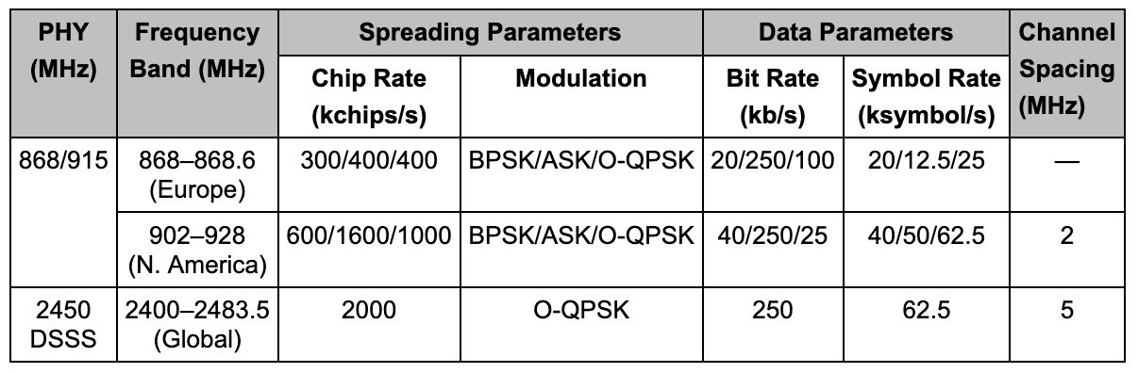
15.4 has multiple PHY layer choices
We focus on the 2.4 GHz one, that uses DSSS

Slide 23
802.15.4 actually sends way more data than symbols
For every 4 bits we want to send (one symbol)
802.15.4 sends 32 bits of data instead
There’s a mapping from bit pattern to “chip pattern”
One mapping that all 802.15.4 PHY layers must use
This idea is called “Direct Sequence Spread Spectrum” (DSSS)

Slide 24
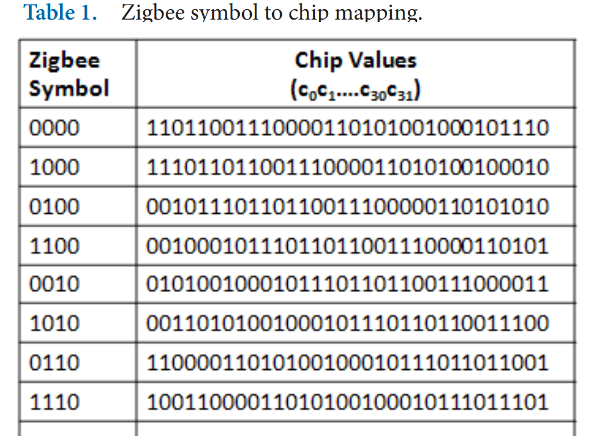
Direct Sequence Spread Spectrum (DSSS)
Increases the signal bandwidth of a transmission beyond information bandwidth
Send sequences of chips, which are a translation of one symbol to a pattern of many bits
Chips are transmitted much faster than symbols, essentially increasing the data rate
Enables better interference avoidance
Received bits are correlated against codes to see which is most likely
802.15.4 tolerates 13-15 bit flips (almost half!)
Notes:
n.b. 802.15.4 channels 5 MHz wide
BT Classic 1 MHz, BLE 2 MHz

Slide 25
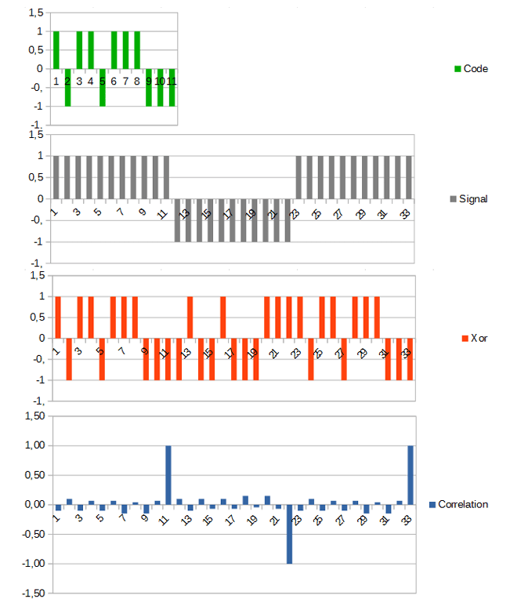
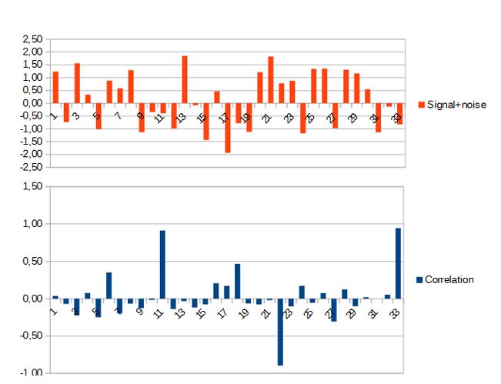
DSSS example
Data sent is 101
Code is longer than data, so we replicate bits
Data is recoverable, even with noise
https://circuitcellar.com/research-design-hub/dsss-in-a-nutshell/

Slide 26
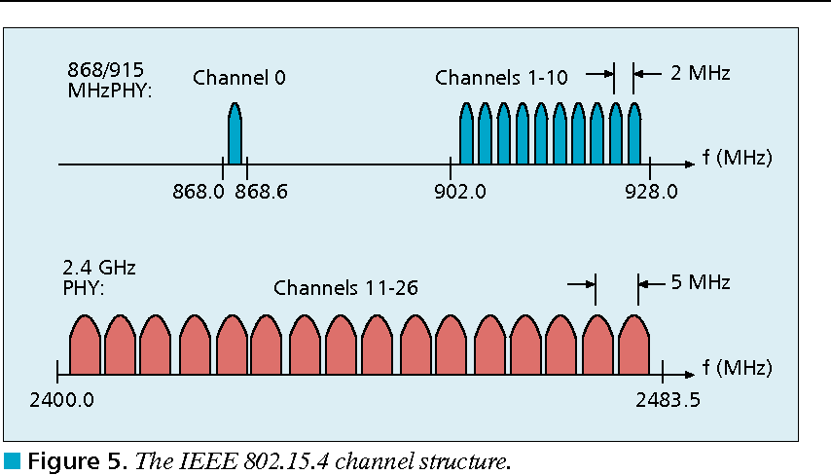
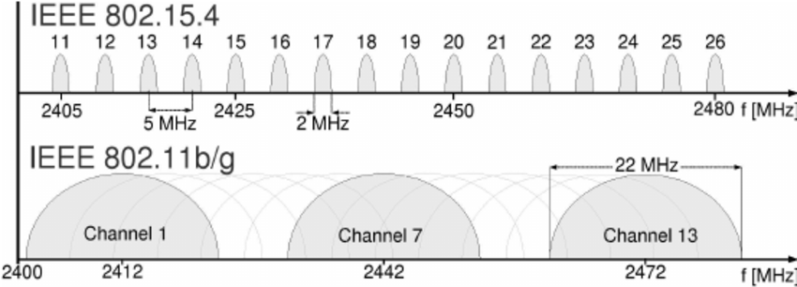
802.15.4 RF channels
27 channels across three bands
5 MHz channel separation at 2.4 GHz
Compare to 2 MHz for BLE

Slide 27
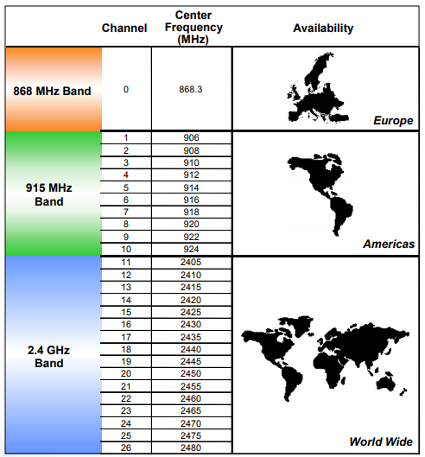
Regional bands
Different RF bands have different regional availability
Also have different rules
915 MHz: 400 ms dwell time
868 MHz: 1% duty cycle

Slide 28
Signal strength
Transmit power
Typical: 0 dBm (remember: 0 dBm equals 1 mW)
Receiver sensitivity
nRF52840 802.15.4: -100 dBm
Compare to BLE sensitivity of -95 dBm
Minimum acceptable (per spec): -85 dBm
Circa-2006 radios (CC2420): -95 dBm
Which has longer range, 802.15.4 or BLE? Why?

Slide 29
Signal strength
Transmit power
Typical: 0 dBm (remember: 0 dBm equals 1 mW)
Receiver sensitivity
nRF52840 802.15.4: -100 dBm
Compare to BLE sensitivity of -95 dBm
Minimum acceptable (per spec): -85 dBm
Circa-2006 radios (CC2420): -95 dBm
Which has longer range, 802.15.4 or BLE? Why?
802.15.4 with +5 dBm more margin;
lower bit rate plays into this, as does increased bandwidth

Slide 30
Outline
Overview
Physical Layer
Link Layer
Packet Structure

Slide 31
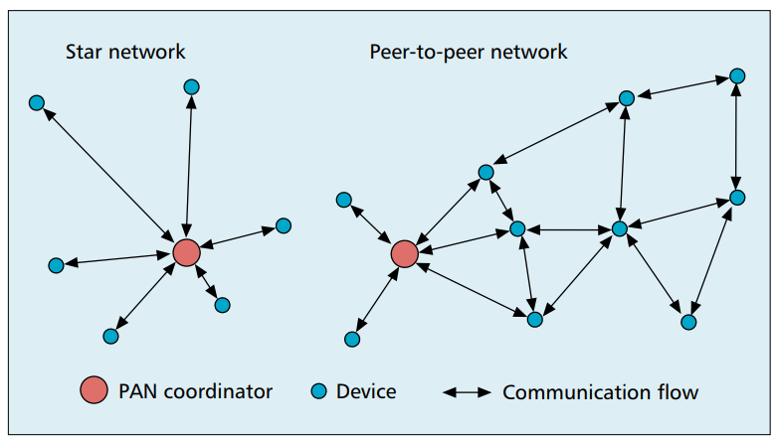
802.15.4 network topologies
Only specifies PHY and MAC, but has use cases in mind

Slide 32
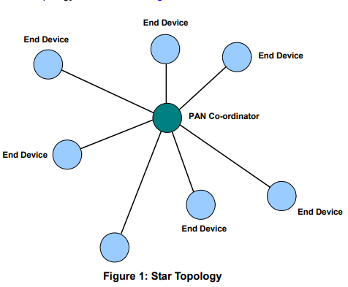
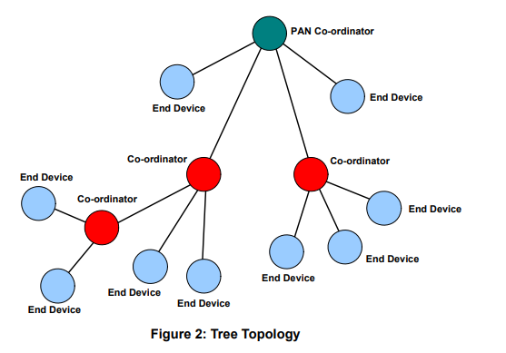
Star and Tree topologies
PAN Coordinator
Receives and relays all messages
Most capable and power-intensive
Coordinators (a.k.a. Routers)
Control “clusters”
Receives and relays to its children
Communicates up to parent coordinator
End Devices
Only communicate with single parent coordinator
Least capable and power intensive

Slide 33
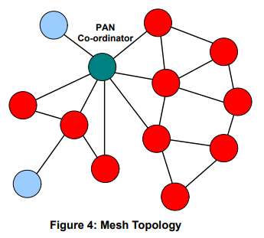
Break + Mesh networks
Most devices are capable of communicating with multiple neighbors
What are advantages of mesh?
What are disadvantages of mesh?

Slide 34
Break + Mesh networks
Most devices are capable of communicating with multiple neighbors
What are advantages of mesh?
Devices can communicate over longer distances
Device failures less likely to collapse the entire network
What are disadvantages of mesh?
Some nodes have to spend more energy communicating
Network protocol becomes more complicated to manage routing

Slide 35
Reminder: CSMA/CA – Carrier Sense Multiple Access with Collision Avoidance
First, wait a random amount (collision avoidance part)
Then, listen for a duration and determine if anyone is transmitting (carrier sense part)
If idle, you can transmit
If busy, repeat step 1 (often increasing maximum wait time)
Can be combined with notion of slotting
Synchronize to slots (smaller than transmit times)
Wait for a number of slots
Listen for idle slots

Slide 36
Modes of operation
Beacon-enabled PAN
Slotted CSMA/CA
Structured communication patterns
Optionally with some TDMA scheduled slots
Non-beacon-enabled PAN
Unslotted CSMA/CA
No particular structure for communication
Could be defined by other specifications, like Thread or Zigbee

Slide 37
Beacon-enabled superframe structure
Beacon
Beacon
…
Contention Access Period
Inactive Period
Beacons occur periodically [15 ms – 245 seconds]
Devices must listen to each beacon
Contention Access Period
Slotted CSMA/CA synchronized by beacon start time
Inactive Period
No communication occurring. Assumes sleepy devices

Slide 38
Guaranteed Time Slots (GTS)
Beacon
Beacon
…
Contention Access Period
Guaranteed Time Slots
Inactive Period
PAN Coordinator may create a Contention Free Period with Guaranteed Time Slots
TDMA schedule assigned to specific devices
Slots eat up part of the Contention Access Period
No CSMA/CA within a guaranteed time slot

Slide 39
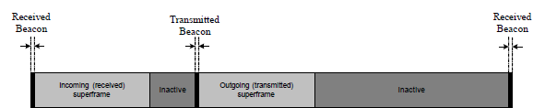
Handling tree-based topologies
All coordinators listen to beacon from PAN coordinator
And can participate in that contention period
Send their own beacons to child devices during inactive period
Children participate in that contention period

Slide 40
Non-beacon-enabled PAN
…
Contention Access Period
Same idea, just no beacons
Which removes synchronization benefit (and slotted CSMA/CA)
Also removes beacon listening cost
Devices only need to check for activity before transmitting
Still need an algorithm to determine when it should receive data
All the time is a huge energy drain
Algorithms can get complicated here

Slide 41
Non-beacon-enabled PAN
…
Contention Access Period
Same idea, just no beacons
Which removes synchronization benefit (and slotted CSMA/CA)
Also removes beacon listening cost
Devices only need to check for activity before transmitting
Still need an algorithm to determine when it should receive data
All the time is a huge energy drain
Algorithms can get complicated here
Could BLE mechanism of listen-after-send apply?

Slide 42
Non-beacon-enabled PAN
…
Contention Access Period
Same idea, just no beacons
Which removes synchronization benefit (and slotted CSMA/CA)
Also removes beacon listening cost
Devices only need to check for activity before transmitting
Still need an algorithm to determine when it should receive data
All the time is a huge energy drain
Algorithms can get complicated here
Could BLE mechanism of listen-after-send apply?
Only if sending to a high-power device, not among equals

Slide 43
Receiving messages
Listen during entire contention period
Can receive direct messages from any other device
Can immediately respond to messages as well
Request messages from Coordinator
Make all communication go through Coordinator
Send a request-for-data packet to coordinator to get information
Coordinator can include list of devices with pending data in beacon
More complicated listening algorithms are possible
See B-MAC, X-MAC, A-MAC, etc.

Slide 44
Clear Channel Assessment (CCA)
The “listen” part of CSMA/CA
Variety of implementations are acceptable
Energy above threshold
Energy for 8 symbol durations above threshold (RSSI)
Carrier sense
Valid 802.15.4 carrier signal
Energy AND/OR Carrier

Slide 45
Slotted CSMA/CA operation
Have data to send
Wait for next backoff slot (synchronized from beacon)
Wait for 0-7 backoff slots (slot is 20 symbol durations: 320 us)
Listen for two empty slots
Idle: Transmit
Occupied: wait 0-15 backoff slots and repeat
Next time: 0-31 backoff slots and repeat
Next time: 0-31 backoff slots and repeat (upper limit configurable)
Next time: 0-31 backoff slots and repeat
Next time: 0-31 backoff slots and repeat
Timeout

Slide 46
Unslotted CSMA/CA operation
Have data to send
Wait for next backoff slot (synchronized from beacon)
Wait for 0-7 backoff slots (slot is 20 symbol durations: 320 us)
Listen for two empty slots
Idle: Transmit
Occupied: wait 0-15 backoff slots and repeat
Next time: 0-31 backoff slots and repeat
Next time: 0-31 backoff slots and repeat (upper limit configurable)
Next time: 0-31 backoff slots and repeat
Next time: 0-31 backoff slots and repeat
Timeout

Slide 47
Break + Question
What are benefits/costs of using or not using beacons?
Beacons
No beacons

Slide 48
Break + Question
What are benefits/costs of using or not using beacons?
Beacons
Enable energy savings by designating period with radios off
Enable structured communication like Guaranteed Slots
Require some central coordinator within range of all devices
Tradeoff in inactive period:
communication latency vs beacon-listening costs
No beacons
Enable all devices to be identical (no coordinator needed)
Require custom communication scheme
Could be better or worse for various qualities… (always-on radios?)

Slide 49
Outline
Overview
Physical Layer
Link Layer
Packet Structure

Slide 50
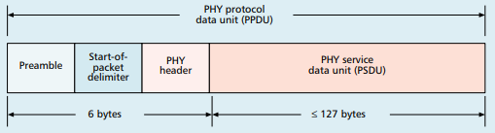
Base packet format
Synchronization
Preamble: four bytes of zeros
Start-of-Packet: 0xA7
PHY Header
One field: length 0-127
Why still 8 bits?

Slide 51
Base packet format
Synchronization
Preamble: four bytes of zeros
Start-of-Packet: 0xA7
PHY Header
One field: length 0-127
Why still 8 bits? Because computers depend on bytes

Slide 52
MAC frame format
Frame control
Header
Sequence number
8-bit monotonically increasing
Addressing fields
PAN and addresses
Varies based on frame type
Frame payload
Depends on frame type
Frame check sequence
16-bit CRC

Slide 53
Frame control
Frame type
Type of payload included
Beacon, Data, Control, Ack
Security enabled
Packet is encrypted
(extra 0-14 byte header)
Frame pending
Fragmented packet
Acknowledgement required
PAN ID compression
No PAN ID if intra-network
Addressing modes
Which fields to expect
Why no length field?

Slide 54
Frame control
Frame type
Type of payload included
Beacon, Data, Control, Ack
Security enabled
Packet is encrypted
(extra 0-14 byte header)
Frame pending
Fragmented packet
Acknowledgement required
PAN ID compression
No PAN ID if intra-network
Addressing modes
Which fields to expect
Why no length field?
Already in prior header

Slide 55
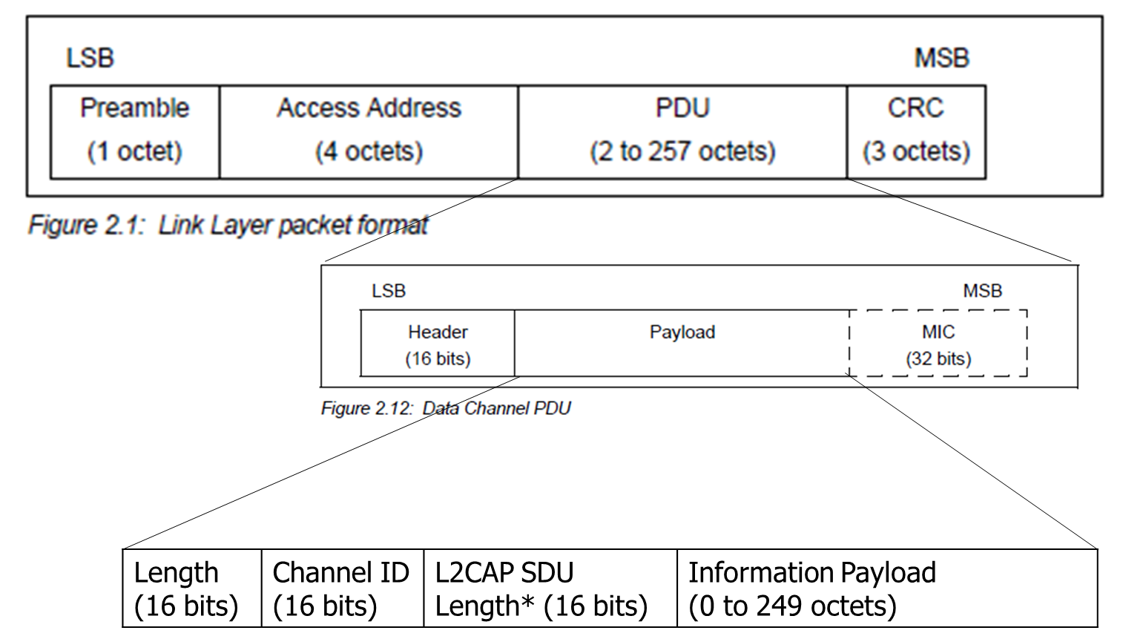
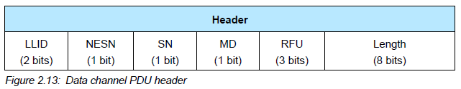
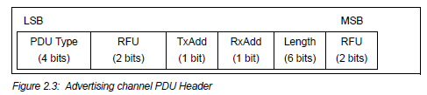
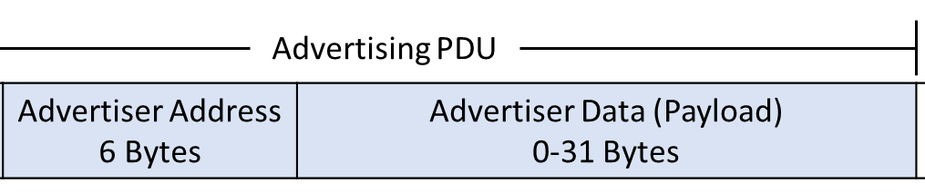
BLE and 15.4 Packet Comparison
Some observations
Both have frame types
LLID/PDU for BLE
15.4 has sequence numbers and more addressing information
Connection Data Packet
OR

Slide 56
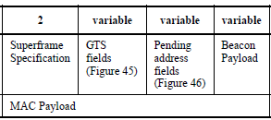
Frame types - Beacon
Beacon
Information about the communication structure of this network
Sent in response to requests from scanning devices
Sent periodically at start of Superframes (if in use)
Sent without CSMA/CA
MAC Header configuration
Source address only, broadcast to everyone
Packet contents
Superframe details, including Guaranteed Time Slots (if any)
Pending addresses lists devices for which Coordinator has data

Slide 57
Frame types - Data
Data
Data from higher-layer protocols
MAC Header configuration
Source and/or Destination addresses as necessary
Packet Contents
Whatever bytes are desired (122 bytes minus address sizes)
May be fragmented across packets for longer data

Slide 58
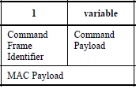
Frame types – MAC Command (i.e., control)
MAC Command
Various commands for supporting link layer
Join/leave network
Change coordinator within network
Request data from coordinator
Request Guaranteed Time Slot
MAC Header configuration
Source and/or Destination addresses as necessary

Slide 59
Frame types - Acknowledgement
Acknowledgement
Acknowledges a Data or MAC Command packet
Not beacons or other acknowledgements
With acknowledgement, packet will automatically be transmitted again
MAC Header
Repeats Sequence Number of acknowledged packet
No Source or Destination addresses
Sent T_{IFS} after the packet it is acknowledging (immediately)

Slide 60
Analysis: maximum goodput
Assume best possible case for data transmission
133 total Bytes per packet (122 payload bytes + 11 bytes of headers)
At 250 kbps -> 4.256 ms
Plus Inter-frame spacing of 40 symbols
At 62.5 kBaud -> 0.640 ms
122 Bytes / 4.896 ms -> 199 kbps
Compare to BLE advertisements: 9.92 kbps
Compare to BLE connections: 520 kbps

Slide 61
Outline
Overview
Physical Layer
Link Layer
Packet Structure

