Slide 1
Lecture 07 Thread
CS433 – Wireless Protocols for IoT
Branden Ghena – Spring 2025
Materials in collaboration with Pat Pannuto (UCSD) and Brad Campbell (UVA)
With some advice from Neal Jackson (UC Berkeley)

Slide 2
Administrivia
Hw: BLE Packets due Friday
Do it. It’s good for you. Much like eating spinach.
Lab: BLE due next week Thursday
Lab tomorrow to continue work on it
Hope is to spend most of the time just working on BLE applications

Slide 3
Today’s Goals
Explore 802.15.4 packet structure
Describe goals and capabilities of Thread networks
Understand addressing in Thread networks
Describe runtime behaviors like network joining

Slide 4
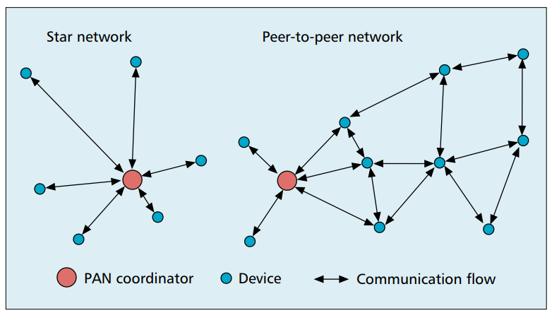
802.15.4 network topologies
Only specifies PHY and MAC, but has use cases in mind

Slide 5
Modes of operation
Beacon-enabled PAN
Slotted CSMA/CA
Structured communication patterns
Optionally with some TDMA scheduled slots
Non-beacon-enabled PAN
Unslotted CSMA/CA
No particular structure for communication
Could be defined by other specifications, like Thread or Zigbee

Slide 6
Non-beacon-enabled PAN
…
Contention Access Period
Same idea, just no beacons
Which removes synchronization benefit (and slotted CSMA/CA)
Also removes beacon listening cost
Devices only need to check for activity before transmitting
Still need an algorithm to determine when it should receive data
All the time is a huge energy drain
Algorithms can get complicated here
Could BLE mechanism of listen-after-send apply?
Only if sending to a high-power device, not among equals

Slide 7
802.15.4 specification versions
2011
Four PHY options (UWB)
MAC capability to support ranging (distance measurements)
2015
Six PHY options (RFID, Smart Utility, TV White Space)
Time Slotted Channel Hopping (TSCH) access control (TDMA+FDMA)
2020
Several new PHY options (China medical band, alternate modulations)

Slide 8
Outline
Overview
Physical Layer
Link Layer
Packet Structure

Slide 9
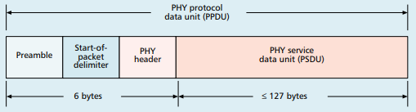
Base packet format
Synchronization
Preamble: four bytes of zeros
Start-of-Packet: 0xA7
PHY Header
One field: length 0-127
Still 8 bits because computers work in units of bytes

Slide 10
MAC frame format
Frame control
Header
Sequence number
8-bit monotonically increasing
Addressing fields
PAN and addresses
Varies based on frame type
Frame payload
Depends on frame type
Frame check sequence
16-bit CRC

Slide 11
Frame control
Frame type
Type of payload included
Beacon, Data, Control, Ack
Security enabled
Packet is encrypted
(extra 0-14 byte header)
Frame pending
Fragmented packet
Acknowledgement required
PAN ID compression
No PAN ID if intra-network
Addressing modes
Which fields to expect

Slide 12
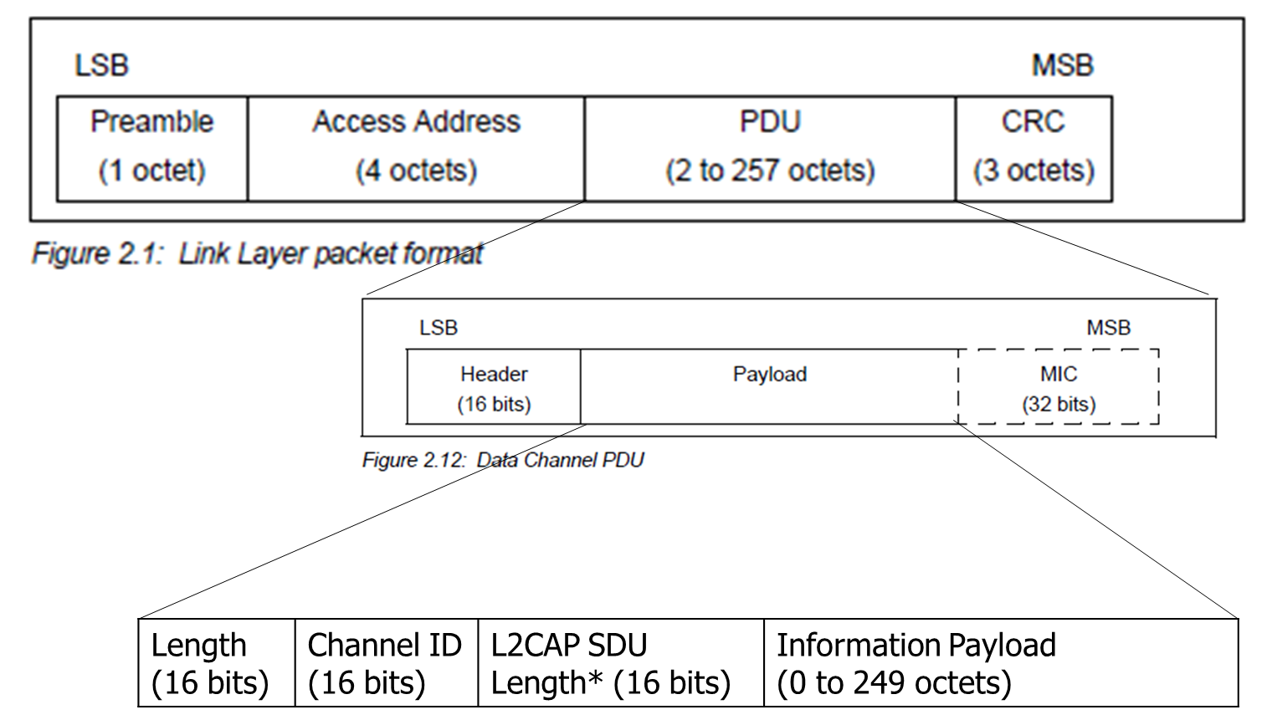
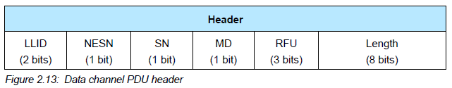
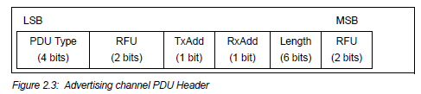
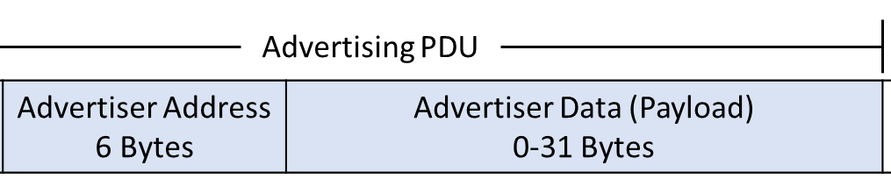
BLE and 15.4 Packet Comparison
Some observations
Both have frame types
LLID/PDU type for BLE
15.4 has
Sequence numbers
Requested acknowledgements
More addressing information
Connection Data Packet
OR

Slide 13
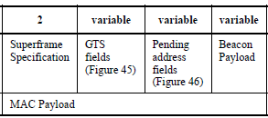
Frame types - Beacon
Beacon
Information about the communication structure of this network
Sent in response to requests from scanning devices
Sent periodically at start of Superframes (if in use)
Sent without CSMA/CA
MAC Header configuration
Source address only, broadcast to everyone
Packet contents
Superframe details, including Guaranteed Time Slots (if any)
Pending addresses lists devices for which Coordinator has data

Slide 14
Frame types - Data
Data
Data from higher-layer protocols
MAC Header configuration
Source and/or Destination addresses as necessary
Packet Contents
Whatever bytes are desired (122 bytes minus address sizes)
May be fragmented across packets for longer data

Slide 15
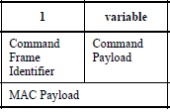
Frame types – MAC Command (i.e., control)
MAC Command
Various commands for supporting link layer
Join/leave network
Change coordinator within network
Request data from coordinator
Request Guaranteed Time Slot
MAC Header configuration
Source and/or Destination addresses as necessary

Slide 16
Frame types - Acknowledgement
Acknowledgement
Acknowledges a Data or MAC Command packet
Not beacons or other acknowledgements
With acknowledgement, packet will automatically be transmitted again
MAC Header
Repeats Sequence Number of acknowledged packet
No Source or Destination addresses
Sent T_{IFS} after the packet it is acknowledging (immediately)

Slide 17
Analysis: maximum goodput
Assume best possible case for data transmission
133 total Bytes per packet (122 payload bytes + 11 bytes of headers)
At 250 kbps -> 4.256 ms
Plus Inter-frame spacing of 40 symbols
At 62.5 kBaud -> 0.640 ms
122 Bytes / 4.896 ms -> 199 kbps
Compare to BLE advertisements: 9.92 kbps
Compare to BLE connections: 520 kbps

Slide 18
Outline
Thread Overview
Thread Addressing
Runtime Behavior
Using IP

Slide 19
Major 802.15.4 uses
Zigbee & Thread
Both build upon the 15.4 PHY and Link primitives
Using most but discarding some
Both consider higher-level application considerations
Building a network
Communicating between devices
Application logic

Slide 20
What’s the need for Thread?
Born from Google’s Nest team
Requirements:
IP-based: interoperate with rest of the Internet
Scalable: hundreds of devices in a network
Low power: years of operation on batteries
Secure: authenticated and encrypted communication
Reliability – mesh networking without single point of failure
2014: Thread Group alliance formed
Goal: develop, maintain and drive adoption of Thread as an industry networking standard for IoT
Source: openthread.io, threadgroup.org

Slide 21
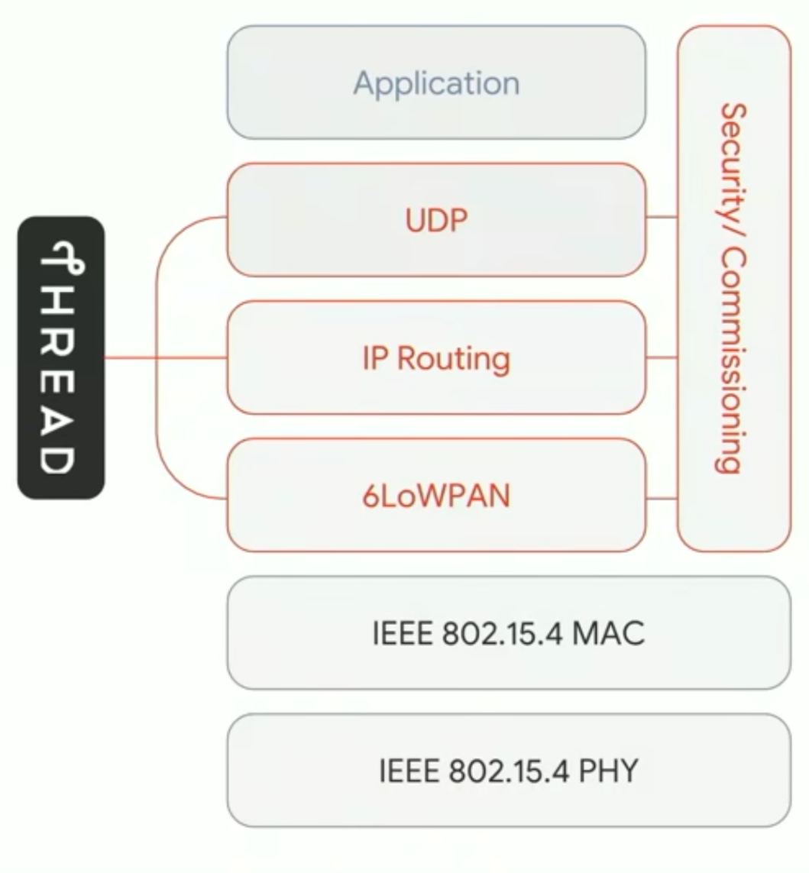
Thread overview
Build a networking layer on top of 15.4
Reuses most of PHY and MAC
Adds IP communication
Handles addressing and mesh maintenance
Industry-focused, but based in academic research

Slide 22
References on Thread
Request for specification: https://www.threadgroup.org/ThreadSpec
Frustratingly locked down 😡
Overview on capabilities: https://openthread.io/guides/thread-primer
Excellent overview
Lifting heavily for these slides
Good overview on Thread Networking:
https://www.threadgroup.org/support#Whitepapers
See the “Thread Network Fundamentals” whitepaper

Slide 23
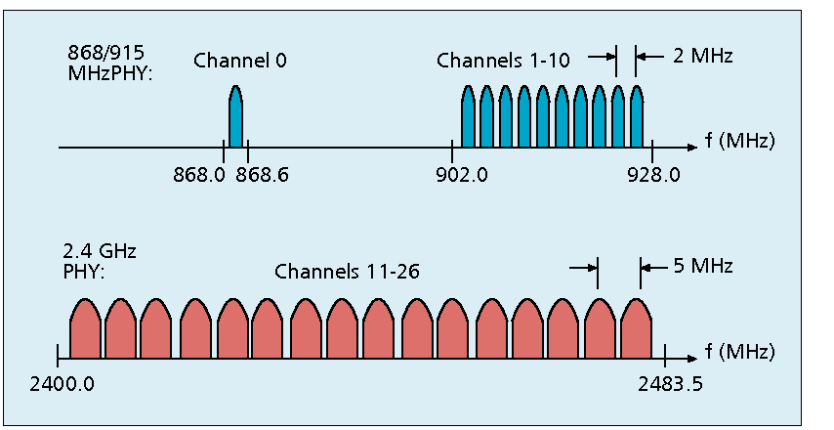
Changes to Physical Layer
Remove all non-2.4 GHz PHY options
Otherwise the same
O-QPSK
16 channels, 5 MHz spacing
Typical TX power 0 dBm
Typical RX sensitivity -100 dBm

Slide 24
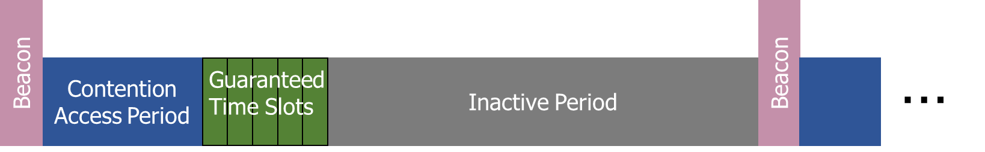
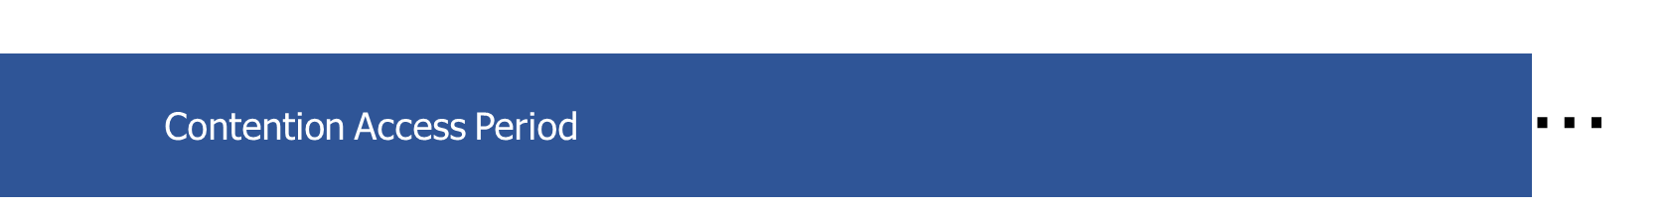
Changes to Link Layer and MAC
Non-beacon-enabled PAN only
No superframe structure
No periodic beacons
No Guaranteed Time Slots
Throw out most existing MAC Commands
Network joining will be handled at a higher layer
Remove network joining/leaving
Remove changing coordinators
Remove Guaranteed Time Slot request

Slide 25
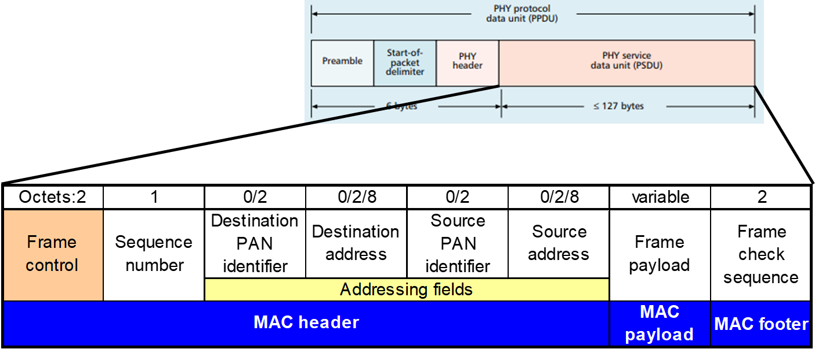
Changes to Link Layer and MAC
Keep unslotted CSMA/CA algorithm
Keep packet structure
Keep Frame Types
Beacon
MAC Command
Beacon Request
Data Request
Data
Acknowledgement

Slide 26
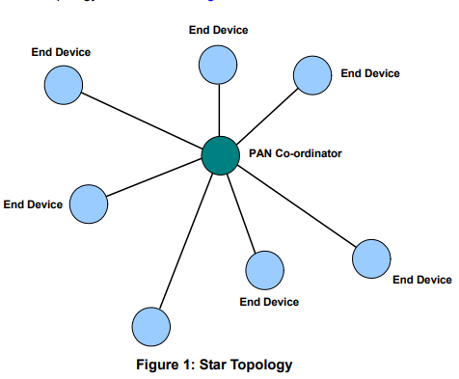
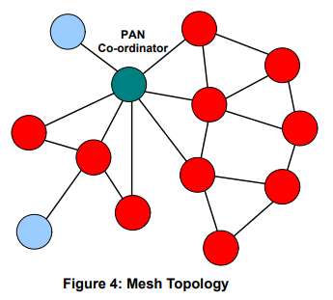
Thread networks use a mix of star and mesh topologies
Central PAN coordinator in charge of network
Single point of failure
End Devices can be less complicated
PAN Coordinator still in charge
But mid-level Routers add route redundancy
And End Devices didn’t have to change at all
Notes:
What are some issues with these topologies?
Central point of failure
Some nodes have to spend more energy communicating

Slide 27
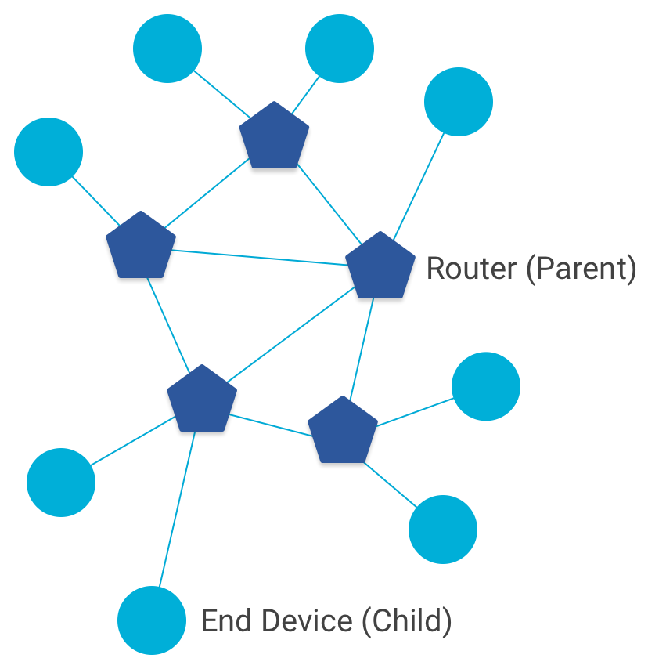
Combination of star and mesh topology
Routers (parent)
Mesh communication with other routers
Radio always on
Forwards packets for network devices
Enables other devices to join network
Up to 32 routers per network
End devices (child)
Communicates with one parent (router)
Does not forward packets
Can disable transceiver to save power
Send packets periodically to avoid timeout
Up to 511 end devices per router (~16k total)

Slide 28
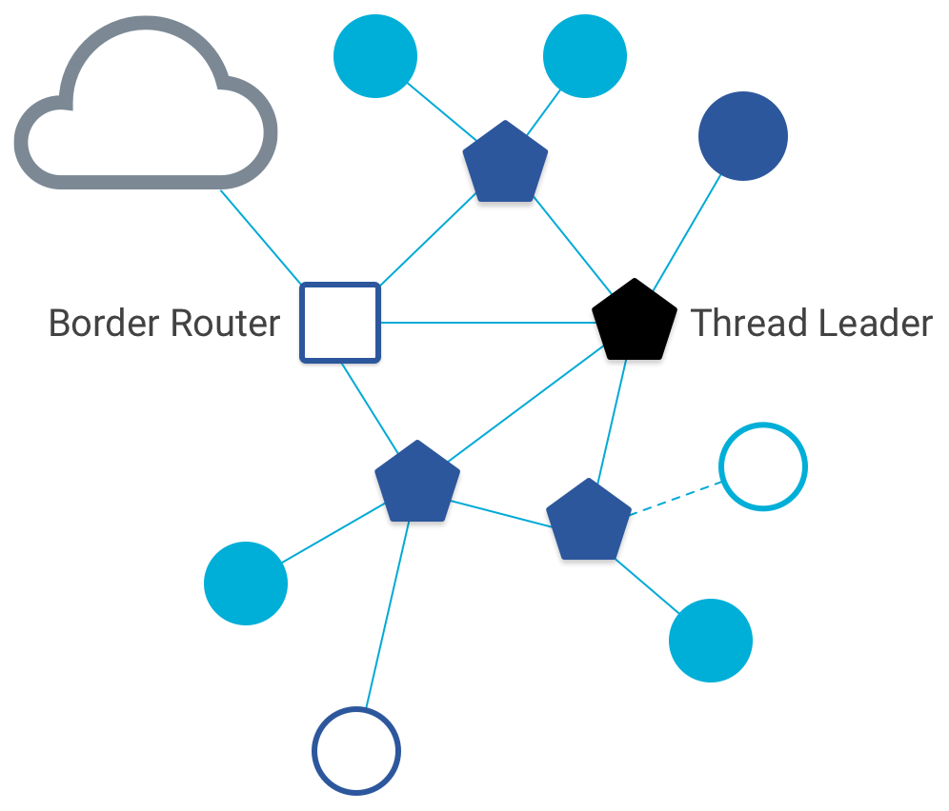
Other special roles
Thread leader
Device in charge of making decisions
Addresses, Joining details
Automatically selected from routers
One leader at any given time
Additional leader is selected if the network partitions
Border router
Router that also has connectivity to another network
Commonly WiFi or Ethernet
Provides external connectivity
Multiple border routers may exist at once

Slide 29
Why use Thread instead of basic 802.15.4?
Full specification of upper layers
Clarifies how data is transmitted between devices on a network
Not just one single hop away
Cleans up a lot of things otherwise left implementation-dependent
Interaction with the world outside of the sensor network!
Gateway can be a dumb forwarder of packets
Devices can directly talk to NTP servers or POST data to a website!

Slide 30
Break + Question
What kinds of IoT devices are likely to have each thread role?
End Device
Router
Border Router

Slide 31
Break + Question
What kinds of IoT devices are likely to have each thread role?
End Device
Battery-powered sensor
Nest Temperature Sensor
Router
Wall-powered device
Nest Thermostat
Border Router
Must have Internet connectivity
Custom gateway of some type?

Slide 32
Outline
Thread Overview
Thread Addressing
Runtime Behavior
Using IP

Slide 33
Thread uses IPv6 for communication
Why IP?
If Wireless Sensor Networks represent a future of billions of connected devices distributed throughout the physical world
Shouldn’t they run standard protocols wherever possible?
Why IPv6?
Clean redesign of IPv4 makes it easier to use to support sensor networks
Address structure makes device addresses more compressible
Benefits
Interoperability with normal computers and networks
Reuse state of the art developed standards instead of remaking them
Security, Naming, Discovery, Services
Costs
Packet overhead can be high (will fix)
Complexity for supporting protocols
Hui and Culler, “IP is Dead, Long Live IP for Wireless Sensor Networks”. 2008

Slide 34
Background: IPv6
Replacement to Internet Protocol v4
(Something unrelated used version number 5)
Extended addressing for devices
32-bits for IPv4 addresses -> 128-bits for IPv6 addresses
340 trillion, trillion, trillion addresses
(> 100 times number of atoms on the surface of the Earth)
Example: a39b:239e:ffff:29a2:0021:20f1:aaa2:2112
Supports multiple transmit models
Broadcast: one-to-all
Multicast: one-to-many
Unicast: one-to-one
Various other improvements

Slide 35
Background: IPv6 address notation rules
Groups of zeros can be replaced with “::”
Can only use “::” in one place in the address
Leading zeros in a 16-bit group can be omitted
0000:0000:0000:0000:0000:0000:0000:0001 → ::1
2345:1001:0023:1003:0000:0000:0000:0000 → 2345:1001:23:1003::
aecb:0222:0000:0000:0000:0000:0000:0010 → aecb:222::10
Special addresses
Localhost - ::1 (IPv4 version is 127.0.0.1)
Link-Local Network - fe80:: (bottom 64-bits are ~device MAC address)
Local Network – fc00:: and fd00::
Global Addresses – 2000:: (various methods for allocating bottom bits)

Slide 36
Background: IPv6 datagram format
Header starts with various data for the router
Priority: like “type of service” in IPv4.
Flow label: marks packets that are part of a transaction for routers
Next header: TCP, UDP, ICMP, etc.
Hop limit: hops to live
version
priority
flow label
payload length
next header
hop limit
source address
(128 bits)
destination address
(128 bits)
data
(variable length, typically a TCP or UDP segment)
32 bits

Slide 37
Fitting an IPv6 datagram in an 802.15.4 frame
version
priority
flow label
payload length
next header
hop limit
source address
(128 bits)
destination address
(128 bits)
data
(variable length, typically a TCP or UDP segment)
32 bits
How many bytes for the IPv6 header?
How much for the MAC header + footer?
How much room do we get for payload?

Slide 38
Fitting an IPv6 datagram in an 802.15.4 frame
version
priority
flow label
payload length
next header
hop limit
source address
(128 bits)
destination address
(128 bits)
data
(variable length, typically a TCP or UDP segment)
32 bits
How many bytes for the IPv6 header?
How much for the MAC header + footer?
How much room do we get for payload?
- 8+16+16 = 40 bytes
- 5 to 25 bytes depending on options
- 127-40-N = 82 to 62 bytes

Slide 39
IPv6 tricky to use directly with 802.15.4
Header overhead very high
around half of bytes in PSDU, even more when security enabled
IP packets may be large, compared to 802.15.4 max frame size
IPv6 requires all links support 1280 byte packets [RFC 2460]
Need some way to compress and fragment!

Slide 40
6LoWPAN
Method for running IPv6 over 802.15.4 links
IPv6 over Low-Power Wireless Personal Area Networks
IETF Standard (RFC4944 + updates in RFC6282)
Directly out of the research world (Jonathan Hui + David Culler)
Research Paper: IP is Dead, Long Live IP for Wireless Sensor Networks
Thesis of work: sensor networks can and should use IPv6
Important goals
Compress IPv6 headers
Handle fragmentation of packets
Enable sending packets through mesh

Slide 41
6LoWPAN header compression
40 bytes of IPv6 header are a lot for a 127-byte payload
Most important goals
Communication with devices inside the 15.4 network should be low-overhead
Communication outside of the 15.4 network must be possible
Still minimize overhead where possible, but might be larger
Assume a bunch of common parameters to save space
A bunch of options are set to default values
Payload length can be re-determined from packet length
Source/Destination addresses can often be reassembled from link layer data
Plus information about network address assignment known by routers
Border router “inflates” the packet before sending externally

Slide 42
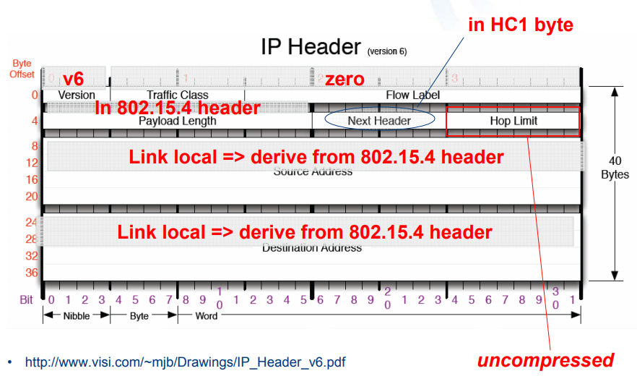
Example of compression
Example of HC1 header compression
Note: Thread actually uses IPHC from rfc6282 (not HC1), but similar idea
Good overview: https://www.youtube.com/watch?v=wRdrCsgJekM

Slide 43
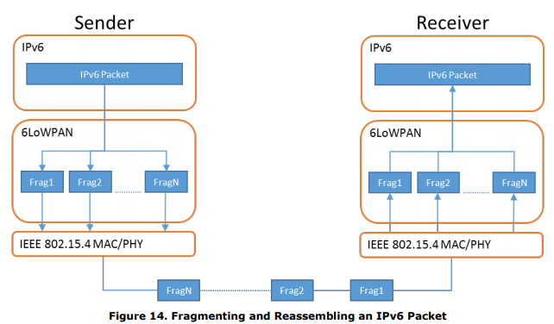
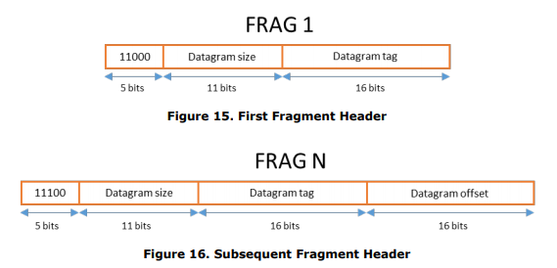
6LoWPAN fragmentation
Only the first packet of the fragments will hold the IPv6 header
Tag, offset, and size are used to reconstruct

Slide 44

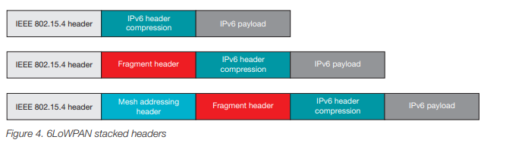
6LoWPAN mesh forwarding
Additional header with originator and final addresses
Which of these headers are used depends on the packet

Slide 45
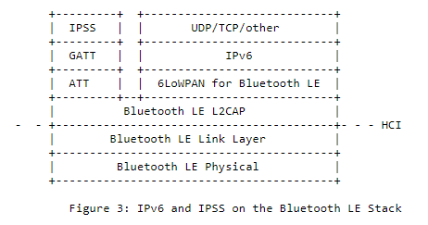
Sidebar: IPv6 over BLE
RFC7668 defines 6LoWPAN techniques for BLE connections

Slide 46
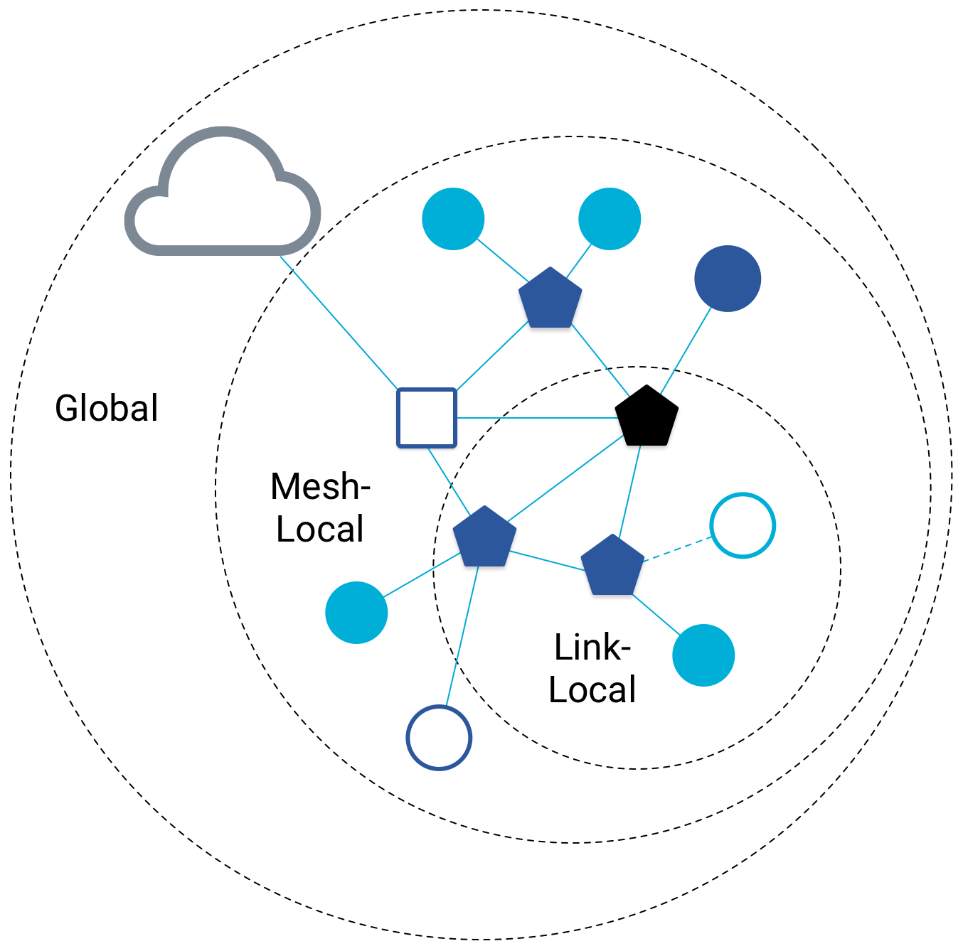
Benefit to IPv6: multiple address spaces per Thread device
Each device gets an IPv6 address for each way to contact it
Global IP address
Mesh-local IP address
Link-local IP address
Topology-based IP address
Send to parent
Send to child
Role-based IP address(es)
Send to all Routers
Send to Border Router

Slide 47
Traditional addresses in Thread
Link-Local Addresses
FE80::/16
Bottommost 64-bits are EUI-64 (MAC address with 0xFFFE in the middle)
Permanent for a given device (no matter the network)
Used for low-layer interactions with neighbors (discovery, routing info)
Mesh-Local Addresses
FD00::/8 (FD00:: and FC00:: are for local networks in IPv6)
Remaining bits are randomly chosen as part of joining the network
Permanent while connection is maintained to a network
Used for application-layer interactions
Global Addresses
2000::/3 (2000:: are for global, unicast IP addresses in IPv6)
Public address for communicating with broader internet through Border Router
Various methods for allocation (SLAAC, DHCP, Manual)

Slide 48
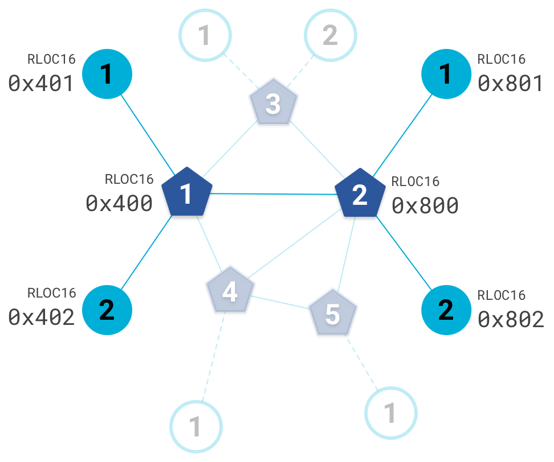
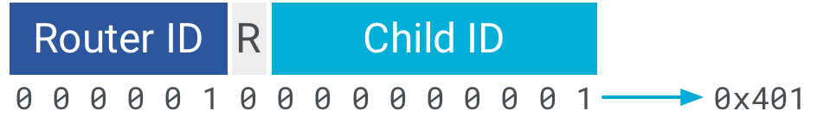
Topology-based addresses in Thread
FD00::00FF:FE00:RLOC16
Same top bits as mesh-local
Routing Locator (RLOC)
Router ID concatenated with Child ID
Changes with network topology
Used for routing packets

Slide 49
Role-based addresses in Thread
Multicast (to all devices with role)
FF02::1 – link-local, all listening devices
FF02::2 – link-local, all routers/router-eligible
FF03::1 – mesh-local, all listening devices
FF03::2 – mesh-local, all routers/router-eligible
Anycast (to any device with role)
FD00::00FF:FE00:FCxx
00 – Thread Leader
01-0F – DHCPv6 Agent
30-37 – Commissioner
etc.

Slide 50
Break + Question
Which type of address(es) could you use for communication?
Global
Mesh-local
Link-local
Topology
Role-based
Communicate with each circled target
4
3
Your Node
1
2

Slide 51
Break + Question
Options
Global
Mesh-local
Link-local
Topology
Role-based
Green node
Mesh-local
Topology (parent)
Link-local
Blue node
Mesh-local
Topology (other child of parent)
Maybe link-local
Orange node
Mesh-local
Role-based
Purple “cloud”
Global
4
3
Your Node
1
2

Slide 52
Outline
Thread Overview
Thread Addressing
Runtime Behavior
Using IP

Slide 53
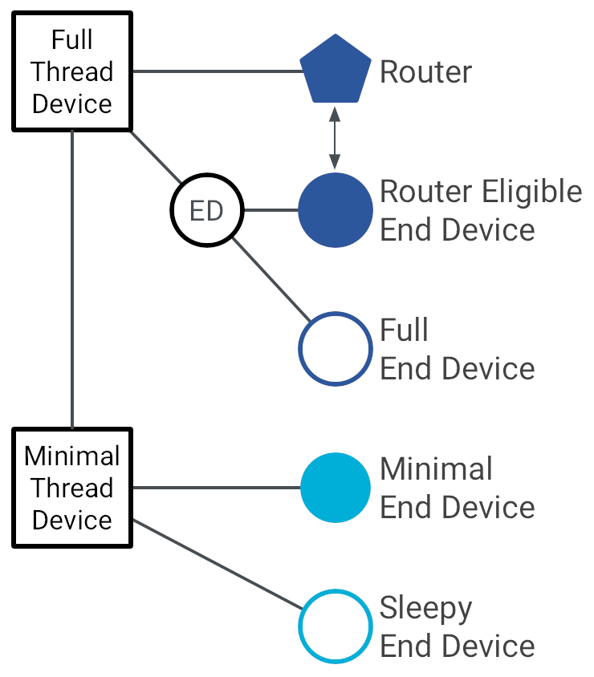
Thread device types
Full Thread Devices
MAC: Always-on
Participate in routing
Examples:
Routers
Thread Leader
Border Router
Router-Eligible End Device (REED)

Slide 54
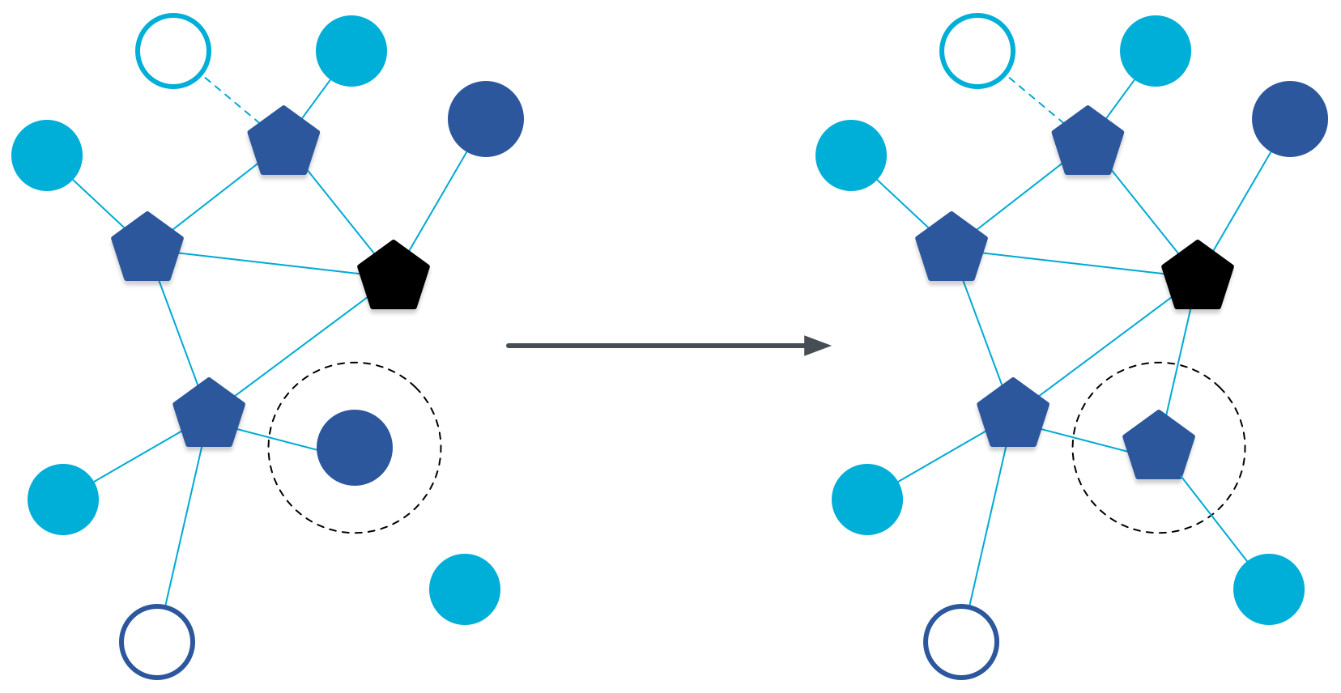
Router promotion
Router Eligible End Device (REED)
A router without any children
Can operate as an end device with one connection (lower power)
Promotes to a router when a joining end device relies on it
If there is room for an additional router (max 32, typical 16-23)

Slide 55
Thread device types
Full Thread Devices
MAC: Always-on
Participate in routing
Examples:
Routers
Thread Leader
Border Router
Router-Eligible End Device (REED)
Minimal Thread Devices
MAC: Can be low power
Only send/receive to/from parent
Examples:
Minimal End Device (MED)
Sleepy End Device (SED)
Synchronized Sleepy End Device (SSED)

Slide 56
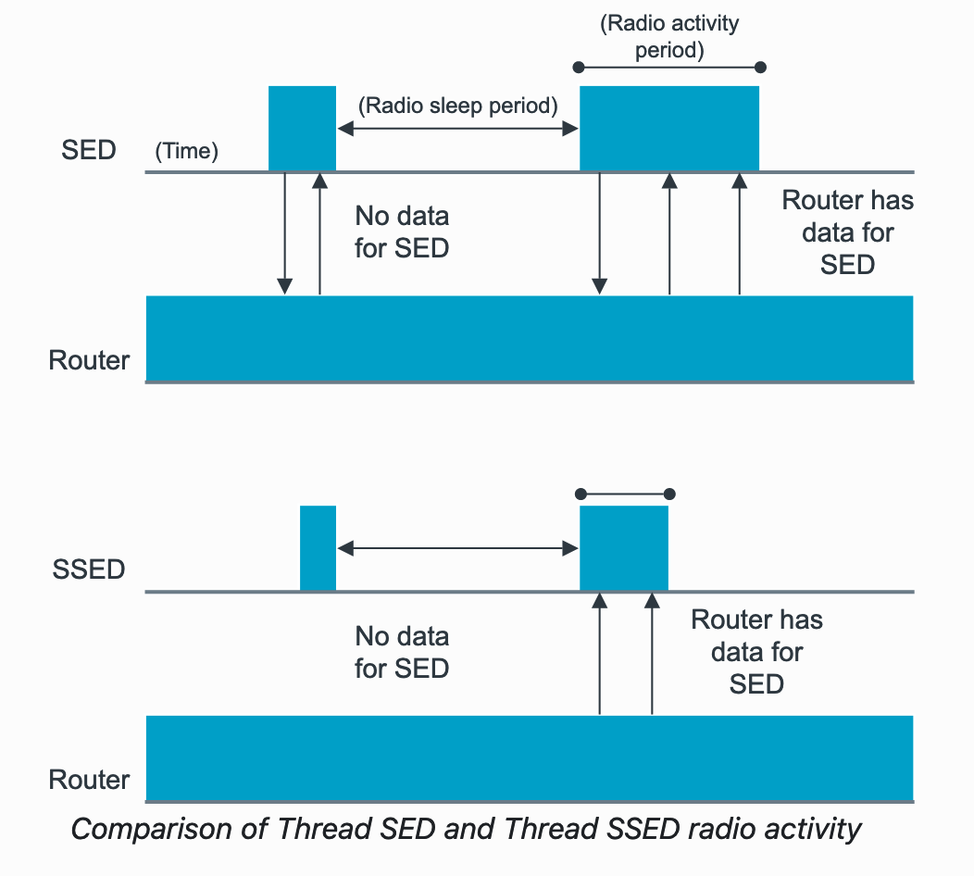
Sleepy End Devices
These are the low power devices
Periodically must exchange messages with Router
Sleepy End Device (SED)
MAC:
TX: Router always-on, so send as needed (ALOHA)
RX: Periodically check in with router if new data pending
Synchronized Sleep End Device (SSED)
MAC:
TX: ALOHA
RX: Listen during pre-configured windows
https://developer.nordicsemi.com/nRF_Connect_SDK/doc/latest/nrf/protocols/thread/sed_ssed.html

Slide 57
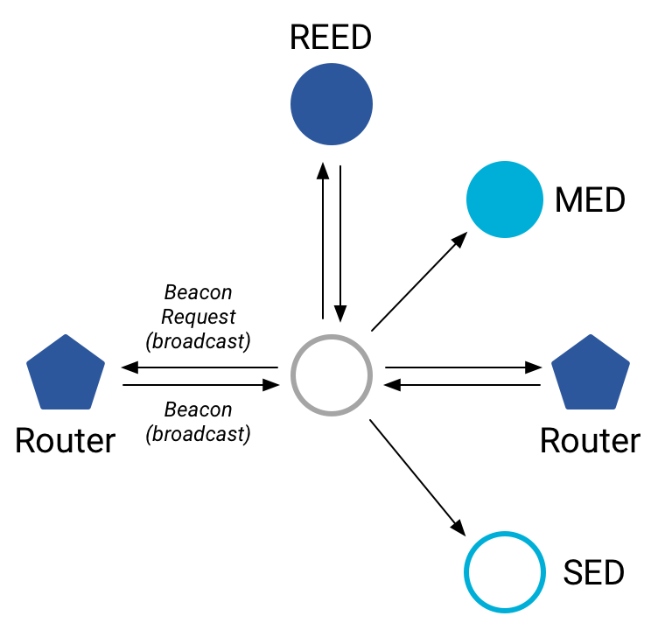
Discovering Thread networks
“Beacon Request” MAC command
Routers/Router-eligible devices respond
Payload contains information about network
Thread network specification
PAN ID – 16-bit ID
XPAN ID – extended 64-bit ID
Network Name – human-readable
Active scanning across channels can quickly find all existing nearby networks

Slide 58
Creating a new network
Select a channel (possibly by scanning for availability)
Become a router
Elect yourself as Thread Leader
Respond to Beacon Requests from other devices
Further organization occurs through Mesh-Level Establishment protocol

Slide 59
Mesh-Level Establishment (MLE)
Creating and configuring mesh links
Payloads placed in UDP packets within IPv6 payloads
Commands for mesh
Establish link
Advertise link quality
Connect to parent
TLVs (Type-Length-Value)
Various data types that may be helpful within those packets
Addresses, Link Quality, Routing Data, Timestamps
0 | Command Type | TLV | … | TLV
OR (secure version)
255 | Aux Header | Command Type | TLV | … | TLV | MIC

Slide 60
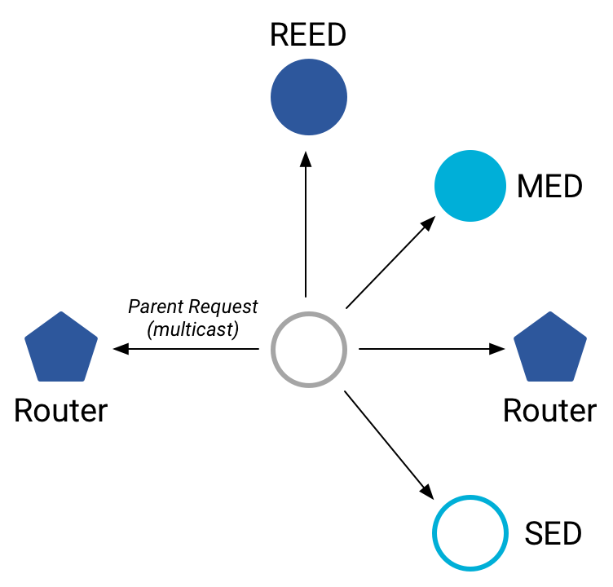
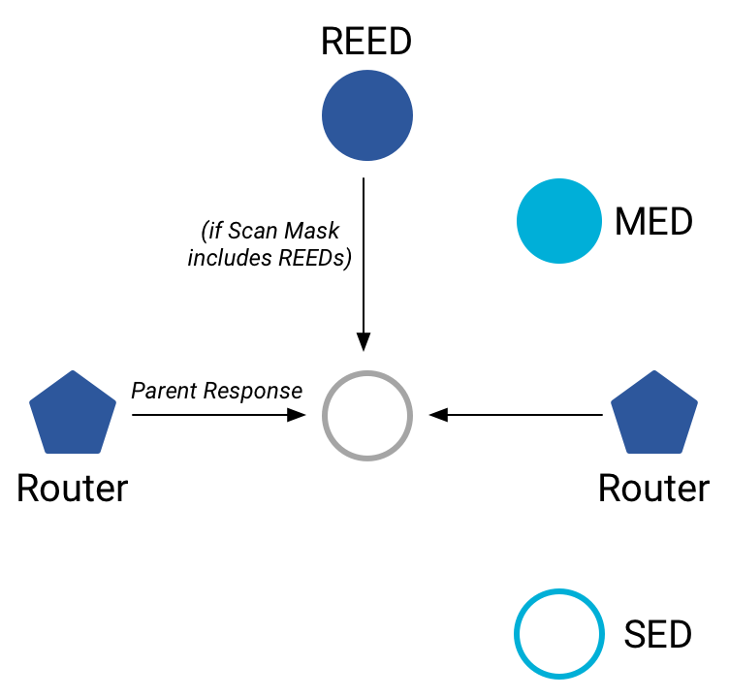
Joining an existing network
All devices join as a child of some existing router
Send a Parent Request (to all routers/router-eligible)
Using the multicast, link-local address
Receive a Parent Response (from all routers/router-eligible separately)
Contains information on link quality
Send a Child ID Request (to router with best link)
Contains parameters about the new child device
Receive a Child ID Response (from that router)
Contains address configurations

Slide 61
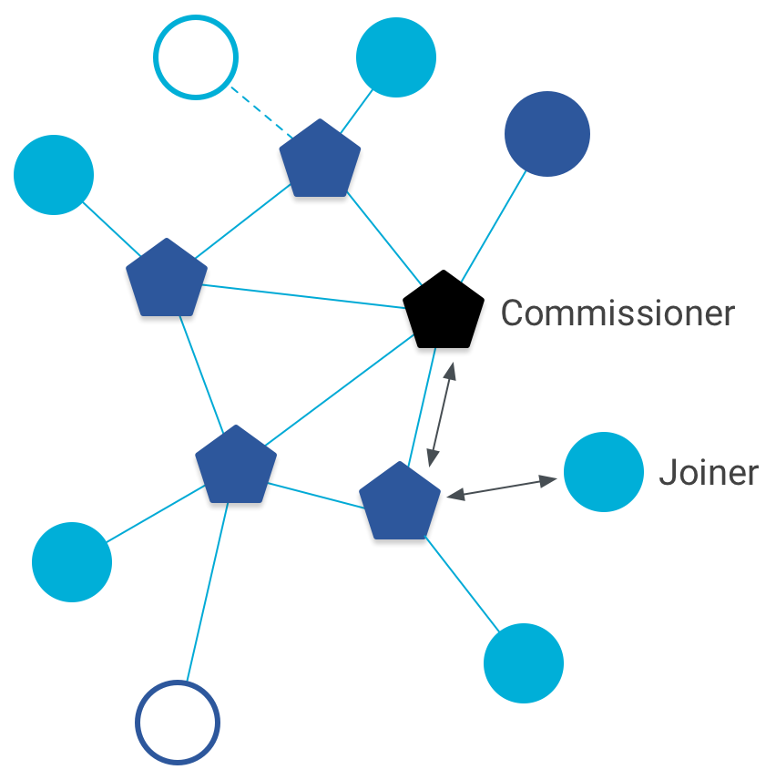
Thread Commissioning
As part of joining a network, a thread device is also “commissioned”
Bonus step in the joining process for real-world networks
Authenticates the joining device allowing it to join and encrypt communications
https://www.threadgroup.org/Portals/0/documents/support/CommissioningWhitePaper_658_2.pdf

Slide 62
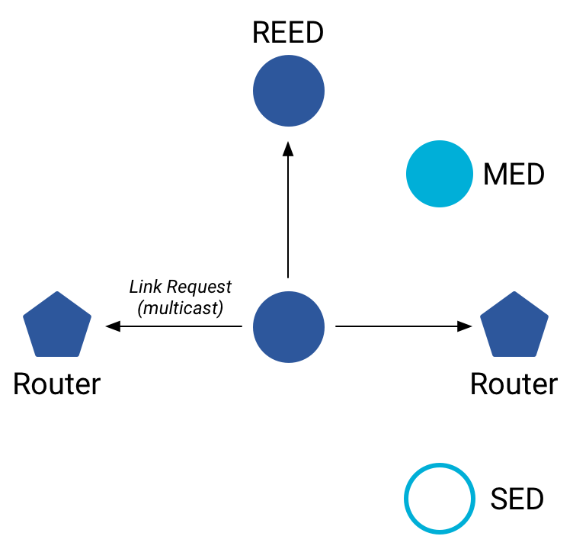
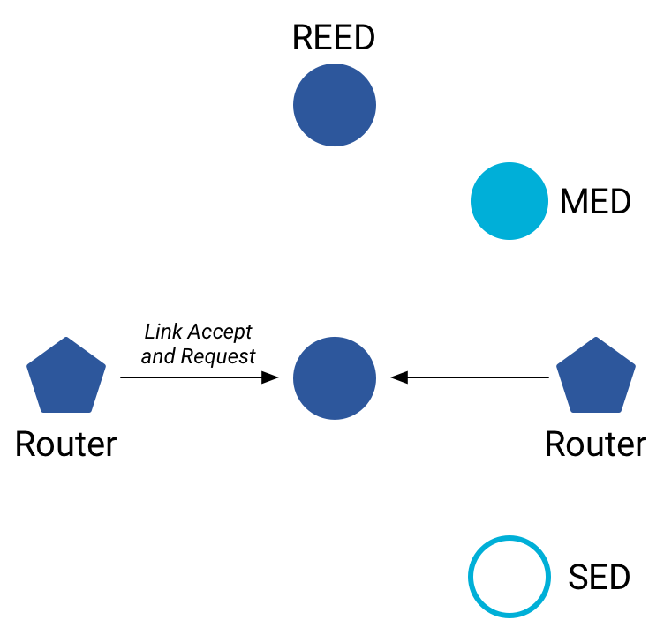
Becoming a router
Thread tries to maintain 16-23 routers (max 32)
Goals: path diversity, extend connectivity
Send a Link Request (to all routers/router-eligible)
Using the multicast, link-local address
Receive Link Accept and Request (from each router separately)
Forms bi-directional link
Send a Link Accept (to each router individually)

Slide 63
Thread Routing
Uses Distance-vector routing
Routers periodically advertise routing costs to all other Routers and quality of one-hop links to neighbors
Uses MLE messages
Cost to destination is the minimum of what all neighbors advertise to that destination plus your cost to that neighbor
Rate at which advertisements are sent is determined by an instance of the Trickle algorithm
Source: section 5.9 in spec

Slide 64
Each router stores neighbor and routing information
Each router stores a routing database which consists of:
Router ID Set
set of current valid router IDs
Link Set
Information about Routers that are/were recently neighbors
<router_id, link_margin, incoming_quality, outgoing_quality, age>
Route Set
records route cost and next hop about other Routers that are, or recently were, reachable (had a finite routing cost) from this router
<destination, next_hop, route_cost>

Slide 65
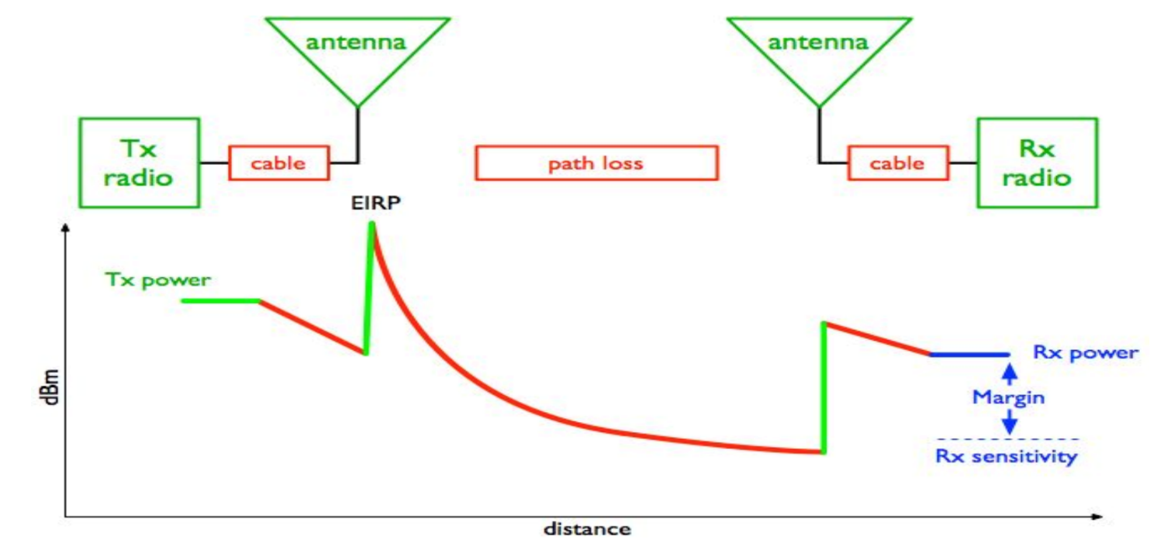
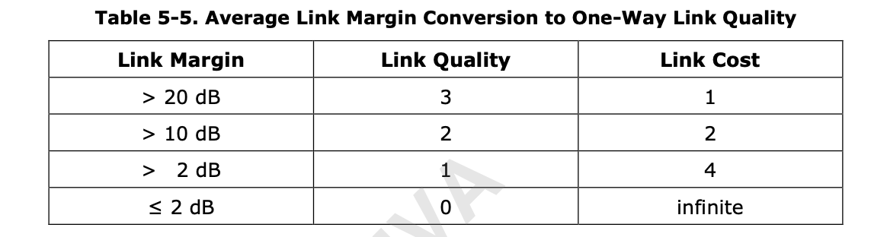
Routers use average link margin to compute Link Cost
Link Margin gives an indication about the quality of the link
Source: https://www.cdt21.com/design_guide/link-budget/

Slide 66
Routing Example
For Router 1
Router ID Set = {2, 3, 4, 5}
Link Set:
Router Id | RLOC16 | Quality In | Quality Out | Age
2 | 0x800 | 2 | 3 | 0
3 | .. | 3 | 3 | 14
4 | .. | 3 | 2 | 0
Route Set:
Destination | Next Hop | Route Cost
1 | 1 | 0
2 | 2 | 2
3 | 3 | 3
4 | 4 | 1
5 | 2 | 3

Slide 67
Updates to Thread specification
Thread version 1.2
Simpler, lower-power end devices
Any packet sent is enough to keep the device attached to network
All acknowledgements identify if packets are available for it
Power control
Reduce transmission power to minimum needed for “good connection”
Reduces potential for “hidden terminal problem”
Thread version 1.3
Better IPv6 support
Coordinate address selection with IP network boarder router connects to
Shuttle DNS Service Discovery messages between networks
Support for TCP
Thread version 1.4
Credential-sharing mechanism to make joining a thread network simpler

Slide 68
Outline
Thread Overview
Thread Addressing
Runtime Behavior
Using IP

Slide 69
Communicating with IP
Any communication that layers on top of IP is now possible
If there is a library to support it
Common choices
UDP
DNS – translate hostnames into IP addresses
SNTP – get real-world time, accuracy better than 1 second
CoAP – send and receive data

Slide 70
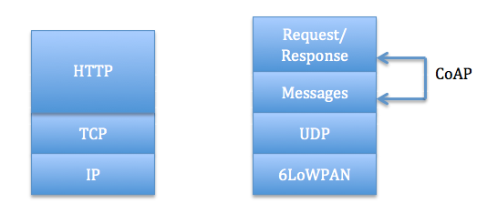
Constrained Application Protocol - CoAP
HTTP, but over UDP targeting less-capable devices
Same REST architecture
Adds capability for automatic retransmissions
CoAP Requests
Have a type: GET, POST, PUT, DELETE
Have a URL: /file/etc
Have data up to 65 KB

Slide 71
Sensor networks don’t use TCP (yet?)
Uncommon choice: TCP
Concerns: Too large, too slow, poorly suited to lossy networks
Also concerning: We’re just replicating TCP poorly
Active research:
Sam Kumar, Michael Anderson, Hyung-Sin Kim, David Culler. “Performant TCP for Low-Power Wireless Networks”. 2020.
The debate is still very much open
2023 update: Thread now supports TCP!!
Primarily for large data payloads, like firmware updates

Slide 72
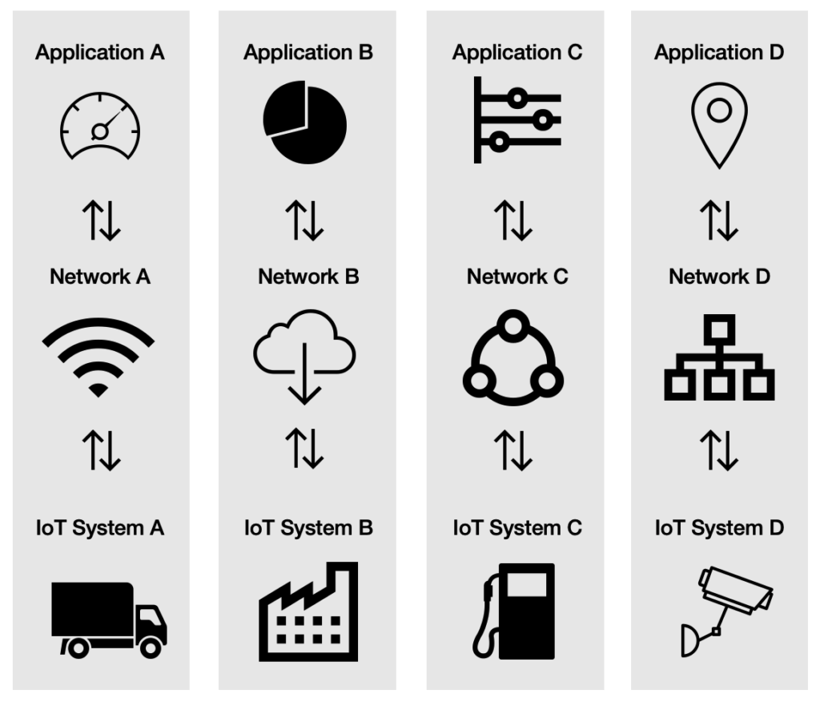
A problem: the siloed internet of things
Problem: companies are more interested in selling you the whole stack
Which then makes it harder for devices to be interoperable
This is not Thread or IP-specific, but a problem all IoT devices are facing
Concerns
What IP address do you send data to?
Manufacturer’s server is an obvious choice
We’ll talk about the Matter standard as an approach to this issue

Slide 73
Outline
Thread Overview
Thread Addressing
Runtime Behavior
Using IP

