Slide 1
Lecture 11 WiFi MAC
CS433 – Wireless Protocols for IoT
Branden Ghena – Spring 2025
Materials in collaboration with Pat Pannuto (UCSD) and Brad Campbell (UVA)

Slide 2
Administrivia
Hw: Matter due today
Another week on Lab: Thread
Lab: WiFi starts on Friday

Slide 3
Today’s Goals
Introduce MAC layer concepts in 802.11
Understand what exists, what is actually used, and why
Explore two additional areas in 802.11
Microcontroller use of WiFi
Future of WiFi

Slide 4
Outline
802.11 Access Control
802.11 Frame format
802.11e Improvements to MAC
Roaming
Microcontrollers and WiFi
MQTT

Slide 5
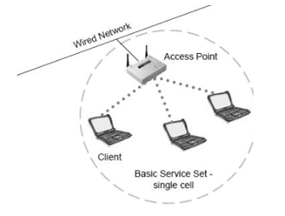
Basic WiFi network
Star topology network
Basic Service Set (BSS)
Access point(s)
Multiple connected clients
Service Set ID (SSID)
Identifies network
Broadcast by access point in beacons

Slide 6
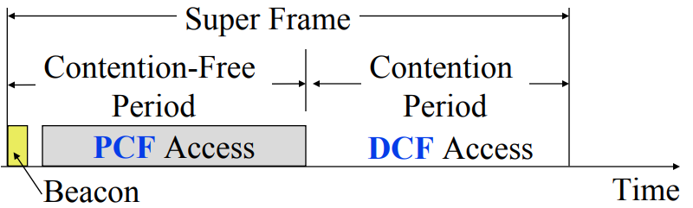
WiFi superframe structure
Beacon followed by contention-free period followed by contention
Repeats periodically (default ~100 ms)
802.15.4 adopted a similar superframe
This is more hypothetical than real

Slide 7
Contention-free access
Known as Point Coordination Function (PCF)
Allocates a contention-free period for specific devices
Access Point decides when to grant based on requests
Drawbacks
Latency depends on beacon intervals
Mechanism for explicit Quality of Service is unclear
PCF is not used in practice
802.11e adds a revised Quality of Service mechanism
Especially with the adoption of MU-MIMO and OFDMA techniques, it’s just not necessary

Slide 8
WiFi superframe in practice
Continuous contention access period
Any device may send at any time
PCF is unused in practice
Periodic beacons
Which also use CSMA and therefore may be delayed
Contention
Based Access
Delayed Beacon
Beacon
Time

Slide 9
802.11 beacons
Transmitted periodically (~100 ms by default)
Enable discovery of network
Contain capabilities and SSID for the network (802.11b/g/n/ac/ax…)
Assign contention-free slots if used
Notify devices of waiting packets
Traffic Indication Map (TIM) has a bitmap specifying which devices data is for
Enables devices to sleep, skipping a number of beacons
Handles broadcast/multicast messages
Every N beacons includes a notation of available broadcast messages
Messages are transmitted during next contention access period using normal CSMA
Defines maximum sleep period for devices (must listen to these beacons)

Slide 10
Contention-based access
Known as Distributed Coordination Function (DCF)
Base communication method for WiFi (essentially always)
All packets are immediately ACK’d by receiving device
Uses CSMA/CA to determine when it can send
With random backoff
Problem: packets can be very long (up to 20 milliseconds)
Solution: Network Allocation Vector (NAV)
Packets include a notation of their duration
Sensing the beginning of a packet allows backoff to skip the whole packet duration before continuing

Slide 11
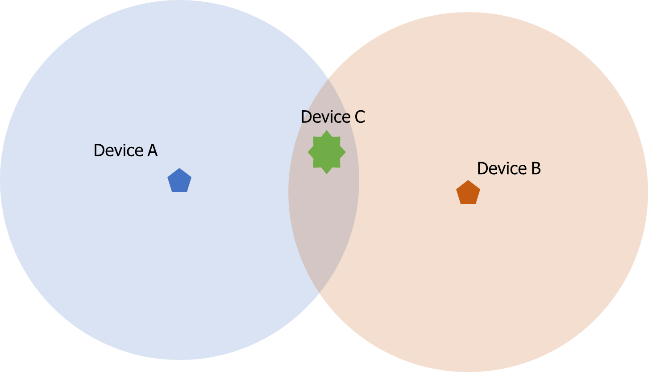
Reminder: hidden terminal problem
Two devices communicating with Access Point may not be able to hear each other
CSMA fails and Access Point losses both messages
A solution: RTS/CTS (Request/Clear To Send)

Slide 12
Drawbacks of RTS/CTS
Four packets per data (RTS, CTS, Data, Ack)
Could have just sent data instead of RTS
Significant portion of traffic are application-layer Acks
Probably better to just have it fail and try again later
RTS/CTS only used for very large packets in practice
*It’s mentioned still in 802.11n and 802.11ac, so not entirely unused

Slide 13
Backoff in WiFi
Listen for activity
If free
Wait for Inter Frame Spacing (IFS)
If still free, transmit
If busy
Randomly select a number of backoff Slots
Count down slots whenever medium is not busy
If busy when backoff completes:
Increase maximum backoff Slots
Repeat
Slot time: basic time unit for protocol
Total time of: switch from Rx to Tx, plus processing time, plus propagation delay

Slide 14
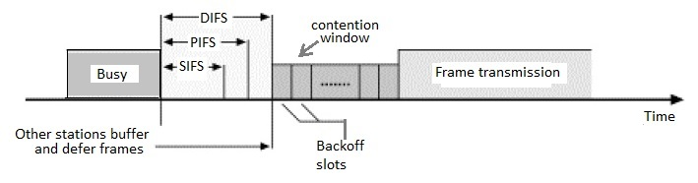
Prioritizing packets with varying IFS
Tiered Contention Multiple Access (TCMA)
Idea: assign different inter-frame spacing based on traffic class
Inherently prioritizes communication
Acknowledgements sent with Short IFS (SIFS)
Will always transmit before new data clears CSMA check
New data sent with longer DCF IFS (DIFS)

Slide 15
Putting backoff together
Two variables
Contention Window (CW) – maximum backoff amount
Backoff Count (BO) – current remaining backoff
When attempting to send, if busy Backoff selected in [0, CW]
Countdown Backoff slots whenever medium is not busy
At 0, attempt to transmit if not busy
If busy, double Window and select Backoff again
802.11g values:
Slot time= 20 us, CWmin= 15 slots (300 us), CWmax= 1023 slots (20 ms)
SIFS= 10 us, DIFS= 50 us

Slide 16
802.11 backoff example
A and B want to send, but they see that the medium is busy
Followed by an Acknowledgement after SIFS
Other Traffic
ACK
SIFS
DIFS
A
Arrival A
B
Arrival B
C

Slide 17
802.11 backoff example
Each chooses a random backoff [0, CW] (we’ll say CW is 32)
Start counting down backoff slots
Other Traffic
ACK
SIFS
DIFS
A
Arrival A
Backoff = 10
B
Arrival B
Backoff = 8
C

Slide 18
802.11 backoff example
C wants to send, waits DIFS, and can send immediately
No other traffic is going on
A and B pause backoff for packet duration
Other Traffic
ACK
C Traffic
SIFS
DIFS
DIFS
A
Arrival A
Backoff = 10
B
Arrival B
Backoff = 8
C
Arrival C

Slide 19
802.11 backoff example
A and B used NAV to pause backoff for entire traffic plus ACK
After DIFS, resume backoff count from its previous value
Other Traffic
ACK
C Traffic
ACK
SIFS
DIFS
DIFS
SIFS
DIFS
A
Arrival A
Backoff = 10
Backoff = 6
B
Arrival B
Backoff = 8
Backoff = 4
C
Arrival C

Slide 20
802.11 backoff example
B reaches zero backoff, finds channel empty, transmits
A pauses its backoff again for duration plus ACK
Other Traffic
ACK
C Traffic
ACK
B Traffic
SIFS
DIFS
DIFS
SIFS
DIFS
A
Arrival A
Backoff = 10
Backoff = 6
B
Arrival B
Backoff = 8
Backoff = 4
C
Arrival C

Slide 21
Break + Hacking
If you wanted maximum data throughput on a WiFi radio, and you were willing to be non-standards-compliant, what would you do?

Slide 22
Break + Hacking
If you wanted maximum data throughput on a WiFi radio, and you were willing to be non-standards-compliant, what would you do?
Never backoff at all. Just try during the next open period
Always be “device C” in our previous example
Use a shorter SIFS than other devices
If you start transmitting sooner, you get to keep transmitting!
Other devices will backoff on your transmission
Tragedy of the Commons: this utterly fails if many radios follow it

Slide 23
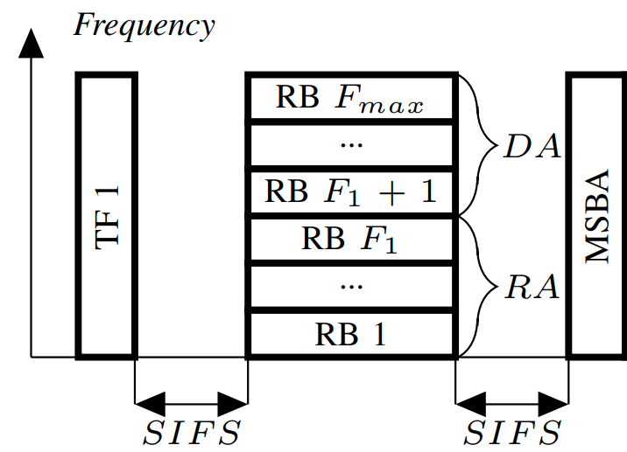
CSMA + OFDMA
For WiFi 6 to be backwards compatible, the OFDMA stuff has to obey the normal CSMA/CA rules as well
Downlink from AP
The AP wins contention and then transmits various data at various frequencies
Uplink to AP
The AP wins contention, sends a “OFDMA uplink trigger frame”, then devices send their responses
https://ieeexplore.ieee.org/document/8422767

Slide 24
Outline
802.11 Access Control
802.11 Frame format
802.11e Improvements to MAC
Roaming
Microcontrollers and WiFi
MQTT

Slide 25

802.11 frame
Frame control (various bits)
Type of packet (Control, Management, Data)
Subtype (Association, RTS, CTS, Ack, etc.)
Indication of to/from “distribution system” (Internet rather than intranet)
Duration
Specifies on-air time of full packet in microseconds
Note: no actual length field 😱
Surprising, but smart!
Recall MCS vary — but everyone needs to be able to parse header (for duration, for NAV)
Length can be very large (e.g. in ac: 5.5 ms max duration is 4.5 MB length!); sent at full data rate

Slide 26
802.11 frame
Sequence control
4-bit fragment number
12-bit sequence number
Quality of Service control
Identifies traffic category
High Throughput Control
Configurations for selecting best data rate
Frame body
Max size depends on PHY
~2000 for lower rates
~8000 for 802.11n
~11000 for 802.11ac
Frame check sequence
32-bit CRC

Slide 27
Address field use cases
Source
AP
1
Repeater
Destination
Devices filter on Address 1
 | To DS | From DS | Address 1 | Address 2 | Address3 | Address4 | Use Case
1 | 0 | 0 | Destination Addr | Source Addr | BSS ID | - | Direct communication
2 | 0 | 1 | Destination Addr | BSS ID | Source Addr | - | Traffic from Internet
3 | 1 | 0 | BSS ID | Source Addr | Destination Addr | - | Traffic to Internet
4 | 1 | 1 | Receiver Addr | Transmitter Addr | Destination Addr | Source Addr | Repeater

Slide 28
Address field use cases
Source
AP
2
Repeater
2
Destination
Devices filter on Address 1
 | To DS | From DS | Address 1 | Address 2 | Address3 | Address4 | Use Case
1 | 0 | 0 | Destination Addr | Source Addr | BSS ID | - | Direct communication
2 | 0 | 1 | Destination Addr | BSS ID | Source Addr | - | Traffic from Internet
3 | 1 | 0 | BSS ID | Source Addr | Destination Addr | - | Traffic to Internet
4 | 1 | 1 | Receiver Addr | Transmitter Addr | Destination Addr | Source Addr | Repeater

Slide 29
Address field use cases
3
Source
3
AP
Repeater
Destination
Devices filter on Address 1
 | To DS | From DS | Address 1 | Address 2 | Address3 | Address4 | Use Case
1 | 0 | 0 | Destination Addr | Source Addr | BSS ID | - | Direct communication
2 | 0 | 1 | Destination Addr | BSS ID | Source Addr | - | Traffic from Internet
3 | 1 | 0 | BSS ID | Source Addr | Destination Addr | - | Traffic to Internet
4 | 1 | 1 | Receiver Addr | Transmitter Addr | Destination Addr | Source Addr | Repeater

Slide 30
Address field use cases
Source
4
AP
Repeater
4
Destination
Devices filter on Address 1
 | To DS | From DS | Address 1 | Address 2 | Address3 | Address4 | Use Case
1 | 0 | 0 | Destination Addr | Source Addr | BSS ID | - | Direct communication
2 | 0 | 1 | Destination Addr | BSS ID | Source Addr | - | Traffic from Internet
3 | 1 | 0 | BSS ID | Source Addr | Destination Addr | - | Traffic to Internet
4 | 1 | 1 | Receiver Addr | Transmitter Addr | Destination Addr | Source Addr | Repeater

Slide 31

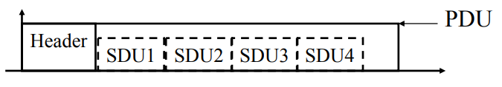
Sending frames in WiFi
Frame bursting (handles one really big packet)
Transmit multiple frames in a row
Frame fragmentation
Split service data over multiple frames
Frame aggregation (handles many very small packets)
Multiple service data in a single frame
Allows multiple packets to reach Access Point in a single transmission

Slide 32
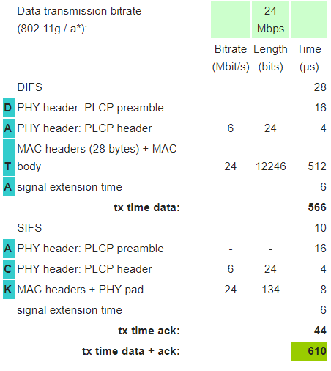
Calculating packet durations
Example duration for a 1500 byte 802.11g packet
6 Mbps for header
24 Mbps for payload
566 μs for total packet
Plus 10 μs for SIFS
Plus 34 μs for ACK
https://sarwiki.informatik.hu-berlin.de/Packet_transmission_time_in_802.11

Slide 33
Implementation Drives Specification Sometimes
SIFS nominally defined by processing time
Aside: Big challenge for SDRs
Convolutional decoders need(ed) 16 µs to finish processing
For highest-rate MCS (ERP-OFDM)
SIFS is 10 μs, so extension needed
Processing must finish before next packet starts
To be able to decode NAV in header
Notes:
https://www.electronics-notes.com/articles/connectivity/wifi-ieee-802-11/802-11g.php

Slide 34
Outline
802.11 Access Control
802.11 Frame format
802.11e Improvements to MAC
Roaming
Microcontrollers and WiFi
MQTT

Slide 35
802.11e improves MAC layer
Hybrid Coordination Function (HCF)
Modifies contention-free access (still no one uses it)
Modifies contention-based access: Enhanced Distributed Channel Access (EDCA)
Adapts Quality of Service based on application
Example of breaking layering for an optimization
Categories (lowest to highest priority):
Background
Best Effort
Video
Voice

Slide 36
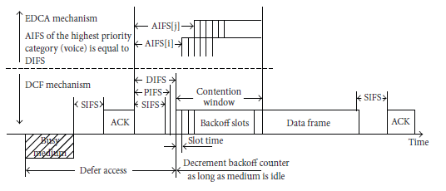
Different priority for different application category
Expand to more IFS lengths for different traffic categories
Smallest AIFS (equal to DIFS) goes to Voice, Largest to Background
Contention Window min and max also change for each category
Selects a probability that most important category goes first

Slide 37
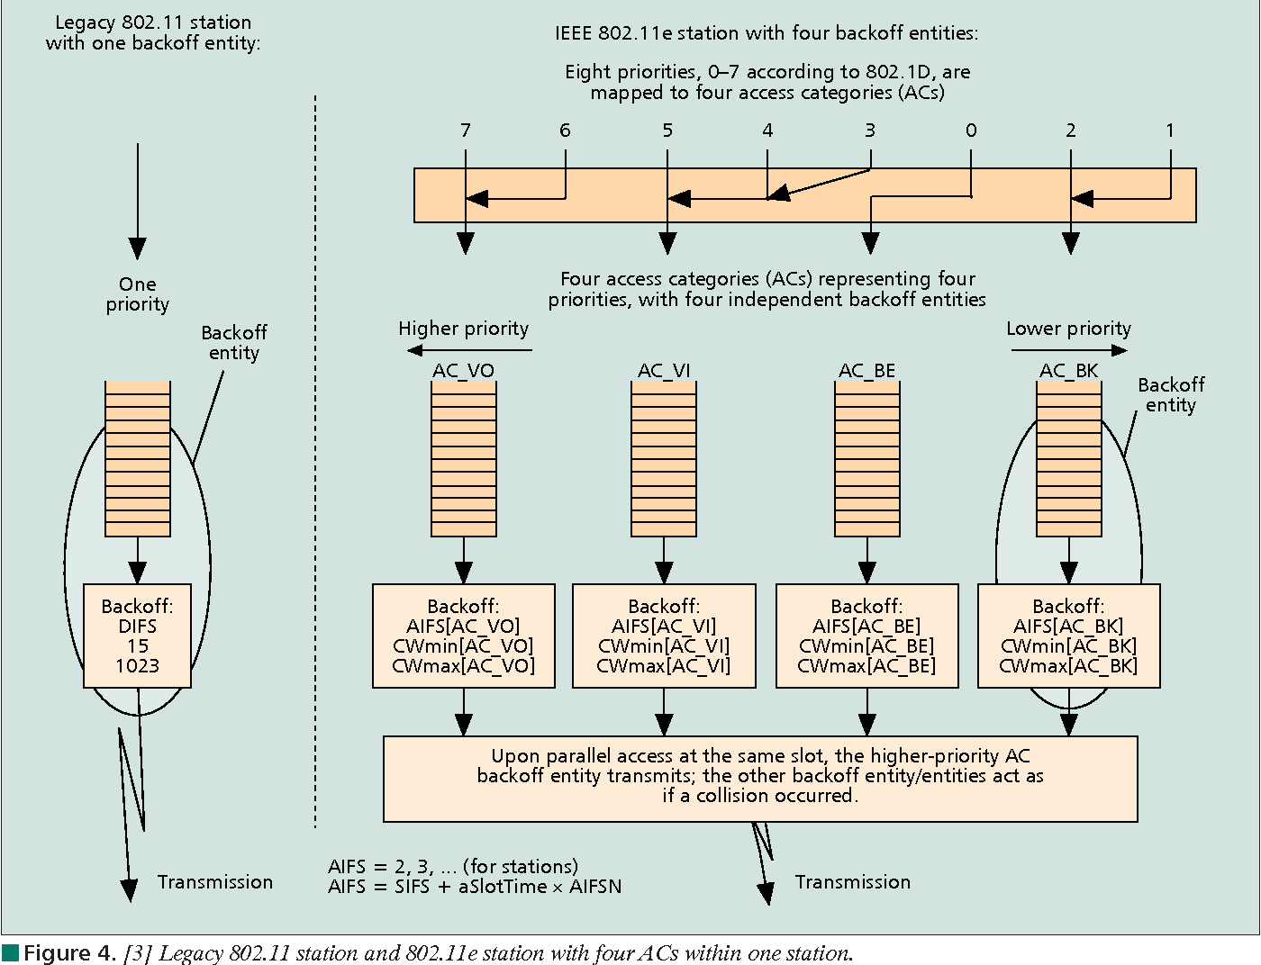
Multiple queues within a single device

Slide 38
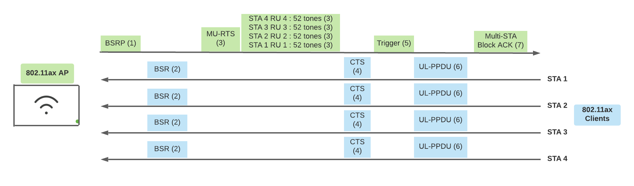
Brief 802.11ax aside
WiFi 6 and beyond use EDCA for their OFDMA scheduling. Steps:
Access point decides to start an OFDMA communication window
Mechanism called “Buffer Status Report Poll” asks how much data each device has queued to send
Access Point wins contention in the normal CSMA method
Access Point sends a TXOP (Transmit Opportunity) message with schedule
Some back-and-forth handshakes here
Devices respond back with uplink messages
Uses a fast IFS to maintain contention

Slide 39
802.11e also adds maximum durations
802.11e also defines duration a device can transmit for
Based on PHY in use and Application category
Background/Best Effort: one frame per contention win
Example, up to 11 ms for Voice on 802.11ac
Could be one really big frame at a low data rate
Could be multiple frames in a row separated by SIFS

Slide 40
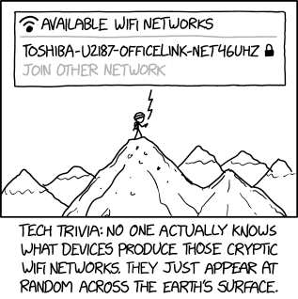
Break + xkcd
https://xkcd.com/2199/

Slide 41
Outline
802.11 Access Control
802.11 Frame format
802.11e Improvements to MAC
Roaming
Microcontrollers and WiFi
MQTT

Slide 42
How do WiFi devices decide to change networks?
WiFi “handoffs” are always initiated by the Client
It decides to change to a different network
802.11k
Access Points track information about neighbors
Clients can request a list of nearby Access Points
802.11v
Access Points can send messages to Clients with recommendations of which network to connect to
Which devices may choose to ignore

Slide 43
Apple roaming decision details
Devices look at RSSI of packets from the Access Point
-70 to -75 dBm triggers roaming
Looks for Access Points that are 8-12 dBm stronger
Given multiple choices, prefers in this order
Better version (WiFi 6 > WiFi 5)
Larger bandwidth (80 MHz > 40 MHz)
Result ends up preferring faster communication
More reliable
Higher capabilities
Android has a more complicated “scoring” mechanism
https://support.apple.com/guide/deployment/wi-fi-roaming-support-dep98f116c0f/web

Slide 44
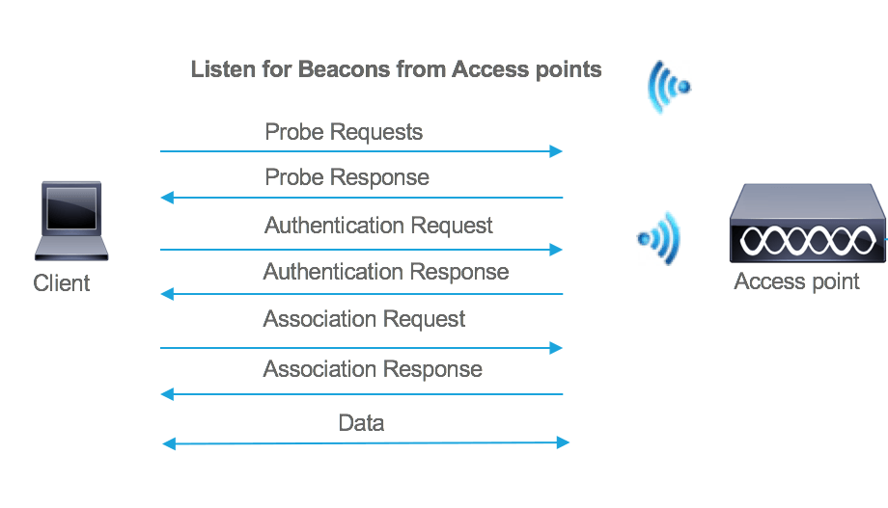
Handling roaming
For a basic WiFi connection, several packets must be sent
Probe response from all Access Points with details
Authentication does basic connection to network
Association shares encryption options and 802.11 capabilities

Slide 45
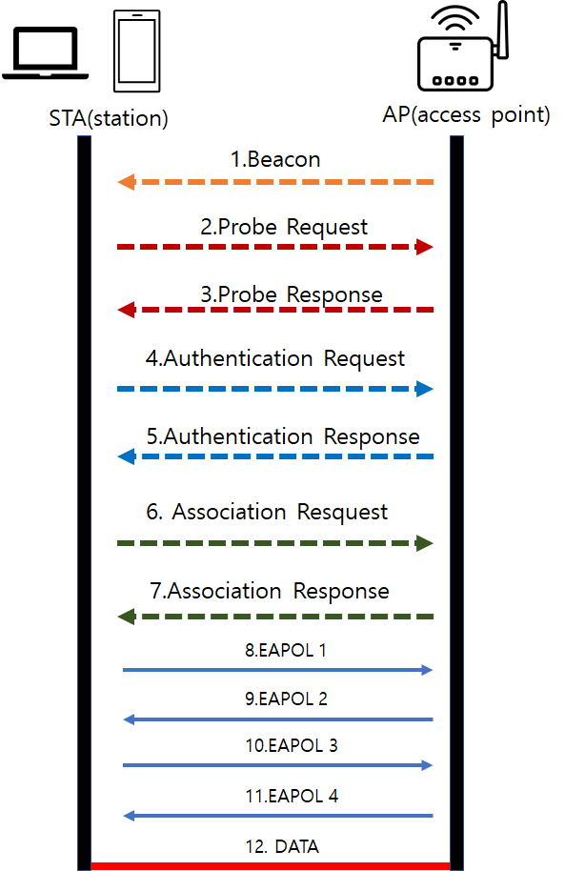
Security has complicated this process
Additional packets need to be sent to verify the device’s identity and exchange keys
802.1x (not 11) is a standard for an authentication server
Enterprise networks often use this

Slide 46
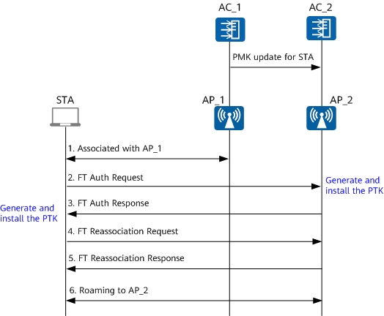
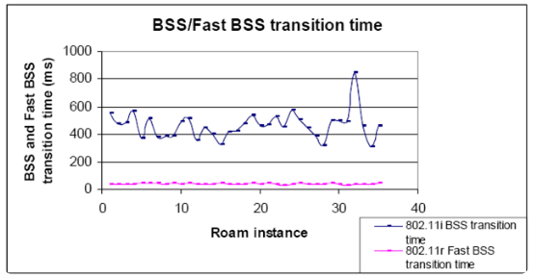
802.11r shares information for faster connections
FT: Fast Transition

Slide 47
Outline
802.11 Access Control
802.11 Frame format
802.11e Improvements to MAC
Roaming
Microcontrollers and WiFi
MQTT

Slide 48
Why, why not, talk WiFi in a wireless for IoT class
Pros
Ubiquitous
High-performance
Cons
Complex configuration
And security requirements
Device-Northwestern anyone?
Expensive in energy and money

Slide 49
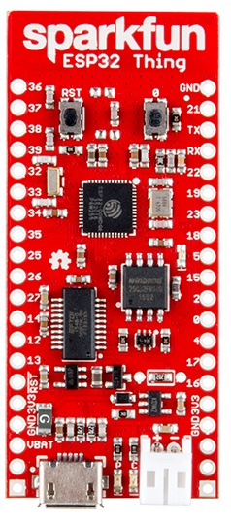
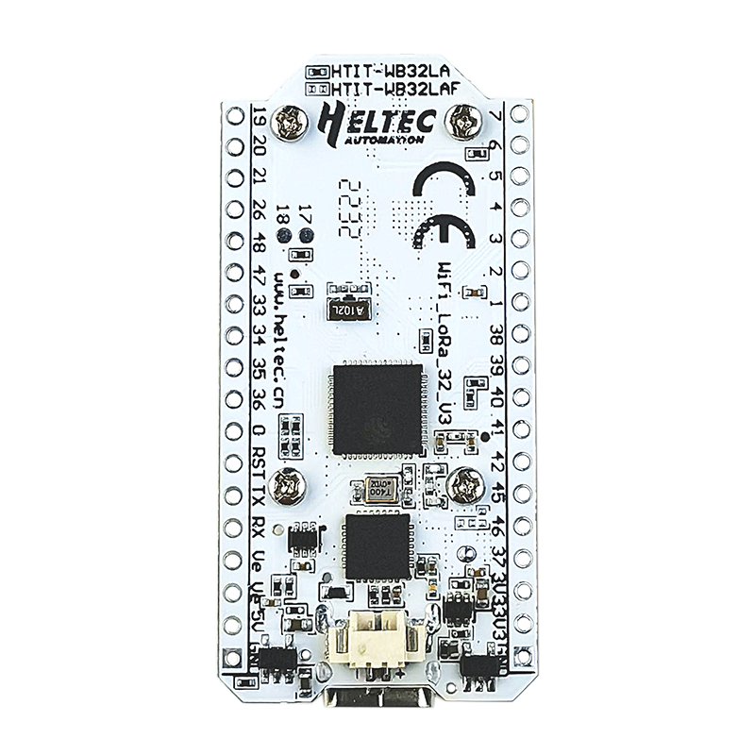
WiFi capability in microcontrollers
ESP32
Microcontroller plus WiFi radio in single chip
(Same idea as nRF52840)
Capabilities
802.11b/g/n 2.4 GHz only
20 MHz or 40 MHz channels
Single antenna only (no MIMO)
MCS0-7
7 Mbps – 150 Mbps
Tx power up to 20.5 dBm

Slide 50
Low power WiFi
Question: should a microcontroller stay connected or reconnect?
Light sleep: stay connected always, only listening to beacons
Deep sleep: reconnect to network each time data is ready
Answer for ESP32 depends on security and data interval
Resecuring during connection takes lots of energy
Crossover point is about 60 seconds
Insecure transmissions have a crossover of 5-15 seconds
https://blog.voneicken.com/2018/lp-wifi-esp-comparison/#conclusions

Slide 51
Outline
802.11 Access Control
802.11 Frame format
802.11e Improvements to MAC
Roaming
Microcontrollers and WiFi
MQTT

Slide 52
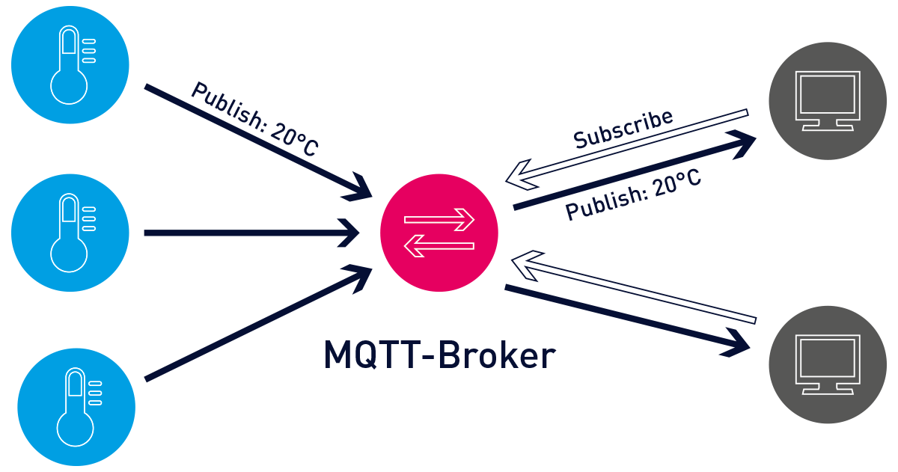
MQTT – an answer to the “where do you send data” question

Slide 53
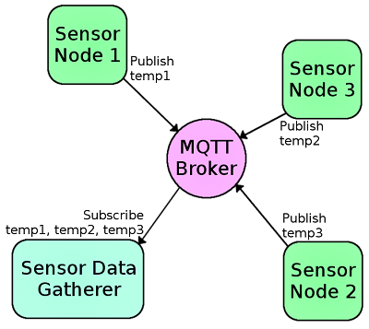
MQTT Roles
MQ Telemetry Transport
Built for IBM MQ products
Broker
Server that distributes information
Client
Any device connected to the Broker

Slide 54
Pub/Sub Architecture
Topic
String that names the data being sent
Publish
Sends data with an associated Topic to Broker
Subscribe
Inform Broker of which Topics you want data from
ALL subscribed Clients get copies of the data

Slide 55
MQTT Access Control
Nothing is required by default
Which is its own concern
Can require a password to communicate with Broker
Can make access control lists on a per-topic basis
Each user with a given password can only access certain topics

Slide 56
Value of MQTT
And that’s pretty much everything there is to MQTT
MQTT is very simple, and that’s a benefit
Packets are sent over TCP, so the reliability is already handled sufficiently
Variants can function over UDP instead
How is data formatted?
However you want. It’s just bytes attached to a Topic string
Could be an array of data bytes, JSON blob, image data, whatever
Up to MB of data in a single payload
Application-level probably knows how to decode

Slide 57
Outline
802.11 Access Control
802.11 Frame format
802.11e Improvements to MAC
Roaming
Microcontrollers and WiFi
MQTT

