Slide 1
Lecture 05: Concurrency Sources and Challenges
CS343 – Operating Systems
Branden Ghena – Fall 2022
Some slides borrowed from: Stephen Tarzia (Northwestern), and UC Berkeley CS61C and CS162

Slide 2
Administrivia
Get started on Scheduling Lab right away!
Getting Started lab was NOT an accurate representation of workload
Don’t plan on being able to get schedulers working at the last minute
Scheduling Lab debugging tip:
Make your own workloads and test on them
That’s the only way to know for sure that your scheduler is right
We will test on many workloads that have not been provided to you

Slide 3
Today’s Goals
Describe where and why concurrency and parallelism are involved in computing.
Be disappointed by performance limits on concurrency.
Understand purpose and challenges of interrupts and signals.
Introduce concept of data races as a concurrency problem.

Slide 4
Outline
Threads
Need for Parallelism
Processor Concurrency
Concurrency Challenges
Amdahl’s Law
Data Races

Slide 5
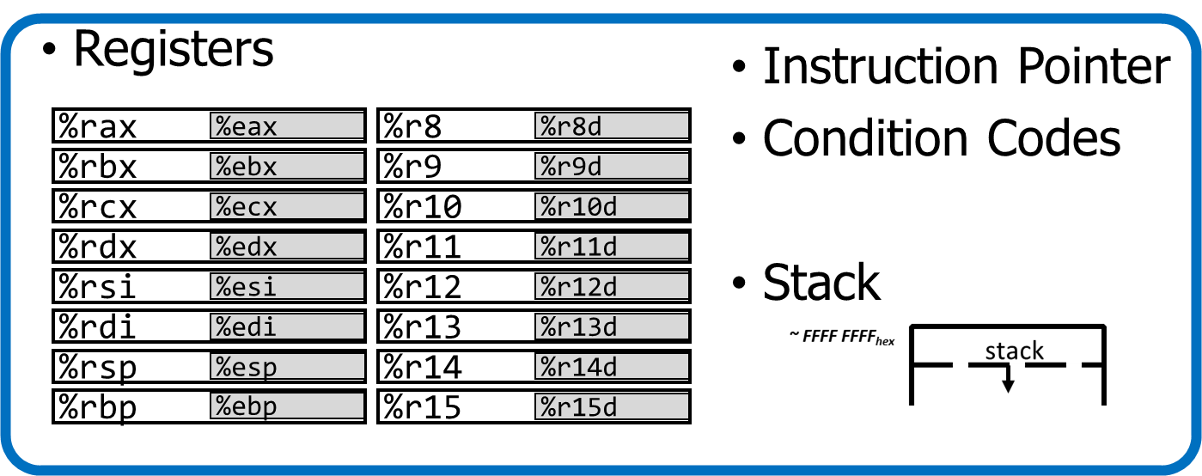
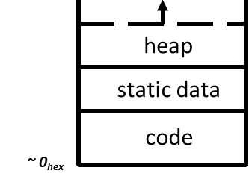
Processes and threads
A process could have multiple threads
Each with its own registers and stack
Threads have separate:
Instruction Pointer
Registers
Stack Memory
Condition Codes
Threads share:
Code
Global variables
Code and Data

Slide 6


Thread use case: web server
Example: Web server
Receives multiple simultaneous requests
Reads web pages from disk to satisfy each request

Slide 7
Web server option 3: multi-threaded web server
One thread per request. Thread handles only that request.
Easy to program (maybe), and fast!
State is stored in the stacks of each thread and the thread scheduler
Simple to program if they are independent…
Main Thread
Request 1 arrives
Create thread
Request 2 arrives
Create thread
Thread 1
Read in request 1
Start disk I/O
Disk I/O finishes
Respond to request 1
Exit
Thread 2
Read in request 2
Start disk I/O
time

Slide 8
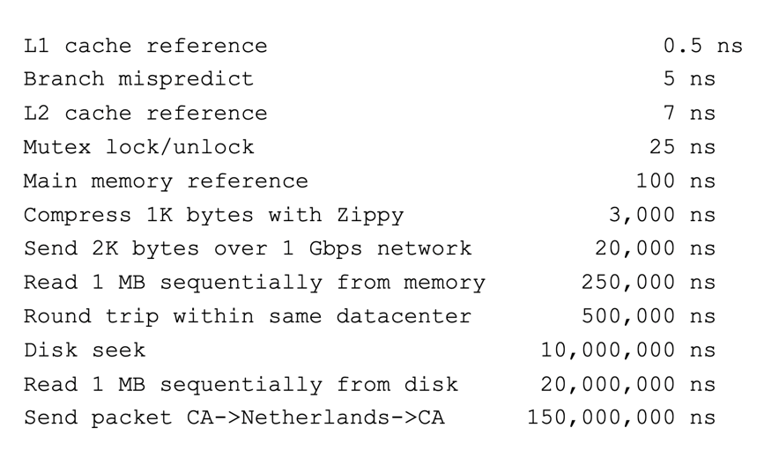
More Practical Motivation
Back to Jeff Dean’s “Numbers Everyone Should Know”
Handle I/O in separate thread, avoid blocking other progress

Slide 9

Models for thread libraries: User Threads
Thread scheduling is implemented within the process
OS only knows about the process, not the threads
Upsides
Works on any hardware or OS
Performance is better when creating and switching
Downsides
A system call in any thread blocks all threads
Processes
Thread Library
OS Kernel
Scheduler

Slide 10
Models for thread libraries: Kernel Threads
Thread scheduling is implemented by the operating system
OS manages the threads within each process
Upsides
Other threads can continue while one blocks on I/O
No additional scheduler
Downsides
Higher overhead
This is what we’ll focus on in CS343
Processes
OS Kernel
Scheduler

Slide 11
POSIX Threads Library: pthreads
https://man7.org/linux/man-pages/man7/pthreads.7.html
int pthread_create(pthread_t *thread, const pthread_attr_t *attr, void *(*start_routine)(void*), void *arg);
thread is created executing start_routine with arg as its sole argument.
return is implicit call to pthread_exit
void pthread_exit(void *value_ptr);
terminates the thread and makes value_ptr available to any successful join
int pthread_join(pthread_t thread, void **value_ptr);
suspends execution of the calling thread until the target thread terminates.
On return with a non-NULL value_ptr the value passed to pthread_exit() by the terminating thread is made available in the location referenced by value_ptr.

Slide 12
Pthread system call example
What happens when pthread_create() is called in a process?
Library:
int pthread_create(…) {
Do some work like a normal function
Put syscall number into register
Put args into registers Special trap instruction
clone (56) syscall on Linux
Kernel:
Get args from regs
Do the work to spawn the new thread
Store return value in %eax
Get return values from regs
Do some more work like a normal function
};

Slide 13
Threads versus Processes
Threads
pthread_create()
Creates a thread
Shares all memory with all threads of the process.
Scheduled independently of parent
pthread_join()
Waits for a particular thread to finish
Can communicate by reading/writing (shared) global variables.
Processes
fork()
Creates a single-threaded process
Copies all memory from parent
Can be quick using copy-on-write
Scheduled independently of parent
waitpid()
Waits for a particular child process to finish
Can communicate by setting up shared memory, pipes, reading/writing files, or using sockets (network).

Slide 14
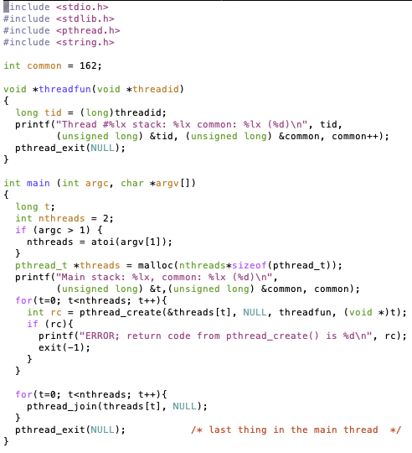
Threads Example

Slide 15
Threads Example
Reads N from process arguments
Creates N threads
Each one prints a number, then increments it, then exits
Main process waits for all of the threads to finish

Slide 16

Threads Example

Slide 17
Check your understanding
How many threads are in this program?
Does the main thread join with the threads in the same order that they were created?
Do the threads exit in the same order they were created?
If we run the program again, could the result change?

Slide 18
Check your understanding
How many threads are in this program? Five
Does the main thread join with the threads in the same order that they were created? Yes
Do the threads exit in the same order they were created? Maybe??
If we run the program again, could the result change? Possibly!

Slide 19
Outline
Threads
Need for Parallelism
Processor Concurrency
Concurrency Challenges
Amdahl’s Law
Data Races

Slide 20
It’s the mid 1990s and you work at Microsoft.
You need to double the speed of Excel in two years.
What do you do?

Slide 21
It’s the mid 1990s and you work at Microsoft.
You need to double the speed of Excel in two years.
What do you do? Take a vacation

Slide 22

Moore’s Law – CPU transistors counts
“Number of transistors in a chip doubles every 18 months”
How? Transistors are getting exponentially smaller!
How small? Today: 7nm! (maybe smaller, kind of complicated)
< ½ the size of most viruses!
Notes:
Gordon Moore – first version of the law – ’65: double every year; restated in ‘75: double every two years
Was simplified to “every 18 months”

Slide 23
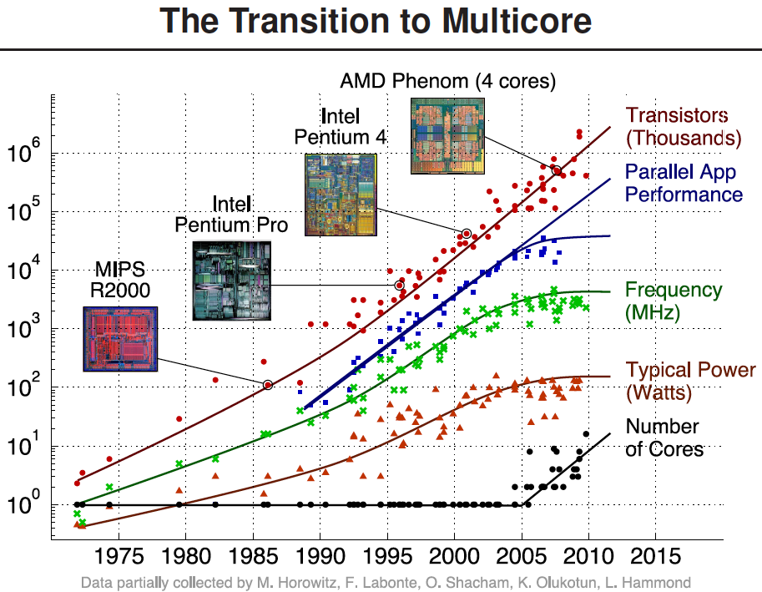
Processors kept getting faster too

Slide 24
Power is a major limiting factor on speed
We could make processors go very fast
But doing so uses more and more power
More power means more heat generated
And chips typically work up to around 100°C
Hotter than that and things stop working
We add heat sinks and fans and water coolers to keep chips cool
But it’s hard to remove heat quickly enough from chips
So, power consumption ends up limiting processor speed

Slide 25
Denard Scaling
Moore’s Law corollary: Denar Scaling
As transistors get smaller, the power density stays the same
Which is to say that the power-per-transistor decreases!
Making the processor clock speed faster uses more power
But the two balance out for roughly net even power
So not only do we get more transistors, but chip speed can be faster too
From our Excel example:
In two years, new hardware would run the existing software twice as fast

Slide 26
Then they stopped getting faster
~2006: Leakage current becomes significant
Now smaller transistors doesn’t mean lower power

Slide 27
So… now what?
In summary:
Making transistors smaller doesn’t make them lower power,
so if we were to make them faster, they would take more power,
which will eventually lead to our processors melting…
and because of that, we can’t reliably make performance better by waiting for clock speeds to increase.
How do we continue to get better computation performance?

Slide 28
Exploit parallelism!

Slide 29
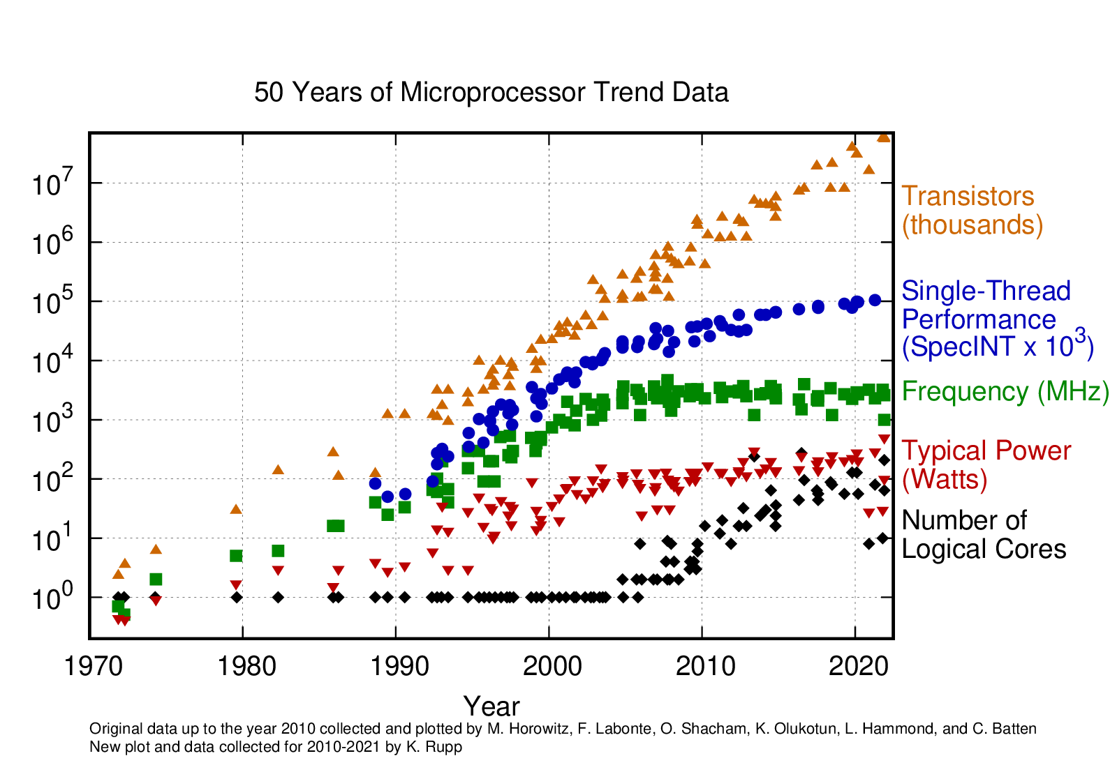
Update: 2010-2021
Still growing!
Small improvement
Stable
Stable
Still growing for servers

Slide 30
Key question: how do we use all these cores?

Slide 31
Break + Parallelism Analogy
I want to peel 100 potatoes as fast as possible:
I can learn to peel potatoes faster
OR
I can get 99 friends to help me
Whenever one result doesn’t depend on another, doing the task in parallel can be a big win!

Slide 32
Outline
Threads
Need for Parallelism
Processor Concurrency
Concurrency Challenges
Amdahl’s Law
Data Races

Slide 33
Parallelism versus Concurrency
Two processes A and B
A
B
time
Serial execution
Parallel execution
Concurrent execution
A
B
time
A
B
time
time
A
OR
B

Slide 34
Parallelism versus Concurrency
Parallelism
Two things happen strictly simultaneously
Concurrency
More general term
Two things happen in the same time window
Could be simultaneous, could be interleaved
Concurrent execution occurs whenever two processes are both active
time
time
time
A
OR
B
OR

Slide 35
What are the hardware sources of concurrency?

Slide 36
Model of a processor
CPU
Updated
Registers and
Memory
Instructions,
Registers,
Memory
CPU
Instruction Fetch
Instruction Decode
Execute
Memory
Writeback

Slide 37
But instructions don’t always have to be executed in order
movq (%rdi), %rax movq (%rsi), %rdx movq %rdx, (%rdi) movq %rax, (%rsi) addq %rcx, %rbx
We can apply the multiprogramming approach of executing this addq while the movq is waiting on memory.
Doesn’t have to go after the movq instructions because it uses different registers

Slide 38
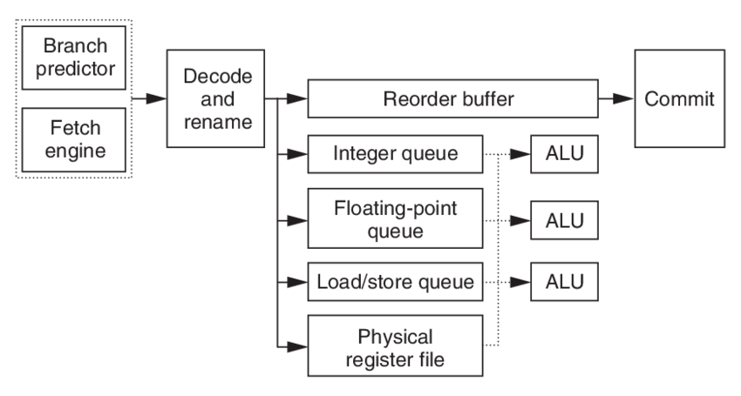
Out-of-order machines
Reorder instructions to make best use of CPU
Commit, or “write back” data to memory and regfile in the order the programmer expects
Fetch many instructions at once!
Read register file, handle data dependencies with register renaming
Generally: looks for independent instructions it can execute early

Slide 39
Out-of-order processors obey normal execution results
Initial thoughts on out-of-order execution
😱
The processor could be executing my program in order it feels like?!!
How do I possibly reason about anything?
Answer: the processor promises to have the same results as if things were done in the normal order.
CPU
Updated
Registers and
Memory
Instructions,
Registers,
Memory

Slide 40
Multiple threads might rely on memory ordering
The processor can’t account for multiple threads though
If memory results are shared by two threads, the processor might mess something up for you.
What will Thread 1 print?
f = 0;
x = 0;
// split into threads
Thread 1
Thread 2
while (f == 0);
printf(“%d\n”, x);
x = 42;
f = 1;

Slide 41
Multiple threads might rely on memory ordering
The processor can’t account for multiple threads though
If memory results are shared by two threads, the processor might mess something up for you.
What will Thread 1 print? Could be 42. Could be 0.
f = 0;
x = 0;
// split into threads
Thread 1
Thread 2
while (f == 0);
printf(“%d\n”, x);
x = 42;
f = 1;
This can be addressed with memory barriers

Slide 42
How else do processors employ concurrency?
Goal: Make computer faster by performing multiple tasks
Solutions:
Use multiple cores to run multiple tasks in parallel
Run multiple tasks on a single core concurrently

Slide 43
How else do processors employ concurrency?
Goal: Make computer faster by performing multiple tasks
Solutions:
Use multiple cores to run multiple tasks in parallel
Run multiple tasks on a single core concurrently

Slide 44
Multicore Systems (in pictures)
Core 0
Memory
Core 0 Memory Accesses
Input
Control
Datapath
PC
Bytes
Registers
(ALU)
Core 1
Control
Core 1 Memory Accesses
Datapath
Output
PC
Registers
(ALU)
I/O-Memory Interfaces

Slide 45
Multicore Systems (in words)
A computer system with at least 2 processor cores
Each core has its own registers
Each core executes independent instruction streams
Cores share the same system memory
But usually use different parts of it
Communication possible through memory accesses
Deliver high throughput for independent jobs via task-level parallelism

Slide 46
Multicore use case
Run Chrome and Spotify simultaneously
Each are separate programs
Each has a different memory space
Each can run on a separate core
Don’t even need to communicate...
Note: OS can fake this by interleaving processes, but hardware can make it actually simultaneous

Slide 47
How else do processors employ concurrency?
Goal: Make computer faster by performing multiple tasks
Solutions:
Use multiple cores to run multiple tasks in parallel
Run multiple tasks on a single core concurrently

Slide 48
Multithreading processors
Basic idea: Processor resources are expensive and should not be left idle
Long memory latency to memory on cache miss?
Hardware switches threads to bring in other useful work while waiting for cache miss
Cost of thread context switch must be much less than cache miss latency
Switching threads is less expensive than processes because they share memory

Slide 49
Hardware support for multithreading
Processor
Memory
Control
Input
Datapath
PC 0
PC 1
Registers 0
Registers 1
(ALU)
Bytes
Two copies of PC and Registers inside processor hardware
Looks like two processors to software (hardware thread 0, hardware thread 1)
Control logic decides which thread to execute an instruction from next
Output
I/O-Memory Interfaces
49

Slide 50
Multithreading versus Multicore
Multithreading => Better utilization
≈5% more hardware for ≈1.3x better performance?
Gets to share ALUs, caches, memory controller
Multicore => Duplicate cores
≈50% more hardware for ≈2x better performance?
Share some caches (L2 cache, L3 cache), memory controller
Modern machines do both
Multiple cores with multiple threads per core

Slide 51
Clearing up vocabulary
Core: computation unit within the CPU
ALU, Registers, etc.
Capable of running one or more threads
CPU (processor): the chip that goes in your computer
Contains one or more cores
Computers could have multiple CPU chips as well
Sometimes people equate processors and cores, which is confusing
I’ll definitely do it by mistake at some point if I haven’t already. Sorry!

Slide 52
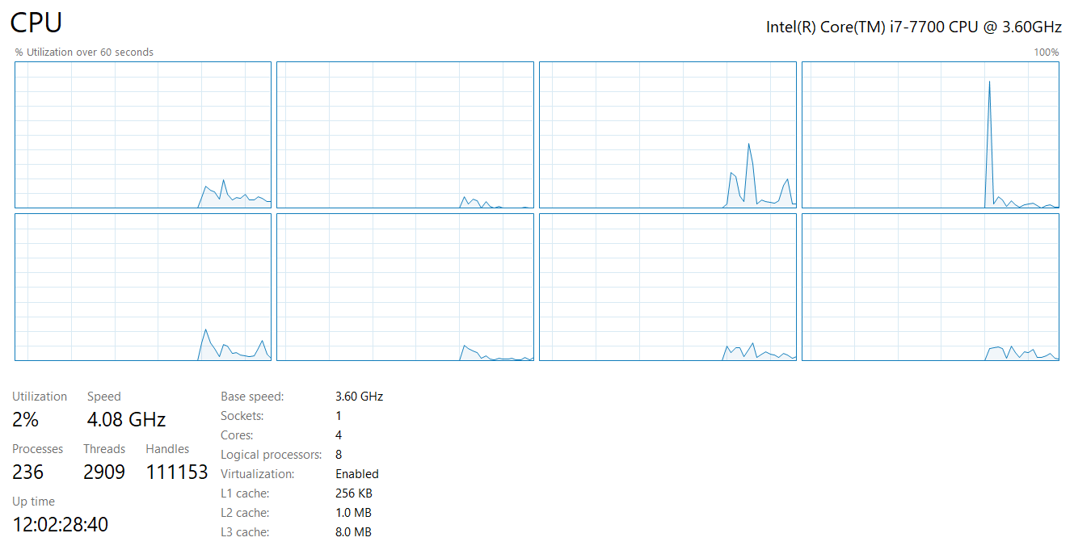
My desktop computer
4 total cores
Each capable of 2 threads
≈ 8 jobs at once

Slide 53
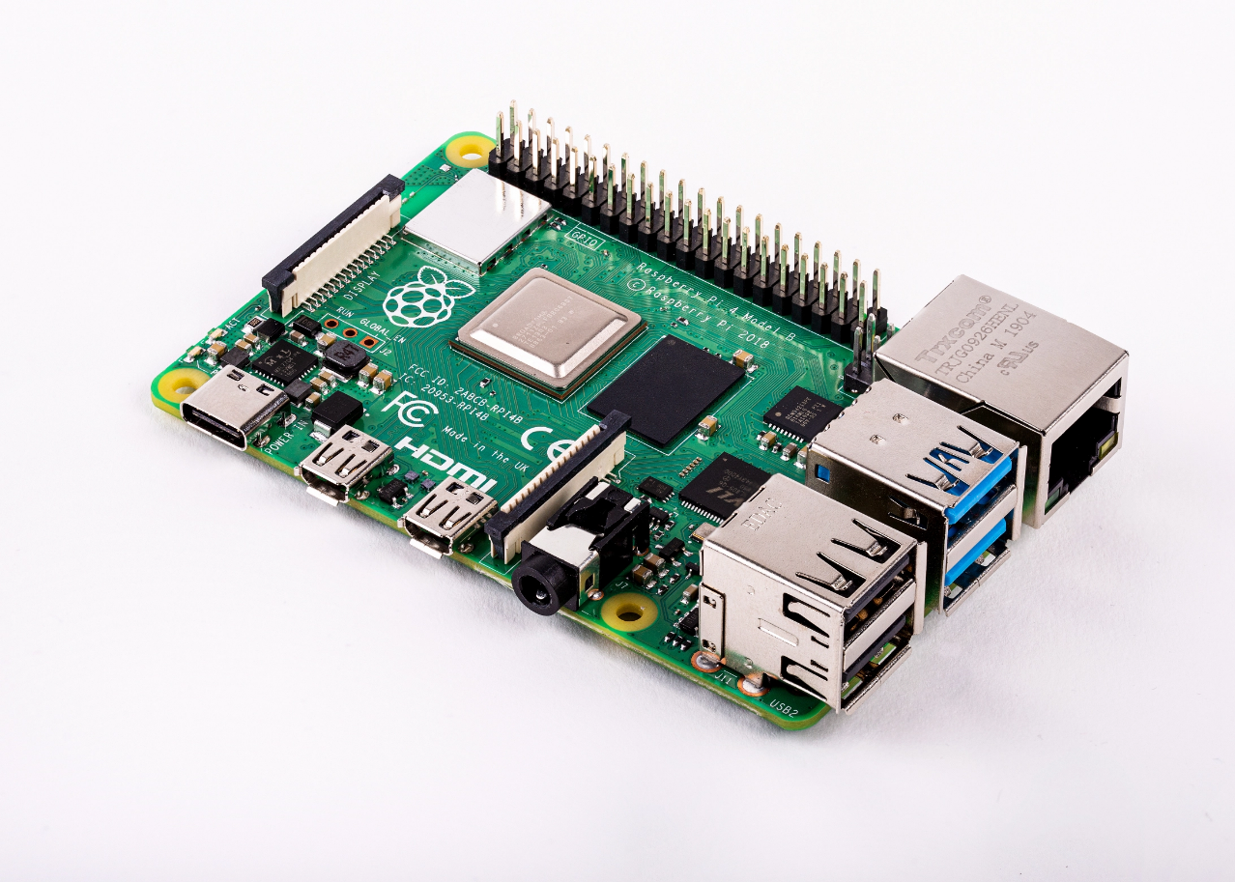
Raspberry Pi 4
Quad core processor
One thread per core
3-way superscalar pipeline
L1 Cache
32 KiB 2-way set associative data cache
48 KiB 3-way set associative instruction cache
Per core
L2 Cache
512 KiB to 4 MiB (shared)
RAM 1-4 GB
$35
Literally all computers are doing parallelism these days

Slide 54
Back up to the OS perspective
Modern operating systems must manage concurrency
Both parallel operation and interleaving operations
Concurrency is valuable
Performance gains are the reason

Slide 55
Break + Real-world Connection
How many cores/threads does your processor support?
Windows: Task Manager -> Performance -> CPU
MacOS: About this Mac -> System Report -> Hardware
M1 processor only does 1 thread per core
Linux: In terminal: lscpu
Android/iOS: You’ll need to google it

Slide 56
Outline
Threads
Need for Parallelism
Processor Concurrency
Concurrency Challenges
Amdahl’s Law
Data Races

Slide 57
Challenges to concurrency
Concurrency is great! We can do so many things!!
But what’s the downside…?
How much speedup can we get from it?
How hard is it to write parallel programs?

Slide 58
Challenges to concurrency
Concurrency is great! We can do so many things!!
But what’s the downside…?
How much speedup can we get from it?
How hard is it to write parallel programs?

Slide 59
Speedup Example
95 s | 5 s
Imagine a program that takes 100 seconds to run
95 seconds in the blue part
5 seconds in the green part

Slide 60
Speedup from improvements
Speedup with Improvement | = | Execution time without improvement
 |  | Execution time with improvement
95 s | 5 s
5 s -> 2.5 s: Speedup = 100/97.5 = 1.026
5 s -> 1 s: Speedup = 100/96 = 1.042
5 s -> 0.001s: Speedup = 100/95.001 = 1.053
The impact of a performance improvement is relative to the importance of the part being improved!

Slide 61
Amdahl’s Law
Equivalent to prior equation
1
Speedup =
F = Fraction of execution time speed up S = Scale of improvement
(1 - F) + F
Non-speed-up part
S
Speed-up part
Example: 2x improvement to 25% of the program
1
1
=
=
1.14
0.75 + 0.25
0.75 + 0.125
2

Slide 62
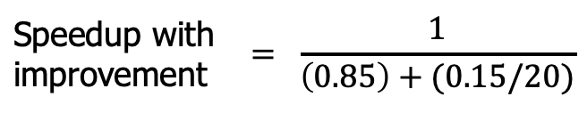
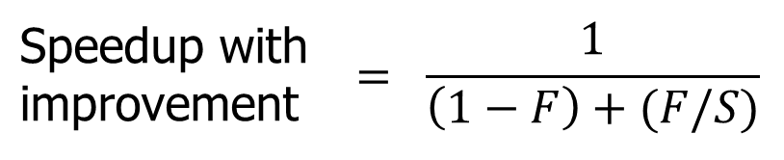
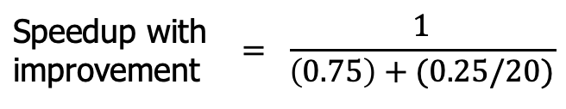
Parallel speedup example
Speedup with improvement | $$= \frac{1}{\left(1−F\right)+(F/S)}$$
Consider an improvement which runs 20 times faster but is only usable 15% of the time
Speedup with improvement | $$= \frac{1}{\left(0.85\right)+(0.15/20)}$$
= 1.166
Nowhere near 20x speedup!
What if it’s usable 25% of the time?
Speedup with improvement | $$= \frac{1}{\left(0.75\right)+(0.25/20)}$$
= 1.311

Slide 63
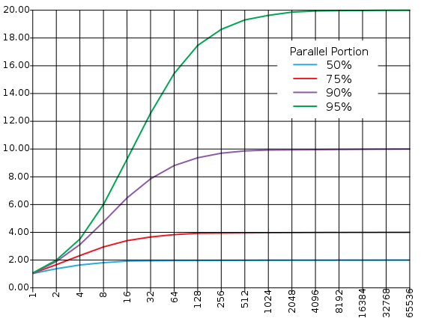
Amdahl’s (heartbreaking) Law (in pictures)
The amount of speedup that can be achieved through parallelism is limited by the non-parallel portion of your program!
Time
Speedup
Parallel
portion
Serial
portion
1
2
3
4
5
Number of Processors
Number of Processors

Slide 64
Amdahl’s (heartbreaking) Law (in words)
Amdahl’s Law tells us that to achieve linear speedup with more processors:
none of the original computation can be serial (non-parallelizable)
To get a speedup of 90 from 100 processors, the percentage of the original program that could be scalar would have to be 0.1% or less
Speedup = 1/(.001 + .999/100) = 90.99

Slide 65
Break + Question
Speedup with improvement | $$= \frac{1}{\left(1−F\right)+(F/S)}$$
50% | 50%
Suppose a program spends 50% of its time in a square root routine.
How much must you speed up square root to make the program run 2x faster?
(A)
10
(B)
20
(C)
100
(D)
None of the above

Slide 66
Break + Question
Speedup with improvement | $$= \frac{1}{\left(1−F\right)+(F/S)}$$
50% | 50%
Suppose a program spends 50% of its time in a square root routine.
How much must you speed up square root to make the program run 2x faster?
Speedup = 1 / [ (1 - F) + (F/S) ]
2 = 1 / [ (1 - 0.5) + (0.5/S)]
S = 0.5 / ((1/2) – 0.5) = ∞
(A)
10
(B)
20
(C)
100
The square root would need to decrease to nothing before you got 2x speedup
(D)
None of the above

Slide 67
Outline
Threads
Need for Parallelism
Processor Concurrency
Concurrency Challenges
Amdahl’s Law
Data Races

Slide 68
Challenges to concurrency
Concurrency is great! We can do so many things!!
But what’s the downside…?
How much speedup can we get from it?
How hard is it to write parallel programs?

Slide 69
Concurrency problem: data races
Consider two threads with a shared global variable: int count = 0
count could end up with a final value of 1 or 2. How?
Thread 1:
void main(){
count += 1;
}
Thread 2:
void main(){
count += 1;
}

Slide 70
Concurrency problem: data races
Consider two threads with a shared global variable: int count = 0
count could end up with a final value of 1 or 2. How?
These instructions could be interleaved in any way.
Assuming “count” is in memory location 0x8049a1c
Thread 1:
void thread_fn(){
mov $0x8049a1c, %edi
mov (%edi), %eax
add $0x1, %eax
mov %eax, (%edi)
}
Thread 2:
void thread_fn(){
mov $0x8049a1c, %edi
mov (%edi), %eax
add $0x1, %eax
mov %eax, (%edi)
}

Slide 71
Data race example
Assuming “count” is in memory location pointed to by %edi
Thread 1 | Thread 2
mov (%edi), %eax
add $0x1, %eax
mov %eax, ($edi)
 | mov (%edi), %eax
 | add $0x1, %eax
 | mov %eax, (%edi)
Thread 1 | Thread 2
mov (%edi), %eax
 | mov (%edi), %eax
 | add $0x1, %eax
 | mov %eax, (%edi)
add $0x1, %eax
mov %eax, (%edi)
Time
Final value of count: 2
Final value of count: 1

Slide 72
Data race explanation
Thread scheduling is non-deterministic
There is no guarantee that any thread will go first or last or not be interrupted at any point
If different threads write to the same variable
The final value of the variable is also non-deterministic
This is a data race

Slide 73
Check your understanding: data races with multiple threads
Consider three threads with a shared global variable: int count = 0
What are the possible values of count?
Thread 1:
void main(){
count += 2;
}
Thread 2:
void main(){
count -= 2;
}
Thread 3:
void main(){
count += 3;
}

Slide 74
Check your understanding: data races with multiple threads
Consider three threads with a shared global variable: int count = 0
What are the possible values of count? -2, 0, 1, 2, 3, 5
How are you supposed to reason about this?! Need mechanisms for sharing memory.
Thread 1:
void main(){
count += 2;
}
Thread 2:
void main(){
count -= 2;
}
Thread 3:
void main(){
count += 3;
}

Slide 75
Outline
Threads
Need for Parallelism
Processor Concurrency
Concurrency Challenges
Amdahl’s Law
Data Races

