Slide 1
Lecture 07: Condvars and Semaphores
CS343 – Operating Systems
Branden Ghena – Fall 2022
Some slides borrowed from: Stephen Tarzia (Northwestern), and Shivaram Venkataraman (Wisconsin)

Slide 2
Administrivia
Scheduler lab due by end-of-day today
Remember that slip days are automatic, no need to ask
PC lab available late tonight
Practices concurrency issues: detecting and resolving them

Slide 3
Today’s Goals
Consider another source of concurrency: interrupts
Understand how we can apply locks to gain correctness and maintain performance
Counter
Data Structures (bonus, if time is available)
Signaling between threads to enforce ordering
Condition Variables
Semaphores

Slide 4
Review: Locks/Mutexes
Simple mutual exclusion primitive
Init(), Acquire()/Lock(), Release()/Unlock()
Implementations trade complexity, fairness, and performance
Spinlocks
Ticket locks
Yielding locks
Queueing locks

Slide 5
Outline
Interrupts
Applying Locks
Ordering with Condition Variables
Semaphores

Slide 6
Where else does concurrency come from?
Processors introduce it for performance reasons by running multiple processes and threads
Interactions with the outside world introduce it because events occur whenever they feel like it
Network request arriving
User presses a key
Motion sensor triggers
Also, we need some way to deal with errors the occur when executing instructions
No pathway for returning an error from an instruction

Slide 7
Interrupts
A way for the CPU to be, well, interrupted.
CPU hardware switches to privileged mode
Now any instruction can be executed, including privileged ones.
Execution jumps to a predefined location
Handler specified in the CPU’s interrupt vector table
Lets the kernel deal with whatever the event was
Used to support asynchronous I/O
Lets a hardware device tell the CPU that some data is ready
Remember that a disk operation is millions of times slower than an add.
CPU has electrical pin(s) for hardware interrupts.
There is also an instruction for software interrupts (like traps!)

Slide 8
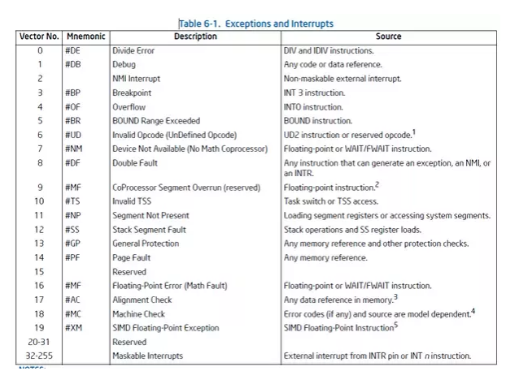
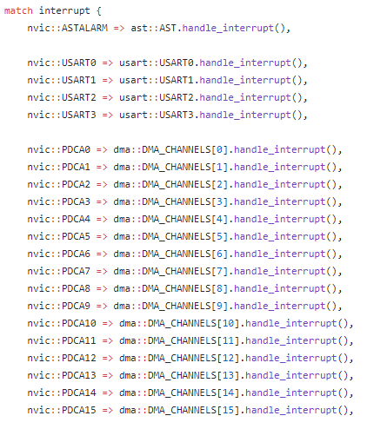
Interrupt Vector Table
Table actually lives in memory somewhere, with function pointers for each vector number
Example from Tock for SAM4L chip (in Rust)

Slide 9
Interrupt Vector Table
Table actually lives in memory somewhere, with function pointers for each vector number
Example from Tock for SAM4L chip (in Rust)

Slide 10
Differences from traps
When we performed a system call:
We knew it was about to happen.
Set up our registers in advance.
Performed what looked sort of like a function call.
Interrupts can happen whenever.
This can get extremely complicated on modern systems with out-of-order execution, multiple cores and threads, and caches

Slide 11
Interrupt handlers
Interrupt context
Can’t just enter the kernel like we did with system calls
Interrupt could have occurred while we were in the kernel
Handler code
Execute some quick processing to deal with the interrupt
Return so the hardware can bring us back to our normal operation
Cannot pause to wait for something else to finish first because the entire core jumped to handling this interrupt
Handled by the operating system
Processes are interrupted, but otherwise not normally involved

Slide 12
Why are interrupts important to the kernel?
Interrupts are a case where the kernel could have a data race with itself!!
Imagine being in the middle of an operation on a device
When an interrupt comes in for that same device
Data structures for the device could end up messed up
Takeaway: concurrency isn’t just about processes and threads
Many different software designs need to deal with it

Slide 13
Data race fix for single-core machines: disable interrupts
void lock() {
disable_interrupts();
}
void unlock() {
enable_interrupts();
}
Disable interrupts to prevent preemption during critical section
Scheduler can’t run if the OS never takes control
Also stops data races in interrupt handlers
Problems
Doesn’t work by itself on multicore machines
Need to use it AND mutexes
Bad Idea™ to let processes disable the OS
Process could freeze the entire computer
Might screw up timing for interrupt handling

Slide 14
Outline
Interrupts
Applying Locks
Ordering with Condition Variables
Semaphores

Slide 15
Review: Need to enforce mutual exclusion on critical sections
#include <stdio.h>
#include <pthread.h>
static volatile int counter = 0;
static const int LOOPS = 1e9;
void* mythread(void* arg) {
printf("%s: begin\n", (char*)arg);
for (int i=0; i<LOOPS; i++) {
counter++;
}
printf("%s: done\n", (char*)arg);
return NULL;
}
int main(int argc, char* argv[]) {
pthread_t p1, p2;
printf("main: begin (counter = %d)\n", counter);
pthread_create(&p1, NULL, mythread, "A");
pthread_create(&p2, NULL, mythread, "B");
// wait for threads to finish
pthread_join(p1, NULL);
pthread_join(p2, NULL);
printf("main: done with both (counter = %d, goal was %d)\n", counter, 2*LOOPS);
return 0;
}

Slide 16
Naively locked counter example
static volatile int counter = 0;
static const int LOOPS = 1e9;
static pthread_mutex_t lock;
void* mythread(void* arg) {
printf("%s: begin\n", (char*)arg);
for (int i=0; i<LOOPS; i++) { pthread_mutex_lock(&lock);
counter++;
pthread_mutex_unlock(&lock);
}
printf("%s: done\n", (char*)arg);
return NULL;
}
int main(int argc, char* argv[]) {
pthread_t p1, p2;
pthread_mutex_init(&lock, 0);
printf("main: begin (counter = %d)\n", counter);
pthread_create(&p1, NULL, mythread, "A");
pthread_create(&p2, NULL, mythread, "B");
// wait for threads to finish
pthread_join(p1, NULL);
pthread_join(p2, NULL);
printf("main: done with both (counter = %d, goal was %d)\n", counter, 2*LOOPS);
return 0;
}

Slide 17
Problem: locking overhead decreases performance
Single-threaded counter: | 3.850 seconds
Multithreaded no-lock counter: | 4.700 seconds (Broken!)
Naïve-locked counter: | 80.000 seconds (Correct…)
When iterating one billion times:
Formerly loop contained 3 instructions (mov, add, mov)
Now it has
Two function calls
Multiple instructions inside of those
Possibly even interaction with the OS…
3 instructions -> 60 instructions

Slide 18
Simple mutual exclusion: one big lock
Simple solution “one big lock”
Find all the function calls that interact with shared memory
Lock at the start of each function call and unlock at the end
Essentially, no concurrent access
Correct but poor performance
If you’ve forgotten all of this years from now, “one big lock” will still work

Slide 19
Counter example with big lock technique
code posted with last lecture on canvas
static volatile int counter = 0;
static const int LOOPS = 1e9;
static pthread_mutex_t lock;
void* mythread(void* arg) {
pthread_mutex_lock(&lock);
printf("%s: begin\n", (char*)arg);
for (int i=0; i<LOOPS; i++) {
counter++;
}
printf("%s: done\n", (char*)arg);
pthread_mutex_unlock(&lock);
return NULL;
}
int main(int argc, char* argv[]) {
pthread_t p1, p2;
pthread_mutex_init(&lock, 0);
printf("main: begin (counter = %d)\n", counter);
pthread_create(&p1, NULL, mythread, "A");
pthread_create(&p2, NULL, mythread, "B");
// wait for threads to finish
pthread_join(p1, NULL);
pthread_join(p2, NULL);
printf("main: done with both (counter = %d, goal was %d)\n", counter, 2*LOOPS);
return 0;
}

Slide 20
Problem: locking decreases performance
Single-threaded counter: | 3.850 seconds
Multithreaded no-lock counter: | 4.700 seconds (Broken!)
Naïve-locked counter: | 80.000 seconds
Big lock counter: | 3.895 seconds
Big lock technique basically returned us to single-threaded execution time (and single-threaded implementation)
Why is the no-lock multithreaded version so slow?
Not 100% certain
Likely something to do with hardware memory/cache consistency

Slide 21
Reducing lock overhead
We want to enable parallelism, but deal with less lock overhead
Need to increase the amount of work done when not locked
Goal: lots of parallel work per lock/unlock event
“Sloppy” updates to global state
Keep local state that is operated on
Occasionally synchronize global state with current local state
Counter example
Keep a local counter for each thread (not shared memory)
Add local counter to global counter periodically

Slide 22
Sloppy counter example
code posted with last lecture on canvas
static volatile int counter = 0;
static const int LOOPS = 1e9;
static pthread_mutex_t lock;
void* mythread(void* arg) {
int sloppy_count = 0;
printf("%s: begin\n", (char*)arg);
for (int i=0; i<LOOPS; i++) {
sloppy_count++;
if (i%1000 == 0) {
pthread_mutex_lock(&lock);
counter += sloppy_count;
pthread_mutex_unlock(&lock);
sloppy_count = 0;
}
}
int main(int argc, char* argv[]) {
pthread_t p1, p2;
pthread_mutex_init(&lock, 0);
printf("main: begin (counter = %d)\n", counter);
pthread_create(&p1, NULL, mythread, "A");
pthread_create(&p2, NULL, mythread, "B");
// wait for threads to finish
pthread_join(p1, NULL);
pthread_join(p2, NULL);
printf("main: done with both (counter = %d, goal was %d)\n", counter, 2*LOOPS);
return 0;
}
Offscreen Tail condition: don’t forget to update “counter” again when the for loop is complete!

Slide 23
Problem: locking decreases performance
Single-threaded counter: | 3.850 seconds
Multi-threaded no-lock counter: | 4.700 seconds (Broken!)
Naïve-locked counter: | 80.000 seconds
Big lock counter: | 3.895 seconds
Sloppy lock (synchronize every 100): | 2.150 seconds
Sloppy lock (synchronize every 10000): | 1.472 seconds
Sloppy lock (synchronize every 1000000): Sloppy lock (synchronize every 1000000000): | 1.478 seconds 1.500 seconds
Optimal for this counter example will be synchronizing once, when entirely finished with the local sum

Slide 24
Break + Open Question
Avoiding data races is challenging
Synchronization means we’re running some code in parallel anyways
Is concurrency worth it? What kinds of problems work best?

Slide 25
Break + Open Question
Avoiding data races is challenging
Synchronization means we’re running some code in parallel anyways
Is concurrency worth it? What kinds of problems work best?
Problems that do not share data will still be HUGE wins!
No (or few) data races. Big concurrency performance gains.
Such problems are termed: embarrassingly parallel
https://en.wikipedia.org/wiki/Embarrassingly_parallel#Examples

Slide 26
Outline
Interrupts
Applying Locks
Ordering with Condition Variables
Semaphores

Slide 27
Requirements for sensible concurrency
Mutual exclusion
Prevents corruption of data manipulated in critical sections
Atomic instructions → Locks → Concurrent data structures
Ordering (B runs after A)
By default, concurrency leads to a lack of control over ordering
We can use mutex’d variables to control ordering, but it’s inefficient:
while(!myTurn) sleep(1);
We would like cooperating threads to be able to signal each other.
Park/unpark and futex could be used solve this problem
But we want a higher-level abstraction

Slide 28
Barriers for all-or-nothing synchronization
Barriers create synchronization points in the program
All threads must reach barrier before any thread continues
pthread_barrier_init(barrier_t)
pthread_barrier_wait(barrier_t)
Use case: neural network processing
Spawn a pool of threads
Each thread handles a portion of the input data
Collect results from all threads at the end of the layer
Distribute results to appropriate threads for next layer

Slide 29
Basic Signaling with Condition Variable (condvar)
Queue of waiting threads
Combine with a flag and a mutex to synchronize threads
wait(condvar_t, lock_t)
Lock must be held when wait() is called
Puts the caller to sleep AND releases lock (atomically)
When awoken, reacquires lock before returning
signal(condvar_t)
Wake a single waiting thread (if any are waiting)
Do nothing if there are no waiting threads
Called while holding the lock; action occurs after lock is released

Slide 30
Waiting for a thread to finish
pthread_t p1, p2; // create child threads pthread_create(&p1, NULL, mythread, "A"); pthread_create(&p2, NULL, mythread, "B");
...
// join waits for the child threads to finish thr_join(p1, NULL); thr_join(p2, NULL); return 0;
How to implement join?

Slide 31
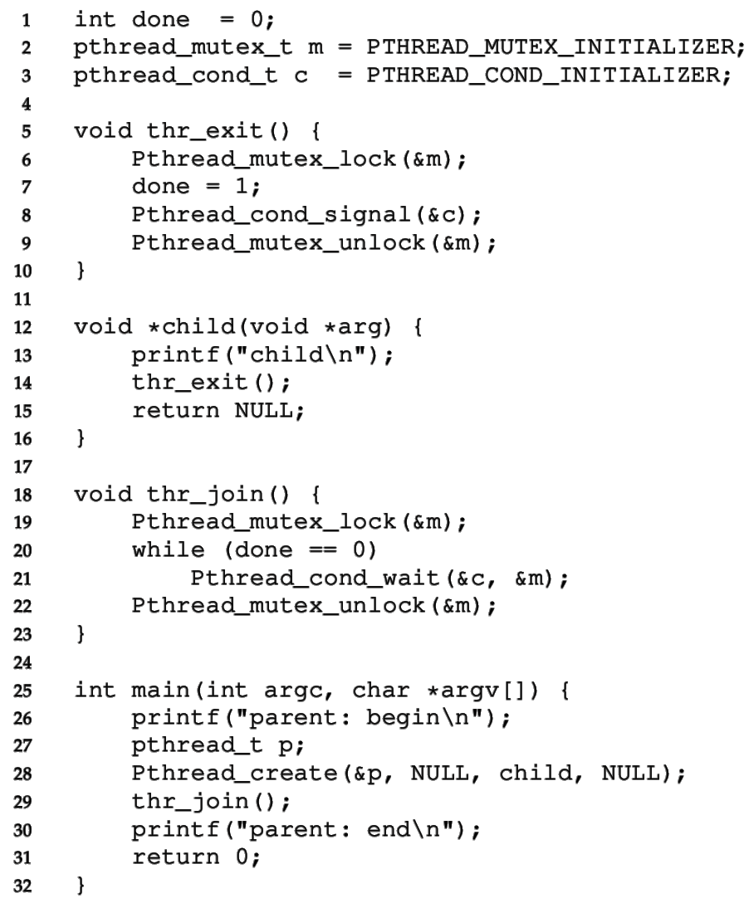
CV for child wait
Must use mutex to protect “done” flag and condvar
Done flag tracks the event
Condvar is used for ordering
Mutex protects both!

Slide 32
CV for child wait
Must use mutex to protect “done” flag and condvar
Parent calls thr_join()
wait()’s until done==1

Slide 33
CV for child wait
Must use mutex to protect “done” flag and condvar
Parent calls thr_join()
wait()’s until done==1
Child calls thr_exit()
sets done to 1
calls signal()
unlocks mutex

Slide 34
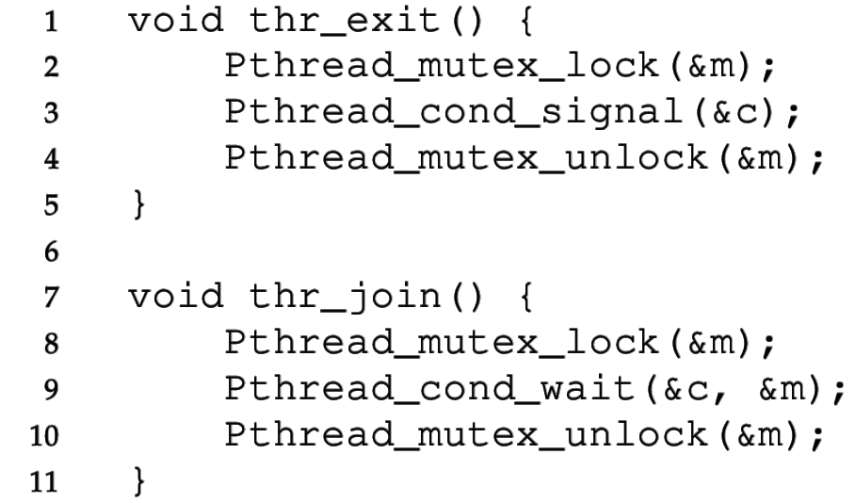
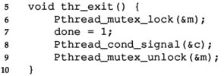
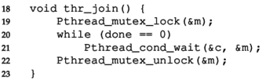
Buggy attempts to wait for a child, no flag
Incorrect Code
Correct Code
Parent Child
1) Without done variable, the child could run first and signal before the parent starts waiting for the child. Parent waits forever…

Slide 35
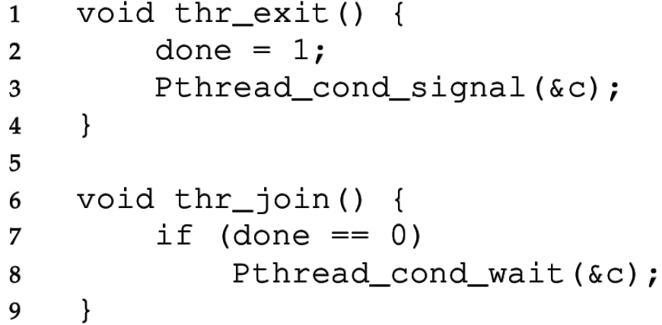
Buggy attempts to wait for a child, no mutex
Incorrect Code
Correct Code
Parent Child
2) Without a lock, the parent could see done==0, then the child could finish and signal, then the parent would start waiting (after missing the signal). Parent waits forever…

Slide 36
Must check condition with in a loop
Thread 1 calls condvar_wait()
Thread 2 does some work, calls condvar_signal()
Before Thread 1 is scheduled, Thread 3 executes and skips the wait because the resource is ready!
Now Thread 1 will run, but the resource will not be ready
There is no guarantee that the condition you’ve been waiting for is true when you are awoken
So, we must also use a “predicate loop.” (while, not if)

Slide 37
Spurious (fake) wakeups
Pthreads allows wakeup to return not just when a signaled, but also when a timer expires or for no reason at all!
Spurious wakeups were included in the specification because they may allow some implementations be more efficient.
Should be safe since we have to wait with a while loop anyways

Slide 38
Another Example: Produce/Consumer Problem
We have multiple producers and multiple consumers that communicate with a shared queue (FIFO buffer).
Concurrent queue allows work to happen asynchronously.
Buffer has finite size (does not dynamically expand)
Two operations:
Put, which should block (wait) if the buffer is full.
Get, which should block (wait) if the buffer is empty.
This is more complex than a (linked-list-based) concurrent queue because of the finite size and waiting.
Example scenario: request queue in a multi-threaded web server.

Slide 39
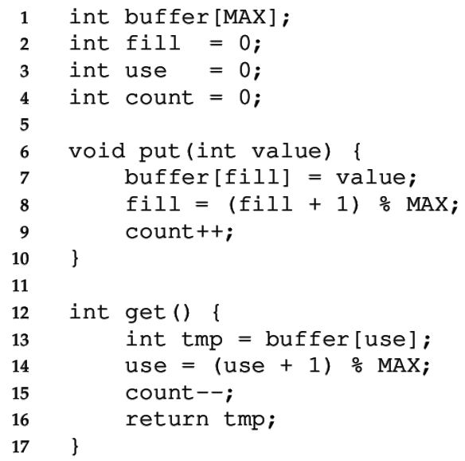
Managing the buffer
A simple implementation of a circular buffer that stores data in a fixed-size array.
fill is the index of the tail
use is the index of the head
count = (fill – use) % MAX
This simple implementation assumes:
Concurrency is managed elsewhere
It will overwrite data if we try to put more than MAX elements.
39

Slide 40
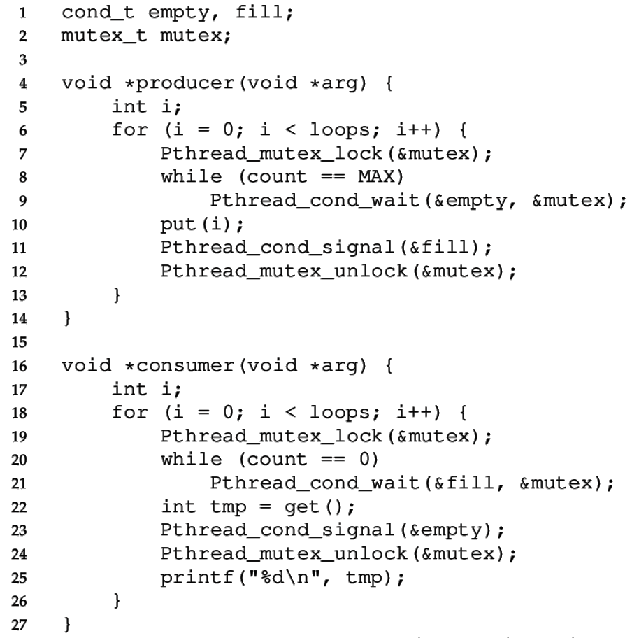
Managing the concurrency
Always acquire mutex
Must use same mutex in both functions
Use two condvars
40

Slide 41
Managing the concurrency
Always acquire mutex
Must use same mutex in both functions
Use two condvars
Producer waits on empty while the buffer is full
Producer signals fill after put
41

Slide 42
Managing the concurrency
Always acquire mutex
Must use same mutex in both functions
Use two condvars
Producer waits on empty while the buffer is full
Producer signals fill after put
Consumer waits on fill while the buffer is empty
Consumer signals empty after get
42

Slide 43
Managing the concurrency
Always acquire mutex
Must use same mutex in both functions
Use two condvars
Producer waits on empty while the buffer is full
Producer signals fill after put
Consumer waits on fill while the buffer is empty
Consumer signals empty after get
Loops re-check count condition after breaking out of wait, to handle spurious wakeups.
43

Slide 44
Broadcast makes more complex conditions possible
Recall that signal wakes one waiting thread (FIFO)
But there are times when threads are not all equivalent
The signal may not be serviceable by any of the threads
For example, consider memory allocation/free requests
An allocation can only be serviced by free of >= size
pthread_cond_broadcast wakes all threads
This approach may be inefficient, but it may be necessary to ensure progress

Slide 45
Condition Variable: rules of thumb
Shared state determines if condition is true or not
Check the state in a while loop before waiting on condvar
Use a mutex to protect:
The shared state on which condition is based, and
Operations on the condvar
Remember to acquire the mutex before calling cond_signal() and cond_broadcast()
Use different condvars for different conditions
Sometimes, cond_broadcast() helps if you can’t find an elegant solution using cond_signal()

Slide 46
Break + Administrivia
Midterm exam is coming soon!
Next week Thursday
I’ll distribute a practice exam soon
Covers all of class material through this week
All of Scheduling and all of Concurrency
We’ll have a review session in class next week Tuesday
It’ll focus on some practice problems

Slide 47
Outline
Interrupts
Applying Locks
Ordering with Condition Variables
Semaphores

Slide 48
Generalizing Synchronization
Condvars have no state or lock, just a waiting queue
The rest is handled by the programmer
Semaphores are a generalization of condvars and locks
Includes internal (locked) state
A little harder to understand and use, but can do everything

Slide 49

Semaphores (by Edsger Dijkstra, 1965)
Keeps an internal integer value that determines what happens to a calling thread
Init(val)
Set the initial internal value
Value cannot otherwise be directly modified
Up/Signal/Post/V() (from Dutch verhogen “increase”)
Increase the value. If there is a waiting thread, wake one.
Down/Wait/Test/P() (from Dutch proberen “to try”)
Decrease the value. Wait if the value is negative.
Dijkstra invented Dijkstra’s Algorithm! Also Semaphores and the entire field of Concurrent Programming
https://en.wikipedia.org/wiki/Edsger_W._Dijkstra

Slide 50
Semaphores vs Condition Variables
Semaphores
Condition Variables
Up/Post: increase value and wake one waiting thread
Down/Wait: decrease value and wait if it’s negative
Signal: wake one waiting thread
Wait: wait
Compared to CVs, Semaphores add an integer value that controls when waiting is necessary
Value counts the quantity of a shared resource currently available
Up makes a resource available, down reserves a resource
Negative value -X means that X threads are waiting for the resource

Slide 51
Check your understanding
How would we build a mutex out of a semaphore?
typdef struct {
sem_t sem;
} lock_t;
init(lock_t* lock){ }
acquire(lock_t* lock) {
}
release(lock_t* lock) {
}
sem_init(sem_t*, int initial)
sem_wait(sem_t*): Decrement, wait until value >= 0
sem_post(sem_t*): Increment value then wake a single waiter

Slide 52
Check your understanding
How would we build a mutex out of a semaphore?
typdef struct {
sem_t sem;
} lock_t;
init(lock_t* lock){ sem_init(&(lock->sem), 1); }
acquire(lock_t* lock) { sem_wait(&(lock->sem));
}
release(lock_t* lock) { sem_post(&(lock->sem));
}
sem_init(sem_t*, int initial)
sem_wait(sem_t*): Decrement, wait until value >= 0
sem_post(sem_t*): Increment value then wake a single waiter

Slide 53
Implementing a lock with a semaphore
Choose an appropriate initial value for the semaphore
To implement a Lock:
Initialize to 1 (access to the critical section is the one shared resource)
Lock → Down: (decreases the value and waits if negative)
Will decrease the value to 0 if it lock is not already taken
Will decrease the value to -1 and wait if the lock is taken (value was 0)
Unlock → Up: (increases the value and wakes one waiting thread)
If value was 0, then no thread was waiting, and no thread is woken
If value was -1, then one thread was waiting, and it is woken
If value was -x, then x threads are waiting, one is woken, value becomes -(x-1).
If value is already 1, Up should not be called. (Unlock before lock?!)

Slide 54
Semaphores reduce effort for numerical conditions
Condition Variable
Semaphore
void thr_exit() {
sem_post(&s);
}
void thr_join() {
sem_wait(&s);
}
sem_init(&s, 0);
Parent Child
Want parent to wait immediately so initialize to 0
If child thread finishes first, semaphore increments to 1

Slide 55
Readers-Writers Problem
Some resources don’t need strict mutual exclusion, especially if they have many read-only accesses. (eg., a linked list)
Any number of readers can be active simultaneously, but
Writes must be mutually exclusive AND cannot happen during read
API:
acquire_read_lock(), release_read_lock()
acquire_write_lock(), release_write_lock()

Slide 56
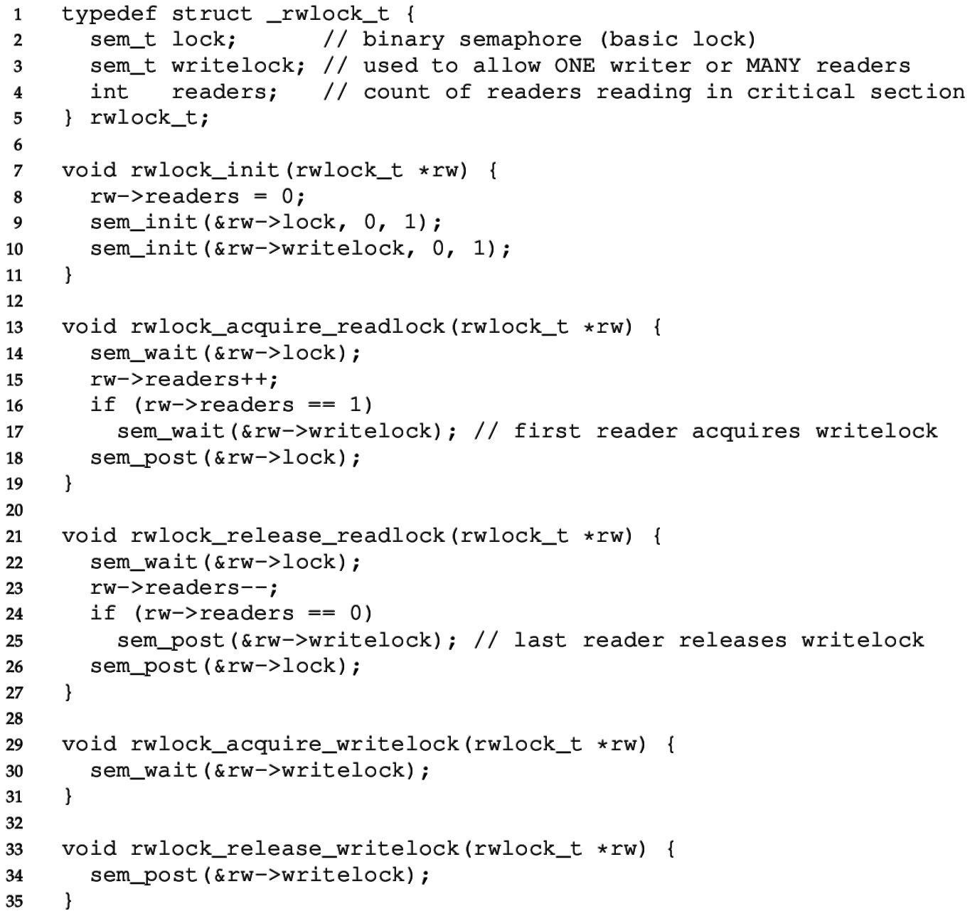
Reader-writer Lock
“lock” semaphore used as a mutex

Slide 57
Reader-writer Lock
“writelock” must be held during read to block writes or during write to block reads.
During reads
Number of active readers is counted.
First/last reader handles acquiring/releasing writelock.

Slide 58
Classical concurrency problems
Note that this particular solution could starve writers
There might always be readers in the critical section
Full solution to readers-writers problem with progress guarantee
https://en.wikipedia.org/wiki/Readers%E2%80%93writers_problem
Generally: try to map your problem to one of these solved problems
Producers/Consumers or Readers/Writers
There are MANY solutions to these problems available online

Slide 59
Outline
Interrupts
Applying Locks
Ordering with Condition Variables
Semaphores

Slide 60
Outline
Bonus: Concurrent Data Structures

Slide 61
Thread-safe data structures
“Thread safe” – works even if used by multiple threads concurrently
Can apply to various libraries, functions, and data structures
Simple data structures implementations are usually not thread safe
Some global state needs to be shared among all threads
Need to protect critical sections
Challenge: multiple function calls each access same shared structure
Need to identify the critical section in each and lock it with shared lock

Slide 62
Linked List
void List_Insert(list_t *L, int key) {
node_t *new = malloc(sizeof(node_t));
if (new == NULL) {
perror("malloc");
return; // fail
}
new->key = key;
new->next = L->head;
L->head = new;
return; // success
}

Slide 63
Concurrent Linked List – Big lock approach
void List_Insert(list_t *L, int key) {
pthread_mutex_lock(&L->lock);
node_t *new = malloc(sizeof(node_t));
if (new == NULL) {
perror("malloc");
pthread_mutex_unlock(&L->lock);
return; // fail
}
new->key = key;
new->next = L->head;
L->head = new;
pthread_mutex_unlock(&L->lock);
return; // success
}
Most important part of this example. Don’t forget to unlock if returning early.
Much better than counter example, because we are only serializing the list itself. Hopefully the rest of the code can run concurrently.

Slide 64
Better Concurrent Linked List – Only lock critical section
void List_Insert(list_t *L, int key) {
node_t *new = malloc(sizeof(node_t));
if (new == NULL) {
perror("malloc");
return; // fail
}
new->key = key;
new->next = L->head;
L->head = new;
return; // success
}
Check your understanding:
Where is the critical section here?

Slide 65
Better Concurrent Linked List – Only lock critical section
void List_Insert(list_t *L, int key) {
node_t *new = malloc(sizeof(node_t));
if (new == NULL) {
perror("malloc");
return; // fail
}
new->key = key;
new->next = L->head;
L->head = new;
return; // success
}
Check your understanding:
Where is the critical section here?

Slide 66
What about malloc? Is that safe to use??
void List_Insert(list_t *L, int key) {
node_t *new = malloc(sizeof(node_t));
if (new == NULL) {
perror("malloc");
return; // fail
}
new->key = key;
new->next = L->head;
L->head = new;
return; // success
}
Thread-safe functions
Capable of being called concurrently and still functioning correctly
(Because they use locks!)
How would we know if malloc is thread-safe?
Must check the documentation

Slide 67
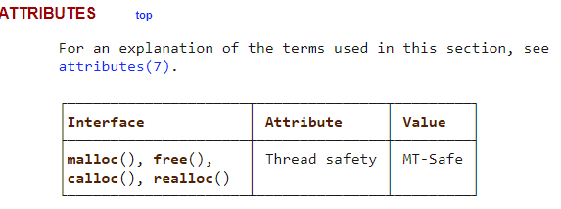
Must check the library documentation to determine thread safety
https://man7.org/linux/man-pages/man3/malloc.3.html
Malloc (and free) is indeed thread-safe
If it wasn’t, we would have to consider it another shared resource that needs to be locked

Slide 68
Better Concurrent Linked List – Only lock critical section
void List_Insert(list_t *L, int key) {
node_t *new = malloc(sizeof(node_t));
if (new == NULL) {
perror("malloc");
return; // fail
}
new->key = key;
pthread_mutex_lock(&L->lock);
new->next = L->head;
L->head = new;
pthread_mutex_unlock(&L->lock);
return; // success
}
Now new node is created locally in parallel
Only actual access to the linked list is serialized

Slide 69
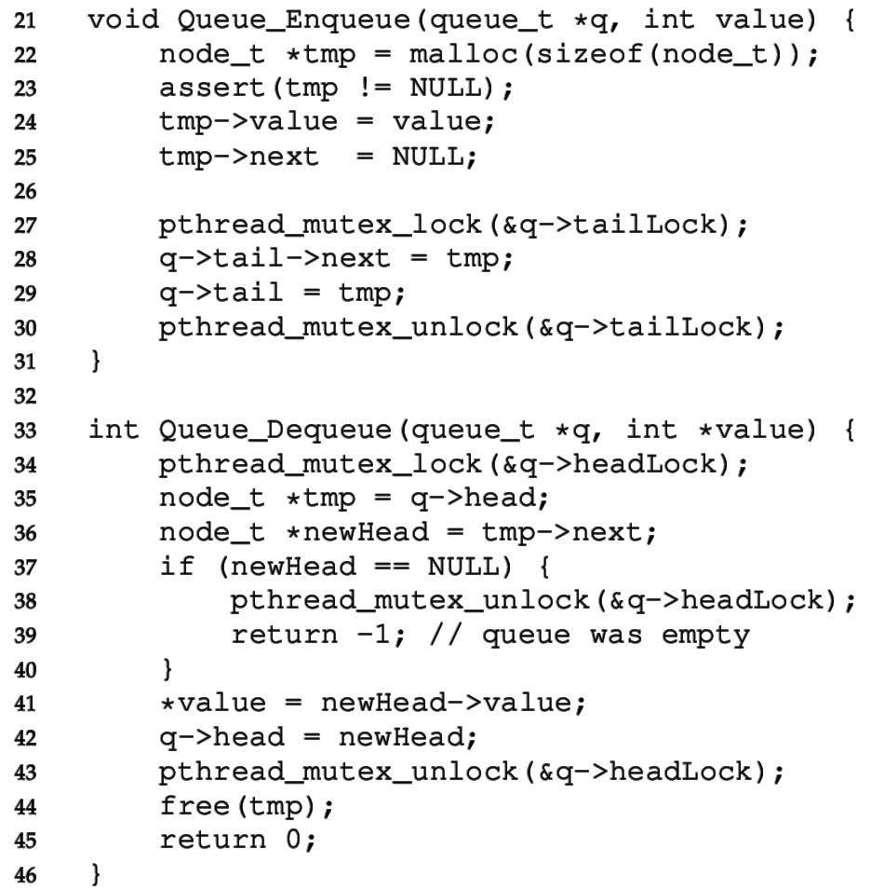

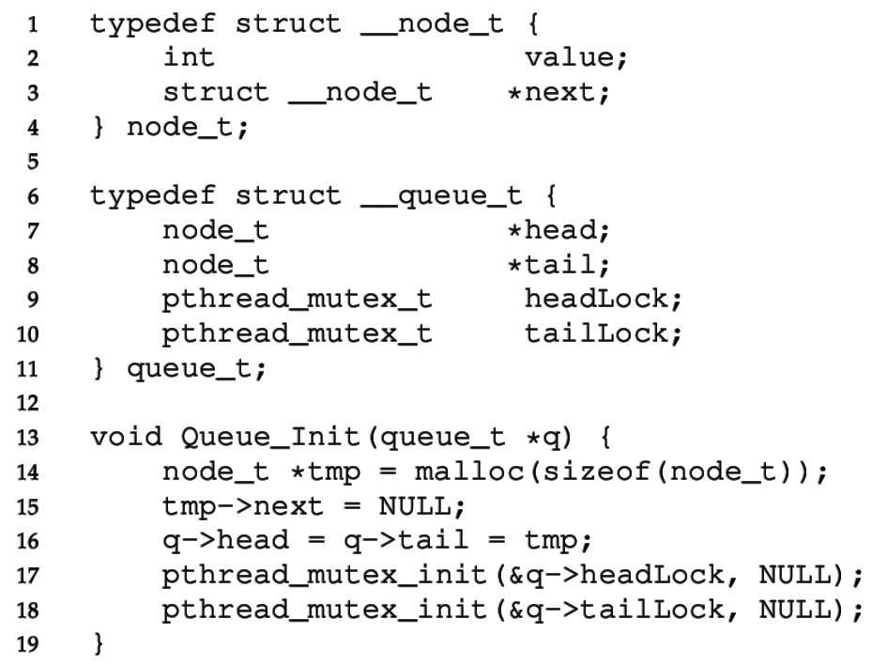

Concurrent Queue
Separate head & tail locks
Allows concurrent add & remove
Up to 2 threads can access without waiting

Slide 70
Concurrent Queue
“tailLock” controls adding elements
Looks similar to ListInsert

Slide 71
Concurrent Queue
Head lock controls removing elements from front
Needs to lock almost entire function

Slide 72
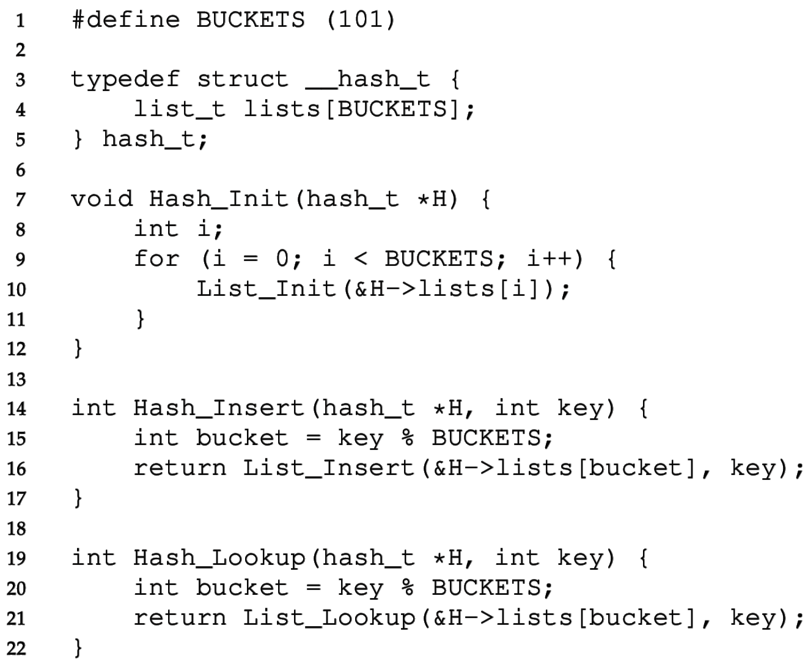
Concurrent Hash Table
Each bucket is implemented with a Concurrent List
We don’t have to define any locks!
(Locks are in the lists)
A thread can access a bucket without blocking other threads’ access to other buckets.
Hash tables are ideal for concurrency.
Hash (bucket id) can be calculated without accessing a shared resource.
Distributed hash tables are used for huge NoSQL databases.

Slide 73
Lock-free data structures
In our original example, we put a lock around counter++
We could have instead used atomic_fetch_and_add to update counter
Lock-free and still atomic!!
This is possible with more complex data structures as well
Often based on a compare-and-swap (CAS) approach
https://www.cs.cmu.edu/~410-s05/lectures/L31_LockFree.pdf
Warning: these are not to be taken lightly
Atomic instructions have performance costs on processors
Getting this correct involves really understanding hardware
https://abseil.io/docs/cpp/atomic_danger

Slide 74
Break + Question: Where is the critical section for vector?
typedef struct { size_t size; size_t count; int** data; } vector_t; void vector_add(vector_t* v, int* item) { if (v->count == v->size) { v->size *= 2; v->data = realloc(v->data, sizeof(int*)*v->size); } v->data[v->count++] = item; }

Slide 75
Break + Question: Where is the critical section for vector?
typedef struct { size_t size; size_t count; int** data; } vector_t; void vector_add(vector_t* v, int* item) { if (v->count == v->size) { v->size *= 2; v->data = realloc(v->data, sizeof(int*)*v->size); } v->data[v->count++] = item; }

