Slide 1
Lecture 08: Synchronization Bugs
CS343 – Operating Systems
Branden Ghena – Fall 2022
Some slides borrowed from: Stephen Tarzia (Northwestern), Harsha Madhyastha (Michigan), Shivaram Venkataraman (Wisconsin), and UC Berkeley CS162

Slide 2
Today’s Goals
Common synchronization bugs
Deadlock
Livelock
Methods to avoid, prevent, and recover in the presence of deadlock
Discuss how thread-safe data structures might work
Touch on what concurrency looks like in other languages

Slide 3
Outline
Synchronization bugs
Deadlock
Solving deadlocks
Livelock
Priority Inversion
Threadsafe data structures
Concurrency in other languages

Slide 4
Common synchronization bugs
Atomicity violation
Critical section is violated (due to missing lock)
Order violation
Something happens sooner (or later) than expected
Deadlock
Two threads wait indefinitely on each other
Livelock (not that common in practice)
Two threads repeatedly block each other from proceeding and retry

Slide 5
Atomicity violation
It’s relatively easy to find and protect critical sections,
But often we forget to add locks around other uses of the shared data.
Obvious critical section is here:
Two threads should not enter this at once
But, we also have to make sure that file is not modified elsewhere.
Even if this one-line close was atomic we have to make sure it doesn’t run during the above critical section.
Main Thread
lock(lck);
if (file == NULL) {
file = open("~/myfile.txt");
}
write(file, "hello file");
unlock(lck);
…
Some Other Thread
close(file); // whoops!!

Slide 6
Order violation
Code often requires a certain ordering of operations, especially:
Objects must be initialized before they’re used
Objects cannot be freed while they are still in use
Parent
file = open("file.dat");
thread_create(child_fcn);
// do some work
…
close(file);
Child Thread
child_fcn() {
write(file, "hello");
}
Close must happen after write, but code does not enforce this ordering.

Slide 7
Why is this difficult?
It seems like we can just add lots of locks and semaphores to be safe, right?
Still tricky! Too many locks can cause deadlock – indefinite waiting.
How about just one big lock?
(+) Cannot deadlock with one lock (unless there are interrupts)
(–) However, this would limit concurrency
If every task requires the same lock, then unrelated tasks cannot proceed in parallel.
Concurrent code is always difficult to write ☹
Although somewhat easier with some higher-level languages

Slide 8
Locking granularity
Coarse grained lock:
Use one (or a few) locks to protect all (or large chunks of) shared state
Linux kernel < version 2.6.39 used one “Big Kernel Lock”
Essentially only one thread (CPU core) could run kernel code
It’s simple but there is much contention for this lock, and concurrency is limited
Fine grained locks:
Use many locks, each protecting small chunks of related shared state
Leads to more concurrency and better performance
However, there is greater risk of deadlock

Slide 9
Outline
Synchronization bugs
Deadlock
Solving deadlocks
Livelock
Priority Inversion
Threadsafe data structures
Concurrency in other languages

Slide 10
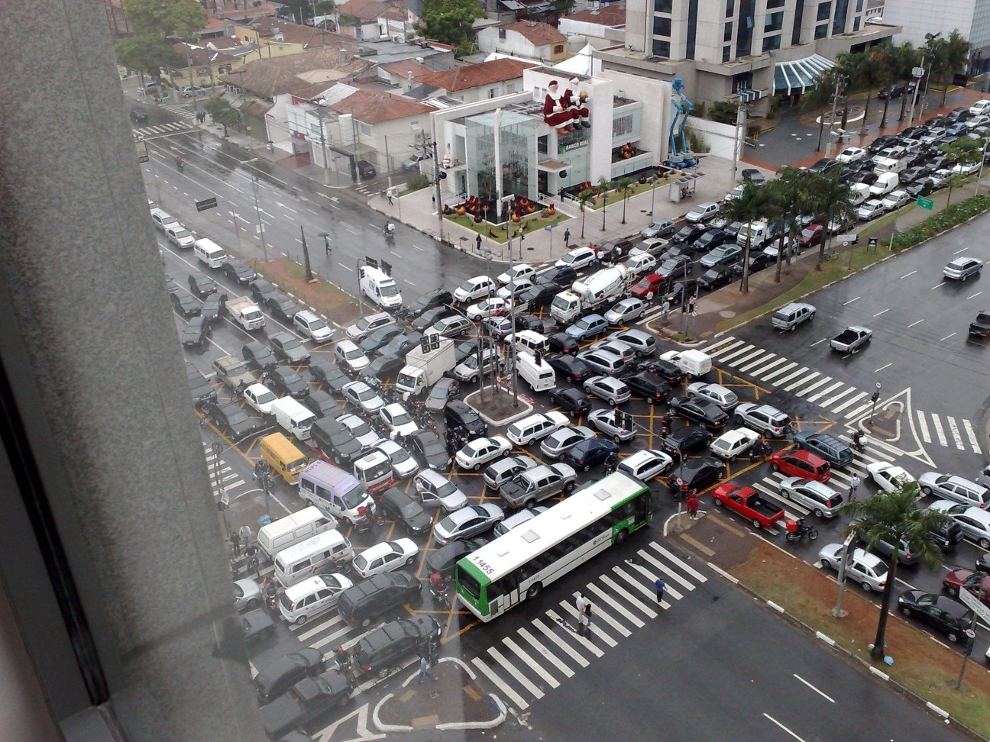

Slide 11
Deadlock
A concurrency bug arising when:
Two threads are each waiting for the other to release a resource.
While waiting, the threads cannot release the resource already held.
Or at least do not release it
So the two threads wait forever.
Can arise when multiple shared resources are used.
For example, acquiring two or more locks.

Slide 12
Deadlock versus starvation
Honk!
Each segment of road can be viewed as a resource
Car must own the segment under them
Must acquire segment that they are moving into
Deadlock: Two cars in opposite directions meet in middle
Starvation (not deadlock): Eastbound traffic doesn’t stop for westbound traffic

Slide 13
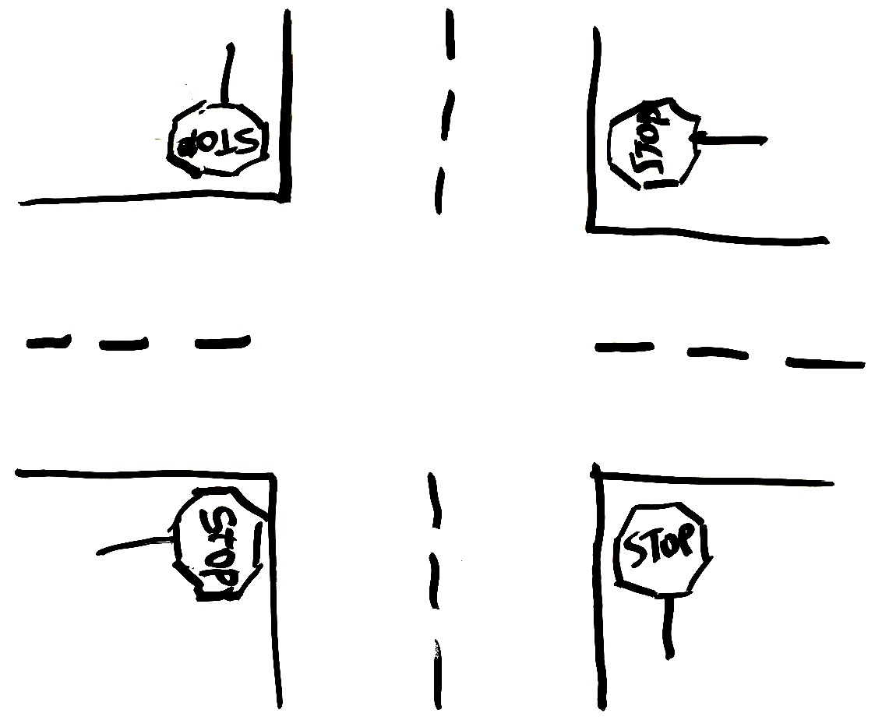

Simple example: four-way stop
Traffic rules state that you must yield to the car on your right if you reach the intersection simultaneously.
This rule usually works well.
But there’s a problem if four cars arrive simultaneously.
Circular waiting!

Slide 14
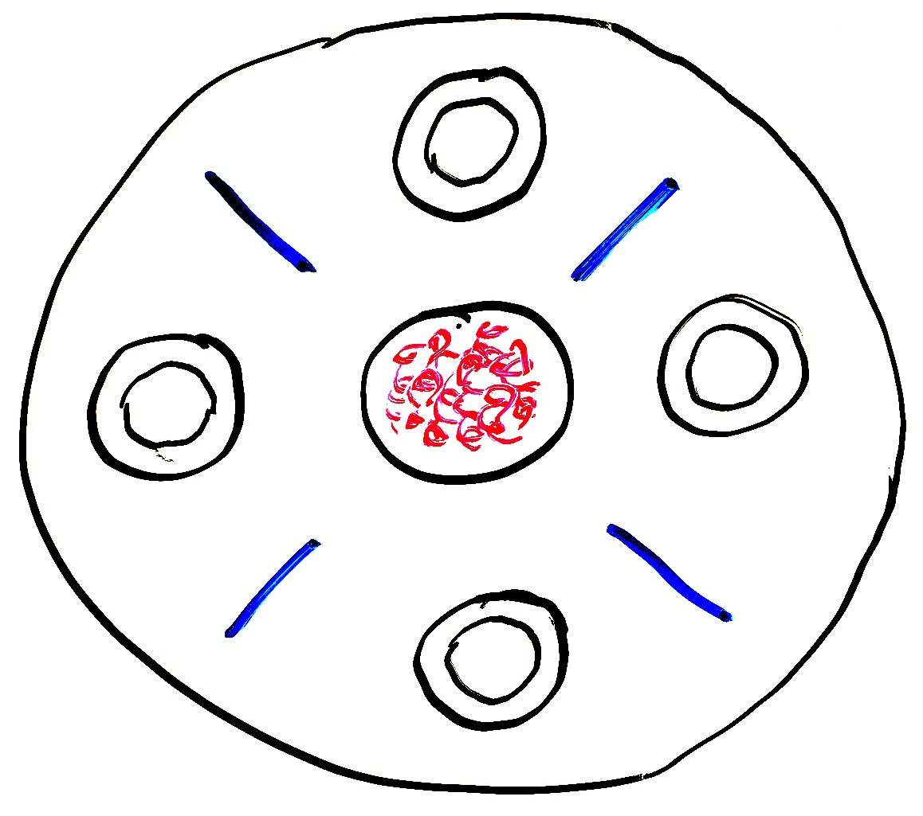
Dining philosophers
A theoretical example of deadlock
There are N philosophers sitting in a circle and N chopsticks
left and right of each philosopher
Philosophers repeatedly run this loop:
Think for some time
Grab chopstick to left
Grab chopstick to right
Eat
Replace chopsticks
If they all grab the left chopstick simultaneously (step 2), they will deadlock and starve!

Slide 15
Dining philosophers
A theoretical example of deadlock
There are N philosophers sitting in a circle and N chopsticks
left and right of each philosopher
Philosophers repeatedly run this loop:
Think for some time
Grab chopstick to left
Grab chopstick to right
Eat
Replace chopsticks
If they all grab the left chopstick simultaneously (step 2), they will deadlock and starve!
A solution: one philosopher must grab right before left

Slide 16
Dining philosophers
A solution: one philosopher must grab right before left

Slide 17
Dining philosophers
A solution: one philosopher must grab right before left

Slide 18
Dining philosophers
A solution: one philosopher must grab right before left
Adding an asymmetry will allow both resources to eventually be obtained

Slide 19
Deadlock with locks
This is a Nondeterministic Deadlock
Whether it occurs depends on scheduling
Thread A
x.Acquire();
y.Acquire();
…
y.Release();
x.Release();
Thread B
y.Acquire();
x.Acquire();
…
x.Release();
y.Release();

Slide 20
No deadlock in the lucky case
Thread A
x.Acquire();
y.Acquire();
…
y.Release();
x.Release();
Thread B
y.Acquire();
x.Acquire();
…
x.Release();
y.Release();
Thread B waits until Thread A is finished

Slide 21
But deadlock can still occur
Thread A
x.Acquire();
y.Acquire();
…
y.Release();
x.Release();
Thread B
y.Acquire();
x.Acquire();
…
x.Release();
y.Release();
Thread A waits until y is available
Thread B waits until x is available
--Unreachable--

Slide 22
Deadlocks involve circular dependencies
Thread
A
Owned
By
Wait
For
Lock x
Lock y
Thread
B
Owned
By
Wait
For

Slide 23
Deadlock can occur on any shared resource
Example deadlock if the system only has 2 MB of memory
Could deadlock on access to hardware as well
Thread A
AllocateOrWait(1 MB)
AllocateOrWait(1 MB)
Free(1 MB)
Free(1 MB)
Thread B
AllocateOrWait(1 MB)
AllocateOrWait(1 MB)
Free(1 MB)
Free(1 MB)

Slide 24
Interrupts can cause deadlocks too
Thread cannot continue until the interrupt is finished
Interrupt cannot finish until the thread continues
Thread A
acquire()
…
release()
Interrupt Handler
acquire()
Deadlock

Slide 25
Reentrant library functions
Functions that can safely and successfully be called again while currently in the middle of its execution are called “reentrant”
Reentrant functions must only modify local variables and input
Must also never call non-reentrant functions
malloc() is thread-safe because it uses locks around shared memory
Malloc is NOT reentrant and it will cause deadlock
Same goes for printf!!!
Must not be called in an interrupt or signal handler!
This matters in PCLab too

Slide 26
Break + Check your understanding
void List_Insert(list_t *L, int key) {
pthread_mutex_lock(&L->lock);
node_t *new = malloc(sizeof(node_t));
if (new == NULL) {
perror("malloc");
pthread_mutex_unlock(&L->lock);
return; // fail
}
new->key = key;
new->next = L->head;
L->head = new;
pthread_mutex_unlock(&L->lock);
return; // success
}
Is it safe to call List_Insert from an interrupt?

Slide 27
Break + Check your understanding
void List_Insert(list_t *L, int key) {
pthread_mutex_lock(&L->lock);
node_t *new = malloc(sizeof(node_t));
if (new == NULL) {
perror("malloc");
pthread_mutex_unlock(&L->lock);
return; // fail
}
new->key = key;
new->next = L->head;
L->head = new;
pthread_mutex_unlock(&L->lock);
return; // success
}
Not safe! If another thread has acquired the mutex, there will be a deadlock

Slide 28
Outline
Synchronization bugs
Deadlock
Solving deadlocks
Livelock
Priority Inversion
Threadsafe data structures
Concurrency in other languages

Slide 29
How Should a System Deal With Deadlock?
Three different approaches:
Deadlock avoidance: dynamically delay resource requests so deadlock doesn’t happen
Deadlock prevention: write your code in a way that it isn’t prone to deadlock
Deadlock recovery: let deadlock happen, and then figure out how to recover from it

Slide 30
Deadlock avoidance
Idea: When a thread requests a resource, OS checks if it would result in an unsafe state that could lead to deadlock
If not, grant the resource
If so, wait until other threads release resources
Must stop acquire here to prevent unsafe state
Thread A
x.Acquire();
y.Acquire();
…
y.Release();
x.Release();
Thread B
y.Acquire();
x.Acquire();
…
x.Release();
y.Release();

Slide 31
Banker’s Algorithm for avoiding deadlock
Each thread states maximum resource needs in advance
OS allows a particular thread to claim a resource if
(available resources - requested) ≥ maximum remaining that might be needed by any thread
For Dining Philosophers, a request for a chopstick is allowed if:
Not the last chopstick
Or is the last chopstick but a philosopher will have two afterwards
See the textbook for more details

Slide 32
How Should a System Deal With Deadlock?
Three different approaches:
Deadlock avoidance: dynamically delay resource requests so deadlock doesn’t happen
Deadlock prevention: write your code in a way that it isn’t prone to deadlock
Deadlock recovery: let deadlock happen, and then figure out how to recover from it

Slide 33
Preventing Deadlocks: deadlock requires four conditions
Mutual exclusion
Threads cannot access a critical section simultaneously.
In other words, we’re using locks so there is the potential for waiting.
Hold-and-wait
Threads do not release locks while waiting for additional locks.
No preemption
Locks are always held until released by the thread.
E.g., if there is no method to cancel a lock.
Circular wait
Thread is waiting on a thread that is waiting on the original thread.
This can involve just two threads or a chain of many threads.
Can eliminate deadlock by eliminating any one of these conditions

Slide 34
1. Do not have mutual exclusion
Lockfree/waitfree data structures
void* mythread(void* arg) {
for (int i=0; i<LOOPS; i++) { pthread_mutex_lock(&lock);
counter++;
pthread_mutex_unlock(&lock);
}
return NULL;
}
void* mythread(void* arg) {
for (int i=0; i<LOOPS; i++) { atomic_fetch_and_add( &counter, 1);
}
return NULL;
}

Slide 35
Lockfree data structures
void insert(int val) {
node_t* n = malloc(sizeof(node_t)); n->val = val;
acquire(&m);
n->next = head;
head = n;
release(&m);
}
void insert(int val) {
node_t* n = malloc(sizeof(node_t)); n->val = val; do { n->next = head;
} while (!cas(&head, n->next, n));
}
atomic_compare_and_swap(destptr, oldval, newval)
If *destptr == oldval { *destptr = newval, return True }
Else { return false }

Slide 36
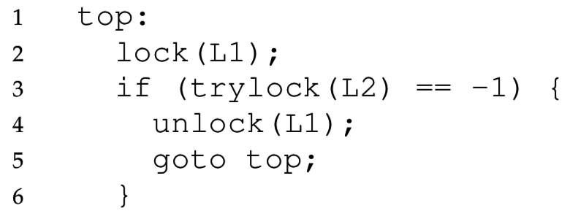
2. Avoid hold and wait with trylock()
We can avoid deadlock if we release the first lock after noticing that the second lock is unavailable.
Trylock() tries to acquire a lock, but returns a failure code instead of waiting if the lock is taken:
This code cannot deadlock, even if another thread does the same with L2 first, then L1.
However it can livelock… we’ll come back to this

Slide 37
3. No preemption
The OS could take away the lock from a blocked thread and give it back before the thread resumes
This sounds pretty complicated to get right
Non-lock resources are easier here
Temporarily take away memory from a thread by swapping it to disk

Slide 38
4. Avoiding Circular Wait
This is the most practical way to avoid deadlock.
The simplest solution is to always acquire locks in the same order.
If you hold lock X and are waiting for lock Y,
Then holder of Y cannot be waiting on you,
Because they would have already acquired X before acquiring Y.
However, in practice it can be difficult to know when locks will be acquired because they can be buried in subroutines.

Slide 39
Ordered locking for dining philosophers
The chopsticks are shared resources, like locks
If we require the lower-numbered chopstick to be grabbed first, this eliminates circular waiting.
Philosophers A, B, C grab left then right.
However philosopher D will grab right then left.
If everyone tries to start at once, A & D race to grab chopstick 0 first, and the winner eats first.
While one is waiting to grab its first chopstick a neighbor will be able to grab two chopsticks.
3
2
C
B
D
A
0
1

Slide 40
Check your understanding
In what order must Thread B acquire the three locks to avoid deadlock?
Thread A
y.Acquire();
x.Acquire();
z.Acquire();
…
z.Release();
x.Release();
y.Release();
Thread B
???

Slide 41
Check your understanding
In what order must Thread B acquire the three locks to avoid deadlock?
The same order!! (at least y first, for the two-thread case)
Thread A
y.Acquire();
x.Acquire();
z.Acquire();
…
z.Release();
x.Release();
y.Release();
Thread B
y.Acquire();
x.Acquire();
z.Acquire();
…
z.Release();
x.Release();
y.Release();

Slide 42
How Should a System Deal With Deadlock?
Three different approaches:
Deadlock avoidance: dynamically delay resource requests so deadlock doesn’t happen
Deadlock prevention: write your code in a way that it isn’t prone to deadlock
Deadlock recovery: let deadlock happen, and then figure out how to recover from it

Slide 43
Deadlock Recovery: how to deal with a deadlock?
Terminate thread, force it to give up resources
Dining Philosophers Example: Remove a dining philosopher
In AllocateOrWait example, OS kills a process to free up some memory
Not always possible—killing a thread holding a lock leaves world inconsistent
Roll back actions of deadlocked threads
Common techniques in databases (transactions)
Of course, if you restart in exactly the same way, you may enter deadlock again

Slide 44
Modern OS approach to deadlocks
Make sure the system isn’t involved in any deadlock
Hopefully by prevention
Generally, be very careful about this stuff in the kernel
Ignore deadlock in applications (“Ostrich Algorithm”)
User can just restart them anyways

Slide 45
Break + Check your understanding
Is there a possibility of deadlock?
If so, how could we fix it?
Thread A
usb.Acquire();
webcam.Acquire();
…
webcam.Release();
usb.Release();
Thread B
printer.Acquire();
usb.Acquire();
…
usb.Release();
printer.Release();
Thread C
webcam.Acquire();
printer.Acquire();
…
printer.Release();
webcam.Release();

Slide 46
Break + Check your understanding
Is there a possibility of deadlock? Yes
If so, how could we fix it? One solution: Global ordering of resources
Example: usb, then webcams, then printers always in that order
Thread A
usb.Acquire();
webcam.Acquire();
…
webcam.Release();
usb.Release();
Thread B
printer.Acquire();
usb.Acquire();
usb.Acquire();
printer.Acquire();
…
usb.Release();
printer.Release();
printer.Release();
usb.Release();
Thread C
webcam.Acquire();
printer.Acquire();
…
printer.Release();
webcam.Release();

Slide 47
Break + Check your understanding
Is there a possibility of deadlock? Yes
If so, how could we fix it? One big lock still works too!
Thread A
lock.acquire();
usb.Acquire();
webcam.Acquire();
…
webcam.Release();
usb.Release();
lock.release();
Thread B
lock.acquire();
printer.Acquire();
usb.Acquire();
…
usb.Release();
printer.Release();
lock.release();
Thread C
lock.acquire();
webcam.Acquire();
printer.Acquire();
…
printer.Release();
webcam.Release();
lock.release();

Slide 48
Outline
Synchronization bugs
Deadlock
Solving deadlocks
Livelock
Priority Inversion
Threadsafe data structures
Concurrency in other languages

Slide 49
Common synchronization bugs
Atomicity violation
Critical section is violated (due to missing lock)
Order violation
Something happens sooner (or later) than expected
Deadlock
Two threads wait indefinitely on each other
Livelock (not that common in practice)
Two threads repeatedly block each other from proceeding and retry

Slide 50
Livelock while avoiding deadlock
// thread 1
getLocks12(lock1, lock2) {
lock1.acquire();
while (lock2.locked()) {
// attempt to step aside // for the other thread
lock1.release();
wait();
lock1.acquire();
}
lock2.acquire();
}
// thread 2
getLocks21(lock1, lock2) {
lock2.acquire();
while (lock1.locked()) {
// attempt to step aside // for the other thread
lock2.release();
wait();
lock2.acquire();
}
lock1.acquire();
}

Slide 51
Avoiding hold and wait could lead to livelock
Avoiding hold and wait can livelock
Two threads could get stuck in this loop forever
Unlikely to occur for any length in personal computing setting
Very possibly stuck forever (or at least extended periods) in a constrained computing setting
Example: embedded system with known tasks at the start

Slide 52

Livelock in agents
Livelock is more common in agent-based programs
All of agent’s options lead to a lack of forward progress
One example: video games
The character can still move and take actions
But cannot complete the level

Slide 53
Livelock versus Deadlock
Livelock is a condition where two threads repeatedly take action, but still don’t make progress.
Differs from deadlock because deadlock is always permanent.
Livelock involves retries that may lead to progress, but there is no guarantee of progress.
A malicious scheduler can always keep the livelock stuck
Any randomness in the timing of retries will fix livelock.
In practice, livelock is a much less serious concern than deadlock.

Slide 54
Helgrind tool
Helgrind (part of the Valgrind tool) detects many common errors when using the POSIX pthreads library in C & C++, such as:
Race conditions (missing locks)
Lock ordering problems (leading to deadlock)
Double-unlocking
Freeing a locked lock
… and much, much more
http://valgrind.org/docs/manual/hg-manual.html

Slide 55
Outline
Synchronization bugs
Deadlock
Solving deadlocks
Livelock
Priority Inversion
Threadsafe data structures
Concurrency in other languages

Slide 56
Systems interact with each other
Scheduling and Concurrency problems are not exclusive
Sharing mutexes between threads can lead to a big problem for schedulers based on priority
Especially dangerous for real-time OS scenarios

Slide 57
A problem with priority schedulers: priority inversion
Other concepts from OS still apply when we’re scheduling
Particularly locks and synchronization
Imagine Task 1 and Task 3 both need to share a lock
Release lock
Task 1 is waiting on Task 2!!
Task 1
Acquire lock
Priority
block
done
Task 2
preempt
preempt
release
Task 3
0
2
4
6
8
10

Slide 58
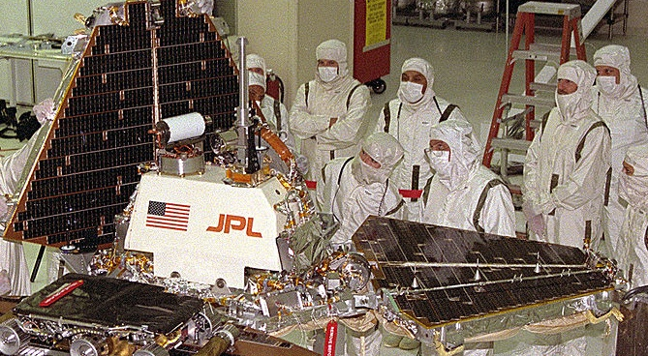
Priority inversion occurred on Pathfinder!
Bus management missed deadlines while waiting on meteorology because medium-priority tasks were taking too long
System rebooted when deadline was missed
Manage Bus
Priority
block
done
Comms
preempt
preempt
release
Weather
0
2
4
6
8
10
Notes:
Glenn Reeves is the guy at JPL who wrote up the report on this
Still there working on flight software as of 2013 (and happy to talk to summer interns about it!)

Slide 59
Priority inheritance solution to priority inversion
A solution is to temporarily increase priority for tasks holding resources that high priority tasks need
Task 3 inherits priority of Task 1 while holding lock Task 1 needs
Release lock
Task 1
done
Acquire lock
Priority
Task 2
preempt
block
release
Preempted by Task 3
done
Task 3
At Priority 1
0
2
4
6
8
10

Slide 60
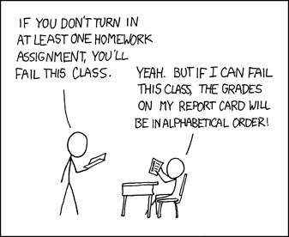
Quick Break! + xkcd (not relevant, just funny)
https://xkcd.com/336/

Slide 61
Outline
Synchronization bugs
Deadlock
Solving deadlocks
Livelock
Priority Inversion
Threadsafe data structures
Concurrency in other languages

Slide 62
Thread-safe data structures
“Thread safe” – works even if used by multiple threads concurrently
Can apply to various libraries, functions, and data structures
Simple data structures implementations are usually not thread safe
Some global state needs to be shared among all threads
Need to protect critical sections
Challenge: multiple function calls each access same shared structure
Need to identify the critical section in each and lock it with shared lock

Slide 63
Linked List
void List_Insert(list_t *L, int key) {
node_t *new = malloc(sizeof(node_t));
if (new == NULL) {
perror("malloc");
return; // fail
}
new->key = key;
new->next = L->head;
L->head = new;
return; // success
}

Slide 64
Concurrent Linked List – Big lock approach
void List_Insert(list_t *L, int key) {
pthread_mutex_lock(&L->lock);
node_t *new = malloc(sizeof(node_t));
if (new == NULL) {
perror("malloc");
pthread_mutex_unlock(&L->lock);
return; // fail
}
new->key = key;
new->next = L->head;
L->head = new;
pthread_mutex_unlock(&L->lock);
return; // success
}
Most important part of this example. Don’t forget to unlock if returning early.
Much better than counter example, because we are only serializing the list itself. Hopefully the rest of the code can run concurrently.

Slide 65
Better Concurrent Linked List – Only lock critical section
void List_Insert(list_t *L, int key) {
node_t *new = malloc(sizeof(node_t));
if (new == NULL) {
perror("malloc");
return; // fail
}
new->key = key;
new->next = L->head;
L->head = new;
return; // success
}
Check your understanding:
Where is the critical section here?

Slide 66
Better Concurrent Linked List – Only lock critical section
void List_Insert(list_t *L, int key) {
node_t *new = malloc(sizeof(node_t));
if (new == NULL) {
perror("malloc");
return; // fail
}
new->key = key;
new->next = L->head;
L->head = new;
return; // success
}
Check your understanding:
Where is the critical section here?

Slide 67
What about malloc? Is that safe to use??
void List_Insert(list_t *L, int key) {
node_t *new = malloc(sizeof(node_t));
if (new == NULL) {
perror("malloc");
return; // fail
}
new->key = key;
new->next = L->head;
L->head = new;
return; // success
}
Thread-safe functions
Capable of being called concurrently and still functioning correctly
(Because they use locks!)
How would we know if malloc is thread-safe?
Must check the documentation

Slide 68
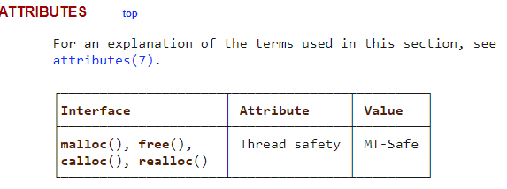
Must check the library documentation to determine thread safety
https://man7.org/linux/man-pages/man3/malloc.3.html
Malloc (and free) is indeed thread-safe
If it wasn’t, we would have to consider it another shared resource that needs to be locked

Slide 69
Better Concurrent Linked List – Only lock critical section
void List_Insert(list_t *L, int key) {
node_t *new = malloc(sizeof(node_t));
if (new == NULL) {
perror("malloc");
return; // fail
}
new->key = key;
pthread_mutex_lock(&L->lock);
new->next = L->head;
L->head = new;
pthread_mutex_unlock(&L->lock);
return; // success
}
Now new node is created locally in parallel
Only actual access to the linked list is serialized

Slide 70
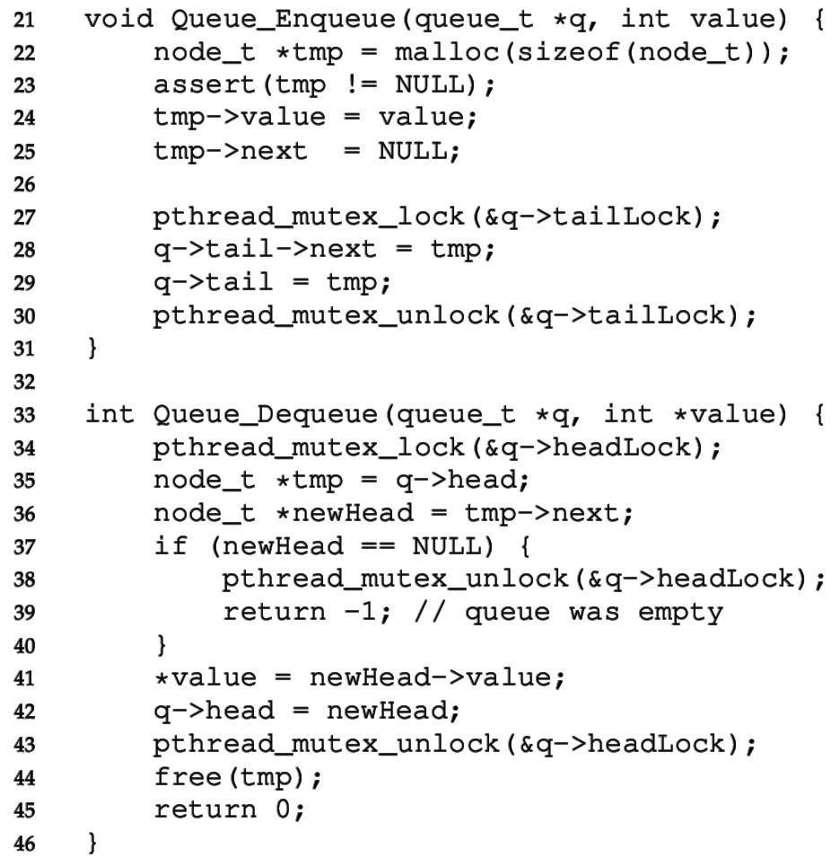

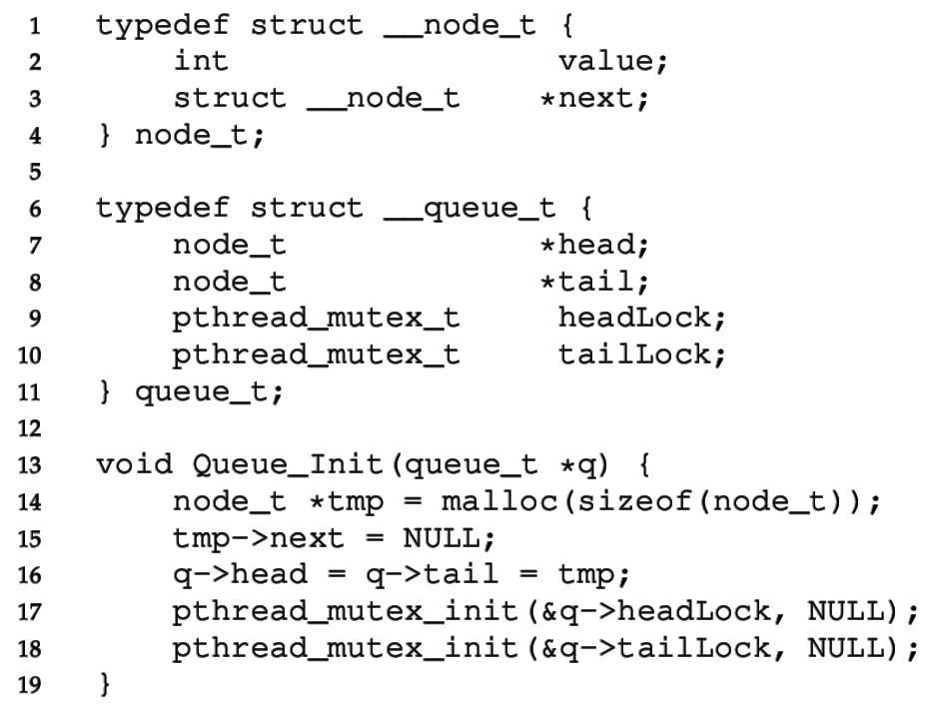

Concurrent Queue
Separate head & tail locks
Allows concurrent add & remove
Up to 2 threads can access without waiting

Slide 71
Concurrent Queue
“tailLock” controls adding elements
Looks similar to ListInsert

Slide 72
Concurrent Queue
Head lock controls removing elements from front
Needs to lock almost entire function

Slide 73
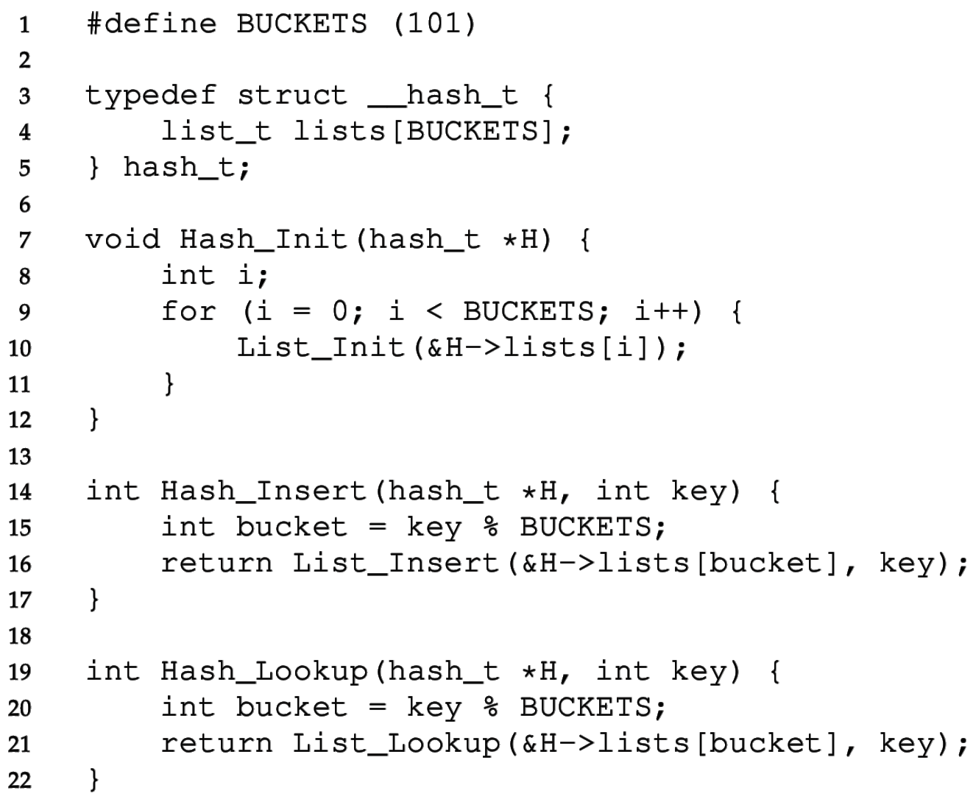
Concurrent Hash Table
Each bucket is implemented with a Concurrent List
We don’t have to define any locks!
(Locks are in the lists)
A thread can access a bucket without blocking other threads’ access to other buckets.
Hash tables are ideal for concurrency.
Hash (bucket id) can be calculated without accessing a shared resource.
Distributed hash tables are used for huge NoSQL databases.

Slide 74
Lock-free data structures
In our original example, we put a lock around counter++
We could have instead used atomic_fetch_and_add to update counter
Lock-free and still atomic!!
This is possible with more complex data structures as well
Often based on a compare-and-swap (CAS) approach
https://www.cs.cmu.edu/~410-s05/lectures/L31_LockFree.pdf
Warning: these are not to be taken lightly
Atomic instructions have performance costs on processors
Getting this correct involves really understanding hardware
https://abseil.io/docs/cpp/atomic_danger

Slide 75
Break + Question: Where is the critical section for vector?
typedef struct { size_t size; size_t count; int** data; } vector_t; void vector_add(vector_t* v, int* item) { if (v->count == v->size) { v->size *= 2; v->data = realloc(v->data, sizeof(int*)*v->size); } v->data[v->count++] = item; }

Slide 76
Break + Question: Where is the critical section for vector?
typedef struct { size_t size; size_t count; int** data; } vector_t; void vector_add(vector_t* v, int* item) { if (v->count == v->size) { v->size *= 2; v->data = realloc(v->data, sizeof(int*)*v->size); } v->data[v->count++] = item; }

Slide 77
Outline
Synchronization bugs
Deadlock
Solving deadlocks
Livelock
Priority Inversion
Threadsafe data structures
Concurrency in other languages

Slide 78
Javascript
Javascript (in browsers) is strictly single-threaded
Therefore, no data races!
A Javascript function will never be interrupted unless it makes an asynchronous call
console.log("1");
setTimeout(function(){console.log("2");},0);
console.log("3");
setTimeout(function(){console.log("4");},1000);
Will always output: 1 3 2 4 in that order
Even timers only trigger whenever the current code is finished

Slide 79
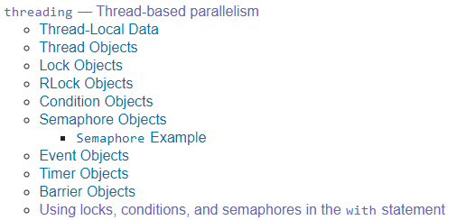
Python
Provides all the same primitives we discussed! https://docs.python.org/3/library/concurrency.html
And some nicer things
with some_lock:
# do something…
Is equivalent to
some_lock.acquire() try: # do something…
finally: some_lock.release()

Slide 80
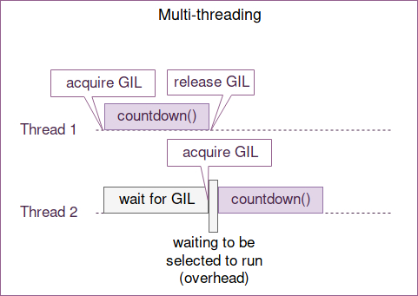
Python threads are concurrent but not parallel
Python uses one big lock technique for thread safety
Global Interpreter Lock (GIL)
Threads that are I/O bound still get a performance boost
Threads that are CPU bound do not increase performance
Multiprocessing library does employ parallelism by spawning entirely new processes
Each with their own python interpreter
https://hackernoon.com/concurrent-programming-in-python-is-not-what-you-think-it-is-b6439c3f3e6a

Slide 81
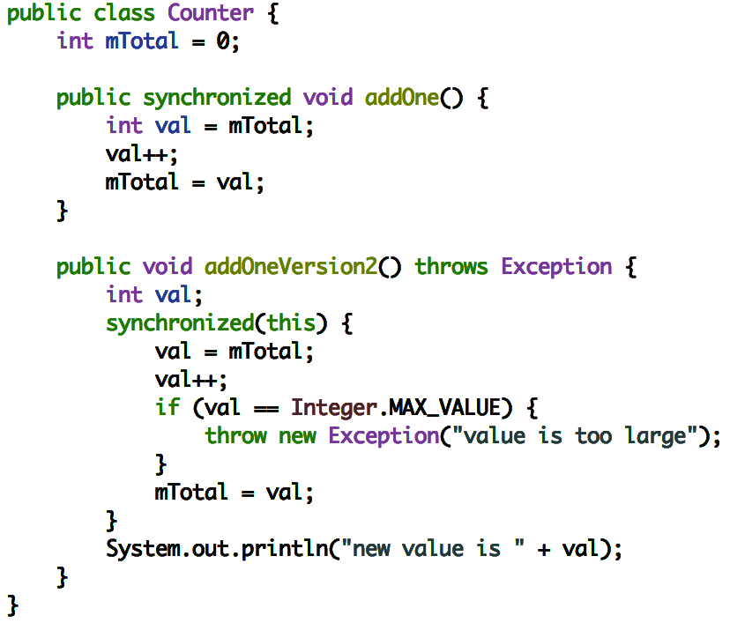
Java
Java has synchronized keyword for surrounding critical sections
Automatically releases the lock when exiting early:
Similar to
Python: “with self.lock:”
Objective-C: “@synchronized”

Slide 82
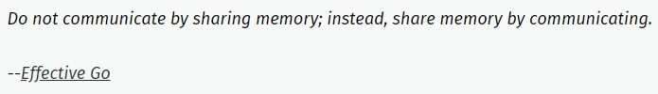
Rust
Rust’s opinion on sharing memory is amusingly to refer to Go’s opinion
Rust has a strong concept of ownership
A writeable (mutable) reference to an object can only be held in one place
Once an object is passed to another thread, the passer no longer has access
Solves many concurrency issues due to lack of shared memory
Rust locks have lifetimes enforced by the compiler
Lock goes out-of-scope at the end of the function, relocking automatically
https://blog.rust-lang.org/2015/04/10/Fearless-Concurrency.html

Slide 83
Advice for the future
Be aware of issues when writing multithreaded code
Use threadsafe data structures when possible
In languages that provide them…
Map your problem onto a classical concurrency problem
Producer/Consumer
Readers/Writers
One big lock for correctness isn’t the worst idea ever
But with some care (possibly a lot of care) we can do better

Slide 84
Outline
Synchronization bugs
Deadlock
Solving deadlocks
Livelock
Priority Inversion
Threadsafe data structures
Concurrency in other languages

