Slide 1
Lecture 16: Filesystem Implementations
CS343 – Operating Systems
Branden Ghena – Fall 2022
Some slides borrowed from: Stephen Tarzia (Northwestern), Shivaram Venkataraman (Wisconsin), Ed Lazowska (Washington), and UC Berkeley CS162

Slide 2
Administrivia
Office hours plan for quarter
Today has a small change due to illness (see Campuswire)
Next week we’ll do Monday and Tuesday hours as normal
Wednesday-Friday are canceled
After Thanksgiving we’ll do the entire week of office hours as normal
Reminder: get started on Paging Lab now
Not the best life decision to start it after Thanksgiving

Slide 3
Today’s Goals
Understand about additional filesystem features
Performance: disk caching
Reliability: checking, journaling, and copy-on-write
Explore real-world filesystem designs
FAT, FFS, ext3/ext4, NTFS, ZFS

Slide 4
File systems abstractions
I/O API and
syscalls
Variable-Size Buffer
Memory Address
Logical Index, Typically 4 KB
File System
Block
Flash Trans. Layer
Hardware Devices
Sector(s)
Sector(s)
Sector(s)
Phys. Block
Phys Index., 4KB
Physical Index,
512B or 4KB
Erasure Page
HDD
SSD

Slide 5
What goes within a partition?
Partition
Header (Superblock)
Details about which filesystem this is
Metadata about the filesystem
Free Space Tracking
Likely a bitmap of whether blocks are used/free
File Tracking
Either allocation table or inodes
File Data
Header
Free Space Tracking
File Tracking
File Data

Slide 6
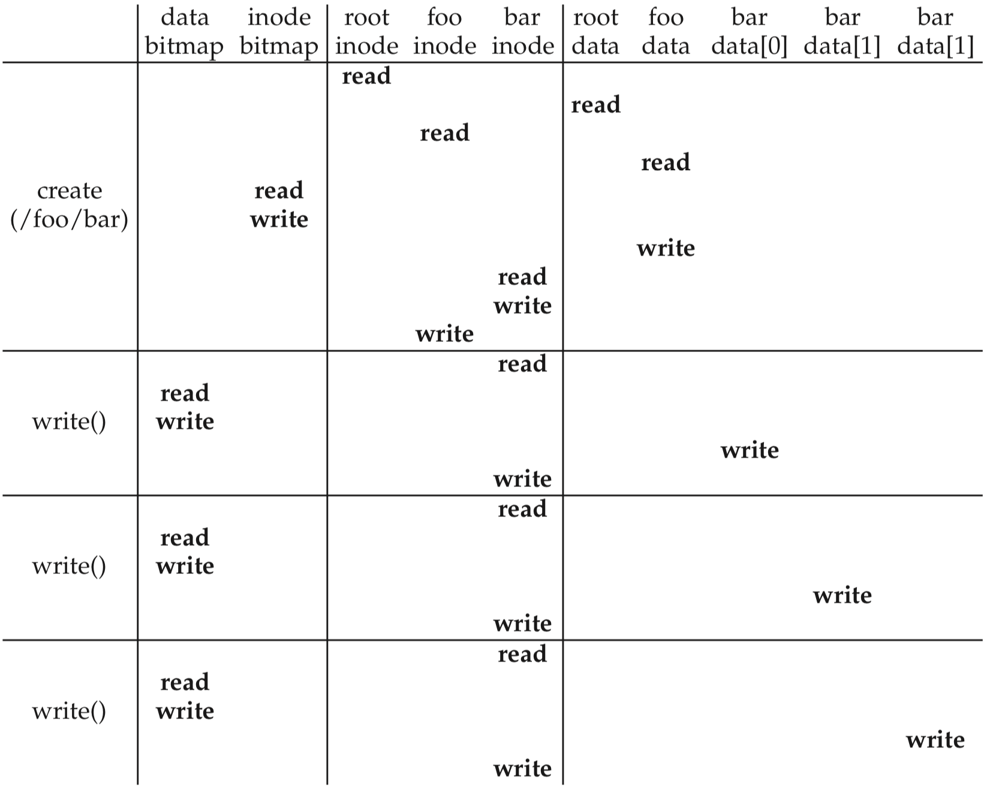
Create and write a file
Create:
First, read the parent directory to ensure that name is not already used.
Find & claim a free inode.
Add <“name”, inode#> to parent directory.
Fill-in file metadata.
1
2
3
4

Slide 7
Create and write a file
Create:
First, read the parent directory to ensure that name is not already used.
Find & claim a free inode.
Add <“bar”, inode#> to parent directory.
Fill-in file metadata.
Write:
Look for remaining space in existing blocks first.
Find & claim a new data block.
Write data to new block
Point to it in inode
1
2
3
4
1
2
3
4

Slide 8
Outline
Disk Caching
Classical Filesystems
FAT
FFS
Improving Reliability
FSCK
Journaling
Journaling Filesystems
ext3/ext4
NTFS
Copy-On-Write
ZFS

Slide 9
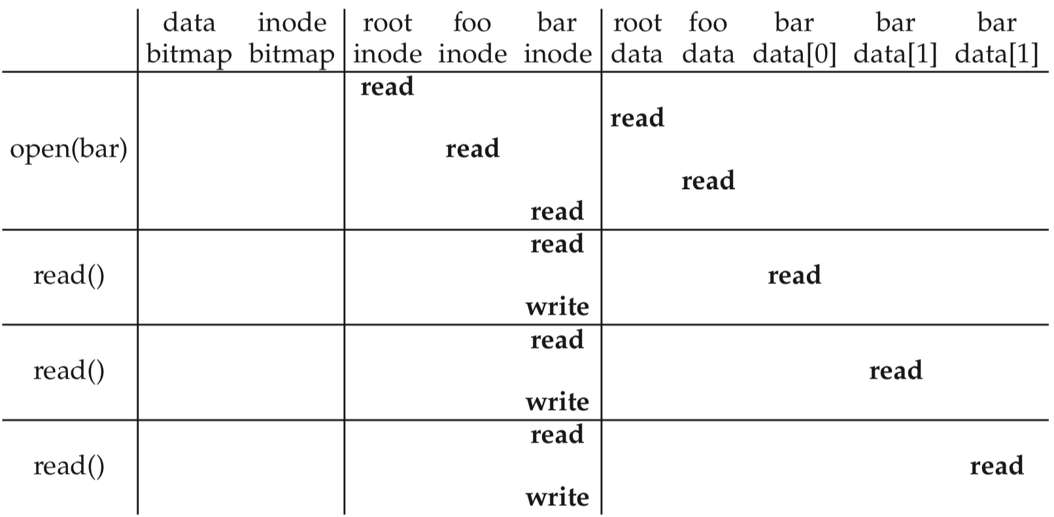
Many disk interactions should be hitting memory instead
open("/foo/bar")
time
inode reads/writes occur in memory

Slide 10
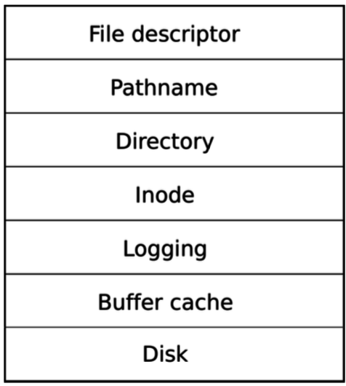
Filesystem caching
File I/O can be a significant bottleneck
So keep useful parts of disk in RAM!
Improves performance
OS kernel does this automatically
Using unused RAM to hold disk blocks

Slide 11
Goals for filesystem caching
Cache popular blocks so the disk can be accessed less frequently.
Recall that disk has 10,000× greater delay than RAM.
Reads are faster if the disk block is already in memory from a recent access.
Writes can be aggregated.
If a thread writes three times briefly to the same file, these can likely be reduced to one write to disk if the writes are delayed.
If a thread creates a new file and quickly deletes it, these writes can be skipped altogether.
Eventually, changes must be flushed to disk, but there is no rush.
Must be careful to prevent two threads from accessing different unsynchronized copies of the disk block.
i.e., make the cache coherent and avoid race conditions

Slide 12
Unified Page Cache
Page replacement policy can simultaneously consider both pages from Virtual Memory and pages cached from disk
May choose to evict either if needed
Priority:
Unwritten disk files or unmodified memory pages
Situational which is more important, but neither requires writeback
Written disk files
Going to have to be written to disk eventually anyways
Modified memory pages
Must go to swap space to be later read again

Slide 13
Prefetching
Any cache can “prefetch”, loading memory before it’s needed
Base idea: read multiple blocks from disk sequentially from each access
Advanced: load specific files based on usage patterns
Need to balance prefetching requests with other disk access
Don’t want to slow down real accesses with possibly needed prefetching

Slide 14
Short break + Question
What percentage of memory should an OS fill with disk pages?

Slide 15
Short break + Question
What percentage of memory should an OS fill with disk pages?
As long as it can do it in the background, as much as possible!
There’s no particular downside:
As long as the page wasn’t written to, the RAM can be repurposed later if needed without requiring additional writes to disk
(Maybe energy use is a downside?)

Slide 16

Real OSes aggressively cache disk in unused RAM
linuxatemyram.com

Slide 17
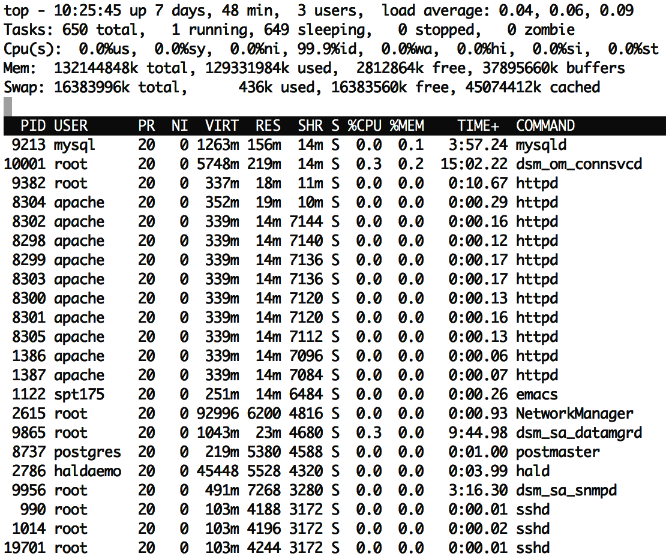
Real OSes aggressively cache disk in unused RAM
buffers and cached both represent file data that is being stored in memory for improved performance
Still available for programs
Just being made useful for now by caching disk
Might be a lot of RAM’s use for big systems
Total RAM: 128 GB
Disk cache: 83 GB

Slide 18
Outline
Disk Caching
Classical Filesystems
FAT
FFS
Improving Reliability
FSCK
Journaling
Journaling Filesystems
ext3/ext4
NTFS
Copy-On-Write
ZFS

Slide 19
FAT (FAT/FAT12/FAT16/FAT32)
File Allocation Table
FAT: Microsoft system from before MS-DOS (1977)
8 MB max file size
9 character file names
No subdirectories
FAT32: Windows 2000 (introduced 1996)
2 GB max file size
255 character file names
Supports up to 16 TB partitions
16 byte granularity for files

Slide 20
FAT design choices
Allocation table for tracking data blocks
Requires four bytes per block in the disk
File attributes need to be kept in the directory data block
Still in use for embedded systems
Simple to implement
Still compatible with modern general-purpose OSes
Works fine for relatively small disks with correspondingly small files
Think SD cards
Implements aggressive block caching

Slide 21
Fast File System (FFS)
Unix FileSystem (FS) from 1970
inode-based design (combination of all the basic stuff covered last time)
Simple and slow
inodes are far from data blocks
data blocks become fragmented over time
BSD Fast File System (mid-1980s)
First “Disk aware file system”
Understands disk seek patterns and sequential access benefits

Slide 22
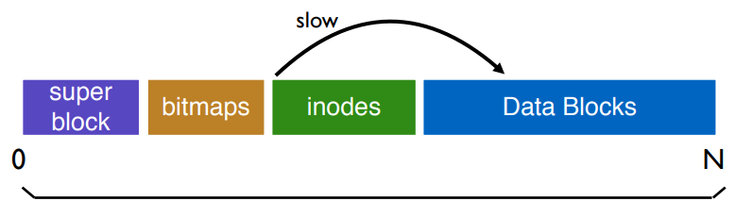
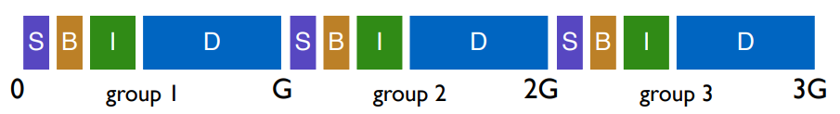
FFS groups
Split disk space into a set of “cylinder groups”
Each group has its own bitmaps, inodes, and data
Keeps data and inodes closer together

Slide 23
FFS file placement strategy
General theme: put related pieces of data near each other
Rules
Put directory data near directory inodes
Put file inodes near directory data
Put data blocks near file inodes
Example
Each directory gets put in an empty group
Keep all files within a directory in that single group

Slide 24
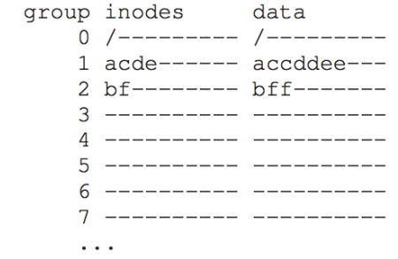
FFS example
Example:
Directories: /, /a/, and /b/
/a/ files: c, d, e
/b/ files: f

Slide 25
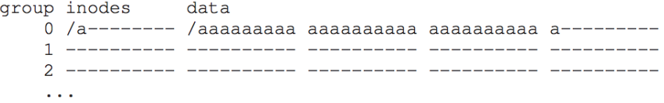
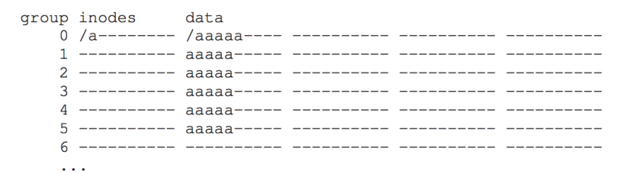
FFS large file problem
A single large file can fill nearly all of a group
So remaining files would have to be placed in other groups
Instead, limit filesize per group and place remaining blocks in other groups
Most files are small so prioritize them
Rare, large files will have worse performance

Slide 26
Outline
Disk Caching
Classical Filesystems
FAT
FFS
Improving Reliability
FSCK
Journaling
Journaling Filesystems
ext3/ext4
NTFS
Copy-On-Write
ZFS

Slide 27
Crash tolerance
Filesystems are persistent and store important data
They cannot rely on a graceful shutdown
Power outages happen
Kernel might panic
USB plug might be yanked out
File system structure updates are critical sections
Not concerned about race conditions, but rather partial updates
Transactions should be performed atomically, “all or none”
All reads and writes aren’t necessarily guaranteed
But system needs to stay consistent

Slide 28
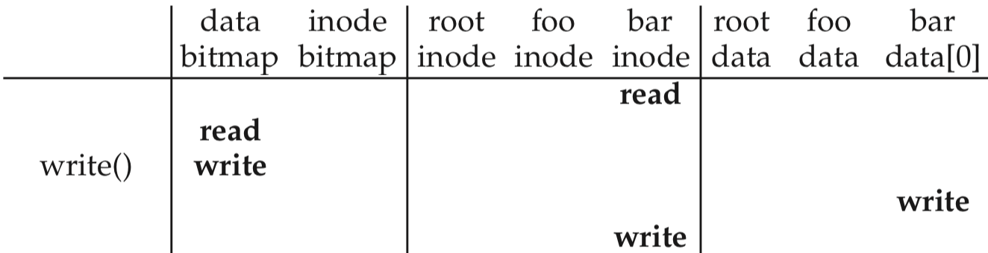
Crash example (writing to /foo/bar)
time
Crash here!
Crash before write to file’s inode could leak a data block
Data bitmap was updated to reserve data block and data was written
But the data block is not pointed to by any inode
Block ends up wasted
Other write order could be worse
Inode points to a block that hasn’t been written and has garbage data
Or block is still marked as free in the bitmap, and another file will overwrite it!!

Slide 29
File system checker (FSCK)
After a crash, scan entire disk for contradictions and “fix”
System pauses boot until FSCK completes
Example: check data bitmap consistency
Read every valid inode
Any referenced data block should be marked as used
Any used blocks that are not referenced can be marked free
Also check
Each inode should only be listed under one directory (without hard links)
Two inodes should not share a data block
All block addresses should be valid

Slide 30
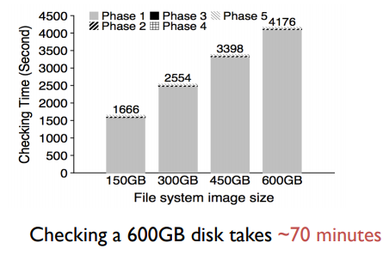
Problems with FSCK
FSCK makes disks consistent, not correct
Not always obvious how best to fix file system image
Trivial way to get consistency: reformat disk
FSCK is very slow
Reading from disk is slow
Reading ALL of disk takes a long time, especially as disks increase in size

Slide 31
Filesystem transactions
Goals
Move reliability mechanism to continuous operations during runtime
Some recovery after crash is fine, but not entire disk
Don’t just make file system consistent
Guarantee correctness
Solution: enforce atomic transactions
Each transaction must be performed in its entirety or not at all
Either all new data is visible
Or all old data is visible

Slide 32
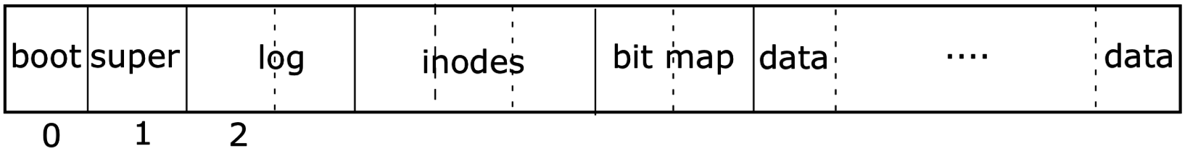
Journaling Filesystems
Write all transactions to journal instead of actual locations
Write the blocks to the log, a reserved part of the disk.
This makes a durable record of the transaction you plan to commit.
Continue putting all writes to the log, until commit is called.
On commit, write a commit message to the log, then start writing all of the logged writes where they belong on disk.
Clear the log after everything is written again.
First, stage changes in log
Later, make changes permanent

Slide 33
Journaling example
Journal
A | 0 | 0 | B | C | 0 | 0 | 0
0 | 1 | 2 | 3 | 4 | 5 | 6 | 7
0
0
0
0
0
0
Current contents of 8 blocks of disk and the journal
Note that the journal is also on disk
Keeping this abstract
Blocks could be bitmaps, inodes, data, or anything

Slide 34
Journaling example
Journal
A | 0 | 0 | B | C | 0 | 0 | 0
0 | 1 | 2 | 3 | 4 | 5 | 6 | 7
Transaction Begin
0
0
0
0
0
Write transaction start to journal

Slide 35
Journaling example
Journal
A | 0 | 0 | B | C | 0 | 0 | 0
0 | 1 | 2 | 3 | 4 | 5 | 6 | 7
Transaction Begin
Write Block 6, Data: Y
Write Block 7, Data: Z
0
0
0
Write transaction start to journal
Then actions for that transaction
Along with the data
Journal must be multiple blocks in size

Slide 36
Journaling example
Journal
A | 0 | 0 | B | C | 0 | 0 | 0
0 | 1 | 2 | 3 | 4 | 5 | 6 | 7
Transaction Begin
Write Block 6, Data: Y
Write Block 7, Data: Z
Transaction End
0
0
Write transaction start to journal
Then actions for that transaction
Along with the data
Journal must be multiple blocks in size
“Commit” by writing transaction end

Slide 37
Journaling example
Journal
A | 0 | 0 | B | C | 0 | Y | Z
0 | 1 | 2 | 3 | 4 | 5 | 6 | 7
Transaction Begin
Write Block 6, Data: Y
Write Block 7, Data: Z
Transaction End
0
0
Sometime after transaction is written, data can actually be recorded to disk

Slide 38
Journaling example
Journal
A | 0 | 0 | B | C | 0 | Y | Z
0 | 1 | 2 | 3 | 4 | 5 | 6 | 7
0
0
0
0
0
0
Sometime after transaction is written, data can actually be recorded to disk
And then journal can be cleared

Slide 39
Resolving crashes with journaling
The next time the computer boots, OS resolves filesystem:
No transactions happening when crash occurred
Journal is empty. Do nothing because there were no outstanding transactions.
Crash occurred before commit (before Transaction End):
There is data in the journal, but no commit message.
Just clear the log to roll back the transaction.
Crash occurred after commit, while writing data to main part of disk.
We don’t know how much of the transaction was finished.
However, the journal tells us exactly what must be done!
Replay the transaction (from the beginning), then clear the journal.

Slide 40
Break + Check your understanding – resolve after crash
Journal
Q | R | 0 | B | C | 0 | Y | Z
0 | 1 | 2 | 3 | 4 | 5 | 6 | 7
Transaction Begin
Write Block 0, Data: Q
Write Block 1, Data: R
Write Block 2, Data: S
Transaction End
0
When did this crash occur?
What steps should be taken?

Slide 41
Break + Check your understanding – resolve after crash
Journal
Q | R | S | B | C | 0 | Y | Z
0 | 1 | 2 | 3 | 4 | 5 | 6 | 7
Transaction Begin
Write Block 0, Data: Q
Write Block 1, Data: R
Write Block 2, Data: S
Transaction End
0
When did this crash occur?
After commit
Some data may have even been written (impossible to know) Note: only look at the journal
What steps should be taken?
Replay transaction and perform the writes

Slide 42
Break + Check your understanding – resolve after crash again
Journal
Q | R | 0 | B | C | 0 | Y | Z
0 | 1 | 2 | 3 | 4 | 5 | 6 | 7
Transaction Begin
Write Block 3, Data: B
Write Block 4, Data: C
0
0
0
When did this crash occur?
What steps should be taken?

Slide 43
Break + Check your understanding – resolve after crash again
Journal
Q | R | 0 | B | C | 0 | Y | Z
0 | 1 | 2 | 3 | 4 | 5 | 6 | 7
0
0
0
0
0
0
When did this crash occur?
Before transaction committed
What steps should be taken?
Delete partial transaction from journal
No need to edit disk blocks

Slide 44
Journaling performance
Transactions only need to be written to the journal for writes
Interactions with disk can still be cached as before
Would be lost in a crash, but no consistency problems
Several writes can be combined into one transaction
Can avoid writing all disk blocks twice by only tracking metadata
Writes to bitmaps, inodes, and directories are journaled
Writes to file data blocks just happen whenever
File could still be corrupted! But the filesystem is safe
Likely only corrupted in units of whole blocks

Slide 45
Outline
Disk Caching
Classical Filesystems
FFS
FAT
Improving Reliability
FSCK
Journaling
Journaling Filesystems
ext3/ext4
NTFS
Copy-On-Write
ZFS

Slide 46
ext2/ext3/ext4
extended filesystem – default for Linux
ext2 (1993)
“Block groups” rather than cylinder groups, of arbitrary size
ext3 (2001)
Adds journaling
Configuration options choose to journal either everything or metadata-only
ext4 (2006)
Extents, encryption
Used on modern-day linux systems

Slide 47
Extents reduce number of pointers to data blocks
Extents
Instead of raw block addresses
Store starting block address and length
Greatly compacts sequentially stored data pointers in inodes
ext4 uses extents
4 extents per file
Large, fragmented files use hierarchical system like original inodes

Slide 48
Other ext4 advances
Encryption
Encrypts a directory and all of its contents
File names and file data
AES encrypt/decrypt is performed on data blocks during read/write
Directory data structure
Htree (specialized B-tree)
Enables large subdirectory chains and many files with good seek time

Slide 49
NTFS
NT File System – modern Windows filesystem (1993)
Designed for Windows NT (Windows 2000 and up)
Uses Master File Table rather than Allocation Table
Has grown to include many features we’ve seen
Journaling
Extents
Encryption
Directories using B-Trees
Adds compression

Slide 50
NTFS Master File Table
Master File Table
Similar in practice to an array of inodes
Except that a single file can claim multiple MFT records
Additional records are indirected additional data block pointers
Each MFT Record contains
Standard attributes
Name and pointer to parent directory
Storage space
Can hold extents to point to series of data blocks
Can hold pointers to additional MFT records (for more data blocks)
Can hold file data itself!! (if small enough)

Slide 51
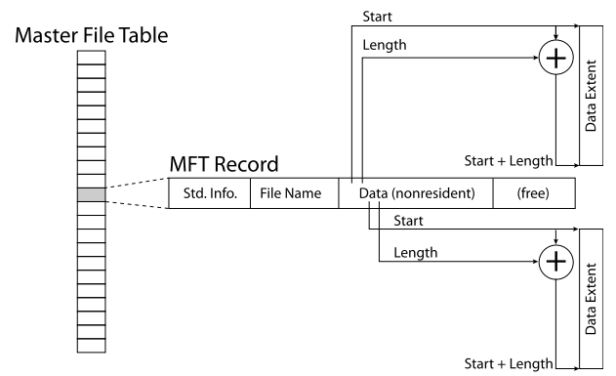
NTFS with medium-sized, mostly non-fragmented file

Slide 52
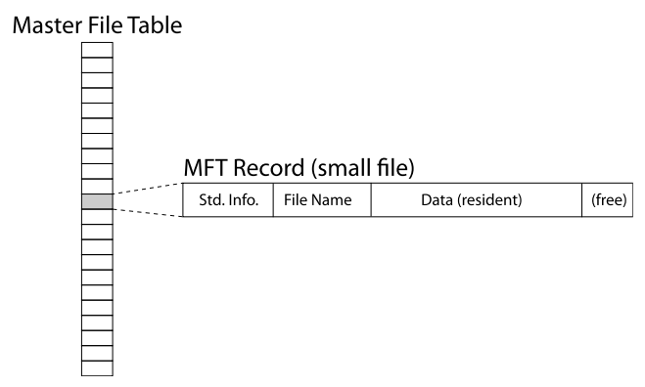
NTFS with a small file

Slide 53
NTFS can automatically compress files
Before write to disk, compress file data blocks
Only write smaller compressed data
After read from disk, decompress file data blocks
Interesting tradeoff
Read less total blocks from disk
Spend more CPU time manipulating blocks

Slide 54
Break + Extend Thinking
In Windows 10, a service compresses infrequently used files
What files will this work on and what won’t this help with?

Slide 55
Break + Extend Thinking
In Windows 10, a service compresses infrequently used files
What files will this work on and what won’t this help with?
Text files are super compressible!!
Code binaries are maybe compressible
Unfortunately, can’t compress already compressed files
Particularly: videos and music

Slide 56
Outline
Disk Caching
Classical Filesystems
FFS
FAT
Improving Reliability
FSCK
Journaling
Journaling Filesystems
ext3/ext4
NTFS
Copy-On-Write
ZFS

Slide 57
Adding file versioning through copy-on-write
Correctness could also come with a bonus: ability to version files
File could be rolled back to an older version from a prior point in time
Method: instead of over-writing existing data block
Write update to a brand new data block
Create a new inode for the file that points to the new data block
And still points to original data for the other unmodified blocks
New inode points to new version of file
Old inode points to old version of file
No longer needs journal for correctness

Slide 58
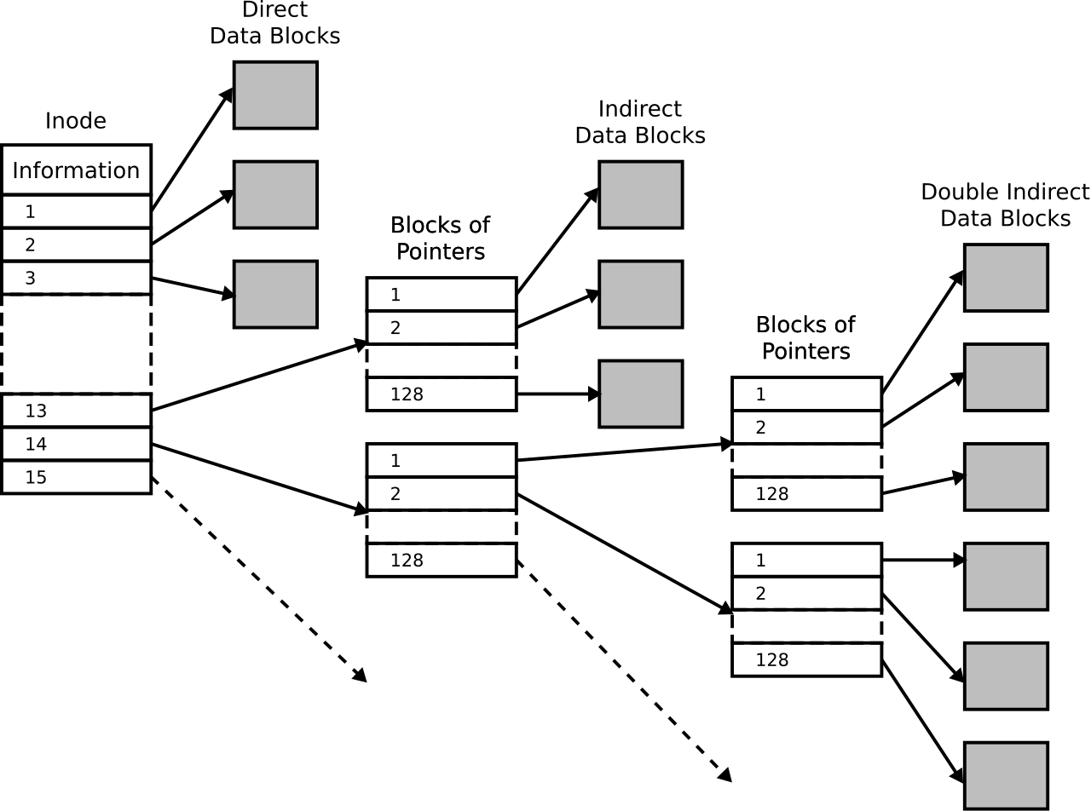
Reminder: hierarchical inodes
Likely some bit in each entry specifies whether it points at:
A data block
A block with additional data pointers
This system can recurse multiple layers deep
Allows for really large files

Slide 59
Copy-on-write example
old version
new version
Inode
Indirect Block Pointers
Data Blocks
Write
Copy + new data

Slide 60
ZFS
Developed by Sun Microsystems, now Oracle (2006)
Uses Copy-on-Write transactions
Snapshots
Enabled by copy-on-write
Points in time for the filesystem can be “snapshot”
Files can be returned to prior versions from the snapshot

Slide 61
Pooled file system
ZFS (and other filesystems) use a concept of pools of storage
Flips around disk-filesystem relationship
Instead of one filesystem per partition and multiple partitions per disk
One filesystem manages multiple disks
Replaces need for RAID by allowing filesystem to make choices
Common design pattern in computer systems
Abstractions make systems easy to use
Breaking abstractions allows for improved performance

Slide 62
Log-Structured File Systems
Can go further along copy-on-write path
Entire disk is just a log of updates to files and inodes
No longer doing small writes all over disk
Jumping between inodes and data blocks
Small, random writes are bad for HDD seek
Instead, treat disk as a circular buffer that updates are written to
Write new data, then new inode after it, then next new data
All writes end up occurring sequentially
Garbage collect old file versions eventually when space gets low

Slide 63
Outline
Disk Caching
Classical Filesystems
FFS
FAT
Improving Reliability
FSCK
Journaling
Journaling Filesystems
ext3/ext4
NTFS
Copy-On-Write
ZFS

