Slide 1
Lecture 01: Introduction
CS343 – Operating Systems
Branden Ghena – Spring 2024
Some slides borrowed from: Stephen Tarzia (Northwestern), Jaswinder Pal Singh (Princeton), and UC Berkeley CS162

Slide 2
Welcome to CS343!
In brief: how does the operating system work and why?
Role of the Operating System
Manages hardware resources
Provides abstractions to support processes
Major topics
Concurrency
Scheduling
Devices
Virtual Memory
File Systems

Slide 3
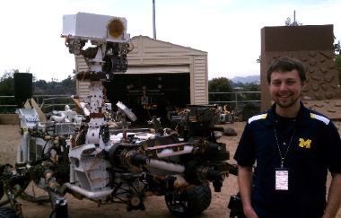
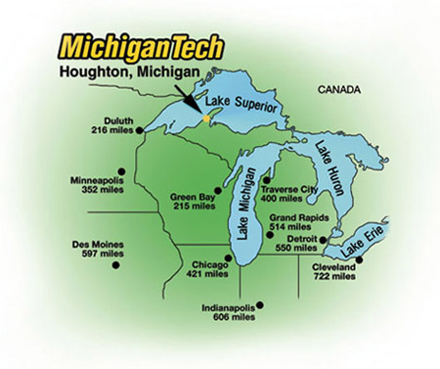
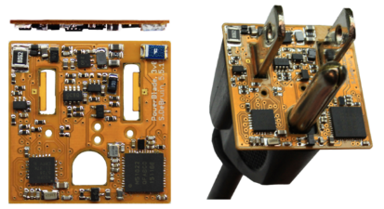

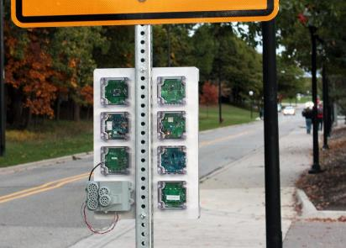




Branden Ghena (he/him)
Assistant Faculty of Instruction
Education
Undergrad: Michigan Tech
Master’s: University of Michigan
PhD: University of California, Berkeley
Research
Resource-constrained sensing systems
Low-energy wireless networks
Embedded operating systems
Teaching
Computer Systems
CS211: Fundamentals of Programming II
CS213: Intro to Computer Systems
CS343: Operating Systems
CE346: Microprocessor System Design
CS397: Wireless Protocols for the IoT
Things I love

Slide 4
Today’s Goals
Discuss the role of an Operating System
Introduce theme and goals of the course
Describe how this class is going to function
Explore trends in OS history

Slide 5
Outline
What is an OS?
Logistics
Operating Systems History
CS343 Focus

Slide 6
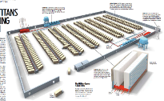
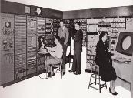
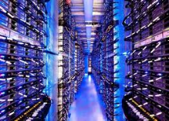
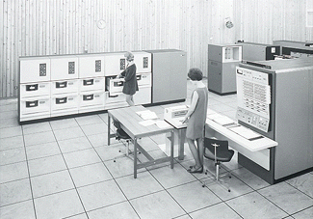
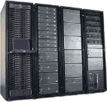

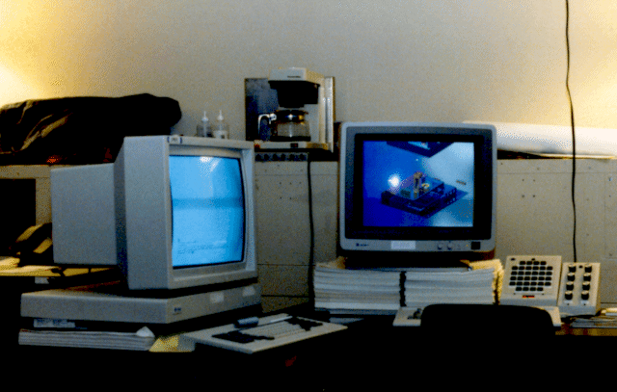



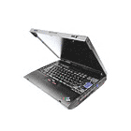




Computers come in incredible diversity
Ratio of Computers to People
Number crunching, Data Storage, Massive Internet Services,
ML, …
1:10⁶
Mainframe
Bell’s Law: New computer class every 10 years
Mini
1:10³
Workstation
Productivity,
Interactive
PC
Laptop
1:1
PDA
Cell
Streaming from/to the physical world
10³:1
Motes
years

Slide 7
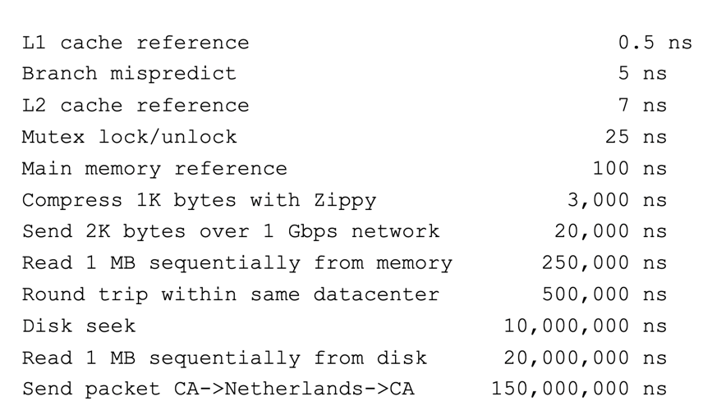
Computing timescales are increasingly large
Jeff Dean (Google AI): “Numbers Everyone Should Know”

Slide 8
Operating systems are at the heart of these challenges
OSes make advancing technology available to rapidly evolving applications. They do so with two major goals:
Provide abstractions to applications to enable hardware compatibility
Why: allow reuse of common features, avoid low-level details
Challenges: What are the correct abstractions?
Manage sharing of resources across many applications
Why: protect applications, enforce fair access
Challenges: What are the mechanisms and what are the policies?
Good operating systems do these quickly, efficiently, and securely

Slide 9
What is an operating system?
User processes
Spotify
Powerpoint
Steam
Chrome
QEMU
Physical computer
Hardware

Slide 10
What is an operating system?
User processes
Spotify
Powerpoint
Steam
Chrome
QEMU
Operating System
Physical computer
Hardware

Slide 11
What is an operating system?
User processes
Spotify
Powerpoint
Steam
Chrome
QEMU
File System
Virtual Memory
Process Manager
Network
Operating System
Device Drivers
Interrupt Handlers
Boot and Init
Physical computer
Hardware

Slide 12
What is an operating system?
User processes
Spotify
Powerpoint
Steam
Chrome
QEMU
Application Interface
File System
Virtual Memory
Process Manager
Network
Operating System
Device Drivers
Interrupt Handlers
Boot and Init
Hardware Abstraction Layer
Physical computer
Hardware

Slide 13
What’s part of the OS?
OS kernel – the part of the OS code that has full control of the system
Process scheduling (who uses CPU)
Memory allocation (who uses RAM)
Accesses hardware devices
Outputs graphics
Reads/writes to network
Read/write to disks
Handles boot-up and power-down
OS distribution – the kernel + lots of other useful stuff
GUI / Window manager
Command shell
Software package manager
“app store”, yum, apt, brew
Common software libraries
Useful apps:
Text editor, compilers, web browser, web server, SSH, anti-virus, file-sharing, media libraries,

Slide 14
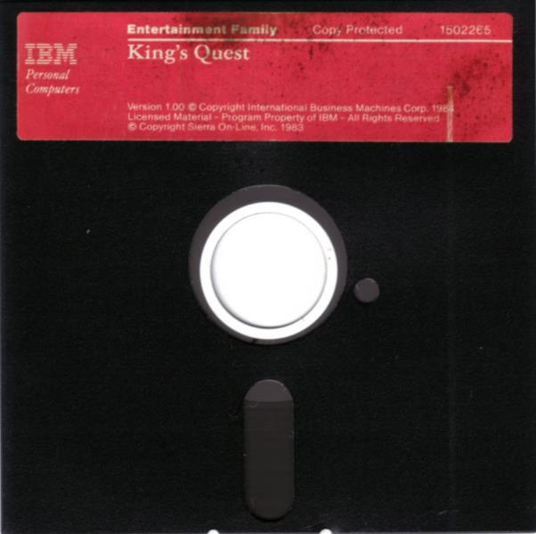
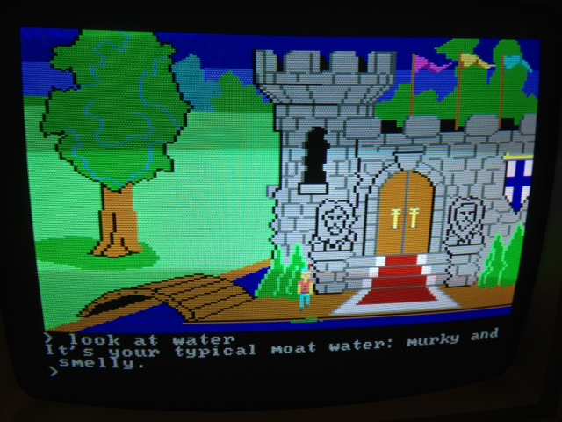
Before operating systems
User could only run one program at a time.
Had to insert the program disk before booting the machine.
Program had to control the hardware directly
This is a nuisance because hardware is complicated
Program will only be compatible with one set of hardware
An example (at right): 1983 “King’s Quest” game for IBM PC Jr.

Slide 15
Operating Systems are middle-management
Applications we care about
Spotify
Powerpoint
Steam
Chrome
QEMU
Operating System
Overhead
Hardware to run things
Hardware

Slide 16
Embedded systems often still run without operating systems
“Bare-metal” embedded systems
Many downsides:
Application must handle things for themselves
Boot and initialization
All hardware it wants to interact with
Applications are not portable
Rewrite, mostly from scratch, for new microcontroller
No malloc, no segfaults
Instead invalid memory accesses likely crash the whole system
Imagine if each CS211 segfault resulted in the EECS server rebooting…
Upside: can be a VERY highly efficient system

Slide 17



Roles of an Operating System give the overhead value
Referee
Manage protection, isolation, and sharing of resources
Resource allocation and communication
Illusionist
Provide clean, easy-to-use abstractions of physical resources
Infinite memory, dedicated machine
Higher level objects: files, users, messages
Masking limitations, virtualization
Glue
Common services
Storage, Window system, Networking
Sharing, Authorization
Look and feel

Slide 18
Example: File Systems
Referee
Prevent users from accessing other’s files without permission
Illusionist
Files can grow infinitely large
Where a file exists in memory or disk isn’t important!
Glue
Default file system types, named directories, file explorer

Slide 19
Architecture of a lecture
Full
Practice Questions
Open Question
Wrapup
+ Bonus
Attention
0
20
25
50
53
78
80
Time (minutes)

Slide 20
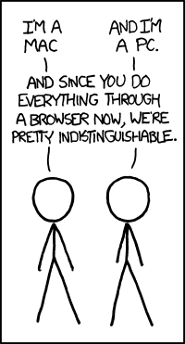
Break + xkcd
Open question:
Are modern web browsers basically operating systems?
https://xkcd.com/934/

Slide 21
Outline
What is an OS?
Logistics
Operating Systems History
CS343 Focus

Slide 22
Course staff
Teaching Assistant
Michael Polinski
PhD student in systems
Peer Mentors (10)
Eli Barlow
Emily Wei
Grigorii Kalin
Joseph Grantham
Justin Dong
Their role: support student questions via office hours and Piazza
We’ll have lots of weekly office hours blocks for you to get help from them
Kellen Bryant
Kevin Hayes
Max Ward
Steve Ewald
Tim Sinaga

Slide 23
Course Details – how to learn stuff
Lectures: here Tuesdays and Thursdays
Provides background on materials
Attend and ask questions!
Panopto tab on Canvas should have best-effort recordings (a few hours later)
I also post the slides right before class to the Canvas homepage
Textbook:
Modern Operating Systems (4th Edition), Tanenbaum and Bos
Very useful reference. Lecture will be relatively in sync with it
Other references are in the syllabus
Office Hours: will start next week

Slide 24
Asking questions
Class and office hours are always an option!
I usually have time after class to answer a bunch of questions
Right after a break is a great time for questions too
Piazza: (similar to Campuswire)
Post questions
Answer each other’s questions
Find lab partners
Information from the course staff
Post private info just to course staff
Please do not email me! Post to Piazza instead!
Let me know if you don’t have access. I’ll update the roster

Slide 25
Course grade
20% Midterm (first half of the course)
20% Final (second half of the course)
60% Labs
05% Getting Started Lab (individual)
15% Queuing/Scheduling Lab
10% Producer-Consumer Lab
15% Device Driver Lab
15% Paging Lab
Exact number to letter mapping is a little flexible
But this course is NOT curved
Only flexible in your favor

Slide 26
Midterm exams
Test on your knowledge of course material (like a 213 exam)
In-person, on paper
I’ll allow a notes sheet
Not cumulative. Two midterms on two halves of the class
First midterm will be during class time: April 25th (Thursday)
Week before the drop deadline
Second midterm will be during exam week: June 5th (Wednesday)
Make sure you can be here in-person for it!

Slide 27
Labs
These are a significant amount of the learning in this class
Hands-on experience with the topics we’re talking about
Labs primarily involve written code in C
Can be quite a bit of work
Work on these in groups of up to three students
Preferably two or three
Goal: collaboration, not splitting labs
If you don’t work on it, you’re not going to learn from it
Pair programming more often results in code written right the first time

Slide 28
Lab logistics
Getting Started Lab
Learn how everything works
Queuing/Scheduling Lab
OS application scheduling
Producer-Consumer Lab
Concurrency and locks
Device Driver Lab
Driver for a GPU
Paging Lab
Memory management
Getting started lab is special
One week deadline (due 04/04)
Must do alone
All-or-nothing grading
Normally teams of 2 or 3 students
Find partners now!
We’ll put out a survey soon for those who don’t know anyone

Slide 29
Late policy
You can submit labs late
20% penalty to maximum grade per day late
Example: three days late means maximum grade is 40%
We will be flexible with deadlines for problems outside of your control
Sick, family emergency, broken computer
Contact me! (via Piazza)

Slide 30
Slip days
Slip days let you turn in a homework late and receive no penalty
Each student gets 3 slip days
Apply to labs
You don’t need to tell us you’re using them, we’ll just automatically apply them at the end of the year
Be sure to coordinate about them on partner assignments
Examples:
Turn in Scheduling Lab three days late
Turn in Scheduling Lab two days late and Paging lab one day late
Turn in Paging Lab five days late with only a two-day penalty

Slide 31
Academic integrity
This is something I take very seriously
Collaboration good; plagiarism bad
You should know where that line is, and be nowhere near it
When in doubt, ask the instructor before you do something you’re not sure about
At no point should you see someone else’s solutions
Not your colleagues’, not your friends’, not your cousin’s, not something you found online
I report everything suspicious to the dean

Slide 32
Expectations
Give yourself time to complete labs
Dealing with C code
Handling a large code base
Dealing with concurrency!!
You’ll learn a lot through the challenge
Don’t fall behind on lecture materials
Material builds on itself, like in CS213
Use course staff to help you out
Office hours & Piazza are for your benefit

Slide 33
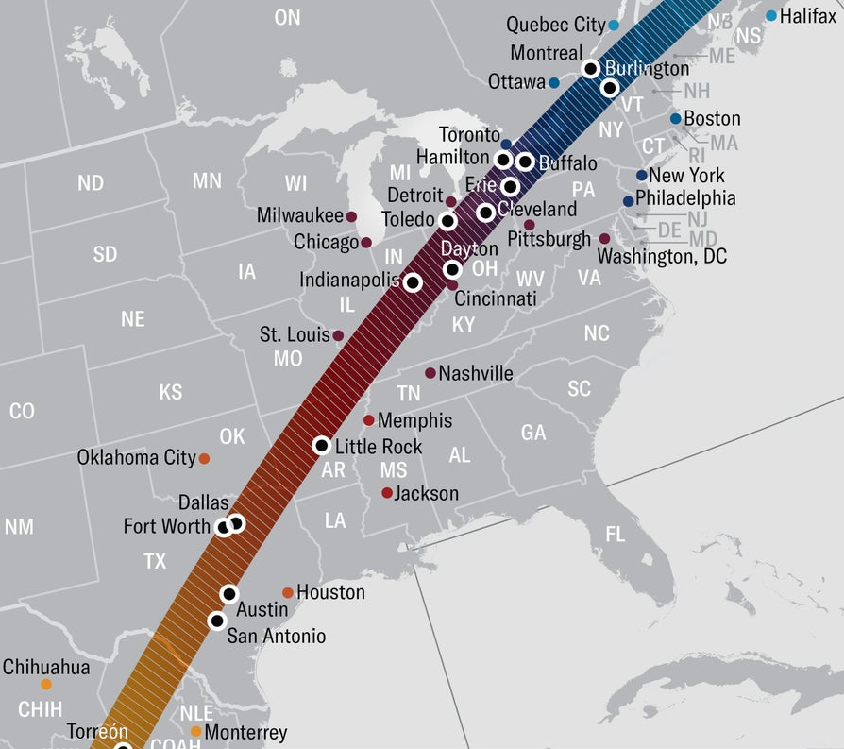
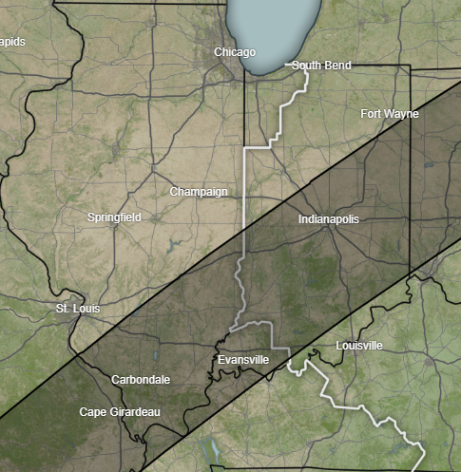
Great American Total Solar Eclipse
Roughly 2:00 pm Central in southern Illinois/Indiana
3.5 minutes of total solar eclipse
Get yourself to 100% eclipse
99% was “oh that’s kind of neat”
100% was “the coolest thing I’ve ever seen in my entire life”
Skip class, find a car, go see it (4-5 hour drive)
Next opportunity is 2044
https://science.nasa.gov/eclipses/future-eclipses/eclipse-2024/where-when/

Slide 34
Break + First Tasks
Getting Started Lab
Makes sure you’ve got everything set up to do all the labs
Should be available right now
Get this done on time
Find partner(s) for assignments
We’ll put out a form in the next few days if you don’t know people in the class
Take a break, chat with your neighbors, look at your phone, reset your brain for a minute

Slide 35
Outline
What is an OS?
Logistics
Operating Systems History
CS343 Focus

Slide 36
Computer History
Check out the textbook!
In-depth history
Entertaining writing with just the right amount of sarcasm
This isn’t a computer history course
But there is a good reason to understand the lineage of the techniques we explore in this course

Slide 37
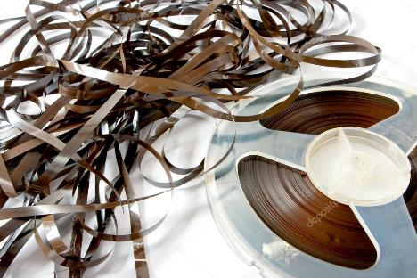
Early evolution of computing systems – Batch
1955: Batch systems
Collect a bunch of program punch cards and write them all one magnetic tape.
Run the tape through the mainframe to execute all the jobs in sequence.
OS responsibility
Libraries for managing Input/Output (I/O)
Problems
I/O is VERY slow. 80-90% of total time just waiting.

Slide 38
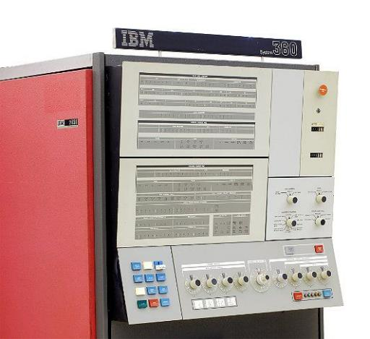
Early evolution of computing systems – Multiprogramming
1960s: Multiprogramming (IBM OS/360)
Keep multiple runnable jobs in memory at once.
Allows overlap I/O of one job with computing of another.
Uses asynchronous I/O and interrupts or polling to detect I/O completion
OS responsibility
Schedule jobs
Monitor I/O
Problems
Still need to submit all jobs in advance

Slide 39
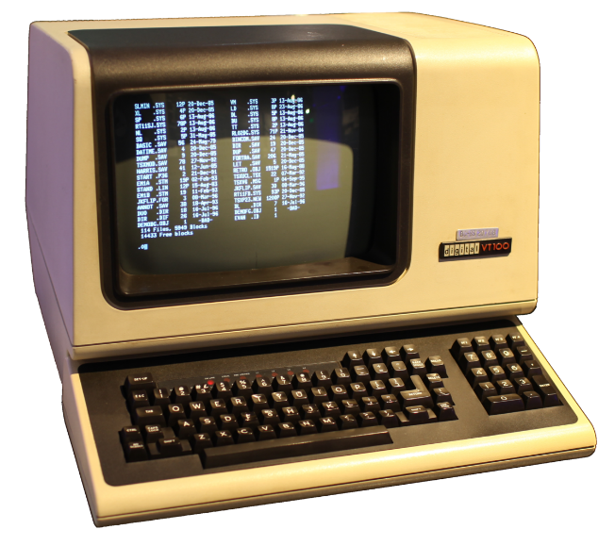
Early evolution of computing systems – Timesharing
1960s-70s: Timesharing (MULTICS, Unix)
Multiple user terminals connected to one machine
Allows interactive use of machine to be efficient (because another user’s job can run while you’re thinking).
OS responsibility
Multiple users (with permissions!)
Scheduling processes
Application interface
Shell tools

Slide 40
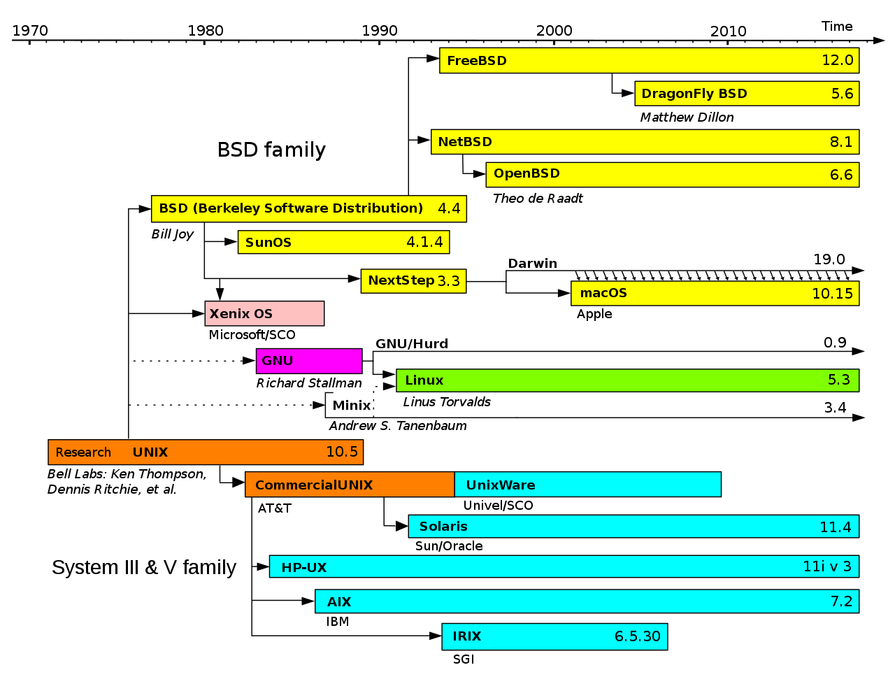
Simplified History of Unix-like Operating Systems
Operating systems are very interconnected

Slide 41
Later evolution of computer systems – PC
1980s-00s: Personal Computers (IBM PC, Macintosh)
Graphical user interfaces were developed
Mainframe OS concepts (like networking) were applied to PCs
Magnetic disk (hard drive) capacity becomes huge, but still slow
OS responsibility
Look and feel of a system, particularly for non-experts
Tools that were distributed with the OS had significant business results
Computers are bought for Excel or for Lotus 1-2-3

Slide 42
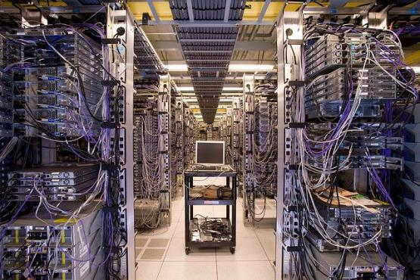
Later evolution of computer systems – Mobile and Cloud
2000s-20s: Mobile and pervasive computing, Cloud Computing
Slow hardware is once again common (phones & wearables)
OS manages sensitive information like location and internet behavior
Fast flash storage is common.
Server hardware is shared by many different cloud computing customers
OS responsibility
Diverse hardware drivers
Security
Massive parallelism

Slide 43
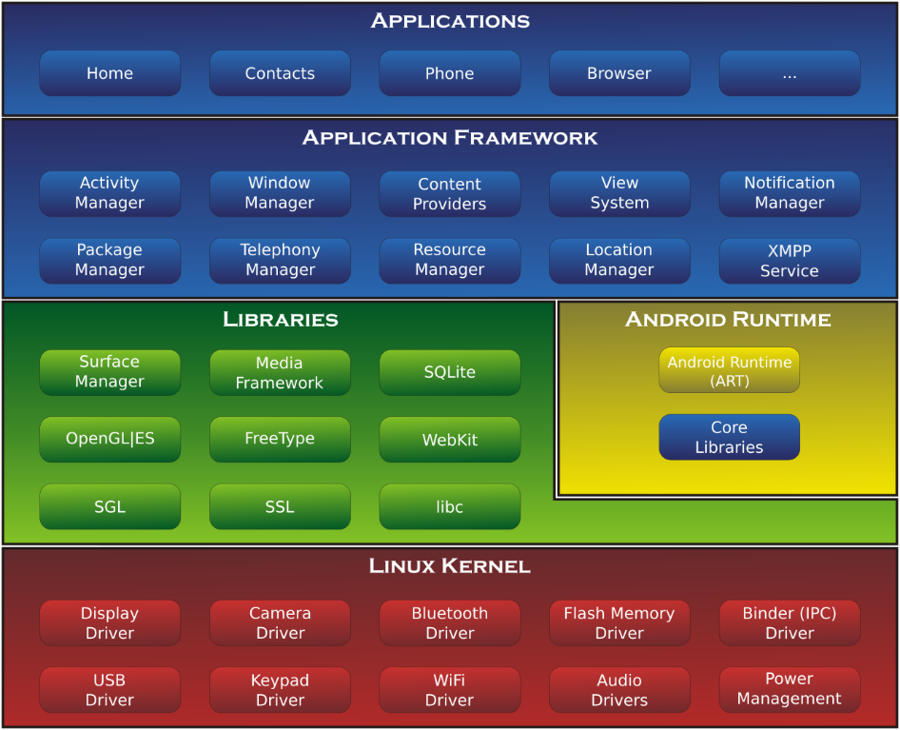
An example: Android Operating System
Kernel - Linux
With modifications particularly in power management
And additional drivers
Distribution
Look and feel of “Android”
App framework
Some of this changes per vendor (Samsung vs Google)

Slide 44
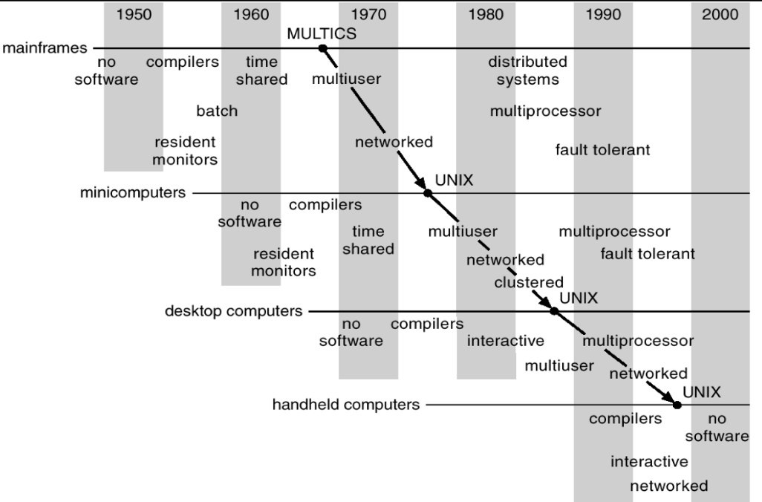
Operating systems have evolved with hardware in a cycle
Sophisticated operating systems first arose on mainframes.
OS ideas migrated to smaller machines as those machines became more powerful.
In 2024, a smart watch has 1 GB RAM, 32 GB SSD storage, two CPU cores, and a real OS.

Slide 45
Some future OS directions
Manage increasingly specialized hardware
Post-Moore’s law, general-purpose CPUs loose out to special-purpose chips
OS must maintain abstractions while enabling capabilities
Energy as another resource
Already considered in laptop/smartphone worlds
Increasingly important to data center operations as well
Very small-scale, ubiquitous devices
Computers are becoming part of everything around us
How do we develop applications for those devices and coordinate them?

Slide 46
Outline
What is an OS?
Logistics
Operating Systems History
CS343 Focus

Slide 47
Schedule for first half of the course
Scheduling
Managing CPU utilization
Workload, Queuing, Real-time
Concurrency
Dealing with the realities of modern-day computing
Sources, Control, Challenges

Slide 48
Schedule for second half of the course
Device Drivers
Management and abstraction of devices
Interrupts, DMA, Abstractions
Virtual Memory
Management and abstraction of memory
Paging, Allocation, Security
File Systems
Management and abstraction of data
Principles, Examples

Slide 49
Why do we care about OS?
Performance
Speed is influenced by
Parallelism, resource contention, memory management
Generally OS overhead
Security
Process and data isolation when actually all running together
The biggest security vulnerabilities break abstractions
Meltdown and Spectre
Systems Design and Implementation
Maybe you won’t ever build an OS (maybe you will!)
But you might work on other large, backend systems that will deal with similar concerns. This is good practice!

Slide 50
Outline
What is an OS?
Logistics
Operating Systems History
CS343 Focus

