Slide 1
Lecture 02: Processes and Threads
CS343 – Operating Systems
Branden Ghena – Spring 2024
Some slides borrowed from: Stephen Tarzia (Northwestern), Jaswinder Pal Singh (Princeton), Harsha Madhyastha (Michigan), and UC Berkeley CS61C and CS162

Slide 2
Administrivia
Getting Started Lab
Due on Thursday (don’t be late on this)
Purpose is to make sure that you’ve got everything set up right
SSH login for EECS servers (if this fails, IT turnaround is ~24 hours)
Github account and Git SSH access
Ability to build the Nautilus Kernel
Let us know if you’re having problems with this
Should not take long to complete
94/120 of you have at least made your own repo (most are done)

Slide 3
Today’s Goals
Understand the operating system’s view of a process.
Explore the context switches and exceptional control flow.
Understand the basics of system calls and signals.
What are threads and why are they useful?

Slide 4
Outline
Processes
Context Switching
Running a Process
Exceptions
Running the Kernel
System Calls
Signals
Threads

Slide 5
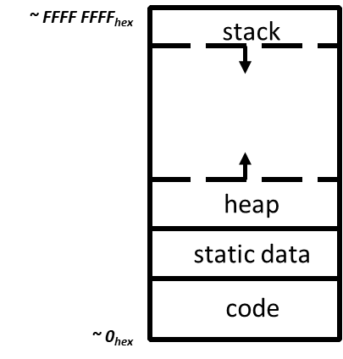
View of a process
Process: program that is being executed
Contains code, data, and a thread
Thread contains registers, instruction pointer, and stack
Code and Data
Registers
Instruction Pointer
Condition Codes
Stack
%rax
%r8
%eax
%r8d
%rbx
%r9
%ebx
%r9d
%rcx
%r10
%ecx
%r10d
%rdx
%r11
%edx
%r11d
%rsi
%r12
%esi
%r12d
%rdi
%r13
%edi
%r13d
%rsp
%r14
%esp
%r14d
%rbp
%r15
%ebp
%r15d

Slide 6
POSIX processes also have file descriptors
Integers specifying a file the process is interacting with
Process contains a table linking integers to files (and permissions)
Default file descriptors
0 - Standard input (stdin)
1 - Standard output (stdout)
2 - Standard error (stderr)
Function calls to interact with files
int open (const char *path, int oflag, ... );
ssize_t read (int fildes, void *buf, size_t nbyte);
ssize_t write (int fildes, const void *buf, size_t nbyte);

Slide 7
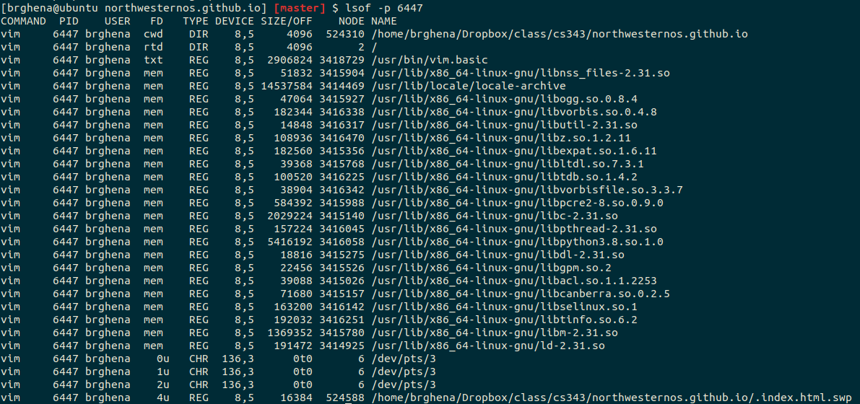
Example file descriptors

Slide 8
Also the code files mapped to the address space

Slide 9
Additional process contents
Whatever else the OS thinks is useful
Process ID
Priority
Time Used
Process State
Different OSes will attach different things to the “process abstraction”

Slide 10
Processes are an abstraction provided by the OS
The machine itself usually doesn’t support processes
Just has a processor and a set of registers
Memory is just arbitrary memory
OS provides the abstraction
Multiple processes can run at the “same time”
Each has its own registers
Each has its own isolated memory
Processes enable
Multiple functionalities on a computer
Multiprogramming of a system

Slide 11
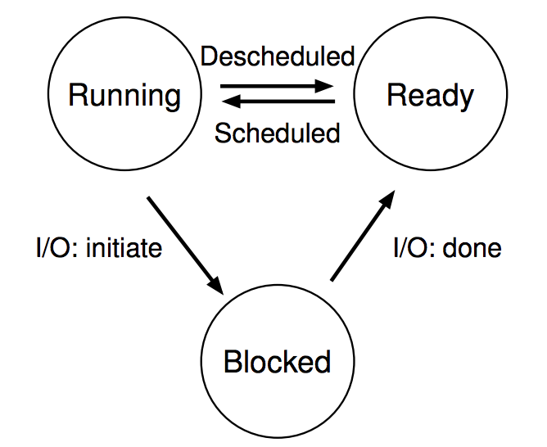
Processes don’t run all the time
The three basic process states:
OS schedules processes
Decides which of many competing processes to run.
A blocked process is not ready to run.
I/O means input/output – anything other than computing.
For example, reading/writing disk, sending network packet, waiting for keystroke, updating display.
While waiting for results, the process often cannot do anything, so it blocks, and the OS schedules a different process to run.

Slide 12
Multiprogramming processes
The three basic process states:
When one process is Blocked, OS can schedule a different process that is Ready
Even with a single processor, the OS can provide the illusion of many processes running simultaneously
OS usually sets a maximum runtime before switching limit for processes (timeslice)

Slide 13
Key difference between kernel and processes: privilege
Processes have limited access to the computer
Hardware supports different “modes” of execution (kernel and user)
Kernel mode has access to physical memory and special instructions
They run when the OS lets them
They have access to the memory the OS gives them
They cannot access many things directly
Must ask the OS to do so for them

Slide 14
Break + Question
Is it safe for two processes to have the same code section?

Slide 15
Break + Question
Is it safe for two processes to have the same code section?
Usually yes!
The OS can mark the code section as read-only
Example: multiple instances of a shell share the same code
Self-modifying code would be a problem…

Slide 16
Outline
Processes
Context Switching
Running a Process
Exceptions
Running the Kernel
System Calls
Signals
Threads

Slide 17

Context: Tock Operating System
Usually we’ll use Nautilus as an example (last two labs are in it)
But Nautilus doesn’t have a userspace!!
(also I honestly understand it less well than Tock)
Tock OS
Embedded operating system
Targets resource-constrained embedded systems
Written in Rust
Reliability and Security are key goals
Multi-programming traditional OS environment
One core, with as many processes as you want
https://tockos.org/ - https://github.com/tock/tock

Slide 18
Switch to Process
When a kernel decides to start running a process it does a context switch into the process
This includes starting a process for the first time
Or continuing running a process after it was stopped
Blocked for I/O or just timesliced off the processor
High-level steps for switching into a process
Scheduler decides which process should be running
Save kernel register values to kernel stack
Restore process register values (usually from a data structure)
Switch to process mode instead of kernel mode
Jump to next instruction in process

Slide 19
Tock ARM implementation: Switch to Process
Tock ARM-v7m implementation
Save kernel register values to kernel stack
https://github.com/tock/tock/blob/master/arch/cortex-v7m/src/lib.rs#L237
Restore process register values (usually from a data structure)
https://github.com/tock/tock/blob/master/arch/cortex-v7m/src/lib.rs#L251
Bonus: enter exception handler
Switch to process mode instead of kernel mode
https://github.com/tock/tock/blob/master/arch/cortex-v7m/src/lib.rs#L94
Jump to next instruction in process
https://github.com/tock/tock/blob/master/arch/cortex-v7m/src/lib.rs#L104

Slide 20
Tock RISC-V implementation: Switch to Process
Tock rv32i implementation
Save kernel register values to kernel stack
https://github.com/tock/tock/blob/master/arch/rv32i/src/syscall.rs#L276
Bonus: pause exceptions
https://github.com/tock/tock/blob/master/arch/rv32i/src/syscall.rs#L300
Restore process register values (usually from a data structure)
https://github.com/tock/tock/blob/master/arch/rv32i/src/syscall.rs#L336
Switch to process mode instead of kernel mode AND jump to next instruction in process AND enable exceptions again
https://github.com/tock/tock/blob/master/arch/rv32i/src/syscall.rs#L370

Slide 21
Processes run until an exception occurs
While the process is running, the OS is NOT running
In a single-core environment at least
So, when does the OS kernel get to run again?
Whenever an exception occurs
Hardware can be a source of this
Random device event occurring
Timer expiring (source of the process timeslice)
Software can also cause this
System calls

Slide 22
Outline
Processes
Context Switching
Running a Process
Exceptions
Running the Kernel
System Calls
Signals
Threads

Slide 23
Control flow
Processors do only one thing:
From startup to shutdown, a CPU simply reads and executes (interprets) a sequence of instructions, one at a time
This sequence is the CPU’s control flow (or flow of control)
Physical control flow
<startup>
inst₁
inst₂
inst₃
…
inst_{n}
<shutdown>
Time

Slide 24
Altering control flow
Instructions that change control flow allow software to react changes in program state
Jumps/branches
Call/return
Also need to react to changes in system state
Data arrives at network adapter
Instruction divides by zero
User hits Ctrl-C on the keyboard
System timer expires
These mechanisms are known as “exceptional control flow”

Slide 25
Exceptional control flow
Mechanisms that could cause exceptional control flow
Exceptions: events cause execution to jump to OS handler
Context switch: request or timeout causes execution to jump to OS
Signals: event plus OS causes execution to jump to process handler
Running process
Other code (usually OS)
Event
I_current
Exception
I_next
Exception processing
by exception handler
Return to I_next

Slide 26
Exceptions
Hardware detects an event that OS software needs to resolve immediately
Could be an error
Invalid memory access
Invalid instruction
Could just be something the OS should handle (known as interrupts)
Page fault
USB device detected
OS has a table of “exception handlers”, which are functions that handle each exception class (also known as interrupt handlers)
Hardware jumps execution to the proper handler

Slide 27
Tock exception vector
Array of functions for each exception type
In Tock, most are “unhandled” which just crashes the system
Some are device interrupts (which don’t matter for today’s lecture
Interrupt “vector”
https://github.com/tock/tock/blob/master/chips/nrf52/src/crt1.rs#L31
SVC is a “service call” instruction
It’s used by processes to request an action from the OS
SVC_Handler is a function to handle those requests
https://github.com/tock/tock/blob/master/arch/cortex-v7m/src/lib.rs#L76

Slide 28
Outline
Processes
Context Switching
Running a Process
Exceptions
Running the Kernel
System Calls
Signals
Threads

Slide 29
How does a process ask the OS to do something?
Certain things can only be accessed from kernel mode
All of memory, I/O devices, etc.
Kernel: the portion of the OS that is running and in memory
Bad Idea to allow processes to just enter kernel mode
We do NOT trust processes
So there shouldn’t be any instruction that switches to kernel mode unless that instruction also switches to kernel code
Requirements
Switch execution to the kernel
Change into kernel mode
Inform the kernel what you want it to do

Slide 30
Hardware can save us!
Solution: trigger an exception to run an OS handler
Hardware instruction: trap
When instruction runs:
Mode is changed to kernel mode AND
Instruction Pointer is moved to a known location in the kernel
Same mechanism is used for other exceptions
Division by zero, invalid memory access
Also very similar to hardware interrupts

Slide 31
System call example
System call: making a request of the OS from a process
Uses exceptional control flow to enter OS kernel
Returns back to process when complete
Instruction after the system call
Kernel code
User code
Exception
syscall
next instruction
Do the thing
Returns

Slide 32
Switch to Kernel
Assume the process wants to switch to the kernel, what occurs?
High-level steps for switching to the kernel
Process executes a system call
Processor enters kernel mode and runs an exception handler
Save process registers
Restore kernel registers
Figure out why a context switch occurred

Slide 33
Tock ARM Implementation: Switch to Kernel
Tock ARM-v7m implementation
Process executes a system call
https://github.com/tock/libtock-c/blob/master/libtock/tock.c#L257
Processor enters kernel mode and runs an exception handler
https://github.com/tock/tock/blob/master/arch/cortex-v7m/src/lib.rs#L76
Bonus: return to switch_to_user implementation
https://github.com/tock/tock/blob/master/arch/cortex-v7m/src/lib.rs#L135
Save process registers
https://github.com/tock/tock/blob/master/arch/cortex-v7m/src/lib.rs#L264
Restore kernel registers
https://github.com/tock/tock/blob/master/arch/cortex-v7m/src/lib.rs#L272
Figure out why a context switch occurred
https://github.com/tock/tock/blob/master/arch/cortex-m/src/syscall.rs#L262

Slide 34
Tock RISC-V Implementation: Switch to Kernel
Tock rv32i implementation
Process executes a system call
https://github.com/tock/libtock-c/blob/master/libtock/tock.c#L485
Processor enters kernel mode and runs an exception handler
https://github.com/tock/tock/blob/master/arch/rv32i/src/lib.rs#L335
Save process registers
https://github.com/tock/tock/blob/master/arch/rv32i/src/lib.rs#L358
Bonus: return to switch_to_process implementation
https://github.com/tock/tock/blob/master/arch/rv32i/src/lib.rs#L437
Restore kernel registers
https://github.com/tock/tock/blob/master/arch/rv32i/src/syscall.rs#L382
Figure out why a context switch occurred
https://github.com/tock/tock/blob/master/arch/cortex-m/src/syscall.rs#L262

Slide 35
Handling the system call
Now the kernel is running again AND it knows why it was running
If a fault occurred crash the process or something
If a syscall occurred, read why from the process’s registers
Which are saved in some data structure somewhere
Then figure out what to do about that request

Slide 36
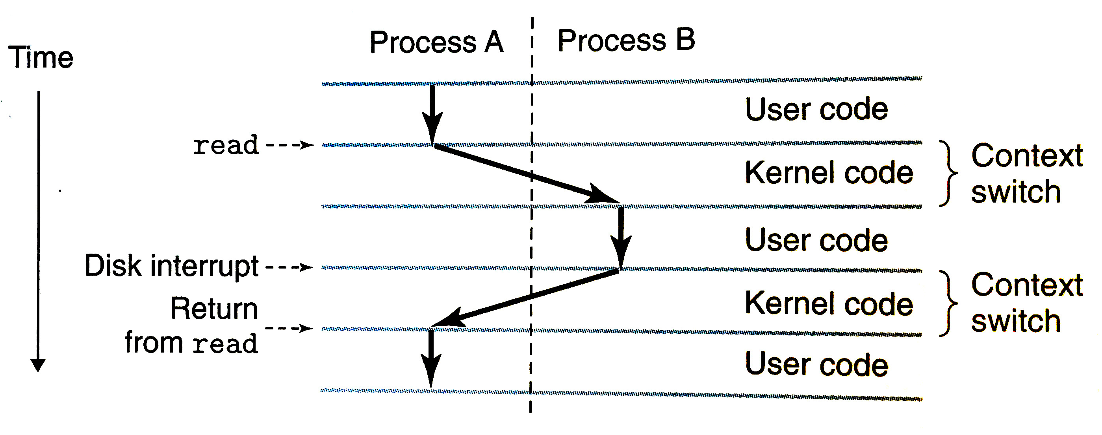
Switching between process and kernel is a context switch
Context switch: switching from process to kernel or kernel to process
Vague term. Sometimes refer to there-and-back as a context switch
Diagram from Bryant & O’Hallaron book

Slide 37
Break + Question
Context switches are expensive
Lots of context switches lead to poor performance
Why?

Slide 38
Break + Question
Context switches are expensive
Lots of context switches lead to poor performance
Why?
Lots of memory manipulation
Saving and restoring registers
All cached data is almost certainly invalid
Triggering an exception isn’t exactly quick
Processor needs to stop everything and jump somewhere
OS needs to figure out what’s going on and respond to it
The figuring it out part can be a lot of code

Slide 39
Outline
Processes
Context Switching
Running a Process
Exceptions
Running the Kernel
System Calls
Signals
Threads

Slide 40
Things a program cannot do itself
Print “hello world”
because the display is a shared resource.
Download a web page
because the network card is a shared resource.
Save or read a file
because the filesystem is a shared resource, and the OS wants to check file permissions first.
Launch another program
because processes are managed by the OS
Send data to another program
because each program runs in isolation, one at a time

Slide 41
Linux system calls
Example system calls
https://man7.org/linux/man-pages/man2/syscalls.2.html
Number | Name | Description
0 | read | Read file
1 | write | Write file
2 | open | Open file
3 | close | Close file
4 | stat | Get info about file
57 | fork | Create process
59 | execve | Execute a program
60 | _exit | Terminate process
62 | kill | Send signal to process

Slide 42
Many other system calls
POSIX contains many others, for example time()
And especially lots of old ones
Windows or other operating systems will have entirely different system calls
Same basic idea for how they function though

Slide 43
Example system call usage
Create new processes with system calls
From process view:
Just look like regular C functions
Take arguments, return values
Underneath:
Function uses special assembly instruction to trigger exception

Slide 44
Process system calls
pid_t fork(void);
Create a new process that is a copy of the current one
Returns either PID of child process (parent) or 0 (child)
void _exit(int status);
Exit the current process (exit(), the library call cleans things up first)
pid_t waitpid(pid_t pid, int *status, int options);
Suspends the current process until a child (pid) terminates
int execve(const char *filename, char *const argv[], char *const envp[]);
Execute a new program, replacing the existing one

Slide 45
Creating a new process
#include <stdio.h>
#include <unistd.h>
int main(){
if(fork() == 0) {
printf("Child!\n");
} else {
printf("Parent!\n");
}
printf("Both!\n");
return 0;
}

Slide 46
Creating a new process
#include <stdio.h>
#include <unistd.h>
int main(){
if(fork() == 0) {
printf("Child!\n");
} else {
printf("Parent!\n");
}
printf("Both!\n");
return 0;
}
Existential crisis

Slide 47
Executing a new program
#include <stdio.h>
#include <unistd.h>
int main(){
if(fork() == 0) {
execve("/bin/python3", ...);
} else {
printf("Parent!\n");
}
printf("Only parent!\n");
return 0;
}

Slide 48
Creating your own shell
https://danishpraka.sh/2018/01/15/write-a-shell.html
void execute(char** args) {
if (strcmp(args[0], "exit") == 0) {
exit(); // exit the shell when requested
}
pid_t cpid = fork();
if (cpid == 0) {
if (execvp(args[0], args) < 0) { // child, execute new process
printf("command not found: %s\n", args[0]); }
} else {
waitpid(cpid, & status, WUNTRACED); // parent, wait for process to be complete
}}
int main(){
char** args;
while(1){
printf("> ");
args = parse_incoming_text(); // complicated in C unfortunately
execute(args);
}}

Slide 49
Creating your own shell
https://danishpraka.sh/2018/01/15/write-a-shell.html
void execute(char** args) {
if (strcmp(args[0], "exit") == 0) {
exit(); // exit the shell when requested
}
pid_t cpid = fork();
if (cpid == 0) {
if (execvp(args[0], args) < 0) { // child, execute new process
printf("command not found: %s\n", args[0]); }
} else {
waitpid(cpid, & status, WUNTRACED); // parent, wait for process to be complete
}}
int main(){
char** args;
while(1){
printf("> ");
args = parse_incoming_text(); // complicated in C unfortunately
execute(args);
}}

Slide 50
Break + Question
What does the following code do?
#include <stdio.h>
#include <sys/types.h>
int main() {
while(1){
fork();
}
return 0;
}

Slide 51
Break + Question
What does the following code do?
#include <stdio.h>
#include <sys/types.h>
int main() {
while(1){
fork();
}
return 0;
}
Creates a new process
Then each process creates a new process
Then each of those creates a new process…
Known as a Fork bomb!
Machine eventually runs out of memory and processing power and will stop working
Defense: limit number of processes per user

Slide 52
Fork bombs in various languages
Python fork bomb
import os
while 1:
os.fork()
Rust fork bomb
#[allow(unconditional_recursion)]
fn main() {
std::thread::spawn(main);
main();
}
Bash fork bomb
:(){ :|:& };:
Bash with spacing and a clearer function name
fork() {
fork | fork &
}
fork

Slide 53
Outline
Processes
Context Switching
Running a Process
Exceptions
Running the Kernel
System Calls
Signals
Threads

Slide 54
Alerting processes of events
How do we let a process know there was an event?
Errors
Termination
User commands (like CTRL-C or CTRL-\)
Events could happen whenever
Need to interrupt process control flow and run an event handler
Linux mechanism to do so is called “signals”

Slide 55
Signals are asynchronous messages to processes
Sometimes the OS wants to send something like an interrupt to a process
Your child process completed
You tried to use an illegal instruction
You accessed invalid memory
You are terminating now
In POSIX systems, this idea is called “Signals”
1) SIGHUP 2) SIGINT 3) SIGQUIT 4) SIGILL 5) SIGTRAP
6) SIGABRT 7) SIGBUS 8) SIGFPE 9) SIGKILL 10) SIGUSR1
11) SIGSEGV 12) SIGUSR2 13) SIGPIPE 14) SIGALRM 15) SIGTERM
16) SIGSTKFLT 17) SIGCHLD 18) SIGCONT 19) SIGSTOP 20) SIGTSTP
21) SIGTTIN 22) SIGTTOU 23) SIGURG 24) SIGXCPU 25) SIGXFSZ
26) SIGVTALRM 27) SIGPROF 28) SIGWINCH 29) SIGIO 30) SIGPWR
31) SIGSYS ...

Slide 56
Signals are asynchronous messages to processes
Sometimes the OS wants to send something like an interrupt to a process
Your child process completed
You tried to use an illegal instruction
You accessed invalid memory
You are terminating now
In POSIX systems, this idea is called “Signals”
1) SIGHUP 2) SIGINT 3) SIGQUIT 4) SIGILL 5) SIGTRAP
6) SIGABRT 7) SIGBUS 8) SIGFPE 9) SIGKILL 10) SIGUSR1
11) SIGSEGV 12) SIGUSR2 13) SIGPIPE 14) SIGALRM 15) SIGTERM
16) SIGSTKFLT 17) SIGCHLD 18) SIGCONT 19) SIGSTOP 20) SIGTSTP
21) SIGTTIN 22) SIGTTOU 23) SIGURG 24) SIGXCPU 25) SIGXFSZ
26) SIGVTALRM 27) SIGPROF 28) SIGWINCH 29) SIGIO 30) SIGPWR
31) SIGSYS ...
Process Errors

Slide 57
Signals are asynchronous messages to processes
Sometimes the OS wants to send something like an interrupt to a process
Your child process completed
You tried to use an illegal instruction
You accessed invalid memory
You are terminating now
In POSIX systems, this idea is called “Signals”
1) SIGHUP 2) SIGINT 3) SIGQUIT 4) SIGILL 5) SIGTRAP
6) SIGABRT 7) SIGBUS 8) SIGFPE 9) SIGKILL 10) SIGUSR1
11) SIGSEGV 12) SIGUSR2 13) SIGPIPE 14) SIGALRM 15) SIGTERM
16) SIGSTKFLT 17) SIGCHLD 18) SIGCONT 19) SIGSTOP 20) SIGTSTP
21) SIGTTIN 22) SIGTTOU 23) SIGURG 24) SIGXCPU 25) SIGXFSZ
26) SIGVTALRM 27) SIGPROF 28) SIGWINCH 29) SIGIO 30) SIGPWR
31) SIGSYS ...
Process Termination

Slide 58
Sending signals
OS sends signals when it needs to
Processes can ask the OS send signals with a system call
int kill(pid_t pid, int sig);
Users send signals through OS from command line or keyboard
Shell command: kill -9 pid (SIGKILL)
CTRL-C (SIGINT)

Slide 59
Handling signals
Programs can register a function to handle individual signals
signal(int sig, sighandler_t handler);
OS keeps track of signal handlers for each signal
Calls that function when a signal occurs
What is the process supposed to do about it?
Do some quick processing to handle it
That needs to be “reentrant” safe
Reset the process and try again
Quit the process (default handler)

Slide 60
Example: catching a signal
#include <stdbool.h>
#include <stdlib.h>
#include <stdio.h>
#include <unistd.h>
#include <signal.h>
void sighandler (int signum) {
printf("HA HA You can't kill me!\n");
}
int main (void) {
signal(SIGINT, sighandler);
printf("Starting\n");
while(true) {
printf("Going to sleep for a second...\n");
sleep(1);
}
return 0;
}

Slide 61
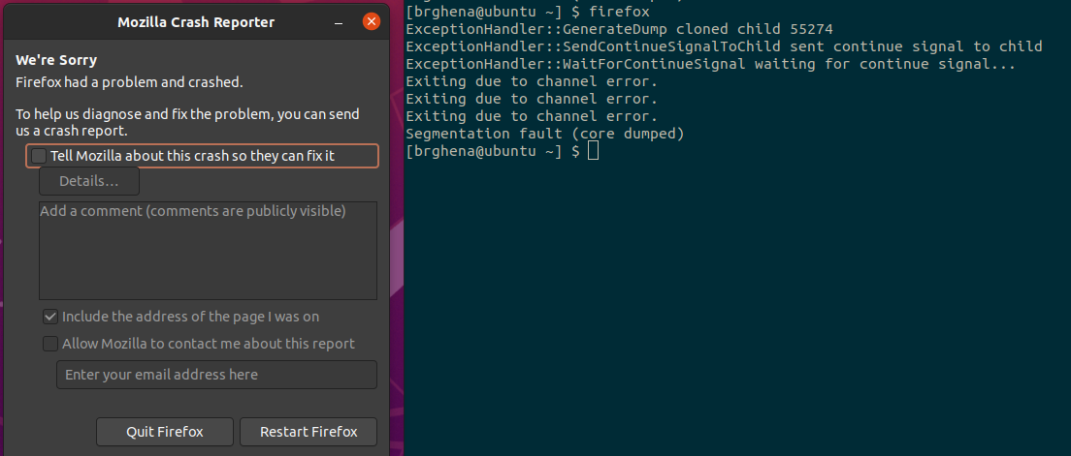
Examples: sending a signal
> kill -11 pid (11 is SIGSEGV – a.k.a segfault)

Slide 62
Outline
Processes
Context Switching
Running a Process
Exceptions
Running the Kernel
System Calls
Signals
Threads

Slide 63
Software Tasks: Threads
Unit of execution within a process
Processes discussed so far have a single thread
They “have a single thread of execution”
They “are single-threaded”
But a single process could have multiple threads

Slide 64
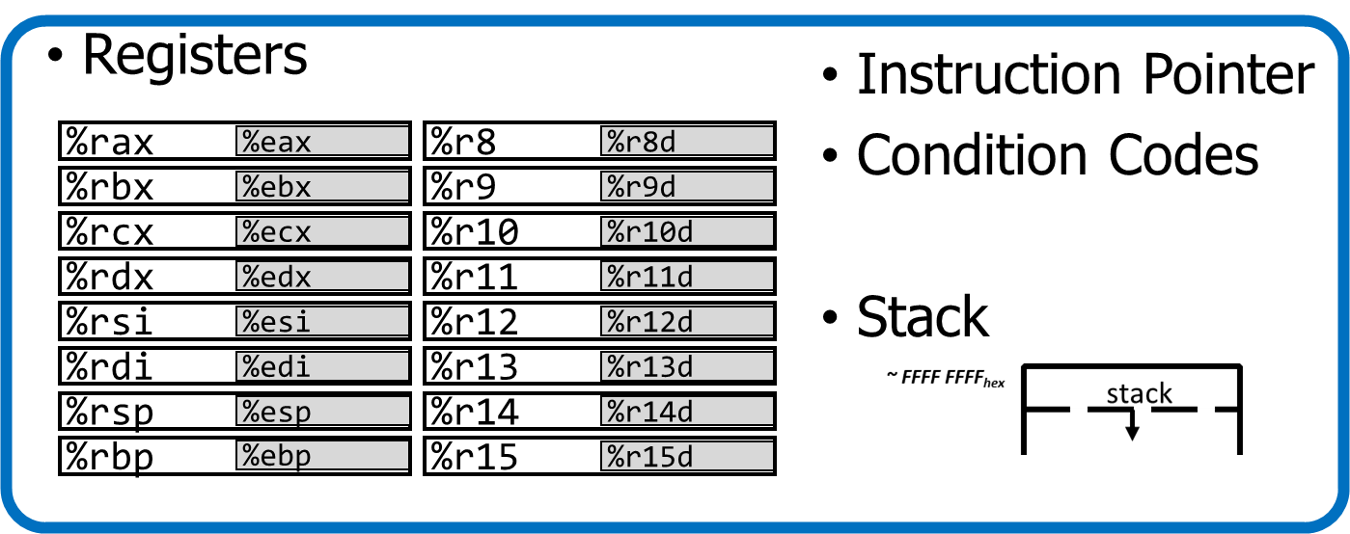
Alternate view of a process
A process could have multiple threads
Each with its own registers and stack
Threads have separate:
Instruction Pointer
Registers
Stack Memory
Condition Codes
Threads share:
Code
Global variables
Code and Data

Slide 65
Process address space with threads
Stack (T1)
Thread 1
Thread 2
Stack (T2)
Stack (T3)
Thread 3
Data
Segment
Heap
Static Data
%RIP (T3)
%RIP (T2)
Code
%RIP (T1)

Slide 66
Thread use case: web browser
Let’s say you’re implementing a web browser:
You want a tab for each web page you open:
The same code loads each website (shared code section)
The same global settings are shared by each tab (shared data section)
Each tab does have separate state (separate stack and registers)
Disclaimer: Actually, modern browsers use separate processes for each tab for a variety of reasons including performance and security. But they used to use threads.

Slide 67
Thread use case: user interfaces
Even if there is only a single processor core, threads are useful
Single-threaded User Interface
While processing actions, the UI is frozen
main() {
while(true) {
check_for_UI_interactions();
process_UI_actions(); // UI freezes while processing
}
}

Slide 68


Thread use case: web server
Example: Web server
Receives multiple simultaneous requests
Reads web pages from disk to satisfy each request

Slide 69
Web server option 1: handle one request at a time
Request 1 arrives
Server reads in request 1
Server starts disk I/O for request 1
Request 2 arrives
Disk I/O for request 1 finishes
Server responds to request 1
Server reads in request 2
Easy to program, but slow
Can’t overlap disk requests with computation
Can’t overlap either with network sends and receives
time

Slide 70
Web server option 1: event-driven model
Issue I/Os, but don’t wait for them to complete
Request 1 arrives
Server reads in request 1
Server starts disk I/O for request 1
Request 2 arrives
Server reads in request 2
Server starts disk I/O for request 2
Disk I/O for request 1 completes
Server responds to request 1
Fast, but hard to program
Must remember which requests are in flight and which I/O goes where
Lots of extra state
time

Slide 71
Web server option 3: multi-threaded web server
One thread per request. Thread handles only that request.
Easy to program (maybe), and fast!
State is stored in the stacks of each thread and the thread scheduler
Simple to program if they are independent…
Main Thread
Request 1 arrives
Create thread
Request 2 arrives
Create thread
Thread 1
Read in request 1
Start disk I/O
Disk I/O finishes
Respond to request 1
Exit
Thread 2
Read in request 2
Start disk I/O
time

Slide 72
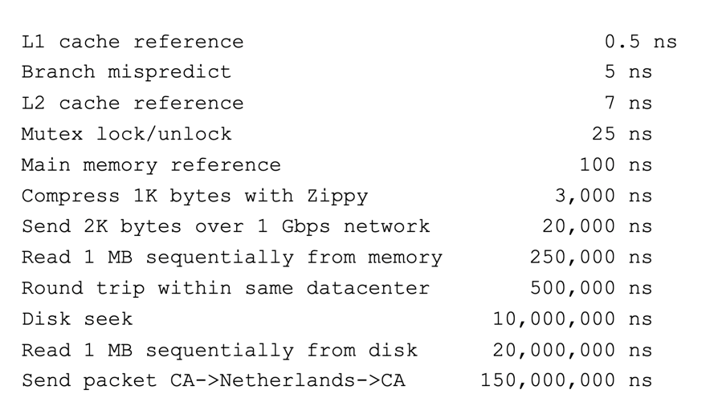
More Practical Motivation
Back to Jeff Dean’s “Numbers Everyone Should Know”
Handle I/O in separate thread, avoid blocking other progress

Slide 73

Models for thread libraries: User Threads
Thread scheduling is implemented within the process
OS only knows about the process, not the threads
Upsides
Works on any hardware or OS
Performance is better when creating and switching
Downsides
A system call in any thread blocks all threads
Processes
Thread Library
OS Kernel
Scheduler

Slide 74
Models for thread libraries: Kernel Threads
Thread scheduling is implemented by the operating system
OS manages the threads within each process
Upsides
Other threads can continue while one blocks on I/O
No additional scheduler
Downsides
Higher overhead
This is what we’ll focus on in CS343
Processes
OS Kernel
Scheduler

Slide 75
Threads versus Processes
Threads
pthread_create()
Creates a thread
Shares all memory with all threads of the process.
Scheduled independently of parent
pthread_join()
Waits for a particular thread to finish
Can communicate by reading/writing (shared) global variables.
Processes
fork()
Creates a single-threaded process
Copies all memory from parent
Can be quick using copy-on-write
Scheduled independently of parent
waitpid()
Waits for a particular child process to finish
Can communicate by setting up shared memory, pipes, reading/writing files, or using sockets (network).

Slide 76
POSIX Threads Library: pthreads
https://man7.org/linux/man-pages/man7/pthreads.7.html
int pthread_create(pthread_t *thread, const pthread_attr_t *attr, void *(*start_routine)(void*), void *arg);
thread is created executing start_routine with arg as its sole argument.
return is implicit call to pthread_exit
void pthread_exit(void *value_ptr);
terminates the thread and makes value_ptr available to any successful join
int pthread_join(pthread_t thread, void **value_ptr);
suspends execution of the calling thread until the target thread terminates.
On return with a non-NULL value_ptr the value passed to pthread_exit() by the terminating thread is made available in the location referenced by value_ptr.

Slide 77
Pthread system call example
What happens when pthread_create() is called in a process?
Library:
int pthread_create(…) {
Do some work like a normal function
Put syscall number into register
Put args into registers Special trap instruction
clone (56) syscall on Linux
Kernel:
Get args from regs
Do the work to spawn the new thread
Store return value in %eax
Get return values from regs
Do some more work like a normal function
};

Slide 78
Outline
Processes
Context Switching
Running a Process
Exceptions
Running the Kernel
System Calls
Signals
Threads

Slide 79
Bonus: Thread example

Slide 80
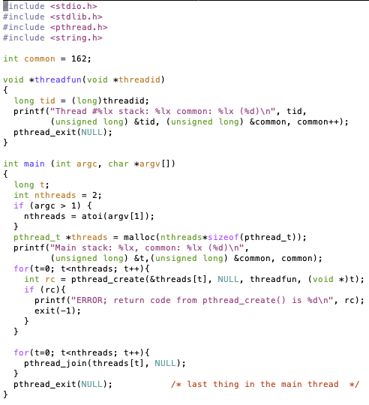
Threads Example

Slide 81
Threads Example
Reads N from process arguments
Creates N threads
Each one prints a number, then increments it, then exits
Main process waits for all of the threads to finish

Slide 82

Threads Example

Slide 83
Check your understanding
How many threads are in this program?
Does the main thread join with the threads in the same order that they were created?
Do the threads exit in the same order they were created?
If we run the program again, would the result change?

Slide 84
Check your understanding
How many threads are in this program? Five
Does the main thread join with the threads in the same order that they were created? Yes
Do the threads exit in the same order they were created? Maybe??
If we run the program again, would the result change? Possibly!

