Slide 1

Lecture 04: Advanced Scheduling
Credit: Andy Mauragis
CS343 – Operating Systems
Branden Ghena – Spring 2024
Some slides borrowed from: Wang Yi (Uppsala), and UC Berkeley CS149 and CS162

Slide 2
Today’s Goals
Describe real-time systems
Understand scheduling policies based on deadlines
Explore modern operating system schedulers

Slide 3
Outline
Real Time Operating Systems
Earliest Deadline First scheduling
Rate Monotonic scheduling
Modern Operating Systems
Linux O(1) scheduler
Lottery and Stride scheduling
Linux Completely Fair Scheduler

Slide 4
Normal OSes don’t cut it for all use cases
Some environments need very specialized systems
Flight controls
Autonomous vehicles
Space exploration
In each of these scenarios
Computer failures are unacceptable
Humans can’t intervene to resolve issues
We’re going to need a computer system with performance guarantees

Slide 5
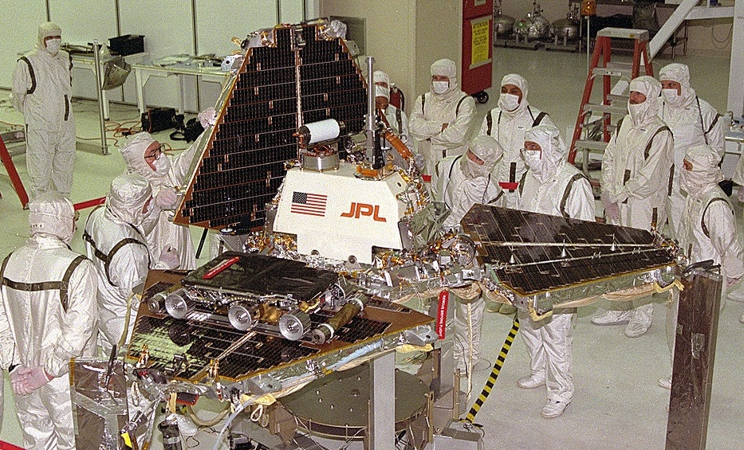
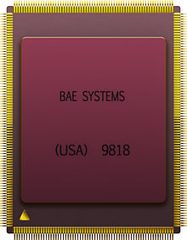
Example: Pathfinder
Radiation-hardened IBM CPU

Slide 6
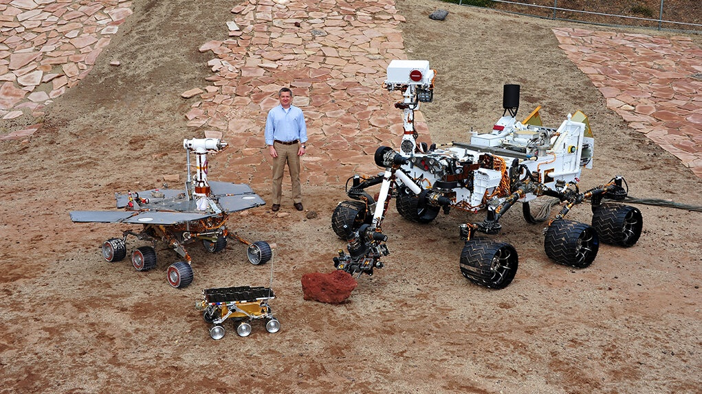

Slide 7
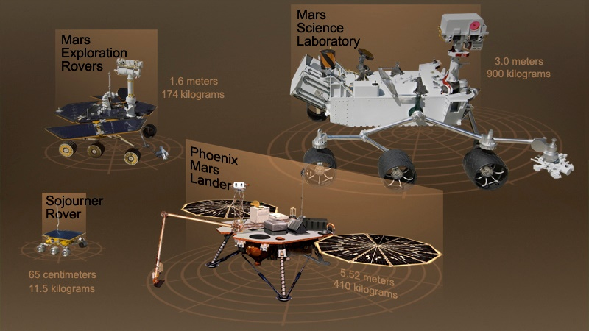
Notes:
Aside: put into perspective how big these things are

Slide 8
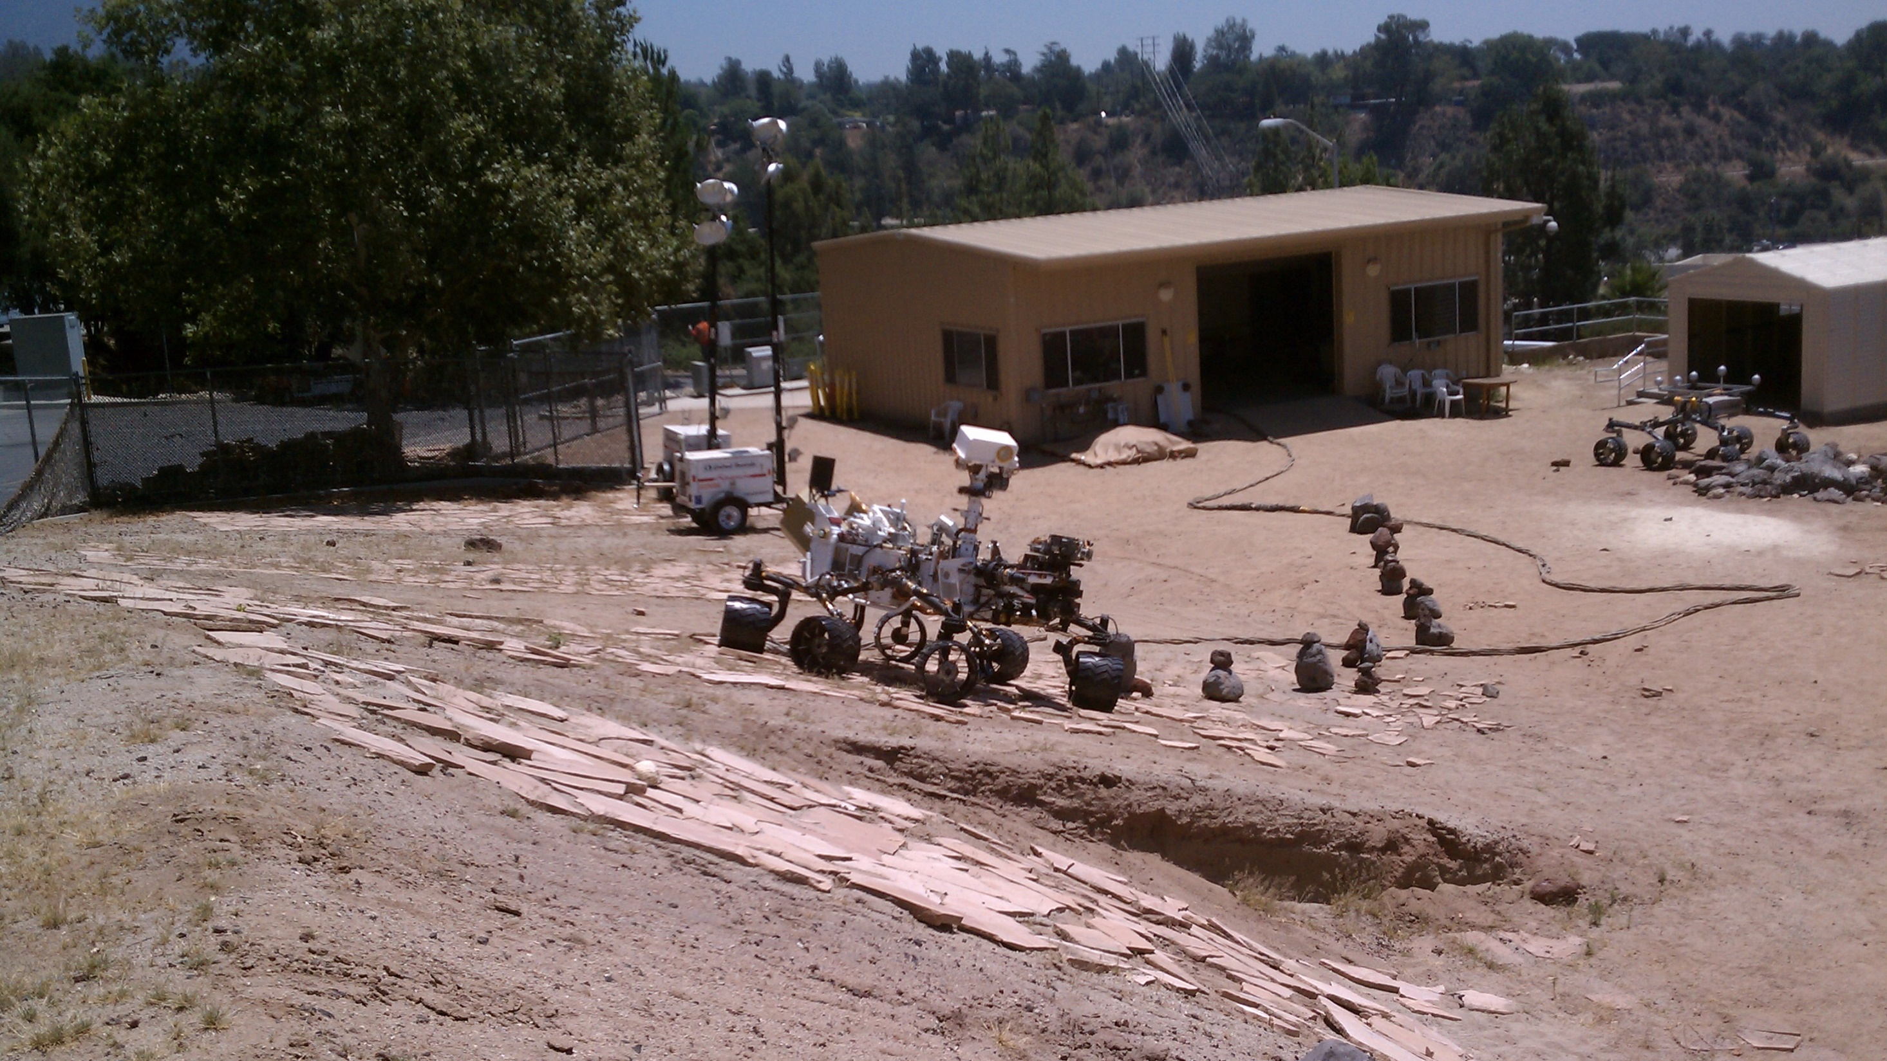
Notes:
Aside: here’s a picture of the second-curiosity they’ve got at NASA JPL for testing purposes

Slide 9
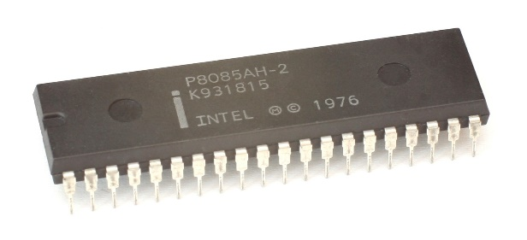
Pathfinder had periodic tasks that must be executed
Tasks to execute
Scheduler (kernel)
Manage Bus
Comms
Weather Report
Comms
Manage Bus
Weather Report
time

Slide 10
Real-Time Operating Systems
Goal: guaranteed performance
Meet deadlines even if it means being slow
Limit how bad the worst case is
Usually mathematically
It’s not about speed, it’s about guaranteed performance
Good turnaround and response time are nice, but insufficient
Predictability is key to providing a guarantee
RTOS is actually a whole other class worth of material
Last taught by Peter Dinda in 2005…

Slide 11
Types of real-time schedulers
Hard real-time:
Meet all deadlines
Otherwise decline to accept the job
Ideally: determine in advance if deadlines will be met
Soft real-time
Attempt to meet deadlines with high probability
Often good enough for many non-safety-critical applications
Quadcopter software

Slide 12
Real-time jobs
Preemptable jobs with known deadlines (D) and computation (C)
Computation duration here are the worst-case execution times
Computation MUST complete before deadline and start after arrival
Can happen anywhere between those boundaries though
Computation
Job arrives
Deadline

Slide 13
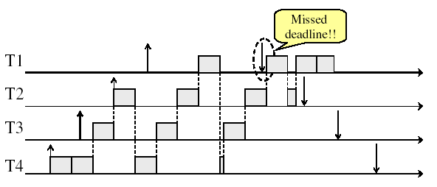
Prior scheduling policies don’t apply here
Need to account for deadlines!
Round Robin example

Slide 14
Types of real-time jobs
Aperiodic
Jobs we are already accustomed to
Unpredictable start times, no deadlines (not real-time)
Sporadic
Unpredictable start time, has a deadline
Must decide feasibility at runtime and either accept or reject job
Periodic (we’ll focus on these)
Recurs at a certain time interval
Deadline for completion is before the start of the next time interval
i.e. deadline equals the period
Can decide feasibility of schedule at compile-time

Slide 15
Periodic real-time jobs
Repeat at their deadline
New work cannot be started until the deadline
Work can take place anytime between deadlines
But MUST finish before the deadline hits
Computation
Computation
Compu
tation
Job arrives
Deadline
and
new arrival
Deadline
and
new arrival
Deadline
and
new arrival

Slide 16
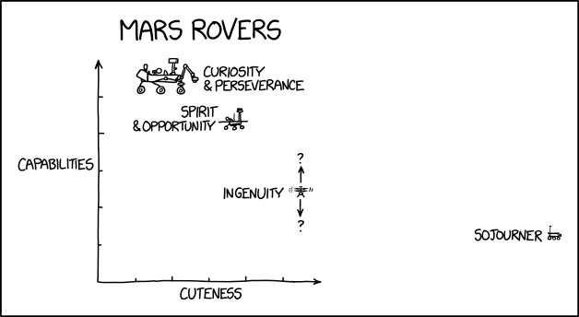
Break + xkcd
https://xkcd.com/2433/

Slide 17
Outline
Real Time Operating Systems
Earliest Deadline First scheduling
Rate Monotonic scheduling
Modern Operating Systems
Linux O(1) scheduler
Lottery and Stride scheduling
Linux Completely Fair Scheduler

Slide 18
Earliest Deadline First (EDF) Scheduling
Priority scheduling with pre-emption
Highest priority given to task with soonest deadline
Task = (Period, Duration)
Initial arrival
Deadline
0
5
10
15

Slide 19
Earliest Deadline First (EDF) Scheduling
Priority scheduling with pre-emption
Highest priority given to task with soonest deadline
Task = (Period, Duration)
Initial arrival
Deadline
0
5
10
15

Slide 20
Earliest Deadline First (EDF) Scheduling
Priority scheduling with pre-emption
Highest priority given to task with soonest deadline
Task = (Period, Duration)
Initial arrival
Deadline
0
5
10
15

Slide 21
Earliest Deadline First (EDF) Scheduling
Priority scheduling with pre-emption
Highest priority given to task with soonest deadline
Task = (Period, Duration)
Initial arrival
Deadline
0
5
10
15

Slide 22
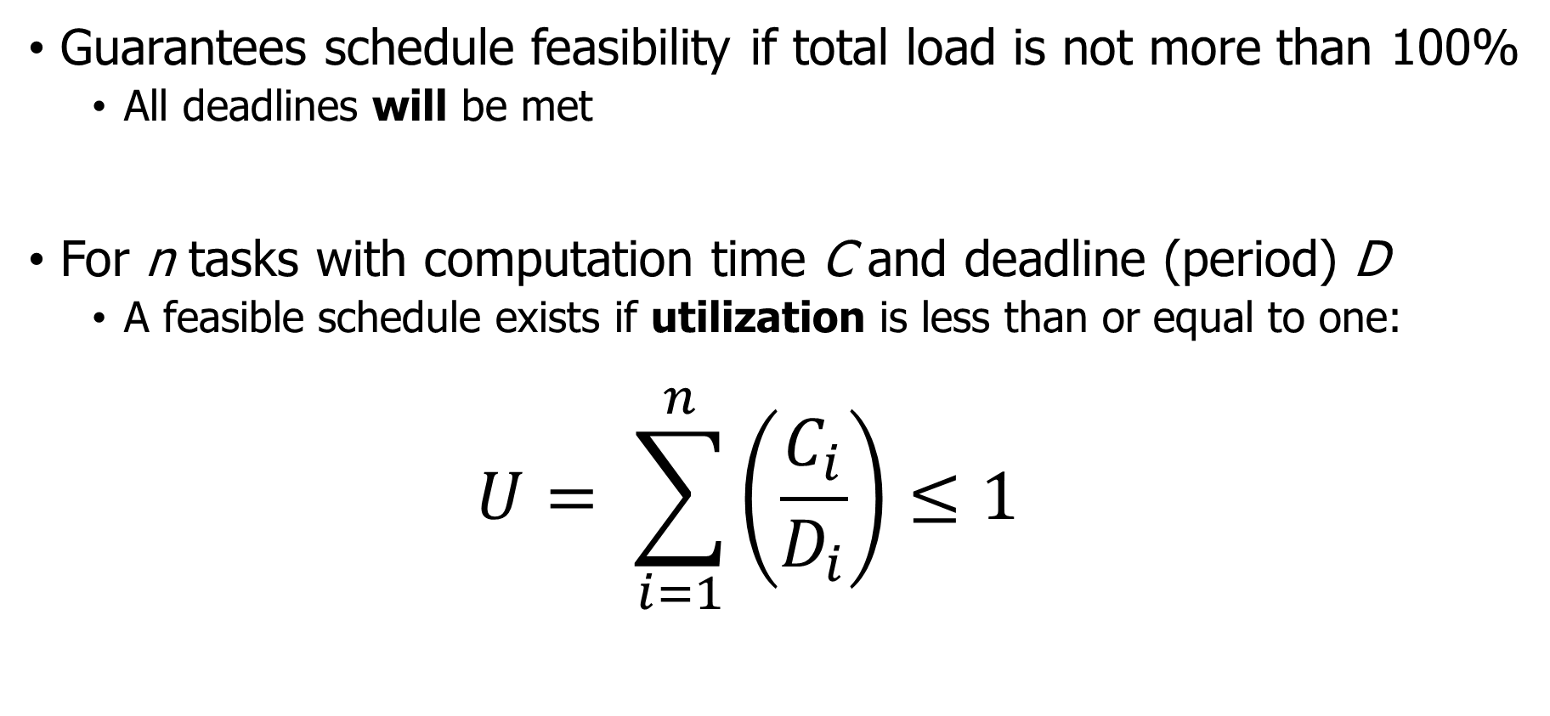
Schedulability test for EDF
Guarantees schedule feasibility if total load is not more than 100%
All deadlines will be met
For n tasks with computation time C and deadline (period) D
A feasible schedule exists if utilization is less than or equal to one:
$$U= \sum_{i=1}^{n}{\left(\frac{C_{i}}{D_{i}}\right)}≤1$$

Slide 23

Check your understanding
Can we schedule the following workload?
Job A: period 3, computation 1
Job B: period 5, computation 2
Job C: period 15, computation 4
$$U= \sum_{i=1}^{n}{\left(\frac{C_{i}}{D_{i}}\right)}≤1$$
A
B
C
0
5
10
15

Slide 24
Check your understanding
Can we schedule the following workload?
Job A: period 3, computation 1
Job B: period 5, computation 2
Job C: period 15, computation 4
$$U= \sum_{i=1}^{n}{\left(\frac{C_{i}}{D_{i}}\right)}≤1$$
1/3 + 2/5 + 4/15 = 1
A
B
C
0
5
10
15

Slide 25
Check your understanding
Can we schedule the following workload?
Job A: period 3, computation 1
Job B: period 5, computation 2
Job C: period 15, computation 4
$$U= \sum_{i=1}^{n}{\left(\frac{C_{i}}{D_{i}}\right)}≤1$$
1/3 + 2/5 + 4/15 = 1
A
B
C
0
5
10
15
Can’t start a job before its period

Slide 26
Check your understanding
Can we schedule the following workload?
Job A: period 3, computation 1
Job B: period 5, computation 2
Job C: period 15, computation 4
$$U= \sum_{i=1}^{n}{\left(\frac{C_{i}}{D_{i}}\right)}≤1$$
1/3 + 2/5 + 4/15 = 1
A
B
C
0
5
10
15
Earliest deadline changes, preempting Job B

Slide 27
Check your understanding
Can we schedule the following workload?
Job A: period 3, computation 1
Job B: period 5, computation 2
Job C: period 15, computation 4
$$U= \sum_{i=1}^{n}{\left(\frac{C_{i}}{D_{i}}\right)}≤1$$
1/3 + 2/5 + 4/15 = 1
A
B
C
0
5
10
15
Schedule repeats at least common multiple

Slide 28
Check your understanding
Can we schedule the following workload?
Job A: period 2, computation 1
Job B: period 3, computation 1
Job C: period 4, computation 1
$$U= \sum_{i=1}^{n}{\left(\frac{C_{i}}{D_{i}}\right)}≤1$$
A
B
C
0
5
10
15

Slide 29
Check your understanding
Can we schedule the following workload?
Job A: period 2, computation 1
Job B: period 3, computation 1
Job C: period 4, computation 1
$$U= \sum_{i=1}^{n}{\left(\frac{C_{i}}{D_{i}}\right)}≤1$$
1/2 + 1/3 + 1/4 = 1.08
A
B
C
0
5
10
15

Slide 30
Check your understanding
Can we schedule the following workload?
Job A: period 2, computation 1
Job B: period 3, computation 1
Job C: period 4, computation 1
$$U= \sum_{i=1}^{n}{\left(\frac{C_{i}}{D_{i}}\right)}≤1$$
1/2 + 1/3 + 1/4 = 1.08
A
B
C
0
5
10
15
Missed deadline!

Slide 31
Break + Thinking
Where do job deadlines come from? Provide an example.

Slide 32
Break + Thinking
Where do job deadlines come from? Provide an example.
Real-world constraints!
Autonomous vehicle:
“If I don’t finish the detection algorithm by time N, then I will no longer be able to stop in time to avoid what it detects.”
In this example, deadline might vary with velocity, or maybe we just choose a deadline based on fastest velocity.

Slide 33
Outline
Real Time Operating Systems
Earliest Deadline First scheduling
Rate Monotonic scheduling
Modern Operating Systems
Linux O(1) scheduler
Lottery and Stride scheduling
Linux Completely Fair Scheduler

Slide 34
Earliest Deadline First tradeoffs
Good qualities
Simple concept and simple schedulability test
Excellent CPU utilization (can use 100% of the CPU)
Bad qualities
Hard to implement in practice
Need to constantly recalculate task priorities
CPU time spent in scheduler needs to be counted against load
Unstable: Hard to predict which job will miss deadline
Utilization was greater than 1, so we knew there was a problem
But we had to work out the whole schedule to see Job C missed

Slide 35
Rate Monotonic Scheduling (RMS)
Priority scheduling
Assign fixed priority of 1/Period for each job
Makes the scheduling algorithm simple and stable
Deterministic failures: only lowest priority jobs might miss deadlines
If any fixed-priority scheduling algorithm can schedule a workload, So can Rate Monotonic Scheduling
There could be dynamic-priority systems that beat it
But they would be more complicated and take more cycles to run

Slide 36
Rate Monotonic Scheduling example
Schedule the following workload with RMS
Job A: period 3, computation 1 -> Priority 1/3
Job B: period 5, computation 2 -> Priority 1/5
A
B
0
5
10
15

Slide 37
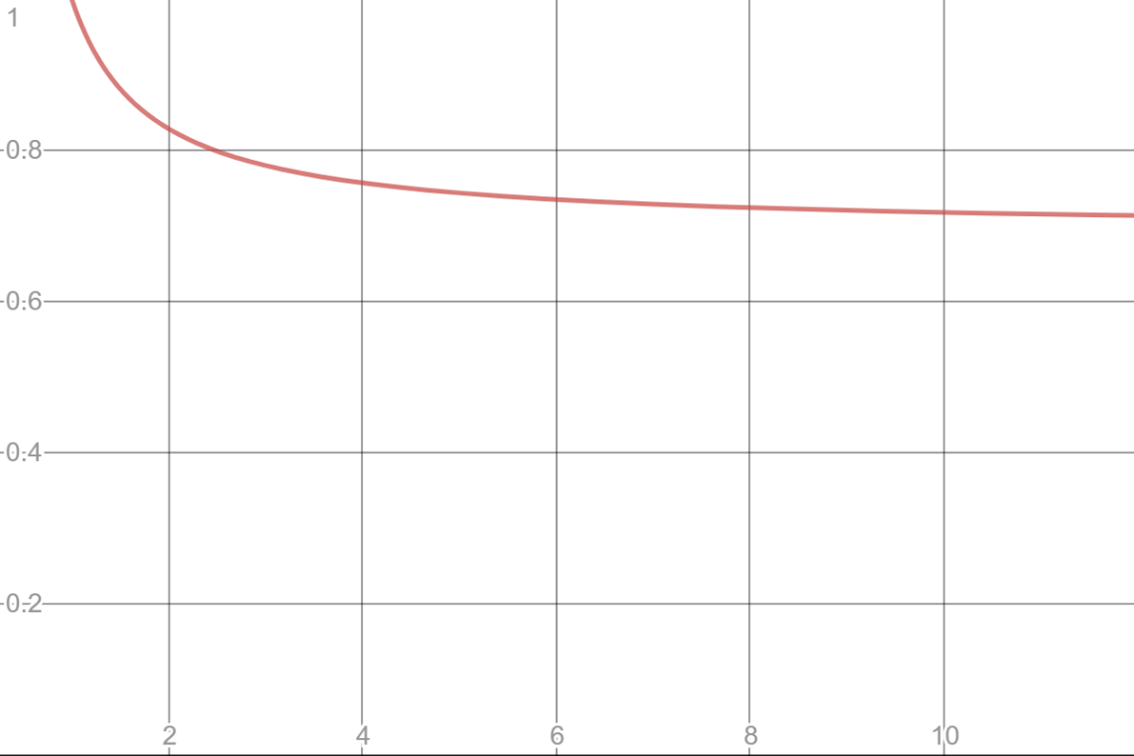
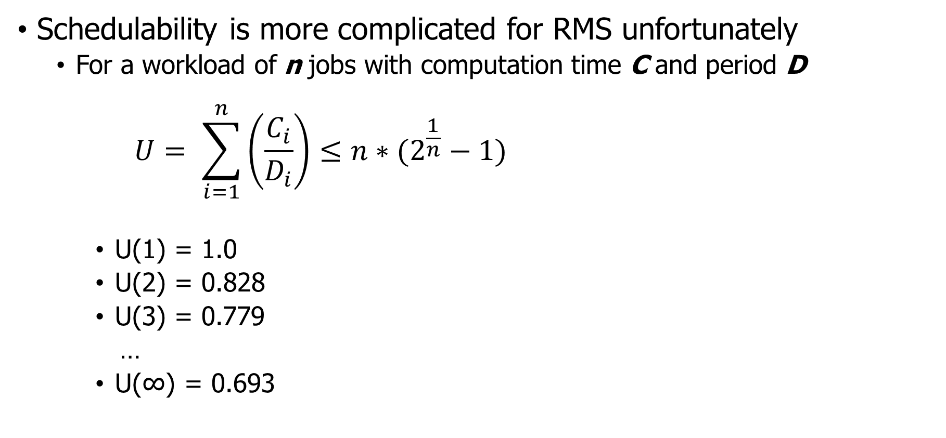
Schedulability test for RMS
Schedulability is more complicated for RMS unfortunately
For a workload of n jobs with computation time C and period D
$$U= \sum_{i=1}^{n}{\left(\frac{C_{i}}{D_{i}}\right)}≤{n∗(2}^{\frac{1}{n}}−1)$$
U(1) = 1.0
U(2) = 0.828
U(3) = 0.779
…
U(∞) = 0.693
Lower Bound on schedulability

Slide 38
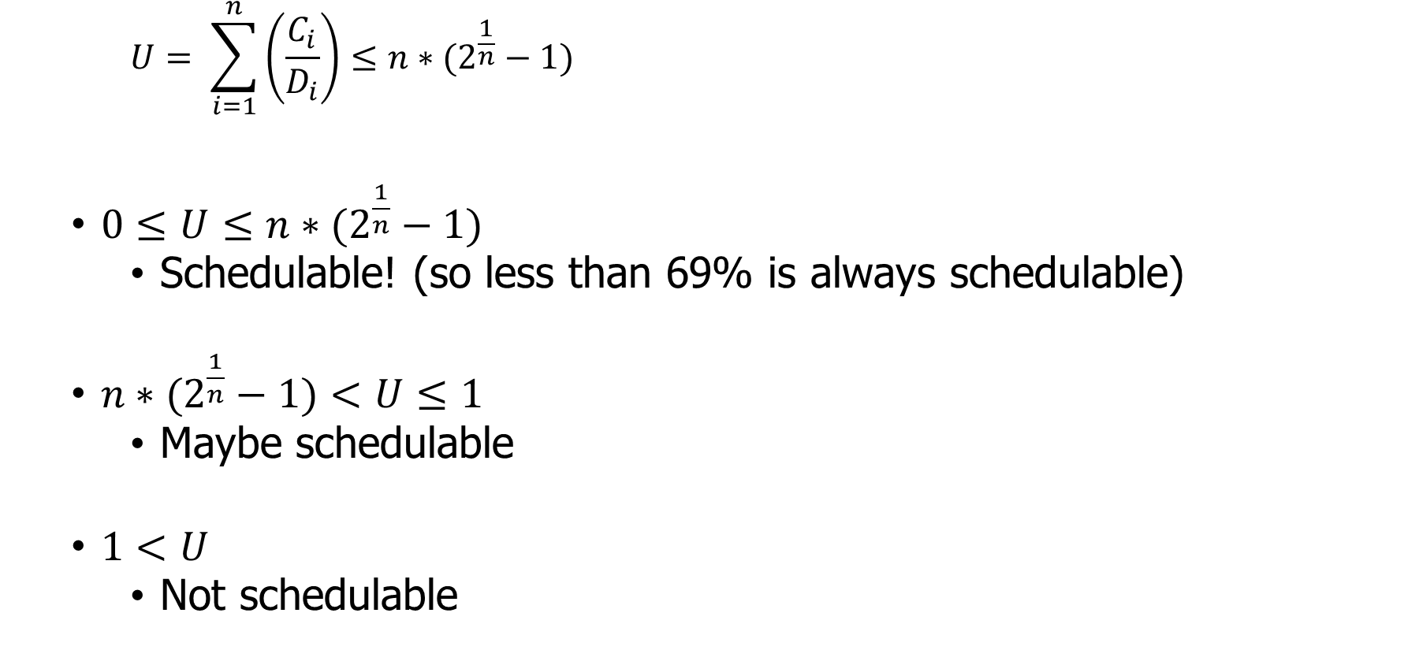
RMS schedulability test is conservative
$$U= \sum_{i=1}^{n}{\left(\frac{C_{i}}{D_{i}}\right)}≤{n∗(2}^{\frac{1}{n}}−1)$$
$0≤U≤{n∗(2}^{\frac{1}{n}}−1)$
Schedulable! (so less than 69% is always schedulable)
${n∗(2}^{\frac{1}{n}}−1)<U≤1$
Maybe schedulable
$1<U$
Not schedulable

Slide 39
Check your understanding
Can we schedule the following workload with RMS?
Job A: period 3, computation 1
Job B: period 5, computation 2
Job C: period 15, computation 4
A
B
C
0
5
10
15

Slide 40
Check your understanding
Can we schedule the following workload with RMS?
Job A: period 3, computation 1
Job B: period 5, computation 2
Job C: period 15, computation 4
1/3 + 2/5 + 4/15 = 1
U = 1 Maybe schedulable!
A
B
C
0
5
10
15

Slide 41
Check your understanding
Can we schedule the following workload with RMS?
Job A: period 3, computation 1 -> Highest priority
Job B: period 5, computation 2 -> Middle priority
Job C: period 15, computation 4 -> Lowest priority
1/3 + 2/5 + 4/15 = 1
U = 1 Maybe schedulable!
A
B
C
0
5
10
15

Slide 42
Rate Monotonic Scheduling tradeoffs
Upsides
Still conceptually simple
Easy to implement
Stable (lower priority jobs will fail to meet deadlines in overload)
Downsides
Lower CPU utilization
Might not be able to utilize more than 70% of the processor
Non-precise schedulability analysis

Slide 43
Break + Open Question
How would you handle sporadic jobs in these systems?
Unpredictable start time, has a deadline, not repeated

Slide 44
Break + Open Question
How would you handle sporadic jobs in these systems?
Unpredictable start time, has a deadline, not repeated
Must decide feasibility at runtime and either accept or reject job
Calculate new Utilization accounting for the additional job
Determine whether the schedule will definitely (or maybe) work
Schedule or reject the job
If scheduled, works just like any other job
Either EDF based on deadline of the job
Or given an RMS priority, based on period (duration)

Slide 45
Outline
Real Time Operating Systems
Earliest Deadline First scheduling
Rate Monotonic scheduling
Modern Operating Systems
Linux O(1) scheduler
Lottery and Stride scheduling
Linux Completely Fair Scheduler

Slide 46
Priority scheduling policies
Systems may try to set priorities according to some policy goal
MLFQ Example:
Give interactive jobs higher priority than long calculations
Prefer jobs waiting on I/O to those consuming lots of CPU
Try to achieve fairness:
elevate priority of threads that don’t get CPU time (ad-hoc, bad if system overloaded)
Priority 3
Job 1
Job 2
Job 3
Priority 2
Job 4
Priority 1
Priority 0
Job 5
Job 6
Job 7

Slide 47
Linux O(1) scheduler (Linux 2.6, 2003-2007)
Goals
Keep the runtime of the scheduler itself short
Avoid O(n) algorithms
Instead, only adjust a single job when it is swapped
Predictable algorithm
Identify interactive versus noninteractive processes with heuristics
Processes with long average sleep time get a priority boost
Note my machines right now:
Ubuntu VM: 332 processes (867 threads)
Windows: 224 processes (2591 threads)
MacOS: 430 processes (2249 threads)
Major concern: many processes mean O(n) could be long…
Notes:
Linux Big O of 1 scheduler

Slide 48
O(1) scheduler: scheduling algorithm
Find the highest priority run queue that’s not empty
Remove and run the first job from it
Active Run Queues
Expired Run Queues
High
0
High
0
1
1
2
2
Priority
Priority
…
…
138
138
Low
139
Low
139

Slide 49
O(1) scheduler: when swapping out a job
Always recalculate job priority
Heuristics: interactivity guess, process “niceness”, possibly other measurements
If job has not expired its quota, place at end of correct active queue (round-robin at a priority level)
If job has expired its quota, place at end of correct expired queue
When all jobs are gone from the active queue, swap which queue is “active” and which is “expired”
Active Run Queues
Expired Run Queues
High
0
High
0
Issue with O(1) scheduler:
Determining priority is challenging
“Complex heuristics” make decisions hard to understand at runtime
1
1
2
2
Priority
Priority
…
…
138
138
Low
139
Low
139

Slide 50
Priorities can lead to starvation
In priority-based schedulers we’ve seen so far:
Always prefer to give the CPU to a prioritized job
Non-prioritized jobs may never get to run
So they need some special mechanism to occasionally run them
“Time quota” at a priority level, or periodic “resets”
But priorities were a means, not an end
The goal was to serve a mix of CPU-bound, I/O bound, and Interactive jobs effectively on common hardware
Give the I/O bound ones enough CPU to issue their next file operation and wait (on those slow discs)
Give the interactive ones enough CPU to respond to an input and wait (on those slow humans)
Let the CPU bound ones grind away without too much disturbance

Slide 51
Idea: proportional-share scheduling
Many of the policies we’ve studied always prefer to give CPU to a prioritized job
Instead, we can share the CPU proportionally
Give each job a portion of the CPU according to its priority
Low-priority jobs get to run less often
But all jobs can at least make progress (no starvation)

Slide 52
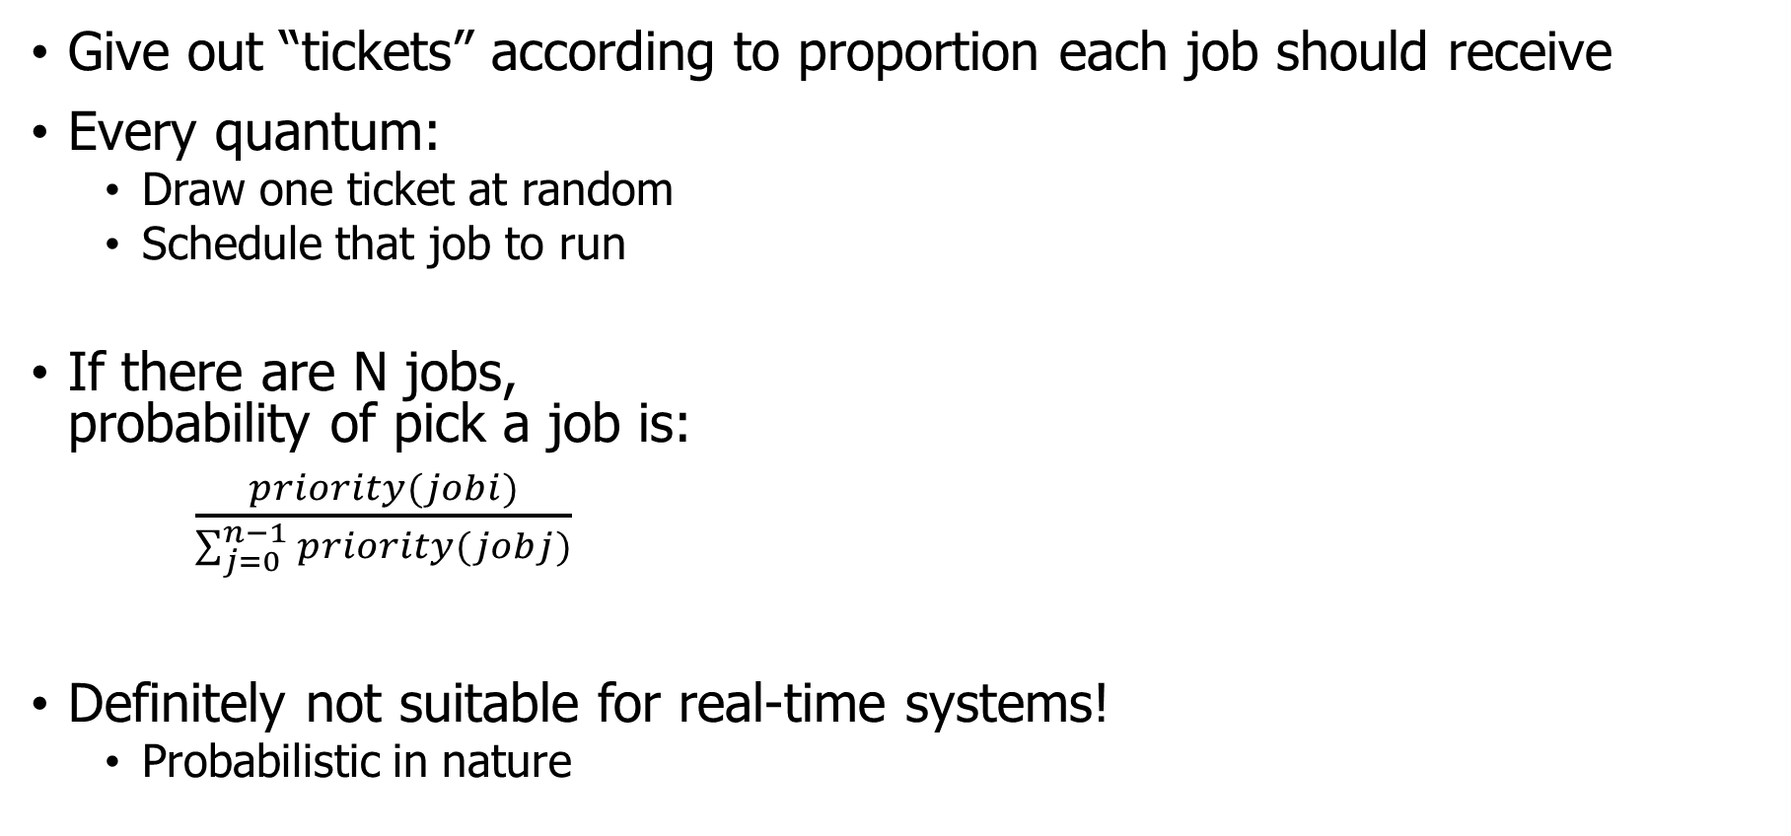
First attempt: lottery scheduling
Give out “tickets” according to proportion each job should receive
Every quantum:
Draw one ticket at random
Schedule that job to run
If there are N jobs, probability of pick a job is:
$\frac{priority(jobi)}{\sum_{j=0}^{n−1}{priority(jobj)}}$
Definitely not suitable for real-time systems!
Probabilistic in nature
10
1

Slide 53
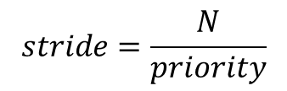
Better idea: stride scheduling
Same idea, but remove the random element
Give each job a stride number inversely proportional to priority
Priority: A=100, B=50, C=10
Stride: A=1, B=2, C=10
Scheduler
Pick job with lowest cumulative strides and run it
Increment its cumulative strides by its stride number
Essentially: low-stride (high-ticket) jobs get run more often
But starvation is no longer possible
$$stride=\frac{N}{priority}$$
Where N is some arbitrary large number
This example: 100

Slide 54
Stride scheduling example
Workload
Priority: A=100, B=50, C=10
Stride: A=1, B=2, C=10
Dynamic Priority (a.k.a. Pass)
Step
A
B
C
Result
1
0
0
0
A
2
1
0
0
B
3
1
2
0
C
4
1
2
10
A
5
2
2
10
A
6
3
2
10
B
7
3
4
10
A

Slide 55
Proportional-share scheduling is impossible instantaneously
Goal: each process gets an equal share of processor
N threads “simultaneously” execute on 1/N^{th} of processor
Doesn’t work in the real world
Jobs block on I/O
OS needs to give out timeslices
At any time t we want to observe:
CPU Time
t/N
T₁
T₂
T₃

Slide 56
Linux Completely Fair Scheduler (CFS) (2007-2023)
What if we make shares proportional over a longer period?
Track processor time given to job so far
Scheduling decision
Choose thread with minimum processor time to schedule
“Repairs” illusion of fairness
Update processor time when the scheduling occurs again
Timeslice expiration is a big update
Blocking I/O results in maintaining small processor time
T₁
CPU Time
t/N
T₃
T₂

Slide 57
Linux CFS: responsiveness and throughput
Constraint 1: target latency
Want a maximum duration before a job gets some service
Dynamically set timeslice based on number of jobs
Quanta = Target_latency / N
20 ms max latency => 5 ms timeslice for 4 jobs, or 0.1 ms for 200 jobs

Slide 58
Linux CFS: responsiveness and throughput
Constraint 1: target latency
Want a maximum duration before a job gets some service
Dynamically set timeslice based on number of jobs
Quanta = Target_latency / N
20 ms max latency => 5 ms timeslice for 4 jobs, or 0.1 ms for 200 jobs
Check your understanding. What’s the problem here?

Slide 59
Linux CFS: responsiveness and throughput
Constraint 1: target latency
Want a maximum duration before a job gets some service
Dynamically set timeslice based on number of jobs
Quanta = Target_latency / N
20 ms max latency => 5 ms timeslice for 4 jobs, or 0.1 ms for 200 jobs
Check your understanding. What’s the problem here?
Timeslice needs to stay much greater than context switch time

Slide 60
Linux CFS: responsiveness and throughput
Constraint 1: target latency
Want a maximum duration before a job gets some service
Dynamically set timeslice based on number of jobs
Quanta = Target_latency / N
20 ms max latency => 5 ms timeslice for 4 jobs, or 0.1 ms for 200 jobs
Constraint 2: avoid excessive overhead
Don’t want to spend all our time context switching if there are many jobs
Set a minimum length for timeslices
Quanta = max(Target_latency/N, minimum_length)

Slide 61
CFS priorities are applied as “virtual runtime”
B is higher priority than A
Virtual runtime doesn’t have to match wall time
Create a conversion from actual runtime to virtual runtime
High priority jobs: 1 second real-time -> 0.5 seconds virtual-time
Low priority jobs: 1 second real-time -> 2 seconds virtual-time
Scheduler makes decisions solely based on equalizing virtual runtime
B
Physical
CPU Time
A
Virtual
CPU Time
B
A

Slide 62
Multicore scheduling
Affinity scheduling: once a thread is scheduled on a CPU, OS tries to reschedule it on the same CPU
Cache reuse
Grouping threads could help or hurt…
Implementation-wise, helpful to have per-core scheduling data structures
Each core can make its own scheduling decisions
Can steal work from other cores, if nothing to do

Slide 63
CFS updates over time
Getting scheduling right on multicore can be difficult
No way to know whether a process will be more I/O or CPU bound in the future
Want to keep threads on the same core, but also not waste cores
In 2016, researchers found issues in Linux scheduler implementation that lead to 13%+ slowdown in jobs
https://blog.acolyer.org/2016/04/26/the-linux-scheduler-a-decade-of-wasted-cores/

Slide 64
Modern scheduling challenges
Fair sharing of CPU time is insufficient
Maximize cache usage
Maximize processor affinity
Reduce energy consumption
Hybrid systems with heterogeneous processing capabilities
Particular focus: latency requirements
Some processes need to respond quickly to new data
They don’t need more processing time. They need the time more quickly
Heuristic shortcuts were added to CFS to allow some jobs to jump the queue

Slide 65
Earliest Eligible Virtual Deadline First (EEVDF) (2023-Present)
Algorithm first described in a 1995 research paper
Run job with earliest “virtual deadline”
TLDR: share processor time proportionally, but schedule within that based on latency
Still divides processor time equally between jobs, like CFS
Biased by priority of the job. Higher priority means larger share
Calculate “lag” for each job
Measurement of how far it’s behind a fair share of processor time
Negative lag means a job has run more than its fair share already
Job won’t be eligible to run until lag >= 0
Lag increases automatically as other jobs run. So time until lag >= 0 can be calculated
Virtual deadline for job: time until lag >= 0, plus duration it should run for
Now + timeslice for any jobs below fair share of processor time
Future + timeslice for any jobs above fair share of processor time
Where timeslices vary by priority of the job
https://lwn.net/Articles/925371/

Slide 66
Summary on schedulers
If You care About: | Then Choose:
CPU Throughput | First-In-First-Out
Average Turnaround Time | Shortest Remaining Processing Time
Average Response Time | Round Robin
Favoring Important Tasks | Priority
Fair CPU Time Usage | Linux CFS or EEVDF
Meeting Deadlines | EDF or RMS

Slide 67
Outline
Real Time Operating Systems
Earliest Deadline First scheduling
Rate Monotonic scheduling
Modern Operating Systems
Linux O(1) scheduler
Lottery and Stride scheduling
Linux Completely Fair Scheduler

