Slide 1
Lecture 06: Data Races & Mutexes
CS343 – Operating Systems
Branden Ghena – Spring 2024
Some slides borrowed from: Stephen Tarzia (Northwestern), Shivaram Venkataraman (Wisconsin), and UC Berkeley CS61C and CS162

Slide 2
Administrivia
Scheduling Lab due Thursday
90% of groups have at least one commit
Hard part is testing your code, not writing it
Producer-Consumer Lab posted now
Solve concurrency problems three ways
First two are ready after today’s lecture
Fill out partnership survey if you want to be grouped up
Start early! Due after the exam, but good practice for the exam
Office hours
Five days a week, with very helpful PMs (schedule on Canvas homepage)
Take advantage of these!

Slide 3
Today’s Goals
Explore problems with concurrently shared memory.
Introduce locks as a simple solution for correctness.
Design of locks
Implementation of locks
Optimize locks to enforce fairness and increase performance.

Slide 4
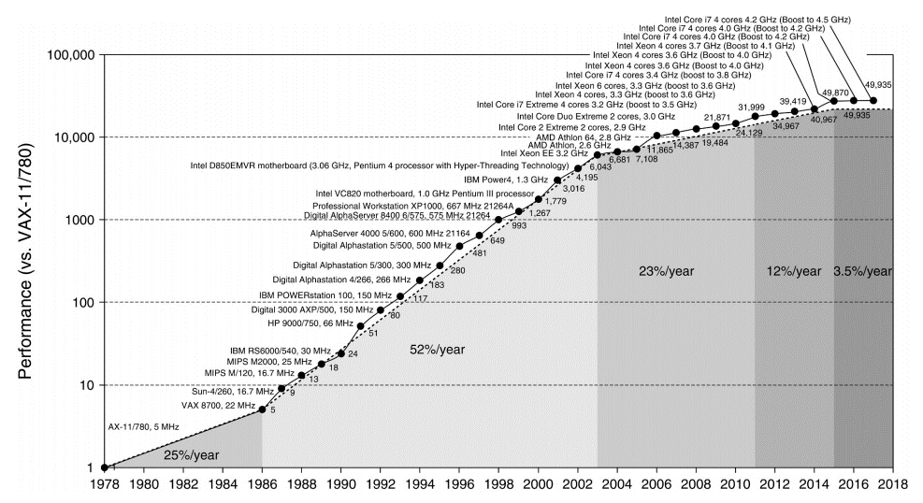
Reminder on performance (SPEC benchmark)
Copyright Elsevier Inc. 2019

Slide 5
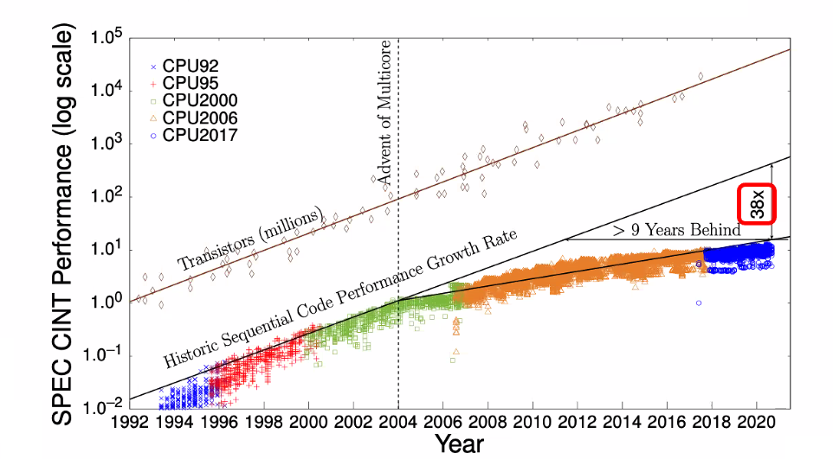
Performance for sequential code is falling behind

Slide 6
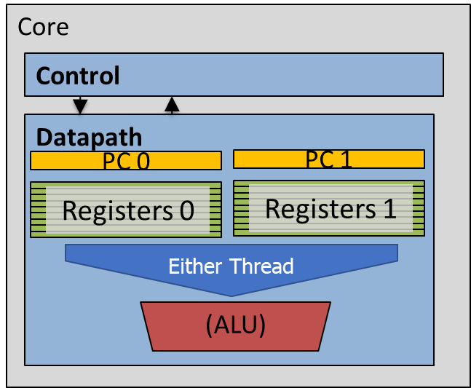
Review: modern hardware capabilities
Processor (also known as CPU)
L1 Cache
L1 Cache
L1 Cache
L1 Cache
L2 Cache
L2 Cache
L2 Cache
L2 Cache
L3 Cache

Slide 7
Outline
Race Conditions
Critical Sections
Lock Design
Overview
Basic Lock Implementation
Lock Optimizations

Slide 8
Challenges to concurrency
Concurrency is great! We can do so many things!!
But what’s the downside…?
How much speedup can we get from it?
How hard is it to write parallel programs?

Slide 9
Concurrency problem: data races
Consider two threads with a shared global variable: int count = 0
count could end up with a final value of 1 or 2. How?
Thread 1:
void main(){
count += 1;
}
Thread 2:
void main(){
count += 1;
}

Slide 10
Concurrency problem: data races
Consider two threads with a shared global variable: int count = 0
count could end up with a final value of 1 or 2. How?
These instructions could be interleaved in any way.
Assuming “count” is in memory location 0x8049a1c
Thread 1:
void thread_fn(){
mov $0x8049a1c, %edi
mov (%edi), %eax
add $0x1, %eax
mov %eax, (%edi)
}
Thread 2:
void thread_fn(){
mov $0x8049a1c, %edi
mov (%edi), %eax
add $0x1, %eax
mov %eax, (%edi)
}

Slide 11
Data race example – Count = 2
Before this code starts
Thread 1
Register | Value
%eax | ???
Thread 2
Register | Value
%eax | ???
Time
Thread 1 | Thread 2
mov (%edi), %eax
add $0x1, %eax
mov %eax, ($edi)
 | mov (%edi), %eax
 | add $0x1, %eax
 | mov %eax, (%edi)
Memory
Variable | Value
count | 0
Assuming “count” is in memory location pointed to by %edi

Slide 12
Data race example – Count = 2
Thread 1
Register | Value
%eax | 0
Thread 2
Register | Value
%eax | ???
Time
Thread 1 | Thread 2
mov (%edi), %eax
add $0x1, %eax
mov %eax, ($edi)
 | mov (%edi), %eax
 | add $0x1, %eax
 | mov %eax, (%edi)
Memory
Variable | Value
count | 0
Assuming “count” is in memory location pointed to by %edi

Slide 13
Data race example – Count = 2
Thread 1
Register | Value
%eax | 1
Thread 2
Register | Value
%eax | ???
Time
Thread 1 | Thread 2
mov (%edi), %eax
add $0x1, %eax
mov %eax, ($edi)
 | mov (%edi), %eax
 | add $0x1, %eax
 | mov %eax, (%edi)
Memory
Variable | Value
count | 0
Assuming “count” is in memory location pointed to by %edi

Slide 14
Data race example – Count = 2
Thread 1
Register | Value
%eax | 1
Thread 2
Register | Value
%eax | ???
Time
Thread 1 | Thread 2
mov (%edi), %eax
add $0x1, %eax
mov %eax, ($edi)
 | mov (%edi), %eax
 | add $0x1, %eax
 | mov %eax, (%edi)
Memory
Variable | Value
count | 1
Assuming “count” is in memory location pointed to by %edi

Slide 15
Data race example – Count = 2
Thread 1
Register | Value
%eax | 1
Thread 2
Register | Value
%eax | 1
Time
Thread 1 | Thread 2
mov (%edi), %eax
add $0x1, %eax
mov %eax, ($edi)
 | mov (%edi), %eax
 | add $0x1, %eax
 | mov %eax, (%edi)
Memory
Variable | Value
count | 1
Assuming “count” is in memory location pointed to by %edi

Slide 16
Data race example – Count = 2
Thread 1
Register | Value
%eax | 1
Thread 2
Register | Value
%eax | 2
Time
Thread 1 | Thread 2
mov (%edi), %eax
add $0x1, %eax
mov %eax, ($edi)
 | mov (%edi), %eax
 | add $0x1, %eax
 | mov %eax, (%edi)
Memory
Variable | Value
count | 1
Assuming “count” is in memory location pointed to by %edi

Slide 17
Data race example – Count = 2
Thread 1
Register | Value
%eax | 1
Thread 2
Register | Value
%eax | 2
Time
Thread 1 | Thread 2
mov (%edi), %eax
add $0x1, %eax
mov %eax, ($edi)
 | mov (%edi), %eax
 | add $0x1, %eax
 | mov %eax, (%edi)
Memory
Variable | Value
count | 2
Assuming “count” is in memory location pointed to by %edi

Slide 18
Theads do not have guaranteed ordering
BUT, there’s no guarantee that the instructions occur in that order!
Since the two threads are running in parallel, the instructions could be interleaved in any way (both threads are really running simultaneously)

Slide 19
Data race example – Count = 1
Remember, each thread has its own separate registers!
Before this code starts
Thread 1
Register | Value
%eax | ???
Thread 2
Register | Value
%eax | ???
Time
Thread 1 | Thread 2
mov (%edi), %eax
 | mov (%edi), %eax
 | add $0x1, %eax
 | mov %eax, (%edi)
add $0x1, %eax
mov %eax, (%edi)
Memory
Variable | Value
count | 0
Assuming “count” is in memory location pointed to by %edi

Slide 20
Data race example – Count = 1
Thread 1
Register | Value
%eax | 0
Thread 2
Register | Value
%eax | ???
Time
Thread 1 | Thread 2
mov (%edi), %eax
 | mov (%edi), %eax
 | add $0x1, %eax
 | mov %eax, (%edi)
add $0x1, %eax
mov %eax, (%edi)
Memory
Variable | Value
count | 0
Assuming “count” is in memory location pointed to by %edi

Slide 21
Data race example – Count = 1
Thread 1
Register | Value
%eax | 0
Thread 2
Register | Value
%eax | 0
Time
Thread 1 | Thread 2
mov (%edi), %eax
 | mov (%edi), %eax
 | add $0x1, %eax
 | mov %eax, (%edi)
add $0x1, %eax
mov %eax, (%edi)
Memory
Variable | Value
count | 0
Assuming “count” is in memory location pointed to by %edi

Slide 22
Data race example – Count = 1
Thread 1
Register | Value
%eax | 0
Thread 2
Register | Value
%eax | 1
Time
Thread 1 | Thread 2
mov (%edi), %eax
 | mov (%edi), %eax
 | add $0x1, %eax
 | mov %eax, (%edi)
add $0x1, %eax
mov %eax, (%edi)
Memory
Variable | Value
count | 0
Assuming “count” is in memory location pointed to by %edi

Slide 23
Data race example – Count = 1
Thread 1
Register | Value
%eax | 0
Thread 2
Register | Value
%eax | 1
Time
Thread 1 | Thread 2
mov (%edi), %eax
 | mov (%edi), %eax
 | add $0x1, %eax
 | mov %eax, (%edi)
add $0x1, %eax
mov %eax, (%edi)
Memory
Variable | Value
count | 1
Assuming “count” is in memory location pointed to by %edi

Slide 24
Data race example – Count = 1
Thread 1
Register | Value
%eax | 1
Thread 2
Register | Value
%eax | 1
Time
Thread 1 | Thread 2
mov (%edi), %eax
 | mov (%edi), %eax
 | add $0x1, %eax
 | mov %eax, (%edi)
add $0x1, %eax
mov %eax, (%edi)
Memory
Variable | Value
count | 1
Assuming “count” is in memory location pointed to by %edi

Slide 25
Data race example – Count = 1
Thread 1
Register | Value
%eax | 1
Thread 2
Register | Value
%eax | 1
Time
Thread 1 | Thread 2
mov (%edi), %eax
 | mov (%edi), %eax
 | add $0x1, %eax
 | mov %eax, (%edi)
add $0x1, %eax
mov %eax, (%edi)
Memory
Variable | Value
count | 1
Assuming “count” is in memory location pointed to by %edi

Slide 26
Data race comparison
Assuming “count” is in memory location pointed to by %edi
Thread 1 | Thread 2
mov (%edi), %eax
add $0x1, %eax
mov %eax, ($edi)
 | mov (%edi), %eax
 | add $0x1, %eax
 | mov %eax, (%edi)
Thread 1 | Thread 2
mov (%edi), %eax
 | mov (%edi), %eax
 | add $0x1, %eax
 | mov %eax, (%edi)
add $0x1, %eax
mov %eax, (%edi)
Time
Final value of count: 2
Final value of count: 1

Slide 27
Data race explanation
Thread scheduling is non-deterministic
There is no guarantee that any thread will go first or last or not be interrupted at any point
If different threads write to the same variable
The final value of the variable is also non-deterministic
This is a data race

Slide 28
Concurrency example: initialization code
int main(int argc, char* argv[]) {
pthread_t p1, p2;
printf("main: begin (counter = %d)\n", counter);
pthread_create(&p1, NULL, mythread, "A");
pthread_create(&p2, NULL, mythread, "B");
// wait for threads to finish
pthread_join(p1, NULL);
pthread_join(p2, NULL);
printf("main: done with both (counter = %d, goal was %d)\n", counter, 2*LOOPS);
return 0;
}
Start two threads
Wait until done

Slide 29
Concurrency example: threaded code
#include <stdio.h>
#include <pthread.h>
static volatile int counter = 0;
static const int LOOPS = 1e7;
void* mythread(void* arg) {
printf("%s: begin\n", (char*)arg);
for (int i=0; i<LOOPS; i++) {
counter++;
}
printf("%s: done\n", (char*)arg);
return NULL;
}
Each thread runs this function
Add to global variable

Slide 30
Concurrency example: threaded code
#include <stdio.h>
#include <pthread.h>
static volatile int counter = 0;
static const int LOOPS = 1e7;
void* mythread(void* arg) {
printf("%s: begin\n", (char*)arg);
for (int i=0; i<LOOPS; i++) {
counter++;
}
printf("%s: done\n", (char*)arg);
return NULL;
}
volatile marks memory that the compiler shouldn’t try to optimize
i.e., something tricky is going on here!

Slide 31
Live example – data race
zip with code linked on Canvas
Compile with “gcc -pthread -o race data_race.c”
[brghena@ubuntu race_condition] $ ./race
main: begin (counter = 0)
B: begin
A: begin
A: done
B: done
main: done with both (counter = 12161815, goal was 20000000)
Different results each time you run it

Slide 32
What’s the problem?
Which thread runs at a given time is unpredictable
Might even be both simultaneously
But is this a problem?
Why does it matter who increments the counter first?
The net result should be 20,000,000 regardless, right?
Actually, there is a serious bug
It will yield a different result every time!
To understand, we need to break the abstraction of C
Think about the assembly instructions
In short, the “counter++” operation is not atomic.
$ ./race
main: begin (counter = 0)
A: begin
B: begin
A: done
B: done
main: done with both (counter = 10416197, goal was 20000000)

Slide 33
Incrementing a number in assembly
“counter++” has to:
Copy from the memory location of the counter variable to a register
Increment the register’s value
Copy from the register back to memory
Assuming that “counter” is in memory location 0x8049a1c:
mov 0x8049a1c, %eax add $0x1, %eax mov %eax, 0x8049a1c
The scheduler can interrupt the thread before or after the “add”
This would cause both threads to read the same value, increment it to the same value, and thus they would repeat work.

Slide 34
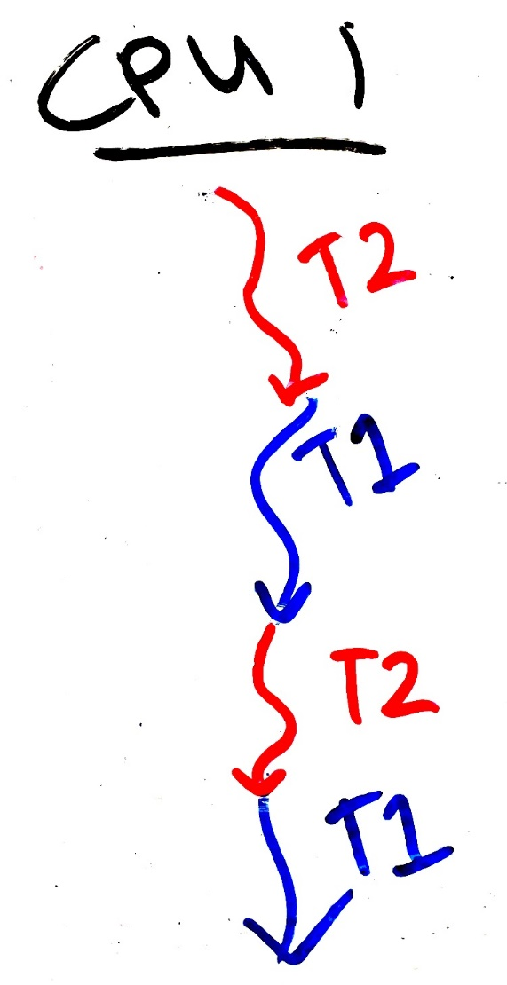
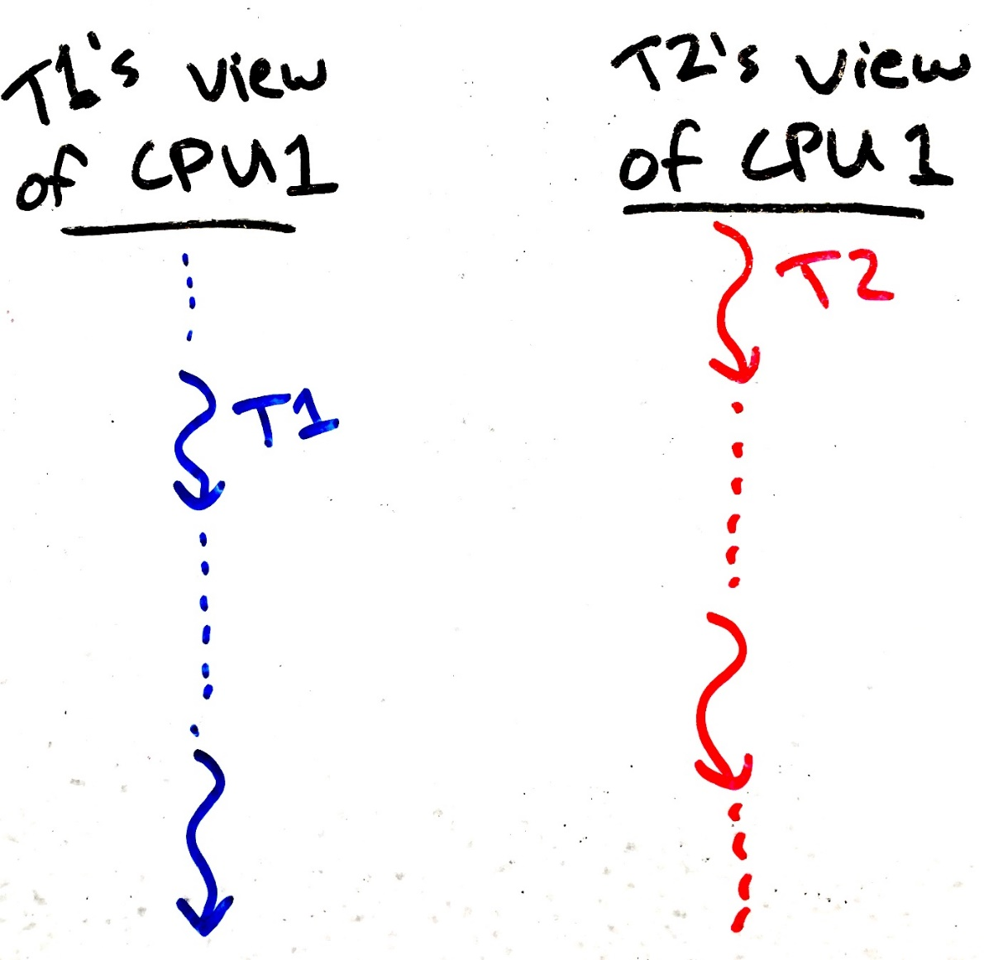
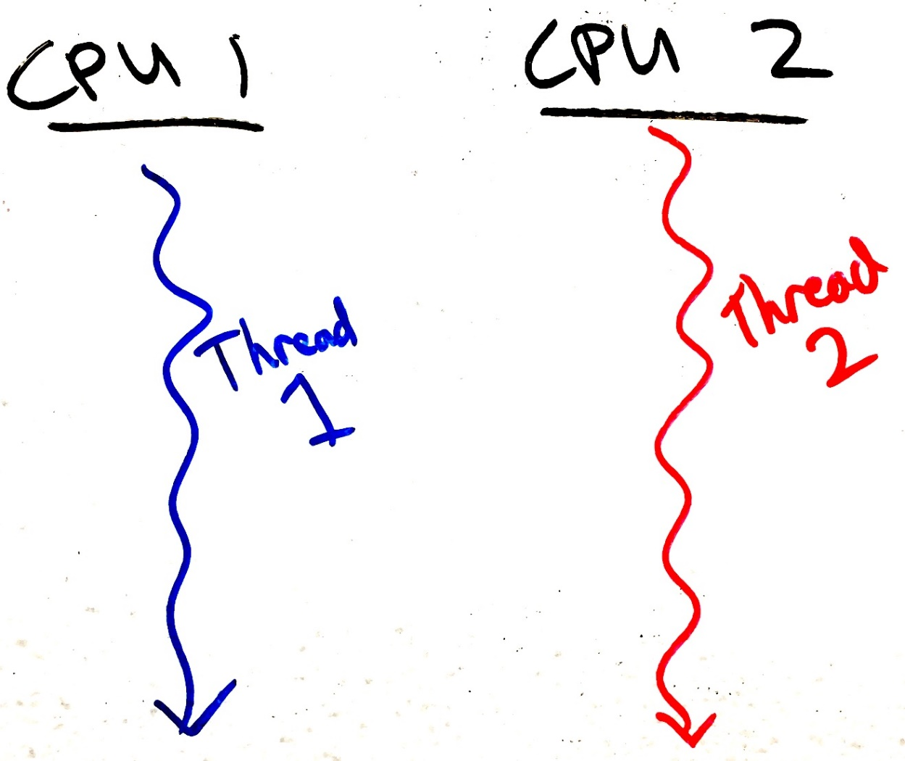
The process scheduler creates concurrency
Even if only one CPU is present, threads operate “concurrently” because they are taking turns using the CPU.
Each process thinks it has its own CPU that is sometimes very, very slow…
Obvious concurrency on two CPU cores:
Simulated concurrency on one CPU core:
Slow
Is like
Slow time
Slow time
Slow time

Slide 35

Assume the scheduler is evil
Remember that processes have no control over the scheduler.
So, to protect against concurrency bugs, we must assume that the scheduler can interrupt us at any time and schedule any other process.
In other words, assume that the scheduler is adversarial, and will do the worst possible scheduling.
To prevent weird and rare concurrency bugs, your code must work correctly even when faced with an evil scheduler.

Slide 36
Live example – data races when executing for less time
What happens if we modify the loop duration?
[brghena@ubuntu race_condition] $ ./race
main: begin (counter = 0)
B: begin
B: done
A: begin
A: done
main: done with both (counter = 200, goal was 200)
Thread is now completing its work before being re-scheduled
The problem is not solved, it will just occur rarely (and be harder to debug)

Slide 37
Race Condition
Two or more things are happening at the same time
It’s not clear which will run when
The result will be different depending on execution order
Result becomes indeterminate (non-deterministic)
Data race:
Two or more threads access shared memory at the same time and at least one modifies it
(Race Conditions are more broad)

Slide 38
Outline
Race Conditions
Critical Sections
Lock Design
Overview
Basic Lock Implementation
Lock Optimizations

Slide 39
Critical Section
Code that interacts with a shared resource must not be executed concurrently
The code that accesses a shared resource is a Critical Section
In other words, code that would lead to a data race
May be multiple, unrelated critical sections for multiple shared resources
Critical sections need to be addressed for correctness
Races can be avoided by never overlapping multiple critical sections
We must execute critical sections “atomically” (all or none)

Slide 40
Critical section occurs when shared memory is accessed
static volatile int counter = 0;
static const int LOOPS = 1e7;
void* mythread(void* arg) {
printf("%s: begin\n“,(char*)arg);
for (int i=0; i<LOOPS; i++) {
counter++;
}
printf("%s: done\n", (char*)arg);
return NULL;
}
Initialization code
int main(int argc, char* argv[]) {
pthread_t p1, p2;
printf("main: begin (counter = %d)\n", counter);
pthread_create(&p1, NULL, mythread, "A");
pthread_create(&p2, NULL, mythread, "B");
// wait for threads to finish
pthread_join(p1, NULL);
pthread_join(p2, NULL);
printf("main: done with both (counter = %d, goal was %d)\n", counter, 2*LOOPS);
return 0;
}

Slide 41
When do critical sections occur?
Critical sections often involve modification of multiple related data
While the modifications are happening there is some inconsistency
The inconsistency is eventually resolved before leaving the critical section
For example:
Inserting an element in the middle of a linked list
Two pointers must change. List is broken if just one is changed.
Reading a value and then modifying it
Don’t have to worry about critical sections if:
Program is single-threaded, OR
The particular data is not shared among threads and modified, OR
Operation is just one assembly instruction (CPU executes these atomically)

Slide 42
Check your understanding. Where is the critical section?
static volatile char* person1;
static volatile char* person2;
static const int LOOPS = 1e4;
void* mythread(void* arg) {
printf("%s: begin\n", (char*)arg);
int i;
for (i=0; i<LOOPS; i++) {
// swap
volatile char* tmp = person1;
person1 = person2;
person2 = tmp;
}
printf("%s: done\n", (char*)arg);
return NULL;
}
Initialization code
int main(int argc, char* argv[]) {
pthread_t p1, p2;
person1 = "Jack";
person2 = "Jill";
printf("main: begin (%s, %s)\n",
person1, person2);
pthread_create(&p1,NULL,mythread,"A");
pthread_create(&p2,NULL,mythread,"B");
// wait for threads to finish pthread_join(p1, NULL);
pthread_join(p2, NULL);
printf("main: end (%s, %s)\n",
person1, person2);
}
42

Slide 43
Buggy concurrent swap. What can go wrong?
static volatile char* person1;
static volatile char* person2;
static const int LOOPS = 1e4;
void* mythread(void* arg) {
printf("%s: begin\n", (char*)arg);
int i;
for (i=0; i<LOOPS; i++) {
// swap
volatile char* tmp = person1;
person1 = person2;
person2 = tmp;
}
printf("%s: done\n", (char*)arg);
return NULL;
}
Initialization code
int main(int argc, char* argv[]) {
pthread_t p1, p2;
person1 = "Jack";
person2 = "Jill";
printf("main: begin (%s, %s)\n",
person1, person2);
pthread_create(&p1,NULL,mythread,"A");
pthread_create(&p2,NULL,mythread,"B");
// wait for threads to finish pthread_join(p1, NULL);
pthread_join(p2, NULL);
printf("main: end (%s, %s)\n",
person1, person2);
}
43

Slide 44
Buggy concurrent swap. What can go wrong?
static volatile char* person1;
static volatile char* person2;
static const int LOOPS = 1e4;
void* mythread(void* arg) {
printf("%s: begin\n", (char*)arg);
int i;
for (i=0; i<LOOPS; i++) {
// swap
volatile char* tmp = person1;
person1 = person2;
person2 = tmp;
}
printf("%s: done\n", (char*)arg);
return NULL;
}
Initialization code
int main(int argc, char* argv[]) {
pthread_t p1, p2;
person1 = "Jack";
person2 = "Jill";
printf("main: begin (%s, %s)\n",
person1, person2);
pthread_create(&p1,NULL,mythread,"A");
pthread_create(&p2,NULL,mythread,"B");
// wait for threads to finish pthread_join(p1, NULL);
pthread_join(p2, NULL);
printf("main: end (%s, %s)\n",
person1, person2);
}
For a brief period in time:
person1: “Jill”
person2: “Jill”
44

Slide 45
Break + Check your understanding. Is there a problem here?
static volatile int sum_amount = 2;
static const int LOOPS = 1e7;
void* mythread(void* arg) {
int counter = 0;
printf("%s: begin\n", (char*)arg);
for (int i=0; i<LOOPS; i++) {
counter += sum_amount;
}
printf("%s: done %d\n",(char*)arg, counter); return NULL;
}
Initialization code
int main(int argc, char* argv[]) {
pthread_t p1, p2;
printf("main: begin\n");
pthread_create(&p1, NULL, mythread, "A");
pthread_create(&p2, NULL, mythread, "B");
// wait for threads to finish
pthread_join(p1, NULL);
pthread_join(p2, NULL);
printf("main: done\n");
return 0;
}

Slide 46
Break + Check your understanding. Is there a problem here?
static volatile int sum_amount = 2;
static const int LOOPS = 1e7;
void* mythread(void* arg) {
int counter = 0;
printf("%s: begin\n", (char*)arg);
for (int i=0; i<LOOPS; i++) {
counter += sum_amount;
}
printf("%s: done %d\n",(char*)arg, counter); return NULL;
}
This code will work!
All threads only read from shared memory.
If at least one wrote to shared memory, it would be a problem.
Initialization code
int main(int argc, char* argv[]) {
pthread_t p1, p2;
printf("main: begin\n");
pthread_create(&p1, NULL, mythread, "A");
pthread_create(&p2, NULL, mythread, "B");
// wait for threads to finish
pthread_join(p1, NULL);
pthread_join(p2, NULL);
printf("main: done\n");
return 0;
}

Slide 47
Outline
Race Conditions
Critical Sections
Lock Design
Overview
Basic Lock Implementation
Lock Optimizations

Slide 48
Solution Requirements
We MUST stop data races from occurring in our programs.
No two threads may simultaneously be in their critical sections.
Threads outside of critical sections should have no impact.
No assumptions should be made about number of cores, speed of cores, or scheduler choices.

Slide 49
Locks (also known as a mutex)
Locks are the simplest mutual exclusion primitive
Represent a resource that can be reserved and freed
Acquire/lock:
Used before a critical section to reserve the resource
If the lock is free (unlocked), then lock it and proceed.
If the lock is already taken (someone else called acquire/lock), then wait until it’s free before proceeding.
Release/unlock:
Used at the end of a critical section to free the resource
Only the thread holding the lock can release it
Allows one waiting (or future) thread to acquire the lock

Slide 50

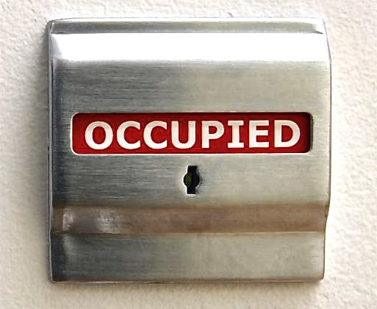
Two different metaphors & etymology
Lock
Think about locking a bathroom door
Our virtual lock works as follows:
Anyone can lock or unlock (there is no “key”).
Trying to enter (lock) if the lock is already-locked will cause you to wait until it’s unlocked.
Token
Holding the token gives you permission to do something.
There is only one token.
Thus, you:
Try to acquire the token (“lock”). You have to wait your turn if someone else is holding it.
When done, release the token/lock.
The token represents exclusive access to a shared resource or a critical section.

Slide 51
Locks prevent data races
static volatile int counter = 0;
static const int LOOPS = 1e7;
static pthread_mutex_t lock;
void* mythread(void* arg) {
printf("%s: begin\n", (char*)arg);
for (int i=0; i<LOOPS; i++) { pthread_mutex_lock(&lock);
counter++;
pthread_mutex_unlock(&lock);
}
printf("%s: done\n", (char*)arg);
return NULL;
}
int main(int argc, char* argv[]) {
pthread_t p1, p2;
pthread_mutex_init(&lock, 0);
printf("main: begin (counter = %d)\n", counter);
pthread_create(&p1, NULL, mythread, "A");
pthread_create(&p2, NULL, mythread, "B");
// wait for threads to finish
pthread_join(p1, NULL);
pthread_join(p2, NULL);
printf("main: done with both (counter = %d, goal was %d)\n", counter, 2*LOOPS);
return 0;
}

Slide 52
Live example – locking critical sections
Compile with “gcc -pthread -o locked locked_data_race.c”
[brghena@ubuntu race_condition] $ ./locked
main: begin (counter = 0)
B: begin
A: begin
A: done
B: done
main: done with both (counter = 20000000, goal was 20000000)
Correct result every time! (code does go a bit slower though…)

Slide 53
Guidelines for implementing locks
Requirements for correctness
Mutual Exclusion:
Only one thread in critical section at a time
Progress (deadlock-free):
If several simultaneous requests, must allow one to proceed
Bounded Wait (starvation-free):
Must eventually allow every waiting thread to proceed
Additional goals
Fairness – each thread waits for the same amount of time
Performance – do the above in minimal execution time

Slide 54
Outline
Race Conditions
Critical Sections
Lock Design
Overview
Basic Lock Implementation
Lock Optimizations

Slide 55
Algorithmic approach: Peterson’s Solution
There are indeed several algorithmic approaches to create a lock!
See textbook (or other sources) for Peterson’s Solution for two threads
Advantages:
Algorithm, so it works on any platform no matter the hardware
Disadvantages:
Solution for N threads gets complicated
Performance is slow

Slide 56
Hardware approach: atomic instructions
Atomic instructions perform operations on memory in one uninterruptable instruction
Guarantees that all parts of the instruction occur before the next instruction
In multicore, guarantees that entire access to memory is serialized
Commonly read, modify, and write in a single instruction

Slide 57
Atomic Instruction: Exchange
Example atomic_exchange
int atomic_exchange(int* pointer, int new_value) {
int old_value = *pointer; // fetch old value from memory
*pointer = new_value; // write new value to memory
return old_value; // return old value
}
atomic_exchange(destptr, newval)
Write a new value to memory, and return the old one
Also known as test-and-set when operating on boolean data
x86-64 instruction: lock; xchg
pseudocode for the instruction: remember, this is actually in hardware NOT C

Slide 58
Atomic Instruction: Compare And Swap
Example atomic_compare_and_swap (remember, this is pseudocode for hardware)
bool atomic_compare_and_swap(int* pointer, int expected_value, int new_value) { int actual_value = *pointer;
if (actual_value == expected_value) {
*pointer = new_value;
return true;
}
return false;
}
atomic_compare_and_swap(destptr, oldval, newval)
x86-64 instruction: lock; cmpxchg
Generalization of exchange

Slide 59
Other atomics: sequential memory consistency
Memory barrier
Guarantees that all load/stores before this line of code are completed before any load/stores after this line of code are started
Comes in software (compiler orders things) and hardware (processor orders things) forms
Both are necessary for correct execution!
C wrappers for atomics allow you to specify a memory barrier
Atomic Load/Store C-wrappers
Guarantee sequential consistency (will happen in order)
Remember:
Normally, accesses could be reordered by compiler or processor!

Slide 60
Atomic instructions can be used to build locks
Spinlocks
Simple lock mechanism built on top of atomic instructions
Thread “spins” in a loop until the lock is available
Notably: spinlock implementation doesn’t interact with the OS kernel
No system calls
Upside: Very cheap – no context switch
Downside: Scheduler isn’t aware that the thread is “blocked”

Slide 61
Spinlock implementation
typedef struct {
int flag; // 0 indicates that mutex is available, 1 that it is held
} lock_t;
void mutex_init(lock_t* mutex) {
mutex->flag = 0; // lock starts available
}
void mutex_acquire(lock_t* mutex) {
while (atomic_exchange(&(mutex->flag), 1) == 1); // spin-wait until available
}
void mutex_release(lock_t* mutex) {
atomic_store(&(mutex->flag), 0); // make lock available
}

Slide 62
Break + Question: did we need atomics?
Initialization: bool lock = false;
// wait for lock released
while (lock != 0);
// lock == 0 now (unlocked)
// set lock
lock = 1;
// access shared resource ...
// release lock
lock = 0;
Is this code sufficient?

Slide 63
Break + Question: did we need atomics?
Initialization: bool lock = false;
// wait for lock released
while (lock != 0);
// lock == 0 now (unlocked)
// set lock
lock = 1;
// access shared resource ...
// release lock
lock = 0;
Is this code sufficient?
No! lock is a shared resource and reading then writing it is not atomic

Slide 64
Outline
Race Conditions
Critical Sections
Lock Design
Overview
Basic Lock Implementation
Lock Optimizations

Slide 65
Evaluating a lock
Requirements for correctness
Mutual Exclusion:
Only one thread in critical section at a time
Progress (deadlock-free):
If several simultaneous requests, must allow one to proceed
Bounded Wait (starvation-free):
Must eventually allow every waiting thread to proceed
Additional goals
Fairness – each thread waits for the same amount of time
Performance – do the above in minimal execution time

Slide 66
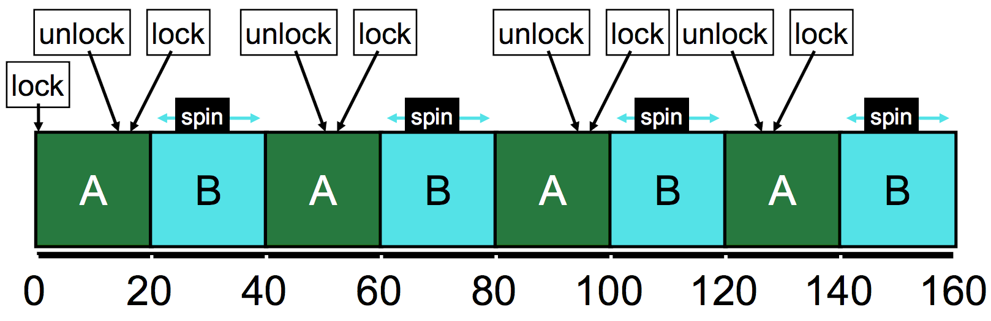
Spinlock evaluation - Correctness
Mutual Exclusion and Progress Yes
Bounded Wait No
No guarantee that a thread will eventually get its turn (assume an infinite system)

Slide 67
Spinlock evaluation – Goals
Fairness
Doesn’t even guarantee no starvation
No control at all over whether each thread waits an even amount
Performance (uniprocessor)
Process “spins”, repeatedly checking a variable that will not change
Timeslice must expire before another thread is given a chance to unlock
If N threads want the lock, then N timeslices are wasted spinning
Performance (multiprocessor)
Doesn’t waste entire timeslice anymore
No calls to OS means process gets the lock as soon as it is free. So fast!

Slide 68
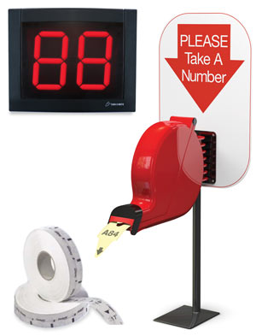
Addressing the bounded wait problem
Need some way to track “whose turn it is” to take the lock
You can have the lock when not held AND it’s no one else’s turn
Idea: hand out numbered tickets

Slide 69
Atomic Instruction: Fetch and Add
Example atomic_fetch_and_add (remember, in hardware not C)
int atomic_fetch_and_add(int* pointer, int increment) {
int old_value = *pointer;
*pointer = old_value + increment;
return old_value;
}
atomic_fetch_and_add(destptr, incr)
Add a new value to the current value in memory, and return the old one
x86-64 instruction: lock; xadd
List of C wrappers available here: https://gcc.gnu.org/onlinedocs/gcc/_005f_005fatomic-Builtins.html

Slide 70
Ticket lock implementation
Each thread atomically reserves its turn
Unique turn numbers prevent a data race
Fails with 2^32 threads!
When finished, set to next turn
typedef struct {
unsigned int ticket; // current available ticket
unsigned int turn; // which ticket gets to proceed
} lock_t;
void mutex_init(lock_t* mutex) {
mutex->ticket = 0; mutex->turn = 0;
}
void mutex_lock(lock_t* mutex) {
int myturn = atomic_fetch_and_add(&(mutex->ticket), 1); // take a ticket
while (mutex->turn != myturn); // spin-wait until available
}
void mutex_unlock(lock_t* mutex) {
atomic_fetch_and_add(&(mutex->turn), 1); // next turn
}
Prevents starvation with FIFO ordering of access!

Slide 71
Ticket Lock Example
A lock(): Ticket 0, Turn 0 // enter critical section!
B lock(): Ticket 1, Turn 0 // wait
C lock(): Ticket 2, Turn 0 // wait

Slide 72
Ticket Lock Example
A lock(): Ticket 0, Turn 0
B lock(): Ticket 1, Turn 0
C lock(): Ticket 2, Turn 0
A unlock(): Turn 1 // B gets to go

Slide 73
Ticket Lock Example
A lock(): Ticket 0, Turn 0
B lock(): Ticket 1, Turn 0
C lock(): Ticket 2, Turn 0
A unlock(): Turn 1
A lock(): Ticket 3, Turn 1
B unlock(): Turn 2 // C gets to go

Slide 74
Ticket Lock Example
A lock(): Ticket 0, Turn 0
B lock(): Ticket 1, Turn 0
C lock(): Ticket 2, Turn 0
A unlock(): Turn 1
A lock(): Ticket 3, Turn 1
B unlock(): Turn 2
C unlock(): Turn 3 // A gets to go again
A unlock(): Turn 4 // Available ticket is turn 4 too, so next request goes immediately

Slide 75
Ticket Lock Evaluation
Correctness: Mutual Exclusion, Progress, Bounded Wait Yes
Goals
Fairness Yes
FIFO ordering of threads
Performance
Similar positives and negatives as original spinlock
One downside: on a release() all threads must check if it is their turn

Slide 76
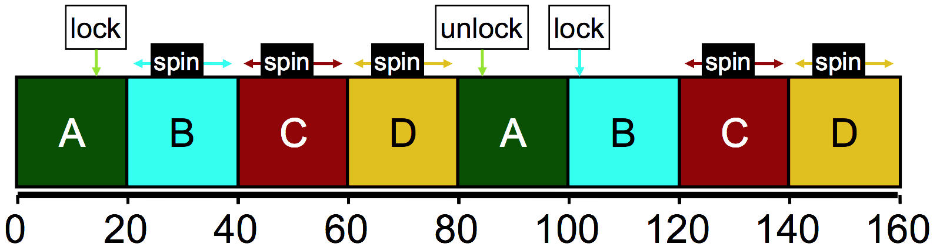
Ticket lock still wastes time spinning
B, C, and D are “busy waiting”
Might be occupying an entire core in multicore
Scheduler is fairly scheduling all threads, but ignorant of locks
Idea: can we skip threads that are waiting on a lock?

Slide 77
Yield timeslice when not yet ready
Yield syscall unschedules the current thread
sched_yield() in POSIX API
Gives the user process just a little control over the scheduler
In acquire(), yield after checking condition
Might delay thread response time in multicore scenario
void mutex_lock(lock_t* mutex) {
int myturn = atomic_fetch_and_add(&(mutex->ticket), 1); // take a ticket
while (mutex->turn != myturn) {
sched_yield(); // not ready yet
}
}

Slide 78
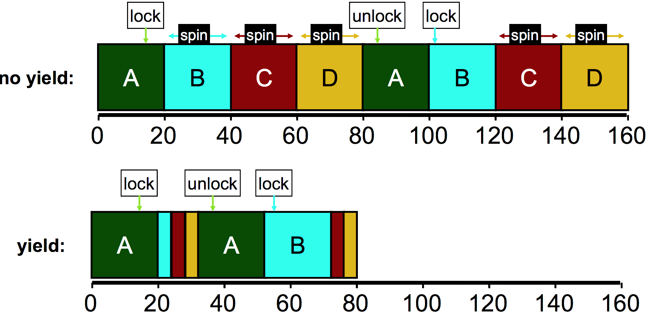
Yielding reduces busy-waiting

Slide 79
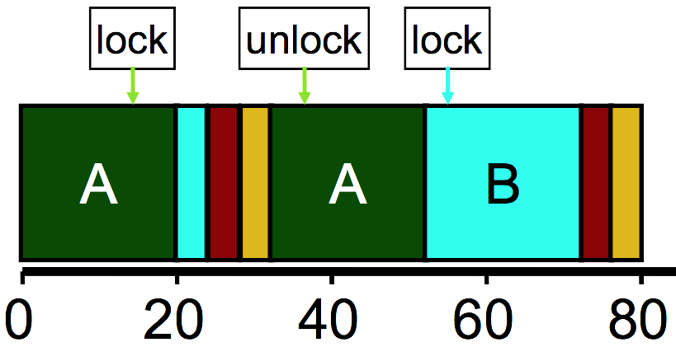
How much does yielding improve things?
Performance better with yield(), but still doing a lot of unnecessary context switches
Wasted CPU cycles
Without yield(): O(threads*timeslice)
With yield(): O(threads*context_switch)
Timeslice ~1 ms, Context switch: ~1 µs
Still expensive if we expect many threads to be contending over the lock

Slide 80
Building a blocking lock
A more performant solution requires cooperation between thread’s locks and the OS scheduler to block threads
Some OSes (Solaris) have system calls to do so
park() – blocks the current thread
unpark(thread_id) – unblocks another thread, specified by thread ID
Building locks on park/unpark
If lock acquire fails, add own thread ID to waiting thread queue and park()
Release dequeues the next waiting thread ID and calls unpark() on it
Fairness: unlocking thread effectively decides which thread goes next

Slide 81
Linux Futex (fast userspace mutex) syscalls
Similar to park/unpark, but the queue is in the kernel
Key idea: only makes the kernel calls when you actually need to wait or wake a sleeping thread
futex_wait(int* pointer, int expected)
Put thread to sleep if the value at address equals “expected”
Used to build acquire()
futex_wake(int* pointer)
Unblock one thread waiting on “pointer”
Used to build release()
See https://eli.thegreenplace.net/2018/basics-of-futexes/

Slide 82
Spinning versus Blocking
Each approach is better under different circumstances
Single core systems
If waiting process is scheduled, then process holding lock is not
Waiting process should always yield its time
Multicore systems
If waiting process is scheduled, then process holding lock could also be
Spin or block depends how long until the lock is released
If the lock is released quickly, spin wait
If the lock is released slowly, block
Where quick and slow are relative to context-switch cost

Slide 83
Two-phase waiting
Problem: we can’t always know how long the wait will be
Programmer might know…
Library definitely can’t know
Idea:
Spin lock for a little while, and then give up and block
Example: Linux Native POSIX Thread Library (NPTL)
Check the lock at least three times before blocking with Futex

Slide 84
Summary on lock implementations
Spinlocks
Ticket locks
Yielding locks
Queueing locks
Futex on Linux
Sophisticated locks are more fair and do not waste processor time “busy waiting”
But also have unnecessary context-switch overhead if the lock is only briefly and rarely held

Slide 85
Outline
Race Conditions
Critical Sections
Lock Design
Overview
Basic Lock Implementation
Lock Optimizations

Slide 86
Outline
Bonus: Interrupts

Slide 87
Where else does concurrency come from?
Processors introduce it for performance reasons by running multiple processes and threads
Interactions with the outside world introduce it because events occur whenever they feel like it
Network request arriving
User presses a key
Motion sensor triggers
Also, we need some way to deal with errors the occur when executing instructions
No pathway for returning an error from an instruction

Slide 88
Interrupts
A way for the CPU to be, well, interrupted.
CPU hardware switches to privileged mode
Now any instruction can be executed, including privileged ones.
Execution jumps to a predefined location
Handler specified in the CPU’s interrupt vector table
Lets the kernel deal with whatever the event was
Used to support asynchronous I/O
Lets a hardware device tell the CPU that some data is ready
Remember that a disk operation is millions of times slower than an add.
CPU has electrical pin(s) for hardware interrupts.
There is also an instruction for software interrupts (like traps!)

Slide 89
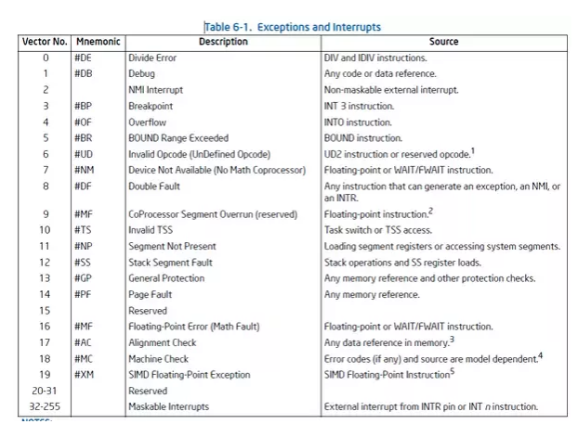
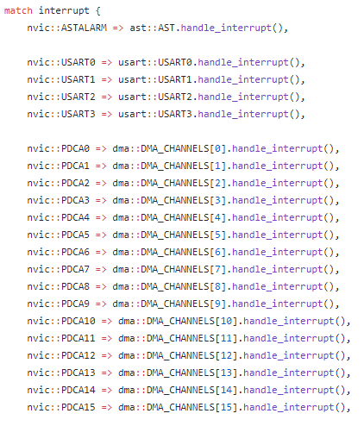
Interrupt Vector Table
Table actually lives in memory somewhere, with function pointers for each vector number
Example from Tock for SAM4L chip (in Rust)

Slide 90
Interrupt Vector Table
Table actually lives in memory somewhere, with function pointers for each vector number
Example from Tock for SAM4L chip (in Rust)

Slide 91
Differences from traps
When we performed a system call:
We knew it was about to happen.
Set up our registers in advance.
Performed what looked sort of like a function call.
Interrupts can happen whenever.
This can get extremely complicated on modern systems with out-of-order execution, multiple cores and threads, and caches

Slide 92
Interrupt handlers
Interrupt context
Can’t just enter the kernel like we did with system calls
Interrupt could have occurred while we were in the kernel
Handler code
Execute some quick processing to deal with the interrupt
Return so the hardware can bring us back to our normal operation
Cannot pause to wait for something else to finish first because the entire core jumped to handling this interrupt
Handled by the operating system
Processes are interrupted, but otherwise not normally involved

Slide 93
Why are interrupts important to the kernel?
Interrupts are a case where the kernel could have a data race with itself!!
Imagine being in the middle of an operation on a device
When an interrupt comes in for that same device
Data structures for the device could end up messed up
Takeaway: concurrency isn’t just about processes and threads
Many different software designs need to deal with it

Slide 94
Data race fix for single-core machines: disable interrupts
void lock() {
disable_interrupts();
}
void unlock() {
enable_interrupts();
}
Disable interrupts to prevent preemption during critical section
Scheduler can’t run if the OS never takes control
Also stops data races in interrupt handlers
Problems
Doesn’t work on multicore machines
Bad Idea™ to let processes disable the OS
Process could freeze the entire computer
Might screw up timing for interrupt handling

