Slide 1
Lecture 08: Synchronization Bugs
CS343 – Operating Systems
Branden Ghena – Spring 2024
Some slides borrowed from: Stephen Tarzia (Northwestern), Harsha Madhyastha (Michigan), Shivaram Venkataraman (Wisconsin), and UC Berkeley CS162

Slide 2
Today’s Goals
Common synchronization bugs
Deadlock
Livelock
Methods to avoid, prevent, and recover in the presence of deadlock
Discuss how thread-safe data structures might work
Touch on what concurrency looks like in other languages

Slide 3
Outline
Interrupts
Synchronization bugs
Deadlock
Solving deadlocks
Livelock
Priority Inversion
Threadsafe data structures
Concurrency in other languages

Slide 4
Where else does concurrency come from?
Processors introduce it for performance reasons by running multiple processes and threads
Interactions with the outside world introduce it because events occur whenever they feel like it
Network request arriving
User presses a key
Motion sensor triggers
Also, we need some way to deal with errors the occur when executing instructions
No pathway for returning an error from an instruction

Slide 5
Interrupts
An event that the processor handles by running special OS handler code
Timer expiration, Keyboard event, Network packet, etc.
Necessary for asynchronous event handling
Don’t wait around for the event, just handle it whenever it happens
Very similar to Exceptions, which are caused by errors occurring
A system call is a way to generate a software interrupt

Slide 6
Differences from system calls
When we performed a system call:
We knew it was about to happen
Set up our registers in advance
Performed what looked sort of like a function call
And we were always switching from process to kernel
Interrupts can happen whenever.
This can get extremely complicated on modern systems with out-of-order execution, multiple cores and threads, and caches

Slide 7
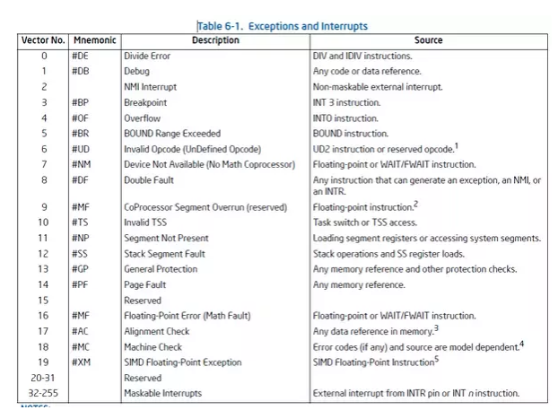
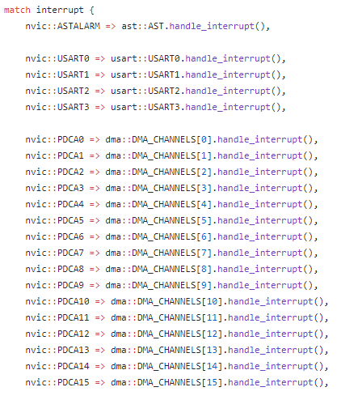
Interrupt Vector Table
Table actually lives in memory somewhere, with function pointers for each vector number
Example from Tock for SAM4L chip (in Rust)

Slide 8
Interrupt Vector Table
Table actually lives in memory somewhere, with function pointers for each vector number
Example from Tock for SAM4L chip (in Rust)

Slide 9
Interrupt handlers
Interrupt context
Running code in a special mode
Pauses whatever was running previously (kernel or process) until finished
Handler code
Execute some quick processing to deal with the interrupt
Return so the hardware can bring us back to our normal operation
Cannot pause to wait for something else to finish first because the entire core jumped to handling this interrupt
Handled by the operating system kernel
Processes are interrupted, but otherwise not normally involved

Slide 10
Why are interrupts important to concurrency?
Interrupts are a case where the kernel could have a data race with itself!!
Imagine being in the middle of an operation on a device
When an interrupt comes in for that same device
Data structures for the device could end up messed up
Takeaway: concurrency isn’t just about processes and threads
Many different software designs need to deal with it

Slide 11
Data race fix for single-core machines: disable interrupts
void lock() {
disable_interrupts();
}
void unlock() {
enable_interrupts();
}
Disable interrupts to prevent preemption during critical section
Scheduler can’t run if the OS never takes control
Also stops data races in interrupt handlers
Problems
Doesn’t work by itself on multicore machines
Need to use it AND mutexes
Bad Idea™ to let processes disable the OS
Process could freeze the entire computer
Might screw up timing for interrupt handling

Slide 12
Outline
Interrupts
Synchronization bugs
Deadlock
Solving deadlocks
Livelock
Priority Inversion
Threadsafe data structures
Concurrency in other languages

Slide 13
Common synchronization bugs
Atomicity violation
An operation that should have been atomic wasn’t
Order violation
Something happens sooner (or later) than expected
Deadlock
Two threads wait indefinitely on each other
Livelock (not that common in practice)
Two threads repeatedly block each other from proceeding and retry

Slide 14
Atomicity Violation
Failing to make an entire option atomic
Must lock all references to shared memory which could be a data race
Must handle entire indeterminant state in one atomic section
lock(lck);
count++;
unlock(lck);
if (count == MAX) {
count = 0; }
Should have been included in critical section

Slide 15
Check your understanding: atomicity violation
Main Thread
lock(lck);
if (file == NULL) {
file = open("~/myfile.txt");
}
write(file, "hello file");
unlock(lck);
…
Some Other Thread
lock(lck);
close(file);
unlock(lck);
// do some unrelated work
lock(lck);
file = NULL;
unlock(lck);
What’s wrong here?
Every access is locked, right?
Here, calling close() and setting the file to NULL need to be one atomic operation
Otherwise the main thread could try to use to file when it’s closed
Example of failing to resolve indeterminant state atomically

Slide 16
Order violation
Code often requires a certain ordering of operations, especially:
Objects must be initialized before they’re used
Objects cannot be freed while they are still in use
Resolve with semaphores or condvars
Parent
file = open("file.dat");
thread_create(child_fcn);
// do some work
…
close(file);
Child Thread
child_fcn() {
write(file, "hello");
}
Close must happen after write, but code does not enforce this ordering.

Slide 17
Why is this difficult?
It seems like we can just add lots of locks and semaphores to be safe, right?
Still tricky! Too many locks can cause deadlock – indefinite waiting.
How about just one big lock?
(+) Cannot deadlock with one lock (unless there are interrupts)
(–) However, this would limit concurrency
If every task requires the same lock, then unrelated tasks cannot proceed in parallel.
Concurrent code is always difficult to write ☹
Although somewhat easier with some higher-level languages

Slide 18
Locking granularity
Coarse grained lock:
Use one (or a few) locks to protect all (or large chunks of) shared state
Linux kernel < version 2.6.39 used one “Big Kernel Lock”
Essentially only one thread (CPU core) could run kernel code
It’s simple but there is much contention for this lock, and concurrency is limited
Fine grained locks:
Use many locks, each protecting small chunks of related shared state
Leads to more concurrency and better performance
However, there is greater risk of deadlock

Slide 19
Outline
Interrupts
Synchronization bugs
Deadlock
Solving deadlocks
Livelock
Priority Inversion
Threadsafe data structures
Concurrency in other languages

Slide 20


Slide 21
Deadlock
A concurrency bug arising when:
Two threads are each waiting for the other to release a resource.
While waiting, the threads cannot release the resource already held.
Or at least do not release it
So the two threads wait forever.
Can arise when multiple shared resources are used.
For example, acquiring two or more locks.

Slide 22
Deadlock versus starvation
Honk!
Each segment of road can be viewed as a resource
Car must own the segment under them
Must acquire segment that they are moving into
Deadlock: Two cars in opposite directions meet in middle
Starvation (not deadlock): Eastbound traffic doesn’t stop for westbound traffic

Slide 23
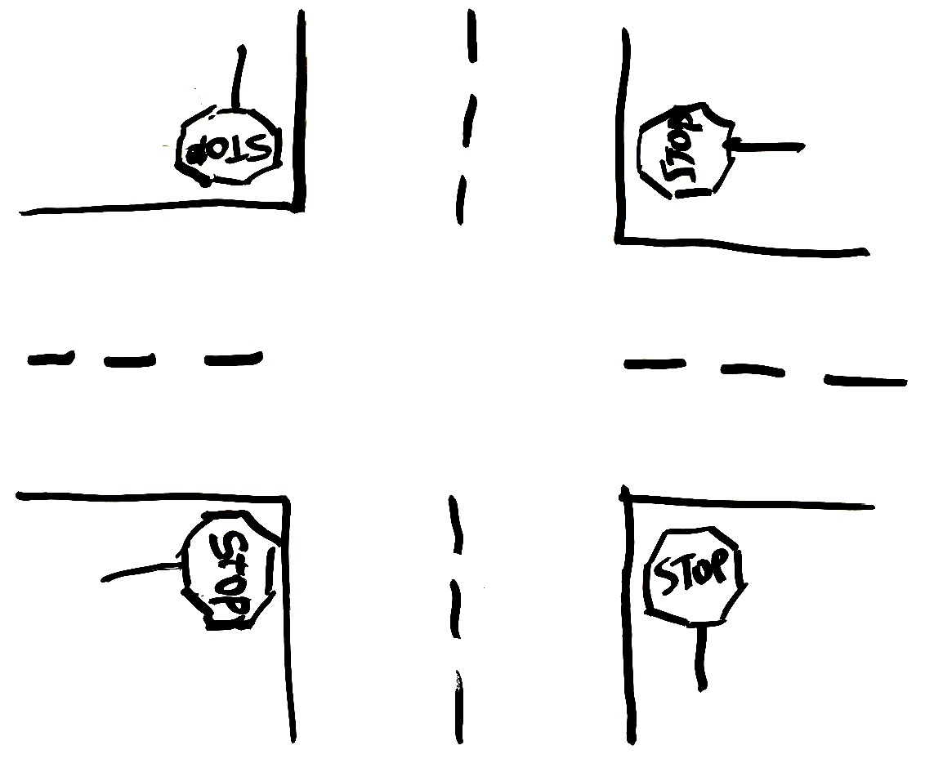

Simple example: four-way stop
Traffic rules state that you must yield to the car on your right if you reach the intersection simultaneously.
This rule usually works well.
But there’s a problem if four cars arrive simultaneously.
Circular waiting!

Slide 24
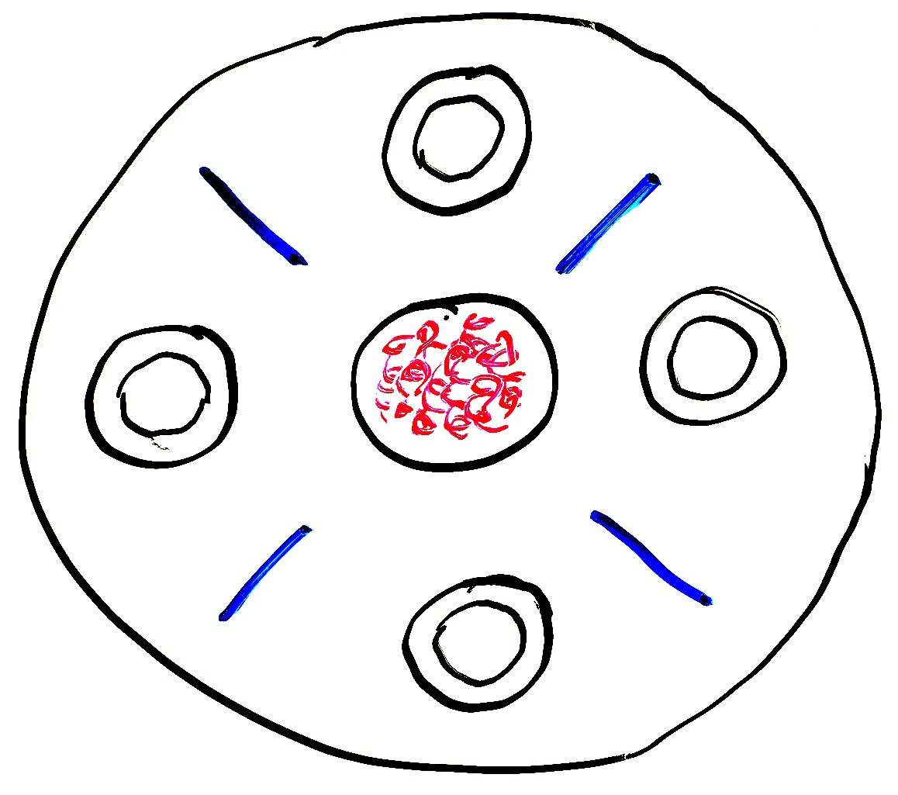
Dining philosophers
A theoretical example of deadlock
There are N philosophers sitting in a circle and N chopsticks
left and right of each philosopher
Philosophers repeatedly run this loop:
Think for some time
Grab chopstick to left
Grab chopstick to right
Eat
Replace chopsticks
If they all grab the left chopstick simultaneously (step 2), they will deadlock and starve!

Slide 25
Dining philosophers
A solution: one philosopher must grab right before left

Slide 26
Dining philosophers
A solution: one philosopher must grab right before left

Slide 27
Dining philosophers
A solution: one philosopher must grab right before left
Adding an asymmetry will allow both resources to eventually be obtained

Slide 28
Deadlock with locks
This is a Nondeterministic Deadlock
Whether it occurs depends on scheduling
Thread A
x.Acquire();
y.Acquire();
…
y.Release();
x.Release();
Thread B
y.Acquire();
x.Acquire();
…
x.Release();
y.Release();

Slide 29
No deadlock in the lucky case
Thread A
x.Acquire();
y.Acquire();
…
y.Release();
x.Release();
Thread B
y.Acquire();
x.Acquire();
…
x.Release();
y.Release();
Thread B waits until Thread A is finished

Slide 30
But deadlock can still occur
Thread A
x.Acquire();
y.Acquire();
…
y.Release();
x.Release();
Thread B
y.Acquire();
x.Acquire();
…
x.Release();
y.Release();
Thread A waits until y is available
Thread B waits until x is available
--Unreachable--

Slide 31
Deadlocks involve circular dependencies
Thread
A
Owned
By
Wait
For
Lock x
Lock y
Thread
B
Owned
By
Wait
For

Slide 32
Deadlock can occur on any shared resource
Example deadlock if the system only has 2 MB of memory
Could deadlock on access to hardware as well
Thread A
AllocateOrWait(1 MB)
AllocateOrWait(1 MB)
Free(1 MB)
Free(1 MB)
Thread B
AllocateOrWait(1 MB)
AllocateOrWait(1 MB)
Free(1 MB)
Free(1 MB)

Slide 33
Interrupts can cause deadlocks too
Thread cannot continue until the interrupt is finished
Interrupt cannot finish until the thread continues
Thread A
acquire()
…
release()
Interrupt Handler
acquire()
Deadlock

Slide 34
Reentrant library functions
Functions that can safely and successfully be called again while currently in the middle of its execution are called “reentrant”
Reentrant functions must only modify local variables and input
Must also never call non-reentrant functions
malloc() is thread-safe because it uses locks around shared memory
Malloc is NOT reentrant and it will cause deadlock
Same goes for printf!!!
Must not be called in an interrupt or signal handler!
This matters in PCLab too

Slide 35
Break + Check your understanding
void List_Insert(list_t *L, int key) {
pthread_mutex_lock(&L->lock);
node_t *new = malloc(sizeof(node_t));
if (new == NULL) {
perror("malloc");
pthread_mutex_unlock(&L->lock);
return; // fail
}
new->key = key;
new->next = L->head;
L->head = new;
pthread_mutex_unlock(&L->lock);
return; // success
}
Is it safe to call List_Insert from an interrupt?

Slide 36
Break + Check your understanding
void List_Insert(list_t *L, int key) {
pthread_mutex_lock(&L->lock);
node_t *new = malloc(sizeof(node_t));
if (new == NULL) {
perror("malloc");
pthread_mutex_unlock(&L->lock);
return; // fail
}
new->key = key;
new->next = L->head;
L->head = new;
pthread_mutex_unlock(&L->lock);
return; // success
}
Not safe! If another thread has acquired the mutex, there will be a deadlock

Slide 37
Outline
Interrupts
Synchronization bugs
Deadlock
Solving deadlocks
Livelock
Priority Inversion
Threadsafe data structures
Concurrency in other languages

Slide 38
How Should a System Deal With Deadlock?
Three different approaches:
Deadlock avoidance: dynamically delay resource requests so deadlock doesn’t happen
Deadlock prevention: write your code in a way that it isn’t prone to deadlock
Deadlock recovery: let deadlock happen, and then figure out how to recover from it

Slide 39
Deadlock avoidance
Idea: When a thread requests a resource, OS checks if it would result in an unsafe state that could lead to deadlock
If not, grant the resource
If so, wait until other threads release resources
Must stop acquire here to prevent unsafe state
Thread A
x.Acquire();
y.Acquire();
…
y.Release();
x.Release();
Thread B
y.Acquire();
x.Acquire();
…
x.Release();
y.Release();

Slide 40
Banker’s Algorithm for avoiding deadlock
Each thread states maximum resource needs in advance
OS allows a particular thread to claim a resource if
(available resources - requested) ≥ maximum remaining that might be needed by any thread
For Dining Philosophers, a request for a chopstick is allowed if:
Not the last chopstick
Or is the last chopstick but a philosopher will have two afterwards
See the textbook for more details

Slide 41
How Should a System Deal With Deadlock?
Three different approaches:
Deadlock avoidance: dynamically delay resource requests so deadlock doesn’t happen
Deadlock prevention: write your code in a way that it isn’t prone to deadlock
Deadlock recovery: let deadlock happen, and then figure out how to recover from it

Slide 42
Preventing Deadlocks: deadlock requires four conditions
Mutual exclusion
Threads cannot access a critical section simultaneously.
In other words, we’re using locks so there is the potential for waiting.
Hold-and-wait
Threads do not release locks while waiting for additional locks.
No preemption
Locks are always held until released by the thread.
E.g., if there is no method to cancel a lock.
Circular wait
Thread is waiting on a thread that is waiting on the original thread.
This can involve just two threads or a chain of many threads.
Can eliminate deadlock by eliminating any one of these conditions

Slide 43
1. Do not have mutual exclusion
Lockfree/waitfree data structures
void* mythread(void* arg) {
for (int i=0; i<LOOPS; i++) { pthread_mutex_lock(&lock);
counter++;
pthread_mutex_unlock(&lock);
}
return NULL;
}
void* mythread(void* arg) {
for (int i=0; i<LOOPS; i++) { atomic_fetch_and_add( &counter, 1);
}
return NULL;
}

Slide 44
Lockfree data structures
void insert(int val) {
node_t* n = malloc(sizeof(node_t)); n->val = val;
acquire(&m);
n->next = head;
head = n;
release(&m);
}
void insert(int val) {
node_t* n = malloc(sizeof(node_t)); n->val = val; do { n->next = head;
} while (!cas(&head, n->next, n));
}
atomic_compare_and_swap(destptr, oldval, newval)
If *destptr == oldval { *destptr = newval, return True }
Else { return false }

Slide 45
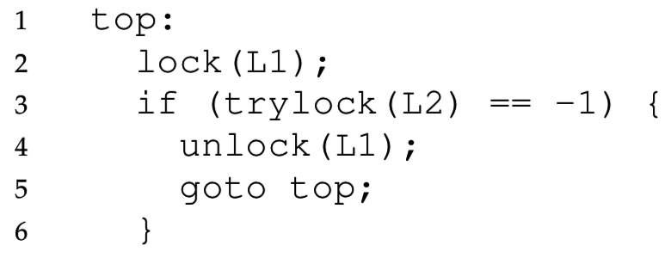
2. Avoid hold and wait with trylock()
We can avoid deadlock if we release the first lock after noticing that the second lock is unavailable.
Trylock() tries to acquire a lock, but returns a failure code instead of waiting if the lock is taken:
This code cannot deadlock, even if another thread does the same with L2 first, then L1.
However it can livelock… we’ll come back to this

Slide 46
3. No preemption
The OS could take away the lock from a blocked thread and give it back before the thread resumes
This sounds pretty complicated to get right
Non-lock resources are easier here
Temporarily take away memory from a thread by swapping it to disk

Slide 47
4. Avoiding Circular Wait
This is the most practical way to avoid deadlock.
The simplest solution is to always acquire locks in the same order.
If you hold lock X and are waiting for lock Y,
Then holder of Y cannot be waiting on you,
Because they would have already acquired X before acquiring Y.
However, in practice it can be difficult to know when locks will be acquired because they can be buried in subroutines.

Slide 48
Ordered locking for dining philosophers
The chopsticks are shared resources, like locks
If we require the lower-numbered chopstick to be grabbed first, this eliminates circular waiting.
Philosophers A, B, C grab left then right.
However philosopher D will grab right then left.
If everyone tries to start at once, A & D race to grab chopstick 0 first, and the winner eats first.
While one is waiting to grab its first chopstick a neighbor will be able to grab two chopsticks.
3
2
C
B
D
A
0
1

Slide 49
Check your understanding
In what order must Thread B acquire the three locks to avoid deadlock?
Thread A
y.Acquire();
x.Acquire();
z.Acquire();
…
z.Release();
x.Release();
y.Release();
Thread B
???

Slide 50
Check your understanding
In what order must Thread B acquire the three locks to avoid deadlock?
The same order!! (at least y first, for the two-thread case)
Thread A
y.Acquire();
x.Acquire();
z.Acquire();
…
z.Release();
x.Release();
y.Release();
Thread B
y.Acquire();
x.Acquire();
z.Acquire();
…
z.Release();
x.Release();
y.Release();

Slide 51
How Should a System Deal With Deadlock?
Three different approaches:
Deadlock avoidance: dynamically delay resource requests so deadlock doesn’t happen
Deadlock prevention: write your code in a way that it isn’t prone to deadlock
Deadlock recovery: let deadlock happen, and then figure out how to recover from it

Slide 52
Deadlock Recovery: how to deal with a deadlock?
Terminate thread, force it to give up resources
Dining Philosophers Example: Remove a dining philosopher
In AllocateOrWait example, OS kills a process to free up some memory
Not always possible—killing a thread holding a lock leaves world inconsistent
Roll back actions of deadlocked threads
Common techniques in databases (transactions)
Of course, if you restart in exactly the same way, you may enter deadlock again

Slide 53
Modern OS approach to deadlocks
Make sure the system isn’t involved in any deadlock
Hopefully by prevention
Generally, be very careful about this stuff in the kernel
Ignore deadlock in applications (“Ostrich Algorithm”)
User can just restart them anyways

Slide 54
Break + Check your understanding
Is there a possibility of deadlock?
If so, how could we fix it?
Thread A
usb.Acquire();
webcam.Acquire();
…
webcam.Release();
usb.Release();
Thread B
printer.Acquire();
usb.Acquire();
…
usb.Release();
printer.Release();
Thread C
webcam.Acquire();
printer.Acquire();
…
printer.Release();
webcam.Release();

Slide 55
Break + Check your understanding
Is there a possibility of deadlock? Yes
If so, how could we fix it? One solution: Global ordering of resources
Example: usb, then webcams, then printers always in that order
Thread A
usb.Acquire();
webcam.Acquire();
…
webcam.Release();
usb.Release();
Thread B
printer.Acquire();
usb.Acquire();
usb.Acquire();
printer.Acquire();
…
usb.Release();
printer.Release();
printer.Release();
usb.Release();
Thread C
webcam.Acquire();
printer.Acquire();
…
printer.Release();
webcam.Release();

Slide 56
Break + Check your understanding
Is there a possibility of deadlock? Yes
If so, how could we fix it? One big lock still works too!
Thread A
lock.acquire();
usb.Acquire();
webcam.Acquire();
…
webcam.Release();
usb.Release();
lock.release();
Thread B
lock.acquire();
printer.Acquire();
usb.Acquire();
…
usb.Release();
printer.Release();
lock.release();
Thread C
lock.acquire();
webcam.Acquire();
printer.Acquire();
…
printer.Release();
webcam.Release();
lock.release();

Slide 57
Outline
Interrupts
Synchronization bugs
Deadlock
Solving deadlocks
Livelock
Priority Inversion
Threadsafe data structures
Concurrency in other languages

Slide 58
Common synchronization bugs
Atomicity violation
An operation that should have been atomic wasn’t
Order violation
Something happens sooner (or later) than expected
Deadlock
Two threads wait indefinitely on each other
Livelock (not that common in practice)
Two threads repeatedly block each other from proceeding and retry

Slide 59
Livelock while avoiding deadlock
// thread 1
getLocks12(lock1, lock2) {
lock1.acquire();
while (lock2.locked()) {
// attempt to step aside // for the other thread
lock1.release();
wait();
lock1.acquire();
}
lock2.acquire();
}
// thread 2
getLocks21(lock1, lock2) {
lock2.acquire();
while (lock1.locked()) {
// attempt to step aside // for the other thread
lock2.release();
wait();
lock2.acquire();
}
lock1.acquire();
}

Slide 60
Avoiding hold and wait could lead to livelock
Avoiding hold and wait can livelock
Two threads could get stuck in this loop forever
Unlikely to occur for any length in personal computing setting
Very possibly stuck forever (or at least extended periods) in a constrained computing setting
Example: embedded system with known tasks at the start

Slide 61

Livelock in agents
Livelock is more common in agent-based programs
All of agent’s options lead to a lack of forward progress
One example: video games
The character can still move and take actions
But cannot complete the level

Slide 62
Livelock versus Deadlock
Livelock is a condition where two threads repeatedly take action, but still don’t make progress.
Differs from deadlock because deadlock is always permanent.
Livelock involves retries that may lead to progress, but there is no guarantee of progress.
A malicious scheduler can always keep the livelock stuck
Any randomness in the timing of retries will fix livelock.
In practice, livelock is a much less serious concern than deadlock.

Slide 63
Outline
Interrupts
Synchronization bugs
Deadlock
Solving deadlocks
Livelock
Priority Inversion
Threadsafe data structures
Concurrency in other languages

Slide 64
Systems interact with each other
Scheduling and Concurrency problems are not exclusive
Sharing mutexes between threads can lead to a big problem for schedulers based on priority
Especially dangerous for real-time OS scenarios

Slide 65
A problem with priority schedulers: priority inversion
Other concepts from OS still apply when we’re scheduling
Particularly locks and synchronization
Imagine Task 1 and Task 3 both need to share a lock
Release lock
Task 1 is waiting on Task 2!!
Task 1
Acquire lock
Priority
block
done
Task 2
preempt
preempt
release
Task 3
0
2
4
6
8
10

Slide 66

Priority inversion occurred on Pathfinder!
Bus management missed deadlines while waiting on meteorology because medium-priority tasks were taking too long
System rebooted when deadline was missed
Manage Bus
Priority
block
done
Comms
preempt
preempt
release
Weather
0
2
4
6
8
10
Notes:
Glenn Reeves is the guy at JPL who wrote up the report on this
Still there working on flight software as of 2013 (and happy to talk to summer interns about it!)

Slide 67
Priority inheritance solution to priority inversion
A solution is to temporarily increase priority for tasks holding resources that high priority tasks need
Task 3 inherits priority of Task 1 while holding lock Task 1 needs
Release lock
Task 1
done
Acquire lock
Priority
Task 2
preempt
block
release
Preempted by Task 3
done
Task 3
At Priority 1
0
2
4
6
8
10

Slide 68
Break + Tools
Helgrind (part of the Valgrind tool) detects many common errors when using the POSIX pthreads library
Bad library calls: unlocking an unlocked mutex, destroying a locked mutex
Deadlocks and Data races
http://valgrind.org/docs/manual/hg-manual.html
ThreadSanitizer (in the family of Address Sanitizer) is compiler instrumentation that detects data races
5-15x slowdown for running code
https://clang.llvm.org/docs/ThreadSanitizer.html

Slide 69
Outline
Interrupts
Synchronization bugs
Deadlock
Solving deadlocks
Livelock
Priority Inversion
Threadsafe data structures
Concurrency in other languages

Slide 70
Thread-safe data structures
“Thread safe” – works even if used by multiple threads concurrently
Can apply to various libraries, functions, and data structures
Simple data structures implementations are usually not thread safe
Some global state needs to be shared among all threads
Need to protect critical sections
Challenge: multiple function calls each access same shared structure
Need to identify the critical section in each and lock it with shared lock

Slide 71
Linked List
void List_Insert(list_t *L, int key) {
node_t *new = malloc(sizeof(node_t));
if (new == NULL) {
perror("malloc");
return; // fail
}
new->key = key;
new->next = L->head;
L->head = new;
return; // success
}

Slide 72
Concurrent Linked List – Big lock approach
void List_Insert(list_t *L, int key) {
pthread_mutex_lock(&L->lock);
node_t *new = malloc(sizeof(node_t));
if (new == NULL) {
perror("malloc");
pthread_mutex_unlock(&L->lock);
return; // fail
}
new->key = key;
new->next = L->head;
L->head = new;
pthread_mutex_unlock(&L->lock);
return; // success
}
Most important part of this example. Don’t forget to unlock if returning early.
Much better than counter example, because we are only serializing the list itself. Hopefully the rest of the code can run concurrently.

Slide 73
Better Concurrent Linked List – Only lock critical section
void List_Insert(list_t *L, int key) {
node_t *new = malloc(sizeof(node_t));
if (new == NULL) {
perror("malloc");
return; // fail
}
new->key = key;
new->next = L->head;
L->head = new;
return; // success
}
Check your understanding:
Where is the critical section here?

Slide 74
Better Concurrent Linked List – Only lock critical section
void List_Insert(list_t *L, int key) {
node_t *new = malloc(sizeof(node_t));
if (new == NULL) {
perror("malloc");
return; // fail
}
new->key = key;
new->next = L->head;
L->head = new;
return; // success
}
Check your understanding:
Where is the critical section here?

Slide 75
What about malloc? Is that safe to use??
void List_Insert(list_t *L, int key) {
node_t *new = malloc(sizeof(node_t));
if (new == NULL) {
perror("malloc");
return; // fail
}
new->key = key;
new->next = L->head;
L->head = new;
return; // success
}
Thread-safe functions
Capable of being called concurrently and still functioning correctly
(Because they use locks!)
How would we know if malloc is thread-safe?
Must check the documentation

Slide 76
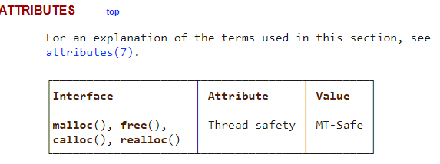
Must check the library documentation to determine thread safety
https://man7.org/linux/man-pages/man3/malloc.3.html
Malloc (and free) is indeed thread-safe
If it wasn’t, we would have to consider it another shared resource that needs to be locked

Slide 77
Better Concurrent Linked List – Only lock critical section
void List_Insert(list_t *L, int key) {
node_t *new = malloc(sizeof(node_t));
if (new == NULL) {
perror("malloc");
return; // fail
}
new->key = key;
pthread_mutex_lock(&L->lock);
new->next = L->head;
L->head = new;
pthread_mutex_unlock(&L->lock);
return; // success
}
Now new node is created locally in parallel
Only actual access to the linked list is serialized

Slide 78
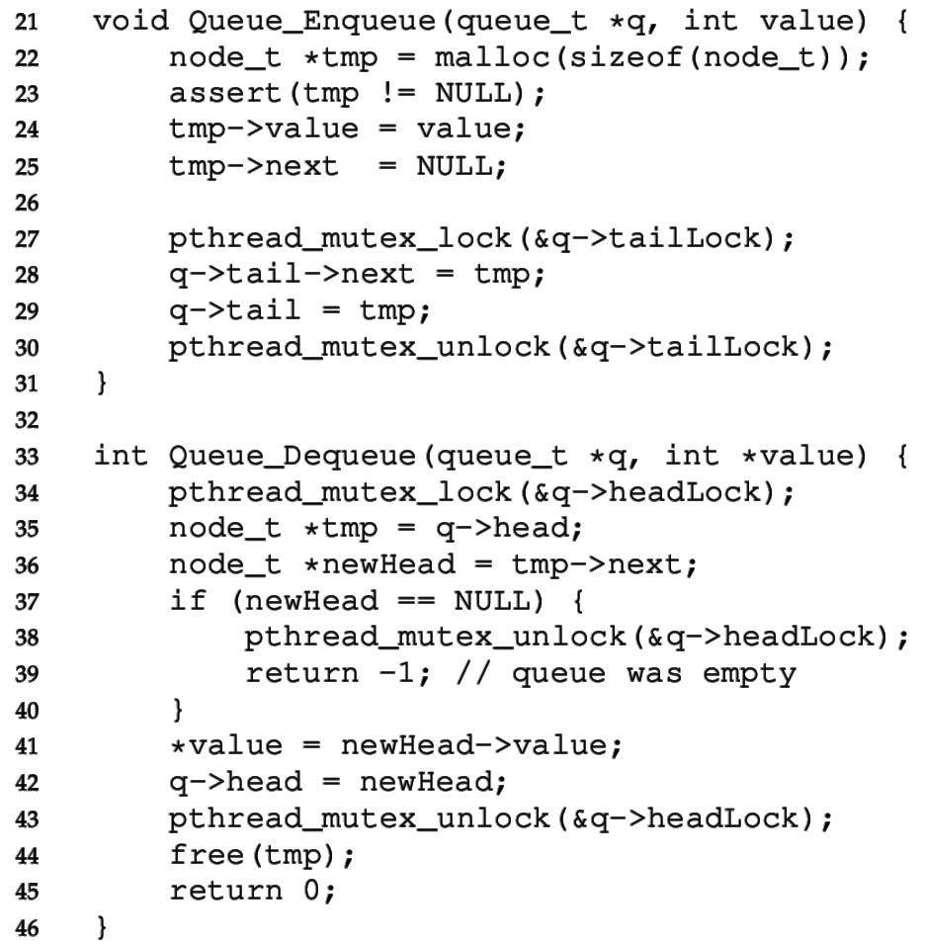

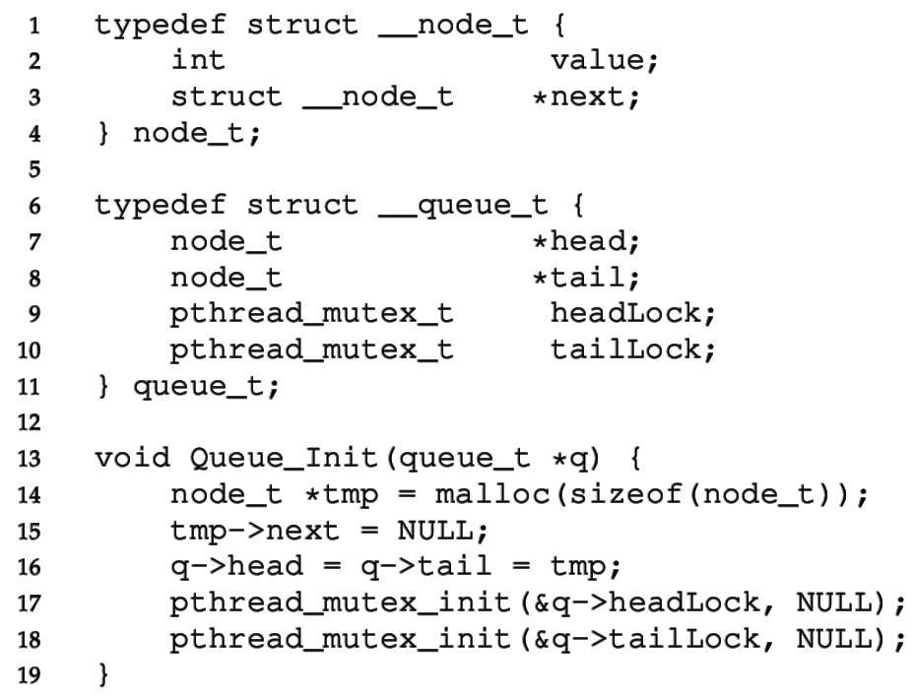

Concurrent Queue
Separate head & tail locks
Allows concurrent add & remove
Up to 2 threads can access without waiting

Slide 79
Concurrent Queue
“tailLock” controls adding elements
Looks similar to ListInsert

Slide 80
Concurrent Queue
Head lock controls removing elements from front
Needs to lock almost entire function

Slide 81
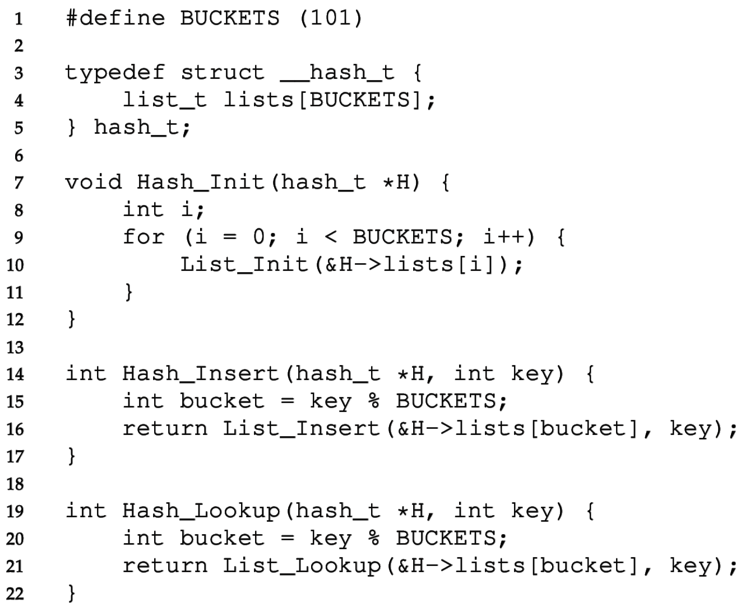
Concurrent Hash Table
Each bucket is implemented with a Concurrent List
We don’t have to define any locks!
(Locks are in the lists)
A thread can access a bucket without blocking other threads’ access to other buckets.
Hash tables are great for concurrency.
Hash (bucket id) can be calculated without accessing a shared resource.
Distributed hash tables are used for huge NoSQL databases.

Slide 82
Lock-free data structures
In our original example, we put a lock around counter++
We could have instead used atomic_fetch_and_add to update counter
Lock-free and still atomic!!
This is possible with more complex data structures as well
Often based on a compare-and-swap (CAS) approach
https://www.cs.cmu.edu/~410-s05/lectures/L31_LockFree.pdf
Warning: these are not to be taken lightly
Atomic instructions have performance costs on processors
Getting this correct involves really understanding hardware
https://abseil.io/docs/cpp/atomic_danger

Slide 83
Break + Question: Where is the critical section for vector?
typedef struct { size_t size; size_t count; int** data; } vector_t; void vector_add(vector_t* v, int* item) { if (v->count == v->size) { v->size *= 2; v->data = realloc(v->data, sizeof(int*)*v->size); } v->data[v->count++] = item; }

Slide 84
Break + Question: Where is the critical section for vector?
typedef struct { size_t size; size_t count; int** data; } vector_t; void vector_add(vector_t* v, int* item) { if (v->count == v->size) { v->size *= 2; v->data = realloc(v->data, sizeof(int*)*v->size); } v->data[v->count++] = item; }

Slide 85
Outline
Interrupts
Synchronization bugs
Deadlock
Solving deadlocks
Livelock
Priority Inversion
Threadsafe data structures
Concurrency in other languages

Slide 86
Javascript
Javascript (in browsers) is strictly single-threaded
Therefore, no data races!
A Javascript function will never be interrupted unless it makes an asynchronous call
console.log("1");
setTimeout(function(){console.log("2");},0);
console.log("3");
setTimeout(function(){console.log("4");},1000);
Will always output: 1 3 2 4 in that order
Even timers only trigger whenever the current code is finished

Slide 87
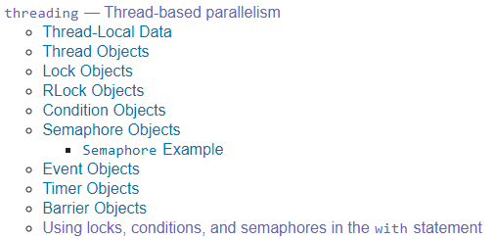
Python
Provides all the same primitives we discussed! https://docs.python.org/3/library/concurrency.html
And some nicer things
with some_lock:
# do something…
Is equivalent to
some_lock.acquire() try: # do something…
finally: some_lock.release()

Slide 88
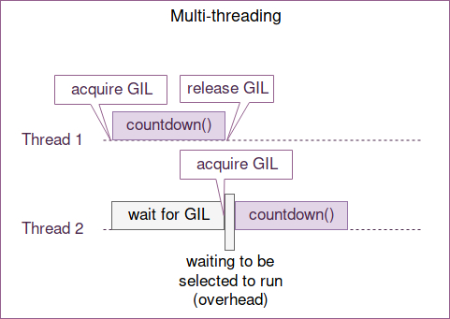
Python threads are concurrent but not parallel
Python uses one big lock technique for thread safety
Global Interpreter Lock (GIL)
Threads that are I/O bound still get a performance boost
Threads that are CPU bound do not increase performance
Multiprocessing library does employ parallelism by spawning entirely new processes
Each with their own python interpreter
https://hackernoon.com/concurrent-programming-in-python-is-not-what-you-think-it-is-b6439c3f3e6a
Active work in changing this: https://peps.python.org/pep-0703/

Slide 89
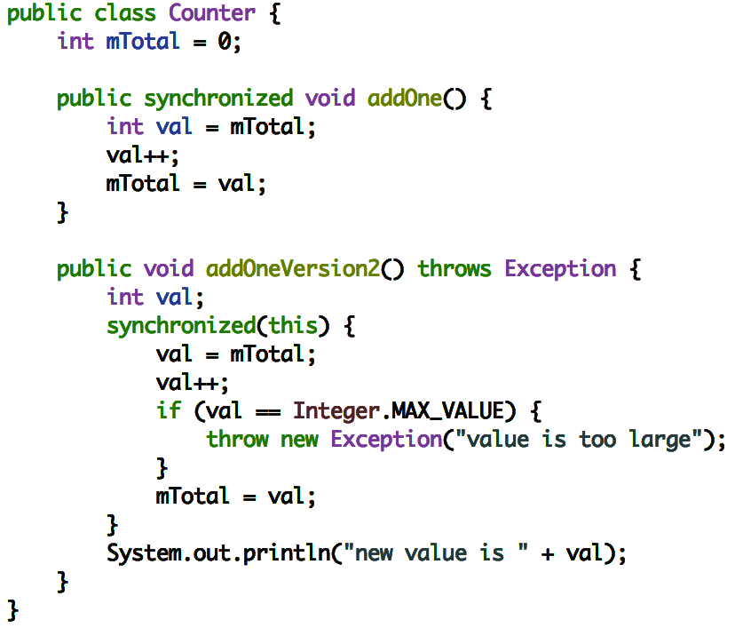
Java
Java has synchronized keyword for surrounding critical sections
Automatically releases the lock when exiting early:
Similar to
Python: “with self.lock:”
Objective-C: “@synchronized”

Slide 90
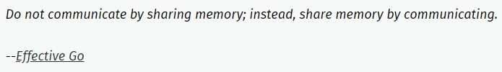
Rust
Rust’s opinion on sharing memory is amusingly to refer to Go’s opinion
Rust has a strong concept of ownership
A writeable (mutable) reference to an object can only be held in one place
Once an object is passed to another thread, the passer no longer has access
Solves many concurrency issues due to lack of shared memory
Rust locks have lifetimes enforced by the compiler
Lock goes out-of-scope at the end of the function, relocking automatically
https://blog.rust-lang.org/2015/04/10/Fearless-Concurrency.html

Slide 91
Advice for the future
Be aware of issues when writing multithreaded code
Use threadsafe data structures when possible
In languages that provide them…
Map your problem onto a classical concurrency problem
Producer/Consumer
Readers/Writers
One big lock for correctness isn’t the worst idea ever
But with some care (possibly a lot of care) we can do better

Slide 92
Outline
Interrupts
Synchronization bugs
Deadlock
Solving deadlocks
Livelock
Priority Inversion
Threadsafe data structures
Concurrency in other languages

