Slide 1
Lecture 14: Filesystem Principles
CS343 – Operating Systems
Branden Ghena – Spring 2024
Some slides borrowed from: Stephen Tarzia (Northwestern), Shivaram Venkataraman (Wisconsin), and UC Berkeley CS162

Slide 2
Administrivia
Driver Lab due tonight
Remember to submit to Gradescope as well!
See Gradescope assignment for instructions
Paging Lab should be out sometime tonight

Slide 3
Today’s Goals
Introduce the general concerns of filesystems.
Revisit application-level view of filesystems.
Explore tradeoffs in how filesystems track which blocks are available and which blocks are in use by which files.
Generally, understand the “design space” of filesystems.
Implementations will be selections of these.

Slide 4
Outline
Introduction to filesystems
Application view
Parts of a file system
Managing disk
Tracking files
Handling file data
Whole filesystem example

Slide 5
Introducing file systems
I/O API and
syscalls
Variable-Size Buffer
Memory Address
Logical Index, Typically 4 KB
File System
Block
Flash Trans. Layer
Hardware Devices
Sector(s)
Sector(s)
Sector(s)
Phys. Block
Phys Index., 4KB
Physical Index,
512B or 4KB
Erasure Page
HDD
SSD

Slide 6

Translation from user to system view
File (Bytes)
File
System
What happens if user says: “give me bytes 2 – 12?”
Fetch block corresponding to those bytes
Return just the correct portion of the block
What about writing bytes 2 – 12?
Fetch block, modify relevant portion, write out block
Everything inside file system is in terms of whole-size blocks
Actual disk I/O happens in blocks
read/write smaller than block size needs to translate and buffer

Slide 7
Classic OS situation
Take limited hardware interface (array of blocks) and provide a more convenient/useful interface with:
Naming: Find file by name, not block numbers
Translation: Map files to blocks
Organization: Tree-based directory structure which holds all files
Protection: Enforce access restrictions
Reliability: Keep files intact despite crashes, hardware failures, etc.
We combine all of this to create a filesystem
Many different approaches and tradeoffs
FAT32, NTFS, ext4, ZFS, etc.

Slide 8
Filesystem challenges
Disk performance
Sequential access is fast; random access is slow (for HDDs)
Persistence of data
Needs to tolerate sudden power loss without corruption
Free space management
Files are created and deleted
Files grow and shrink in size

Slide 9
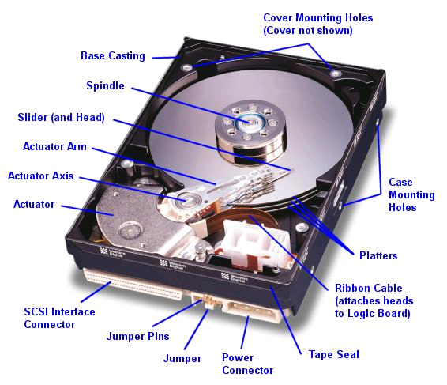
Hard drive disk (HDD) reminder
Western Digital Drive
http://www.storagereview.com/guide/

Slide 10
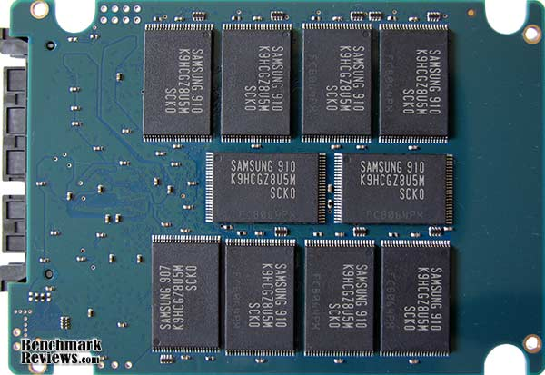
Solid state drive (SSD) reminder
NAND
NAND
NAND
NAND
NAND
NAND
NAND
NAND
Host
Buffer
Manager
(software
Queue)
Flash
Memory
Controller
NAND
NAND
NAND
NAND
NAND
NAND
NAND
NAND
SATA
Flash memory
No issues with random access speed
Writes are a concern though!
Writes 10x slower than reads
Limited write lifetime (~1-10k writes per page)
NAND
NAND
NAND
NAND
NAND
NAND
NAND
NAND
DRAM
NAND
NAND
NAND
NAND
NAND
NAND
NAND
NAND

Slide 11
Outline
Introduction to filesystems
Application view
Parts of a file system
Managing disk
Tracking files
Handling file data
Whole filesystem example

Slide 12
Application view of file system
Directories
Which are just a file where the data is pointers to other files
Files
A handle with associated data
“Type” of the file comes down to the data within it
Reminder: “File extensions” in name of file are a convention, not a necessity
Special files
Character and block devices!!

Slide 13
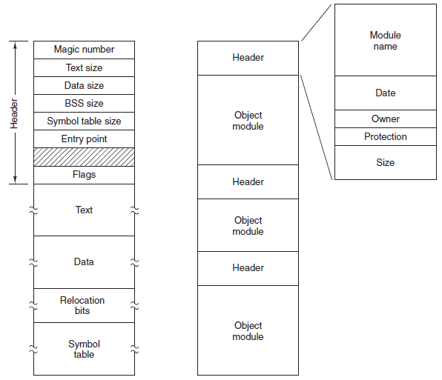
Binary file examples
Executable File
Archive (tar)

Slide 14
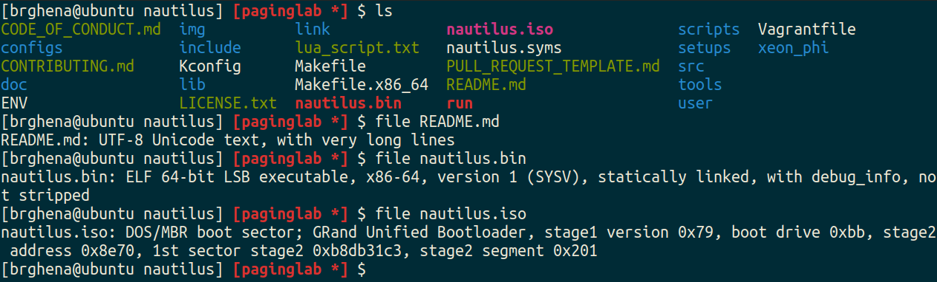
File command
file in Linux command line can determine the type of a file
https://github.com/file/file

Slide 15
Syscalls to interact with files
open (or create) a file with a given path (directories & name) and set the file pointer to the beginning of the file
read up to a certain number of bytes from an open file, and move the file pointer for the next read.
write an array of bytes to an open file (and move the pointer)
close an open file
lseek to move the file pointer to a certain index in the file
fsync to push changes to disk immediately (flush dirty data)

Slide 16
Additional file syscalls
stat/fstat gets file metadata (data about the data)
rename to move a file
unlink to remove a file
mkdir to make a directory
Linux:
getdents to list the contents of a directory
“get directory entries”
Because “read” would be filesystem-specific to interpret

Slide 17
File/directory metadata
Files also have attributes: readable, writeable, access time, etc.
struct stat {
dev_t st_dev; /* ID of device containing file */
ino_t st_ino; /* Inode number (low-level name) */
mode_t st_mode; /* File type and mode (permissions) */
nlink_t st_nlink; /* Number of hard links */
uid_t st_uid; /* User ID of owner */
gid_t st_gid; /* Group ID of owner */
dev_t st_rdev; /* Device ID (if special file) */
off_t st_size; /* Total size, in bytes */
blksize_t st_blksize; /* Block size for filesystem I/O */
blkcnt_t st_blocks; /* Number of 512B blocks allocated */
struct timespec st_atim; /* Time of last access */
struct timespec st_mtim; /* Time of last modification */
struct timespec st_ctim; /* Time of last status change */
};

Slide 18
Filesystem links
ln unix command creates a link to a file – like a pointer.
Allows a file to exist in multiple paths without wasting space
Hard link creates another entry in a directory referring to the same disk address (inode number).
Symbolic/Soft link is a special file whose contents is just the string path of another file.
Symlinks are much more common in modern practice (ln -s)
Allow referring to file in other filesystems
But may lead to a dangling reference – the referred-to file may be deleted

Slide 19

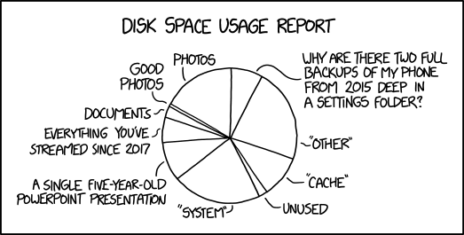
Break + double xkcd
https://xkcd.com/2143/
https://xkcd.com/2531/

Slide 20
Outline
Introduction to filesystems
Application view
Parts of a file system
Managing disk
Tracking files
Handling file data
Whole filesystem example

Slide 21
Data structures on disk
A bit different than data structures in memory
Access must be in units of blocks at a time
Can’t efficiently read/write a single word
Instead must read/write entire block containing it
Ideally want sequential access patterns (sequential accesses are fast)
Durability
File system hopefully should be in a meaningful state upon shutdown
But, shutdown could happen at any moment so that guarantee is tricky!

Slide 22
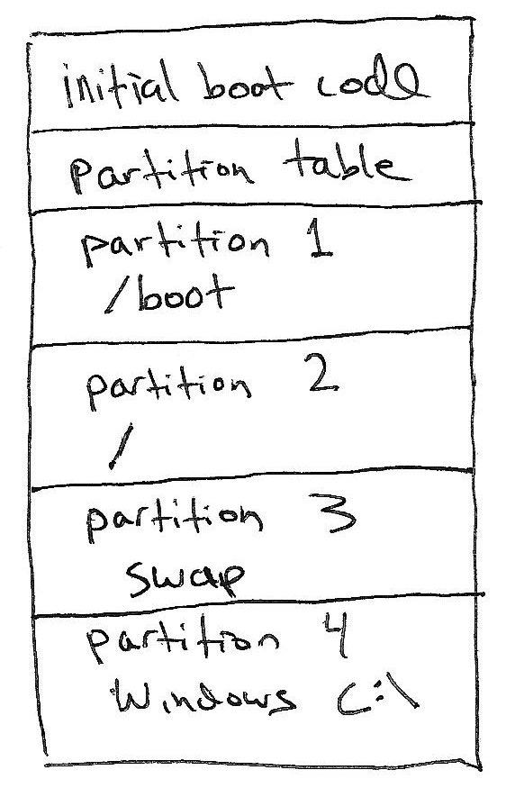
Disk partitions
Disk A
Most computers have one physical disk,
But they may require multiple filesystems.
A disk partition is a contiguous chunk of the disk that can be formatted to store a filesystem.
At left, we have:
Three different Linux partitions: /boot, swap, /
A Windows partition.
Each of the partitions may be formatted differently.
At bootup, initial boot code will present user with a menu to choose Windows or Linux boot.
(not drawn to scale)

Slide 23
What does the filesystem need to track?
Track free disk blocks (within partition)
Need to know which are available for new data
Track blocks containing data for files
Need to know where to read a file from
Track files in a directory
Need to be able to walk the directory hierarchy to find files
All this needs to be maintained in data structures on the disk itself

Slide 24
What goes within a partition?
Partition
Generic view of any filesystem
We’ll talk about specifics next lecture
Header
Free Space Tracking
File Tracking
File Data
Header
Free Space Tracking
File Tracking
File Data

Slide 25
What goes within a partition?
Partition
Generic view of any filesystem
We’ll talk about specifics next lecture
Header (Superblock)
Details about which filesystem this is
Metadata about the filesystem
Header
Free Space Tracking
File Tracking
File Data

Slide 26
Tracking available blocks on a disk
Partition
Free Space Tracking
Track which blocks in “File Data” are in use
Could be a list of block addresses
Assume block address is 32-bits and 4 KB block
1 TB disk -> 250,000,000 blocks
1 GB of block addresses
More complex but space-efficient data structures are possible
Space-efficient is nice because we really want to limit reads to disk
Header
Free Space Tracking
File Tracking
File Data

Slide 27
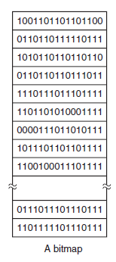
Bitmaps are a more space efficient tracking option
Each block on disk is represented by a single bit
1 means free and 0 means used (or vice versa)
Every block is listed in order
1 TB disk -> 250,000,000 blocks -> 250,000,000 bits -> 30 MB
Bitmaps for tracking free blocks are a constant size for a disk
Upside: easy to work with
Downside: complex data structures could compress runs of free/used blocks
Depends whether disk is expected to be fragmented or not
Bitmaps are typically used in practice

Slide 28
Outline
Introduction to filesystems
Application view
Parts of a file system
Managing disk
Tracking files
Handling file data
Whole filesystem example

Slide 29
Tracking available blocks on a disk
Partition
File Tracking
File attributes
Ordered blocks where the file data is located
Two common implementations
Allocation Table
FAT32
Index Nodes (inodes)
Unix File System, Fast File System,
ext3/ext4, NTFS
Header
Free Space Tracking
File Tracking
File Data

Slide 30
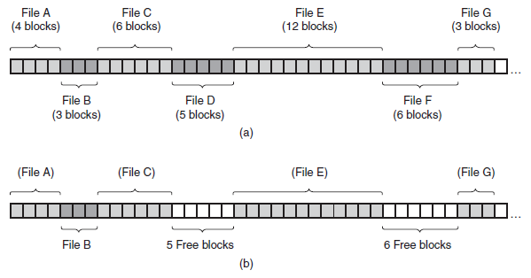
Requiring contiguous blocks won’t work
Need ability to map random blocks to file
Files in contiguous blocks is definitely nice
Sequential reads are fast
But requiring it leads to lots of fragmentation (unusable gaps in disk)

Slide 31
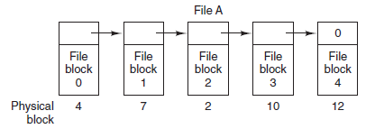
Forcing sequential access to data also won’t work
Partition
Linked list in File Data is undesirable too
Must read each data block to get next pointer
No random access to file
Appending requires reading through all of the file’s blocks first
Header
Free Space Tracking
File Tracking
File Data

Slide 32
Allocation table – an example file tracking solution
Keep the linked list idea, but keep a table of block pointers
Treat “File Tracking” block as an array of block pointers
Index into this array is the block number
Reading the file tracking block gets you all the pointers (so traversal is easy)
Next Block
Example: File “A” starts at Block 4
Block Number
0 | -1
1 | -1
2 | 10
3 | 11
4 | 7
5 | -1
6 | 3
7 | 2
8 | -1
9 | -1
10 | 12
11 | 14
12 | -1
13 | -1
14 | -1
15 | -1

Slide 33
Allocation table
Keep the linked list idea, but keep a table of block pointers
Treat “File Tracking” block as an array of block pointers
Index into this array is the block number
Reading the file tracking block gets you all the pointers (so traversal is easy)
Next Block
Example: File “A” starts at Block 4
Block Number
0 | -1
1 | -1
2 | 10
3 | 11
4 | 7
5 | -1
6 | 3
7 | 2
8 | -1
9 | -1
10 | 12
11 | 14
12 | -1
13 | -1
14 | -1
15 | -1

Slide 34
Allocation table
Keep the linked list idea, but keep a table of block pointers
Treat “File Tracking” block as an array of block pointers
Index into this array is the block number
Reading the file tracking block gets you all the pointers (so traversal is easy)
Next Block
Example: File “A” starts at Block 4
Block Number
0 | -1
1 | -1
2 | 10
3 | 11
4 | 7
5 | -1
6 | 3
7 | 2
8 | -1
9 | -1
10 | 12
11 | 14
12 | -1
13 | -1
14 | -1
15 | -1

Slide 35
Allocation table
Keep the linked list idea, but keep a table of block pointers
Treat “File Tracking” block as an array of block pointers
Index into this array is the block number
Reading the file tracking block gets you all the pointers (so traversal is easy)
Next Block
Example: File “A” starts at Block 4
Block Number
0 | -1
1 | -1
2 | 10
3 | 11
4 | 7
5 | -1
6 | 3
7 | 2
8 | -1
9 | -1
10 | 12
11 | 14
12 | -1
13 | -1
14 | -1
15 | -1

Slide 36
Allocation table
Keep the linked list idea, but keep a table of block pointers
Treat “File Tracking” block as an array of block pointers
Index into this array is the block number
Reading the file tracking block gets you all the pointers (so traversal is easy)
Next Block
Example: File “A” starts at Block 4
Block Number
0 | -1
1 | -1
2 | 10
3 | 11
4 | 7
5 | -1
6 | 3
7 | 2
8 | -1
9 | -1
10 | 12
11 | 14
12 | -1
13 | -1
14 | -1
15 | -1
5 total blocks {4, 7, 2, 10, 12}

Slide 37
Break + Check your understanding – Allocation table size
If each block address is 32 bits, and blocks are 4 kB in size, how big is the Allocation Table for a 2 TB drive?

Slide 38
Break + Check your understanding – Allocation table size
If each block address is 32 bits, and blocks are 4 kB in size, how big is the Allocation Table for a 2 TB drive?
2 TB / 4 KB = 500,000,000 blocks * 4 bytes = 2 GB

Slide 39
Problem 1: we really want the allocation table to fit in RAM
Accessing the allocation table on disk would slow us down
File blocks are not necessarily sequential
You might end up having to load in multiple blocks worth of File Tracking
Instead, at boot, load allocation table into RAM
File accesses will require scanning the linked list in RAM, but only a single disk access
Writes should be sent back to disk occasionally for safety
But 2 GB is a bit big to leave in RAM all the time…

Slide 40
Problem 2: file attributes should be more accessible
Unclear where attributes should go for a file with allocation table
Either in the first block of the file
Or in the directory data
Separation of attributes from block pointers is undesirable
Would be nice to have both of them in a single disk read
Or less than one read if they’re already in RAM

Slide 41
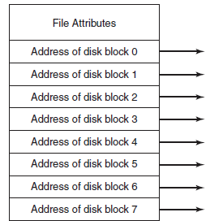
Index node (inode) – alternative file tracking solution
inode
Treat “File Tracking” as an array of inodes
Each inode corresponds to a single file
Size proportional to the number of files
inode contents
File attributes
Ordered list of pointers to data blocks for the file
Many improvements have sprung up
Optimization: coalesce contiguous blocks
Optimization: for very small files, put data right in the inode!

Slide 42
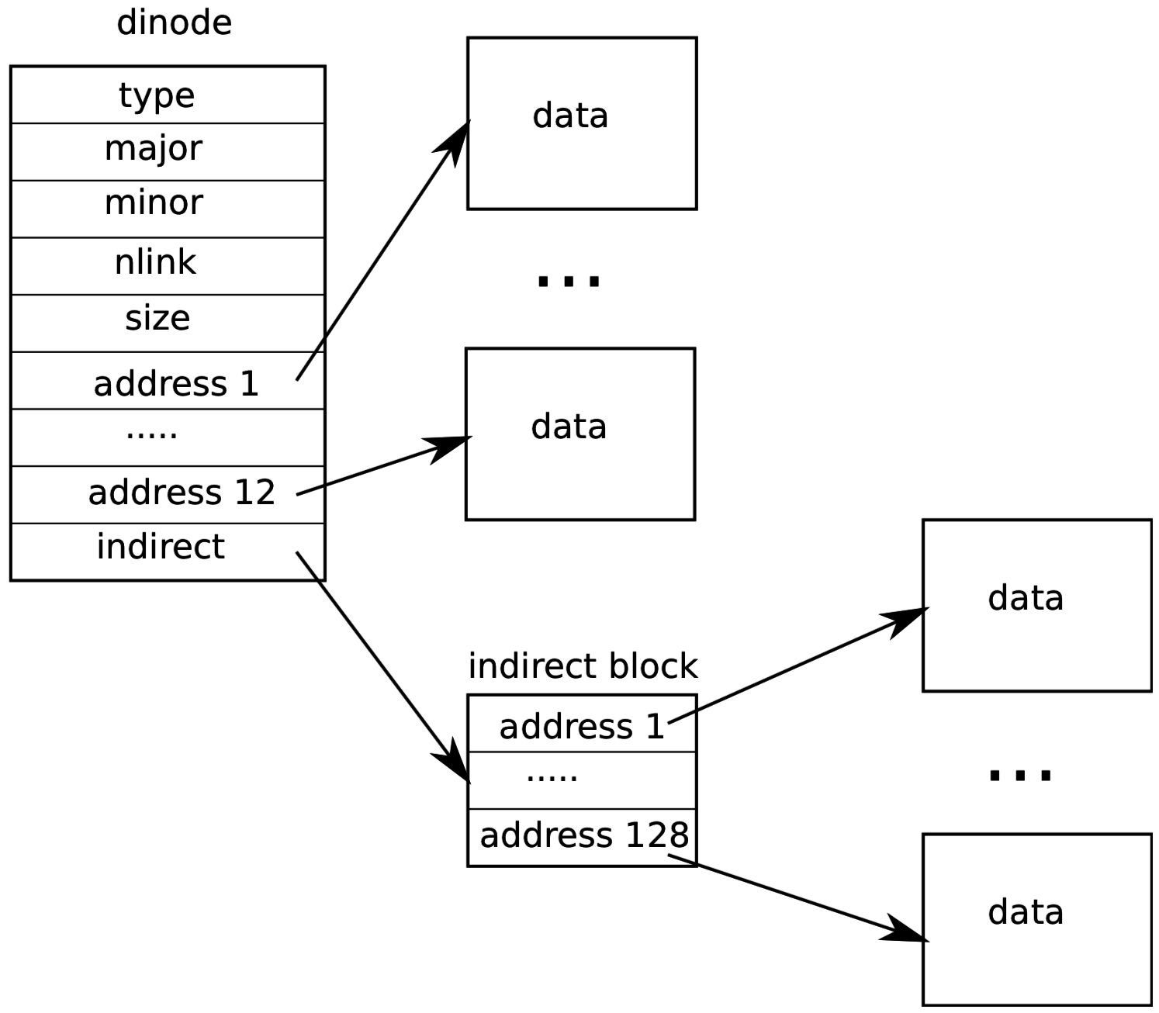
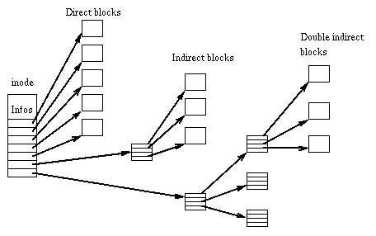
Hierarchical inodes allow for larger file sizes
Each inode is ≤ one block in size
So there would be a limit to how many blocks a file can have
Apply tree structure to block pointers to solve this

Slide 43
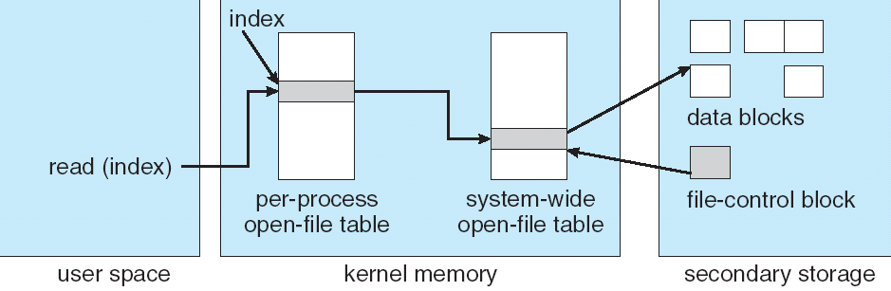
File system access with inodes
Open syscall: find inode and load it into memory
Read/write syscalls: reference inode by file descriptor
fd
(fd)
inode

Slide 44
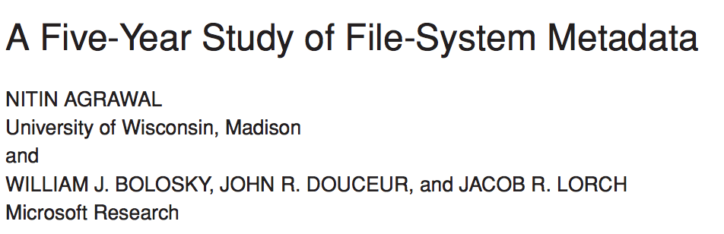
What can we observe about real-world file systems?
2007

Slide 45
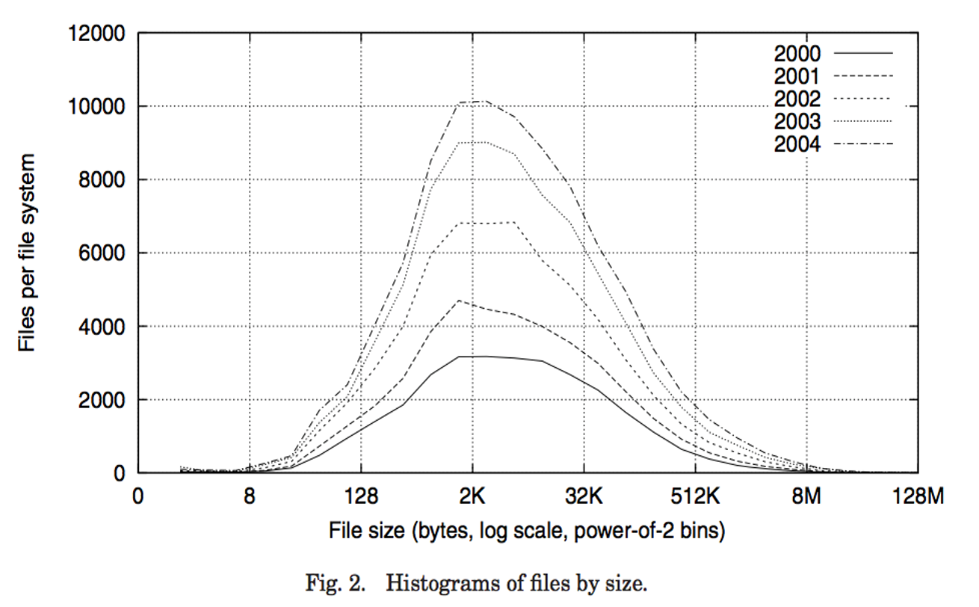
1. Most files are small

Slide 46
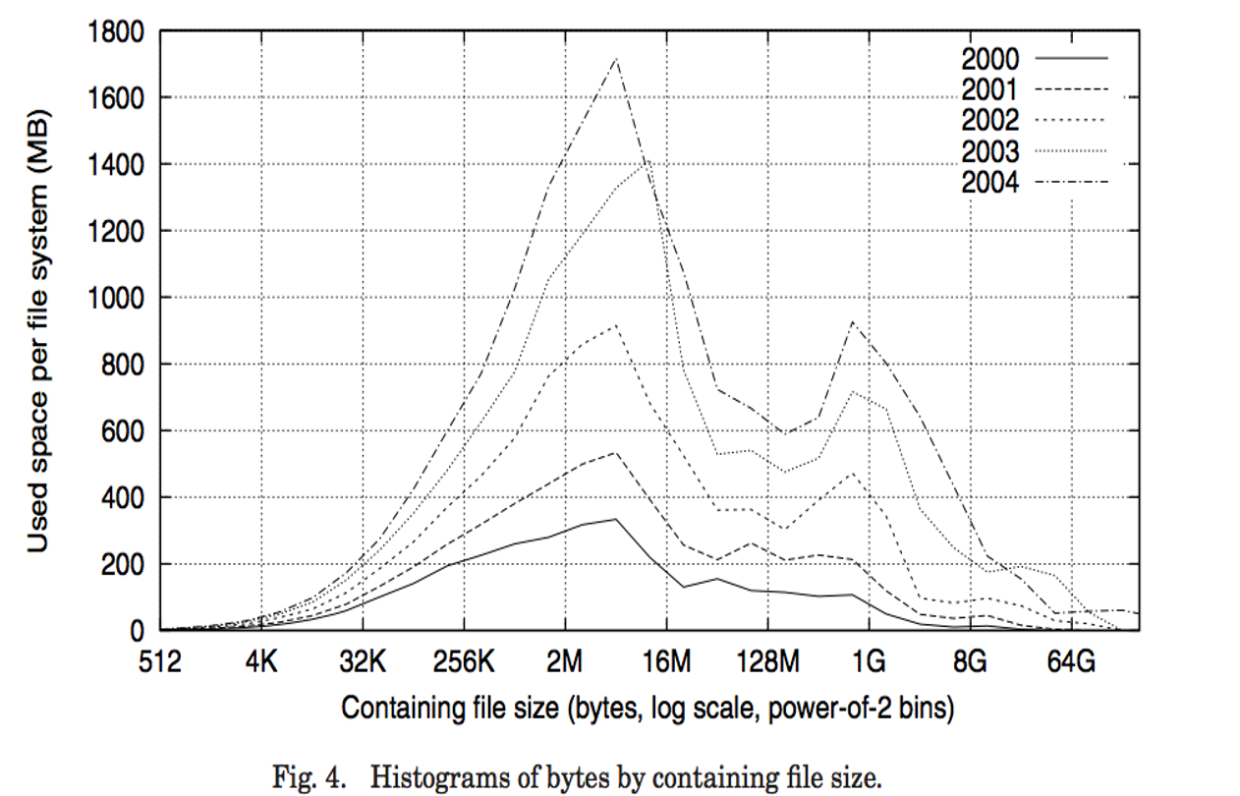
2. Most bytes are spent on a few large files

Slide 47
Break + Broader Thinking
Study was on 60,000 Windows PC file systems in a large corporation from 2000-2004 (over twenty years ago)
Does this still apply today? Why or why not?
Can you think of systems where it especially might not apply?

Slide 48
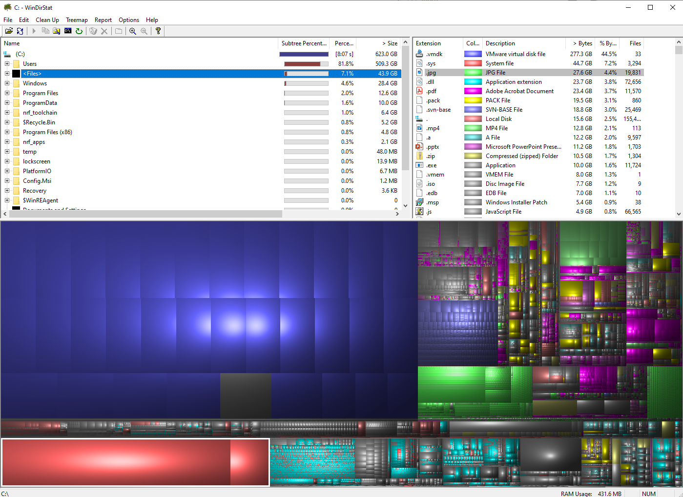
Storage trace of my work desktop
4% JPGs
19,000 total
Roughly 1.5 MB per image
4% PDFs
2% MP4s
2% PPTX
2% Zips
45% for a VM (which is really just a partition in disguise)

Slide 49
Outline
Introduction to filesystems
Application view
Parts of a file system
Managing disk
Tracking files
Handling file data
Whole filesystem example

Slide 50
What goes in the file data?
Partition
Normal files
Just the file’s data
Attributes already handled in inode
Directories
Structure listing files within this directory
File name, inode
Obvious implementation leads to a fixed maximum file name size
8 characters in MS-DOS plus 3 for extension
14 characters in Unix v7
This is the route of much evil abbreviation
Header
Free Space Tracking
File Tracking
File Data

Slide 51
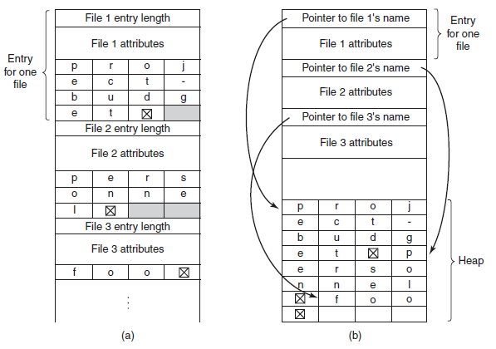
Directory data structures
(a) uses variable-length structures for each file
(b) contains an extra heap section for holding filenames
File attributes could also go here instead of in the inode

Slide 52
Outline
Introduction to filesystems
Application view
Parts of a file system
Managing disk
Tracking files
Handling file data
Whole filesystem example

Slide 53
A trace through the filesystem
Now we have enough knowledge to walk through an entire filesystem access
Here we assume
Bitmap for marking free data blocks
Bitmap for marking free inode blocks
Inode for each file/directory
One or more data blocks for each file/directory
Exact ordering of some of these steps are up for debate
Different implementations may swap ordering of some parts

Slide 54
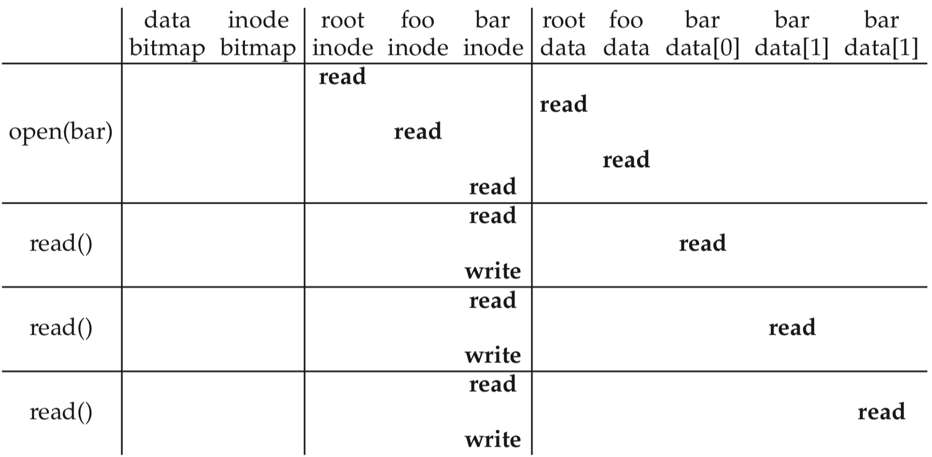
Open and read example
open("/foo/bar")
time
find file inode

Slide 55
Open and read example
open("/foo/bar")
time
inode reads/writes from here occur in memory rather than disk

Slide 56
Open and read example
open("/foo/bar")
time
update attributes

Slide 57
Open and read example
open("/foo/bar")
time
read next file block

Slide 58
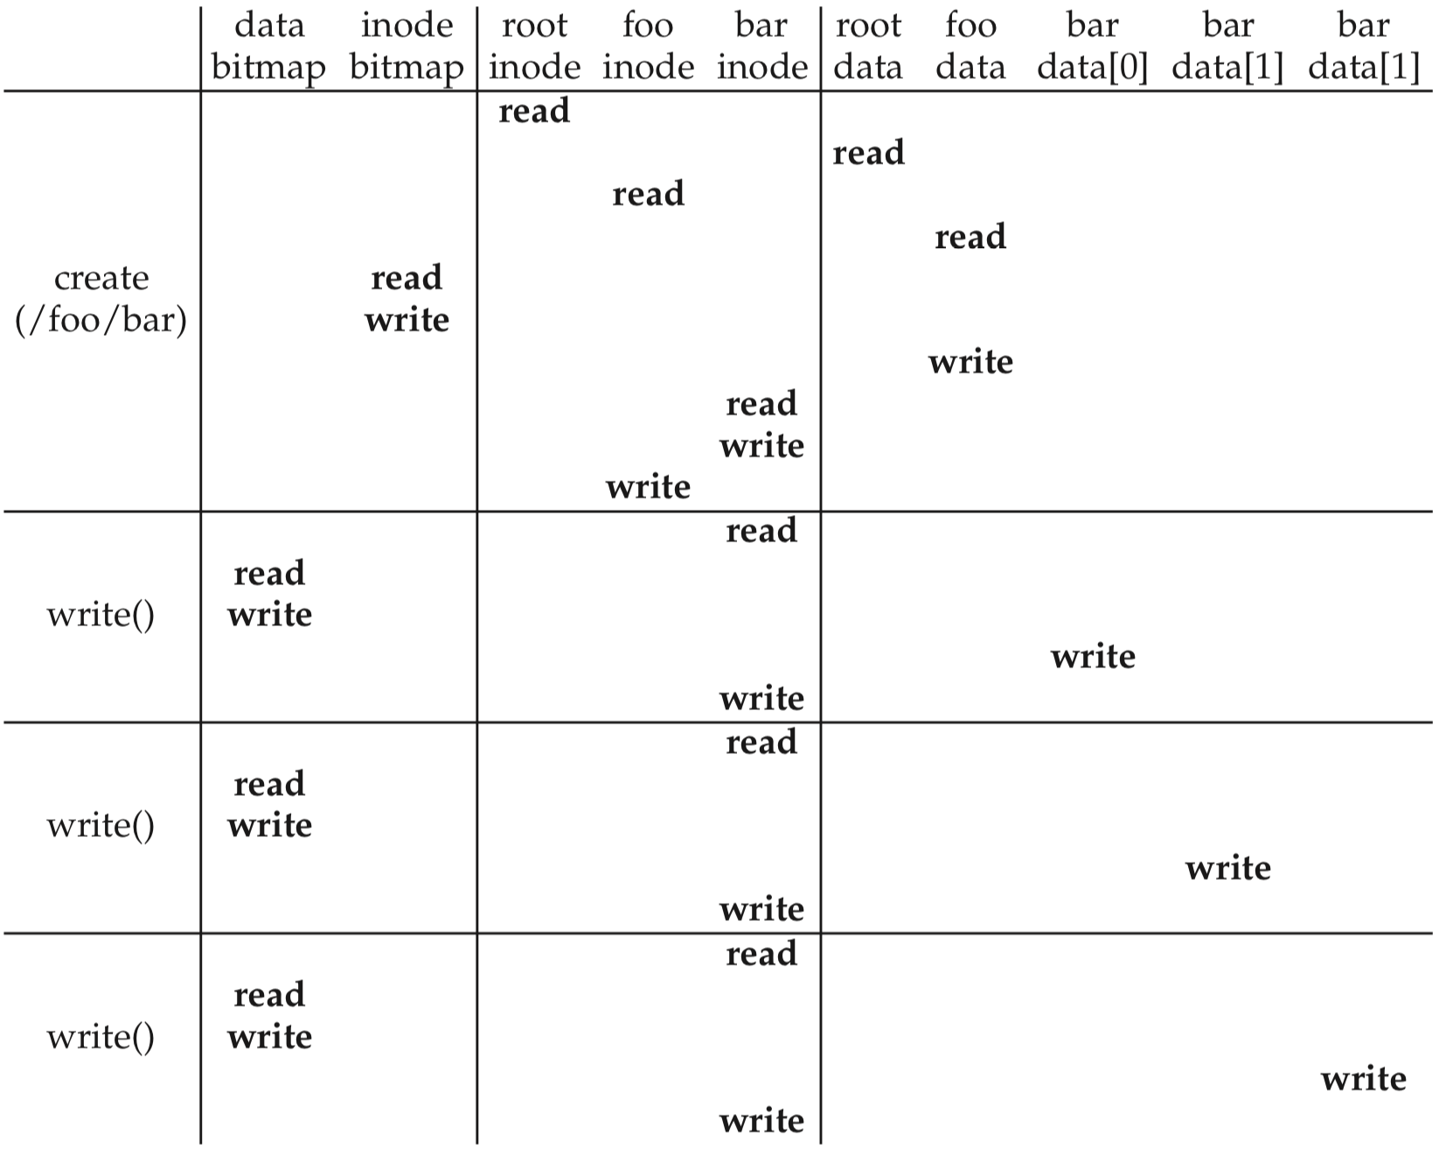
Create and write a file
Create:
First, read the parent directory to ensure that name is not already used.
Find & claim a free inode.
Add <“bar”, inode#> to parent directory.
Fill-in file metadata.
1
2
3
4

Slide 59
Create and write a file
Create:
First, read the parent directory to ensure that name is not already used.
Find & claim a free inode.
Add <“bar”, inode#> to parent directory.
Fill-in file metadata.
Write:
Look for remaining space in existing blocks first.
Find & claim a new data block.
Write data to new block
Point to it in inode
1
2
3
4
1
2
3
4

Slide 60
Outline
Introduction to filesystems
Application view
Parts of a file system
Managing disk
Tracking files
Handling file data
Whole filesystem example

