Slide 1
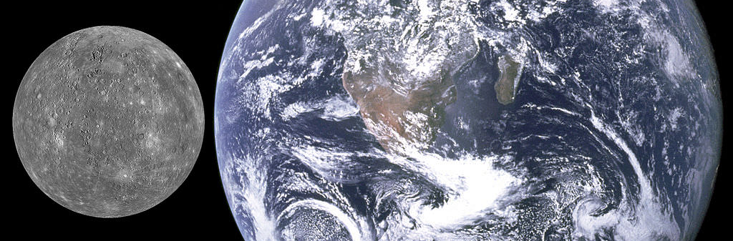

Wings of Mercury
Our Vision
Contact Us
To create family experiences by exploring our Milky Way.
Having fun and learning can go together.
Penn.Hargett@wingsofmercury.com
Wings of Mercury
Tours
Mercury Travel Plan

Slide 2
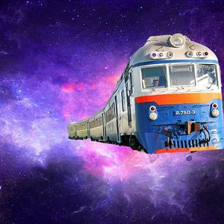
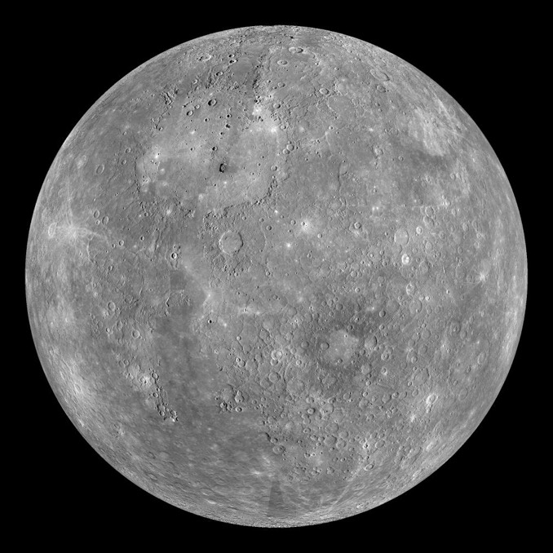
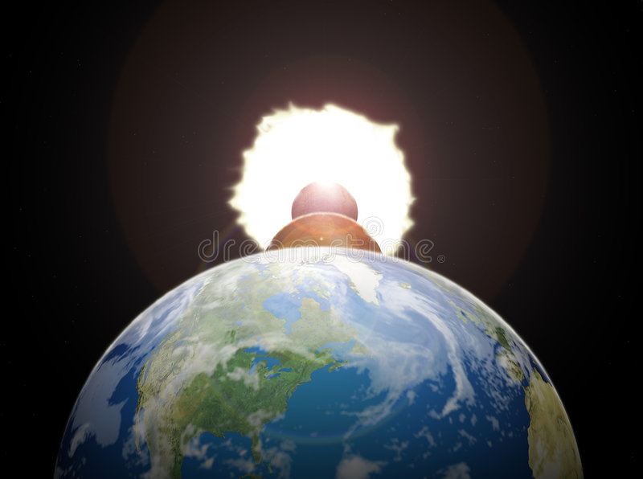

Mercury Facts
Prepare for Trip
Mercury is the smallest planet in the Milk Way Galaxy.
Mercury has no Moon.
Mercury is the closest to the sun so its pretty hot, but according to scientist Venus is hotter.
The earth rotates in 1 day ,it takes Mercury 59 days to rotate.
It takes 88 days to go around the sun to a year.
It get very hot (800°) on the sun side and (-290°) on the dark side.
We provide special eyewear, so you look at the sun up close.
We also provide breathing masks because the sodium, hydrogen, helium. and potassium are not good for you
Travel is via our Space Bullet Train.
Mercury is 48 million miles away; we can get you there in 28 days with comfy seats and beds in your own room.

