Slide 1
Transformations

Slide 2
Quiz-yourself questions Explain to your neighbor once you’ve quizzed yourself. Feel free to Google if you need to.
What does “modeling” mean in a data mining context?
What is the difference between supervised and unsupervised machine learning?
What is ETL?
Which parts are terrible, and why?

Slide 3
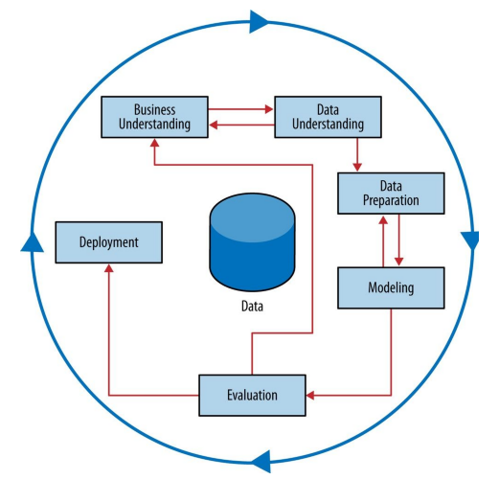

Slide 4
Alteryx

Slide 5
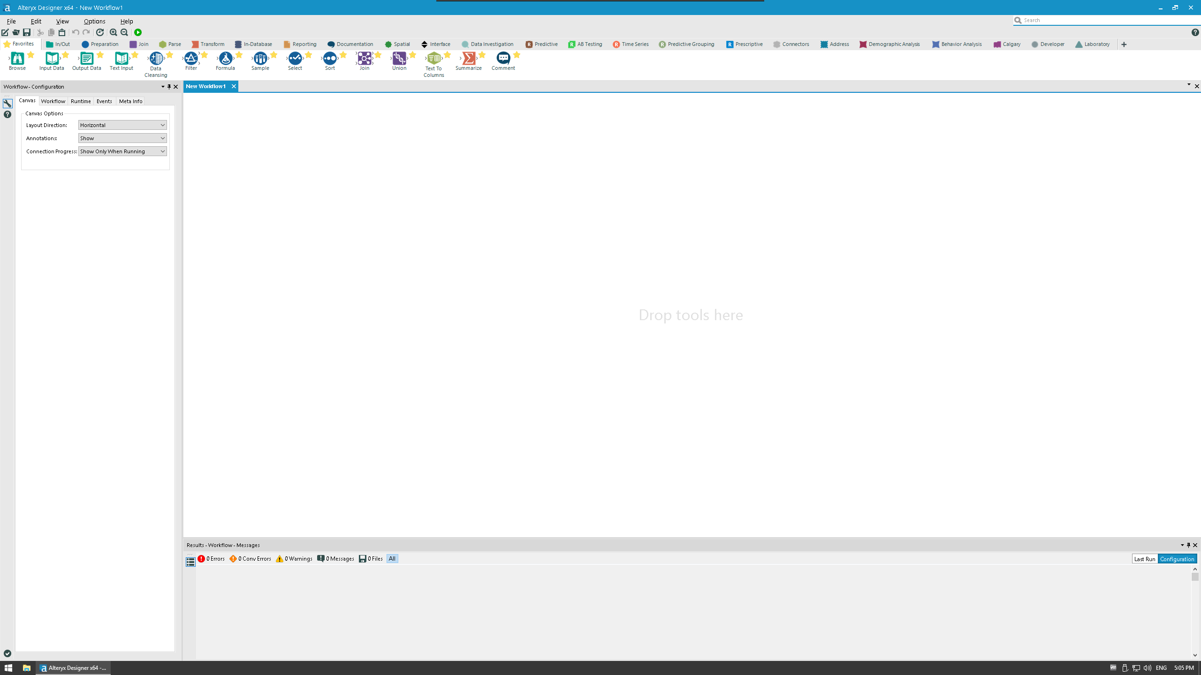

Slide 6
Let’s see datatypes in Alteryx
Sample Workflows > Learn one tool at a time > Preparation > Select
Remember, the first thing you do is “Select”

Slide 7
Download some data

Slide 8

In/Out Tools
These tools allow the input and output of data and generally start and end a workflow.
Tools:
Input data - Connect and import data from a file or database
Text input - Manually add a bit of data
Directory - input names of files, etc. from a directory
Date time now - Insert current date and time
Browse - Look at the data

Slide 9
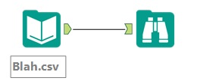
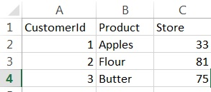
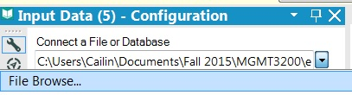

Tool: Input data
Data before (in excel doc):
Tool configuration:
Data after (in Alteryx):
Problem:
Need to open a CSV file in alteryx to run analytics on the data.
Tool description:
Connect and import data from a file or database. Puts file in alteryx for you to work with

Slide 10
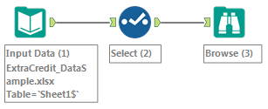
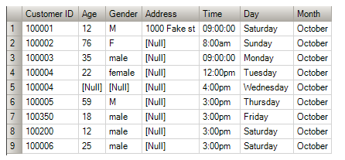
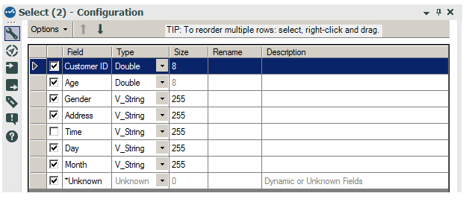
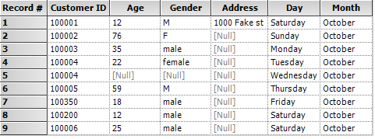
Tool: Select
Data before:
Tool configuration:
Data after:
Problem:
We no longer want the “time” column in our data set. Or we want to rename a column
Tool description:
This tool allows you to remove columns that you deem to be unnecessary. In addition, it allows for you to change the data types [More on those later], rename your variables, and change the order of columns.

Slide 11
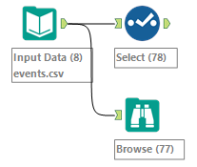
Let’s examine the content of the file
To examine the output data in its entirety, use the “Browse” tool
Or just click on the final node and select “output” for a sample
To examine the data types, use the “Select” tool
Connect both to your Input Data
Click the “run” button (green circle with white arrow) and examine results
or ctrl+r
Tasks and questions
Get rid of timestamp and verify that you succeeded
How many rows do you have?
What datatypes do you have?
Rename longitude and latitude into lon and lat.
Change lon and lat into “Float” data type

Slide 12
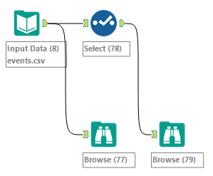
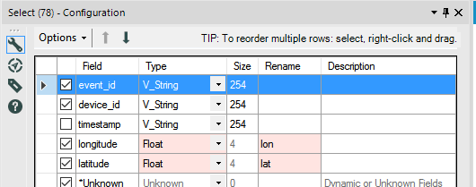

Slide 13
If you need help…
Learn one tool at a time
In/Out
Browse
Directory
Text Input
Output Data
Preparation
Select
Autofield
Imputation
Documentation
Comment
Tutorials
Viewing Data
These areas from within “Alteryx > Help > Sample Workflows” are exhaustive

Slide 14
At this point, you should be able to:
Find Help and Tutorials documentation in Alteryx
Use the tools we covered
Understand datatypes

Slide 15
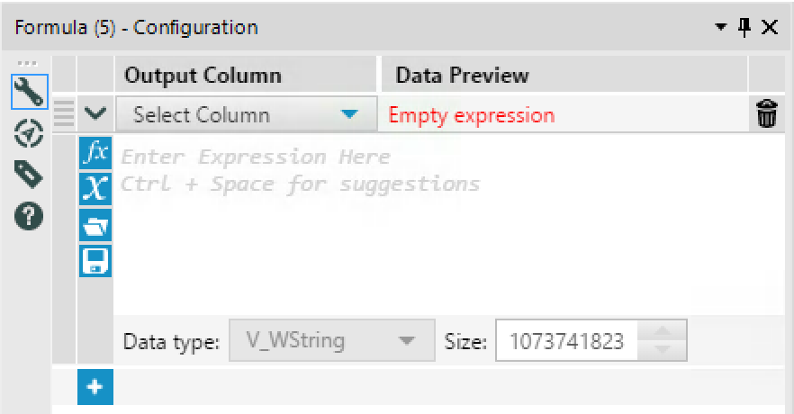
1. Select an existing column or write in a new name to create a new column. This is where changes are made.
2. If you created a new column, add its datatype here.
3. This is where we’ll be typing in our code. IF THEN structure is most common.
4. In this area, you can “cheat” if you don’t remember how to write the code from memory (I often use this one).
It will list variables available to you as well as functions you can use.

Slide 16
Files needed for the following slides
Go to Canvas > Files, then search by name for and download each of the following:
Cust_wTransactions.xls

Slide 17
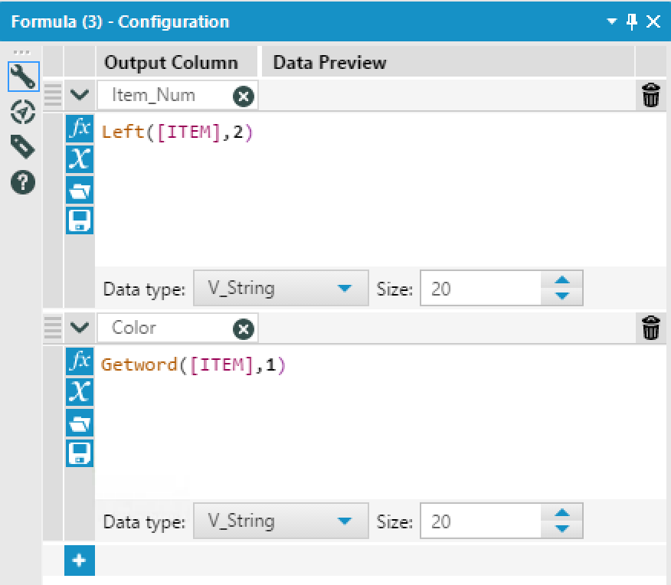


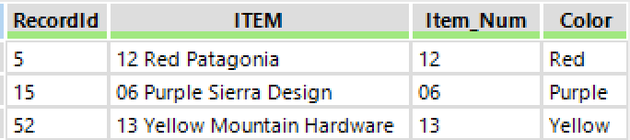
Tool: Formula
Download Clothing_Search.csv
Pull out the Number ID and the Color into separate columns
Data before:
Data after:

Slide 18


Now for some formula fun
goal is for you to experience using an unknown function in alteryx
Download: Cust_wTransactions.xls and load it
Tasks – use to:
Create a new column named “Dollars only”, rounding “Spend” to have no decimals
Create a new column named “FixedVisits” adding 1 to each “Visit” value

Slide 19
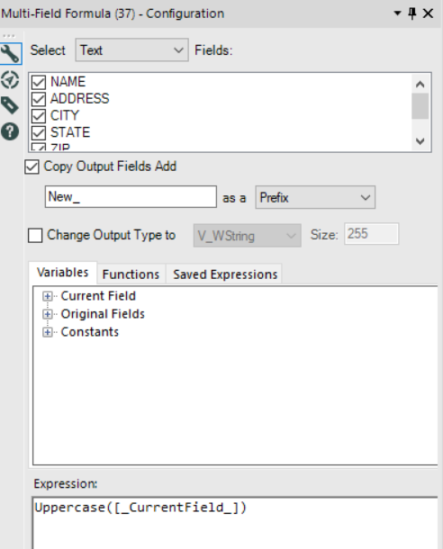

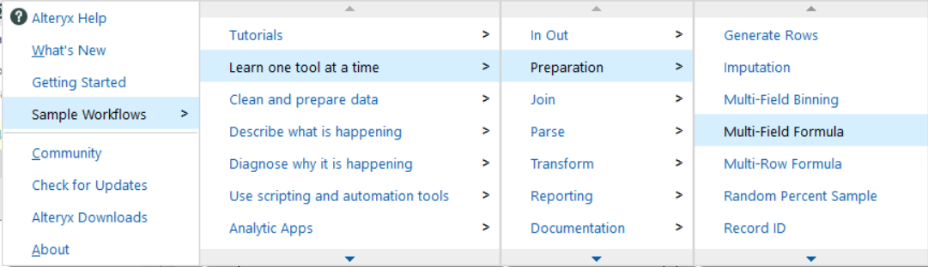
Multi-Field Formulas
Time-saving tool to apply same Formula to multiple features at once
Use a to create two new columns, taking the log of both Visits and Spend

Slide 20
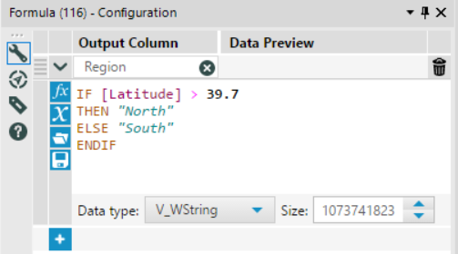
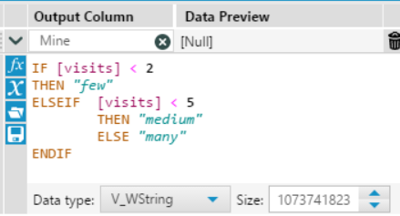
IF c THEN t ELSE f ENDIF
Use Cust_wTransactions
Create new columns (named whatever you want)
if city is Denver, output 1, otherwise 0
if spend > 100, output "big spender", else "little spender"
You can get crazy and “nest” if statements with ELSEIF ➔
Just like in Excel
(Doesn’t use cust_wTransactions data)
Boolean logic – multiple conditions?

Slide 21
Now let’s do this practice workflow
Warning, it is not easy! Meant to be exposure to different tools
Files > search for 03-formula-practice-incomplete-workflow.yxmd

Slide 22

Tiling (a.k.a Binning)
We Bin when we care more about ranges of values instead of precise values
e.g., Age range, Income range, years of education…
Download this file from canvas: address_sale_data_narrow.csv
Look at field “Average Sale.” Conceptually, how might we want to group/bin “Average Sale”?

Slide 23
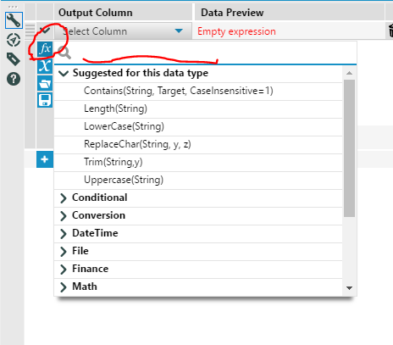
String Manipulations
Practice finding functions to do these tasks
With same customer data from previous slides, do this:
TitleCase [First Name] and [Last Name] – do not create new columns
Count the number of words in [Customer Segment]
Count the length of [City]
Replace all instances of “Office” in [Customer Segment] with “Mancave” or “Womancave” (your choice)

Slide 24
Imputation exercise
With customer data from previous slides,
pretend there was an error in data collection for all records from Aurora. We need to set “spend” to null (a special value, not just the word ‘null’)
google search "alteryx null“
Then, decide you want to replace all null values with the average for other sales
After you complete that, you ask yourself, “But wait, is average appropriate?”
Plot a Histogram of your data (use the search bar to find it). What does it tell you? What should you do instead of average? Do it.
No need to delete the old stuff.
You can also take the log of a right-skewed value
Plot the histogram of a log-transformed value. How does that look

Slide 25
First Lab Assigned, posted on Canvas
Uses the ClassicModels dataset
http://www.richardtwatson.com/dm6e/images/general/ClassicModels.png
Download csvs here for each table in ClassicModels
Extract zip… then, drag-and-drop multiple files to alteryx workflow

Slide 26
Appendix

Slide 27
Formal Logic

Slide 28
Conditionals
Assign one value if a condition is met or a different one if it isn’t
If age > 30 then use numbered candles else use box of single candles
Can include multiple conditions
If age < 5 then party with classmates else if age ≥ 21 then party with illicit drugs else party with friends
Can include conjunctions
If age > 10 and age < 16 then bedtime is 10 PM

Slide 29
Conjunctions
AND – requires both
OR – requires one or both
XOR – requires one but not both
NOT – inverts the truth value

Slide 30
Formal Logic – Truth Tables

Slide 31
Truth table with OR
IF Studies=True OR Lucky=7 THEN Grade=A ELSE Grade=F
 | 3 | 7 | 13
True
False
A
A
A
F
A
F

Slide 32
Truth table with AND
IF Studies=True AND Lucky=7 THEN Grade=A ELSE Grade=F
 | 3 | 7 | 13
True
False
F
A
F
F
F
F

Slide 33
Truth table with NOT
IF Studies=True AND NOT Lucky=3 THEN Grade=A ELSE Grade=F
 | 3 | 7 | 13
True
False
F
A
A
F
F
F

Slide 34
Truth table grouping NOT
IF NOT (Studies=True OR Lucky=3) THEN Grade=F ELSE Grade=A
 | 3 | 7 | 13
True
False
A
A
A
A
F
F

Slide 35
Truth table distributing NOT
IF (NOT Studies=True) AND (NOT Lucky=3) THEN Grade=F ELSE Grade=A
 | 3 | 7 | 13
True
False
A
A
A
A
F
F

Slide 36
Formula

Slide 37
Basic Form
LastName + “, ” + Left(FirstName,1)
Operator
Function
Variable
Literal
Arguments

