Slide 1
1150 Programming Logic
JSON and APIs

Slide 2
How do different computer systems talk to each other?
Scenario to consider:
An e-commerce retailer. Which systems may work together to display products (with reviews, similar product suggestions) on pages, take orders, process orders, ship orders... ?
Typical IT infrastructure has many separate systems that communicate as needed

Slide 3
Many technologies to connect different computer systems over a network
Various technologies including CORBA, Message Passing, PubSub... (we won't cover these)
One technology that's become very popular is using HTTP
Same technology used in your web browser, to request web pages
HTTP can also be used by programs to make requests to API servers
An API server is much like a web server, but it's designed to respond to programs, not humans, and send data, not web pages

Slide 4
HTTP
HTTP is the protocol used for browsers to request web pages, and for servers to send pages, images, other resources in response
Can also use HTTP to send requests from your program to another computer, somewhere else on the network (or internet)
The other computer can respond with data of some kind - a file, text, error message, or JSON

Slide 5
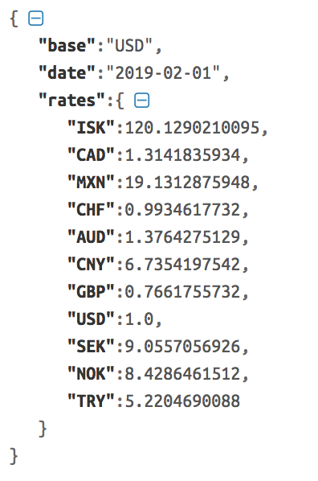
JSON
JavaScript Object Notation, used by the JavaScript language, but widely understood by many other programming languages
The structure looks a lot like a Python dictionary
And, we can turn a JSON response into a Python dictionary in our program, and use the data

Slide 6
HTTP Requests with requests
Python has built-in libraries for making HTTP requests but it's a little clunky to use
So we'll use the requests library instead which is really nice
http://docs.python-requests.org/en/master/

Slide 7
Install requests
Method will vary depending on your version of PyCharm

Slide 8
First HTTP request
We need a random cat fact
So we need a random cat fact service
Let's use the https://catfact.ninja API

Slide 9
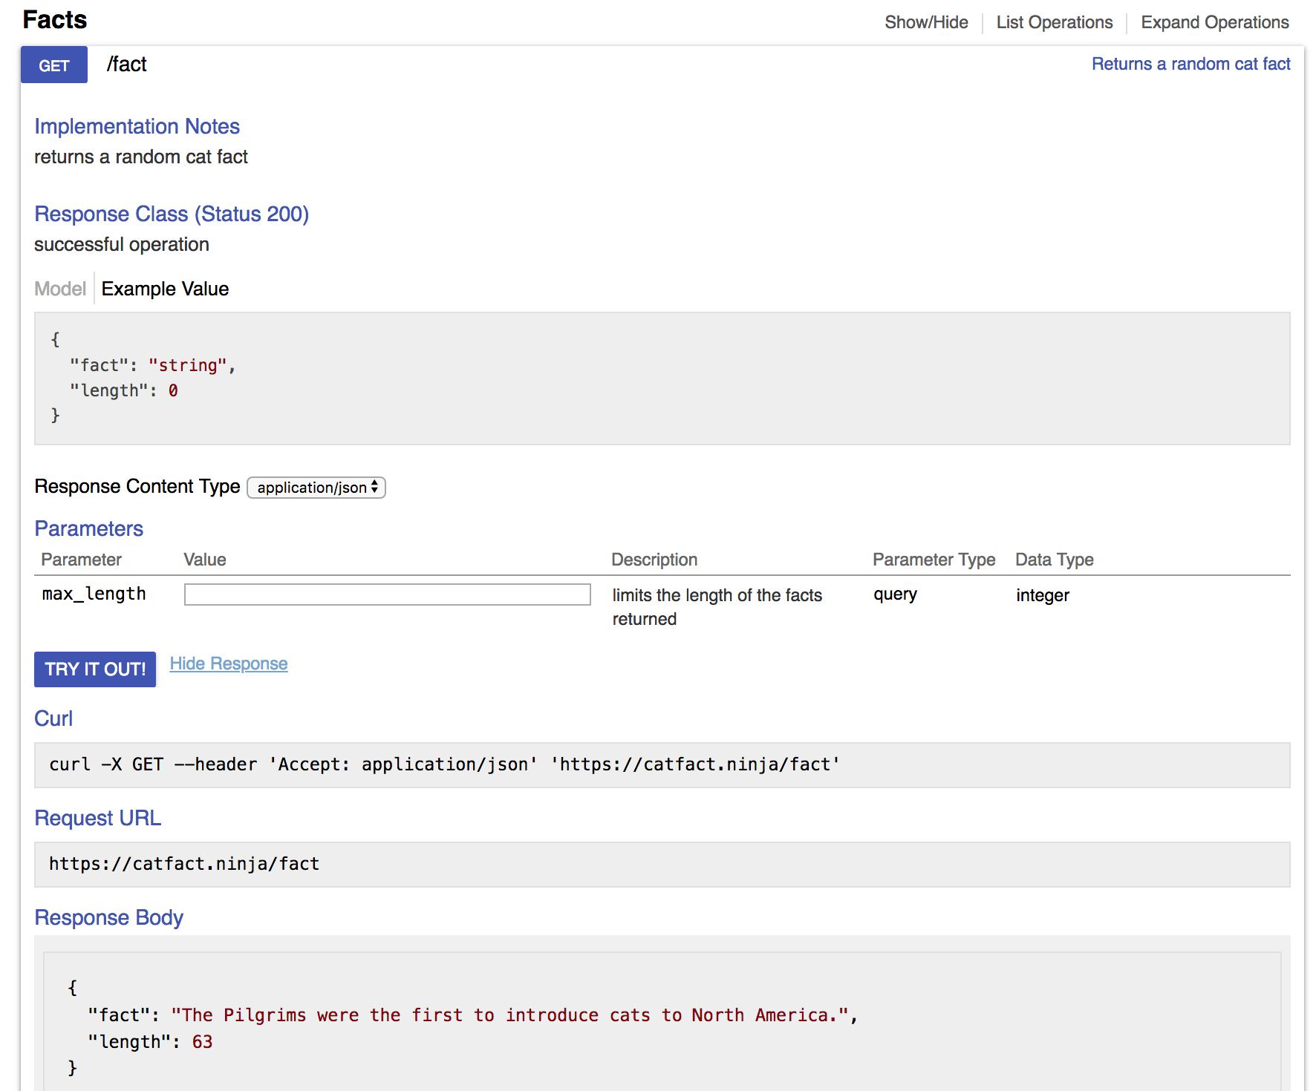
Using an API
Step 1: read the documentation to figure out what request to make
There's an example URL
Paste it into your browser address bar to see what happens

Slide 10
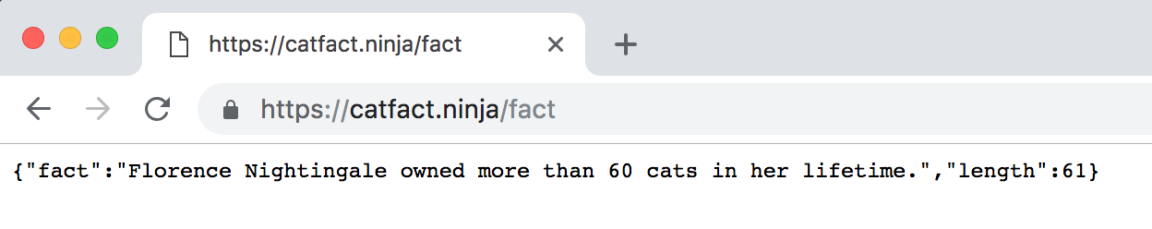
Step 2: Test out the API
Test in browser or with curl
Looks like a random cat fact
What format is the data in?
JSON response - it's plain text but formatted to be readable by computers. The structure is the same as a Python dictionary

Slide 11
Step 3: How is the response structured?
Note the JSON has keys "fact" and "length".
We are interested in the fact

Slide 12
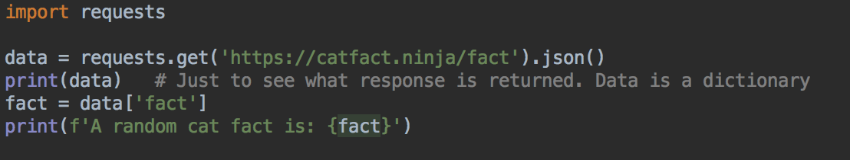
Step 4: Use in program
Import requests
Make request
Parse response into JSON, which is provided to your program as a dictionary
Use response in program

Slide 13
Results
Run and test
Should get a new random fact every time

Slide 14
Another API - Exchange rates
https://exchangeratesapi.io/
You used this in Lab 7
List of currency codes: https://www.iban.com/currency-codes

Slide 15
A basic exchange rate program
Example: we want the dollars-euros exchange rate for conversions

Slide 16
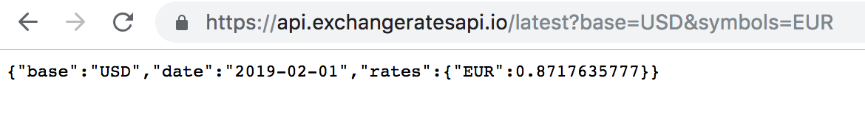
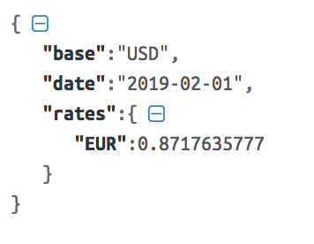
JSON formatter
Helpful to see the structure of the response
https://jsonformatter.curiousconcept.com/
Easier to read format

Slide 17
Response
The response has a rates key
The value for this key is another dictionary
This dictionary has a EUR key, and it's value is the exchange rate from dollars to Euros

Slide 18
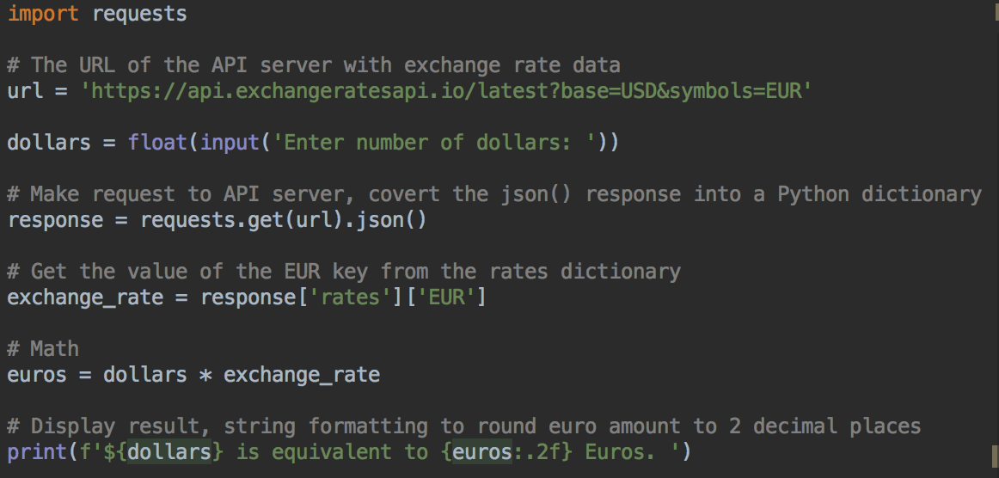

Run and test

Slide 19
Weather
Try this URL
https://api.weather.gov/gridpoints/MPX/107,71/forecast
This is the current weather forecast for Minneapolis, from weather.gov

Slide 20
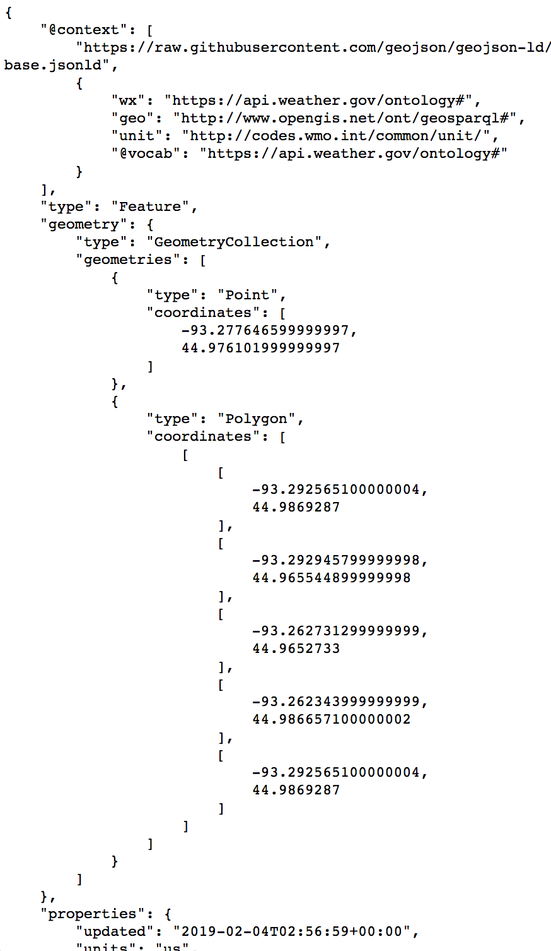
JSON looks more complicated...
It's got a lot more data in it
But, can ignore a lot of it
Scroll down, forecast information starts about 1/3 of the way down
Notice there's a properties key, the value is a dictionary
The properties dictionary has a key periods
The value for this key is a list of forecasts for the next 7 days and nights

Slide 21
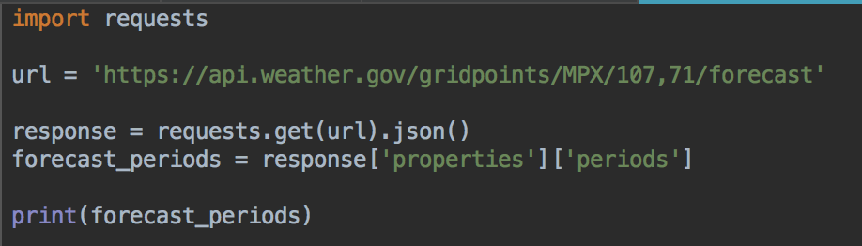
Start of program
Get data, and extract just the forecast data
The properties dictionary, and then the periods list
Should output a really long string with forecast data

Slide 22
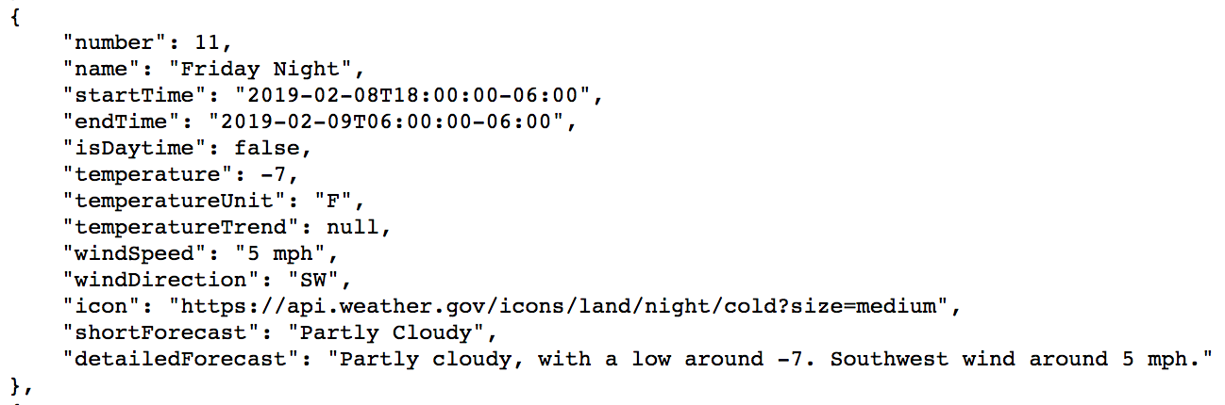
Look at the data from a dictionary in the list
There's a name key, which is the day of the week, and if its day or night
There's a temperature key, for the temperature in F
And a detailedForecast key, text describing the forecast
Example dictionary
from response

Slide 23
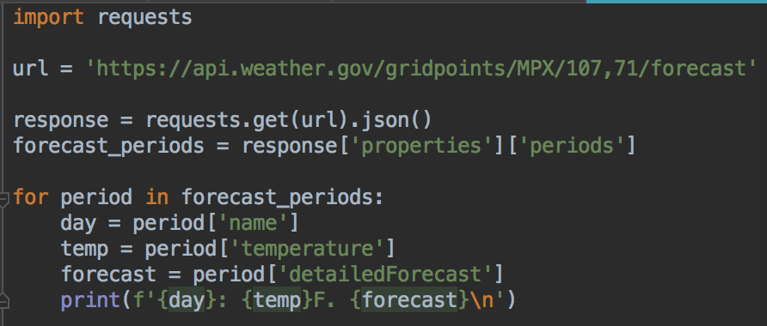
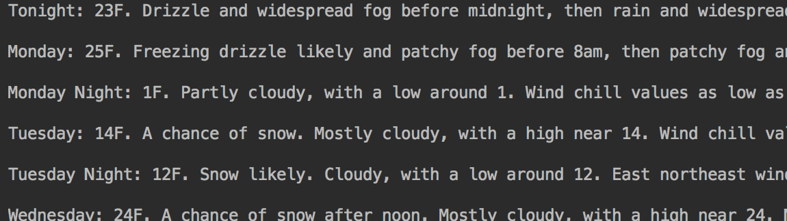
Loop over the list, and get the day, temperature, and forecast for each period

Slide 24
API Keys
These APIs are unusual because you don't have to authenticate to use the service
Most APIs are restricted to authorized users
Why?
Either with OAuth - equivalent of a username and password
Or require a key to access - less security but still useful for managing and monitoring users

Slide 25
Language detection
Sign up for a free account with LanguageLayer https://languagelayer.com/signup?plan=27

Slide 26
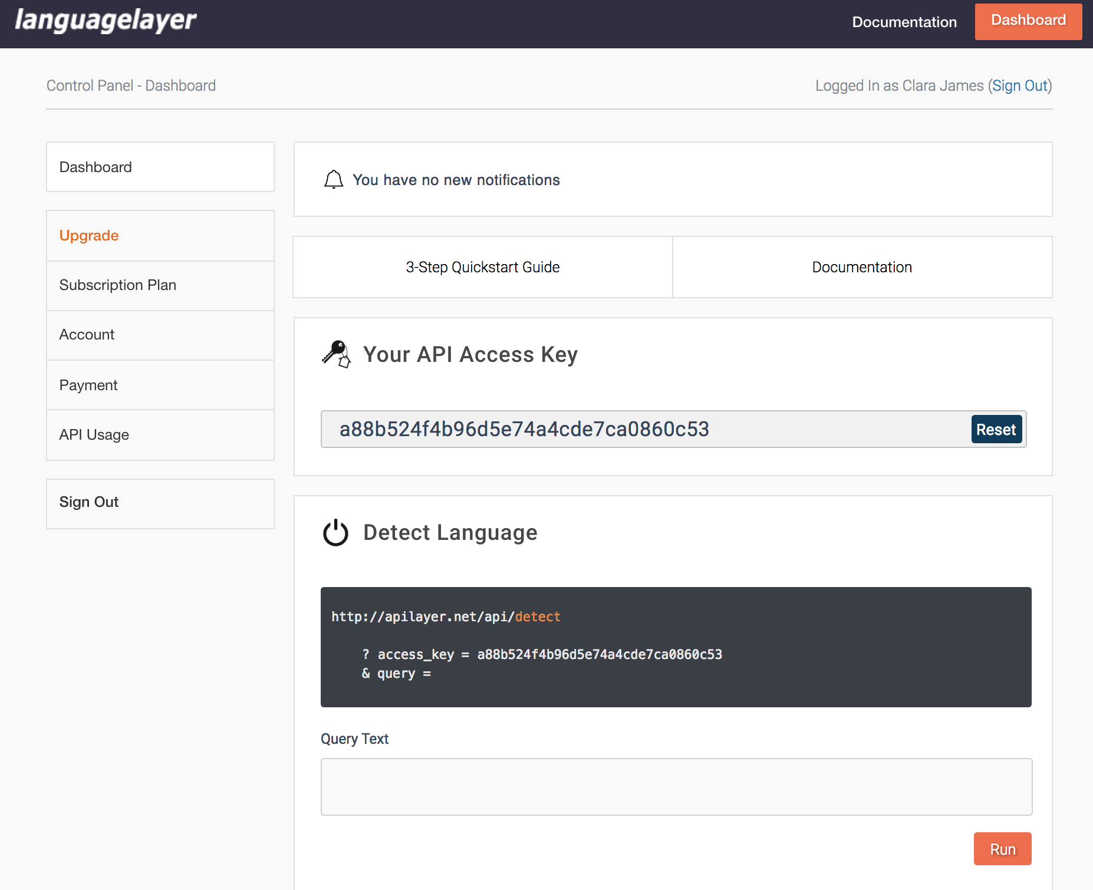
Dashboard
Should have a key generated for you
Keep this page open

Slide 27
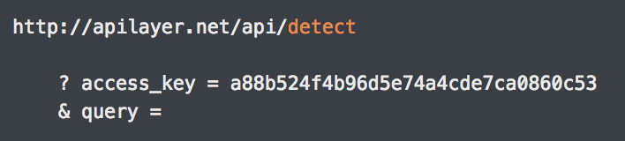
What request do we need to make?
From the documentation
URL
Query parameters

Slide 28
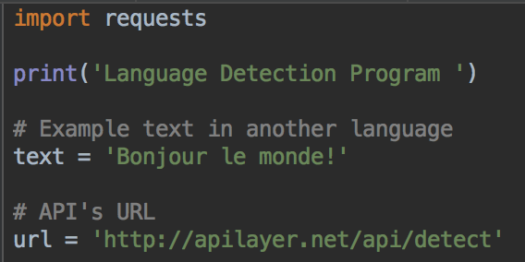
We know the URL, so let's start with this code
Some example text, and save the URL in a variable in the program

Slide 29
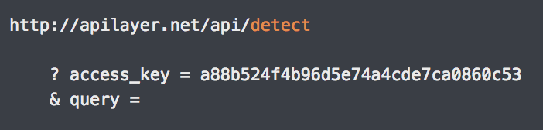
Query Parameters
access_key is your own access key
query is text to detect the language of ( "Bonjour monde" , for testing here)

Slide 30
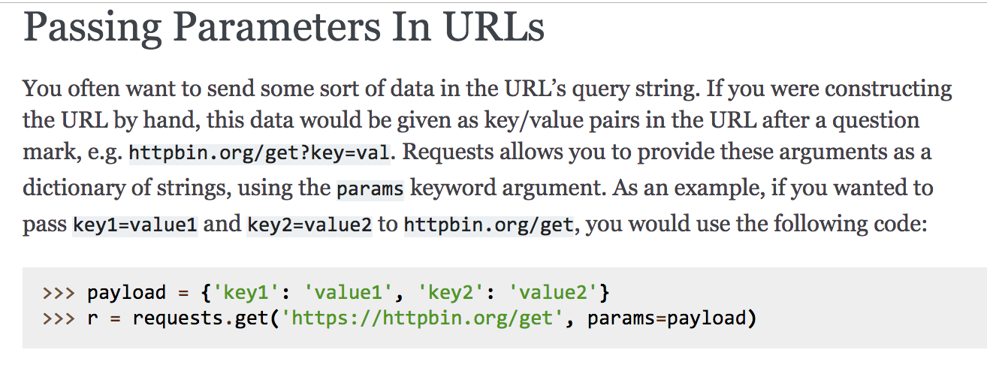
Query Parameters
Building the URL string from other strings is error prone
And we might need to change the city and country, so it would be nice to have more control over what query parameters are used
Requests is helpful - from their documentation:

Slide 31
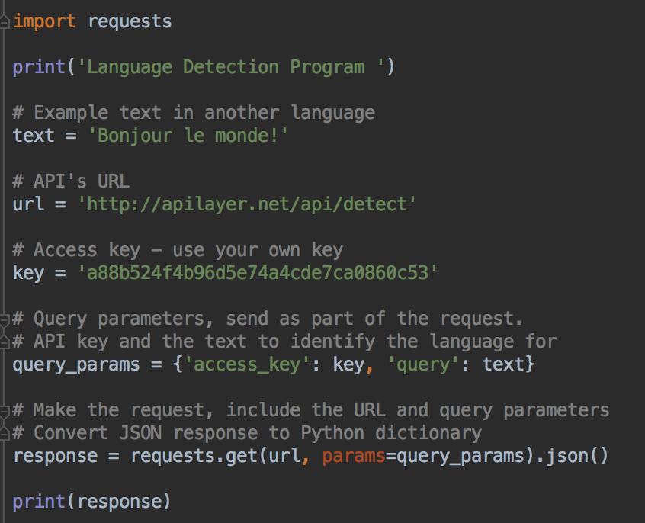
Now can make the request Store query parameters as a dictionary Provide as an argument to the requests.get function

Slide 32
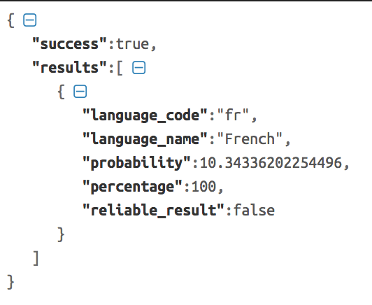
Run and test
Run your code
Same data, formatted
Notice there's a results key, it's value is a list of one item

Slide 33
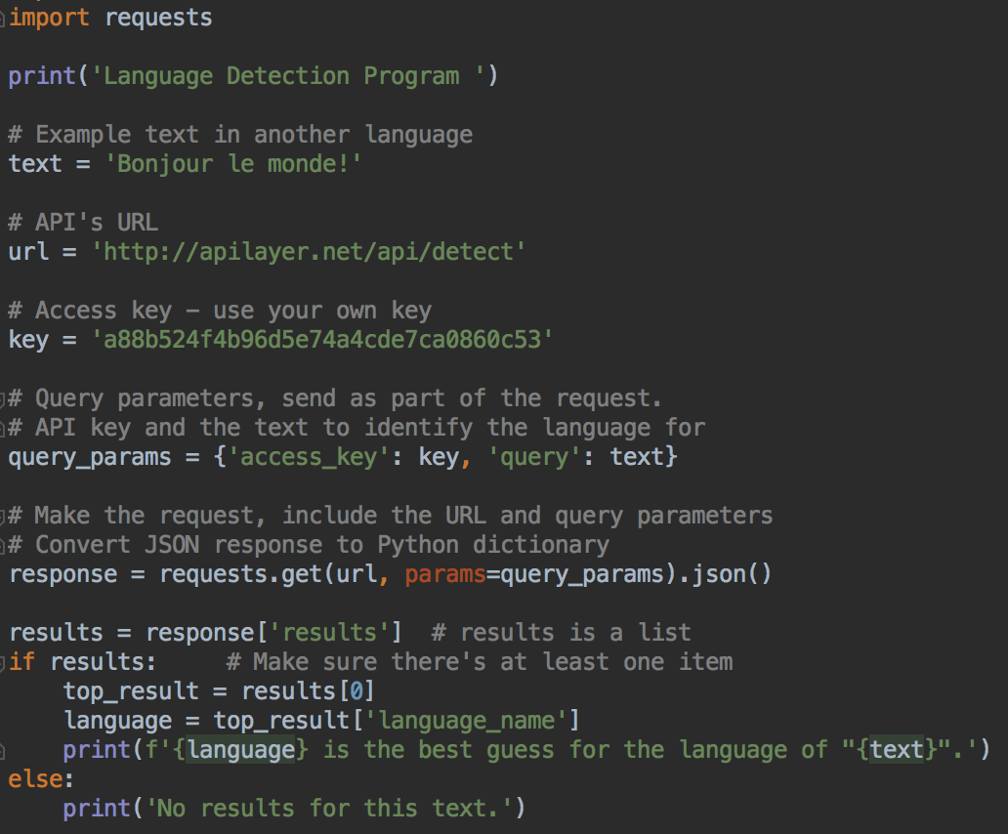
Display the best guess for the language
Empty lists are False in Python

Slide 34
Key Management
It's not a good idea to write your key in code
It's like a password
One solution: save the key in an environment variable

Slide 35
Environment Variables
A variable that your computer stores
Programs can read environment variables
Common solution to private data needed by programs, that should not be part of the codebase
Also used to store database access credentials, other secrets
And for high-level development settings
Run the program in development or production mode?
What port should the web server run on?

Slide 36
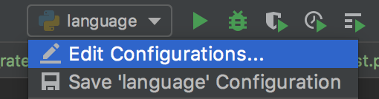
Environment variables, PyCharm
Run your code that expects to have an environment variable
Click on the name of the file you are running, menu bar, top right
Select Edit Configurations...

Slide 37
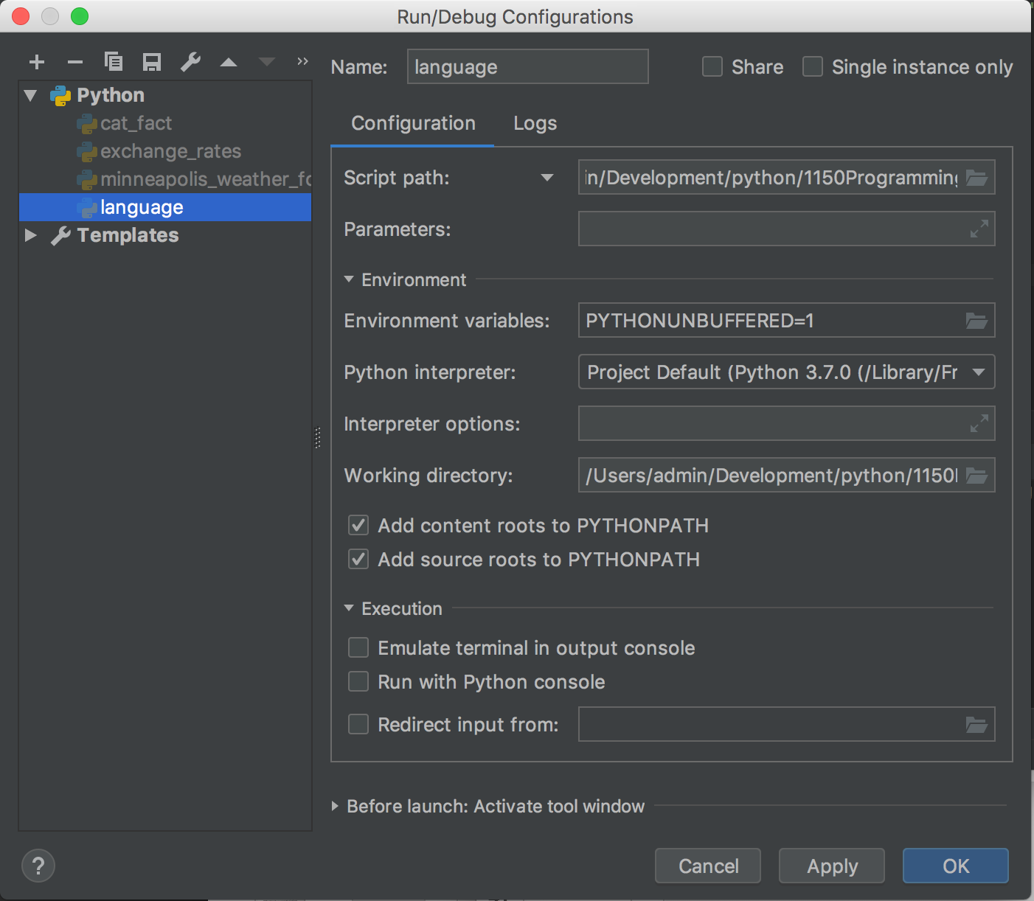
Environment variables, PyCharm
Click on the little folder on the right of the Environment Variables configuration to open the Environment Variables dialog

Slide 38
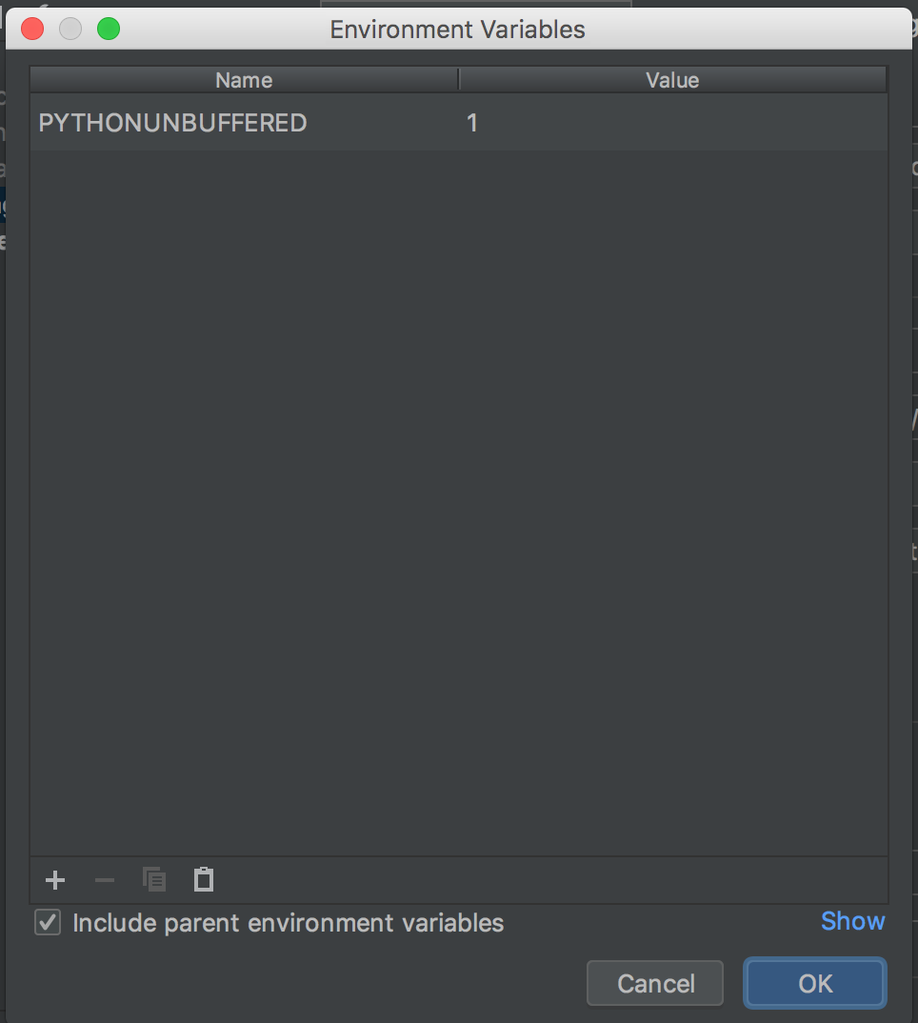
Environment Variables dialog
Click on the + button at the lower left of the window

Slide 39
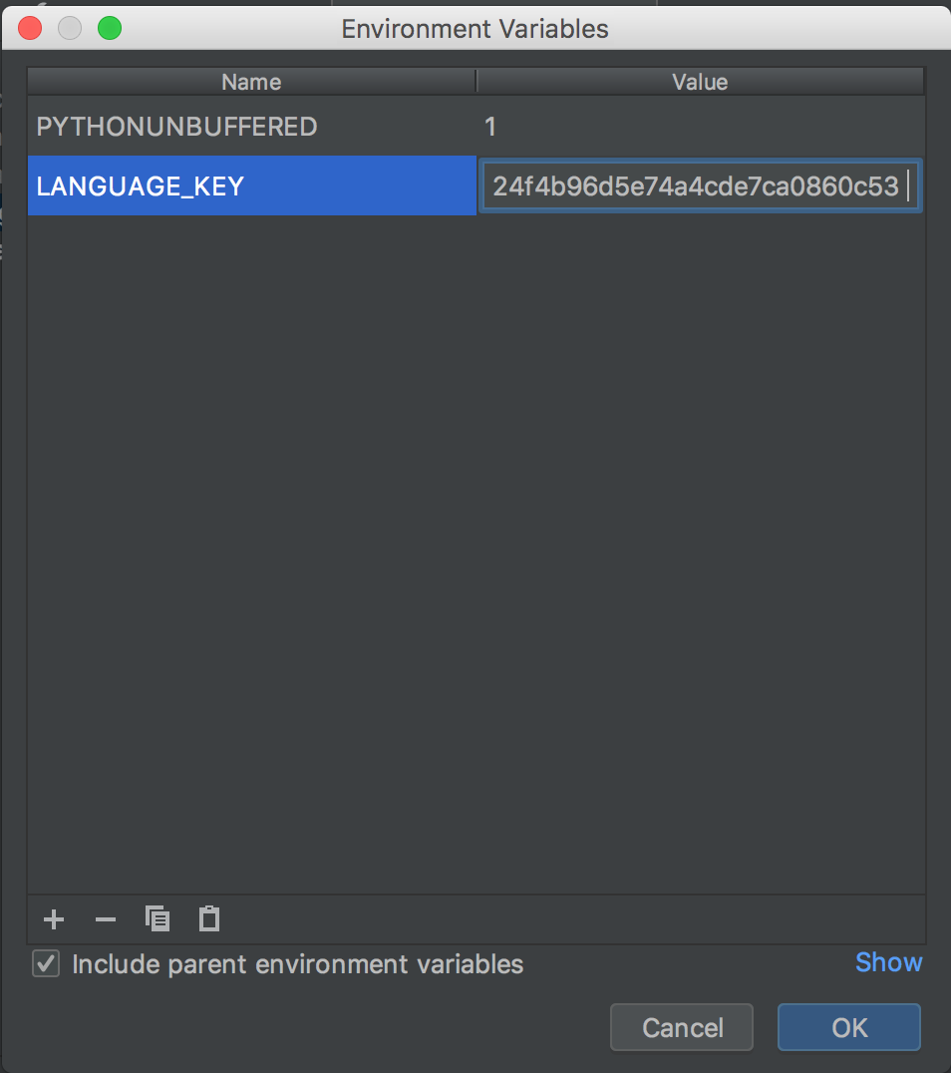
Create new environment variable
Enter LANGUAGE_KEY for the name
Past in your LangugeLayer key for the value
Make sure there are no extra spaces around the key
Click OK

Slide 40
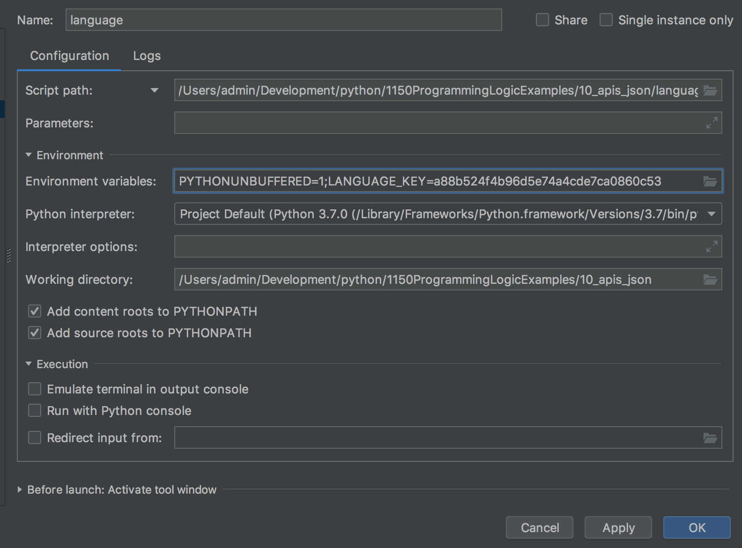
Verify key is set
Should see key in the Environment Variables
Click Apply and OK

Slide 41
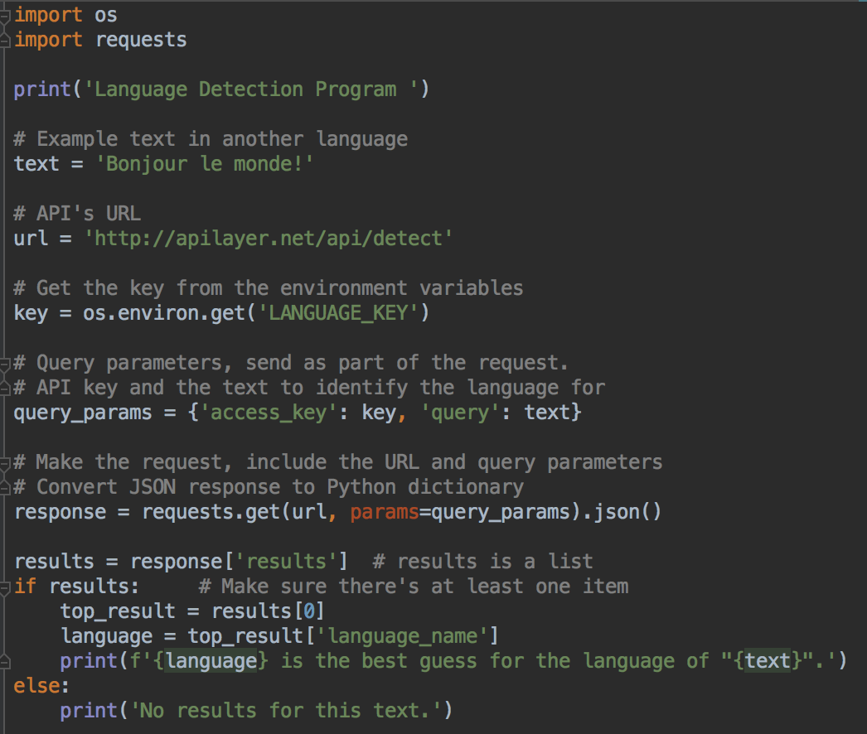
Reading environment variable
import os
Instead of coding the key, read from the environment variables
Program should work as before, but your key is more secure

Slide 42
100's of other APIs
A list https://github.com/toddmotto/public-apis

