Slide 1
APIs

Slide 2
How do different computer systems talk to each other?
Scenario to consider:
An e-commerce retailer. Which systems may work together to display products (with reviews, similar product suggestions) on pages, take orders, process orders, ship orders... ?
Typical IT infrastructure has many separate systems that communicate as needed

Slide 3
Many ways to connect systems
Message Passing https://en.wikipedia.org/wiki/Message_passing
CORBA - turning objects from one programing language into objects in another programming language
PubSub https://en.wikipedia.org/wiki/Publish%E2%80%93subscribe_pattern
But one of the most common is via HTTP - RESTful APIs

Slide 4
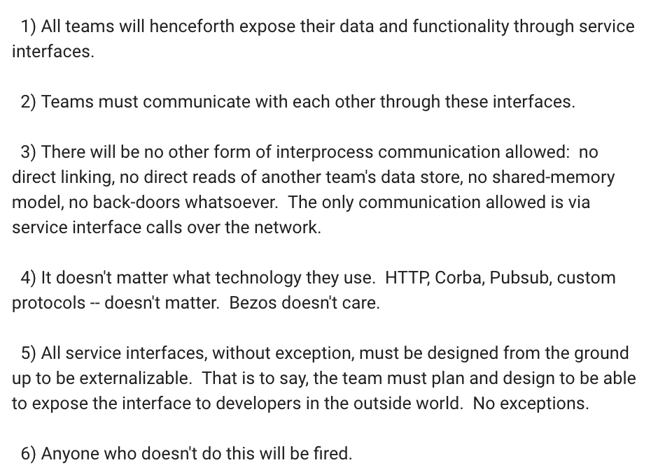
Amazon
Mandate from Jeff Bezoz, circa 2002
Required all the internal systems to communicate and externalize data via services
In other words, everything has a structured way to communicate with other services
How's Amazon doing today?
https://plus.google.com/+RipRowan/posts/eVeouesvaVX

Slide 5
HTTP
HTTP is the protocol used for browsers to request web pages, and for servers to send pages, images, other resources in response
Can also use HTTP to send requests from your program to another computer, somewhere else on the network (or internet)
The other computer can respond with data of some kind - a file, text, error message, or JSON
See Mini topics > JSON in D2L for background on JSON

Slide 6
HTTP Requests with requests
Python has built-in libraries for making HTTP requests but it's a little clunky to use
So we'll use the requests library instead which is really nice
Create a virtual environment, activate it, and install requests with
pip install requests
http://docs.python-requests.org/en/master/
See installing peewee slide from databases for correct version of the pip command for your computer

Slide 7
First HTTP request
We need a random cat fact
So we need a random cat fact service
Let's use the https://catfact.ninja API

Slide 8
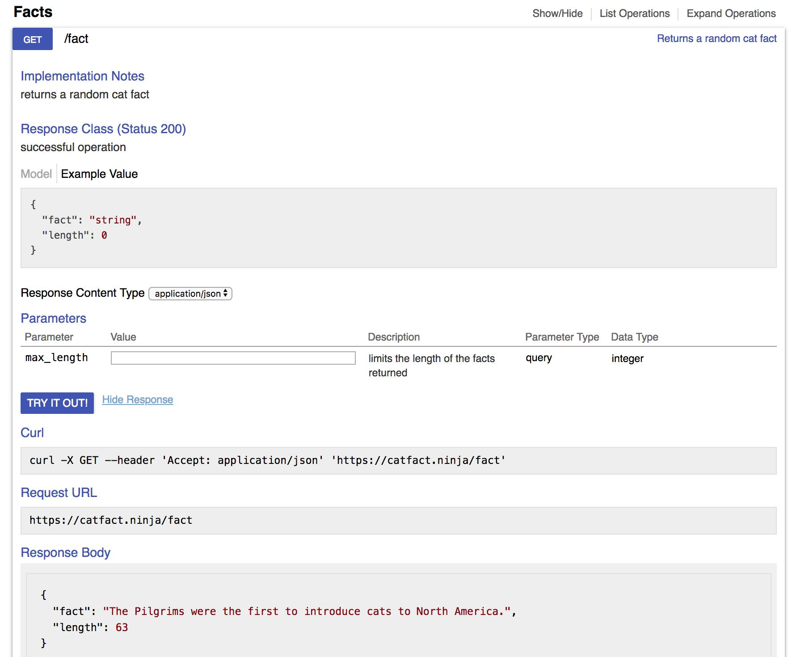
Using an API
Step 1: read the documentation to figure out what request to make
There's an example URL
Paste it into your browser address bar to see what happens

Slide 9
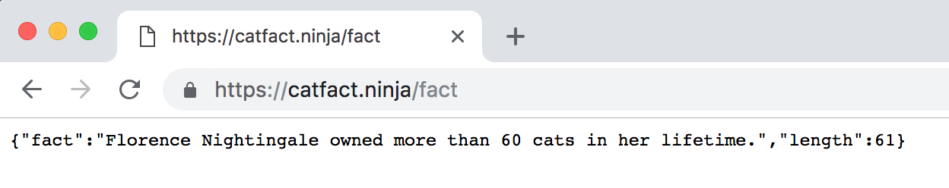
Step 2: Test out the API
Test in browser or with curl
Looks like a random cat fact
What format is the data in?
JSON response - plain text but formatted to be readable by computers. Looks like a Python dictionary

Slide 10
Step 3: How is the response structured?
Note the JSON has keys "fact" and "length".
We are interested in the fact

Slide 11
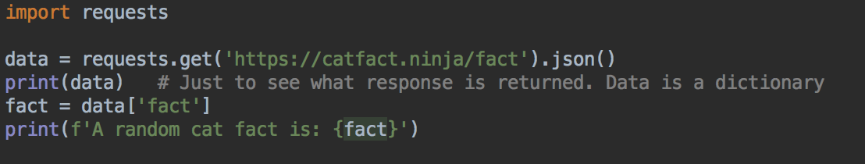
Step 4: Use in program
Import requests
Make request
Parse response into JSON, which is provided to your program as a dictionary
Use response in program

Slide 12
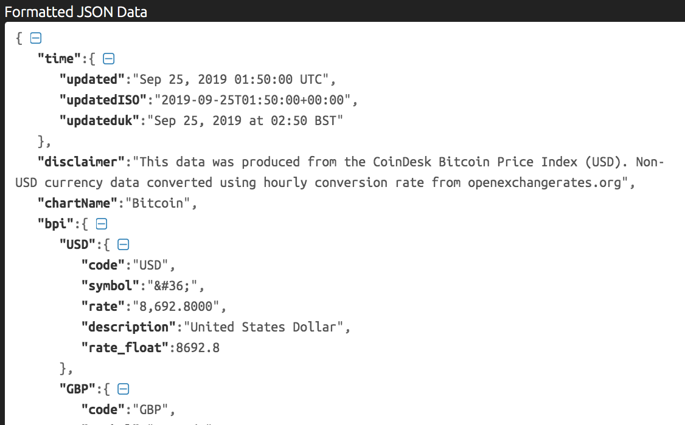
Your Turn: Bitcoin Price API
Write another program to get the current Bitcoin price using an API like https://www.coindesk.com/api
The user should be able to enter a number of Bitcoin. Your program will calculate and display their value in USD
A JSON formatter, for example, https://jsonformatter.curiousconcept.com/ is helpful to make sense of the response
You need this rate value

Slide 13
API Keys
These APIs are unusual because you don't have to authenticate to use the service
Most APIs are restricted to authorized users
Why?
Either with OAuth - equivalent of a username and password
Or require a key to access - less security but still useful for managing and monitoring users

Slide 14
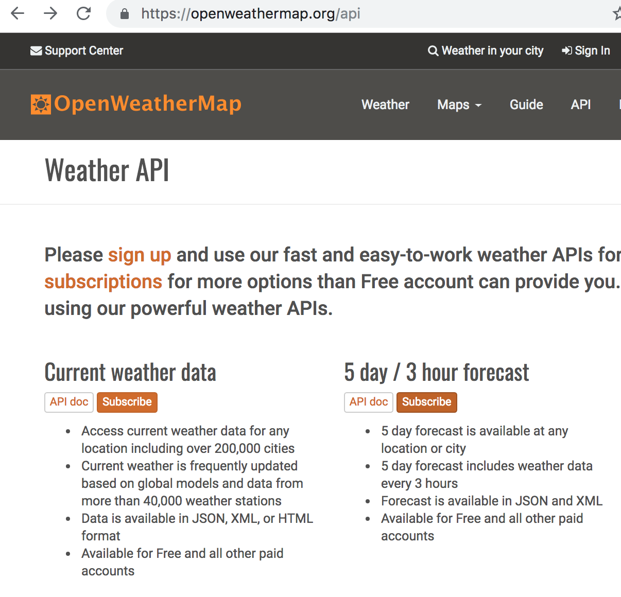
API Keys - Weather
Let's check the weather forecast
https://openweathermap.org/api
Sign up for an account, sign in Subscribe to the 5 day/ 3 hour forecast
Also open the API docs for this service

Slide 15
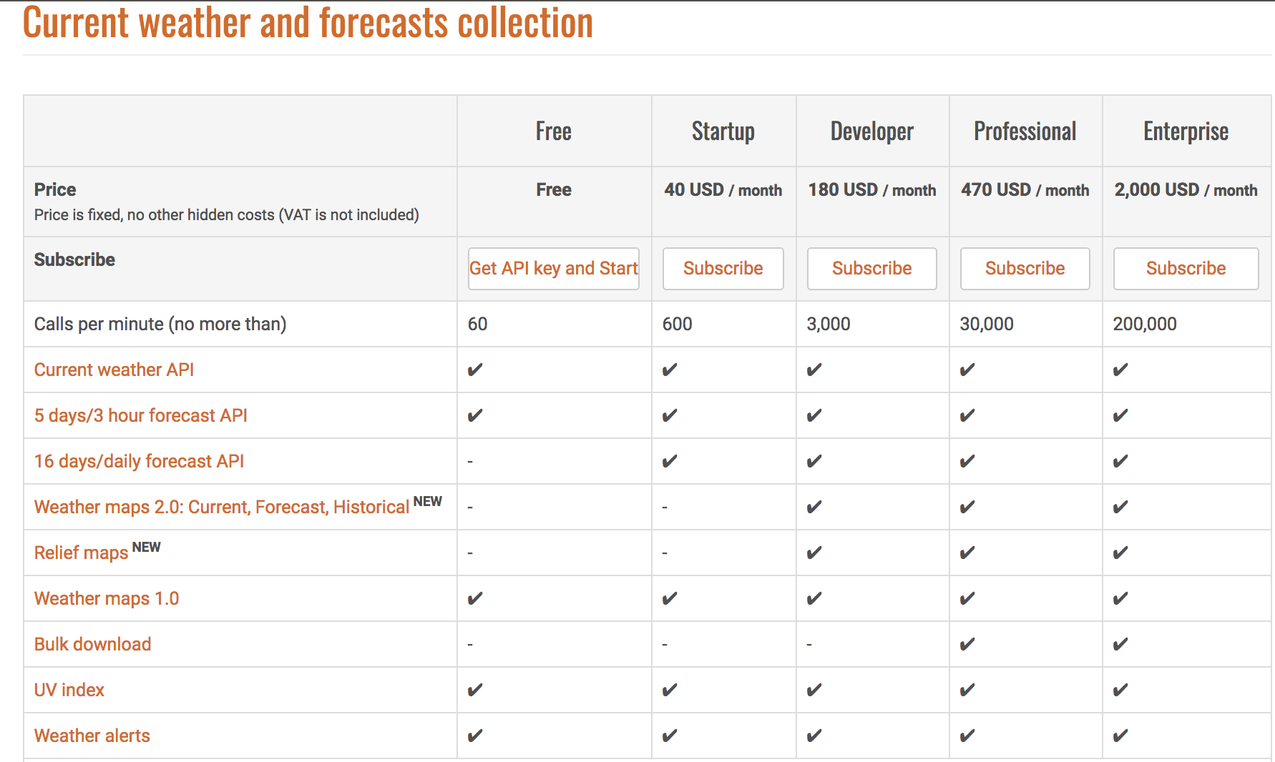
Subscribe to free service
Click Get API key and start
Notice the different levels of service have different pricing
Should take you to keys page, if not
https://home.openweathermap.org/api_keys

Slide 16
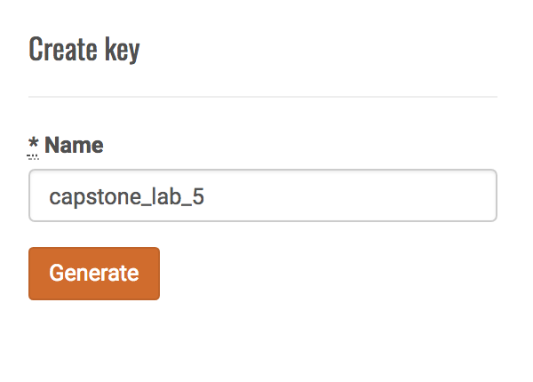
Enter a name for your key and click generate
Developers may need many keys for different services
Copy your key, or leave this page open
This key is like a password to access the API on your behalf, so you should keep it private
You can always check your key in your account

Slide 17
What's the current weather for Minneapolis?
Let's read the docs https://openweathermap.org/forecast5
From the examples, it looks like we need to create a URL in this format for the Paris, France, forecast
But with KEY replaced by your key
The URL includes data as parameters, key=value pairs
http://api.openweathermap.org/data/2.5/weather?q=paris,fr&appid=KEY
Path to resource
parameters
Follow a ?
name=value pairs
separated by &

Slide 18
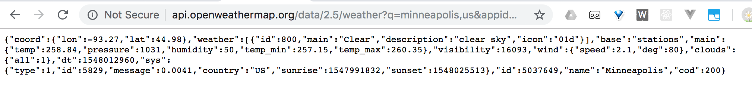
APIs - Parameters
Create a URL like the one on the previous page
Replace paris,fr with minneapolis,us
Replace KEY with your own key
Try this URL in your browser. What response do you get?
Try pasting the response into JSON Formatter to help see the structure

Slide 19
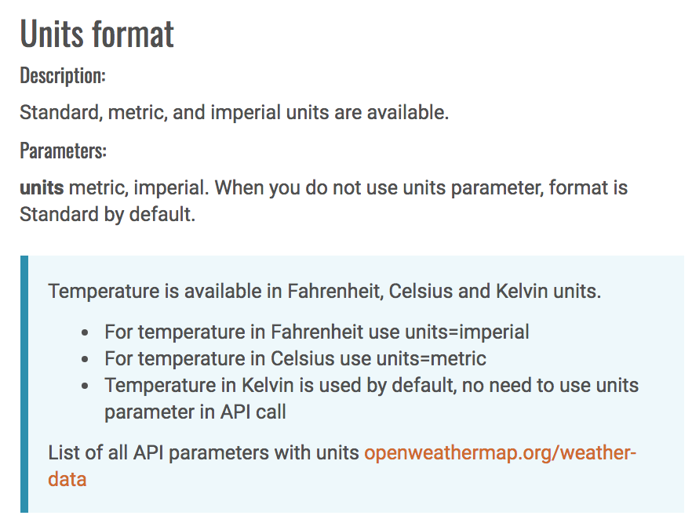
Documentation
Look at the temperatures - looks odd? By default, the temperatures are in standard temperature units called Kelvin
Should we convert in code?
Let's check the documentation first
If we add another parameter we can set the units to something more readable
Since we are in the US, let's use imperial or US measurements for Fahrenheit (although if you prefer Celsius, use metric)
So your URL will look like this
http://api.openweathermap.org/data/2.5/weather?q=paris,fr&units=imperial&appid=KEY
add units=imperial or units=metric parameter

Slide 20
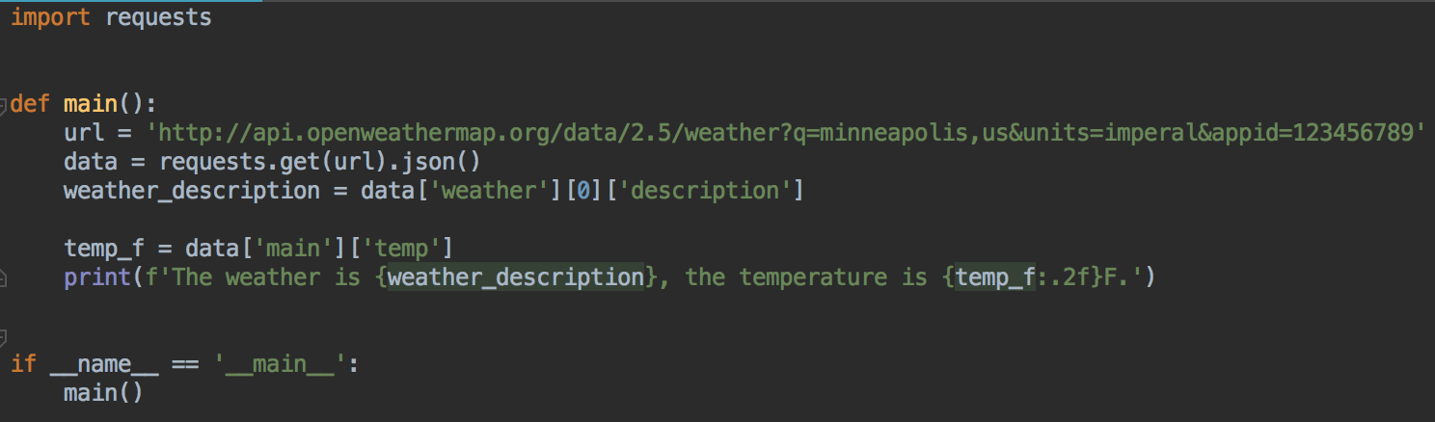
Use in program
Replace the 123456789 key with your own
If you used metric, then adjust the print statement to print C instead of F

Slide 21
Key Management
It's not a good idea to write your key in code
How can you keep the key secret and push code to GitHub?
Keys can change - you might have a different key for development and for the real product
If the key is compromised (e.g. it accidentally got published to GitHub) it needs to be deleted and a new key re-issued
One solution: save the key in an environment variable

Slide 22
Environment Variables
A variable that your computer stores
Programs can read environment variables
Common solution to private data needed by programs, that should not be part of the codebase
Also used to store database access credentials
And for high-level development settings
Run the program in development or production mode?
What port should the web server run on?
Remember how to set an environment variable on your computer
You'll need to set environment variables several more times in this class

Slide 23
Temporarily Setting an Environment Variable
Temporarily, in the terminal/command prompt you will run your Python code from
Replace 123456789 with your actual key
When you close this terminal/command prompt, the environment variable will be forgotten
MAC
export WEATHER_KEY=123456789
PC
set WEATHER_KEY=123456789
To verify on Mac
- Print WEATHER_KEY
echo $WEATHER_KEY
- Print all environment variables
env
To verify on PC
- Print WEATHER_KEY
echo %WEATHER_KEY%
- Print all environment variables
set

Slide 24
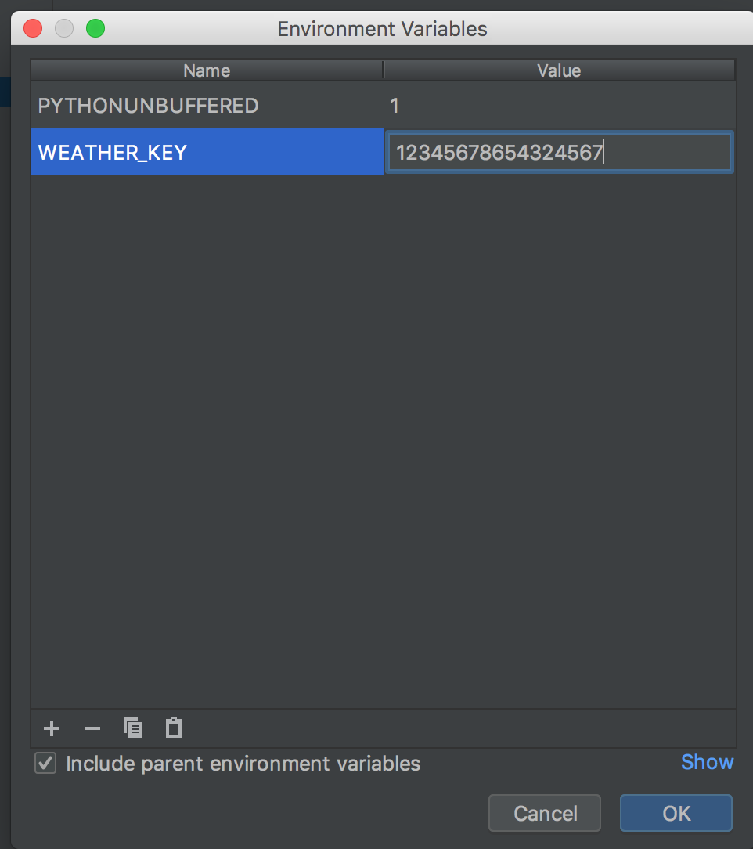
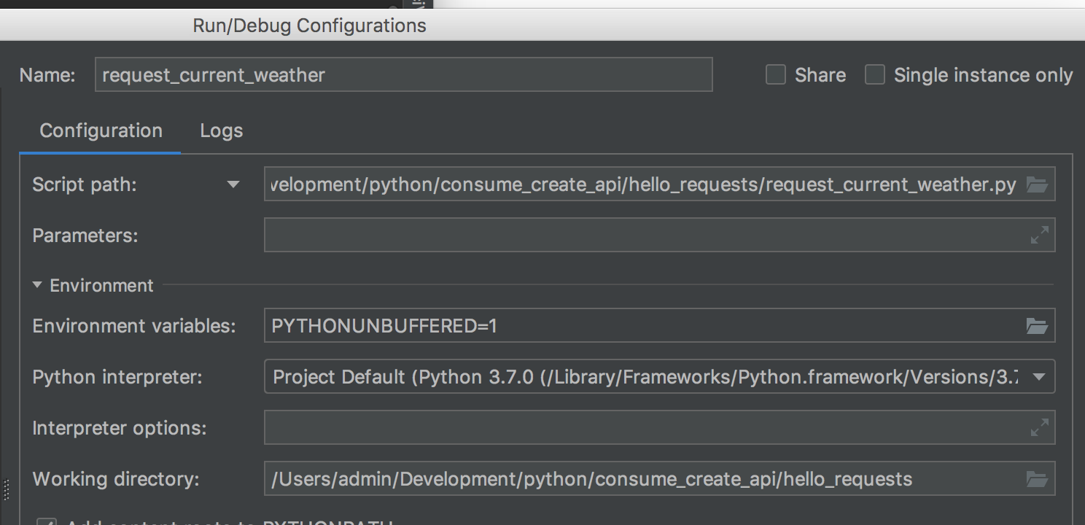
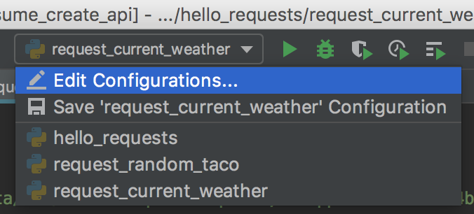
Environment variables, PyCharm
Run your code that expects to have an environment variable
Click on the name of the file you are running, menu bar, top right
Select Edit Configurations, Environment Variables, Add
Environment variable will be set when you run this
code by clicking the play button for the configuration

Slide 25
Environment Variables, Set Permanently (until you change it)
Mac: edit your ~/.bash_profile file and add the same command from the previous slide. Start a new terminal or run source ~/.bash_profile to apply the new variable
PC: in your advanced computer systems, look for the environment variables setting https://www.computerhope.com/issues/ch000549.htm#windows8
Lab PCs don't have permission to set environment variables
Set temporarily, or in PyCharm

Slide 26
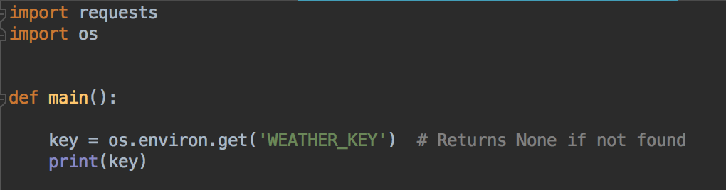
Reading environment variable
Set an environment variable called WEATHER_KEY
In your code, import os, and read environment variable
Temporarily print it out, to verify it was read correctly
Add this to the start of your main method, rest of your program follows

Slide 27
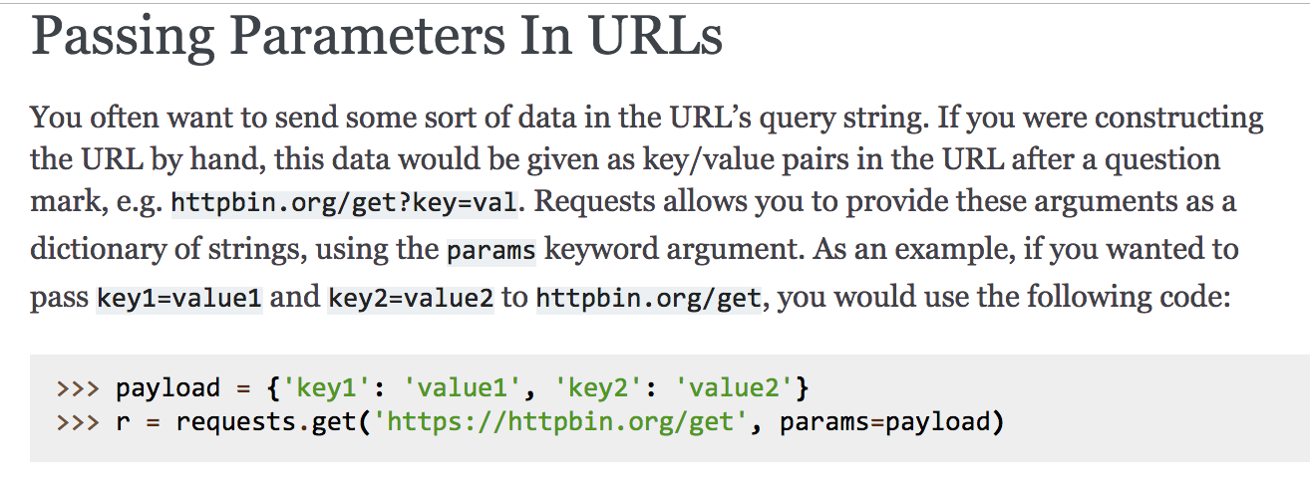
Query Parameters
Building the URL string from other strings is error prone
And we might need to change the city and country, so it would be useful to have more control over what query parameters are used
Requests is helpful - from their documentation:

Slide 28
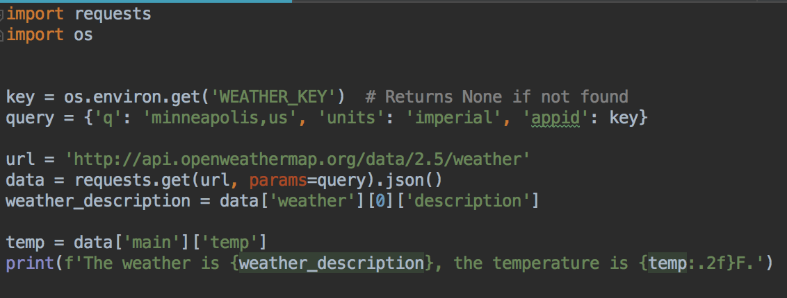
Query Parameters
Modify your main function
Modify the URL - just need the base now
Query parameters in a dictionary
More readable
Your turn: check if the key is None after reading it. If it is None, end the program, print an error message, don't try to make the request

Slide 29
Your Turn
Ask the user what city, and country (as a two-letter country code) they would like the weather for
Use that instead of the hard-coded 'minneapolis,us'
Run and test
List of country codes https://en.wikipedia.org/wiki/List_of_ISO_3166_country_codes

Slide 30
Error Handling
Anyone's code crashed yet?
Why?
What else might go wrong?
You'll add some error handling in lab
Example with some error handling in the code repo for this week

Slide 31
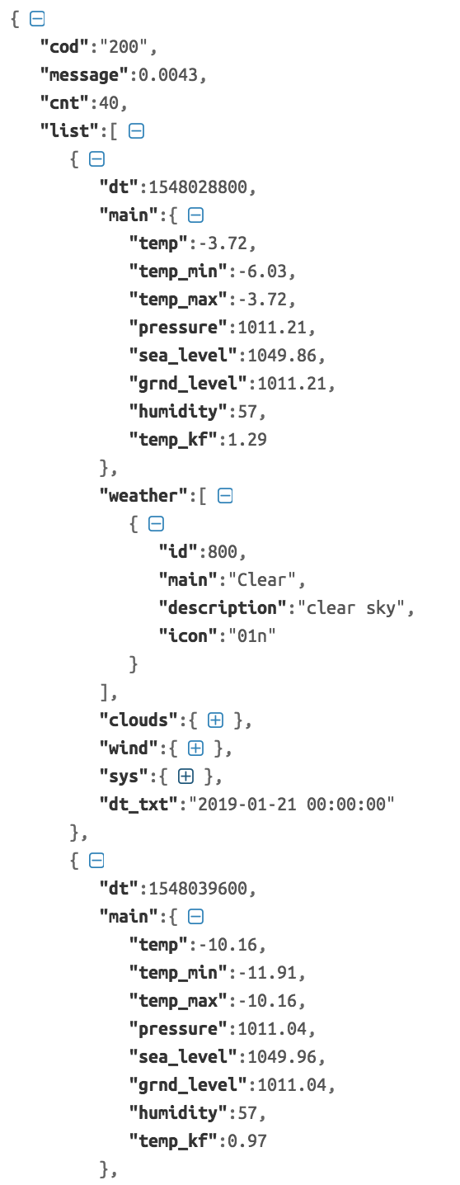
Other requests
Can request a forecast
Returns the five-day forecast in 3-hour increments
Try out this URL
http://api.openweathermap.org/data/2.5/forecast?q=minneapolis,us&units=imperial&appid=KEY
Part of the forecast response
The list attribute is a list, that you can loop over in Python

Slide 32
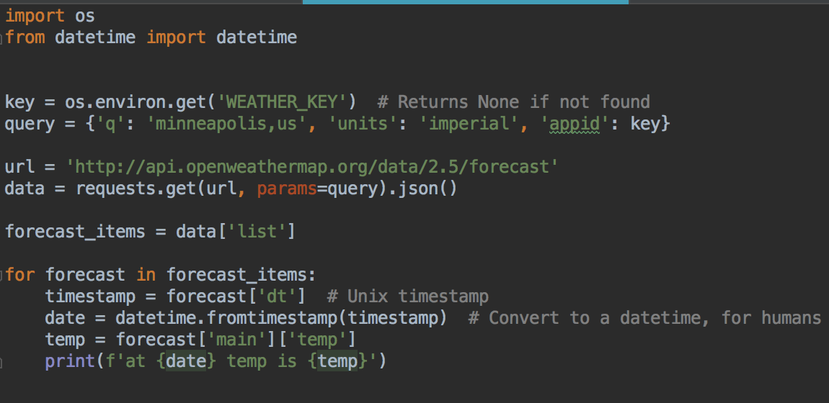
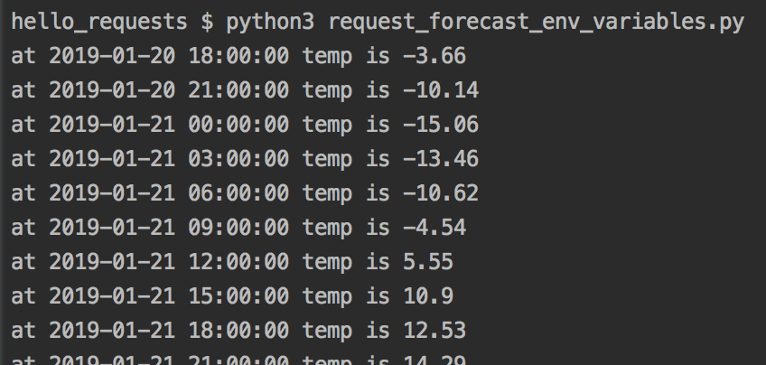
So we could process it like this
There is a dt_txt attribute for every forecast item in the list, but these times are in the UTC timezone. Converting from the timestamp into a datetime will give us a local Minnesota time.
Neither solution is perfect - times and time zones are hard.
See extra materials in D2L on time and timezones.

Slide 33
Other requests - POST, PATCH, DELETE
There are different methods you can use to make a HTTP request
This tells the server if you want to get data, or update data, or you've got a new data item to save....
So far, we've fetched data using a GET request
If you are using a social media app, and you write a new status, your browser will make a POST request to the server to create a new status in your account
If you edit your status, your browser will make a PATCH request to update your status
If you regret everything and want to delete your status, when you click the delete button, your browser will make a DELETE request

Slide 34

Exercise - Star Wars Stats
Can you use the SWAPI API to find out how much R2-D2 weighs?
Once you have his information, can you make another query to find out the name of the planet he is from?
https://swapi.co/

Slide 35
Exercise - Weather Forecast
Use the forecast API to create a neatly formatted 5-day forecast, for anywhere the user chooses.
Make sure your program does not use your API key. It should read the key from an environment variable.
Your forecast should show the temperature and unit (F or C), weather description, and wind speed for three hour intervals over the next 5 days.

