Slide 1
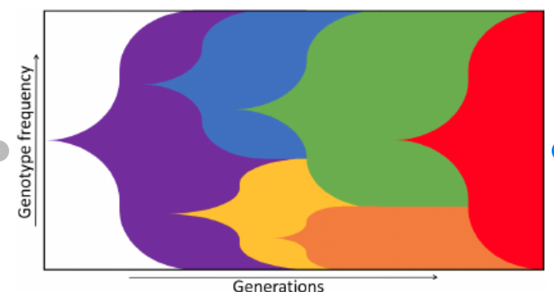


Slide 2
Blending with website header color
Hex# of website header: #7cc7bb

Slide 3
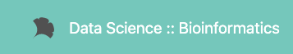

Slide 4


Slide 5


