Slide 1
yeast knockout analyses

Slide 2
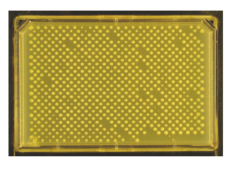
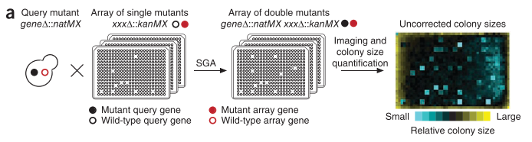
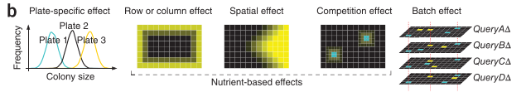
kuzmin et al experimental setup
focused on deleterious negative trigenic interactions
more accurately scored than positive interactions?
“generally more functionally informative than positive digenic interactions”? so more mechanistic insight into function/wiring
Collins … Weissman 2006, Genome Biology
﻿Baryshnikova et al 2010, Nature Methods

Slide 3

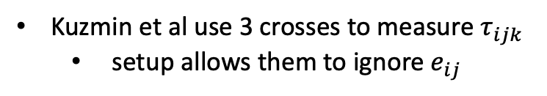








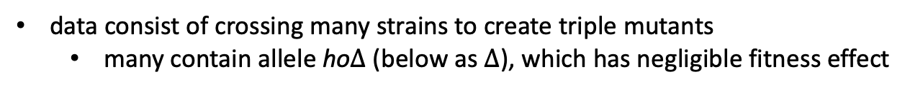

kuzmin et al experimental setup
$$τ_{ijk}$$
$$e_{ij}$$
data consist of crossing many strains to create triple mutants
many contain allele ho$∆$ (below as $∆$), which has negligible fitness effect
$$f_{i}$$
$$f_{j}$$
$$f_{k}$$
$$e_{jk}$$
$$e_{ik}$$
Kuzmin et al use 3 crosses to measure $τ_{ijk}$
setup allows them to ignore $e_{ij}$
Crosses
$f_{i∆}$ X${ f}_{k}$
$f_{j∆}$ X${ f}_{k}$
$f_{ij}$ X${ f}_{k}$
measure ${f_{i},f_{j}, e}_{ik}$, $e_{jk}$
measure $τ_{ijk}$
“query”
strain
“array”
strain

Slide 4









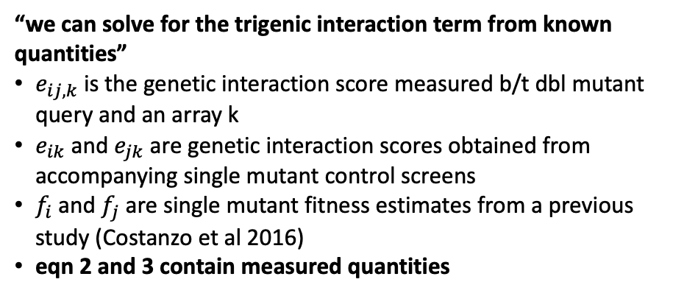






the $τ−SGA$ score
$$τ_{ijk}$$
$$e_{ij}$$
$$f_{i}$$
$$f_{j}$$
$$f_{k}$$
(1)
$τ_{ijk}=f_{ijk}−f_{i}f_{j}f_{k} − e_{jk}f_{i}− e_{ik}f_{j}$ $− e_{ij}f_{k}$
$$e_{jk}$$
$$e_{ik}$$
$f_{ijk}=f_{i}f_{j}f_{k}+{e_{ij}f_{k}+e}_{jk}f_{i}+ e_{ik}f_{j}$ $+ τ_{ijk}$
$$τ_{ijk}$$
*all interactions (in blue) from crossing dbl mutant ij with single mutant k
(2)
$$e_{ij,k}=f_{ijk}−f_{ij}f_{k}$$
$$e_{ij}$$
$$f_{i}$$
$$f_{j}$$
$$f_{k}$$
$$e_{ij,k}=f_{ijk}−{(f}_{i}f_{j}+e_{ij})f_{k}$$
$$e_{jk}$$
$$e_{ik}$$
$$e_{ij,k}=f_{ijk}−f_{i}f_{j}f_{k}−e_{ij}f_{k}$$
$$f_{ijk}=f_{i}f_{j}f_{k}+e_{ij}f_{k}+e_{ij,k}$$
“we can solve for the trigenic interaction term from known quantities”
$e_{ij,k}$ is the genetic interaction score measured b/t dbl mutant query and an array k
$e_{ik}$ and $e_{jk}$ are genetic interaction scores obtained from accompanying single mutant control screens
$f_{i}$ and $f_{j}$ are single mutant fitness estimates from a previous study (Costanzo et al 2016)
eqn 2 and 3 contain measured quantities
$$∴e_{ij,k} =e_{jk}f_{i}+e_{ik}f_{j}+τ_{ijk}$$
(3)
$$τ_{ijk} ={e_{ij,k} − e}_{jk}f_{i}−e_{ik}f_{j}$$

Slide 5
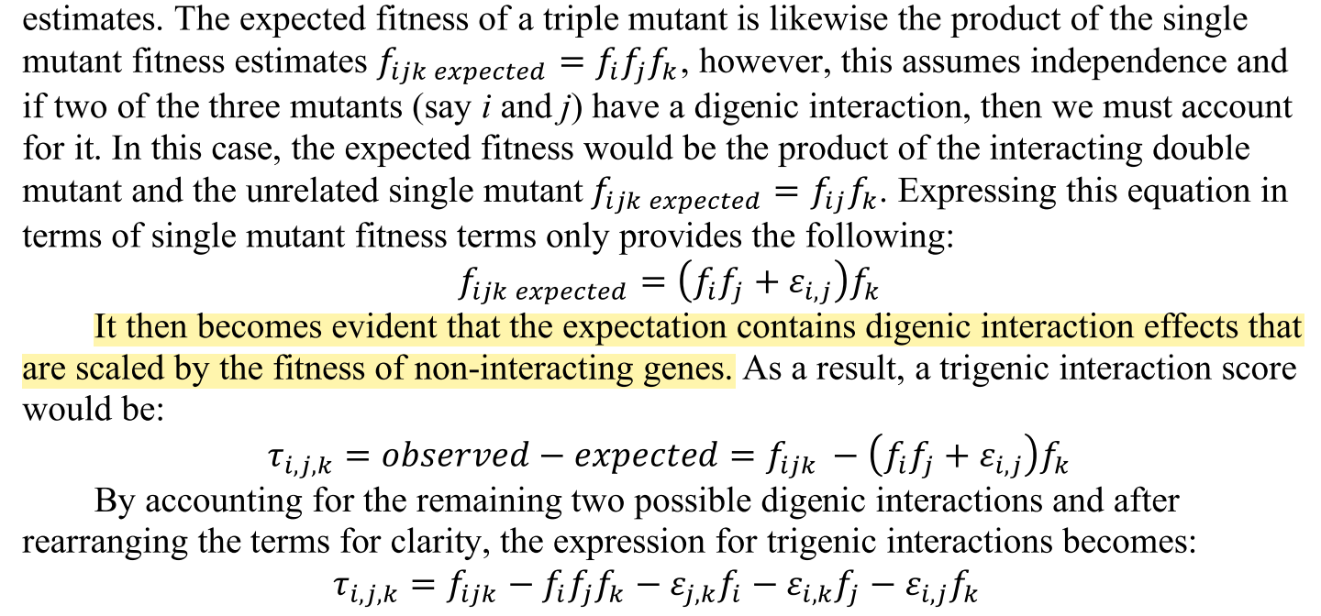
pairwise epistatic coefficients scaled by fitness of noninteracting gene?
their verbal derivation of their formula
conclusion: combining multiplicative and additive scales at the pairwise interaction level creates strange scalings for higher-order dependencies?

Slide 6


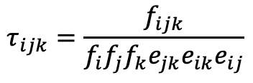


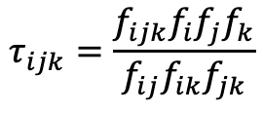
multiplicative version, from scratch
$$τ_{ijk}$$
$$e_{ij}$$
$$f_{i}$$
$$f_{j}$$
$$f_{k}$$
$$f_{ijk}=f_{i}f_{j}f_{k}e_{jk}e_{ik}e_{ij}τ_{ijk}$$
$$e_{jk}$$
$$e_{ik}$$
solve for tau
$$τ_{ijk}$$
$$τ_{ijk}=\frac{f_{ijk}}{f_{i}f_{j}f_{k}e_{jk}e_{ik}e_{ij}}$$
$$e_{ij}$$
$$f_{i}$$
$$f_{j}$$
$$f_{k}$$
$$e_{jk}$$
$$e_{ik}$$
$$e_{ij} =\frac{f_{ij}}{f_{i}f_{j}}$$
$$e_{ik} =\frac{f_{ik}}{f_{i}f_{k}}$$
$$e_{jk} =\frac{f_{jk}}{f_{j}f_{k}}$$
plug in multiplicative epistasis
$$τ_{ijk}=\frac{f_{ijk}f_{i}f_{j}f_{k}}{f_{ij}f_{ik}f_{jk}}$$

Slide 7
part 1
replicate their results to prove we understand their data

Slide 8
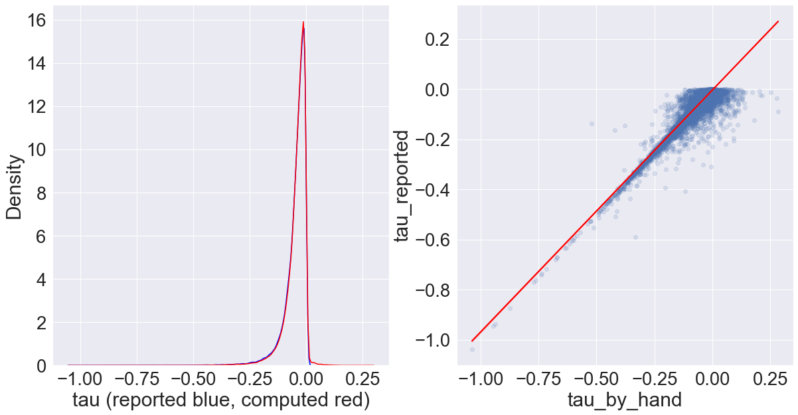
I can’t replicate their results, but I get close?
statistic | tau_reported | tau_by_hand
mean | -0.046795 | -0.043689
median | -0.032901 | -0.031430
std | 0.0521378 | 0.0485061
tau_reported: a column in their data table S1
tau_by_hand: me calculating tau according to description in supplement, grabbing some quantities from Costanzo et al2016
note: blue (reported results) and red (my recalculation) curves overlap too much to be useful here
Pearson correlation b/t reported results and my re-calculations: 0.962393
*all measurements have variability, I might be pulling values from diff table

Slide 9
part 3
comparing results using their formula and standard multiplicative/additive formula

Slide 10
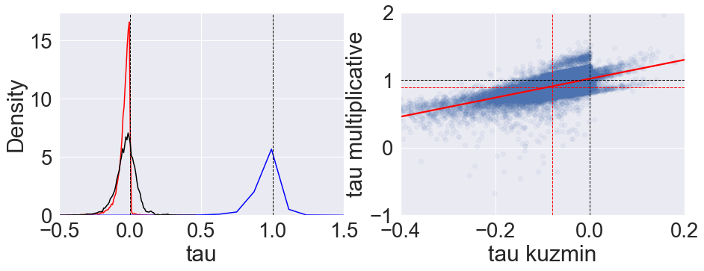
Kuzmin formula vs multiplicative and additive models
Pearson correlation: 0.58574
kuzmin formula (red) , additive model (black), multiplicative model (blue)
calculated significance threshold for multiplicative model using a quantile that corresponded to their cutoff value of -0.08 on their scale
red dashed lines: significance thresholds
black dashed lines: value where epistasis switches signs from negative to positive

Slide 11
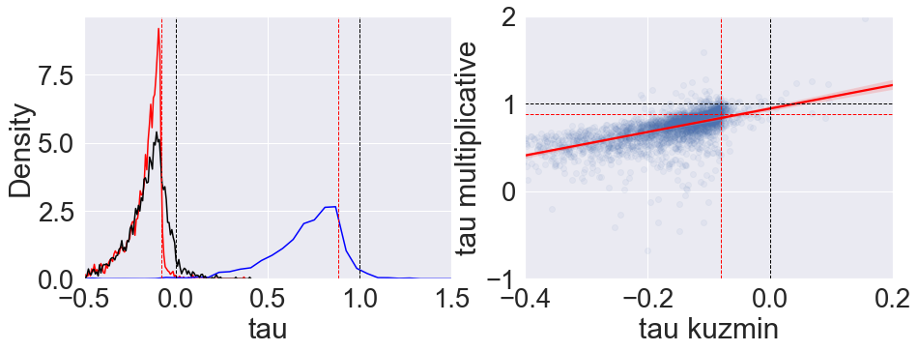
same as previous slide, but only for their ~3k interactions they report as “significant”
Pearson correlation: 0.5235
kuzmin formula (red) , additive model (black), multiplicative model (blue)
calculated significance threshold for multiplicative model using a quantile that corresponded to their cutoff value of -0.08 on their scale
red dashed lines: significance thresholds
black dashed lines: value where epistasis switches signs from negative to positive

Slide 12
epistasis sign switches
 |  | multiplicative model
 |  | “positive” (> 1) | “negative” (< 1) | Total
kuzmin model | positive (> 0) | 1199 | 711 | 1910
 | negative (< 0) | 23988 | 60213 | 84201
 | Total | 25187 | 60924 | 86111
86111, less than 91111 total because 5k nan’s
Notes:
multiplicative model has many more “positive” trigenic interactions (~1/3 of total) compared to mixed model (~2%)
like any two methods to quantify interactions, they won’t give exactly the same results but correlated results. Thus, if you were to select only negative results on one scale, some of these are going to be positive on another scale.

Slide 13
statistical significance
False positives?
They use a threshold of -0.08, such that trigenic interaction scores below this are significant
This corresponds to the ~16% quantile of their distribution
The value on the multiplicative scale that corresponds to this quantile is ~0.88 (< 1 is negative interaction)
~14% of their significantly negative results (using their formula) are above the 0.88 significance threshold on the multiplicative scale
their reported false positive rate is 20%
TO DO: False negatives?
a little more tricky, not sure how they got their significant list b/c there are 13k trigenic interactions below their threshold of -0.08 but they only report ~3k
but I can still look at interactions that fall above -0.08 on their scale (not significantly negative) but are significantly negative on multiplicative scale
TO DO: what about interactions that we detect as significantly positive

Slide 14
to definitely do
make v. brief review (~3-5 sentences) of readings on additive vs multiplicative scales, put in overleaf
full additive, full multiplicative, multiplicative with additive interaction
redo a couple of Kuzmin et al’s analyses (simple correlations mentioned in results)
new trigenic interactions?
can we redo their validation and get better false positive/negative rates
look at Beerenwinkel et al 2007, explanation for “lines”, from mixing of scales?
to maybe do
See what studies have cited Kuzmin et al and used their data and/or formulae
google trigenic interactions, 3-way interactions
collect the diversity of ways people quantify epistasis (experimental studies, mutation correlation studies)
minDC score from another yeast trigenic study in Cell Reports (Haber et al 2013)
mutual information
was miscalculating higher order interactions a one-off mistake, or is it more systemic in literature?
could we advocate for a standard way to calculate epistasis for everyone to adopt?

Slide 15
lingering notes
easy to go between additive and multiplicative models, but a model that includes both scales can introduce novel scaling factors that don’t make sense (this could be phrased more elegantly)
Summary of ongoing epistasis efforts:
unifying epistasis
multivariate bernoulli
reanalysis of data
trigenic Kuzmin et al data, correcting results
reanalysis of beerenwinkel/lenski data
other large datasets generated more recently?

Slide 16
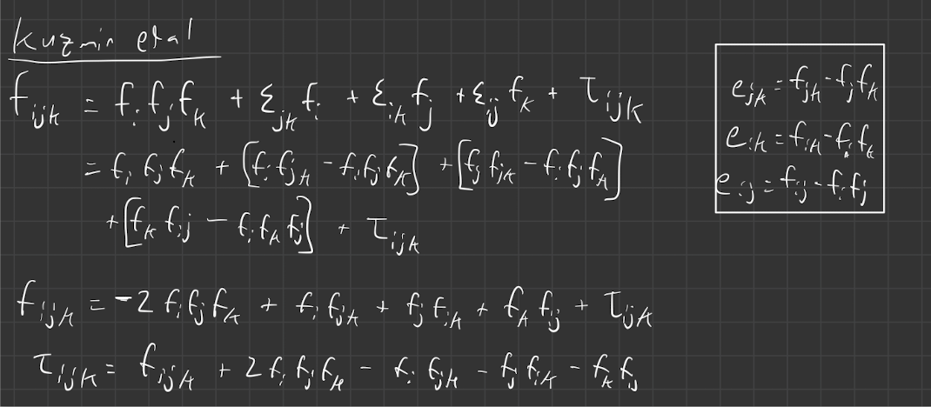
works that cited Kuzmin et al 2018
Tendler et al 2019
The Kuzmin et al 2018 equation is derived from an Isserlis Null model

Slide 17
Kuzmin 2020 paper

Slide 18
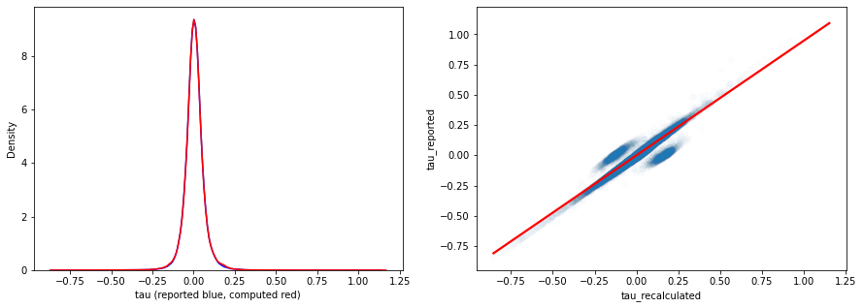
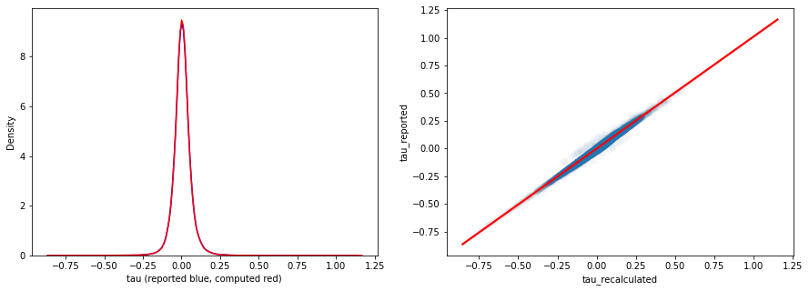



Kuzmin 2020 paper
$$τ_{ijk} ={e_{ij,k} − e}_{jk}f_{i}−e_{ik}f_{j}$$
where $e_{ij,k}=f_{ijk}−f_{ij}f_{k}$
$$τ_{ijk} ={f_{ijk}−f_{ij}f_{k}− e}_{jk}f_{i}−e_{ik}f_{j}$$
removing abs(recalculated – reported) > 0.1
leaves 98.9% of data, ~187k interactions
pearson corr = 0.997
Notes:
expand, cofirm it equals isserlis

Slide 19
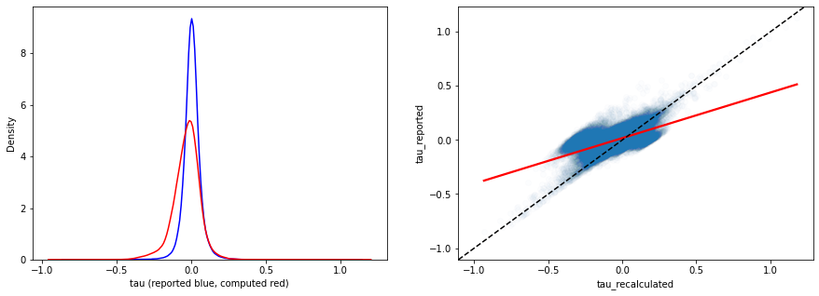
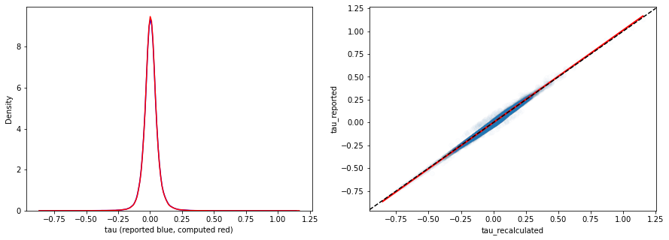

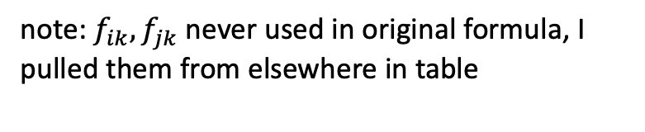


Kuzmin 2020 paper
using Isserlis formula instead
$$τ_{ijk} ={f_{ijk}+{2f_{i}f_{j}f_{k}− f}_{ij}f_{k}−f}_{ik}f_{j}−f_{jk}f_{i}$$
note: $f_{ik},f_{jk}$ never used in original formula, I pulled them from elsewhere in table
negative bias??
subtracting too much?
$$τ_{ijk} ={f_{ijk}−f_{ij}f_{k}− e}_{jk}f_{i}−e_{ik}f_{j}$$
$$τ_{ijk} ={f_{ijk}+{2f_{i}f_{j}f_{k}− f}_{ij}f_{k}−(f}_{i}{f_{k}+e_{ik})f}_{j}−{(f}_{j}f_{k}+ e_{jk})f_{i}$$
$f_{ik}≠{(f}_{i}f_{k}+ e_{ik})$ ??
$f_{jk}≠{(f}_{j}f_{k}+ e_{jk})$ ??
Notes:
this is strange and we should prolly understand it

Slide 20
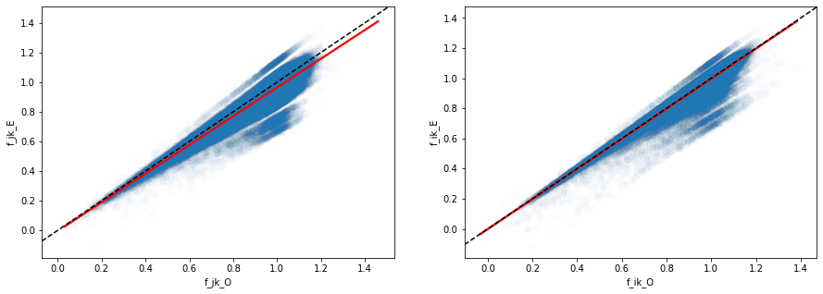




Kuzmin 2020 paper
$${f_{j}f_{k}− e}_{jk}$$
$${f_{i}f_{k}− e}_{ik}$$
$$f_{jk}$$
$$f_{ik}$$
measured value of double mutant systematically higher than expected based on how they calculate e,
substituting them in here leads to subtracting too much -> negative bias?
$$τ_{ijk} ={f_{ijk}+{2f_{i}f_{j}f_{k}− f}_{ij}f_{k}−f}_{ik}f_{j}−f_{jk}f_{i}$$

Slide 21
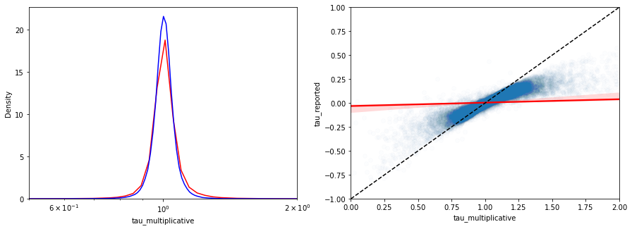
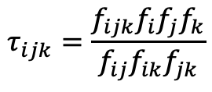
Kuzmin 2020 paper
solution
don’t use measured values of f_jk and f_ik
set e.g. f_jk = f_i*f_j + e_ij, where LHS is some imputed double mutant value
use to compute multiplicative tau_ijk
where
f_ij = f_i*f_j + e_ij
and e_ij_multiplicative = (f_i*f_j + e_ij)/ (f_i*f_j )
statistic | tau_reported | tau_multiplicative
mean | 0.0044771370 | 1.0127539478
median | 0.003783500000 | 1.0045042116
std | 0.05943114514 | 0.4070305624
$$τ_{ijk}=\frac{f_{ijk}f_{i}f_{j}f_{k}}{f_{ij}f_{ik}f_{jk}}$$
pearson corr = 0.24
note: log axis, reported shifted by +1
Notes:
spearman corr higher, how do ranks change?, list ranks in order, compare
just use the reported dbl mutant fitnesses, and compare their reported results with multiplicative formula
is there an additional measurement we aren’t using?
story: cumulant doesn’t measure multiplicative effects

Slide 22
7/6/2022 update

Slide 23

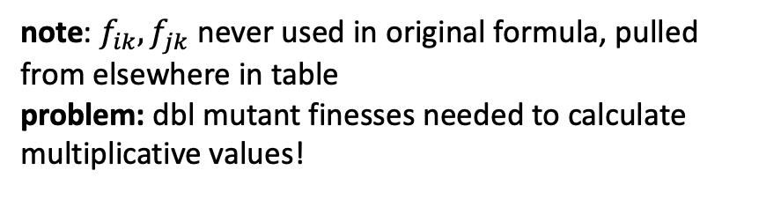
Kuzmin 2020 paper
original formula
$$τ_{ijk} ={f_{ijk}−f_{ij}f_{k}− e}_{jk}f_{i}−e_{ik}f_{j}$$
using cumulant formula instead
$$τ_{ijk} ={f_{ijk}+{2f_{i}f_{j}f_{k}− f}_{ij}f_{k}−f}_{ik}f_{j}−f_{jk}f_{i}$$
negative bias?
note: $f_{ik},f_{jk}$ never used in original formula, pulled from elsewhere in table
problem: dbl mutant finesses needed to calculate multiplicative values!
$$τ_{ijk} ={f_{ijk}+{2f_{i}f_{j}f_{k}− f}_{ij}f_{k}−(f}_{i}{f_{k}+e_{ik})f}_{j}−{(f}_{j}f_{k}+ e_{jk})f_{i}$$
$f_{ik}≠{(f}_{i}f_{k}+ e_{ik})$ ??
$f_{jk}≠{(f}_{j}f_{k}+ e_{jk})$ ??
Notes:
this is strange and we should prolly understand it

Slide 24
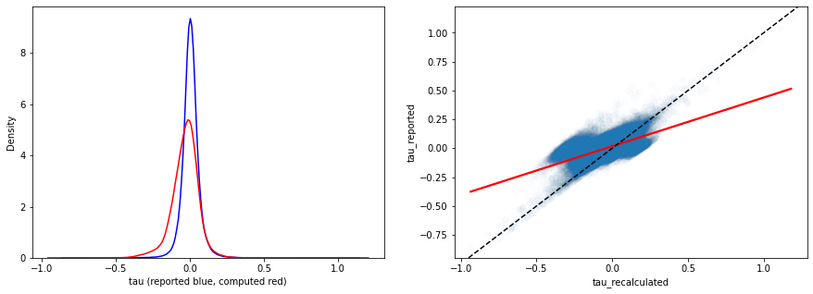
outlier analysis 1st pass: use “imputed” dbl mutant fitness
set
f_ik = f_i*f_k + e_ik
f_jk = f_j*f_k + e_jk
where LHS is imputed double mutant value
if I use reported values of f_ik and f_jk
then the multiplicative values are different from reported values b/c of different scales AND different input values
instead of comparing multiplicative values to reported values, could compare to recalculated cumulant values and use reported double mutant fitness in both calculations
but using reported f_ik and f_jk results in a negative bias w/ cumulant values, such that using their reported cutoff of +/- 0.08 results in many significantly negative interactions on cumulant scale (that weren’t originally reported) that aren’t significantly negative on the multiplicative scale, which we could report as false positive but…
using reported dbl mutant values

Slide 25
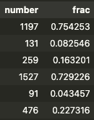
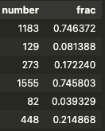
outlier analysis 1st pass: use “imputed” dbl mutant fitness
cmulant +/- 0.08
p < 0.05
mulitplicative 0.9,1.1
p < 0.05
both multiplicative and reported positive
both multiplicative and cumulant positive
only reported positive
only cumulant positive
only multiplicative positive
only multiplicative positive
both multiplicative and reported negative
both multiplicative and cumulant negative
only reported negative
only cumulant negative
only multiplicative negative
only multiplicative negative
Notes:
when multiplicative is significant but cumulant not, are these less likely to be in protein complexes (physical interactions)

Slide 26
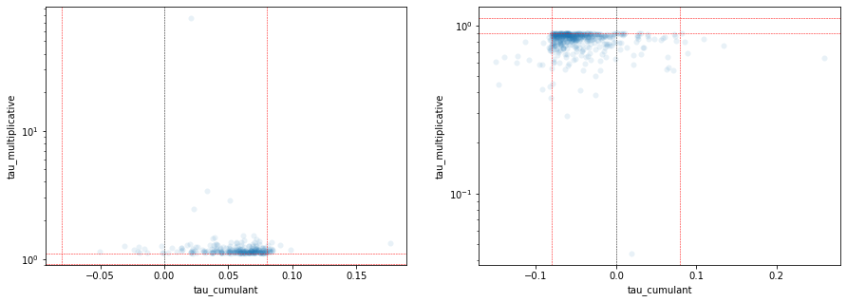
Kuzmin 2020 outlier analysis
multiplicative significantly positive
cumulant not
multiplicative significantly negative
cumulant not
cumulant negative!
cumulant positive!
some significantly so!

Slide 27
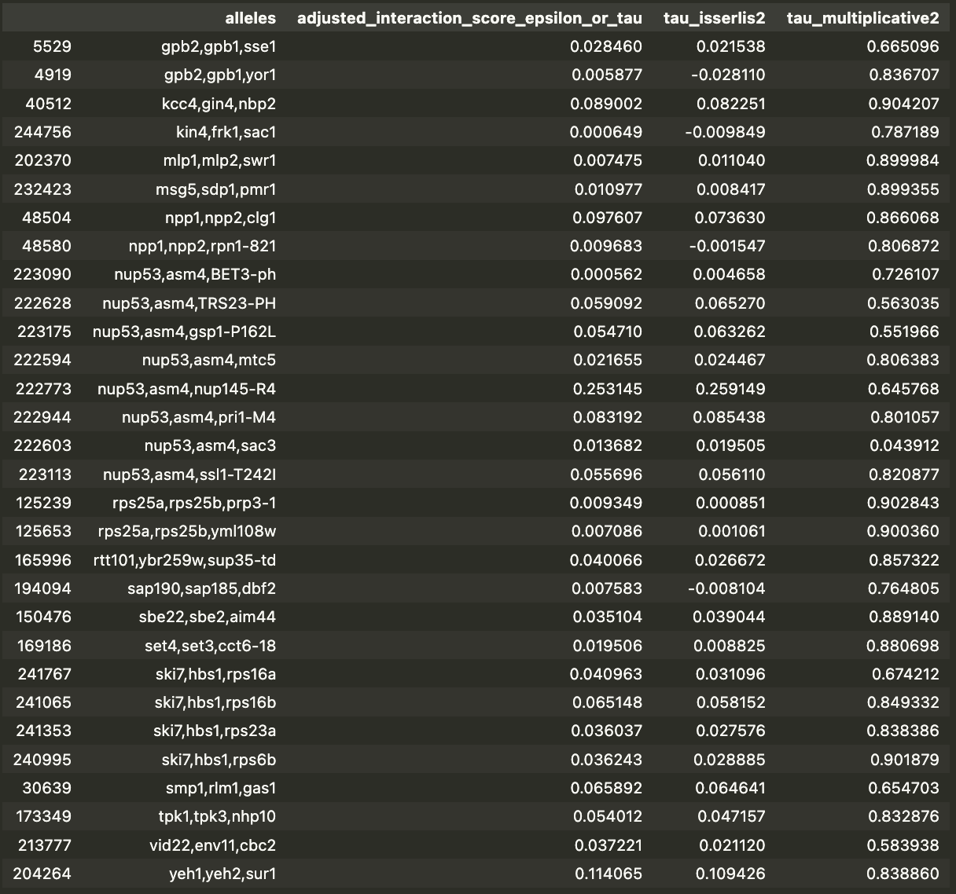
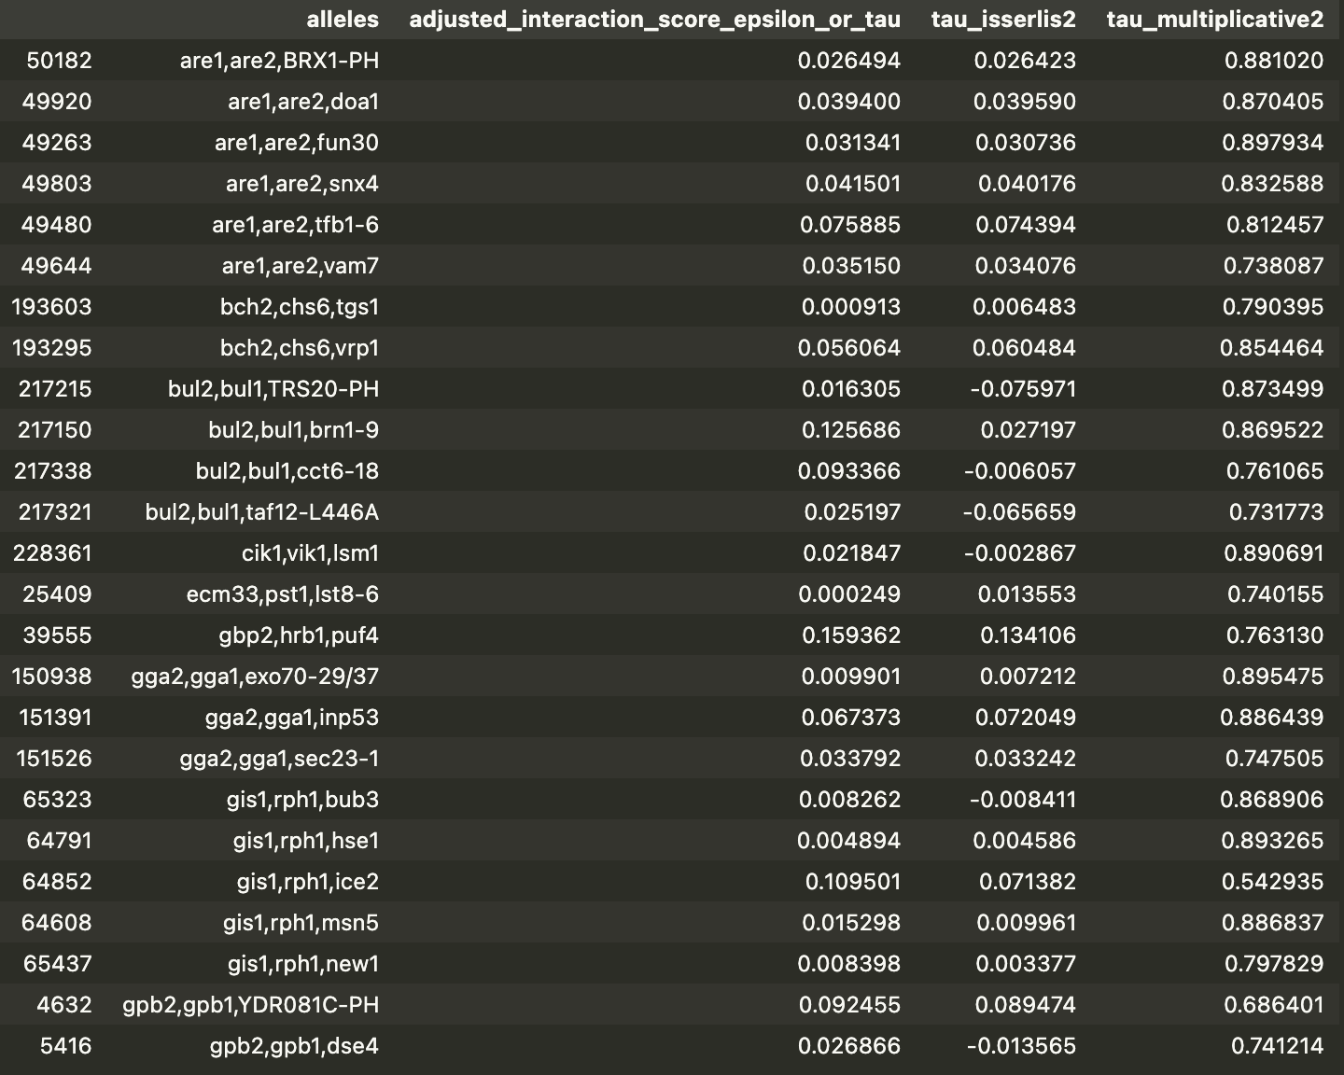
Kuzmin 2020 outlier analysis
multiplicative significantly negative
cumulant positive
Notes:
if pairwise signal is strong, then triple signal Iis strong, i.e. if there’s experimental noise, underestimate digenic score would overestimate trigenic score
do they have physical interctions, see database for physical interactions, look at correspondence b/t physical and genetic interactions
protein complexes
linear regression to see if not accurately estimating digenic score leads to over/under estiamtion of trigenic score. e.g. to explain many trigenic scores that all have same 2 genes, could correcting them by some constant make them all insignificant
our list is “better” than their list in terms of…. how do they claim that their list is reasonable, what analyses do they do? see 2018 and 2020 papers

Slide 28
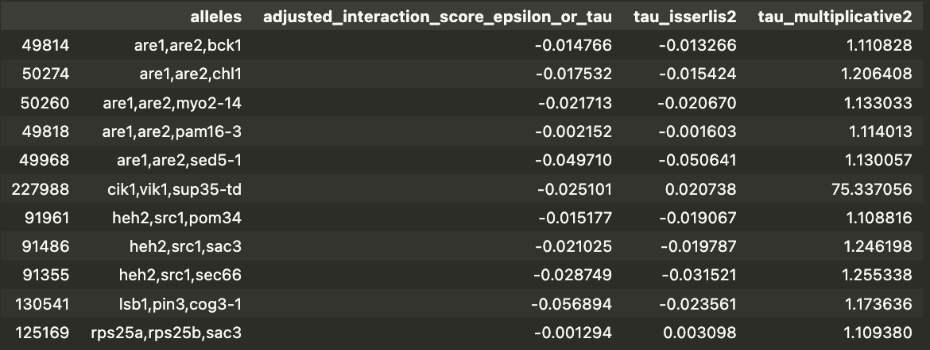
Kuzmin 2020 outlier analysis
multiplicative significantly positive
cumulant negative
Notes:
if you change pairwise genetic score does interaction go away
e_ij + delta makes many trigenic scores disappaear
robustness analysis, are tigenic scores stable under some small perturbation of pairwise scores

Slide 29
XXX update

Slide 30
Kuzmin 2018 analyses
“trigenic interactions are enriched for functionally related genes”
﻿Digenic and trigenic interactions were tested for overlap with several functional standards: protein-protein interactions, GO biological process, co-expression and co- localization. A hypergeometric test of the overlap between interactions and functional annotations, in the space of gene pairs that are both in the standard and have a valid (non- NaN) SGA score, was used to evaluate statistical significance (Fig. 2B, S8B).
I can get PPI and GO from yeastgenome.org
fit logistic regression model of interaction score vs. PPI/in same GO?
Notes:
get PPI from:
http://sgd-archive.yeastgenome.org/curation/literature/

