Slide 1
pval < 0.05

Slide 2
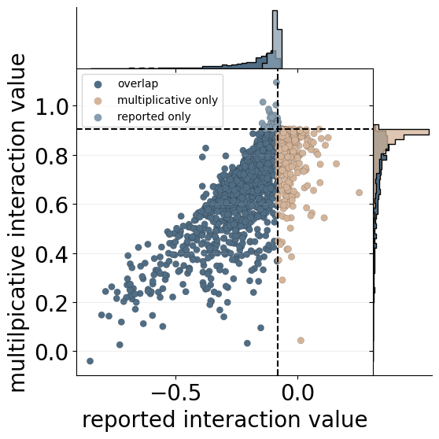
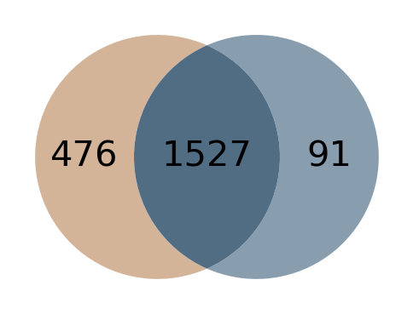
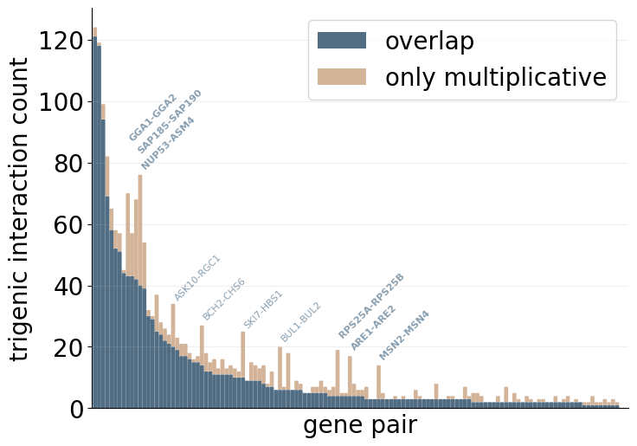
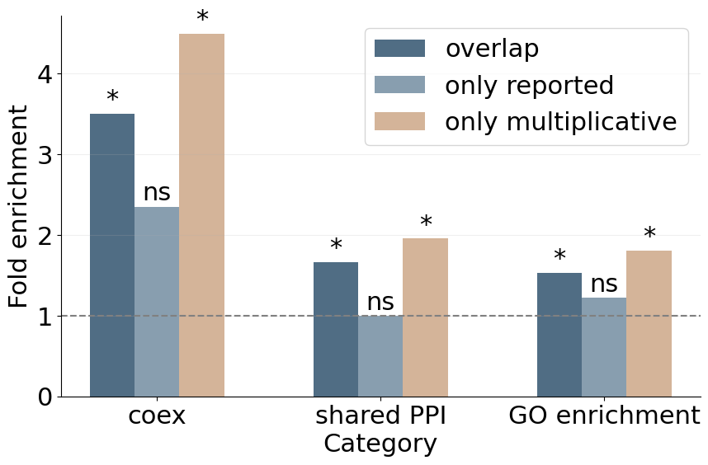
A
B
C
D
Notes:
2020, pval < 0.05

Slide 3
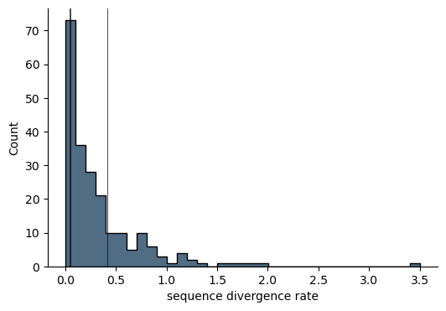
RPS25A-RPS25B
ARE2-ARE1
MSN2-MSN4

Slide 4
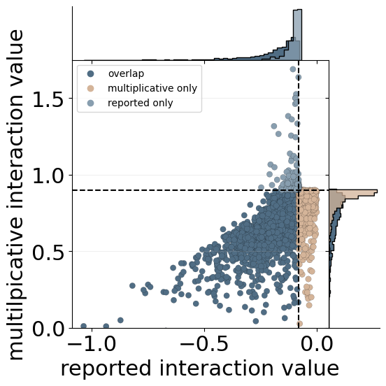
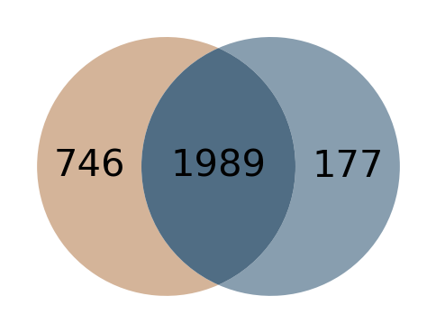
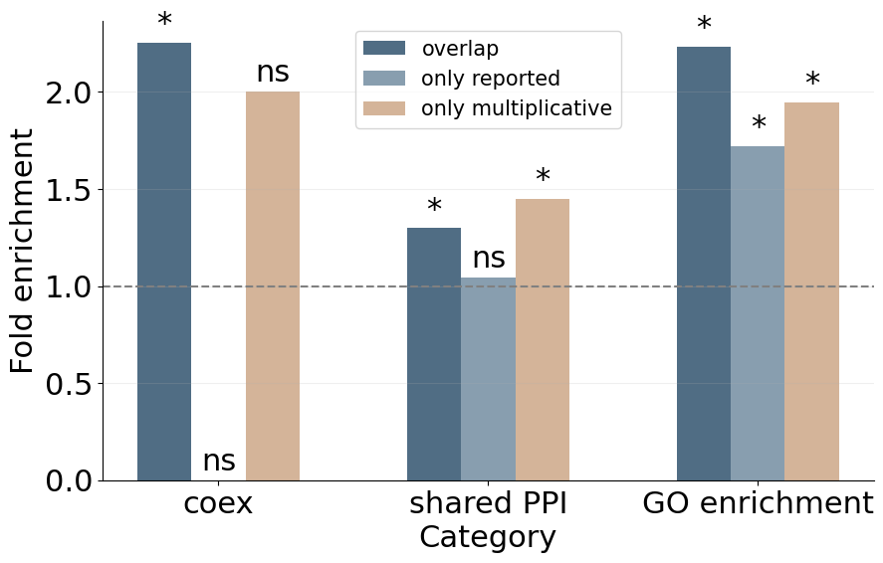
A
B
C
Notes:
2018, pval < 0.05

Slide 5
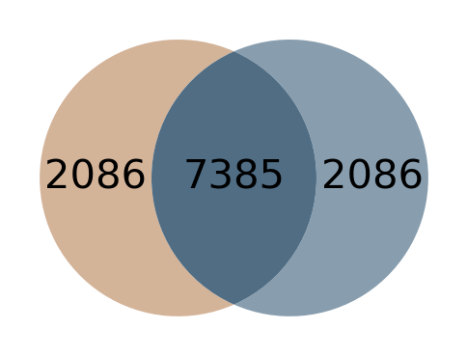
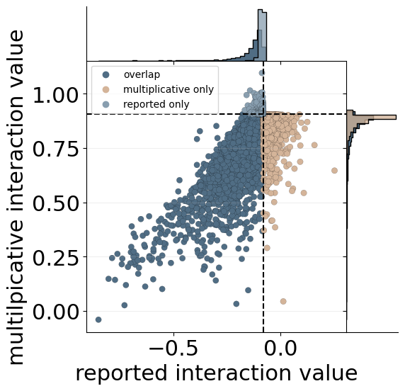
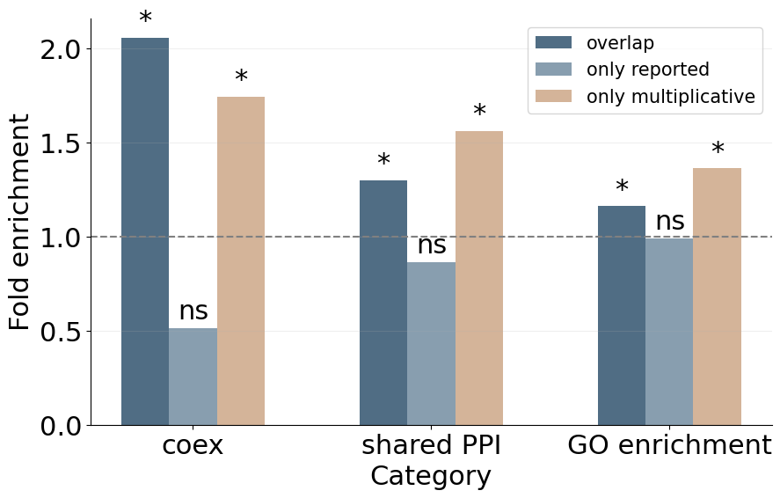
A
B
C
Notes:
2020, pval < 1

Slide 6
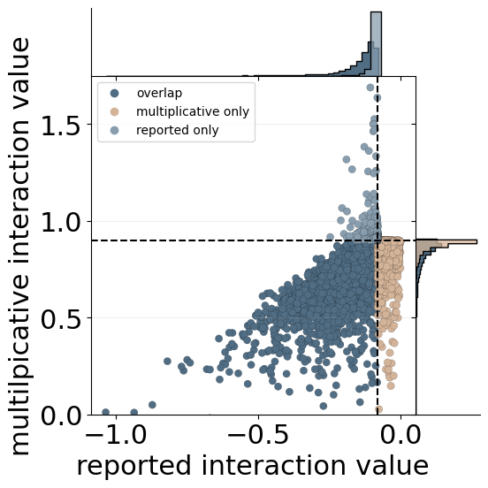
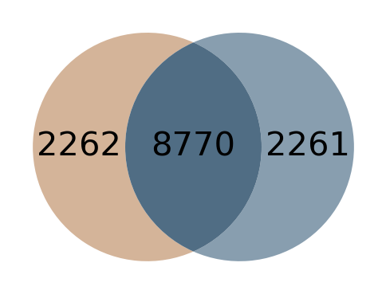
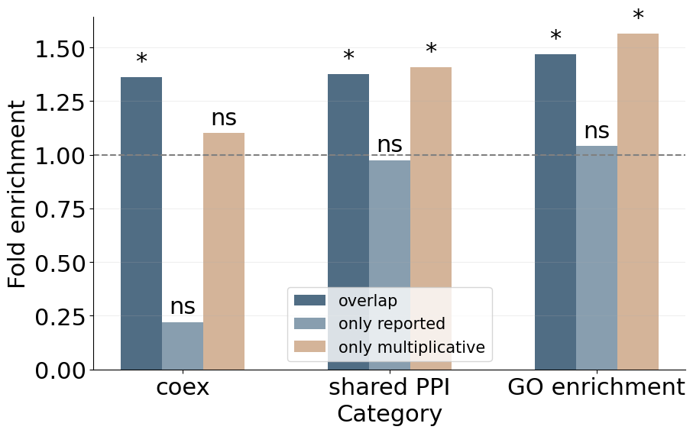
A
B
C
Notes:
2018, pval < 1

Slide 8
A
2020 dataset
B
2018 dataset

Slide 9
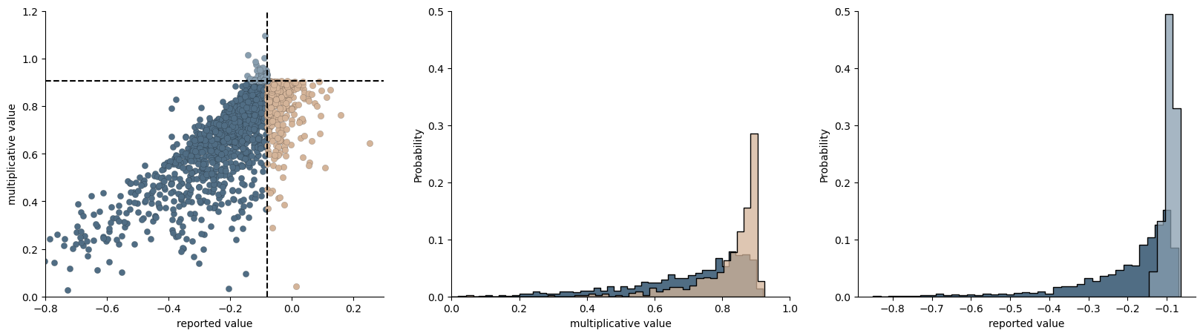
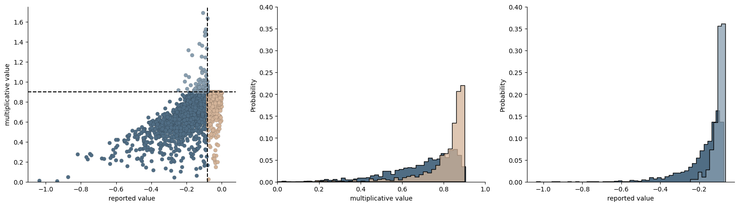
A
2020 dataset
B
2018 dataset

Slide 10
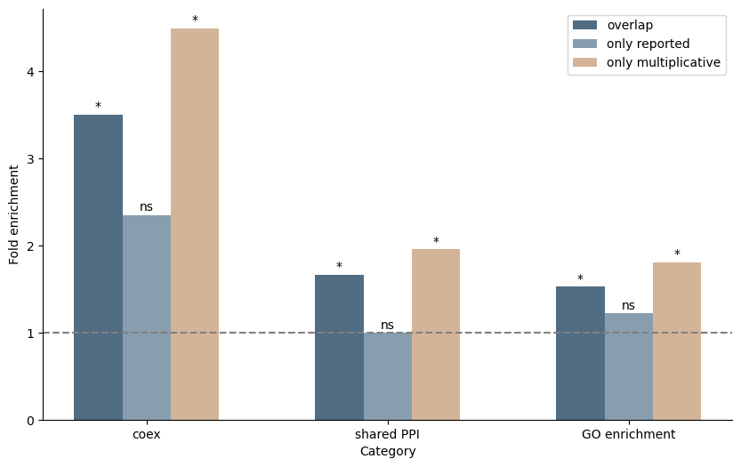
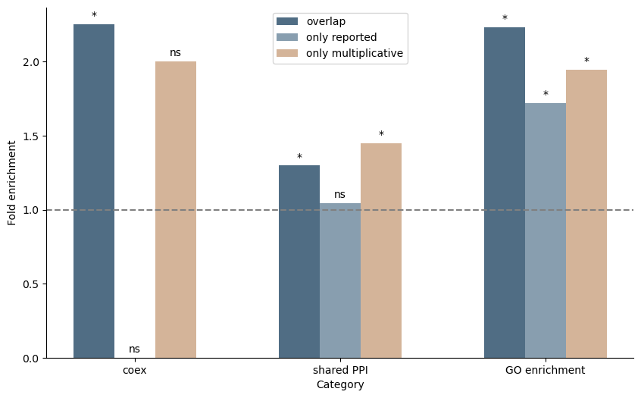
A
2020 dataset
B
2018 dataset

Slide 11
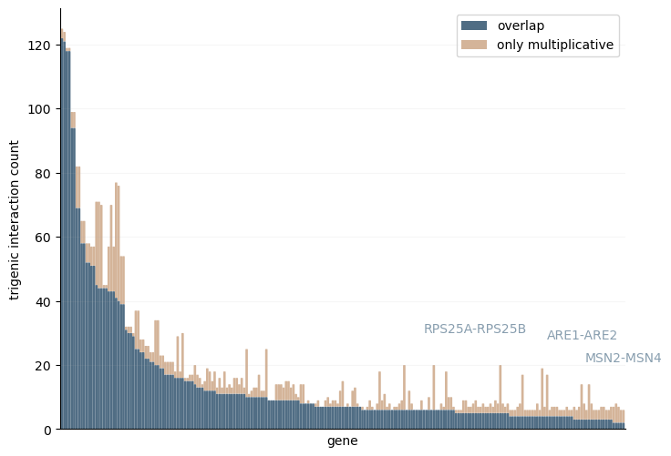
A
B
RPS25A-RPS25B
ARE2-ARE1
MSN2-MSN4
Notes:
evidence of functinally redundant
look into these gene pairs more for story
all math in sep. document with data reanalysis in own manuscript? multivariate bern. in another paper
venues: PNAS? mol. sys.bio., plos comp bio
drug reponse analysis for wider audience, other organisms with knockouts?
just run drug analyses and show they’re different

Slide 12
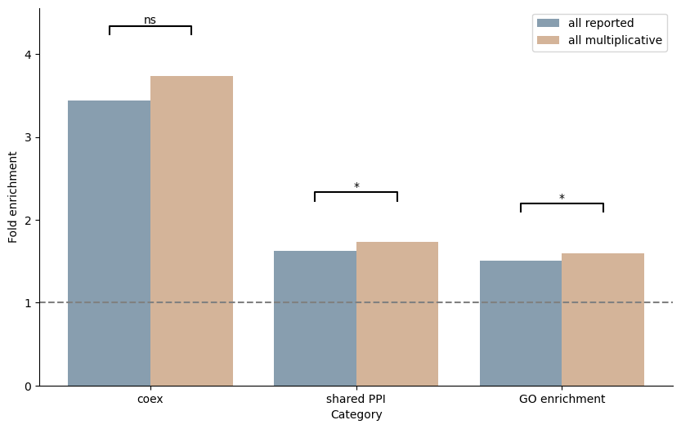
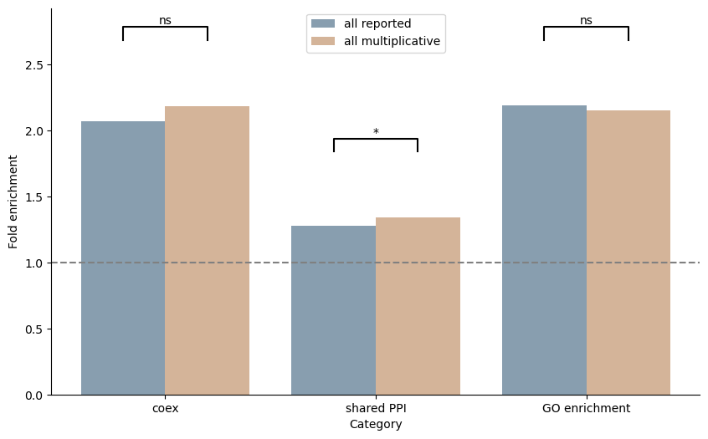
A
2020 dataset
B
2018 dataset

Slide 13
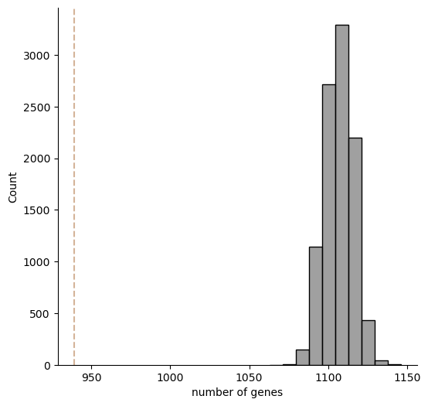
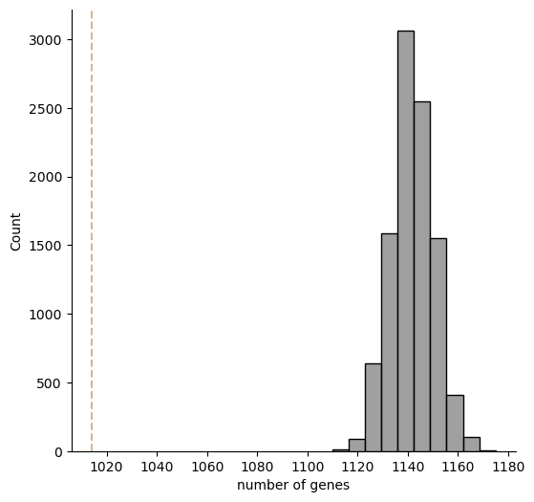
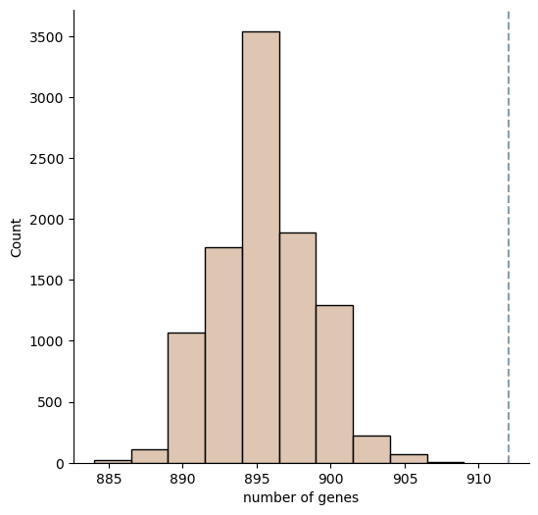
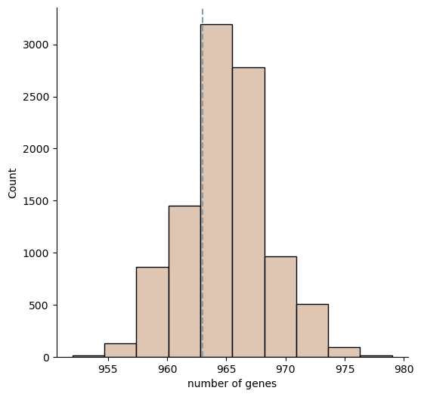
2020 dataset
2018 dataset
A
C
B
D

Slide 14

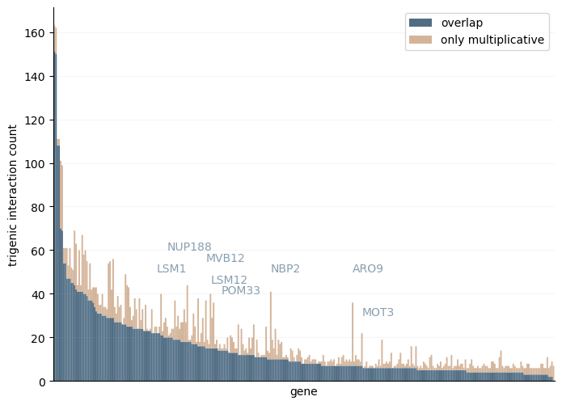
exploring new results: new stories from multiplicative formula?
A
2020 dataset
B
2018 dataset
Notes:
evidence of functinally redundant
look into these gene pairs more for story
all math in sep. document with data reanalysis in own manuscript? multivariate bern. in another paper
venues: PNAS? mol. sys.bio., plos comp bio
drug reponse analysis for wider audience, other organisms with knockouts?
just run drug analyses and show they’re different

Slide 15
pval < 1

Slide 16
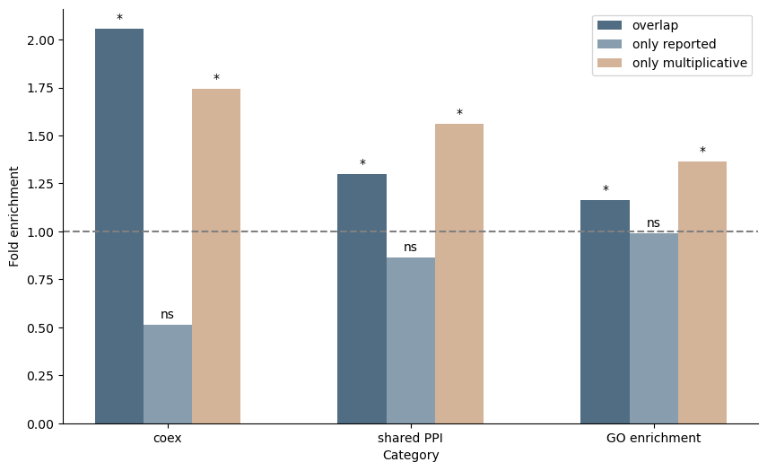
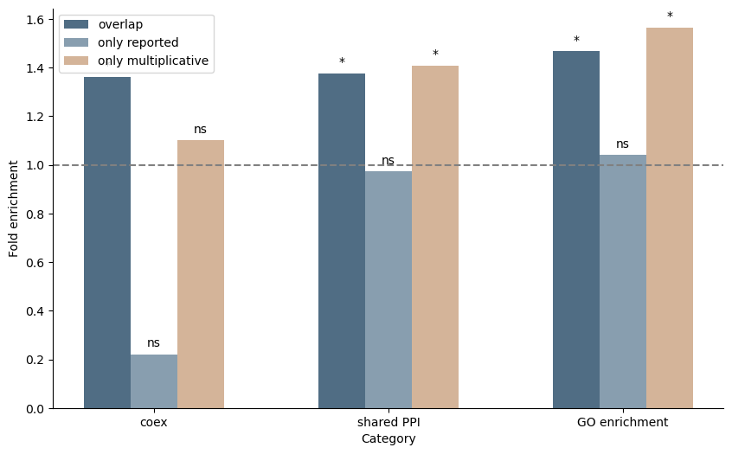
A
2020 dataset
B
2018 dataset

Slide 17
A
2020 dataset
C
2018 dataset
B
D

Slide 18
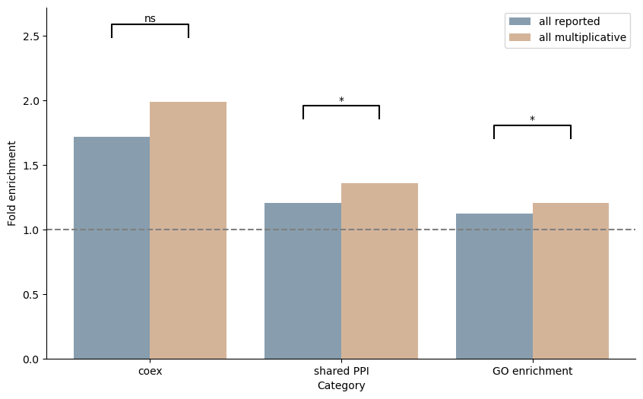
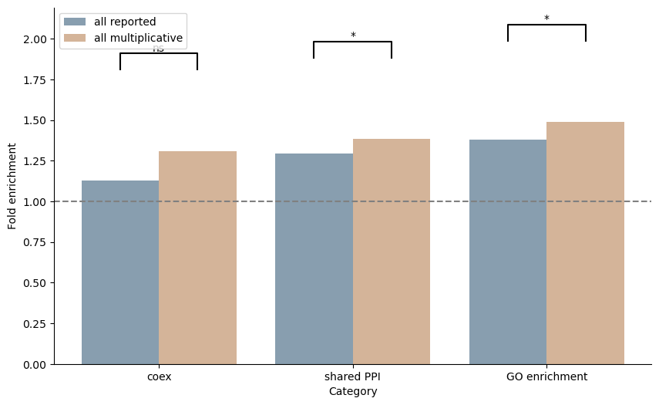
2020 dataset
2018 dataset
A
B

Slide 19
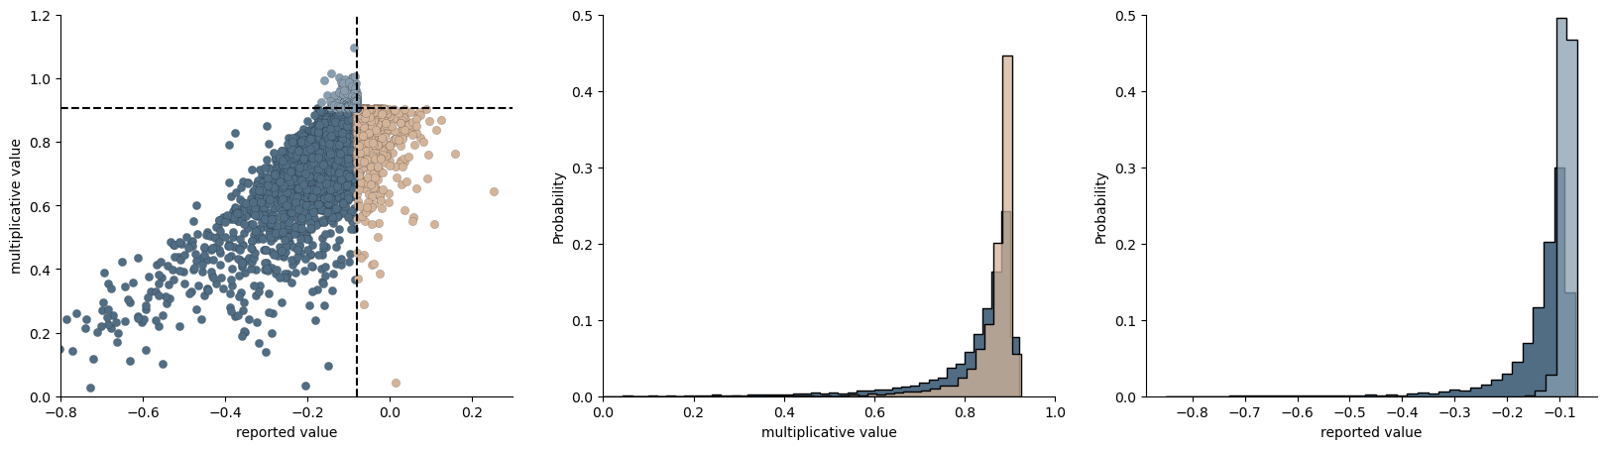
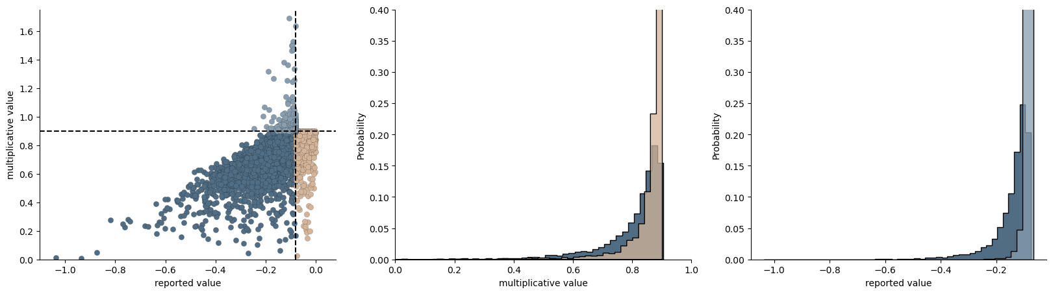
A
2020 dataset
B
2018 dataset

Slide 20
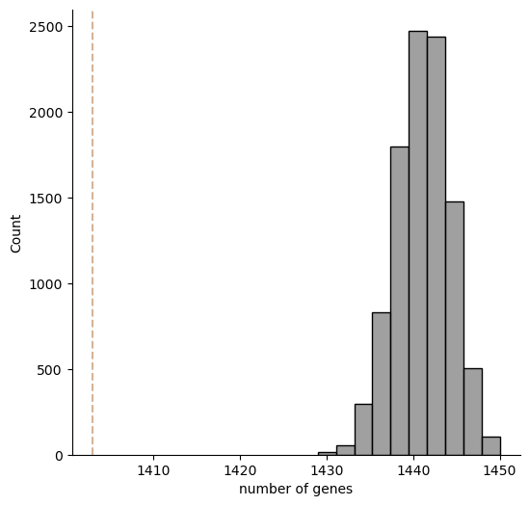
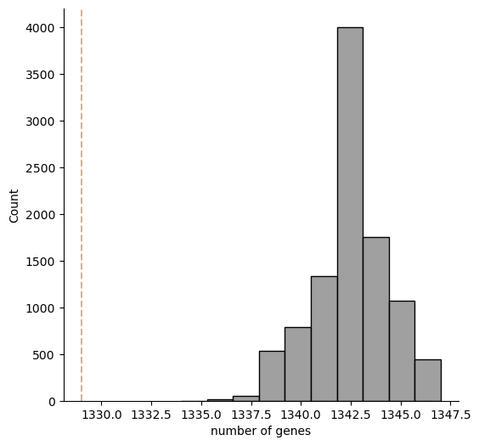
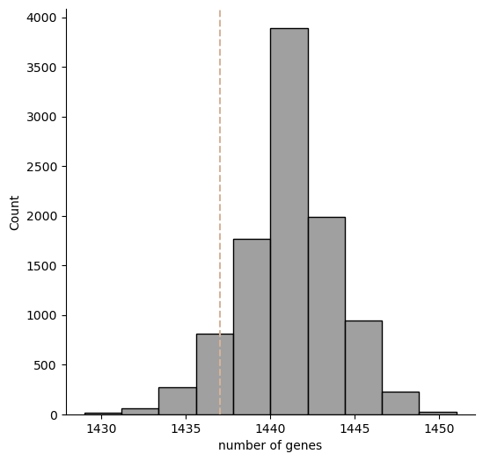
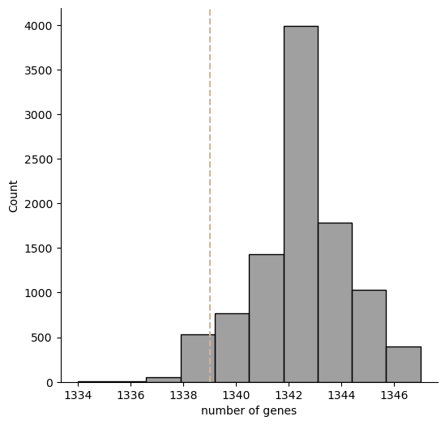
A
2020 dataset
C
2018 dataset
B
D
only reported adds 1437 genes,
0.05 quantile is 1435 genes
only reported adds 1339 genes,
0.05 quantile is 1339 genes, so not P<0.05
since only_reported == only_mult, didn’t subsample

