Slide 1
yeast knockout analyses

Slide 2
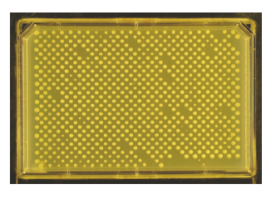
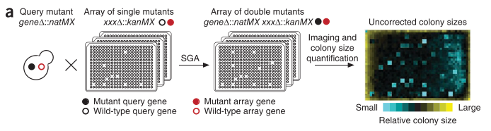
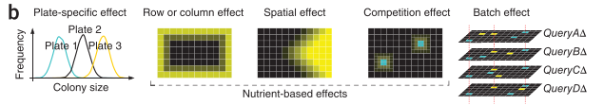
kuzmin et al experimental setup
focused on deleterious negative trigenic interactions
more accurately scored than positive interactions?
“generally more functionally informative than positive digenic interactions”? so more mechanistic insight into function/wiring
Collins … Weissman 2006, Genome Biology
﻿Baryshnikova et al 2010, Nature Methods

Slide 3

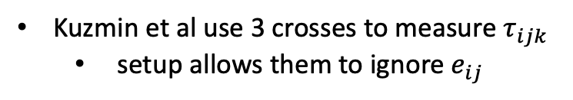








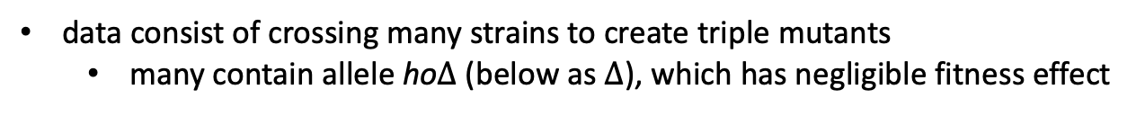

kuzmin et al experimental setup
$$τ_{ijk}$$
$$e_{ij}$$
data consist of crossing many strains to create triple mutants
many contain allele ho$∆$ (below as $∆$), which has negligible fitness effect
$$f_{i}$$
$$f_{j}$$
$$f_{k}$$
$$e_{jk}$$
$$e_{ik}$$
Kuzmin et al use 3 crosses to measure $τ_{ijk}$
setup allows them to ignore $e_{ij}$
Crosses
$f_{i∆}$ X${ f}_{k}$
$f_{j∆}$ X${ f}_{k}$
$f_{ij}$ X${ f}_{k}$
measure ${f_{i},f_{j}, e}_{ik}$, $e_{jk}$
measure $τ_{ijk}$
“query”
strain
“array”
strain

Slide 4









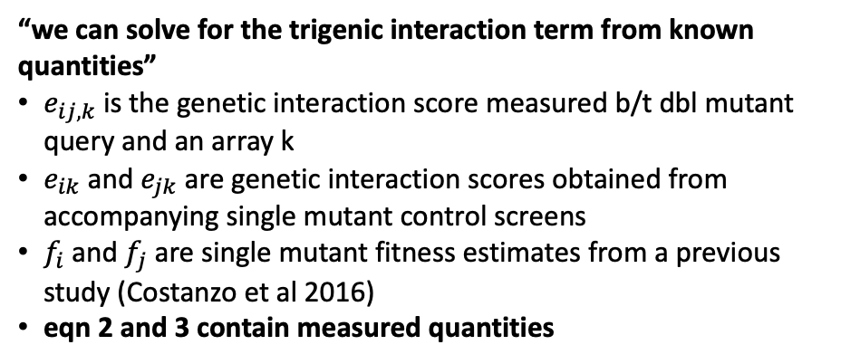






the $τ−SGA$ score
$$τ_{ijk}$$
$$e_{ij}$$
$$f_{i}$$
$$f_{j}$$
$$f_{k}$$
(1)
$τ_{ijk}=f_{ijk}−f_{i}f_{j}f_{k} − e_{jk}f_{i}− e_{ik}f_{j}$ $− e_{ij}f_{k}$
$$e_{jk}$$
$$e_{ik}$$
$f_{ijk}=f_{i}f_{j}f_{k}+{e_{ij}f_{k}+e}_{jk}f_{i}+ e_{ik}f_{j}$ $+ τ_{ijk}$
$$τ_{ijk}$$
*all interactions (in blue) from crossing dbl mutant ij with single mutant k
(2)
$$e_{ij,k}=f_{ijk}−f_{ij}f_{k}$$
$$e_{ij}$$
$$f_{i}$$
$$f_{j}$$
$$f_{k}$$
$$e_{ij,k}=f_{ijk}−{(f}_{i}f_{j}+e_{ij})f_{k}$$
$$e_{jk}$$
$$e_{ik}$$
$$e_{ij,k}=f_{ijk}−f_{i}f_{j}f_{k}−e_{ij}f_{k}$$
$$f_{ijk}=f_{i}f_{j}f_{k}+e_{ij}f_{k}+e_{ij,k}$$
“we can solve for the trigenic interaction term from known quantities”
$e_{ij,k}$ is the genetic interaction score measured b/t dbl mutant query and an array k
$e_{ik}$ and $e_{jk}$ are genetic interaction scores obtained from accompanying single mutant control screens
$f_{i}$ and $f_{j}$ are single mutant fitness estimates from a previous study (Costanzo et al 2016)
eqn 2 and 3 contain measured quantities
$$∴e_{ij,k} =e_{jk}f_{i}+e_{ik}f_{j}+τ_{ijk}$$
(3)
$$τ_{ijk} ={e_{ij,k} − e}_{jk}f_{i}−e_{ik}f_{j}$$

Slide 5
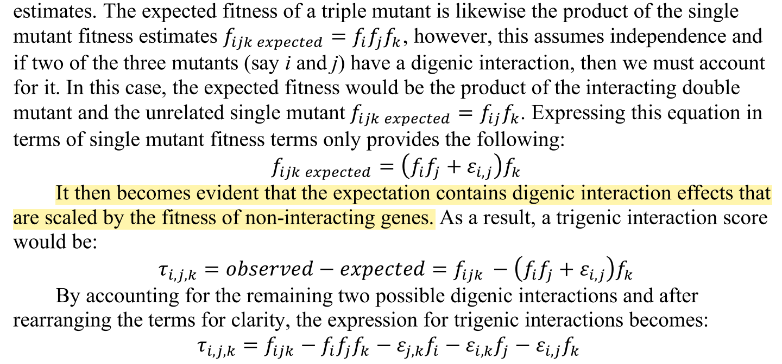
pairwise epistatic coefficients scaled by fitness of noninteracting gene?
their verbal derivation of their formula
conclusion: combining multiplicative and additive scales at the pairwise interaction level creates strange scalings for higher-order dependencies?

Slide 6


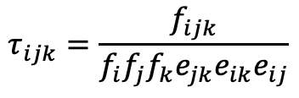


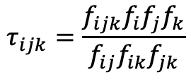
multiplicative version, from scratch
$$τ_{ijk}$$
$$e_{ij}$$
$$f_{i}$$
$$f_{j}$$
$$f_{k}$$
$$f_{ijk}=f_{i}f_{j}f_{k}e_{jk}e_{ik}e_{ij}τ_{ijk}$$
$$e_{jk}$$
$$e_{ik}$$
solve for tau
$$τ_{ijk}$$
$$τ_{ijk}=\frac{f_{ijk}}{f_{i}f_{j}f_{k}e_{jk}e_{ik}e_{ij}}$$
$$e_{ij}$$
$$f_{i}$$
$$f_{j}$$
$$f_{k}$$
$$e_{jk}$$
$$e_{ik}$$
$$e_{ij} =\frac{f_{ij}}{f_{i}f_{j}}$$
$$e_{ik} =\frac{f_{ik}}{f_{i}f_{k}}$$
$$e_{jk} =\frac{f_{jk}}{f_{j}f_{k}}$$
plug in multiplicative epistasis
$$τ_{ijk}=\frac{f_{ijk}f_{i}f_{j}f_{k}}{f_{ij}f_{ik}f_{jk}}$$

Slide 7
part 1
replicate their results to prove we understand their data

Slide 8
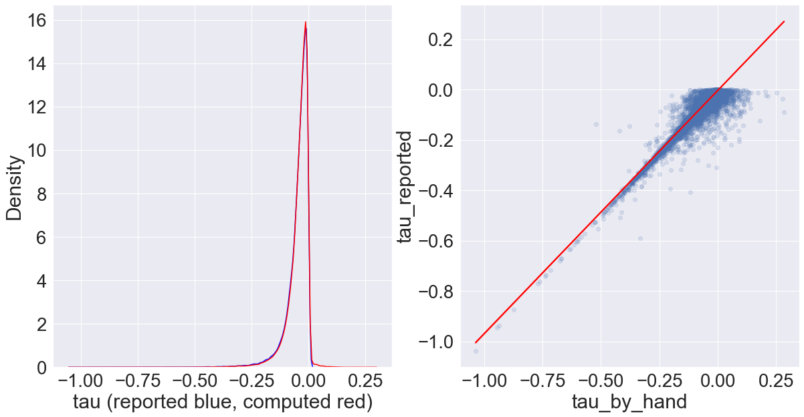
I can’t replicate their results, but I get close?
statistic | tau_reported | tau_by_hand
mean | -0.046795 | -0.043689
median | -0.032901 | -0.031430
std | 0.0521378 | 0.0485061
tau_reported: a column in their data table S1
tau_by_hand: me calculating tau according to description in supplement, grabbing some quantities from Costanzo et al2016
note: blue (reported results) and red (my recalculation) curves overlap too much to be useful here
Pearson correlation b/t reported results and my re-calculations: 0.962393
*all measurements have variability, I might be pulling values from diff table

Slide 9
part 3
comparing results using their formula and standard multiplicative/additive formula

Slide 10
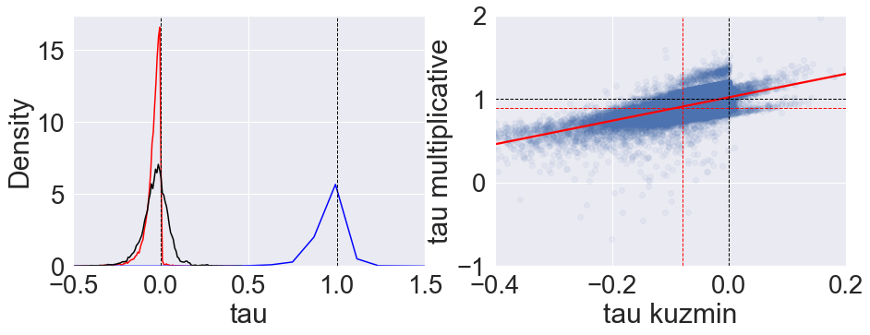
Kuzmin formula vs multiplicative and additive models
Pearson correlation: 0.58574
kuzmin formula (red) , additive model (black), multiplicative model (blue)
calculated significance threshold for multiplicative model using a quantile that corresponded to their cutoff value of -0.08 on their scale
red dashed lines: significance thresholds
black dashed lines: value where epistasis switches signs from negative to positive

Slide 11
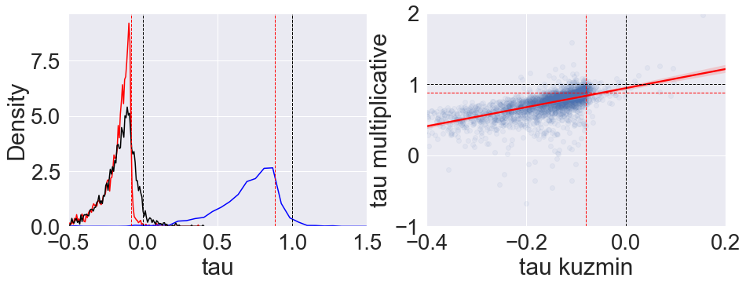
same as previous slide, but only for their ~3k interactions they report as “significant”
Pearson correlation: 0.5235
kuzmin formula (red) , additive model (black), multiplicative model (blue)
calculated significance threshold for multiplicative model using a quantile that corresponded to their cutoff value of -0.08 on their scale
red dashed lines: significance thresholds
black dashed lines: value where epistasis switches signs from negative to positive

Slide 12
epistasis sign switches
 |  | multiplicative model
 |  | “positive” (> 1) | “negative” (< 1) | Total
kuzmin model | positive (> 0) | 1199 | 711 | 1910
 | negative (< 0) | 23988 | 60213 | 84201
 | Total | 25187 | 60924 | 86111
86111, less than 91111 total because 5k nan’s
Notes:
multiplicative model has many more “positive” trigenic interactions (~1/3 of total) compared to mixed model (~2%)
like any two methods to quantify interactions, they won’t give exactly the same results but correlated results. Thus, if you were to select only negative results on one scale, some of these are going to be positive on another scale.

Slide 13
statistical significance
False positives?
They use a threshold of -0.08, such that trigenic interaction scores below this are significant
This corresponds to the ~16% quantile of their distribution
The value on the multiplicative scale that corresponds to this quantile is ~0.88 (< 1 is negative interaction)
~14% of their significantly negative results (using their formula) are above the 0.88 significance threshold on the multiplicative scale
their reported false positive rate is 20%
TO DO: False negatives?
a little more tricky, not sure how they got their significant list b/c there are 13k trigenic interactions below their threshold of -0.08 but they only report ~3k
but I can still look at interactions that fall above -0.08 on their scale (not significantly negative) but are significantly negative on multiplicative scale
TO DO: what about interactions that we detect as significantly positive

Slide 14
to definitely do
make v. brief review (~3-5 sentences) of readings on additive vs multiplicative scales, put in overleaf
full additive, full multiplicative, multiplicative with additive interaction
redo a couple of Kuzmin et al’s analyses (simple correlations mentioned in results)
new trigenic interactions?
can we redo their validation and get better false positive/negative rates
look at Beerenwinkel et al 2007, explanation for “lines”, from mixing of scales?
to maybe do
See what studies have cited Kuzmin et al and used their data and/or formulae
google trigenic interactions, 3-way interactions
collect the diversity of ways people quantify epistasis (experimental studies, mutation correlation studies)
minDC score from another yeast trigenic study in Cell Reports (Haber et al 2013)
mutual information
was miscalculating higher order interactions a one-off mistake, or is it more systemic in literature?
could we advocate for a standard way to calculate epistasis for everyone to adopt?

Slide 15
lingering notes
easy to go between additive and multiplicative models, but a model that includes both scales can introduce novel scaling factors that don’t make sense (this could be phrased more elegantly)
Summary of ongoing epistasis efforts:
unifying epistasis
multivariate bernoulli
reanalysis of data
trigenic Kuzmin et al data, correcting results
reanalysis of beerenwinkel/lenski data
other large datasets generated more recently?

Slide 16
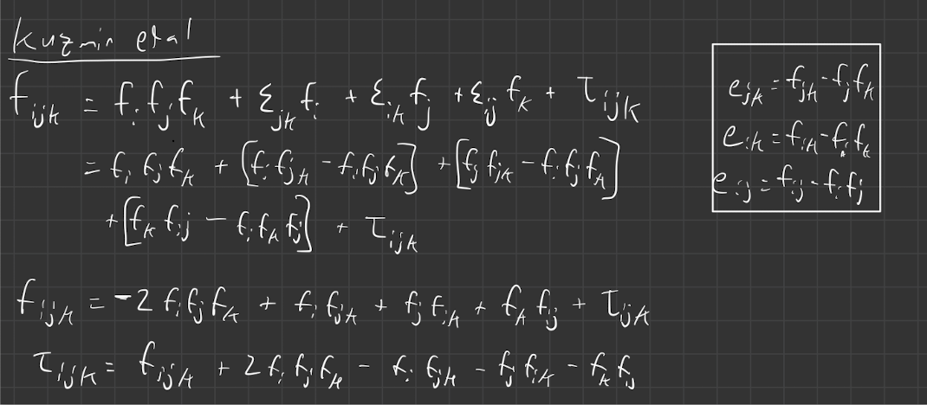
works that cited Kuzmin et al 2018
Tendler et al 2019
The Kuzmin et al 2018 equation is derived from an Isserlis Null model

Slide 17
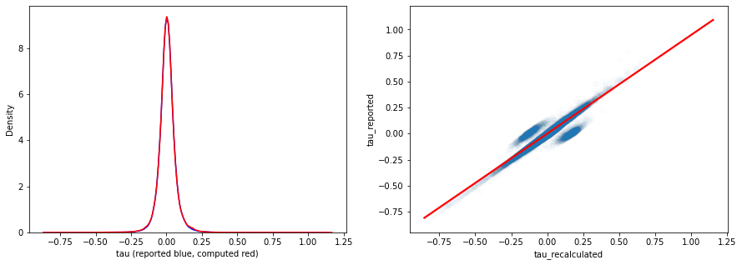
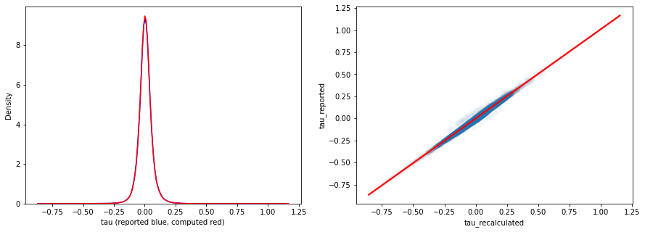



Kuzmin 2020 paper
$$τ_{ijk} ={e_{ij,k} − e}_{jk}f_{i}−e_{ik}f_{j}$$
where $e_{ij,k}=f_{ijk}−f_{ij}f_{k}$
$$τ_{ijk} ={f_{ijk}−f_{ij}f_{k}− e}_{jk}f_{i}−e_{ik}f_{j}$$
removing abs(recalculated – reported) > 0.1
leaves 98.9% of data, ~187k interactions
pearson corr = 0.997

Slide 18
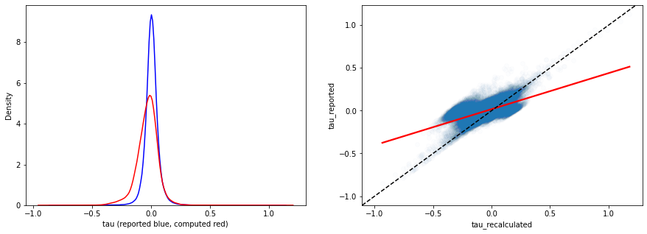
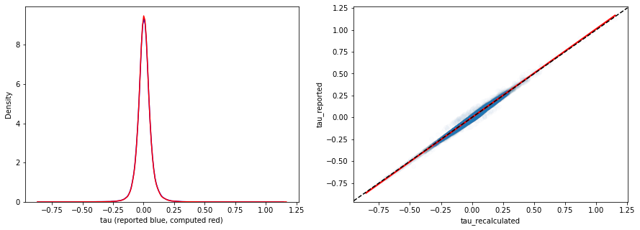


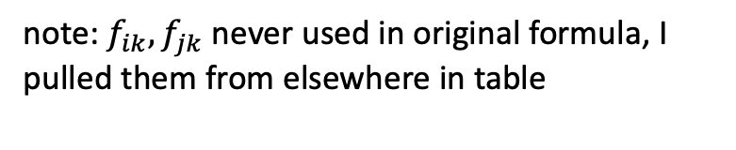

Kuzmin 2020 paper
using Isserlis formula instead
$$τ_{ijk} ={f_{ijk}+{2f_{i}f_{j}f_{k}− f}_{ij}f_{k}−f}_{ik}f_{j}−f_{jk}f_{i}$$
note: $f_{ik},f_{jk}$ never used in original formula, I pulled them from elsewhere in table
negative bias??
subtracting too much?
$$τ_{ijk} ={f_{ijk}−f_{ij}f_{k}− e}_{jk}f_{i}−e_{ik}f_{j}$$
$$τ_{ijk} ={f_{ijk}+{2f_{i}f_{j}f_{k}− f}_{ij}f_{k}−(f}_{i}{f_{k}+e_{ik})f}_{j}−{(f}_{j}f_{k}+ e_{jk})f_{i}$$
$f_{ik}≠{(f}_{i}f_{k}+ e_{ik})$ ??
$f_{jk}≠{(f}_{j}f_{k}+ e_{jk})$ ??

Slide 19
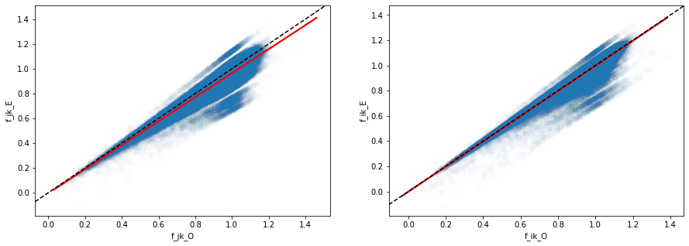




Kuzmin 2020 paper
$${f_{j}f_{k}− e}_{jk}$$
$${f_{i}f_{k}− e}_{ik}$$
$$f_{jk}$$
$$f_{ik}$$
measured value of double mutant systematically higher than expected based on how they calculate e,
substituting them in here leads to subtracting too much -> negative bias?
$$τ_{ijk} ={f_{ijk}+{2f_{i}f_{j}f_{k}− f}_{ij}f_{k}−f}_{ik}f_{j}−f_{jk}f_{i}$$

Slide 20
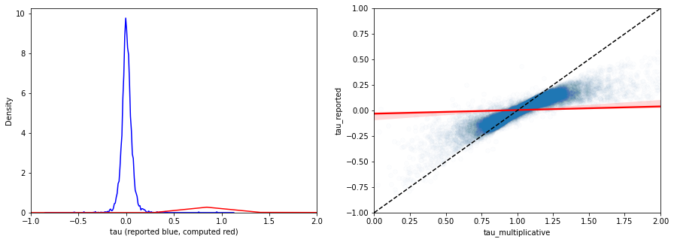
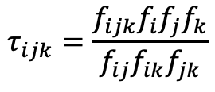
Kuzmin 2020 paper
solution
don’t use measured values of f_jk and f_ik
set e.g. f_jk = f_i*f_j + e_ij, where LHS is some imputed double mutant value
use to compute multiplicative tau_ijk
where
f_ij = f_i*f_j + e_ij
and e_ij_multiplicative = (f_i*f_j + e_ij)/ (f_i*f_j )
$$τ_{ijk}=\frac{f_{ijk}f_{i}f_{j}f_{k}}{f_{ij}f_{ik}f_{jk}}$$

