Slide 1
pval < 0.05

Slide 2
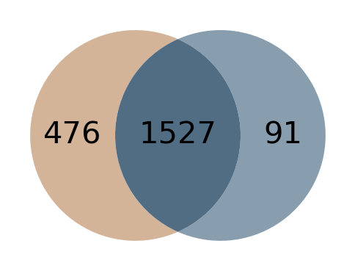
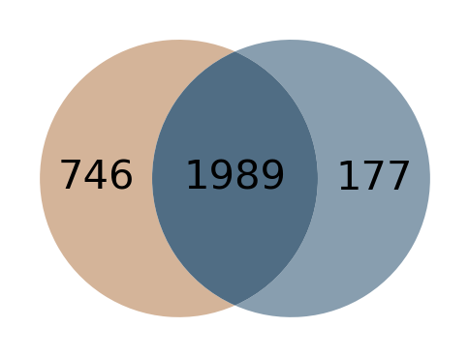
A
2020 dataset
B
2018 dataset

Slide 3
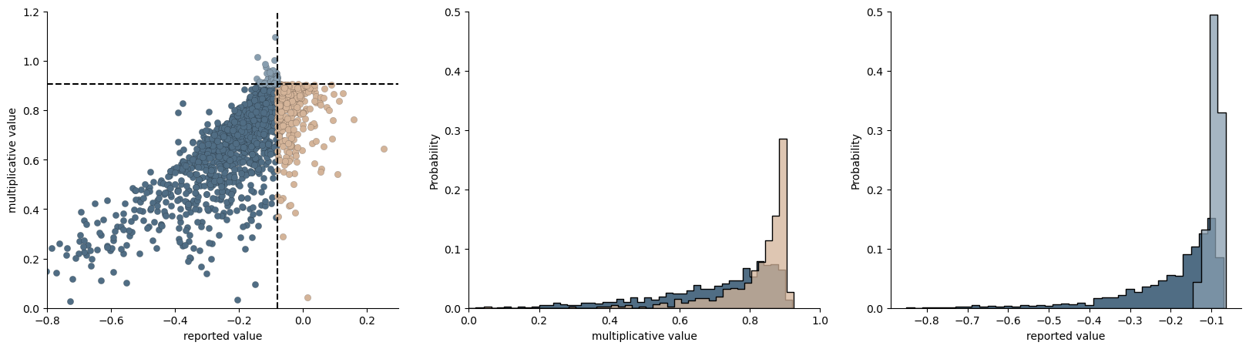
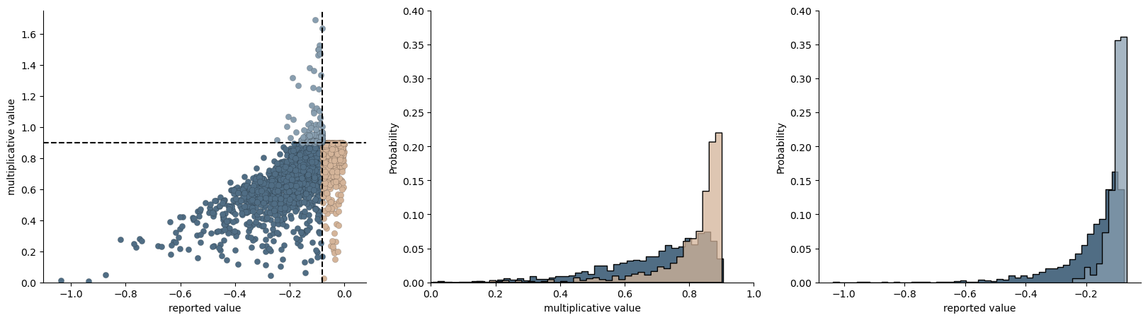
A
2020 dataset
B
2018 dataset

Slide 4
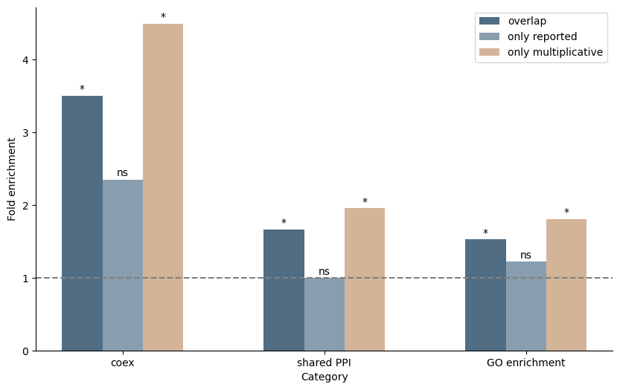
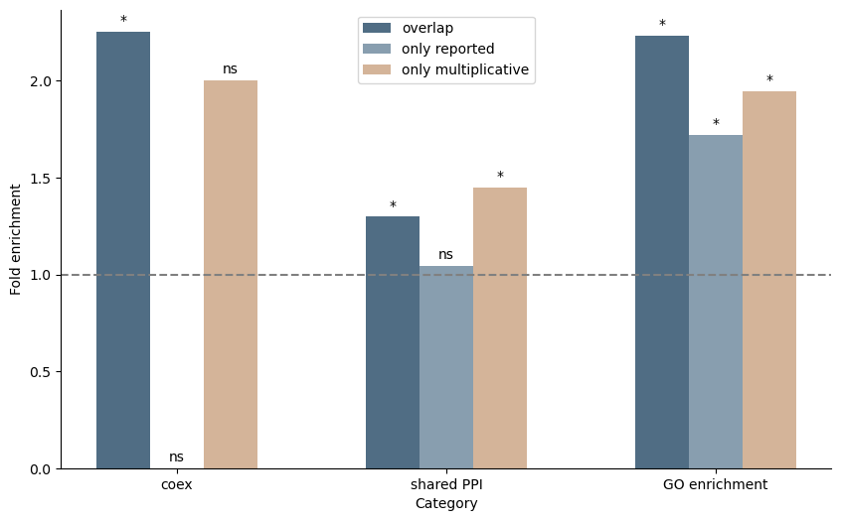
A
2020 dataset
B
2018 dataset

Slide 5
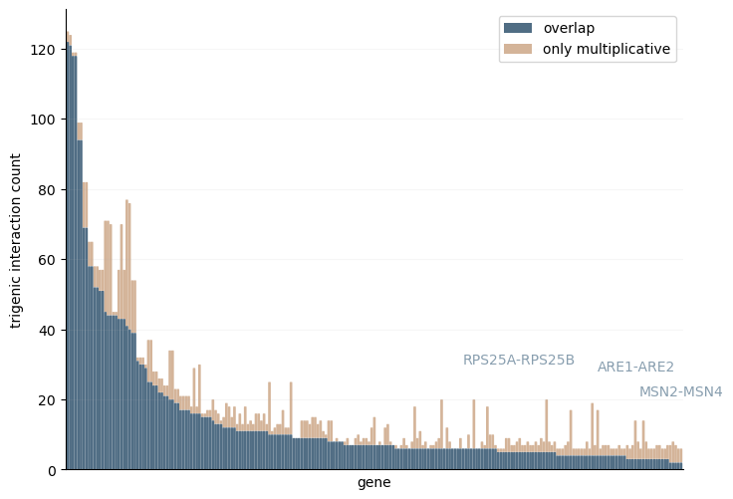
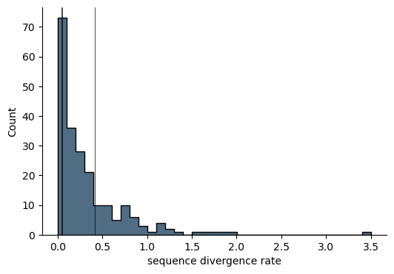
A
B
RPS25A-RPS25B
ARE2-ARE1
MSN2-MSN4
Notes:
evidence of functinally redundant
look into these gene pairs more for story
all math in sep. document with data reanalysis in own manuscript? multivariate bern. in another paper
venues: PNAS? mol. sys.bio., plos comp bio
drug reponse analysis for wider audience, other organisms with knockouts?
just run drug analyses and show they’re different

Slide 6
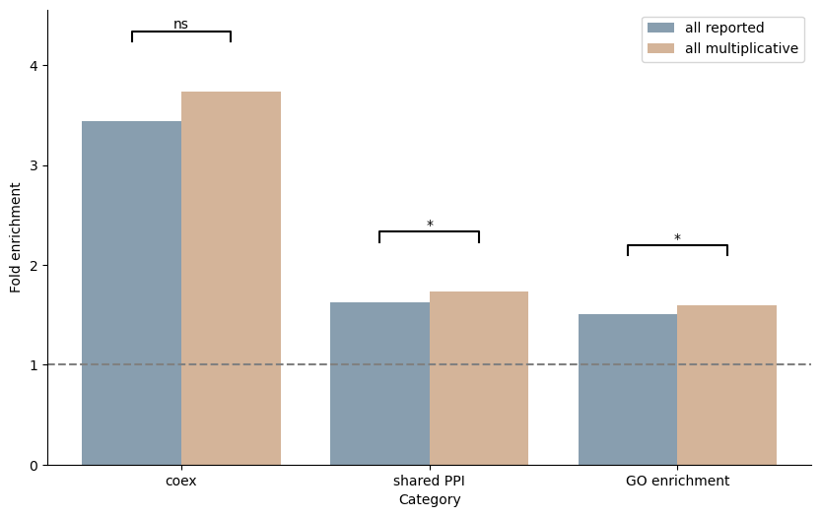
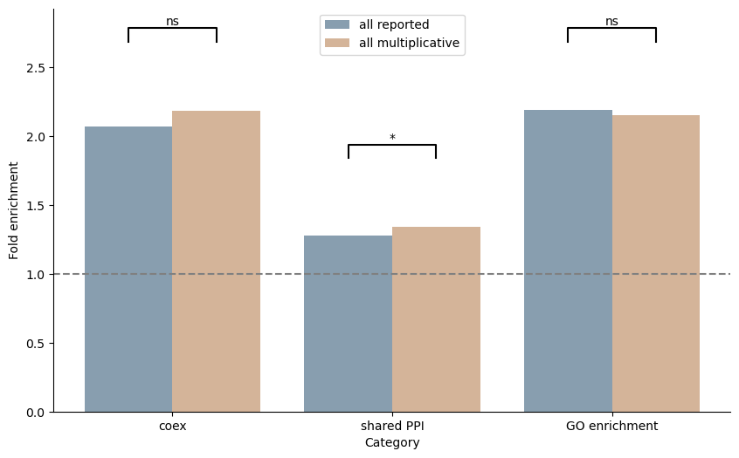
A
2020 dataset
B
2018 dataset

Slide 7
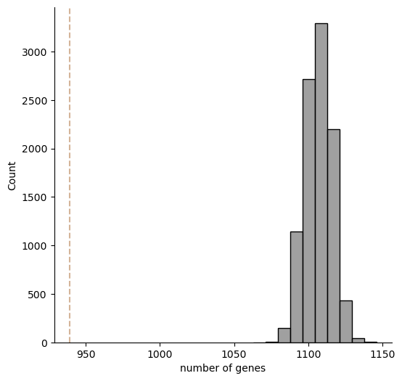
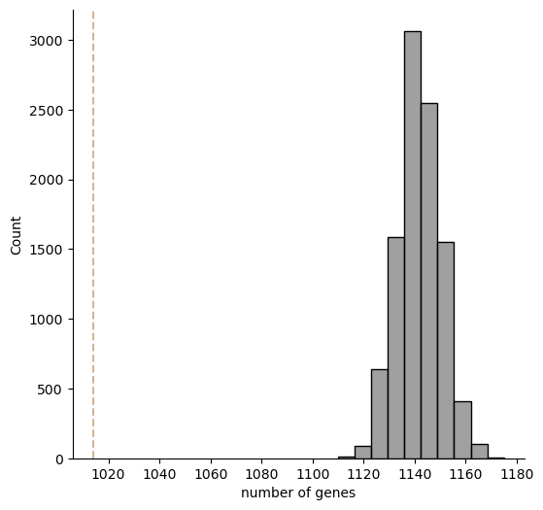
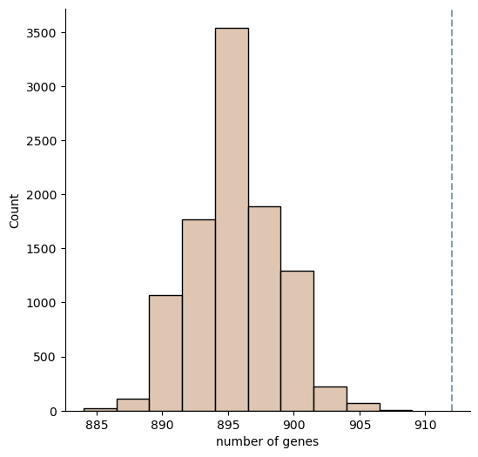
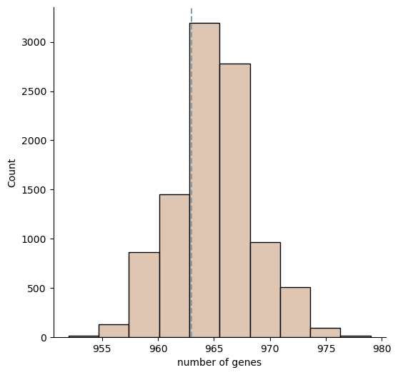
2020 dataset
2018 dataset
A
C
B
D

Slide 8

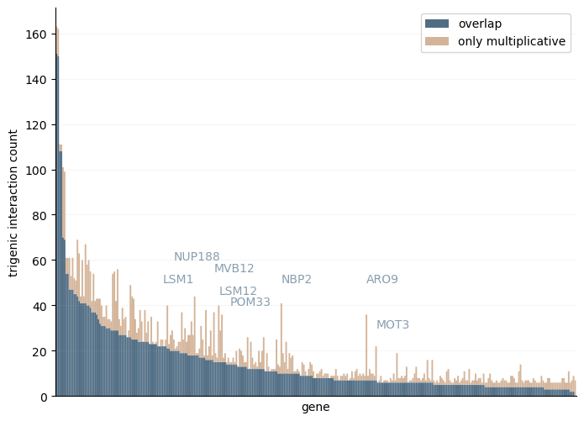
exploring new results: new stories from multiplicative formula?
A
2020 dataset
B
2018 dataset
Notes:
evidence of functinally redundant
look into these gene pairs more for story
all math in sep. document with data reanalysis in own manuscript? multivariate bern. in another paper
venues: PNAS? mol. sys.bio., plos comp bio
drug reponse analysis for wider audience, other organisms with knockouts?
just run drug analyses and show they’re different

Slide 9
pval < 1

Slide 10
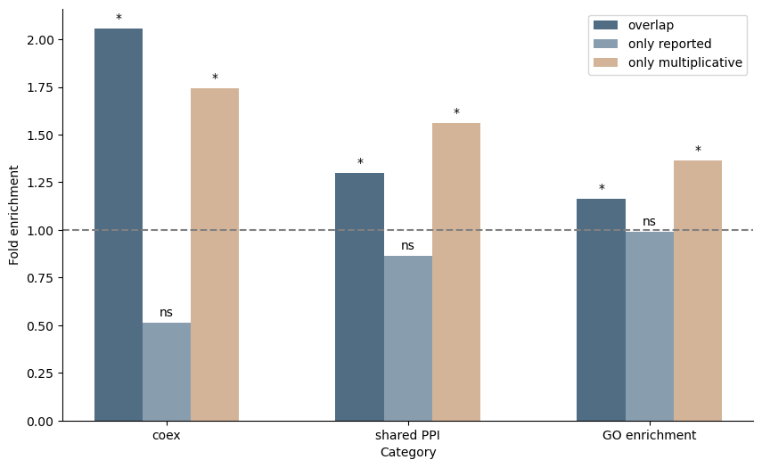
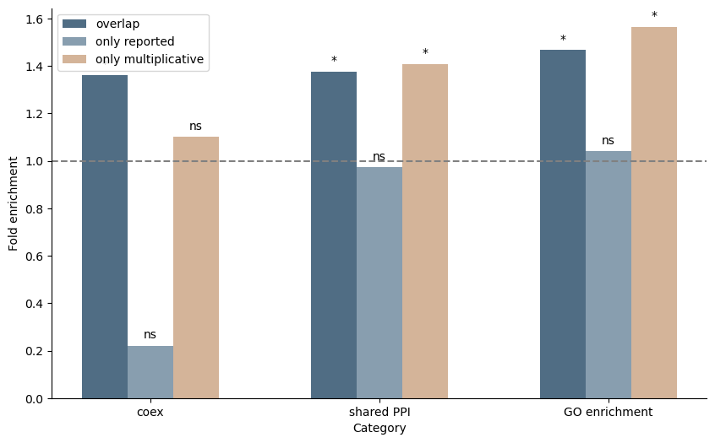
A
2020 dataset
B
2018 dataset

Slide 11
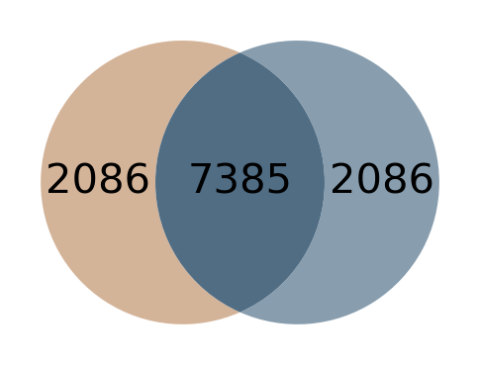
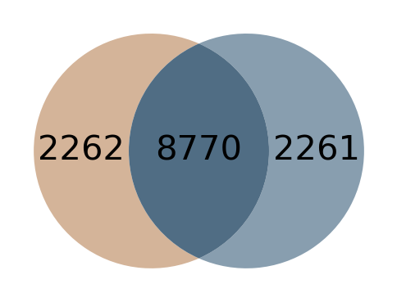
A
2020 dataset
C
2018 dataset
B
D

Slide 12
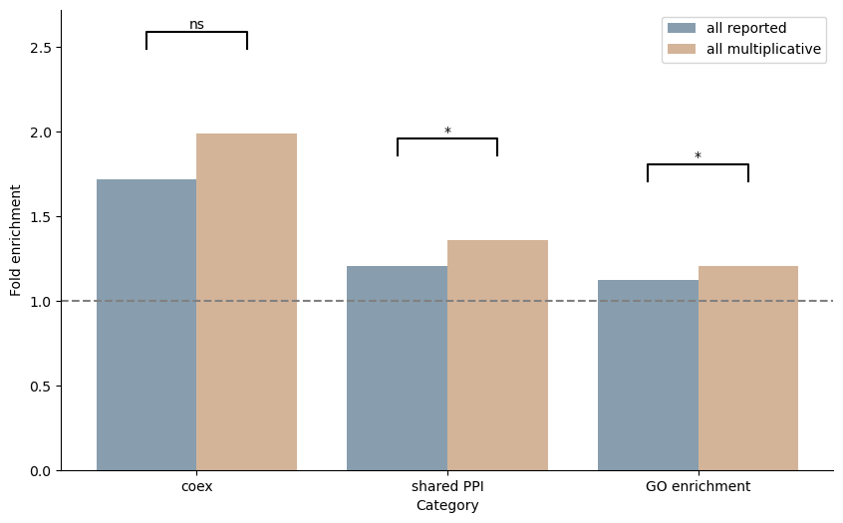
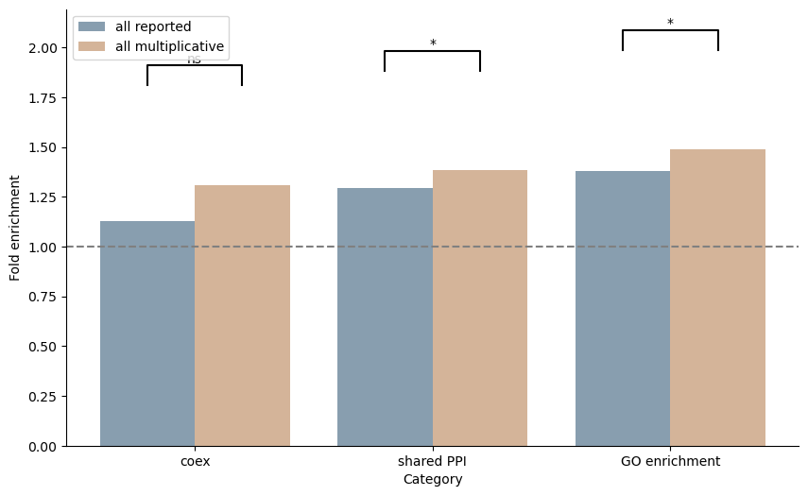
2020 dataset
2018 dataset
A
B

Slide 13
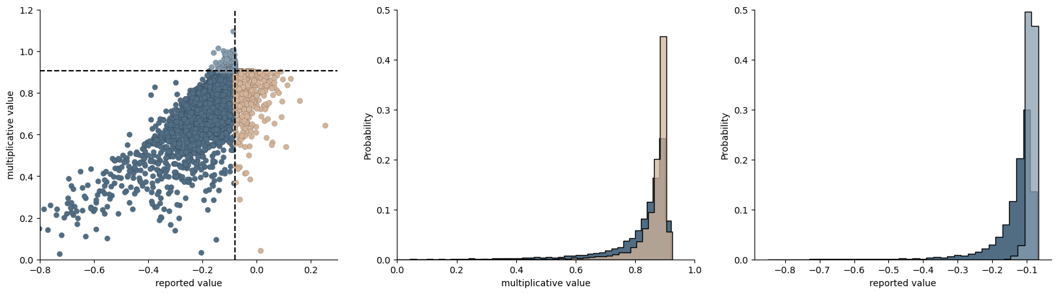
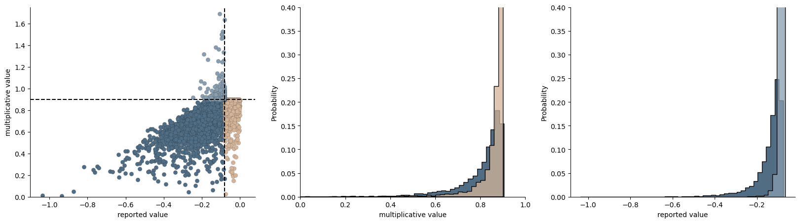
A
2020 dataset
B
2018 dataset

Slide 14
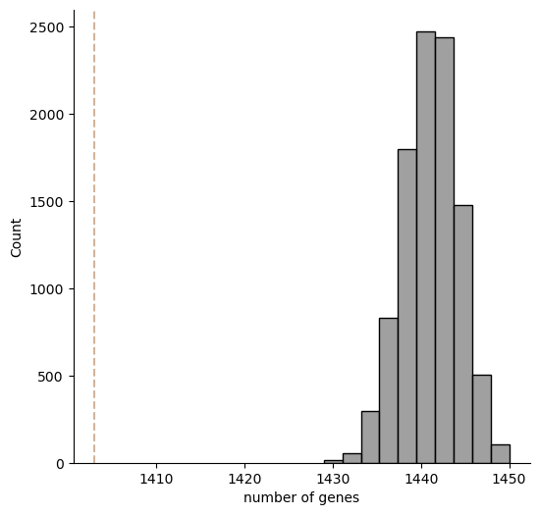
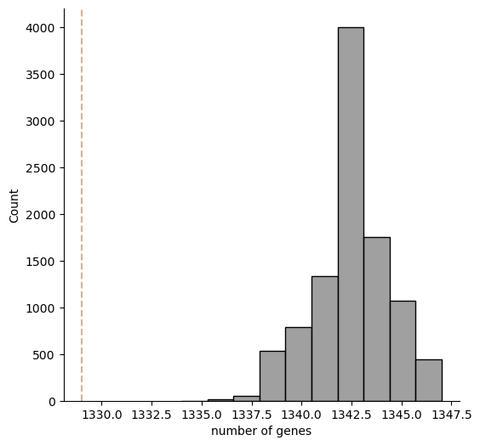
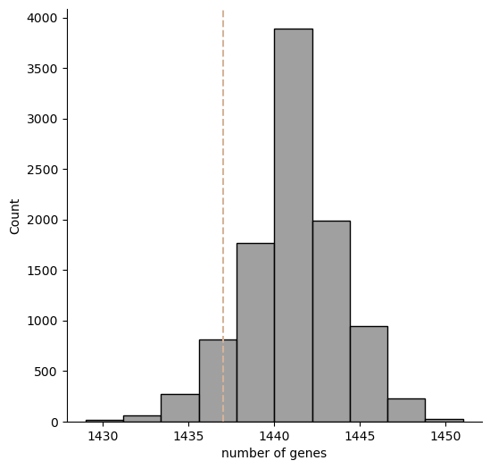
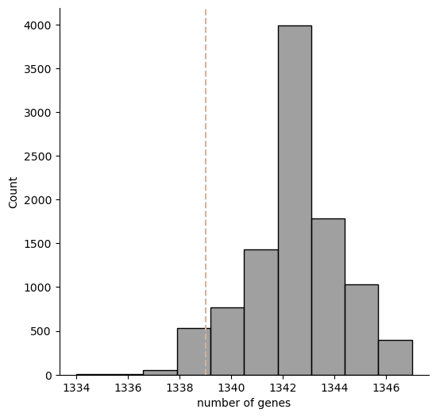
A
2020 dataset
C
2018 dataset
B
D
only reported adds 1437 genes,
0.05 quantile is 1435 genes
only reported adds 1339 genes,
0.05 quantile is 1339 genes, so not P<0.05
since only_reported == only_mult, didn’t subsample

