Slide 1
Snakemake

Slide 2

What is snakemake?
Snakemake is a python-based workflow language
A workflow consists of rules that have the following parts:
input: file(s) that must exist for rule to run
output: file(s) that must exist after rule runs, otherwise error
shell or run: the code that the rule must use to go from input to output
shell if running a BASH command
run for python command
input file
rule
runs command
output file
Notes:
Content inspired by https://ucdavis-bioinformatics-training.github.io/2020-Genome_Assembly_Workshop/snakemake/snakemake_intro

Slide 3
Snakemake example 1
a single rule run on many files
if you give snakemake many cores, it will run independent rules in parallel and finish much faster
input file
rule
runs command on each
output file
combined output file
or
examples
bioinformatics: many raw FASTQ files, rule runs program to process/clean each one
climate research: process satellite imagery
etc.
Notes:
Content inspired by https://ucdavis-bioinformatics-training.github.io/2020-Genome_Assembly_Workshop/snakemake/snakemake_intro

Slide 4
Snakemake example 2
two rules, the output of rule 1 is the input of rule 2
when rule 1 finishes, rule 2 automatically begins
input file
rule 1
output file
rule 1 output == rule 2 input
input file
rule 2
output file
combined output file
or
Notes:
Content inspired by https://ucdavis-bioinformatics-training.github.io/2020-Genome_Assembly_Workshop/snakemake/snakemake_intro

Slide 5
other details
Snakemake doesn’t know what each rule is doing, treats as black boxes
it just knows a rule finished successfully if
the file(s) specified in the rule output get created
the code in the shell/run section didn’t exit with an error message
To make a workflow with several steps, the name of the output file of rule 1 has to be identical to input file name of rule 2
Rules get put into a ‘Snakefile’ that get run using the ‘snakemake’ command
Notes:
Content inspired by https://ucdavis-bioinformatics-training.github.io/2020-Genome_Assembly_Workshop/snakemake/snakemake_intro

Slide 6
Snakemake example
A simple workflow (written by chatGPT4)
Convert RNA sequence to DNA sequence
Get the reverse complement of DNA sequence
RNA seq
rule 1
DNA seq
rule 2
rev. comp. DNA seq

Slide 7
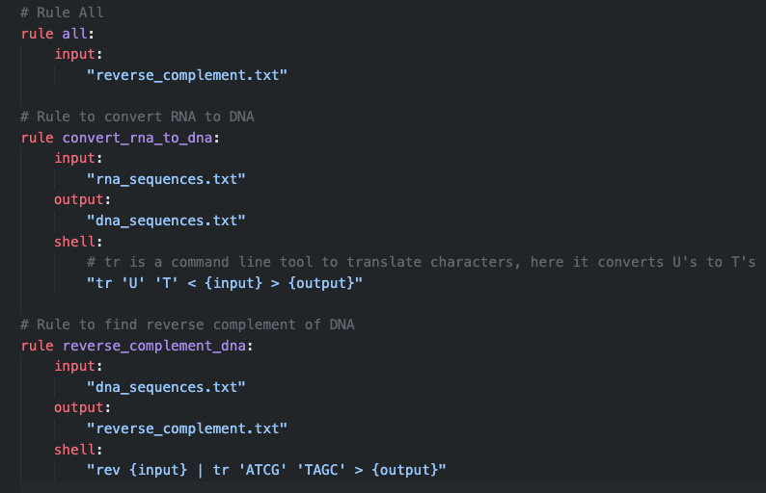
Snakemake example
A simple workflow (written by chatGPT4)
Convert RNA sequence to DNA sequence
Get the reverse complement of DNA sequence
Special rule all
typically written towards top of file
the final rule, with only input: the final file(s) of the workflow
Snakemake figures out which rules need to be run to make file(s) in rule all
all other rules can be written in any order, named anything
snakemake figures out which rules need to be run in which order

Slide 8
See example on cluster

Slide 9
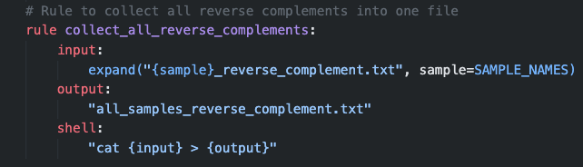
Snakemake (advanced)
Snakemake can handle many files or data sets, using ‘wildcards’
‘wildcards’ can be used to expand rules across multiple samples
Use expand('somedir/{sample}.txt, sample=SAMPLE_NAMES))
Where SAMPLES is a list of sample names that we made
…
Notes:
Content inspired by https://ucdavis-bioinformatics-training.github.io/2020-Genome_Assembly_Workshop/snakemake/snakemake_intro

Slide 10
See example on cluster

Slide 11
Review: previous pipeline
fastp
BWA
Picard
GATK
RAW
FASTQ
CLEANED
FASTQ
BAM
deduplicated
BAM
VCF
Each step involves a program that was run using a bash script
Problems
Must wait for one step to finish before running the next
Was only made for a single sample
Could extend to make it fancier for many samples, but BASH is an ugly language
solution
Use a ‘workflow’ language
Snakemake is an example that’s extremely popular in biology
Notes:
Content inspired by https://ucdavis-bioinformatics-training.github.io/2020-Genome_Assembly_Workshop/snakemake/snakemake_intro

Slide 12
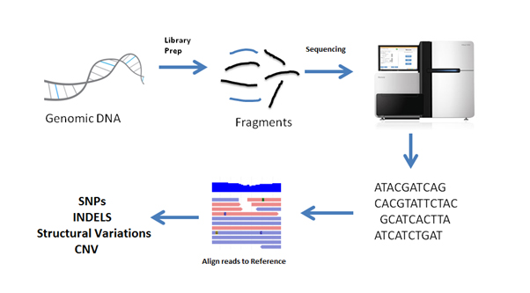
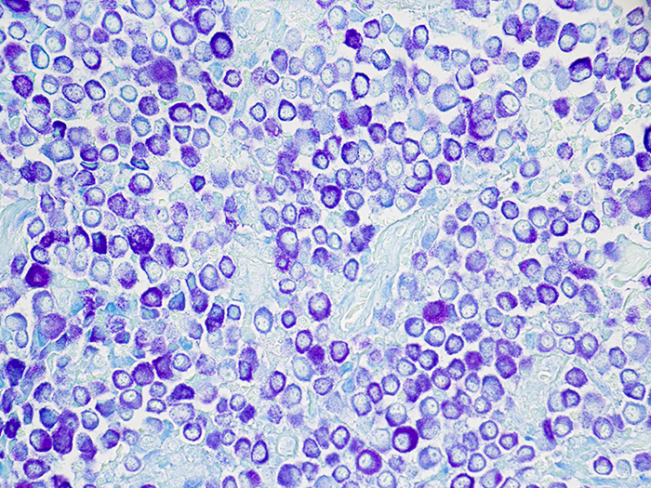
Review: WGS workflow
generic key takeaways:
data needs to be processed in many steps
output of step n is input of step n+1
each step involves a different program
if you have data for 100’s of samples, you must do this 100’s of times, so organized + automated is best!
extract DNA
give to sequencer
shear
DNA fragments
file type
RAW
FASTQ
CLEANED
FASTQ
BAM
deduplicated
BAM
VCF
Clean raw data
Align sequencing reads
Clean
BAM
file
Find mutations
analyzing this file typically answers evolutionary questions
step in pipeline
Notes:
This is a high-level overview to show what we’re about to go through. Things probably don’t make sense at this point, but we will go through each one of these steps individually.
Regardless of what analyses you want to do with your DNA sequences, chances are you’ll have to do all these steps
Things in boxes are kinds of files, or file types
Things between file types describe what gets done to go from one file type to another file type
FASTQ is derived from FASTA, with an added Q to represent “quality”
BAM stands for binary aligned map
VCF stands for variant call format

Slide 13
Snakemake summary
Sample 1
Sample 2
RAW FASTQ
Initial input files
2981B_1.fastq.gz
2981B_2.fastq.gz
2982B_1.fastq.gz
2982B_2.fastq.gz
fastp
fastp
CLEANED FASTQ
01_trimmed/2981B_1.fastq.gz
01_trimmed/ 2981B_2.fastq.gz
01_trimmed/2982B_1.fastq.gz
01_trimmed/ 2982B_2.fastq.gz
BWA
BWA
BAM
02_aligned/2981B.bam
02_aligned/2982B.bam
Files created by snakemake
sambamba
sambamba
BAM deduplicated
02_aligned/2981B_dedup.bam
02_aligned/2982B_dedup.bam
freebayes
VCF
03_variants/results.vcf
Every step/program in green can be coded as a different rule in snakemake

Slide 14
See example on cluster

Slide 15
Advantages (some) of snakemake
Parallelization
Snakemake finds all tasks that can be done independently to make the final output file
Ex: for WGS workflow, all analyses can be done per sample before the variant-calling stage, which combines information across samples to detect mutations
It can submit each independent task as a separate job on the cluster
If it fails or gets interrupted, it can pick up from where it left off
upon failure, it can also resubmit jobs with more memory and CPU
One one task is done, snakemake automatically starts the next one without needing input from the user
If you need to rerun all your analyses, snakemake makes it easy
For others to reproduce your work
After you analyze your data, you realize one of your programs should be run differently (this often happens to me)
You get new samples and need to put them through the same set of programs
Works well with conda or docker containers
Many workflows have already been made that you can use

Slide 16
Important snakemake commands
snakemake –dry-run
Does a ‘dry-run’
snakemake --cores 20
Starts running snakemake workflow with 20 cores/cpus
Runs snakemake workflow wherever this command is run; this doesn’t submit many jobs, one per independent task, as this requires a little extra work beyond the scope of this class
snakemake --unlock
If your snakemake job was cancelled while running, it will lock the directory so that subsequent snakemake runs will not start
snakemake --rerun-incomplete
Once the directory is unlocked, rerun the workflow, telling snakemake to re-do any tasks that did not complete
snakemake --profile

