Slide 1
Snakemake

Slide 2

What is snakemake?
Snakemake is a python-based workflow language
you don’t really need to know python though
A workflow consists of rules that have the following parts:
input: file(s) that must exist for rule to run
output: file(s) that must exist after rule runs, otherwise error
shell or run: the code that the rule must use to go from input to output
shell if running a BASH command
run for python command
Notes:
Content inspired by https://ucdavis-bioinformatics-training.github.io/2020-Genome_Assembly_Workshop/snakemake/snakemake_intro

Slide 3
Snakemake example 1
a single rule run on many files
if you give snakemake many cores, it will run rules in parallel and finish much faster
input file
rule
runs command on each
output file
combined output file
or
examples
many raw FASTQ files, rule runs program to process/clean each one
many FASTA files of enhancer sequences, each one for a different species, rule runs program to detect TFBS enrichment in each species
Notes:
Content inspired by https://ucdavis-bioinformatics-training.github.io/2020-Genome_Assembly_Workshop/snakemake/snakemake_intro

Slide 4
Snakemake example 2
two rules, the output of rule 1 is the input of rule 2
when rule 1 finishes, rule 2 automatically begins
examples
any analysis using sequence data
input file
rule 1
output file
rule 1 output == rule 2 input
input file
rule 2
output file
combined output file
or
Notes:
Content inspired by https://ucdavis-bioinformatics-training.github.io/2020-Genome_Assembly_Workshop/snakemake/snakemake_intro

Slide 5
other details
Snakemake doesn’t know what each rule is doing, treats as black boxes
it just knows a rule finished successfully if
the file(s) specified in the rule output get created
the code in the shell/run section didn’t exit with an error message
To make a workflow with several steps, the name of the output file of rule 1 has to be identical to input file name of rule 2
Rules get put into a ‘Snakefile’ that get run using the ‘snakemake’ command
Notes:
Content inspired by https://ucdavis-bioinformatics-training.github.io/2020-Genome_Assembly_Workshop/snakemake/snakemake_intro

Slide 6
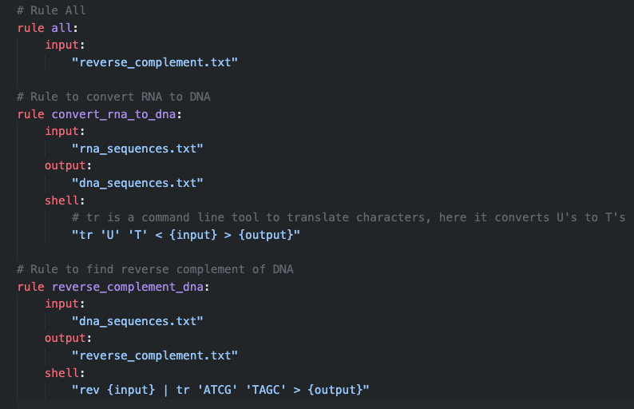
Snakemake example
A simple workflow (written by chatGPT4)
Convert RNA sequence to DNA sequence
Get the reverse complement of DNA sequence
Special rule all
typically written towards top of file
final rule, with only input: the final file(s) of the workflow
Snakemake figures out which rules need to be run to get file(s) in rule all
rules can be written in any order
snakemake figures out which rules need to be run in which order

Slide 7
See example on cluster

Slide 8
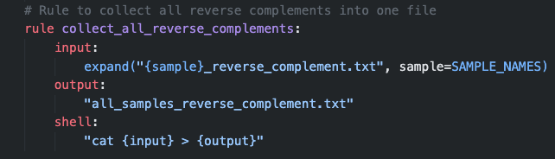
Snakemake (advanced)
Snakemake can handle many samples or data sets, using ‘wildcards’
‘wildcards’ can be used to expand rules across multiple samples
Use expand('somedir/{sample}.txt, sample=SAMPLE_NAMES))
Where SAMPLES is a list of sample names that we made
…
Notes:
Content inspired by https://ucdavis-bioinformatics-training.github.io/2020-Genome_Assembly_Workshop/snakemake/snakemake_intro

Slide 9
See example on cluster

Slide 10
Review: previous pipeline
fastp
BWA
Picard
GATK
RAW
FASTQ
CLEANED
FASTQ
BAM
deduplicated
BAM
VCF
Each step involves a program that was run using a bash script
Problems
Must wait for one step to finish before running the next
Was only made for a single sample
Could extend to make it fancier for many samples, but BASH is an ugly language
solution
Use a ‘workflow’ language
Snakemake is an example that’s extremely popular in biology
Notes:
Content inspired by https://ucdavis-bioinformatics-training.github.io/2020-Genome_Assembly_Workshop/snakemake/snakemake_intro

Slide 11
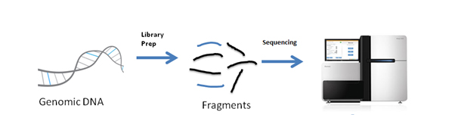
WGS summary: programs to get there
fastp
BWA
Picard
GATK
RAW
FASTQ
CLEANED
FASTQ
BAM
deduplicated
BAM
VCF

Slide 12
Snakemake summary
Sample 1
Sample 2
RAW FASTQ
Initial input files
2981B_1.fastq.gz
2981B_2.fastq.gz
2982B_1.fastq.gz
2982B_2.fastq.gz
fastp
fastp
CLEANED FASTQ
01_trimmed/2981B_1.fastq.gz
01_trimmed/ 2981B_2.fastq.gz
01_trimmed/2982B_1.fastq.gz
01_trimmed/ 2982B_2.fastq.gz
BWA
BWA
BAM
02_aligned/2981B.bam
02_aligned/2982B.bam
Files created by snakemake
sambamba
sambamba
BAM deduplicated
02_aligned/2981B_dedup.bam
02_aligned/2982B_dedup.bam
freebayes
VCF
03_variants/results.vcf
Every step/program in green can be coded as a different rule in snakemake

Slide 13
See example on cluster

Slide 14
Advantages (some) of snakemake
Parallelization
Snakemake finds all tasks that can be done independently to make the final output file
Ex: for WGS workflow, all analyses can be done per sample before the variant-calling stage, which combines information across samples to detect mutations
It can submit each independent task as a separate job on the cluster
If it fails or gets interrupted, it can pick up from where it left off
One one task is done, snakemake automatically starts the next one without needing input from the user
If you need to rerun all your analyses, snakemake makes it easy
For others to reproduce your work
After you analyze your data, you realize one of your programs should be run differently (this often happens to me)
You get new samples and need to put them through the same set of programs
Works well with conda or docker containers
Many workflows have already been made that you can use

Slide 15
Important snakemake commands
snakemake –dry-run
Does a ‘dry-run’
snakemake --cores 20
Starts running snakemake workflow with 20 cores/cpus
Runs snakemake workflow wherever this command is run; this doesn’t submit many jobs, one per independent task, as this requires a little extra work beyond the scope of this class
snakemake --unlock
If your snakemake job was cancelled while running, it will lock the directory so that subsequent snakemake runs will not start
snakemake --rerun-incomplete
Once the directory is unlocked, rerun the workflow, telling snakemake to re-do any tasks that did not complete
snakemake --profile

