Slide 1
Ames housing
Intro and Motivation
Data Pre-processing
Feature Importance
Model Selection
Feature Selection
Conclusion and Future work

Slide 2
Ames housing
Intro and Motivation
Data Pre-processing
Feature Importance
Model Selection
Feature Selection
Conclusion and Future work

Slide 3
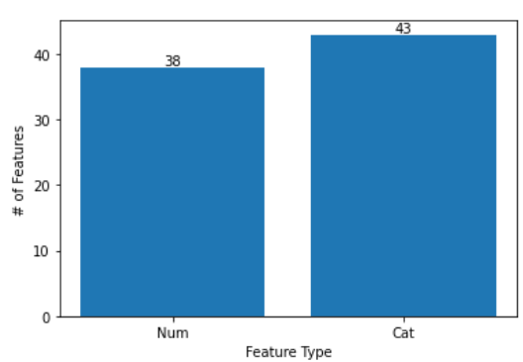
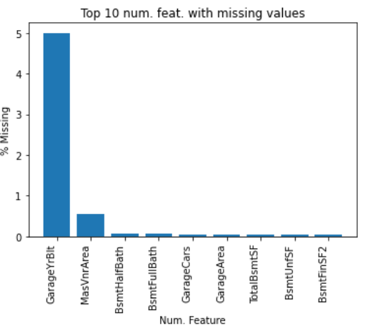
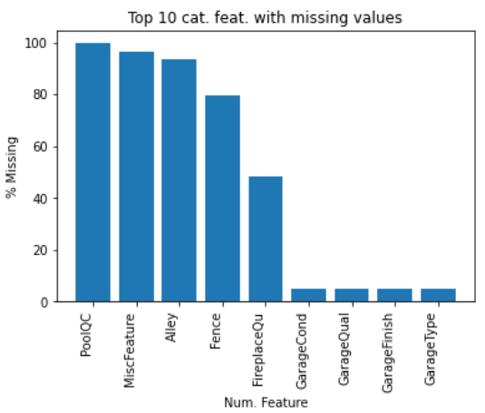
Intro: Data and Ames Backgruond
Ames Data:
Population: ~66,427
ISU: ~31,000
Density: ~2,500 people/(sq. mi)
*(Manhattan ~72k/sq. mi. ; 28x larger)
USDA, USDOE Lab (within ISA).
9th largest city in Iowa
Data Set:
Kaggle Competition ~4years ago.
2580 rows
81 columns:
38 Num.
GarageYrBlt (~5% missing)
43 Categ.
>80% missing: PoolQC, MiscFeat,
Alley, Fence
What are the most important features for home buyers in a College Town?
Notes:
Dumification will automatically remove NaN’s from categorical columns.

Slide 4
Ames housing
Intro and Motivation
Data Pre-processing
Feature Importance
Model Selection
Feature Selection
Conclusion and Future work

Slide 5
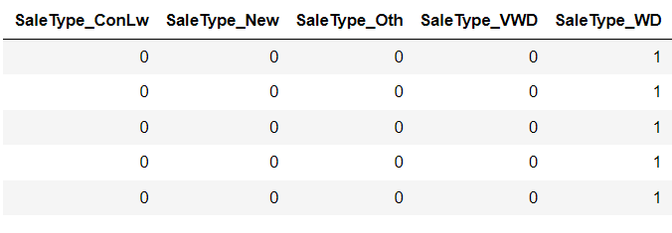
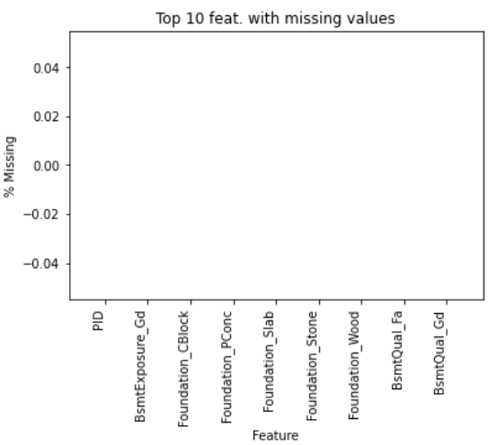
Data Prep.
Fig. 1
Dummification: Categorical goes from 43 -> 255 (Fig. 1)
Resulting matrix: 2580x255
Numerical feature: Filled NA’s with mean of each column (615 values filled – Fig. 2).
Used “train_test_split” from sklearn.model_selection to split into 40% Test and 60% Train.
Fig. 2
Fig. 2
Notes:
Dumification will automatically remove NaN’s from categorical columns.

Slide 6
Ames housing
Intro and Motivation
Data Pre-processing
Feature Importance
Model Selection
Feature Selection
Conclusion and Future work

Slide 7
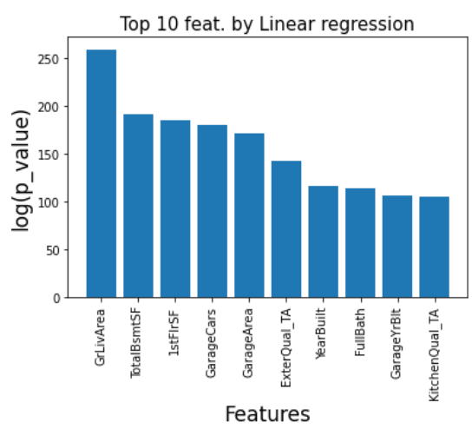
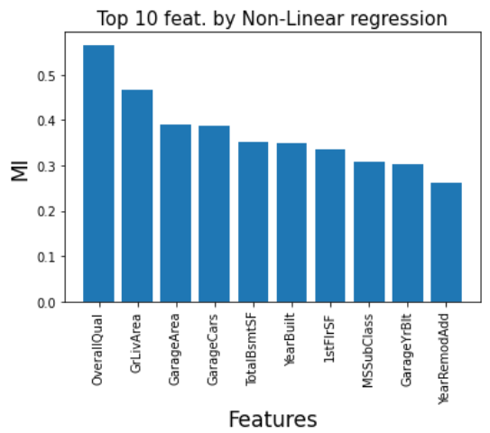
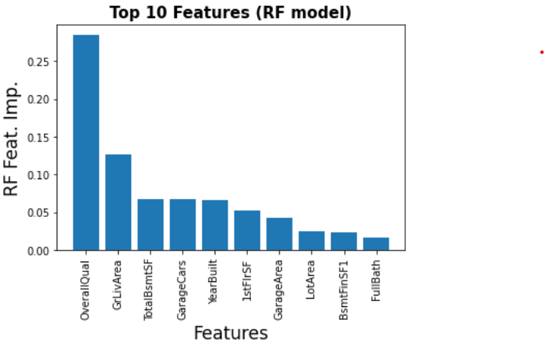
Feature Importance: Linear vs MI vs RF
Fig. 1:
Fig. 2:
Fig. 2:
Using a linear regressions p-values we see that the top 3 features are “GrLivArea”,“TotalBsmSF” and “1stFlSF” (Fig. 1).
However when using a nonlinear method (Fig. 2) such as mutual information (MI) we see that top 3 change: “OverallQual”,”GrLivArea”,”GarageArea”.
Since MI doesn’t agree with FI, some degree of non-linearity is important for the price of homes in Ames. .Using an RF feature importance seems to be the most accurate and captures all the dependancies due to its non-linear nature (Fig. 3).
Top 3 by RF Feat. Importance:
OverallQual
GrLivArea
TotalBsmSF
Fig. 3:
Notes:
Mutual Information (MI): this method tried to capture non-linear dependencies amongst the target variable and the features (i.e. y=sin(x)). This is useful since FI only takes into account linear dependencies to estimate their importance. It uses entropy estimation from k-nearest neighbors distances [1].
[1] A. Kraskov, H. Stogbauer and P. Grassberger, “Estimating mutual information”. Phys. Rev. E 69, 2004.

Slide 8
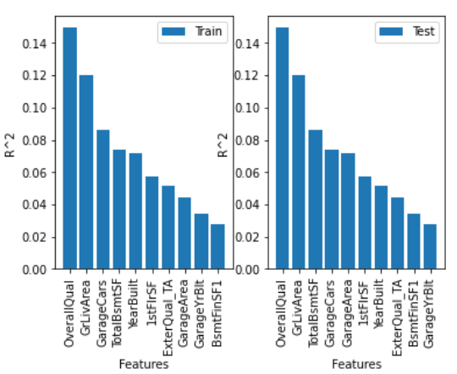
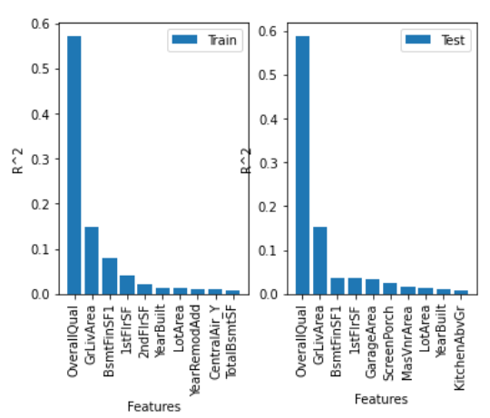
Feature Importance: Test vs Train
Feature Importance is slightly diff. w/ Train and Test models, however its generally recommended to use the Training feature importance*
Notes:
*See lecture: supervised learning roundup

Slide 9
Ames housing
Intro and Motivation
Data Pre-processing
Feature Importance
Model Selection
Feature Selection
Conclusion and Future work

Slide 10
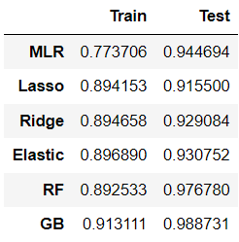
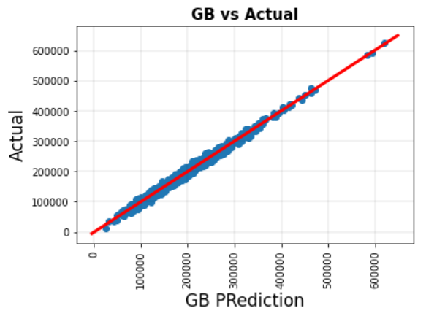
Model
Fig. 1:
Each model used the following:
GridSearch on hyperparameters
2-fold CV
2 jobs (improve calc time)
Score = R^2
'random_state': [0]
MLR Hyperparms:
normalize
Lasso/Ridge Hyperparms:
'alpha': range(0,100,10)
'normalize': [False, True]
'tol': [1e-1]
Elastic Hyperparms:
'l1_ratio': np.linspace(0,1,11)
'alpha': range(0,100,10)
'normalize': [False, True]
RF:
'n_estimators': range(10,150,10)
'max_features': range(1,100,10)
'max_samples’:np.linspace(0,1,11)
GB:
'learning_rate': np.linspace(0,1,11),
'n_estimators': range(100,300,25)
'subsample': np.linspace(0,1,11)
Fig. 2:
GB is best predictive algo. with <2% error on sale price
Notes:
Confusingly, the alpha hyperparameter can be set via the “l1_ratio” argument that controls the contribution of the L1 and L2 penalties and the lambda hyperparameter can be set via the “alpha” argument that controls the contribution of the sum of both penalties to the loss function.

Slide 11
Ames housing
Intro and Motivation
Data Pre-processing
Feature Importance
Model Selection
Feature Selection
Conclusion and Future work

Slide 12
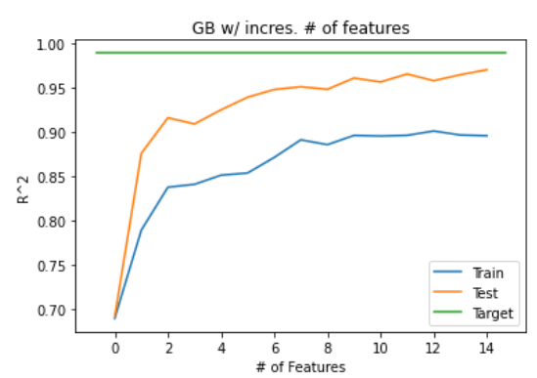
Feature Selection
Fig. 1
The top 15 features were selected according to the GB “feature_importance”.
15 models were created with increasing # of features and the Test/Trains coef. Of determination are shown in Fig. 1.
With 15 features we achieve ~97% (96.98) R^2 which is comparable to RF and only ~2% lower than GB w/ all 81 features.
Notes:
Top 15 features using GB.feature_importance_: 'OverallQual', 'GrLivArea', 'TotalBsmtSF', '1stFlrSF', 'GarageArea', 'LotArea', 'YearBuilt', 'BsmtFinSF1', 'GarageCars', 'YearRemodAdd', '2ndFlrSF', 'ScreenPorch', 'OpenPorchSF', 'Condition2_PosN', 'LotFrontage'

Slide 13
Ames housing
Intro and Motivation
Data Pre-processing
Feature Importance
Model Selection
Feature Selection
Conclusion and Future work

Slide 14
Conclusions and Future Work
Top three features affecting home purchases in Ames:
OverallQuality
LivingAreaSF
Basement SF
Top 15 will 97% accuracy, you only need to measure these to get predictions.
Gradient boosting was the best algo for predictive means.
Future Work:
Normalizing skewed data
Feature Engineering
More models (Neural Newtorks, SVM…)
Create an interface
Map of predicted home prices by area
Web scraping home values
Notes:
Extra work: Since overall quality explains ~68% of the sale price create a map using this feature to show to home buyers.
Since OverallQual+GrLivArea explains ~80% of the sale price create a map using this feature to show to home buyers.

Slide 15
