Slide 1

Understanding the Impact of Temperature on Influenza Hospitalizations, With a Look at Population and Historical Temperature Trends
Brian Campbell
Mike Saunders
Ryan Donegan

Slide 2
Data Sets
Weather
openweathermap.org
Columbus, Cincinnati, Cleveland
40 years of hourly weather data
Influenza Hospitalizations
Ohio Department of Health
Weekly hospitalization due to influenza for Franklin, Hamilton, and Cuyahoga Counties (corresponds with Columbus, Cincinnati, and Cleveland)
2017 – 2021 Influenza Seasons
Census
Ohio Census

Slide 3
Questions to Answer
Do the number of influenza hospitalizations rise with falling temperatures?
Does the weather data show a warming trend over 40 years?
Are weather trends related to population growth/decrease?

Slide 4
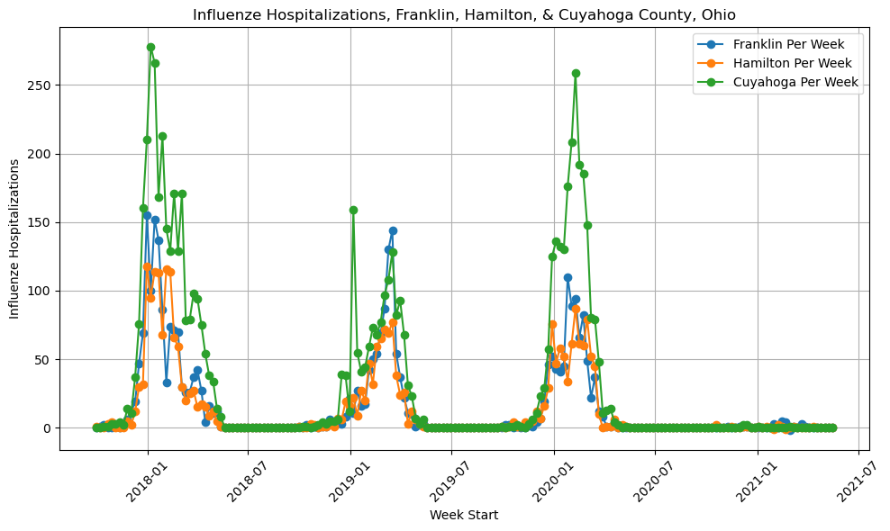
Influenza Hospitalizations
Note 2020-2021 - Covid

Slide 5
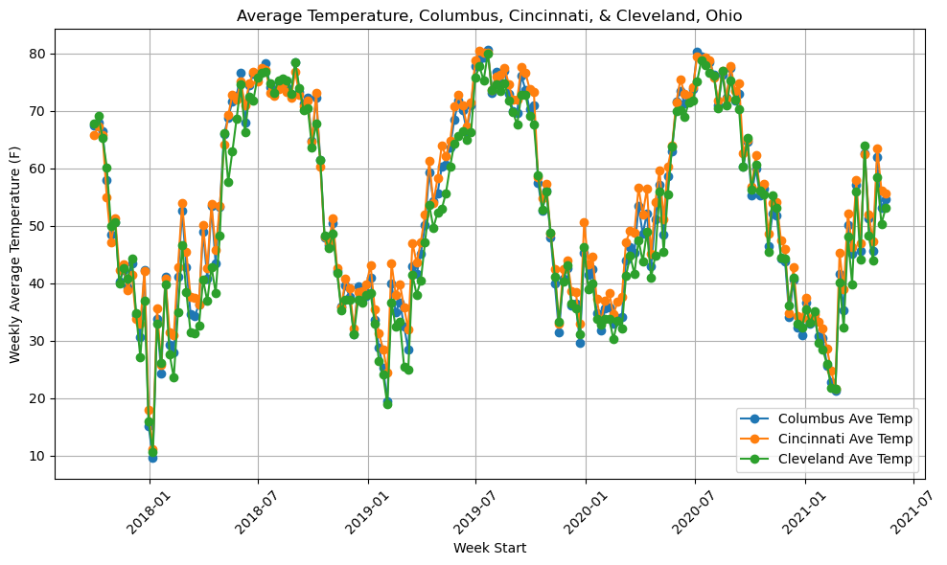
Weekly Average Temperatures

Slide 6
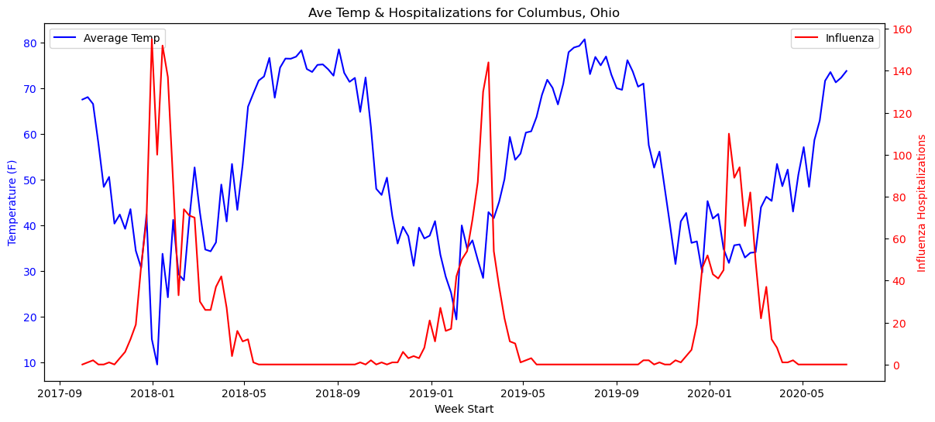
Weekly Temperatures & Influenza Hospitalizations - Columbus
Note: 2020-2021 Season Was Excluded Due To Covid
Correlation: -0.520

Slide 7
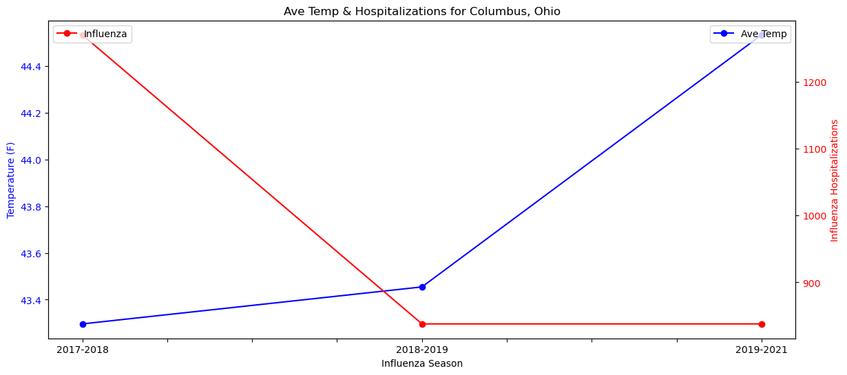
Seasonal Average Temperature & Seasonal Total Hospitalizations - Columbus
Correlation: -0.598

Slide 8
Backup

Slide 9
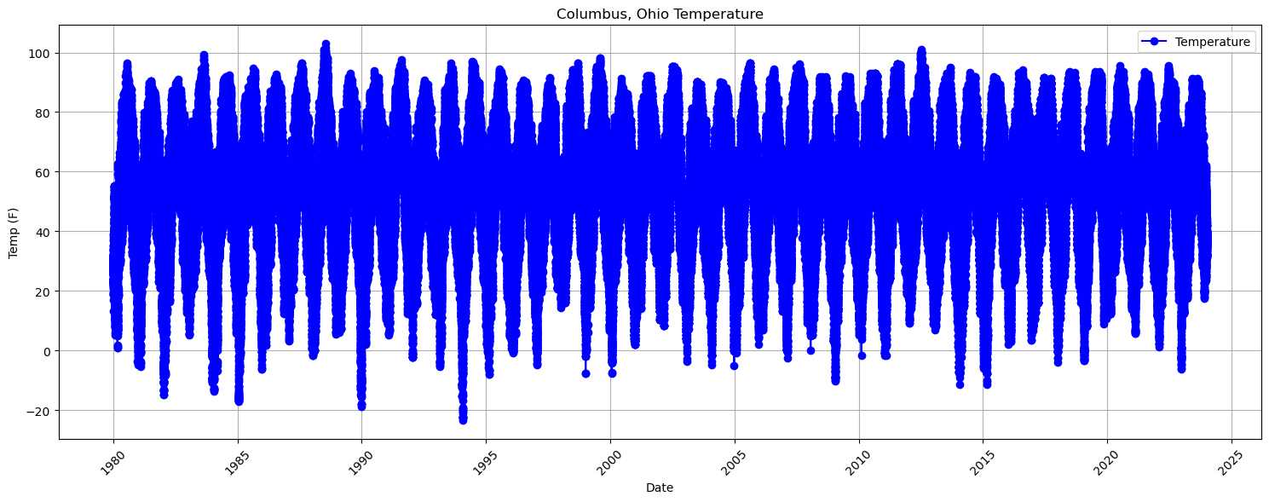
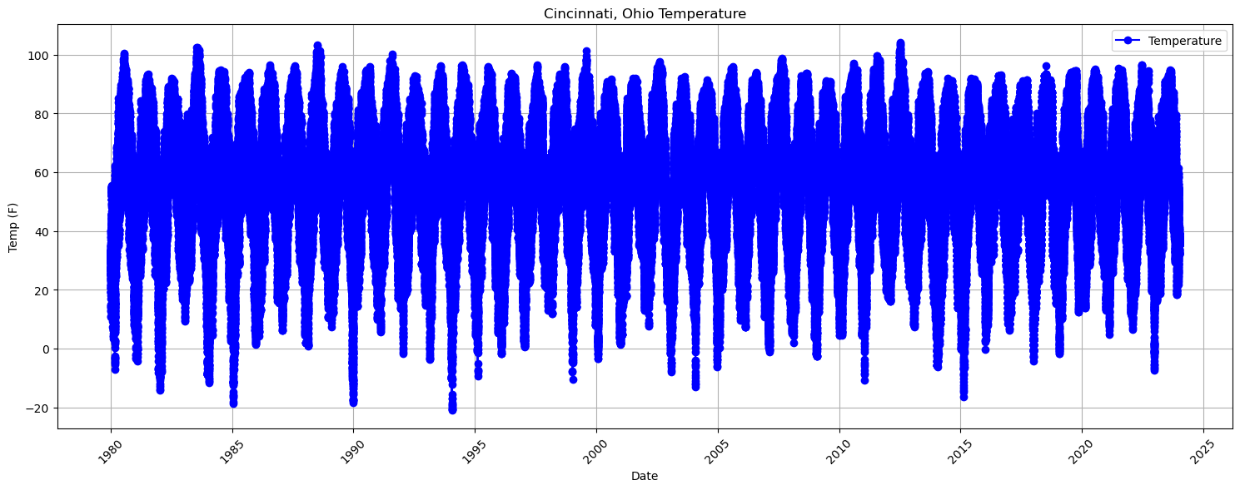
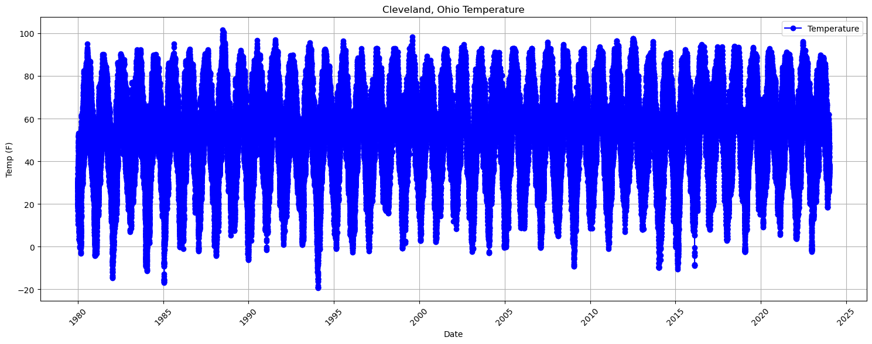
Temperature Trends

Slide 10
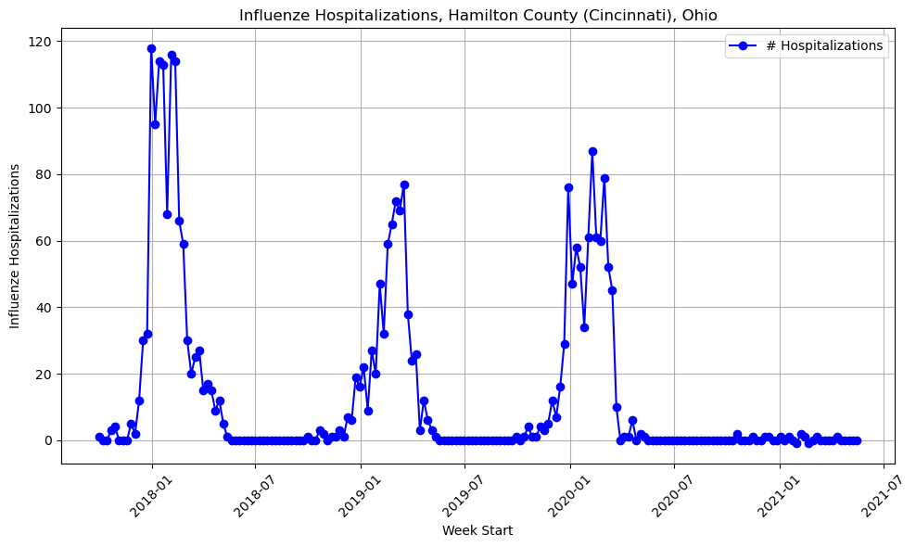
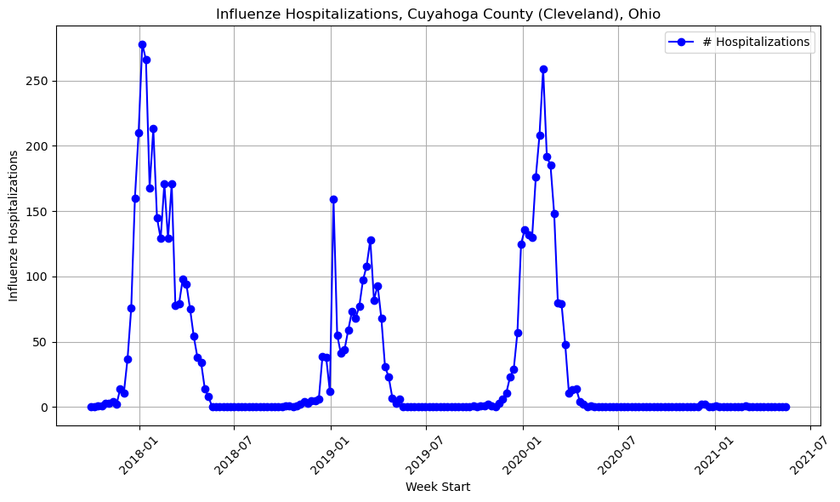
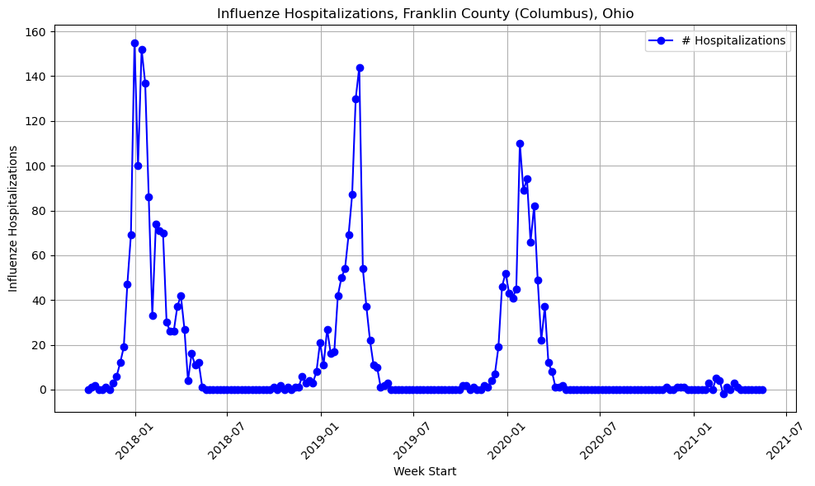
Influenza Hospitalizations
Note 2020-2021 - Covid

Slide 11
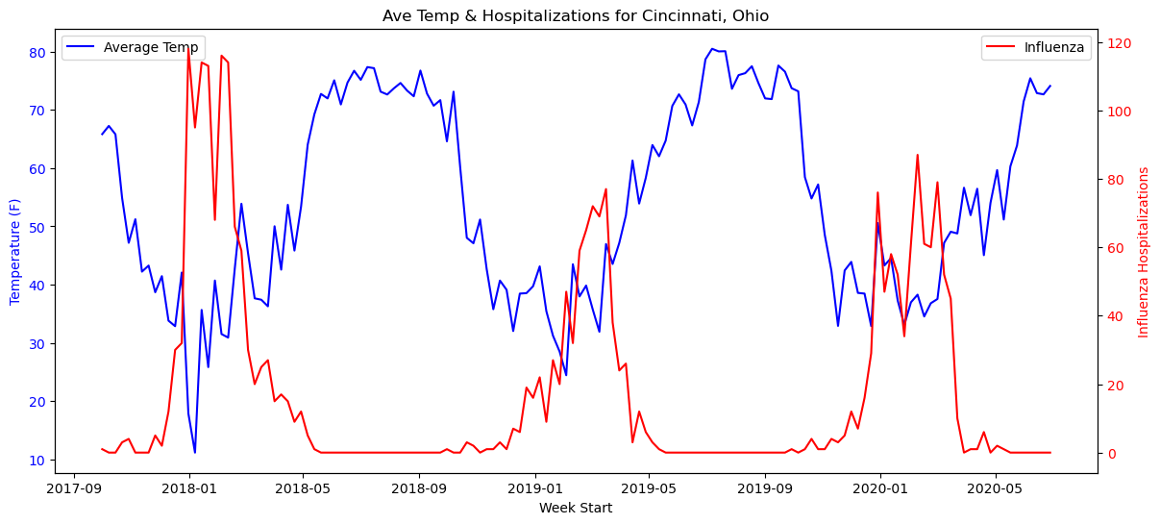
Weekly Temperatures & Influenza Hospitalizations - Cincinnati
Note: 2020-2021 Season Was Excluded Due To Covid
Correlation: -0.513

Slide 12
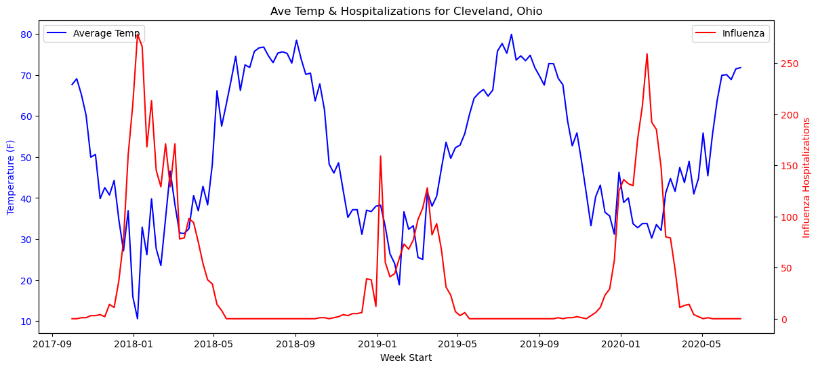
Weekly Temperatures & Influenza Hospitalizations - Cleveland
Note: 2020-2021 Season Was Excluded Due To Covid
Correlation: -0.534

Slide 13
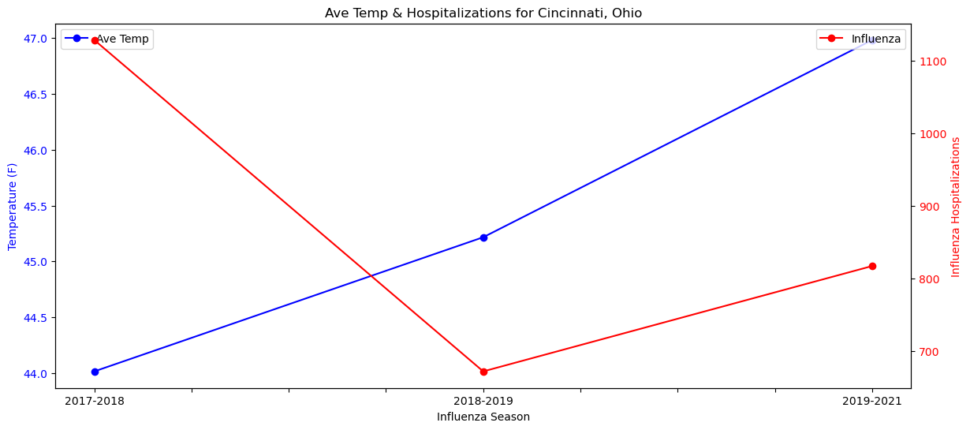
Seasonal Average Temperature & Seasonal Total Hospitalizations - Cincinnati
Correlation: -0.582

Slide 14
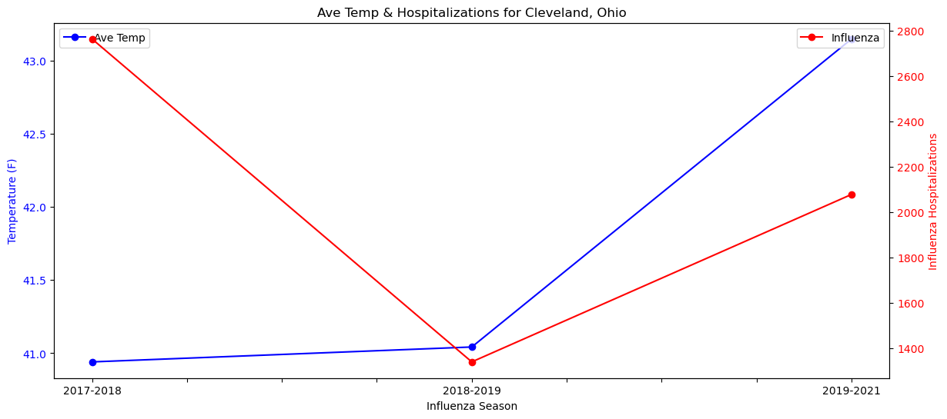
Seasonal Average Temperature & Seasonal Total Hospitalizations - Cleveland
Correlation: -0.019

Slide 15
Next Steps
Influenza
XXX
Temperature
XXX
Census
Analyze temperatures based on seasons, graph, and look for correlation

