Slide 1
Machine Learning of Phishing URL Data
Vu Pham
Brian E Campbell

Slide 2
Topics
Goals
Phishing and URL Basics
Overview of Data
Basic Analysis and Clean Up
Models
RandomForest
LightGBM
XGBoost
What We Learned
Questions

Slide 3
Goals
Can we accurately predict phishing URLs
Use 3 different ML Models and compare the results
Meet all requirements of Project 2

Slide 4
Phishing and URL Basics
Phishing – a form of social engineering where attackers deceive targets into revealing sensitive information or installing malware.
Usually starts with an email but can be other forms such as chat messages
Contain some kind of malicious URL

Slide 5
Phishing and URL Basics
URL – Uniform Resource Locator
http://www.example.com:80/path/to/myfile.html?key1=value1&key2=value2
scheme
domain (w/subdomain)
port
path and file name
parameters

Slide 6
Overview of Data
Retrieved from https://github.com/GregaVrbancic/Phishing-Dataset
Professor of Computer Science at University of Maribor (Slovenia)
Used in cyber security research

Slide 7
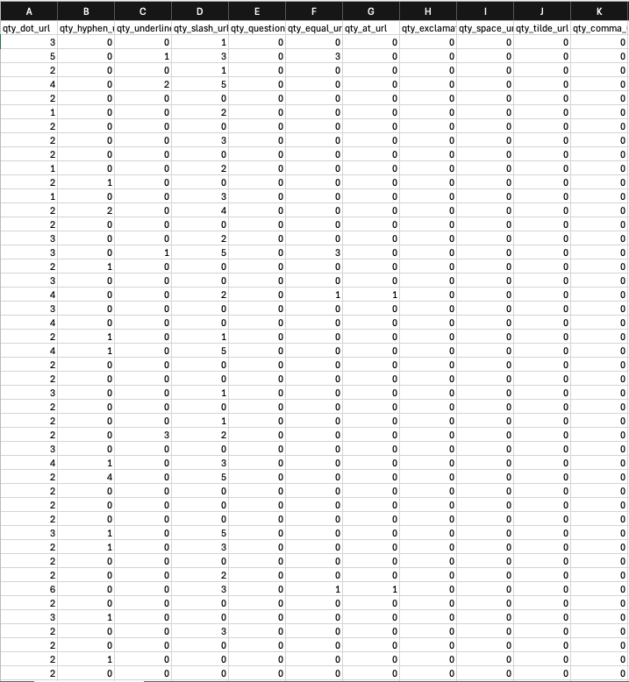
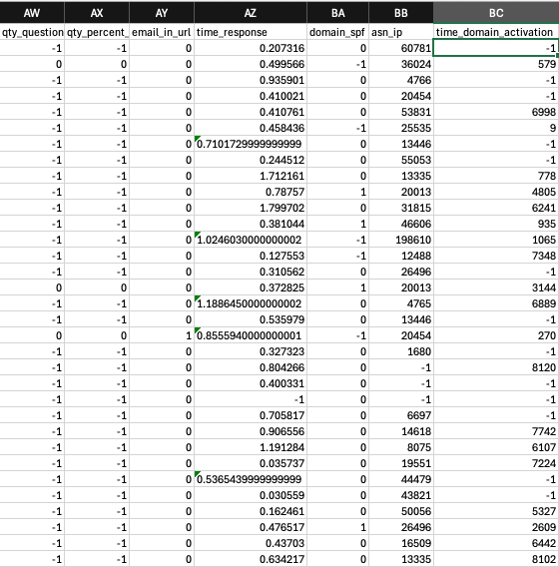
Overview of Data
Notes:
Show Excel file

Slide 8
Overview of Data
Original data
112 columns
Count of various attributes of URL
For URL, domain, directory, file, parameters
’@’, ‘&’, ‘?’, ‘/’, ‘%’, etc.
Other
Time domain activation, qty nameservers, tls/ssl certificate, qty redirects, etc.
Phishing indicator

Slide 9
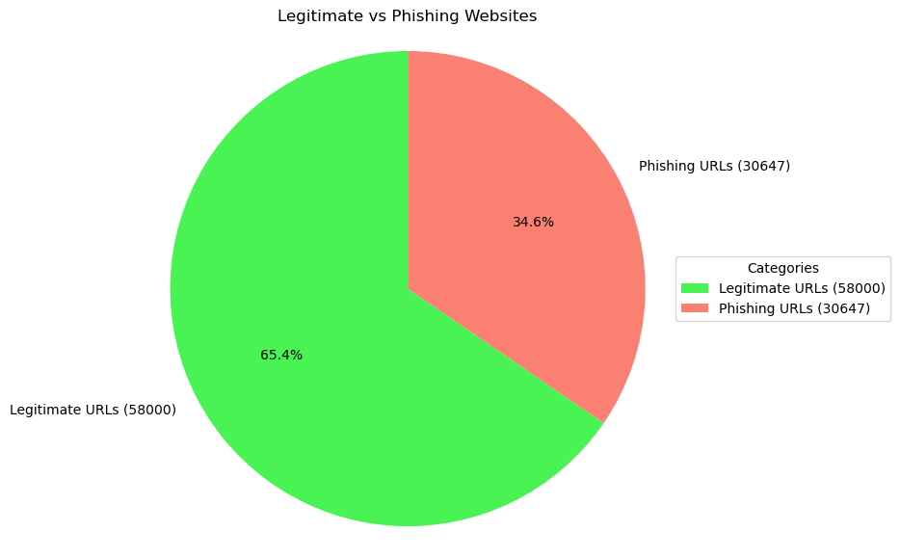
Basic Analysis and Clean Up

Slide 10
Basic Analysis and Clean Up
112 columns too much data
Removed highly correlated data (>= 80%): 112 →66 columns
Removed columns where every value was 0: 66 → 53 columns

Slide 11
Three Machine Learning Models
RandomForest
LightGBM
XGBoost

Slide 12
Dataset Features
Non-linear interactions of phishing data
E.g., URL structure, metadata, network features.
Features importance
Identifying most significant phishing factors important for model interpretation/predictions
Phishing datasets often imbalanced
More legitimate than phishing cases
Adjusts class weights or oversample

Slide 13
Why These Three
RandomForest | LightGBM | XGBoost
Handles mixed data types | Handles large datasets efficiently | Works on small and large datasets
Provides feature importance for better interpretation. | Gradient boosting learning for speed | Works well with imbalanced datasets using custom loss functions
Non-linear relationships captured | Good handling of categorical features | Captures complex non-linear patterns
Robust to overfitting | Robust to overfitting | Robust to overfitting
Good with missing data | Scalable and efficient memory usage | Good with missing data
Effective on imbalanced data | Boosting for effective handling of imbalanced data | Highly efficient gradient boosting
Parallelizable for faster computation |  | Optimized for speed
Notes:
Bold/red shows attributes that are present in the phishing dataset

Slide 14
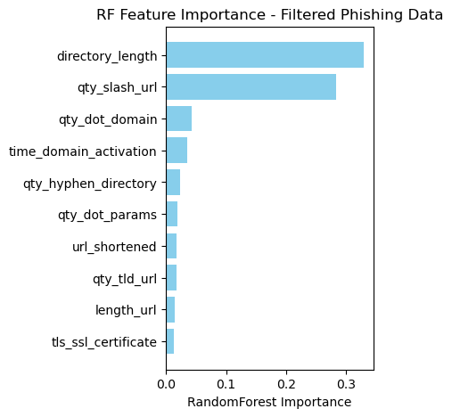
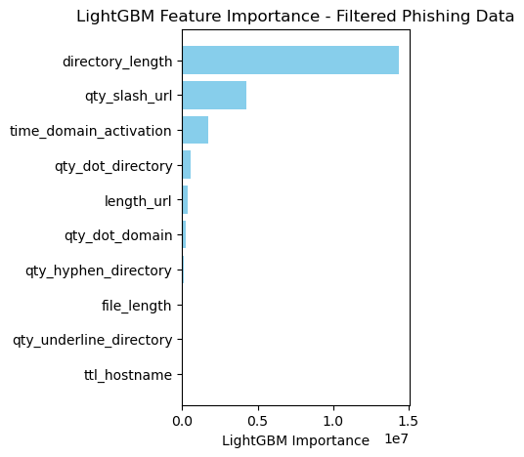
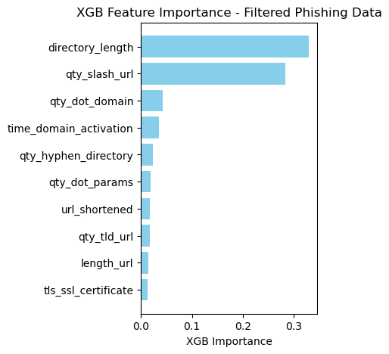
Top 10 Feature Importance
Notes:
Common top 10 feature importance: 6 are the same
Directory_length
Qty_slash_url
Qty_dot_domain
Time_domain_activation
Qty_hyphen_directory
Length_url

Slide 15
Comparing Results
 | RandomForest | LightGBM | XGBoost
Accuracy of TEST data before feature selection | 0.97 | 0.9187
Accuracy of TEST after feature selection | 0.96 | 0.9187
Train Accuracy | 1.00 | 0.9196 | 0.984 / 0.996
Test Accuracy | 0.97 | 0.9416 | 0.969 / 0.971

Slide 16
Observations
RandomForest | LightGBM | XGBoost
Not a fast as LightGBM or XGBoost | Very fast | Very fast (slower when training)
Easiest to use | Harder to use | Medium level ease of use
Not as configurable as LightGBM or XGBoost* | Highly configurable* | Highly configurable*
Most accurate | Less accurate than other models | Most accurate
Results nearly identical to XGBoost | Different results than LightGBM or XGBoost | Results nearly identical to RandomForest
*based on current experience

Slide 17
Next Steps
More tuning of models
Create code to build similar dataset from random URLs
Run more data through models
Integrate into real world scenarios
Email gateways
Use in our Threat Intelligence

Slide 18
Questions

