Slide 1
Machine Learning of Phishing URL Data
Vu Pham
Brian E Campbell

Slide 2
Topics
Goals
Phishing and URL Basics
Overview of Data
Basic Analysis and Clean Up
Models
RandomForest
LightGBM
XGBoost
What We Learned
Questions

Slide 3
Goals
Can we accurately predict phishing URLs
Use 3 different ML Models and compare the results
Meet all requirements of Project 2

Slide 4
Phishing and URL Basics
Phishing – a form of social engineering where attackers deceive targets into revealing sensitive information or installing malware.
Usually starts with an email but can be other forms such as chat messages
Contain some kind of malicious URL

Slide 5
Phishing and URL Basics
URL – Uniform Resource Locator
http://www.example.com:80/path/to/myfile.html?key1=value1&key2=value2
scheme
domain (w/subdomain)
port
path and file name
parameters

Slide 6
Overview of Data
Retrieved from https://github.com/GregaVrbancic/Phishing-Dataset
Professor of Computer Science at University of Maribor (Slovenia)
Used in cyber security research

Slide 7
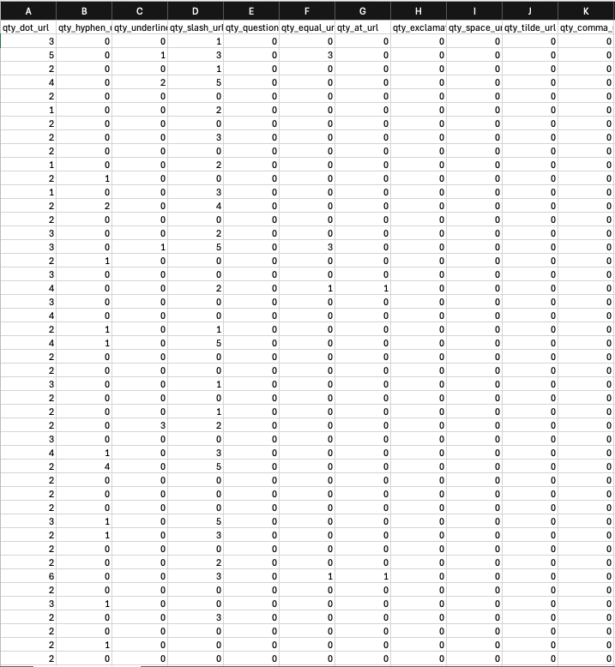
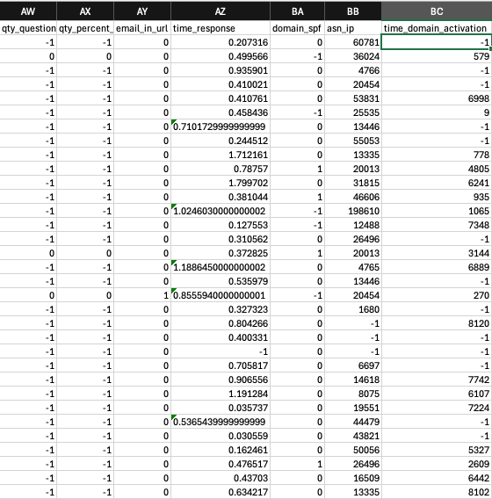
Overview of Data

Slide 8
Overview of Data
Original data
112 columns
Count of various attributes of URL
For URL, domain, directory, file, parameters
’@’, ‘&’, ‘?’, ‘/’, ‘%’, etc.
Other
Time domain activation, qty nameservers, tls/ssl certificate, qty redirects, etc.
Phishing indicator

Slide 9
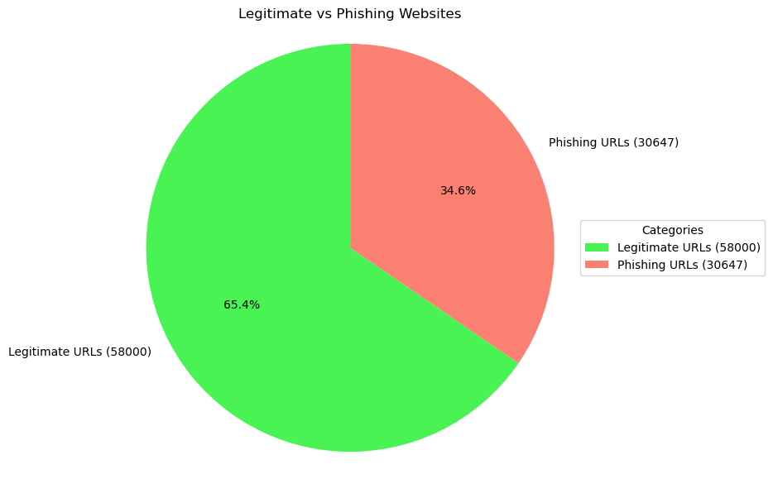
Basic Analysis and Clean Up

Slide 10
Basic Analysis and Clean Up
112 columns too much data
Removed highly correlated data (>= 80%): 112 →66 columns
Removed columns where every value was 0: 66 → 53 columns

Slide 11
Three Machine Learning Models
RandomForest
LightGBM
XGBoost

Slide 12
Three Machine Learning Models
Table to compare three models
Why we used them for our data

Slide 13
Three Machine Learning Models
RandomForest | LightGBM | XGBoost

Slide 14
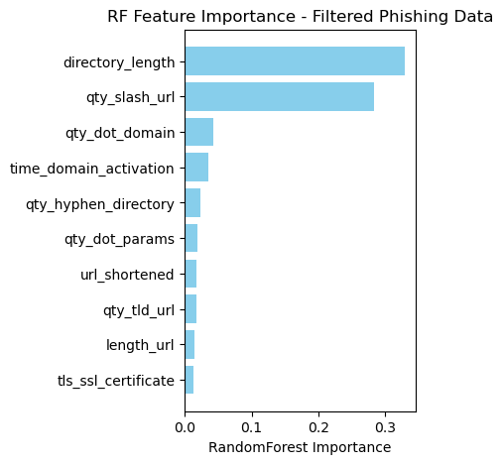
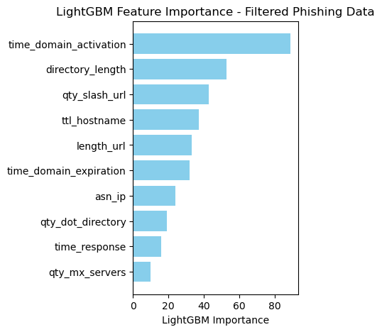
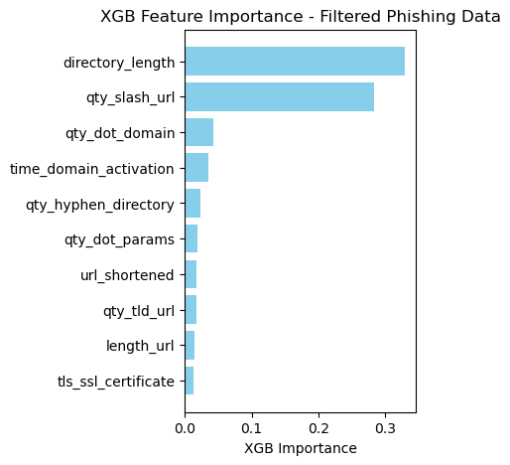
Selected Values

Slide 15
Comparing Results
RandomForest | LightGBM | XGBoost

Slide 16
Observations
RandomForest | LightGBM | XGBoost

Slide 17
RandomForest
Core Idea: A Random Forest is an ensemble learning method that builds multiple decision trees. Each tree is built on a random subset of features and data. The final prediction is made by taking the majority vote for classification or averaging for regression.
Strengths: Simple, interpretable, and robust to overfitting.
Weakness: Slower for large datasets and less accurate than boosting algorithms.

Slide 18
RandomForest
Non-linear interactions of phishing data
E.g., URL structure, metadata, network features.
Offers features importance
Identifying most significant phishing factors important for model interpretation
Phishing datasets often imbalanced
More legitimate than phishing cases
Adjusts class weights or oversample

Slide 19
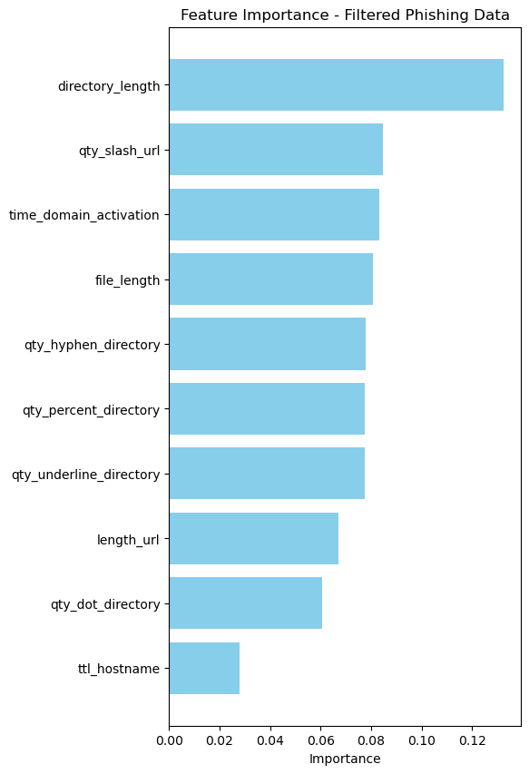
RandomForest
Accuracy of test data before feature selection: 97%
Accuracy of test data after feature selection: 96.9%

Slide 20
RandomForest
Table to compare feature set of all three models

Slide 21
RandomForest
Table to compare accuracy of all three models

Slide 22
LightGBM

Slide 23
XGBoost

Slide 24
Next Steps

Slide 25
Questions

Slide 26
Slide Title
Make Effective Presentations
Using Awesome Backgrounds
Engage your Audience
Capture Audience Attention

Slide 27
Slide Title
Product A
Product B
Feature 1
Feature 2
Feature 3
Feature 1
Feature 2
Feature 3

Slide 28


